Slide 1

ANGUILLA
A Brief Overview

Slide 2
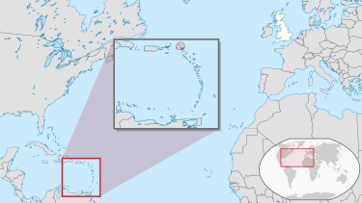
Anguilla is a British overseas territory located in the Eastern Caribbean
Capital City: “The Valley”
Religious orientation: Christian
Total Area: 35 sq. mi

Slide 3

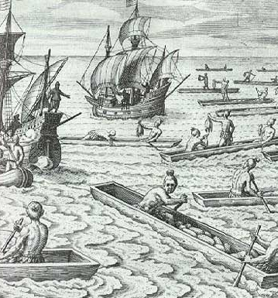
Originally settled by Amerindians, arrived to “Malliouhana” on rafts and dugout canoes
For most of pre-modern history, it was constantly fought over and re-colonised by Dutch, Spanish, and English becoming a slave colony
Relatively unsuccessful as a plantation economy

Slide 4
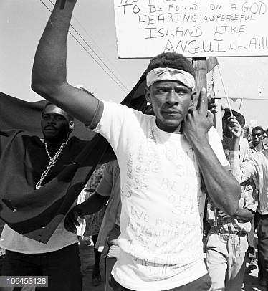
Anguilla has had a relatively unique struggle for independence
Had to fight for its own nationhood in the shadow of nearby larger islands it has often been associated with, such as Saint Kitts and Nevis
Still not an independent country.

