Slide 1
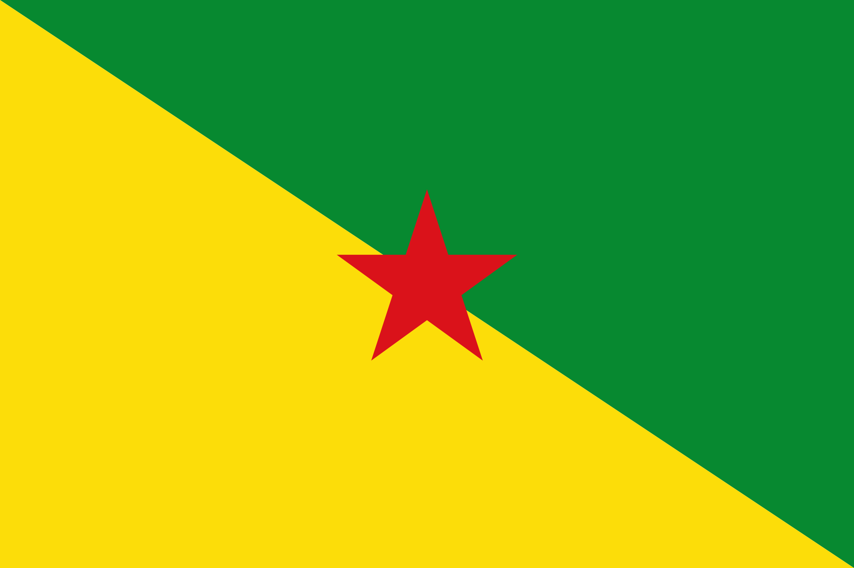
French Guiana

Slide 2
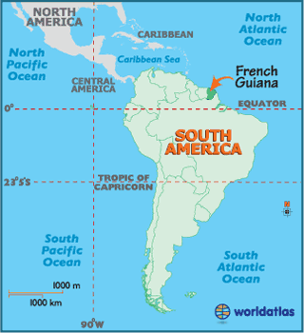
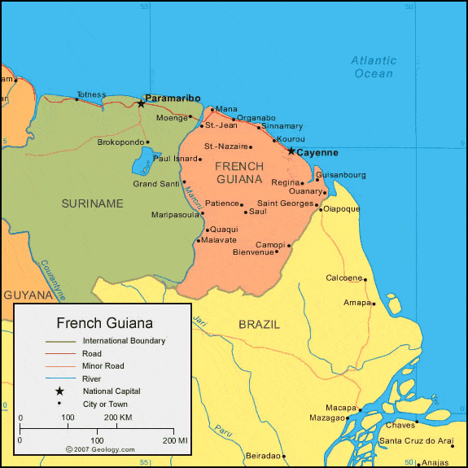

Slide 3
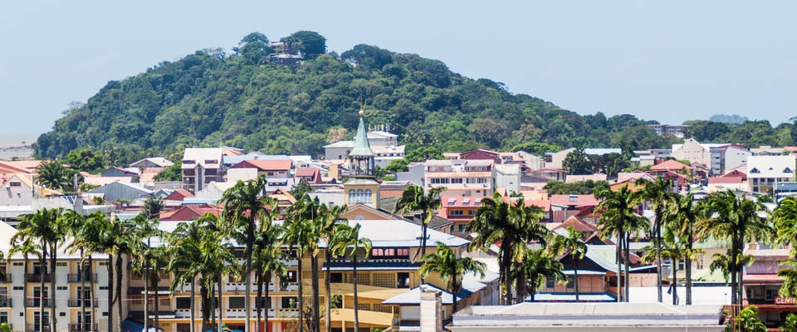
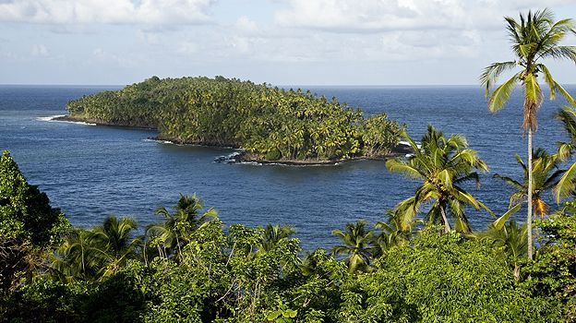
Facts
Capital: Cayenne
Official language: French
Though the most widely spoken language is Guianan Creole
Political system: overseas department and region of France (it is also a special state territory of the European Union)
Notes:
French Guiana has been the only territory of the mainland Americas that is still part of a European country.
Guiana is a part of the European Union, and its official currency is the euro. The region has the highest nominal GDP per capita in South America
Guianan Creole: influenced by French and Portuguese
Was used as a penal colony by the French from

