Slide 1
Martinique

Slide 2
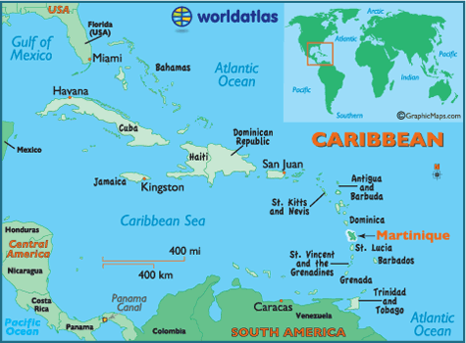
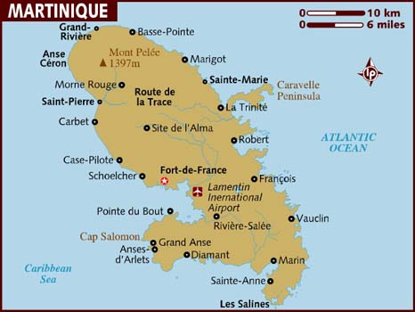

Slide 3
A total of 4 queens who have ruled France, Holland and Turkey, have all been born in Martinique.
Capital: Fort-De France
Population: 385,000
Official Language: French (however most also speak Martiniquan Creole- a form of Antillean Creole)
Constitutional Status: Department of France (It is part of the European Union)
Religion: 80% Roman Catholic, 10% Protestant, 10% Hindu or Other
Empress Josephine
Hortense de Beauharnais?
Aimée du Buc de Rivéry
Françoise d'Aubigné?

