Slide 1

The Bahamas

Slide 2
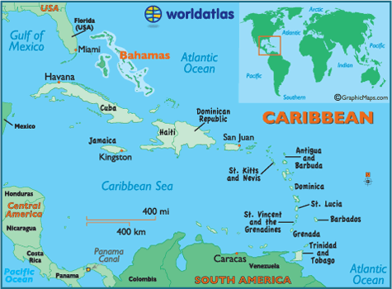
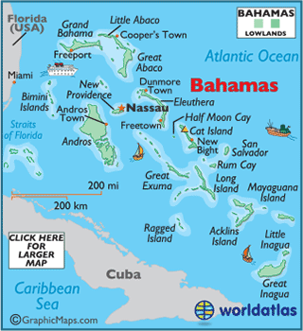

Slide 3
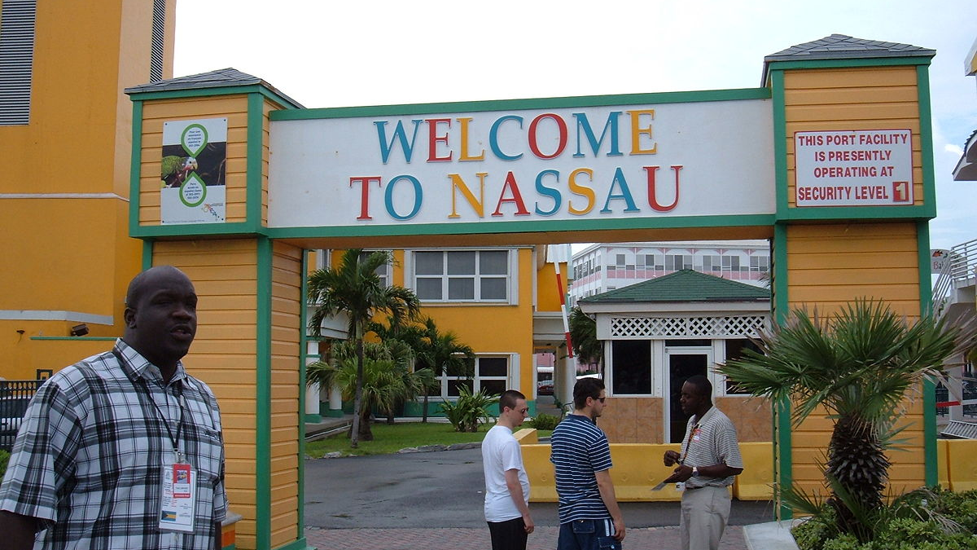
CAPITAL
Nassau

Slide 4
POPULATION
The current population of Bahamas is 400,860 (Tuesday, November 27, 2018)
Population of Nassau- 266,100 (2016)

Slide 5
Independence and Language
Became an independent commonwealth realm on 10th July 1973
Official Language: English

Slide 6
FUN FACTS
Only 30 of the total 700 islands
The Bahamas is one of the two countries whose official name begins with the word “the”.
During the 1980s, the island became an established site for the drug trade. Reportedly, almost 90% of the cocaine entered the United States passing through the Bahamas.
It is reported that during the 1980s, almost 90% of the cocaine entering the United States passing through the Bahamas.
There is no income or sales tax for Bahamas residents

