Slide 1
Curacao
Historial nexus of Netherlands Antilles

Slide 2
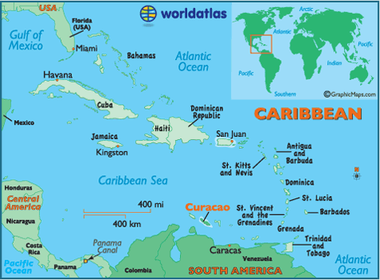

Slide 3
Curacao is the largest island in the Netherland Antilles

Slide 4
Land
Barren soil which is a result of centuries of overgrazing
Water is usually attained from distilled sea water
Mostly drought resistant plants abound

Slide 5
Fun facts
Curacao is believed to be the historical Nexus of the Netherlands Antilles
The Nether Antilles also known as the Dutch Antilles
Curacao is one of the four islands that form the Dutch Antilles including Aruba, Bonaire, Curcao (ABC) and the Leeward islands which was later split into its own territory in 1983.
These islands were once a part of the Kingdom of the Netherlands

Slide 6
Fun facts
In 2006 the Dutch Government decided to discontinue the Netherland Antilles
All the islands that were part of the Netherland Kingdom were disassociated from the Dutch government in October 2010
But none chose full independence. Curacao became an autonomous country within the kingdom

Slide 7
Migration to Curacao from other places increased after it opened it oil refinery in 1918

