Slide 1
Caribbean History: Fascinating* Facts
*Cannot guarantee that all historical facts will be fascinating

Slide 2
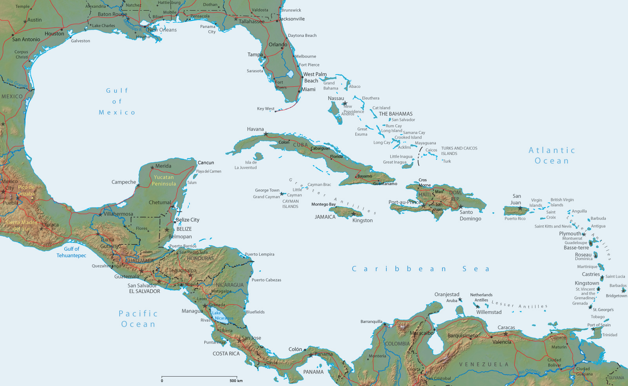
Nevis

Slide 3
Nevis

Slide 4
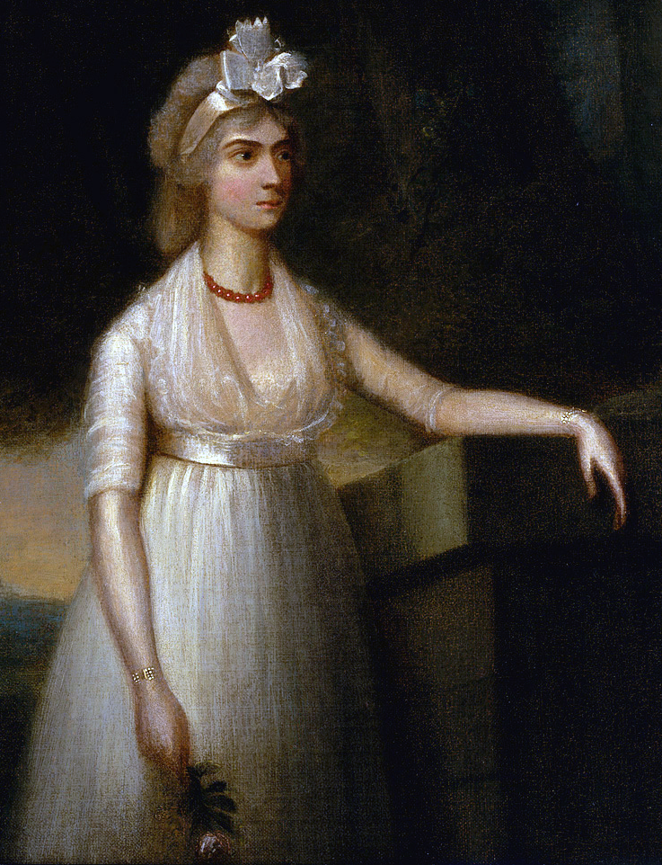
Birth place of Frances Nisbet

Slide 5
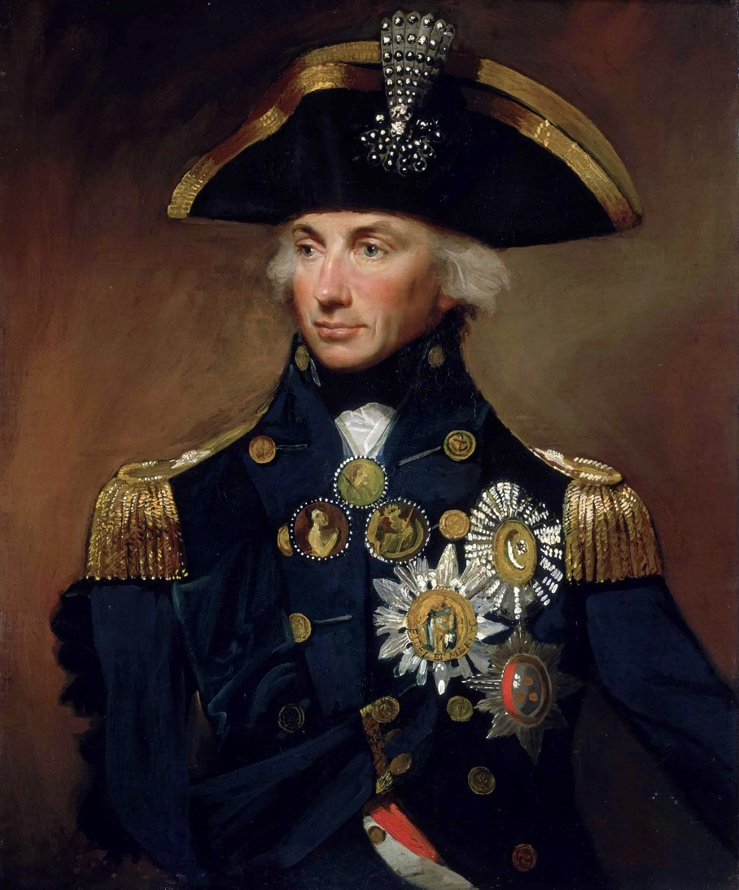
Birth place of Frances Nisbet, wife of Horatio Nelson

Slide 6
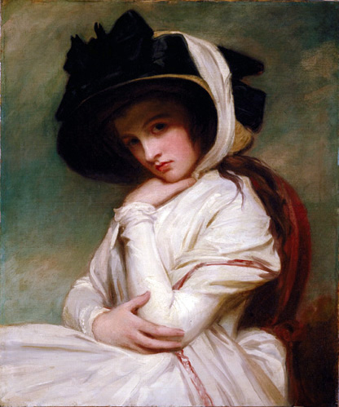
Birth place of Frances Nisbet, wife of Horatio Nelson

Slide 7
Caribbean History: Fascinating* Facts
*Cannot guarantee that all historical facts will be fascinating

