Slide 1
Caribbean History: Fascinating* Facts
*Cannot guarantee that all historical facts will be fascinating

Slide 2
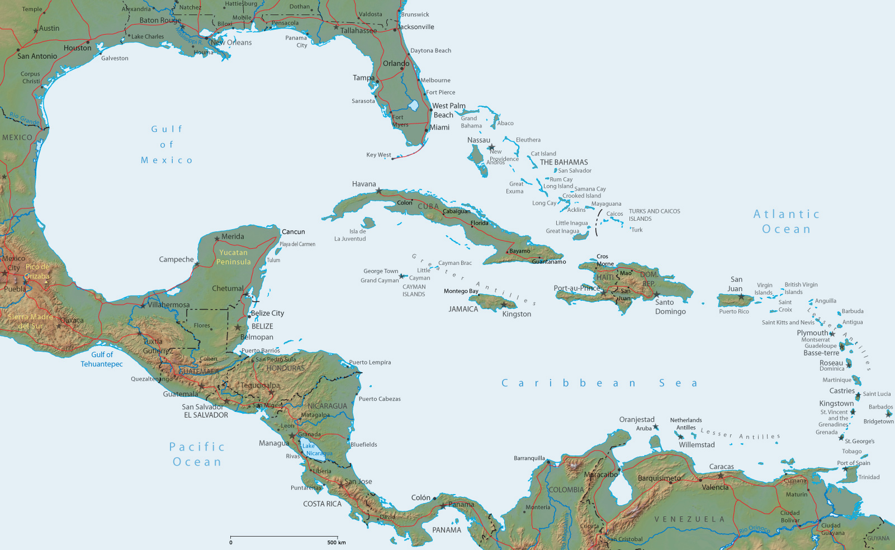
US Virgin Islands

Slide 3
US Virgin Islands

Slide 4

Charlotte Amalie, St Thomas
Notes:
Queen Charlotte Amalie, wife of King Christian V of Denmark

Slide 5
Caribbean History: Fascinating* Facts
*Cannot guarantee that all historical facts will be fascinating

