Slide 1
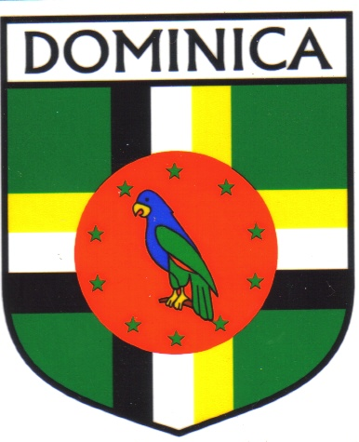
Dominica
Harriet Ramsden

Slide 2
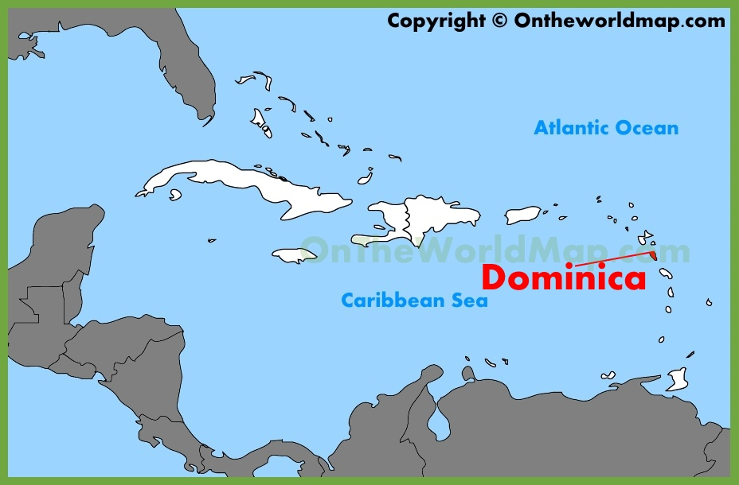
Where is it?
Part of the Windward Islands in the Lesser Antilles archipelago in the Caribbean Sea
Lies south-southeast of Guadaloupe and northwest of Martinique
Area is 750 square kilometres

Slide 3
Brief History
Originally inhabited by the Kalingo (Island Caribs)
Later colonised by Europeans
  Spain had little success in colonising Dominica
  Predominantly by French from 1690s (French woodcutters settled to supply French islands with wood)
  Great Britain took over in 1763 after the Seven Years’ War - gradually established English as the official language
Gained independence in 1978
  After shortly being apart of the West Indies Federation, Dominica became an associated state of the UK in 1967 (formally took responsibility for internal affairs)
  3rd November 1978 – Commonwealth of Dominica granted independence, becoming a republic

Slide 4
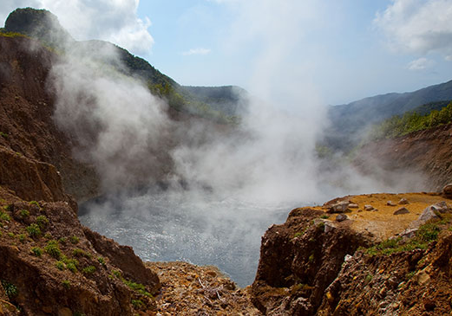
General
Name comes from the Latin word for Sunday – day in which the island was spotted by Christopher Columbus in November 1493
Economy depends on tourism and agriculture
Nicknamed the ‘Nature Isle of the Caribbean’ for its unspoiled natural beauty
  Youngest isle in the Lesser Antilles – still being formed by geothermal-volcanic activity
  Largely covered by rainforest. Has many waterfalls, springs and rivers
  Home to the world’s second largest hotspring, Boiling Lake
  Has several protected areas, including Cabrits National Park
  Home to many rare plants, animals and bird species

Slide 5
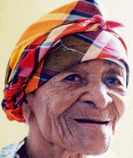
Interesting Fact: Elizabeth Israel (‘Ma Pampo’)
Dominica has a large centenarian population (those who live over age of 100) with a count of 22 people – population (only about 70,000)
Israel born and resided in Dominica
Focus of one of most widely publicised longevity claims of recent years
December 1999 – publicly stated to be 124 years old and the world’s oldest person
Said she accomplished this through a diet of local legumes, fruit, dumplings
Was used to promote tourism in Dominica - a haven for longevity
Her attested birthdate would have made her 128 years old at death
Guinness Book of World Records rejected her longevity based on lack of evidence
Was believed to be probably at least 100 upon her death in 2003

