Slide 1
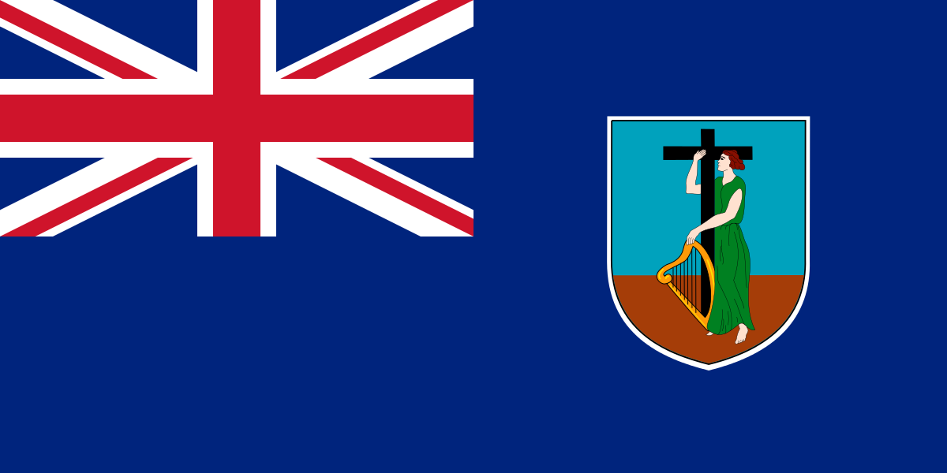
Montserrat

Slide 2
Fact file
POPULATION: 4900 (2012)
AREA: 102 km² (39 sq mi)
GDP (per capita): US $12,384
CAPITAL: Brades
OFFICIAL LANGUAGE: ENGLISH
ESTABLISHED: 1632

Slide 3
Economy
Sugar, cotton plantations, along with rum, formed the backbone of Montserrat’s economy
France briefly captured the island in 1782 but became a British territory under the Treaty of Paris
St Patrick’s Day became an official public holiday after a failed March 17, 1768 slave uprising, but the island did not abolish slavery until 1834.
British philanthropist Joseph Sturge purchased his own sugar estate in 1857 to prove that hiring paid workers was more beneficial than using slave labor.
The Sturges became Montserrat’s most powerful family engaging in a number of social projects
Sir George Martin opened his AIR recording studio in 1979, many of the world’s top musicians flocked to the island to record their albums in Montserrat’s private and tranquil surroundings.

Slide 4
Federation of the West Indies
Created under British Caribbean Federation Act 1956
Became enacted in 1958
Intended to become a fully independent state, thus simultaneously satisfying the demands for independence from all the colonies in the region.
Collapses in 1963
Ultimately fails due to internal political conflicts

Slide 5
1967
1967 - Elects to retain colonial status instead of associated status within the West Indies Associated States (WISA)
2002 - British Overseas Territories Act grants British citizenship to Montserratians.

Slide 6
Storm Hugo 1989
Hurricane Hugo hit Montserrat very hard
Category 4 storm destroyed 90 percent of the island’s buildings, including AIR Studios.
Soufrière Hills volcanic eruption buried Plymouth, the island’s capital, in over 39 feet of mud. The Soufrière Hills volcano also destroyed Montserrat’s airport and forced over half the population to relocate
Island has never really recovered

Slide 7
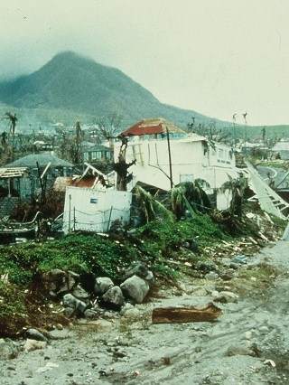
Storm Hugo

Slide 8
Fun fact
Soufrière Hills volcano is the most studied volcano in the world and Montserrat is regarded as a 'Modern Day Pompeii' in the Caribbean.

