Slide 1
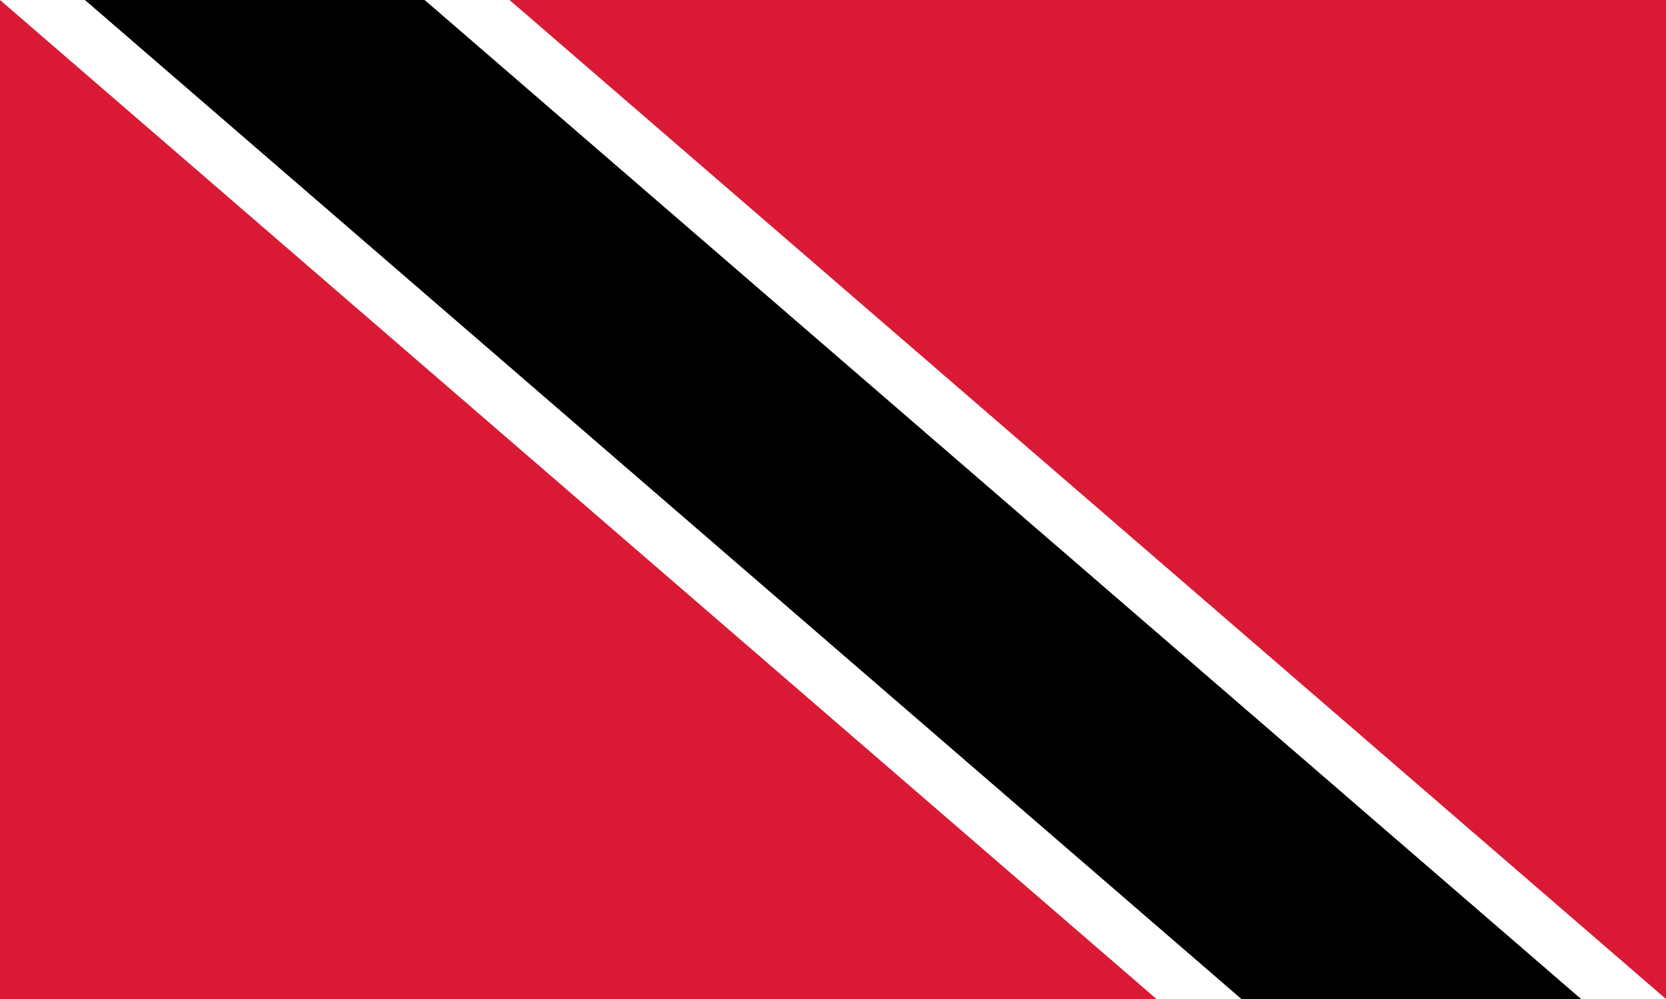
tobago

Slide 2
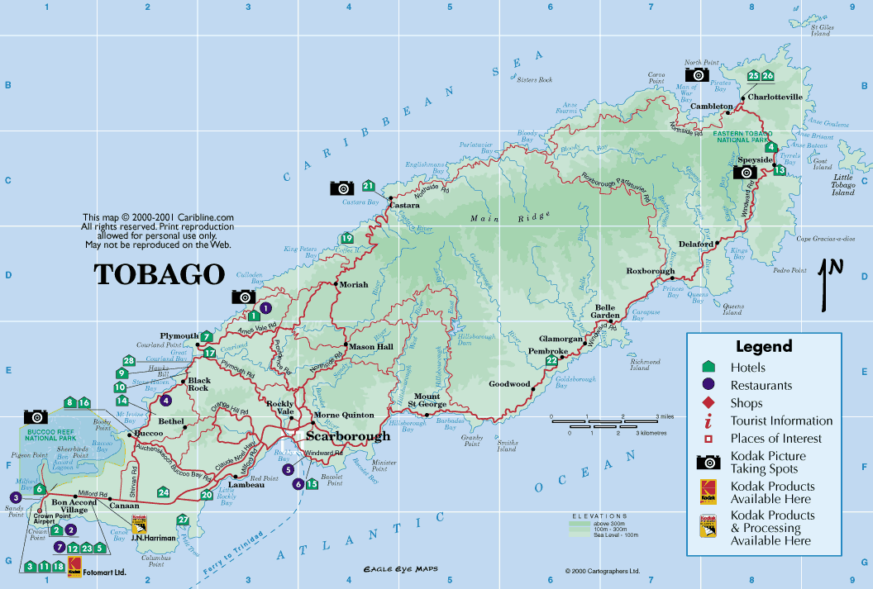
autonomous island within the Republic of Trinidad and Tobago
located northeast of the mainland Trinidad and southeast of Grenada
population of under 61,000 people (according to 2011) census)
the capital, Scarborough, has a population of about 25,550
while Trinidad is multiethnic, Tobago’s population is primarily of African descent
according to the Oxford English dictionary, Tobago bore a name that has become the English word ‘tobacco’

Slide 3
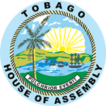
Christopher Columbus first sighted Tobago in 1498. Subsequently, several powers fought over possession of the island.
the original Carib population were forced to defend themselves against other Amerindian tribes. In subsequent years, the Dutch, English and French transformed Tobago into a battle zone, and the island changed hands 31 times before it was ceded to the British in 1814 (Treaty of Paris).
The Trinidad and Tobago Independence Act 1962 granted independence from the United Kingdom; led to the granting of a new Constitution of Trinidad and Tobago

Slide 4
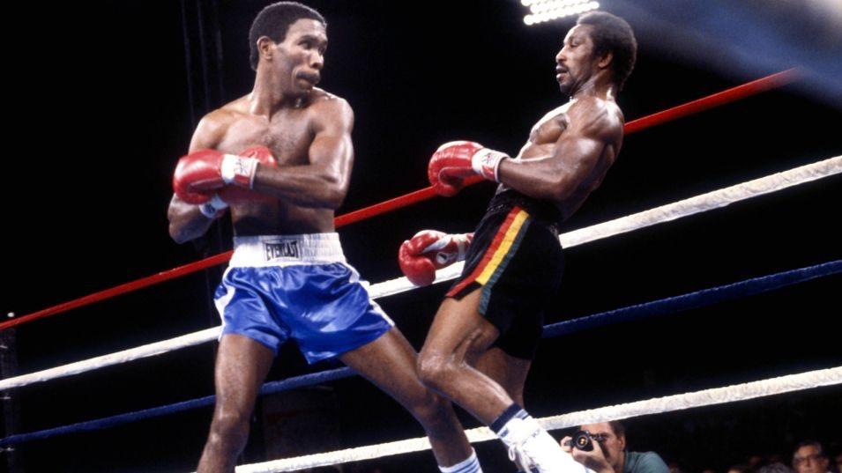
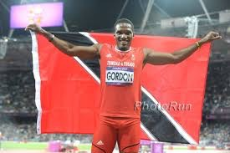
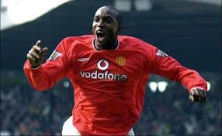
Lalonde Gordon, Bronze medalist at the 2012 London Olympics
Claude Noel, former WBA World Lightweight and Commonwealth Lightweight titleholder
Dwight Yorke, former Aston Villa, Manchester United and Sunderland footballer

Slide 5
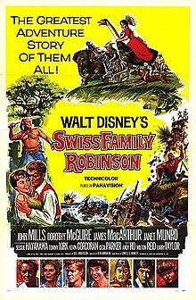
1960 Disney film Swiss Family Robinson, based on the 1812 novel of the same name, was filmed in Tobago

