Slide 1
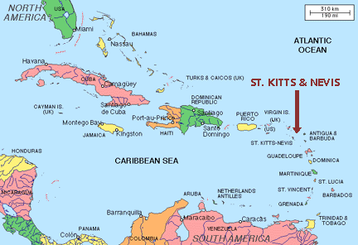
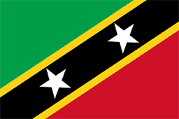
Saint Kitts

Slide 2
Federation of Saint Kitts and Nevis
Independence in 1983 from Britain
Smallest country in the Caribbean with a population of 35,000
Home to the Warner Park Cricket Stadium which was used during the 2007 Cricket World Cup
Carnivals and music play an important role in the culture of Saint Kitts
St Kitts Music Festival
Notes:
Saint Kitts and Nevis are one country, separated by a 3km channel know as ‘The Narrows’.
British influence is still present with English remaining the official language
This was the first time the Cricket World Cup had been held in the Caribbean despite being the 2nd most successful team in previous World Cups.

Slide 3
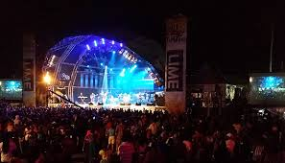



Notes:
Music Festival held annually in June since 1996. Celebrates Caribbean artists and culture. This is tourism but maybe changing the idea of the Caribbean as just the sun, sand and sea paradise(?) appealing to different ‘type’ of tourist. Also maybe, more accessible to Caribbean people as well

Slide 4
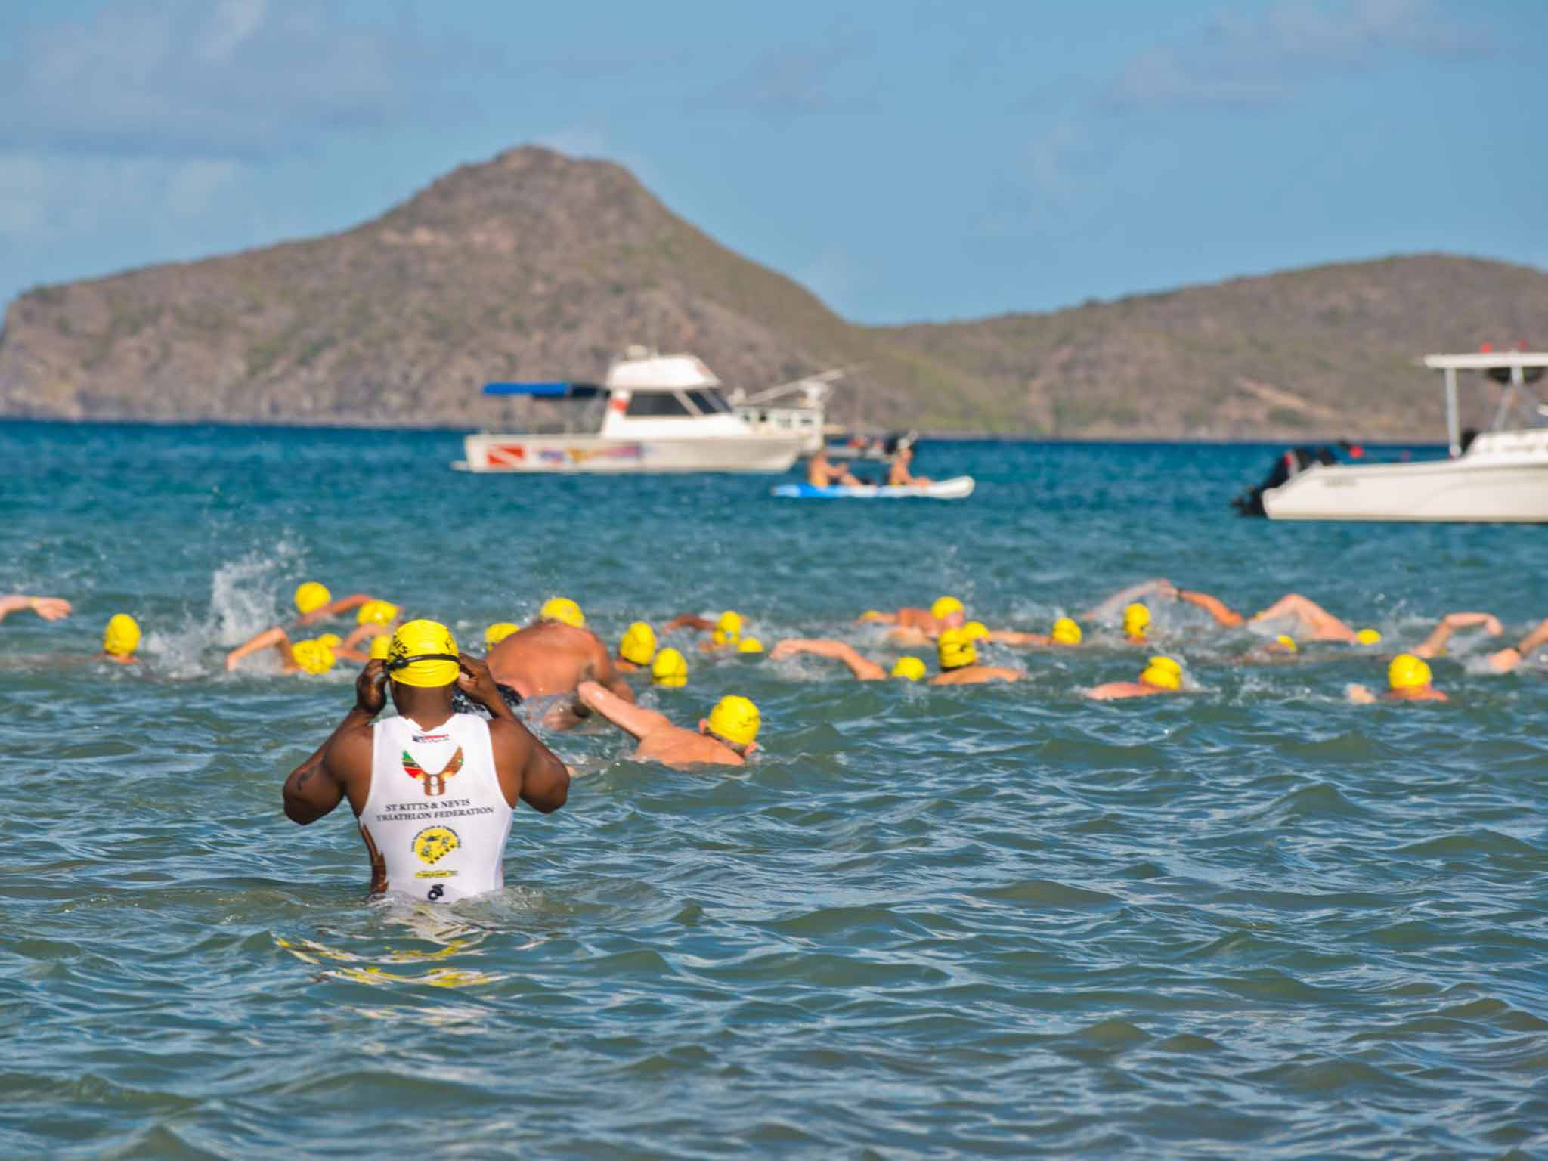
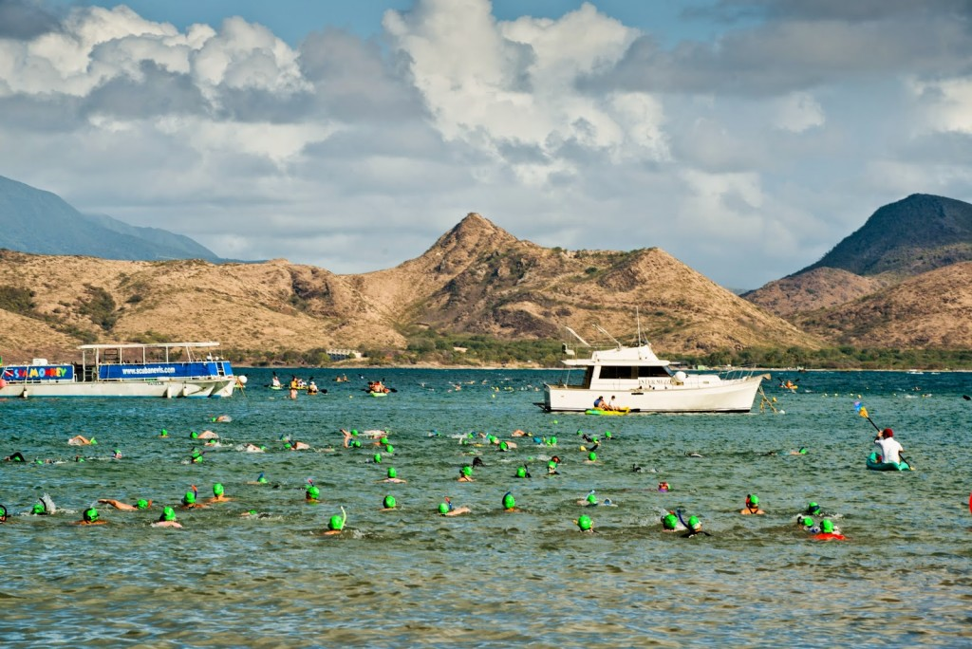
Annual swim across the channel between Saint Kitts and Nevis, a distance of 4 km

