Slide 1
Saint Lucia

Slide 2
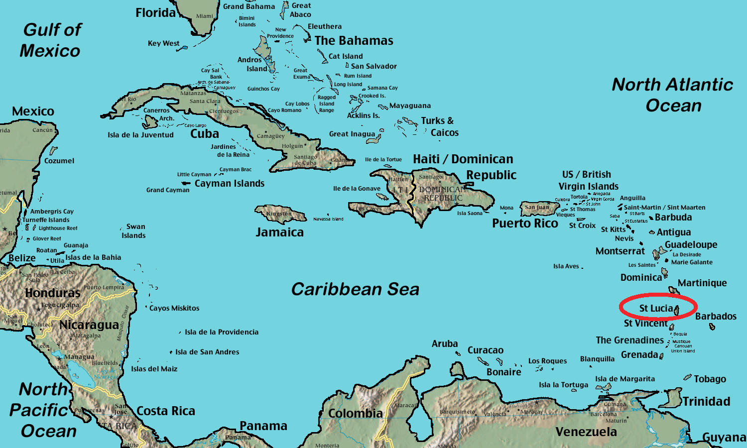
One of the Windward Islands and part of the chain of the Lesser Antilles.

Slide 3
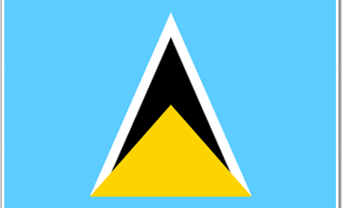
The Saint Lucian Flag
The blue represents the sky and the arrow shape represent the Pitons, the island’s famous twin volcanic peaks.

Slide 4
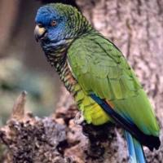
Facts:
Saint Lucia changed hands nearly 14 times throughout the 17th and 18th centuries between France and Britain.
The national bird is the St Lucia Parrot,
or Jacquot, which is native only to Saint
Lucia. Its scientific name is Amazona
Versicolor.
Saint Lucia has 2 Nobel Prize Winners: Sir Arthur Lewis for economic sciences in 1979 and Derek Walcott for Literature in 1992.

