Slide 1
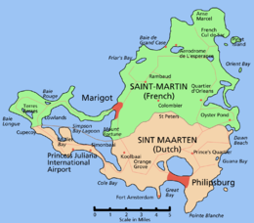
Saint Martin

Slide 2
1. St. Martin is the smallest island in the world divided between two countries, France and the Netherlands. The island is 34 square miles in total size,
2. The northern French part of the island is known as St. Martin and is an overseas collectivity of France. The southern Dutch part is known as St. Maarten and is one of four constituent countries that form the Kingdom of the Netherlands.
The land mass of St. Martin is split roughly 60/40 with the larger French side covering about 20 square miles.
4. Slightly more people, however, live on the Dutch side of the island (where the estimated population is 39,689) while 31,754 people reside on the French side. Philipsburg is the biggest city of the Dutch side while Marigot is the capital of the French side.
5. The division of the island between the Netherlands and France dates to March 23, 1648, under the Treaty of Concordia. Local folklore indicates that the division of land began with walking contest between a Frenchman and a Dutchman. Before they started, the Frenchman drank wine while the Dutchman drank the stronger jenever (Dutch gin), allowing the Frenchman to cover more territory and claim more land. (The Dutch say he cheated.)

Slide 3
6.Before the French or the Dutch arrived, Christopher Columbus claimed the island for Spain on November 11, 1493. Since that day was celebrated as St. Martin Day, he named it Isla de San Martín after Saint Martin of Tours. Spain did not make settling the island a priority.
7. Wanting the island’s salt, the Dutch founded a settlement in 1631, erecting Fort Amsterdam as protection from invaders. Jan Claeszen Van Campen became its first governor, and the Dutch East India Company began their salt mining operations. French and British settlements sprang up on the island as well.
8.Despite its short runway that is located between a large hill and a beach, major airlines fly large jet aircraft into St. Martin’s Princess Juliana International Airport. This scene results in spectacular photo ops of aircraft directly above sunbathers on Maho Beach.

Slide 4
