Slide 1
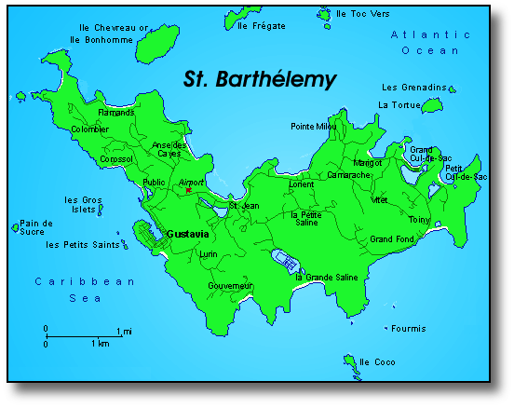
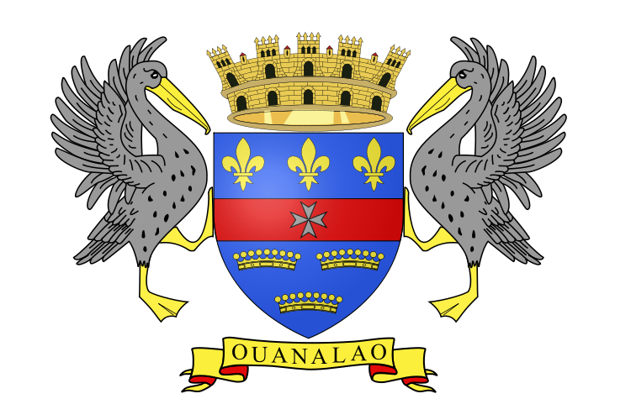
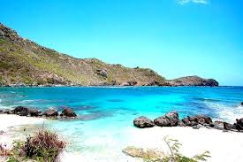
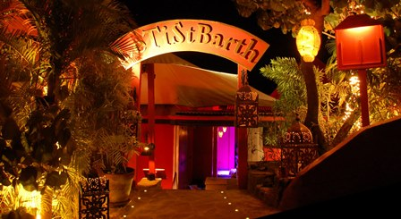
St barthelemy
AKA: Territorial Collectivity of St Barthelemy, Ouanalao, St Barts/St Barth
POPULATION: 9,279
CAPITAL: Gustavia
LANGUAGES: French, English, Antillean Creole

