Slide 1
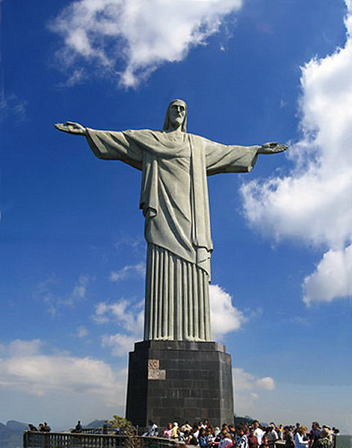
Introduction to Modern Brazil Dr Camillia Cowling (c.cowling@warwick.ac.uk)

Slide 2
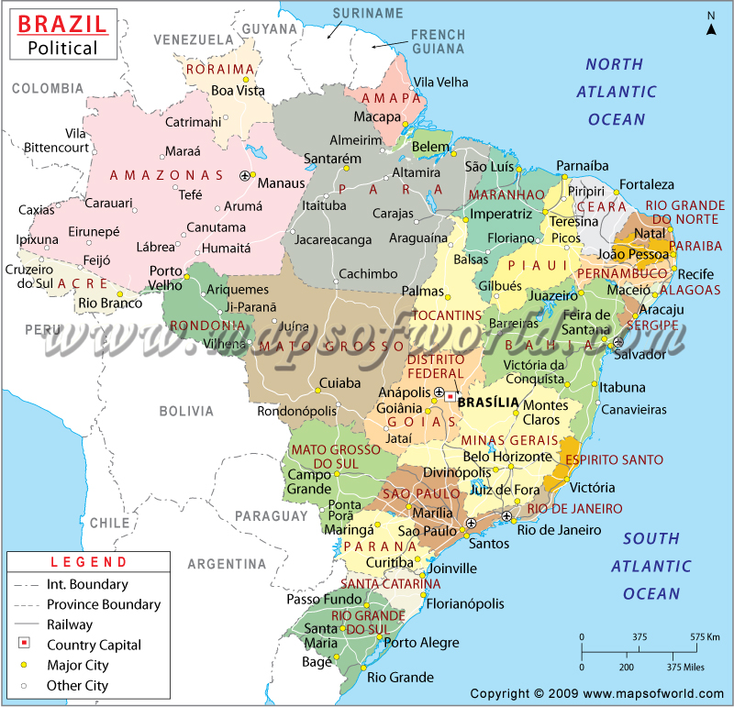

Slide 3
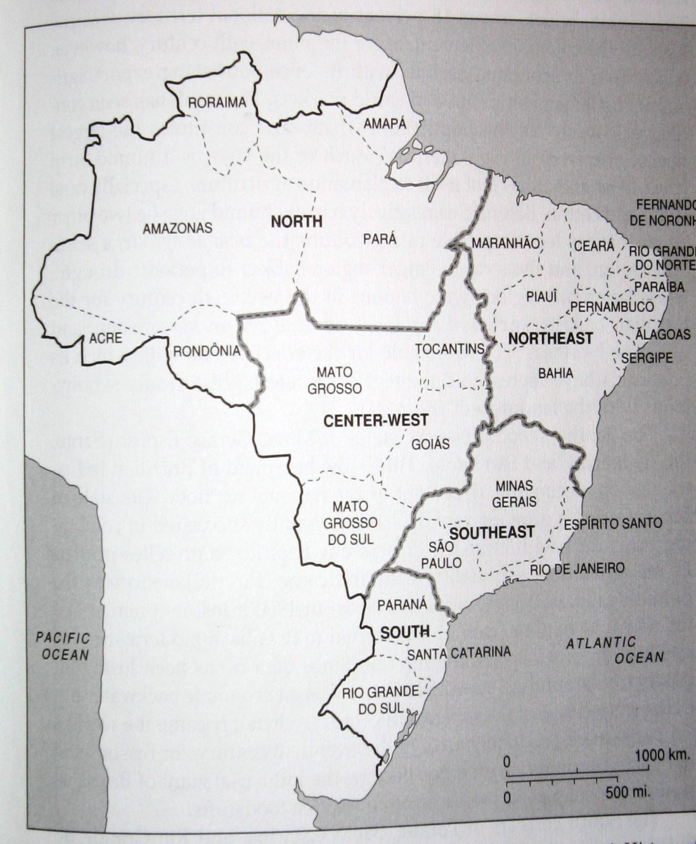

Slide 4
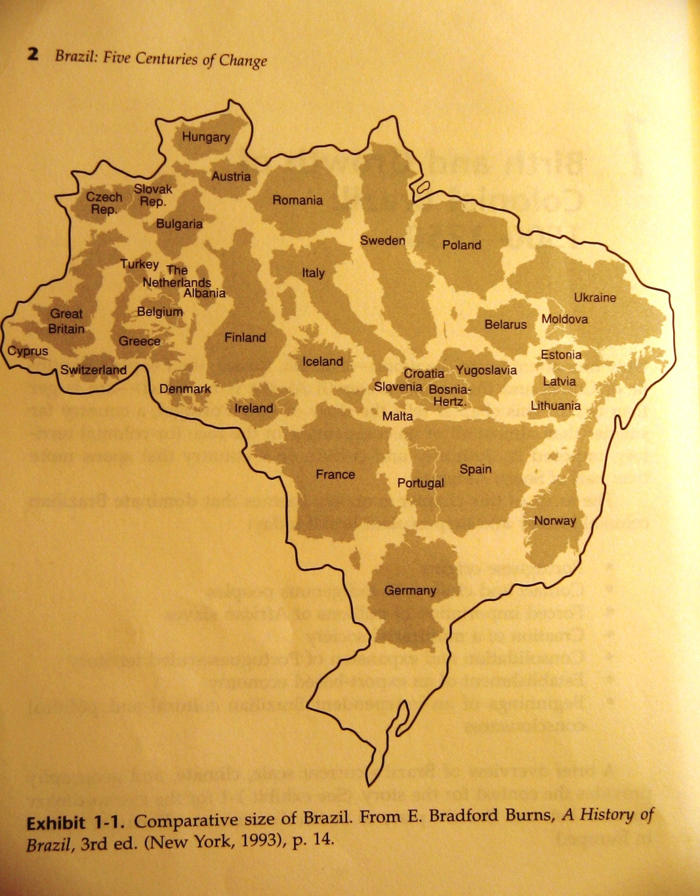

Slide 5
Themes in the study of Brazil
Nation-building, cultural unity despite huge size and regional diversity
Co-existence of “cordiality” and violence; extreme social inequality
Race mixture and relatively harmonious race relations; yet long history of racism
Optimism, “country of the future”; environmental questions...
Popular culture
Economy based on export products; but also more industrialization than other parts of Latin America

Slide 7
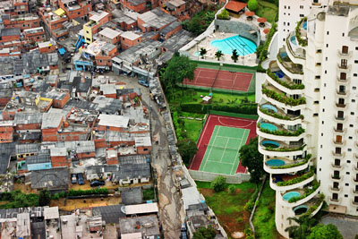
Morumbi neighbourhood, São Paulo, with Paraíso favela next door

Slide 9
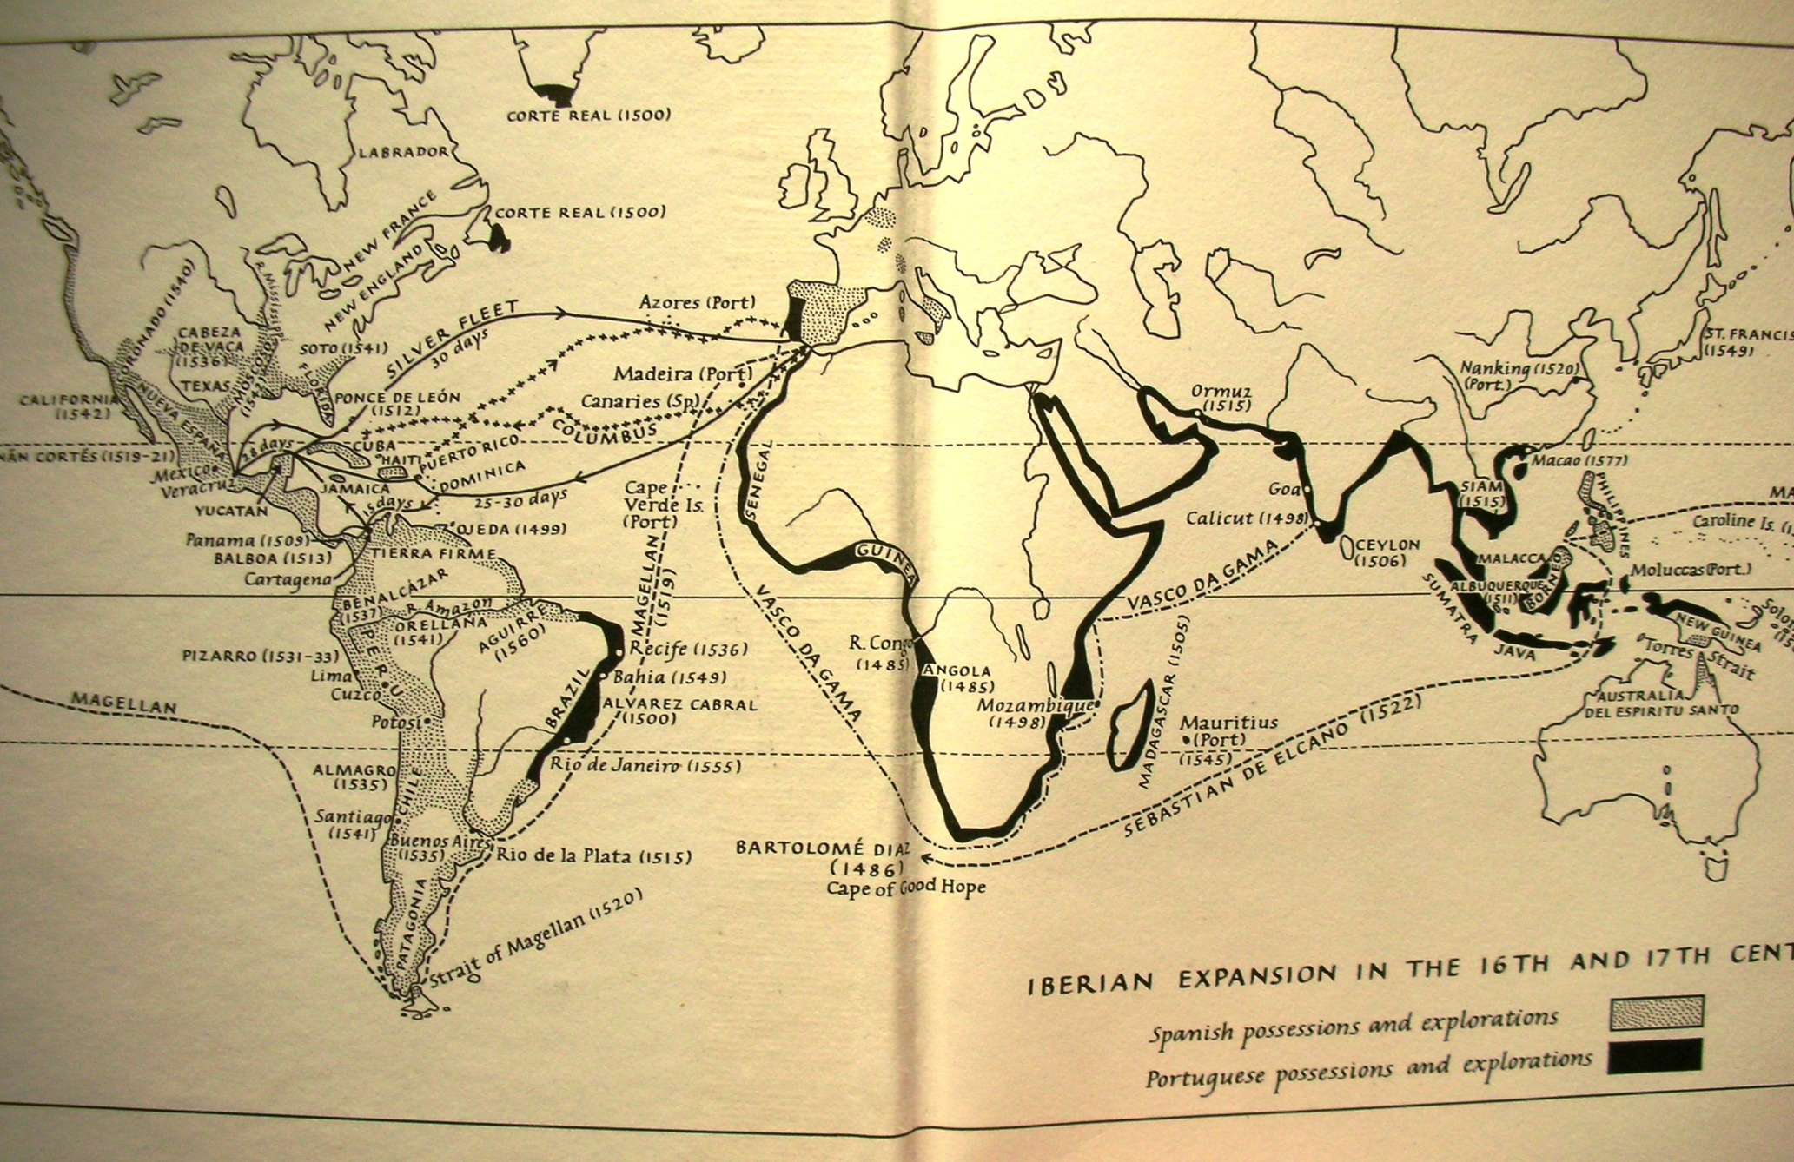
Notes:
Iberian expansion in 16th / 17th centuries (J Elliott, Imperial Spain)

Slide 10
“Discovery” and Early Administration
Major Portuguese trading empire: Azores, Madeira, Africa; Asia
1500 Pedro Alvares de Cabral reaches N.E. Brazil
1530s territorial consolidation (threat from European powers)
Land grants allotted by Crown
By 1570s: Crown authority on coasts, not interior; Governors General; capital city Salvador da Bahia in North-East
Seventeenth century: territorial expansion but, basic shape of colony doesn’t change
Eighteenth century: population shift south. Capital becomes Rio de Janeiro

Slide 11
Economy: Sugar Cycle (17th century)
Portuguese already have experience growing sugar
Earliest Brazilian society is North-East sugar plantations
Indian labour unsatisfactory → Africans imported
1600-1650: Sugar provides 90-95% of Brazil’s export earnings
1680s: Decline in productivity; Caribbean competition

Slide 12
Economy: Eighteenth-Century Mining Cycle
Sugar declining by end of 17th century
Gold discovered 1690s in Minas Gerais; diamonds later
Brazil is world’s biggest gold producer by early eighteenth century
Shift of power, wealth, population to South-East
Mining also based on slave labour
Mining wealth goes to Portugal... an asset or a liability??

Slide 13


Slide 14
Society
Hierarchy based on race, origins, gender: white men at top, black slaves at bottom
Elite women: cloistered, subject to authority of patriarch along with servants/ minors
Miscegenation: growing sector of free people of colour; some opportunities for advancement despite prejudice
Slave society: life unthinkable without slaves; Brazil imports around 3.5 million slaves to 1850. More opportunities for manumission than in (e.g.) United States; but treatment usually harsh, life expectancy low

Slide 15
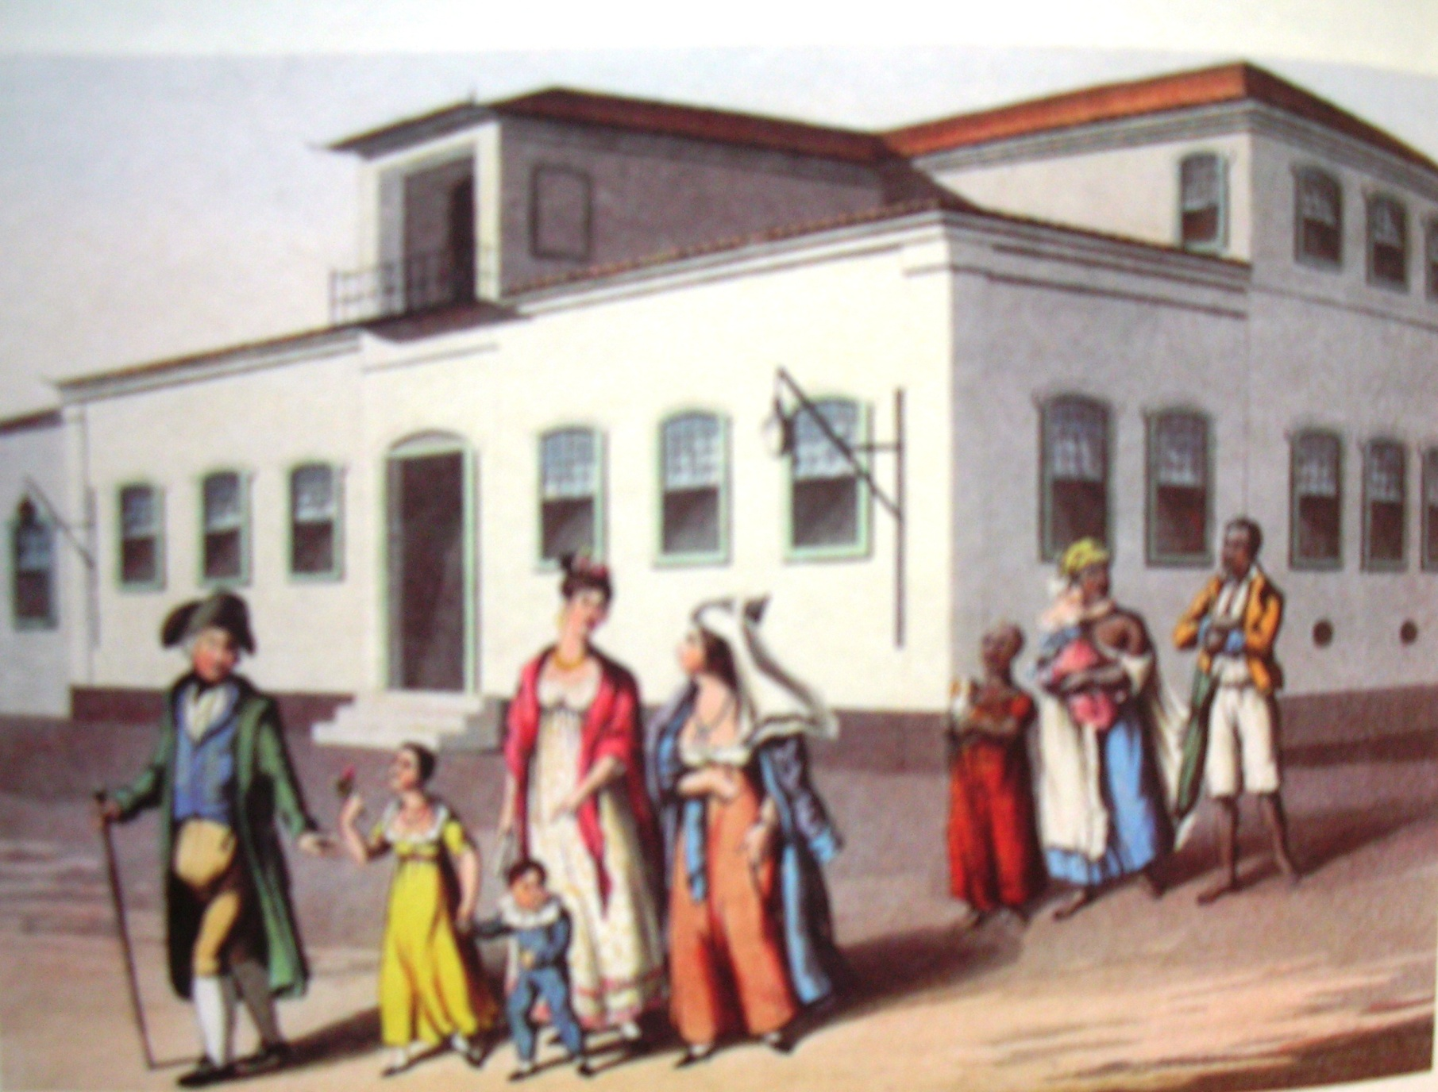
Notes:
Elite family going to mass with servants/ slaves behind (from Junia Furtado, Chica da Silva)

Slide 16
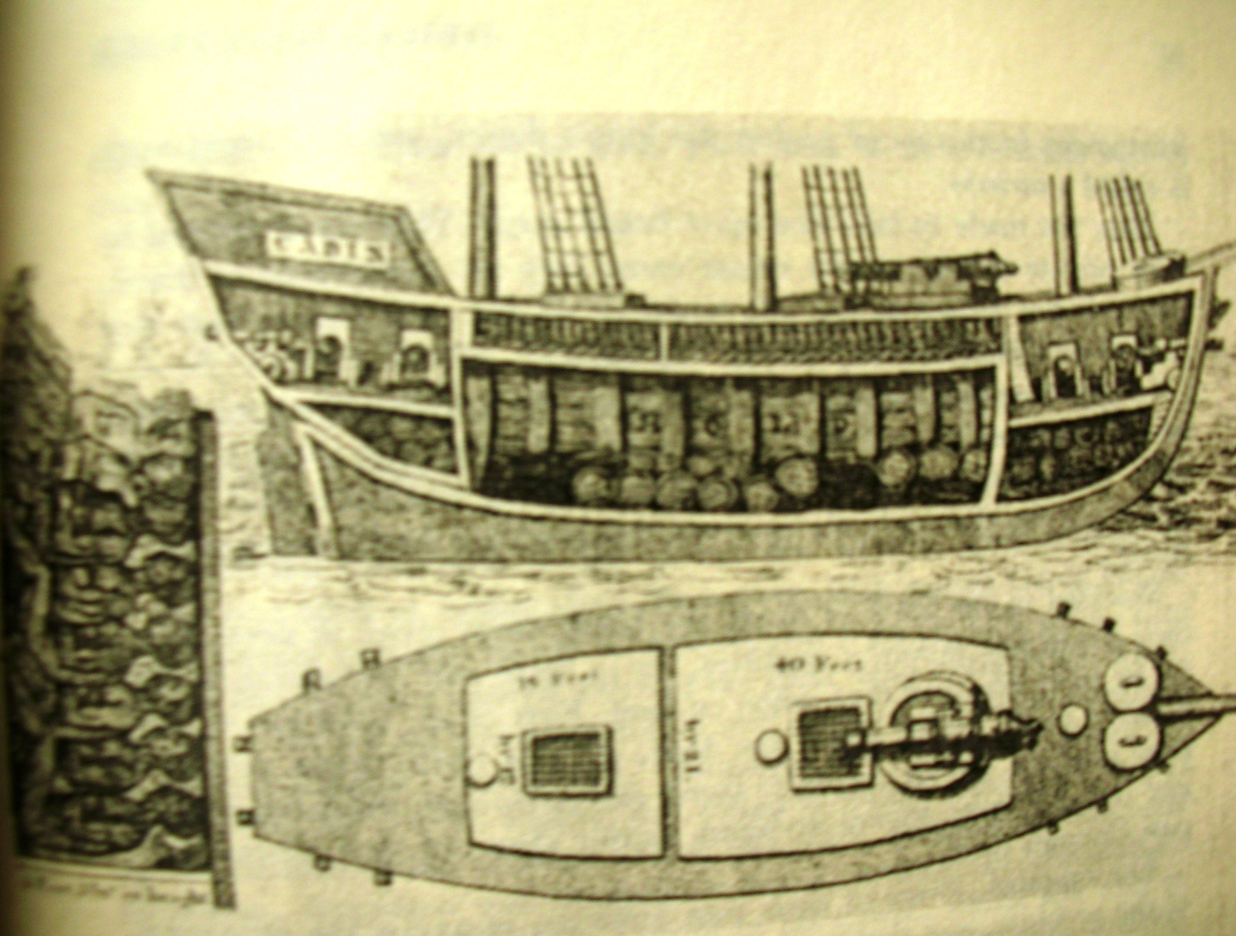
Notes:
Inside of slave ship 2

Slide 17
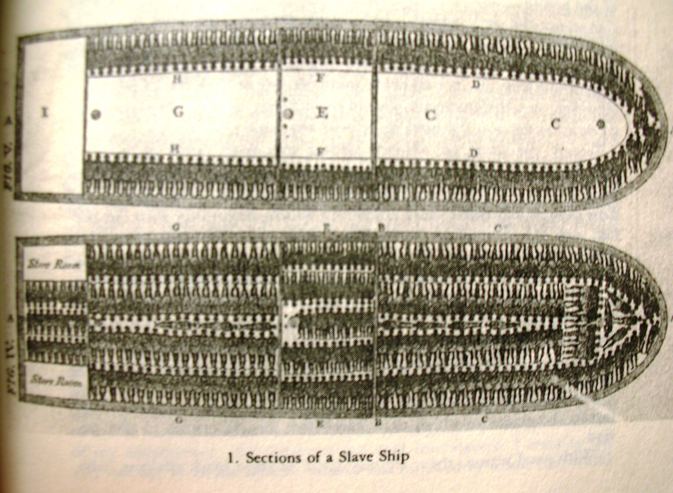
Notes:
Slave ship 1 (Conrad, Children of God’s Fire)

Slide 18
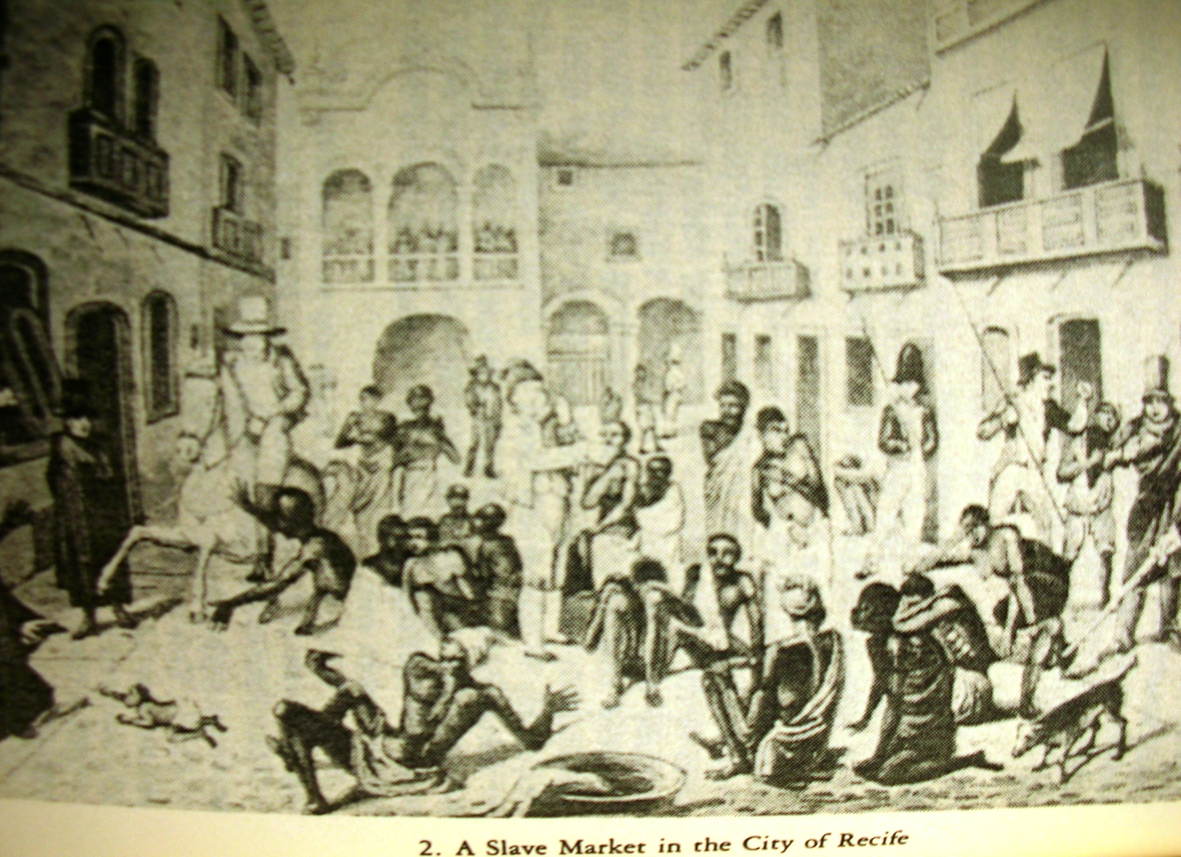
Notes:
Slave market, Recife (Conrad, Children of God’s Fire)

Slide 19
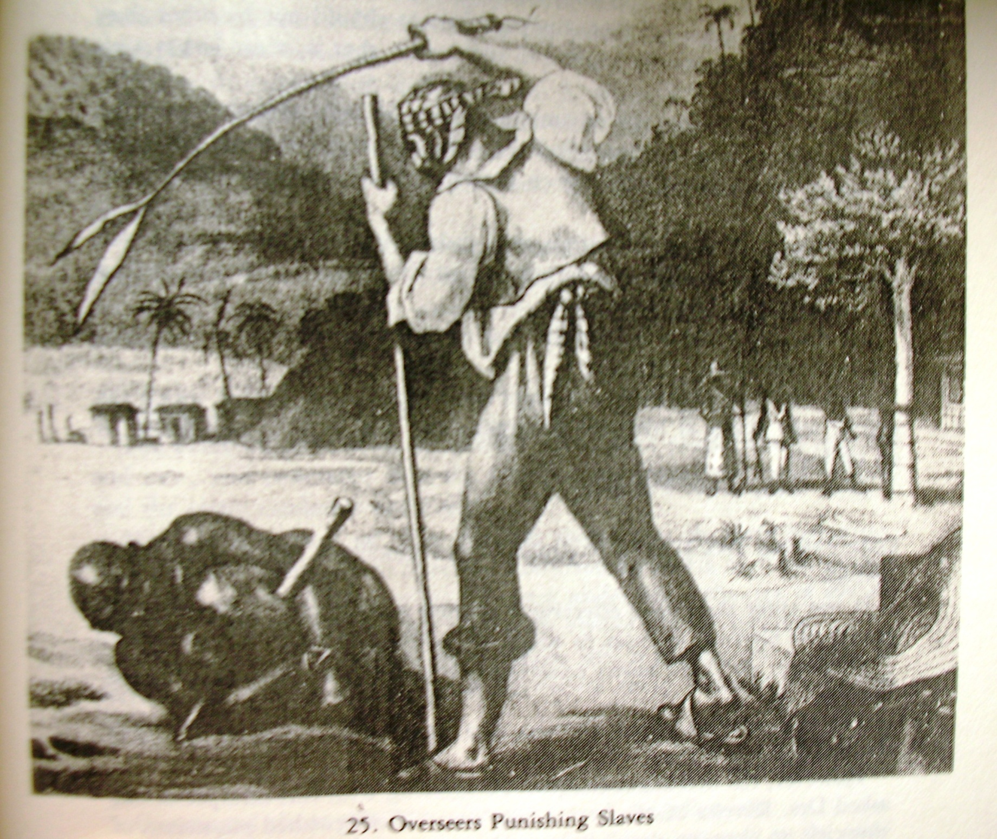
Notes:
Slave punishments (from Conrad, Children of God’s Fire)

Slide 20
Brazil by 1750
Powerful local families (seeds of future oligarchies) dominate local affairs but also linked closely to Portugal
No universities or printing press, although development of some seeds of “Brazilian” culture & identity
Brazil has become richer & more important than mother country: “Without Brazil, Portugal is an insignificant power.”

Slide 21
Portuguese solutions
Series of reforms implemented by 3 men:
1: Sebastião José de Carvalho e Melo (Marquis of Pombal) 1750-1770
2: Martinho de Melo e Castro, 1770-95
3: Rodrigo de Sousa Coutinho, 1796-1803
“Enlightened despotism”
Mercantilism

Slide 22
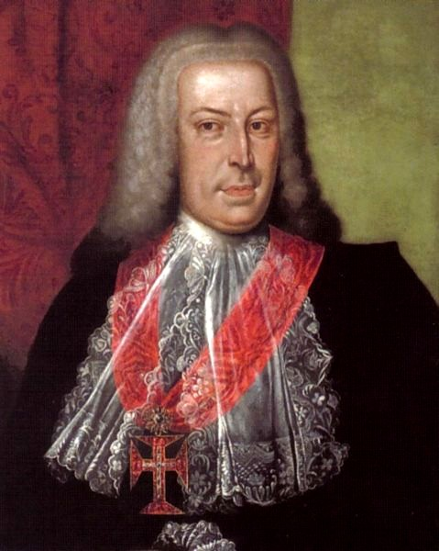
Notes:
Marquis of Pombal

Slide 23
Pombaline Reforms
ADMINISTRATIVE: state of Grão-Pará & Maranhão integrated into one Estado do Brasil ruled from Rio de Janeiro
TRADE: monopoly trading companies replace old fleet system of trading
ECONOMY / PRODUCTION: stimulate production of Brazilian agricultural products and demand for Portuguese manufactures
RELIGIOUS: Expulsion of Jesuits 1759

Slide 24
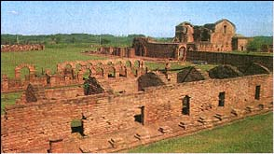
Notes:
Ruins of Jesuit Guarani mission, Asuncion, Paraguay

Slide 25
Results of reforms
General economic recovery for Brazil and Portugal by 1790s
Coffee exported from Brazil for first time; sugar recovers; new products: rice, wheat, indigo...
Portugal’s trade deficit reduced by 70%, 1751-1775
Brazil supplies 61% of Portugal’s trade surplus: dependence on Brazil increases

Slide 26
Tensions in late eighteenth century
Material resentments: tax increases; dominance of Portuguese merchants; growing anti-Portuguese sentiment; awareness of Brazil’s greater economic power
Influence of Enlightenment ideas among elite (via Coimbra) . Influence of Enlightenment-inspired revolutions: United States; France

