Slide 1
Week 2:
The Breakdown of the Old Order: the 1920s and the 1930 Revolution

Slide 2
Last week: the Republic to about 1914
The advent of a Brazilian Republic that toppled the Old Empire in a coup in 1889
Changes:
Rise of the military as a political power broker (a new “moderative power”)?
Positivism: notions of “order and progress”
applied to e.g. race and whitening, or urban modernisation, “discovery” of interior
Continuities:
Coffee dominates economy
Powerful coffee families dominate politics

Slide 3
First World War
Brazil is neutral for first 3 years, then comes in on Allied side (only Latin American country to take part)
Ideologically: frustrated quest for world recognition → idea of Brazilian solutions to Brazilian problems.
Isolation from European trading partners…
prevents imports of machinery and materials for industrialisation in some sectors
Promotes industrialisation in others; trade among Latin American nations
Industry overall grows 4.4% per year 1915-1917.

Slide 4
Post-war economic developments
Growth increases dramatically : 10.1% in 1920
Recovery in 1920s; coffee prices remain high
Some government investment in e.g. cement, steel, paper, rubber, machinery
Decline of Britain as main trading partner, replaced by US and Germany

Slide 5
Demographic change by the 1920s
National population has grown : 22M in 1910; 30.6M in 1920, over 35M by 1930
Huge urban expansion: Rio de Janeiro has 1.16M people in 1920; São Paulo has 580,000
Growth of Rio Grande do Sul: third most populous state by 1920s
650,000 immigrants arrive 1900-1910; and 820,000 1910-1920
By 1920, Brazil has largest percentage of foreign-born people in its whole history.

Slide 6
Social changes by 1920s
Literacy rates much higher: 29% of men, 20% of women
Growing middle class in cities; their interests not represented by oligarchic politics
Plus working Brazilians completely ignored
Rural vote (managed by coroneis) always outweighs urban sectors
Ie politics not keeping pace with social change

Slide 7
Economic changes by 1920s
Still primarily rural economy:
1920: over 6M of labour force (70%) in agriculture; 1.2M in industry
But: significant increase in industrialisation: agricultural sector falls from 45% of GDP in 1900 to 35% in 1913.
Industry goes from 10% of GDP in 1900 to over 20% by 1929.

Slide 8
Regional divides
South/ South-East industrialises and develops; NE/ North decline
Internal migration: DROUGHTS in North-East; uneven regional economic development brings rural migrants to cities of South-East
Separate military forces for each state
Poor transport / communication
Fear by 1920s that Brazil will break apart

Slide 9
Brazilian Modernism
New artistic/ literary developments in 1920s
Artists/ writers based in S Paulo
E.g. the artist Tarsila do Amaral; the writer Oswald de Andrade
Influenced by European art trends but also in Brazilian national realities
Journeys of “discovery” to rest of country
Use French modernism, cubism, later surrealism, to produce “authentically” Brazilian works…
tropical colours, ordinary people and customs…

Slide 10
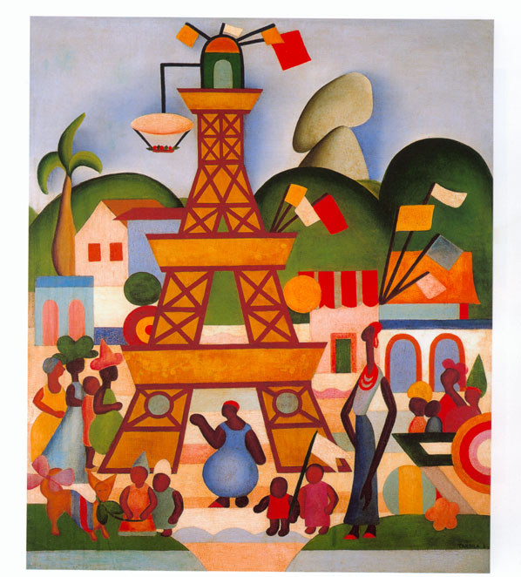
Tarsila do Amaral, “Carnival in Madureira,” 1924

Slide 11
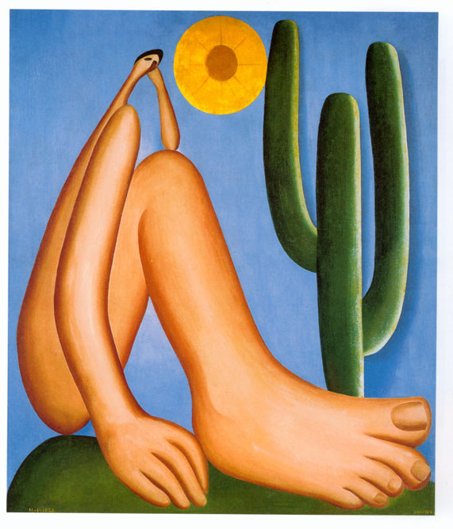
Tarsila do Amaral, Abaporu (“the man who eats”)

Slide 12
Anthropophagism
Painting “Abaporu” (1928) meaning “the man who eats people” in Tupi-Guarani
Sparks “anthropophagist manifesto” by Oswald de Andrade (1928)
resist European cultural dominance by “eating” it and creating something uniquely Brazilian
Preoccupation with non-elites, but still an elite cultural movement

Slide 13
Politics in the 1920s
Early Republic: military leave centre stage, but broker deals in the “wings”
1891 constitution: read by many in military as ALLOWING this
Meanwhile, politics dominated by oligarchic “coffee with milk alliance” (Minas and S Paulo)
Dissatisfaction among: new urban middle classes; Rio Grande do Sul
Elections seen increasingly as corrupt, managed, people know they are not being represented…

Slide 14
Tenentismo
Periodic attempts within the MILITARY to shake this up, usually the younger ranks…
Emergence of the TENENTES - lieutenants - by early 1920s → “tenentismo”
dissatisfied with Brazil’s progress; comparison with US/ Argentina
Idea of “Brazilian solutions for Brazilian problems”

Slide 15
Strife in the 1920s
Contentious fraudulent election 1922
Barracks revolt Copacabana 1922 – participants become national “heroes”
Second military revolt: starts in Rio Grande do Sul; occupation of S. Paulo for 18 days…
Retreat to backlands: 2,000 mile, 3-year march through interior – “Prestes Column” [led by Luiz Carlos Prestes]

Slide 16
1930: Collapse of the Republic
1929 election: Julio Prestes (paulista) nominated by incumbent, Washington Luiz
Liberal Alliance against S Paulo: Minas, Rio, Rio Grande do Sul (under Vargas)
Wall Street crash: coffee prices fall by 1/3, Sept to Dec 1929, and another 70% by second half of 1930
Júlio Prestes wins with 1.1M votes; Vargas gets 600,000 votes in RGS and MG, and 200,000 in rest of country
Coup following murder of João Pessoa
Minas, Rio Grande do Sul provide military support
Military in Rio support the coup.
Vargas in power from 1930

Slide 17
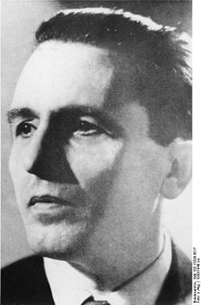
Luís Carlos Prestes (The “Knight of Hope”)

Slide 18
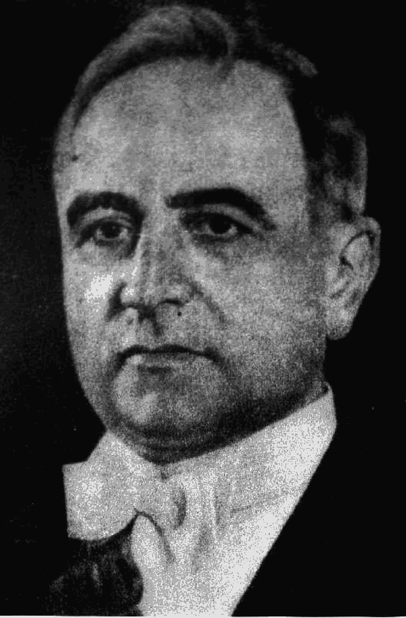

Slide 19
Seminar questions
How did Brazil change demographically, politically, and culturally between 1914 and 1930? With what (if any) significance?
What was Euclides da Cunha’s view of ordinary rural Brazilians and their culture around the turn of the twentieth century?
How did the modernists of the 1920s start rethinking Brazilian culture and identity?
Why did Vargas come to power in 1930?
Was the collapse of the Republic inevitable?

Slide 20
Seminar readings
Bethell (ed), Empire & Republic, chapter 6 (“Society and Politics”
And, from the Brazil Reader:
Dain Borges, “A Mirror of Progress” (on Canudos)
Carol Damian and Cristina Mehrtens, “Tarsila and the 1920s” (on modernism)
Luís Carlos Prestes, “Manifesto” (response to Liberal Alliance), 1930
Liberal Alliance Manifesto, 1930

