Slide 1
Week 6: Vargas and the Estado Novo, 1930-1945

Slide 2
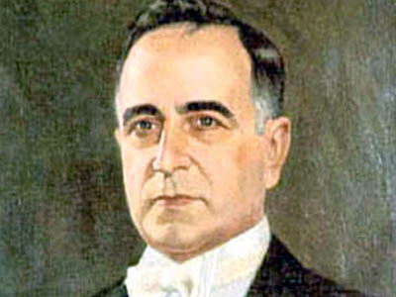
Getúlio Dornelles Vargas (1882-1954)

Slide 3
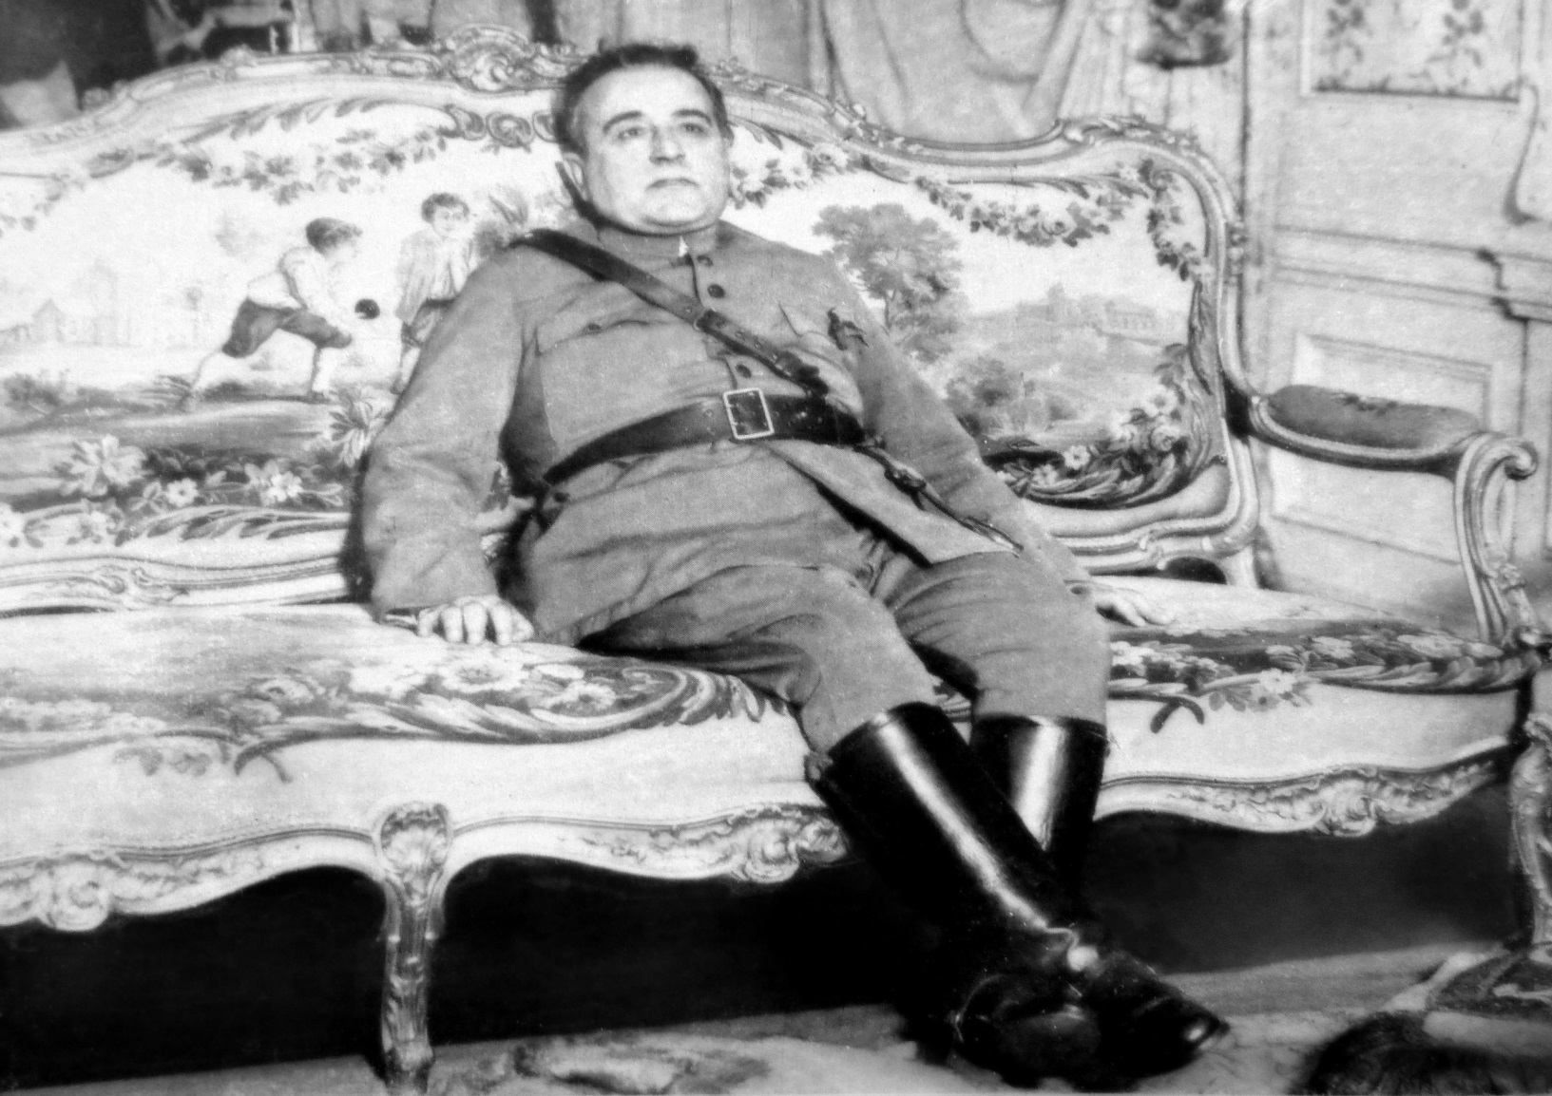
A former military man…

Slide 4
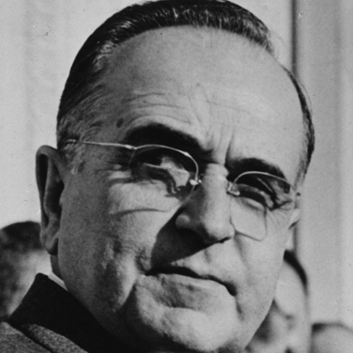
… and wily political operator

Slide 5
Vargas comes to power, 1930
Elections perceived as corrupt and flawed
Dissatisfaction among tenentes; barracks revolts and Prestes Column
regional jealousy of Sao Paulo’s dominance; growth of Rio Grande do Sul
Wall St Crash 1929: coffee prices massively hit…
1929 “Liberal Alliance” formed to elect Vargas instead of another paulista president…
Assassination of João Pessoa → Vargas coup from Rio Grande and Minas
Military back Vargas from Rio

Slide 6
Vargas: a product of the Old Republic
“Vargas managed with extreme competence the complex regional political game, redefining loyalties, isolating resistance and shaping a new system of subordination to the goals of a new power centre. To this end, he could count on his experience as a politician coming from the Old Republic, something he never ceased to be.”
Aspasia Camargo et. al, O Golpe Silencioso (1989)
Notes:
Aspasia Camargo, Dulce Chaves Pandolfi, Eduardo Rodrigues Gomes, Mria Celina Soares D’Aajujo and Mario Grynszpan, O Golpe Silencioso: As origens da Republica Corporativa (Rio de Janeiro: Rio Fundo Editora, 1989), 35

Slide 7
How much change does Vargas effect personally?
Vargas builds a cult of personality, but:
Structural economic and social changes are common to other Latin American countries in the period
International political arena: communism v fascism; build-up to World War II; US and Germany vie for influence in Brazil
How successful are initiatives of Vargas’ regimes? Distinction between rhetoric and practice?

Slide 8
Consolidating power, 1930-1934
Heterogeneous aims / interests behind Liberal Alliance and 1930 Revolution
Therefore, just staying in power is a challenge initially
Economic crisis (Wall Street crash, 1929)
Declaration of emergency powers November 1930; states now controlled by central government; rule by “interventors”
Sao Paulo Constitutionalist War, 1932
No backing for SP from other states
Military loyal in exchange for favours
→ regionalist threat defeated

Slide 9
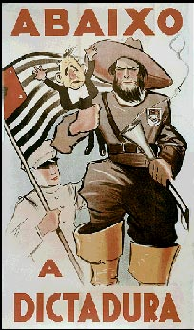
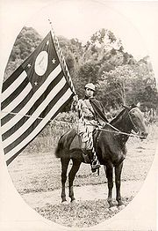
Notes:
Vargas being squeezed in the hand of a giant bandeirante on a recruiting poster of the 1932 Constitutionalist Revolution (the text reads "Down with the Dictatorship"). Right: a volunteer soldier

Slide 10
A new Constitution, 1934
Liberal political structures largely remain
Balances new centralised power with ongoing significant influence of states
new government responsibility for social and economic welfare
Women’s suffrage; secret ballot; collective representation for unions as well as individual voters

Slide 11
Negotiating between right and left
1930s ideological polarisation...
Vargas probably further to the right, but not reducible to either left or right
Instead he manipulates both to stay in power
Left: Partido Comunista Brasileiro (est. 1922); Aliança National Libertadora
Right: Ação Integralista Brasileira (AIB)
Coup attempt by Left, 1935 → Vargas establishes emergency powers again
Vargas declares Estado Novo, November 1937
Coup attempt by Right, 1938: excuse to repress the Right

Slide 12
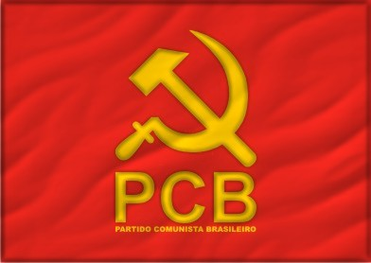
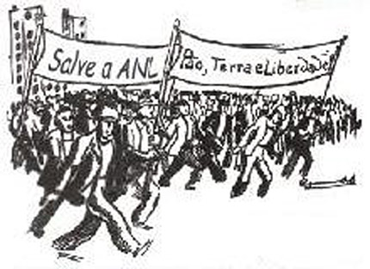
Brazilian communism

Slide 13
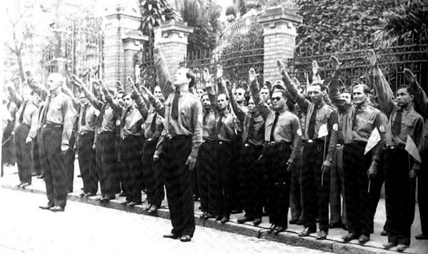
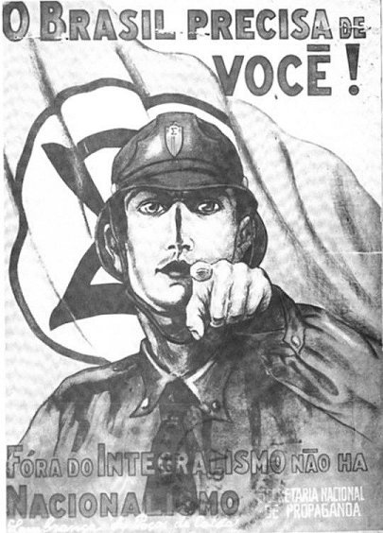
Brazilian integralismo

Slide 14
Dictatorship: The Estado Novo, 1937-1945
Repression of political enemies: imprisonment, torture, exile, censorship...
Extradition of Olga Prestes to Nazi concentration camp
Centralization of power; use of intendentes in states, and “technocrats” controlled by expanding central government
Military co-opted (for now): army budget grows, states’ powers curbed
Industrialisation: industrial output doubles during 1930s; economic growth about 4% average, 1930-1945
Nationalism through popular culture

Slide 15

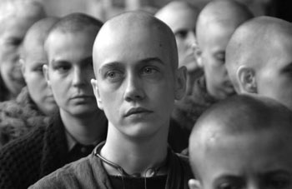
Extradition to Germany of Olga Prestes

Slide 16
Corporatism
Incorporation of different interest groups and economic sectors (syndicates) within state apparatus
So they cannot be sources of conflict
Unions co-opted into state as political base for Vargas
No inter-union communication; no right to strike
Social / welfare legislation for urban workers (“Father of the Poor”?)
Murilo de Carvalho: idea of “social citizenship” without “political citizenship”
Rural areas neglected
New style from Old Republic: appeal to ordinary Brazilians
Many poor Brazilians idolize Vargas for improvements in their lives

Slide 17
World War II
Sympathy with Axis powers: fascism, German/ Italian communities
But also sympathy and ties to US/ Britain/ France
Military/ trade relationship with Germany, e.g. in 1938 $55M worth of armaments ordered from Krupp Industries
Americans “court” Brazil economically and culturally, e.g. 1940 loan of $20M, later $45M, to build VOLTA REDONDA STEEL MILL
Japanese bomb Pearl Harbour, 1941; Brazil comes in on Allied side
...but, sows seeds for Vargas’ downfall

Slide 18
The Mineiro Manifesto, 1943
“If we fight against Fascism alongside the United Nations so that liberty and democracy may be restored to all peoples, surely we are not asking too much in demanding the same rights and guarantees for ourselves?”

Slide 19
Readings
-Skidmore, Brazil, ch 5;
Frank D McCann, Soldiers of the Pátria : a history of the Brazilian Army, 1889-1937 (2004), Chapter 7, “The Revolution of 1930”, pp 259-300
-Robert Levine, Father of the Poor? ch 3;
Oliveira Vianna, “Why the Estado Novo?” in Brazil Reader
-“Ordinary People” in Brazil Reader;
-Joel Wolfe, “Guest Editor’s Introduction: Getúlio Vargas and his Enduring Legacy for Brazil,” Luso-Brazilian Review 1994

Slide 20
Discussion questions
What was the rationale for the Estado Novo? What political problems of the day did it purport to solve (beyond keeping Vargas in power)?
To what degree were the aims of the Estado Novo implemented?
Did Vargas deserve the title “Father of the Poor”?
What was the relationship between Vargas and the military?
What were Vargas’ legacies to Brazilian politics?

