Slide 1
Week 4: National Identity
Samba, Football and “Racial Democracy”

Slide 2
Last week: Vargas in power, 1930-1945
Initial rule legitimised by the “Revolution” of 1930
Co-opts or beats off threats: regionalist threat (S Paulo); Communists; Integralists…
1937 establishment of Estado Novo dictatorship
Corporatism: different political interest groups incorporated into the state
“Father of the Poor” image: state responsibility for welfare (how successful?)

Slide 3
The military and World War 2
Key military figures (Eurico Gaspar Dutra and Pedro Aurélio de Góis Monteiro) turn away from Germany, embrace liberal democracy
This initially brings them closer to Vargas …
…but then they move further away from him
Brazil: initial poor military performance, but later improvements thanks to US money and training
Brazilian Expeditionary Force (FEB): become heroes after 1944 battles in Italy (450 deaths, 2,500 wounded of 25,000 troops)
This gives the military political leverage, which they use to oust Vargas in 1945

Slide 4
Steps towards re-democratisation
WW2 provokes ideological contradiction: Brazilian dictatorship fights to defend liberal democracy abroad
Vargas had promised to hold elections in 1943 (postponed thanks to war)
A domestic opposition forms: União Democrática Nacional (UDN)
Release of Luiz Carlos Prestes and 500 political prisoners
Civil society calls for elections – e.g. National Union of Students; Manifesto Mineiro

Slide 5
Vargas plays a new political game
Co-opts Luiz Carlos Prestes (other communists are disgusted):
Prestes: "Getúlio is very flexible. When it was fashionable to be a fascist, he was a fascist. Now that it is fashionable to be democratic, he will be a democrat.“
Two new parties: Partido Social Democrático (PSD); Partido Trabalhista Brasileiro (Brazilian workers’ party)
Elections called…

Slide 6
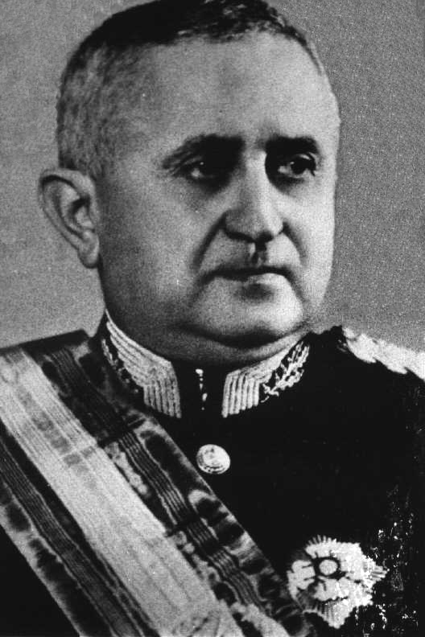
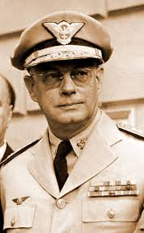
Two military presidential candidates
Eurico Gaspar Dutra (PSD – pro-Vargas)
Brigadier Eduardo Gomes (UDN – anti-Vargas)

Slide 7
Nationalism and popular culture
Nationalism is about self-interest for Vargas…
But, in process, transformation of Brazilian culture and identity
Samba: Afro-Brazilian origins; originates during/ after slavery; despised under Old Republic
State sponsorship of Rio’s samba schools under Vargas
Samba moves from favelas to mainstream (encouraged by spread of radio)

Slide 8
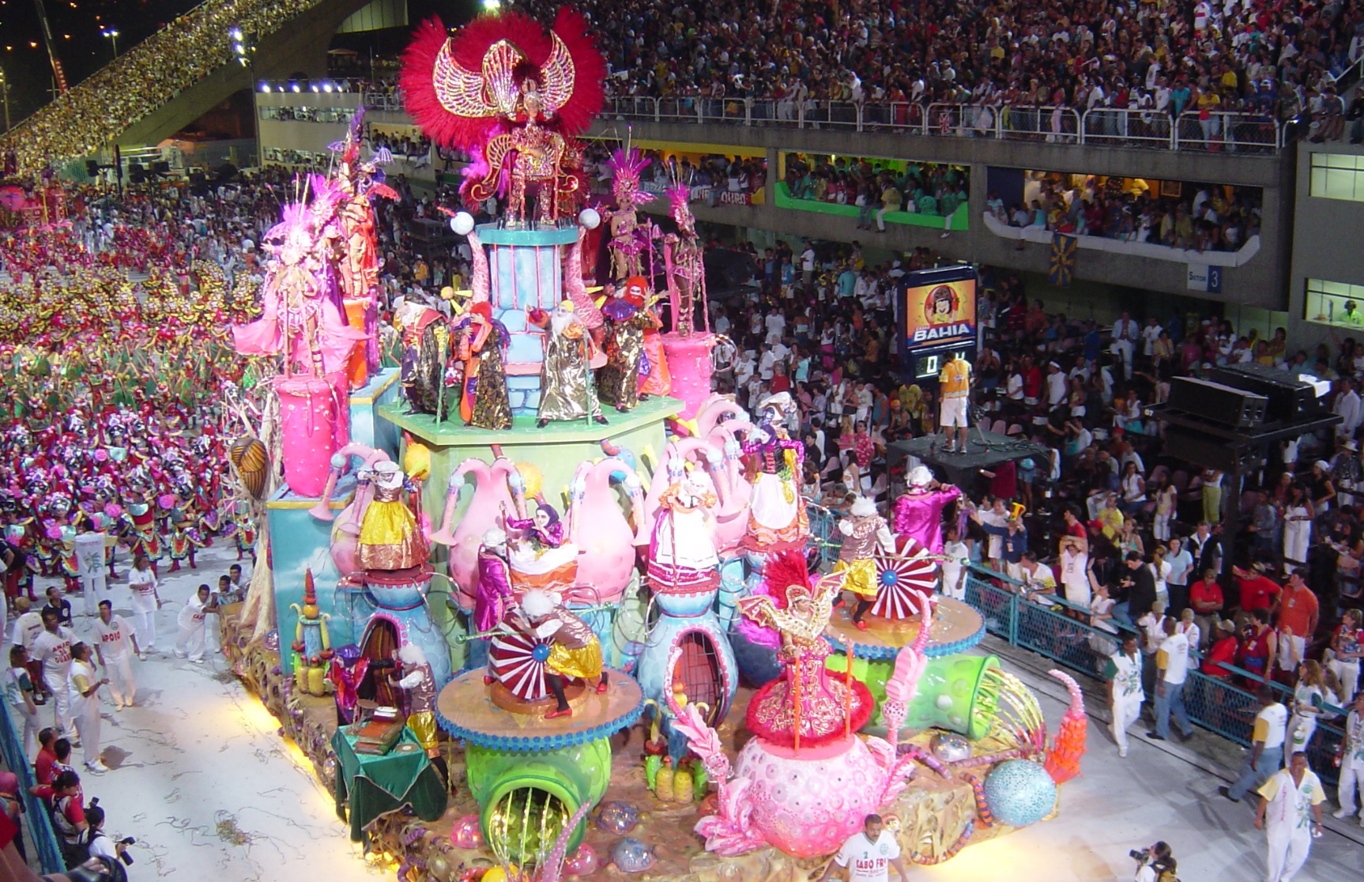
Carnival in Rio

Slide 9
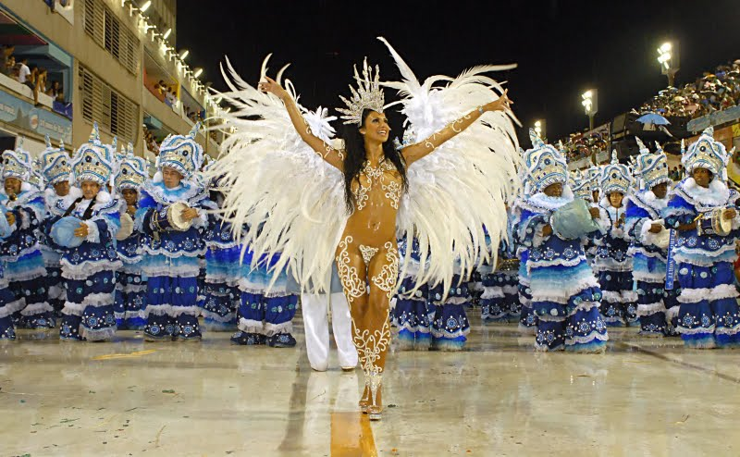
Carnival in Rio

Slide 10
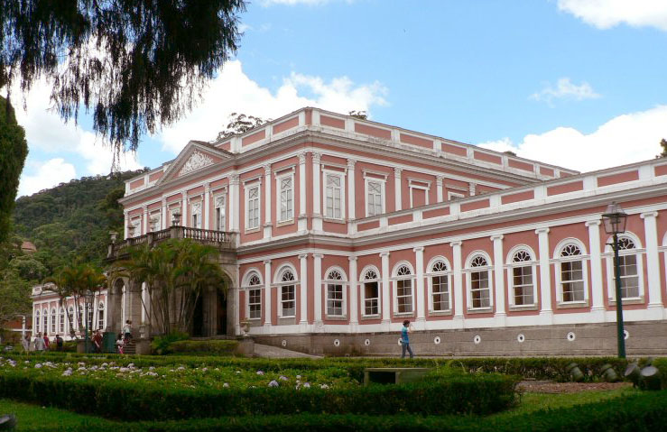
Restoration of historical sites and museums: The Museu Imperial, Petrópolis

Slide 11
Brazilian futebol
Origins in British railroad companies and other commercial interests
Hugely popular at amateur level before Vargas
Vargas creates National Sport Council 1941 to provide state funding
Brazil is the only country to have qualified for every World Cup since 1930
First World Cup win in 1958

Slide 12
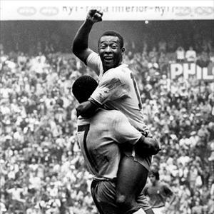
The first world cup win in 1958

Slide 13
Capoeira: the Afro Brazilian dance/ fight/ game
Descends from days of slavery
Criminalised and spurned by Old Republic, associated with blackness, crime, poverty
1940 penal code decriminalises capoeira
1941: National Department of Brazilian Martial Arts formed under Sports Council
Professionalisation of capoeira in Bahia under Mestre Bimba in 1940s

Slide 14
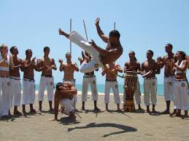
Capoeira – an Afro-Brazilian martial art, now practised the world over

Slide 15
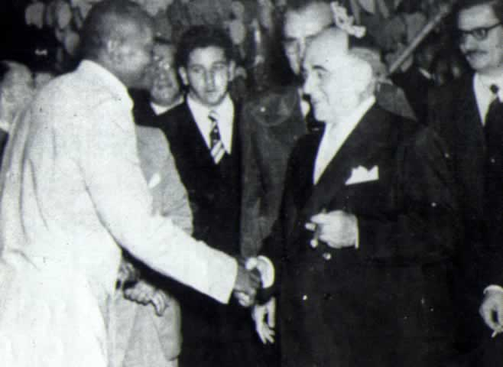
President Vargas meets Mestre Bimba, 1951
Vargas:
“Capoeira is the only authentically Brazilian contribution to physical education and it should be considered our national martial art”

Slide 16
“Racial democracy” or racist exclusion?
Gilberto Freyre’s 1933 classic The Masters and the Slaves is published in Brazil (1933) [see e-book at library]
Book is very well received in Brazil although Freyre himself is in exile from 1930; founding moment for Brazilian notions of “racial democracy”
Part of 1930s/40s rethinking of Afro-Brazilian contributions to Brazilian culture and history
… meanwhile, Vargas regime is very close to some of the integralist/ quasi-fascist elements of national political life
Immigration: Africans are barred (since late C19) but also non-whites, non-Catholics, Jews…
See Jeffrey Lesser “Immigration and shifting concepts of national identity” (seminar reading for today)

Slide 17
International dimensions of culture
US “wooing” Latin America culturally, politically, economically – “Good Neighbour” policy in Latin America
Wants military alliance and market for consumer goods
American culture in Brazil; “Brazilian” culture exported to US… e.g. Carmen Miranda...

Slide 18
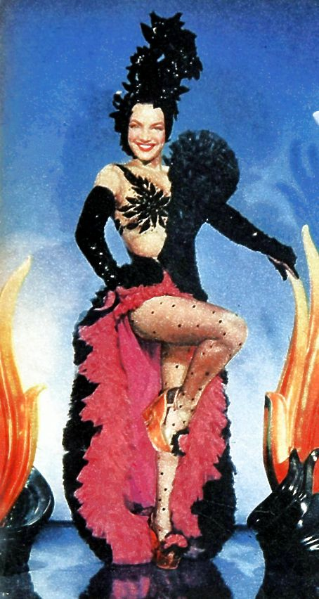
Notes:
Carmen Miranda

Slide 19
New books on futebol, working-class culture and internal migration
Paulo Fontes, Migration and the Making of Industrial Sao Paulo, trans. Ned Sublette, forward by Barbara Weinstein. Duke University Press, 2016 [e-book at Library]
Paulo Fontes and Bernardo Buarque de Holanda, The Country of Football: Politics, Culture and the Beautiful Game in Brazil. 2014 [two copies in library]

Slide 20
Questions and readings
In what ways did Brazilian national identity develop from about the 1930s?
What contradictions emerged?
Was it a top-down or a bottom-up process?
Leonardo Pereira, “Domingos da Guia,” in The Human Tradition
Bryan McCann, "Geraldo Pereira: Samba Composer," The Human Tradition
Jeffrey Lesser, “Immigration and Shifting Concepts of National Identity in Brazil during the Vargas Era,” Luso-Brazilian Review, 1994
Daryle Williams, “Ad perpetuam rei memoriam: The Vargas Regime and Brazil’s National Historical Patrimony, 1930-1945,” LBR 1994
Robert Levine, “Sport and Society: The Case of Brazilian Futebol,” LBR 1980

