Slide 1
Week 5: The Collapse of Democracy: 1954-1964

Slide 2
Last week…
Labour politics in mid-twentieth-century Brazil (Vargas and beyond)
Rapid industrialisation leads to growing urban population (in the South-East): how to incorporate politically?
Solutions found by Vargas under Estado Novo: authoritarian corporatism
later, “populist” solutions after 1945
Problems outlive Vargas himself

Slide 3
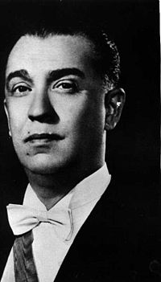
Juscelino Kubitschek (1956-61)
- A “Vargas product”…
Member of the PARTIDO SOCIAL DEMOCRÁTICO (PSD) (founded by Vargas in 1945)
successful politician in Minas Gerais
Disliked by the military for association to Vargas
Notes:
JK.

Slide 4
JK: election and office
Voted in through “politics of optimism.”
Platform is his “plano de metas” (plan of Goals): “fifty years’ progress in five”
31 goals; 6 themes: transport, energy, food, base industries, education, Brasília.
Expand and diversify the Brazilian economy
Initially precarious political position (polarised political scene; disliked by UDN and military for Vargas associations
Makes important concessions on many sides
Political skill in reconciling opposing camps allows him to stay in power

Slide 5
“Fifty years’ progress in five”?
Five-year “plano de metas” for development and industrialisation
Motor industry almost from scratch: 321,000 vehicles by 1960
Average growth of 8% per year
Iron production doubles to 7.5M tonnes per year;
Steel-making capacity from 1.15M tonnes in 1956 to 3.5 M tonnes by 1964
Plus: electricity; roads...

Slide 6
Brasilia (1956-1960)
Kubitschek’s flagship project
Idea dates from C19 and 1889 constitution: bring economic development & population to interior
This will correct long-standing geographic imbalances (population, economy, power)
Long-cherished national ambition: links to nationalism and optimism
Built from scratch; no infrastructure/ airstrips;
30,000 workers (known as candangos) transported in from all over country, mainly the NE.
Designed in distinctive futuristic style of architect Oscar Niemeyer, along with landscape designer Oscar Burle Marx and urban planner, Lucio Costa; flagship architecture.
One of the world’s most famous planned cities.

Slide 7
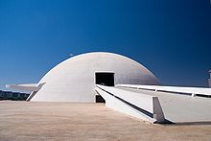

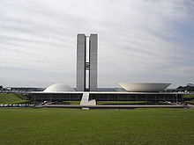
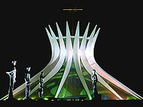
Notes:
Brasilia. Top left: Juselino Kubitschek bridge. Top right: Cultural Complex of the Republic. Bottom left: National Congress building. Bottom right: Cathedral.

Slide 8
But: Debt and inequality
National debt grows from 87M dollars to 297M during his time in office.
Inflation soars; JFK defies IMF → popularity, but problematic economic legacy
Increased income inequality. South-East and urban workers benefit disproportionately:
Life expectancy nationally is about 53 by 1961; but 40 in Rio Grande do Norte
Rapid urbanisation in the SE: social problems, no urban planning, no sanitary provision or basic quality of life; unemployment

Slide 9
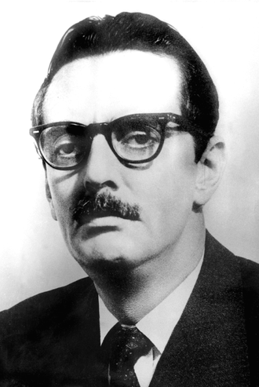
Notes:
Quadros

Slide 10
Jânio Quadros
Wins on a landslide: 5.5M votes to Lott’s under 4 M
Political “loner” - promises to “clean up” politics
Uncharismatic/ odd personality
Sponsored by UDN but then alienates them
Economy in crisis
Crisis over stabilization programme
→ resigns (miscalculation?)
Dangerous unstable situation; power vacuum

Slide 11
João Goulart (1961-4)
Power vacuum after Quadros resigns
Goulart: vice-president , in line to be president
Product of Vargas regime: ex-minister under Vargas; member of PTB (Partido Trabalhista Brasileiro, Brazilian Labour Party)
Right/ military suspicious… fear of coup or civil war
Compromise: prime ministerial system
First year spent staying in power, not solving economic and political problems

Slide 12
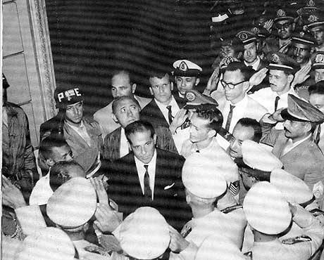
Notes:
Goulart

Slide 13
Problems for Goulart
Polarisation of politics between left and right (Cold War; Fidel Castro in Cuba)
Gains full presidential powers in 1963 plebiscite; but, this sets military against him, suspicious he is too left-wing…
“Democratic Parliamentary Action” mobilises on Right (US backing); Nationalist Parliamentary Front on Left
Economic crisis: attempts stabilisation but Left resists

Slide 14
Crisis
Urban labour pushes Goulart to the left by 1964: nationalises industries & oil refineries; enfranchises illiterates; pushes land reform
Right organises to bring him down…
International context: Cold War; Brazil strategically significant for US in preventing communism
US and big business both back right wing of military;
Polarisation of politics: little room to manoeuvre to left or to right

Slide 15
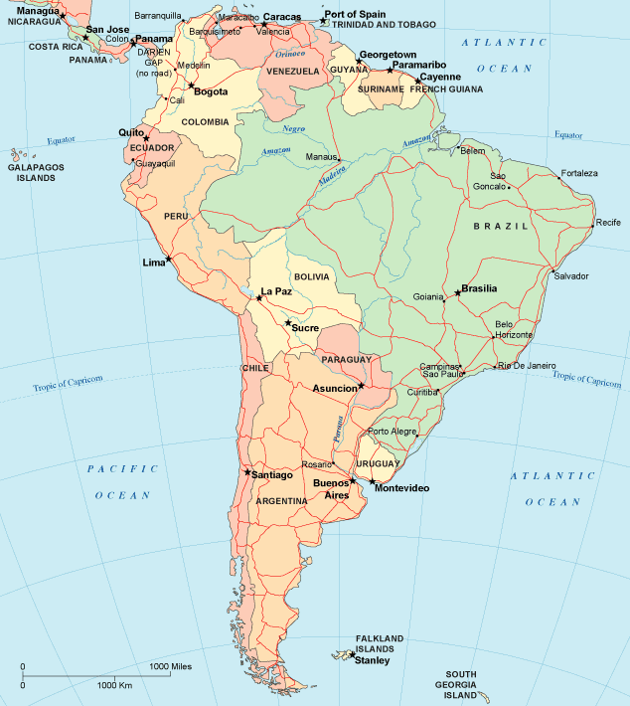

Slide 16
The military step back in
Military coup, 31 March – 1 April 1964
Congress purged but not closed
Support of CIVILIAN ELEMENTS: urban middle class (disenfranchised by Brazilian political system) and state governments

