Slide 1
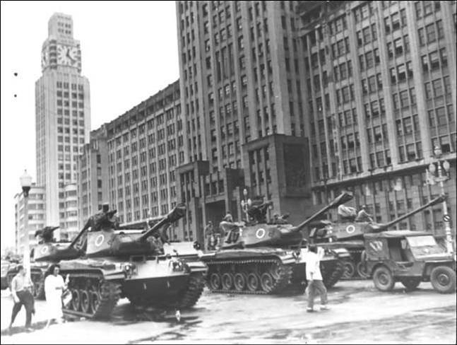
Week 8: The Military in Power, 1964-1973

Slide 2
Recapping: a turbulent decade, 1954-1964
Just a decade separates Vargas’ 1954 suicide and the military coup of 1964…
Breakneck growth, industrialisation, and infrastructure development (and a new capital city)
But: rapid inflation, inequality
Both the above points occur under JK in particular
Economic and political instability under the governments of Jânio Quadros and João Goulart
And the military waiting in the wings…
Importance of Cold War context: other Latin American countries (esp Argentina, Chile) experience vicious military dictatorships from the 1960s and 1970s

Slide 3
The military step back in
Military coup, 31 March – 1 April 1964
Congress purged but not closed
Divisions from beginning between “hard-line” and moderates (“castelistas”, under Castelo Branco)
Need for legitimacy/ legality
Support of CIVILIAN ELEMENTS: urban middle class (disenfranchised by Brazilian political system) and state governments

Slide 4
Early phase of military rule
Washington supports the coup (though with doubts later)
9 April 1964 “Institutional Act” (AI 1) gives extraordinary powers to executive
Congress purged; military-UDN alliance...
→ Congress votes in General Castelo Branco (a moderate) as president
“Technocrats” under economist Roberto Campos successfully implement stabilisation programme

Slide 5
Growing resistance and growing repression
Military supported by middle class
But, strong opposition on Left
Military create 2 new parties: ARENA (pro-government; later becomes PDS); MDB (opposition; later becomes PMDB)
Three more institutional acts: emergency powers for military
Stabilisation programme forces wages down, job cuts in public sector...
... -> Generalised strikes and protest in 1968
Artur Costa e Silva becomes president 1967…

Slide 6
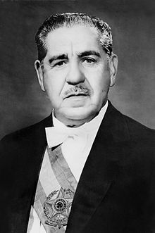
Rise of the “hard line”: Artur da Costa e Silva (1967-69)

Slide 7
“AI-5”, the 5th Institutional Act, December 1968
Start of fully-fledged dictatorship
No expiry date
full press censorship
congress dissolved indefinitely
president can:
- recess legislative bodies
- intervene in states with no limit;
- ignore habeas corpus;
These actions can’t be undone by the courts.

Slide 8
Armed resistance
Influence of Fidel Castro/ guerrilla warfare; Marxists; Liberation Theology Catholics
Over a dozen urban guerrilla groups: rob banks, kidnap foreign diplomats
Unsuccessful. Further justification for military
Bloody repression of significant rural insurgency in Araguaia (Amazon)

Slide 9
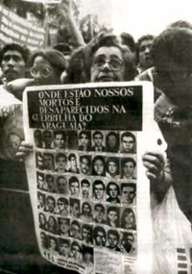
Protest about relatives “disappeared” in Araguaia

Slide 10
An “economic miracle”? 1968-74
Economy as justification for dictatorship: “Project Brazil: Great Power”
Inflation falls from 90% in 1964 to 27% in 1967
1968-1974: 10-14% growth per year
Major foreign investment (especially from US)
Foreign trade in 1970: exports $2.7B; imports of $2.8B
Foreign trade by 1973: exports $6.2B, imports $7B
Diversification away from coffee: oranges, soybeans...
Infrastructure projects: Itaipu Dam, Transamazon Highway…

Slide 11
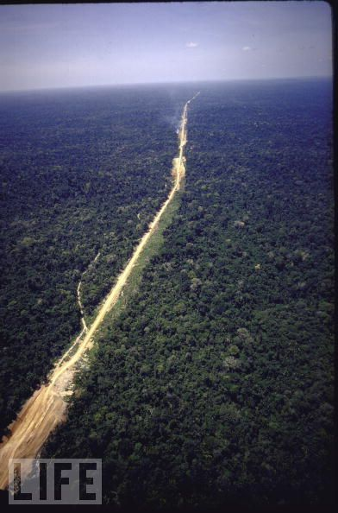
Notes:
Transamazon Highway.

Slide 12
But… inequality and debt…
Increasing inequality: UN declares Brazil the world’s most unequal country by end of twentieth century; N/S divides increase under military
Agriculturally, huge farms benefit not small farmers; land inequality increases
Industry grows at 12.6%; agriculture only by 5.3%
Foreign DEBT doubles 1970-1973: to $12.6 billion
Brazil very dependent on OIL –hundreds of thousands of CARS
OIL CRISIS of 1973: opens road back to democratisation

Slide 13
Use of culture and propaganda by the military
Military use violence and torture…
But: also concerned about support and appearance of legitimacy
Culture therefore a useful tool…
TV: 0.5M TVs in Brazil 1960; 26.5M by 1986
Military partnership with Globo network (founded 1965). World’s 4th largest network by 1985
Press self-censors (but circulation relatively low)

Slide 14
Readings
Skidmore, Brazil, chapter 7, “Rule of the Military”
Shawn Smallman, Fear and memory in the Brazilian army and society, 1889-1954 (2002), Chapter 8, “The Foundations of Military Rule”
Araken Tavora, “Rehearsal for the Coup,” in The Brazil Reader, ed. Levine, pp. 231-34

Slide 15
Questions
Why did the military take power?
What methods did they use to stay in power?
Who lost and who gained from military rule?
Is “economic miracle” an appropriate way to describe the military’s economic record?
Was there an alternative to military rule in 1964?

