Slide 1
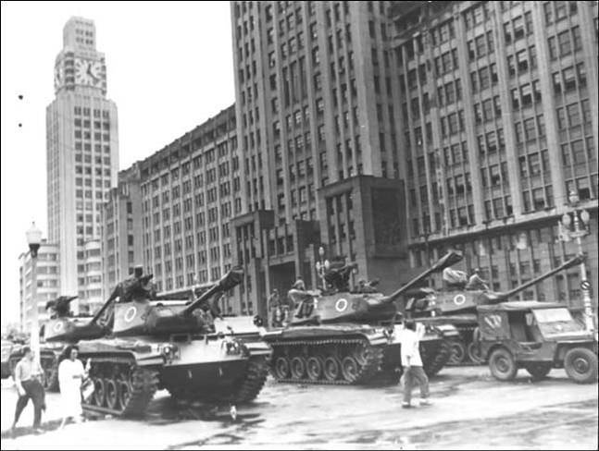
Weeks 7 & 8: Military Rule and the Transition to Democracy, 1964-1985

Slide 2
The military step back in
Military coup, 31 March – 1 April 1964
Congress purged but not closed
Divisions from beginning between “hard-line” and moderates (“castelistas”, under Castelo Branco)
Need for legitimacy/ legality
Support of CIVILIAN ELEMENTS: urban middle class

Slide 3
Early phase of military rule
Washington supports the coup
9 April 1964 “Institutional Act” (AI 1) gives extraordinary powers to executive
Congress purged; military-UDN alliance...
→ Congress votes in General Castelo Branco (a moderate) as president
“Technocrats” under economist Roberto Campos successfully implement stabilisation programme

Slide 4
Building to a full dictatorship, 1964-1968
Military supported by middle class
But, strong opposition on Left
Military create 2 new parties: ARENA (pro-government; later becomes PDS); MDB (opposition)
Three more institutional acts: emergency powers for military
Stabilisation programme forces wages down, job cuts
... -> Generalised strikes and protest in 1968
Artur Costa e Silva becomes president 1967…
5th Institutional Act (AI5), Dec 1968: start of full dictatorship
no end date; full presidential powers over legislative bodies; can set aside habeas corpus; president’s actions can’t be undone by courts

Slide 5
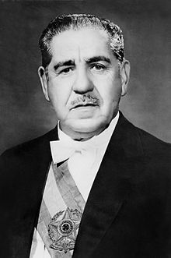
Rise of the “hard line”: Artur da Costa e Silva (1967-69)

Slide 6
An “economic miracle”? 1968-74
Economy as justification for dictatorship: “Project Brazil: Great Power”
Inflation falls from 90% in 1964 to 27% in 1967
1968-1974: 10-14% growth per year
Major foreign investment (especially from US)
Foreign trade in 1970: exports $2.7B; imports of $2.8B
Euphoria: “Brazil: Love it or leave it”
Foreign trade by 1973: exports $6.2B, imports $7B
Diversification away from coffee: oranges, soybeans...
Infrastructure projects: Itaipu Dam, Transamazon Highway…

Slide 7
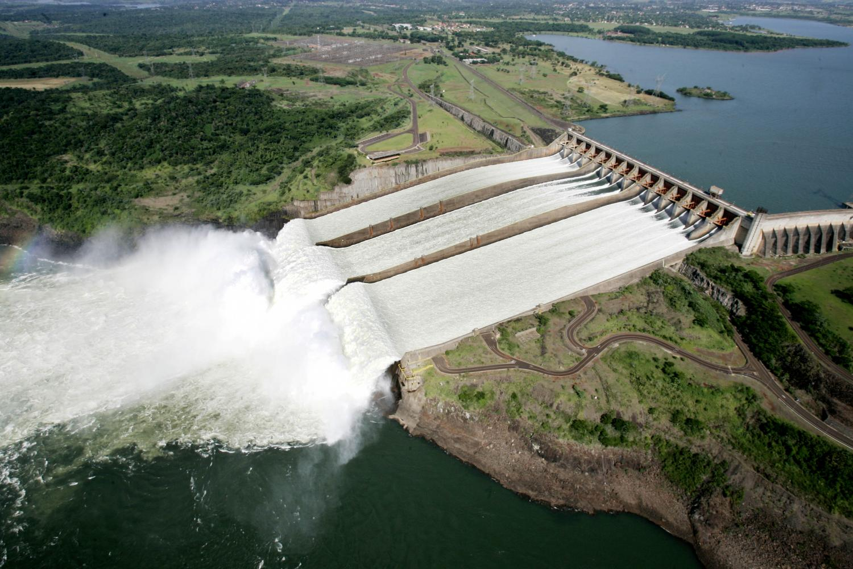
Itaipu Dam

Slide 8
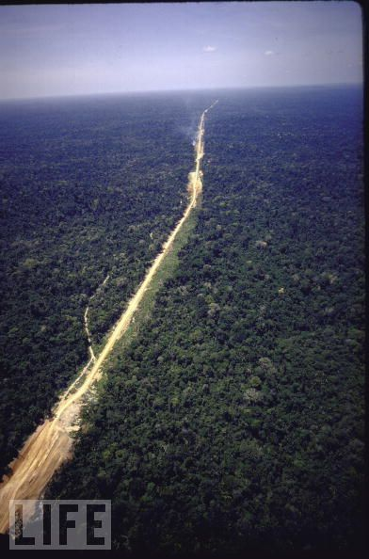
Notes:
Transamazon Highway.

Slide 9
The price: inequality; debt…
Increasing inequality: UN declares Brazil the world’s most unequal country by end of twentieth century;
North-South divides and migration /urban crises increase under military
Agriculturally, huge farms benefit not small farmers; land inequality increases (Landless Workers’ Movement begins to combat)
Industry grows at 12.6%; agriculture only by 5.3%
Foreign DEBT doubles 1970-1973: to $12.6 billion
Brazil very dependent on OIL –hundreds of thousands of CARS

Slide 10
Use of culture and propaganda by the military
TV: 0.5M TVs in Brazil 1960; 26.5M by 1986
Military partnership with Globo network (founded 1965). World’s 4th largest network by 1985
Press self-censors (circulation relatively low anyway)

Slide 11
Culture as a tool for resistance
Subtle criticism can evade censors (film, music)
Media not totally censored, e.g. radical bishop Dom Helder Camara gets 15 mins airtime per week; becomes basis for Liberation Theology
“Tropicalismo”: avant-garde cultural movement plus subtle/ creative lyrics criticising regime
Eventual exile of most tropicalismo musicians (Gilberto Gil, Caetano Veloso, and briefly Chico Buarque)

Slide 12
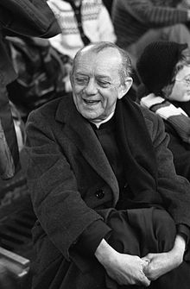
Dom Helder Camara of Brazil
"When I give food to the poor, they call me a saint. When I ask why they are poor, they call me a communist.”

Slide 13
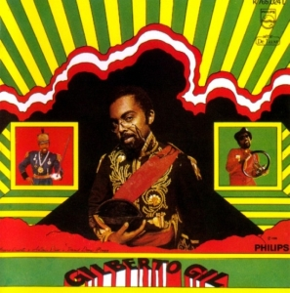
Gilberto Gil’s album Gilberto Gil in 1968

Slide 14
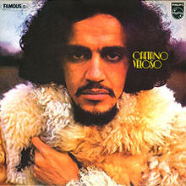
Caetano Veloso, album “Caetano Veloso,” released 1971 in exile in London

Slide 15
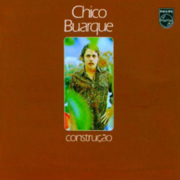
Chico Buaque’s 1971 album Construção, featuring critical songs about the dictatorship

Slide 16
Other sources of opposition
General exile of Brazilians on the left from late ‘60s: opposition thinking evolves in exile
Criticism of torture when used against middle class
US support for military, but with increasing reservations about human rights violations
Bar Association defends political prisoners
Catholic Church provides legitimate focal point

Slide 17
Loss of economic justification for rule from 1973
Earlier “economic miracle” (1968-74) gives way to…
Oil crises, 1973, 1979
Initial decision for “debt-led growth” - disastrous
1981 credit squeeze by US Federal Reserve
Brazil back in DEBT
1980s “lost decade” in Latin America
→ military rule loses economic justification

Slide 18
“Abertura”: the military road back to democracy
Impetus for democracy from moderates within military (“abertura”)
Ernesto Geisel assumes presidency, 1974
New military generation less concerned with Cold War politics
Concern with Brazil’s “legalistic” image abroad; government gradually lets go of “managed” majority in Congress; amnesty law 1979
Opposition MDB becomes political party (PMDB)
Election through congress of Tancredo Neves (PMDB) 1985
His sudden death → vice president, Jose Sarney, becomes first post-military president
New constitution 1988: input from civil society resistance groupings…

Slide 19
Remaining topics on the course
New claims on the Brazilian state before and after 1988:
Liberation Theology; grassroots political organising (today in seminars)
Black Movement; indigenous issues, land reform (MST)
Political story 1980s-2011 (Skidmore / other class readings):
1980s/mid-90s: economic crises/ inflation / debt/ inequality/ urban crisis
mid-90s: stabilisation under Fernando Henrique Cardoso and the Real Plan
2002-2011 Lula’s two terms in office; improved economic picture (partly due to good luck); new global role as BRIC country; SOME offsetting of social / economic inequalities (less than supporters hoped)
Brazil since Lula (Dilma and the current crisis) isn’t part of the course itself

