Slide 1
Week 9:
The Transition to Democracy, 1974-1985

Slide 2
Themes this week
Gradual “opening” (abertura) back to democracy
Impetus from within the military: moderates gain upper hand, gradual paving of way for democratic transition
BUT: at same time, bottom-up impetus: civil society movements:
Women’s movements; Black Movement; indigenous organising; land rights (MST) – next week
Liberation Theology (Catholic Church): this week
* “Identity politics”: groups make citizenship demands on basis of particular issues or identities
But: many aims and practices also overlap
E.g. growth of PT often intersects with Liberation Theology movements

Slide 3
Last week…
Military coup 1964; initially moderates have upper hand
1967 Costa e Silva takes over as president; 1968 “AI5” (5th institutional act); start of full-blown military dictatorship
Resistance ongoing in various forms… armed guerrillas
As well as violent suppression of resistance, military also maintains power through control of the MEDIA

Slide 4
Culture as a tool for resistance?
Subtle criticism can evade censors (film, music)
Media not totally censored, e.g. radical bishop Dom Helder Camara gets 15 mins airtime per week; becomes basis for Liberation Theology
“Tropicalismo”: avant-garde cultural movement plus subtle/ creative lyrics criticising regime
Eventual exile of most tropicalismo musicians (Gilberto Gil, Caetano Veloso, and briefly Chico Buarque)

Slide 5
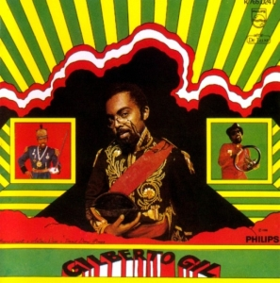
Gilberto Gil’s album Gilberto Gil in 1968

Slide 6
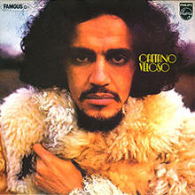
Caetano Veloso, album “Caetano Veloso,” released 1971 in exile in London

Slide 7
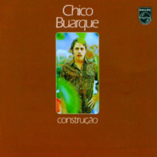
Chico Buaque’s 1971 album Construção, featuring critical songs about the dictatorship

Slide 8
Other sources of opposition
General exile of Brazilians on the left from late ‘60s: opposition thinking evolves in exile
Criticism of torture when used against middle class
US support for military, but with increasing reservations about human rights violations
Bar Association defends political prisoners
Catholic Church provides legitimate focal point

Slide 9
Recapping: the “economic miracle,” 1968-74
Inflation down from 90% in 1964 to 27% in 1967
1968-1974: 11% growth per year
Encouragement of major foreign investment (especially from US)
Infrastructure projects: Itaipu Dam, Transamazon Highway

Slide 10
A new economic reality from 1973…
Earlier “economic miracle” (1968-74) gives way to…
Oil crises, 1973, 1979
Initial decision for “debt-led growth” - disastrous
1981 credit squeeze by US Federal Reserve
Brazil back in DEBT
1980s “lost decade” in Latin America
→ military rule loses economic justification

Slide 11
“Abertura”: the military road back to democracy
Impetus for democracy from moderates within military (“abertura”)
Ernesto Geisel assumes presidency, 1974
New military generation less concerned with Cold War politics
Concern with Brazil’s “legalistic” image abroad
Government gradually lets go of “managed” majority in Congress
Amnesty law 1979; exiles start returning, but, prevents “truth and reconciliation” process in Brazil

Slide 12
The role of civil society
Role of the Church as umbrella for dissent
Civil society movements: women, unions, indigenous, religious, Afro-Brazilian, human rights, gay & lesbian rights, environmental, land reform...
Growth of the PT (Partido dos Trabalhadores, Workers’ Party) through grass-roots and labour organising
Failed but influential campaign for direct presidential elections, 1985: support of Church, PMDB, massive public rallies in RJ/ SP

Slide 13
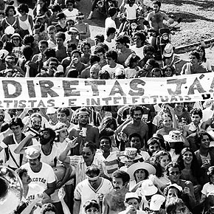
Campaigns for direct elections in Brazil, 1984-5

Slide 14
The election of Tancredo Neves, 1985
2 political parties, both military creations:
- PDS (formerly ARENA) – pro-government
- PMDB (opposition) supports Tancredo
One portion of PDS backs Trancredo → majority in Congress achieved
Military agree to democratic transition
Massive excitement: first civilian president since Quadros
Death in mysterious circumstances; national mourning
Vice-president José Sarney (PDS) takes over

Slide 15
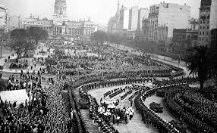
Funeral procession for Tancredo

Slide 16
Liberation Theology
Theological reaction to poverty and inequality in Latin America (urbanisation, industrialisation…)
Intersects with changes in the Church led by the Vatican, but also with Latin American dependency theory and Marxism
Formulated by Peruvian bishop, Gustavo Gutiérrez, book Teología de la Liberación (1971)
Also influential in Brazil; Chile; El Salvador
Brings together social analysis with Christian belief

Slide 17
Context
Second Vatican Council (Vatican II) – 1962: conference of world’s cardinals. Aims to address:
Loss of members to PENTECOSTALISM
need for clearer global mission and presence
Advocates a “turning out towards the world”
Conference of Latin American Bishops in Medellín, Colombia (1968): importance of church’s work at the “base” of society
Conference of Latin American Bishops in Puebla (Mexico) 1979: “preferential option for the poor” formulated

Slide 18
Liberation Theology in practice
Bottom-up organizing; respect for and interest in the daily experiences of the poor
In Brazil alone, between late 1960s and early 1980s, there were 80,000 to 100,000 Ecclesiastical Base Communities; 1-2M participants
Bible study; practical and political messages; literacy
Interpretation of social injustice as a sin
Concern by God with HUMAN HISTORY and need for social justice on Earth not just in heaven

Slide 19
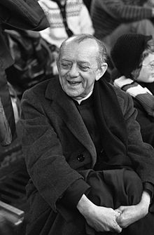
Dom Helder Camara of Brazil
"When I give food to the poor, they call me a saint. When I ask why they are poor, they call me a communist.”

Slide 20
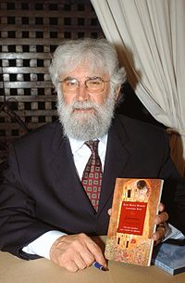
Leonardo Boff of Brazil
"One of the worst fundamentalisms is that of neoliberalism”

Slide 21
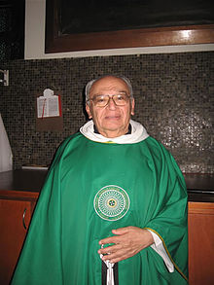
Gustavo Gutierrez, Peru
"Poverty is not fate, it is a condition; it is not a misfortune, it is an injustice. It is the result of social structures and mental and cultural categories, it is linked to the way in which society has been built..."

Slide 22
Readings
Kenneth Serbin, “Dom Helder Camara: The Father of the Church of the Poor,” in Beattie, ed, The Human Tradition
Robin Nagle and Jill Nagle, Claiming the Virgin: The Broken Promise of Liberation Theology in Brazil (1997), Ch 1
Rebecca Abers, Inventing local democracy: grassroots politics in Brazil (2000), Chapter 2, “Urban Politics and Neighbourhood Organizing in Brazil.”

Slide 23
Questions
Why did Brazil move back to democracy by 1985?
Who drove the process of “opening” (abertura)?
What was the role of the Church and Liberation Theology?
What were the goals of Liberation Theology and how successfully were they implemented in Brazil in the 1970s and 1980s?
Did the transition to democracy bring new methods of grassroots political organising, or simply re-package older ones?

