Slide 1
Week 2: Late Colonial Brazil
Ripe for independence?

Slide 2
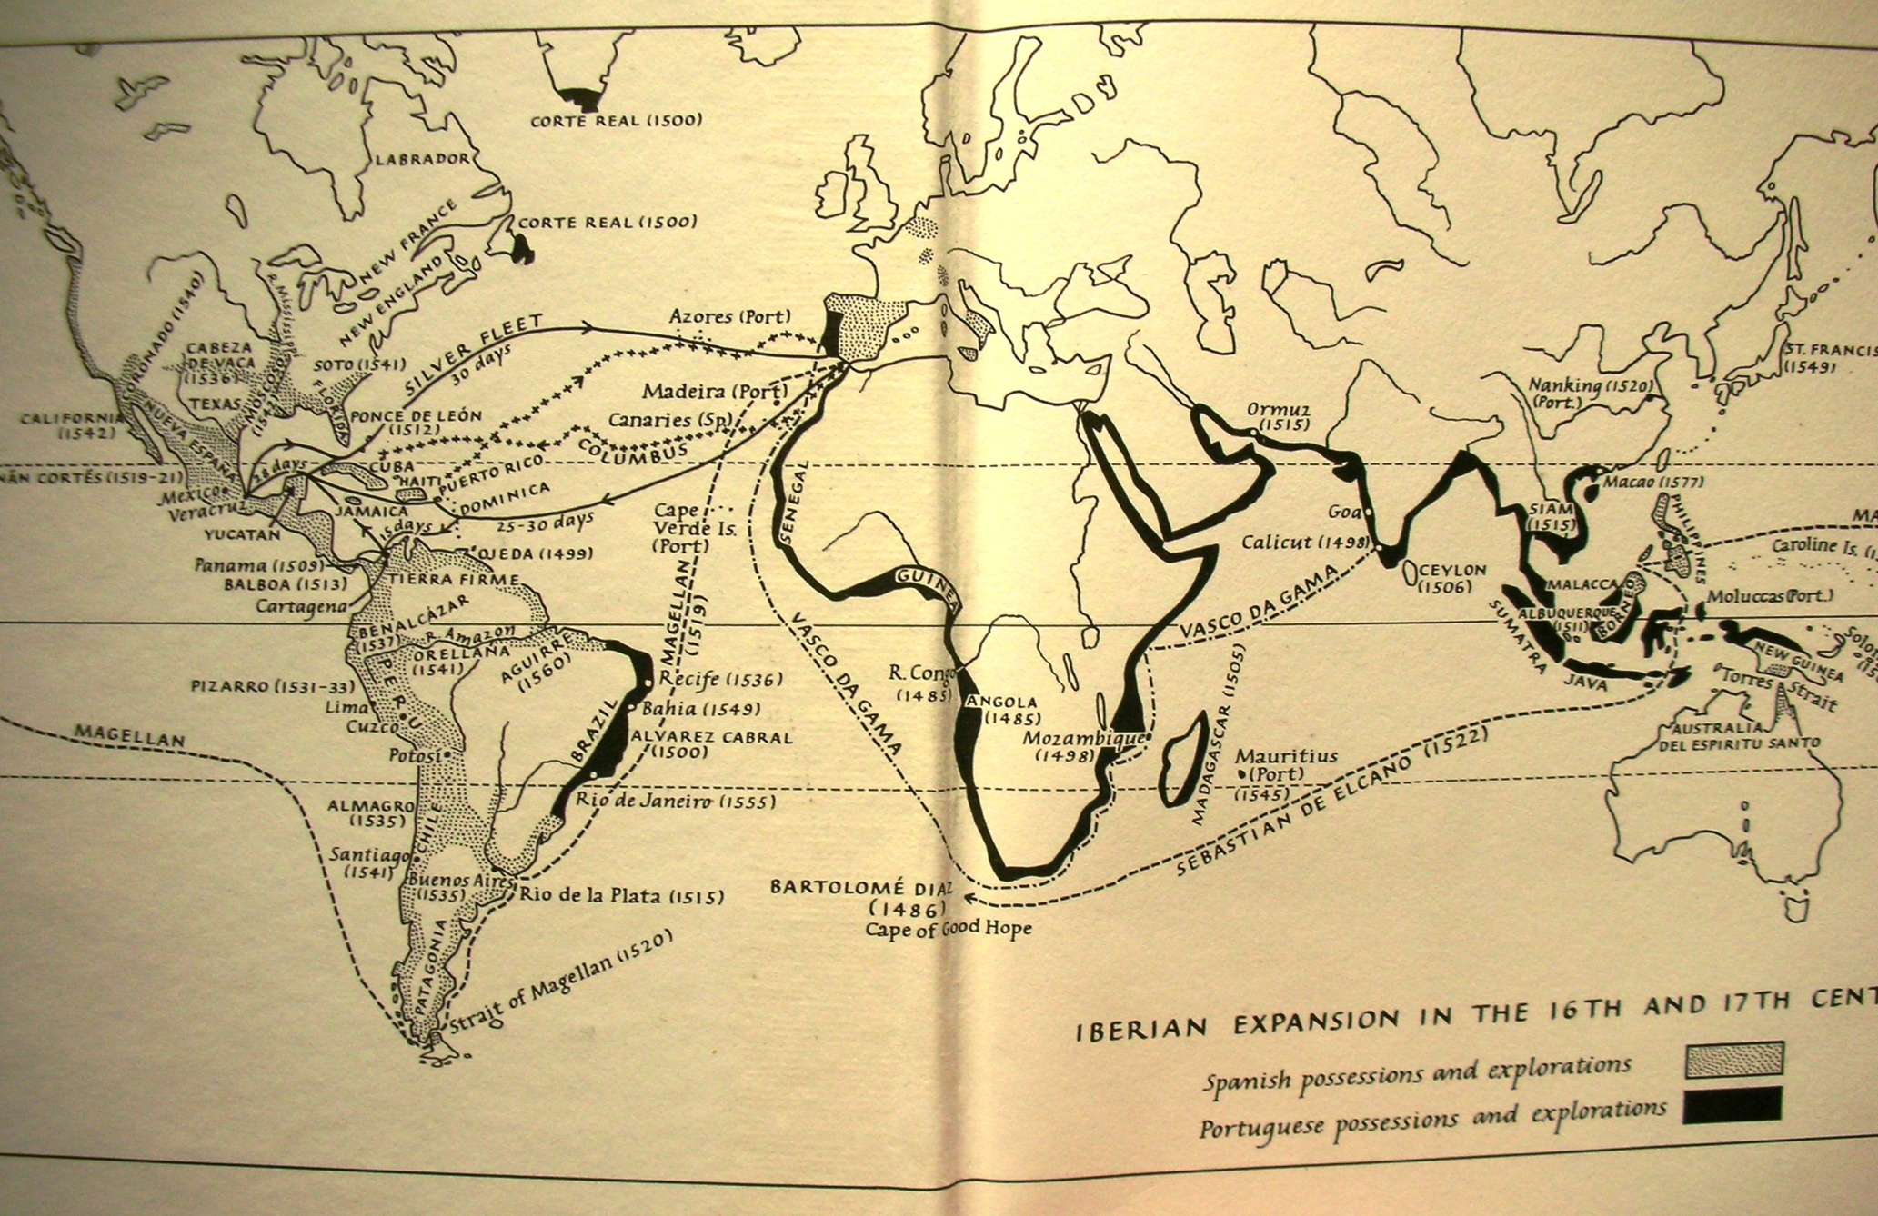
Notes:
Iberian expansion in 16th / 17th centuries (J Elliott, Imperial Spain)

Slide 3
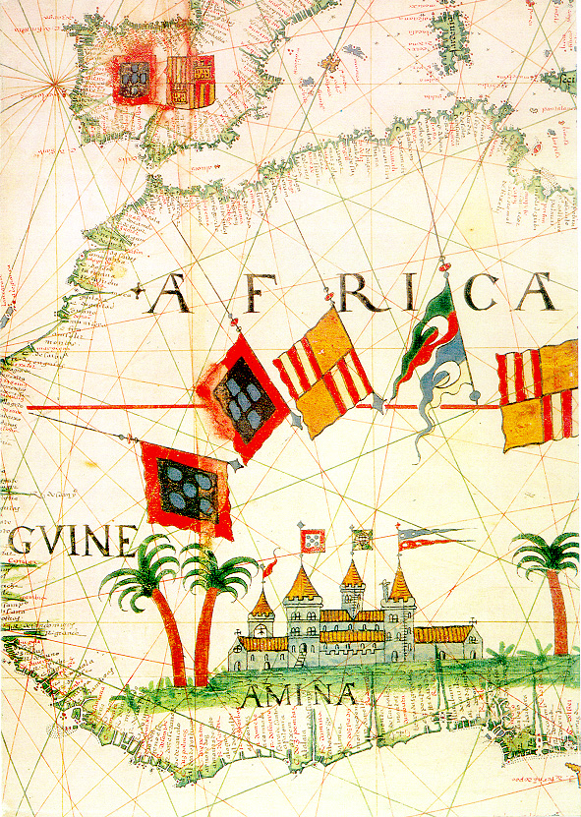
Portuguese expansion into Africa: 16th-century coastal trading feitorias

Slide 4
“Discovery” and Early Administration
Major Portuguese trading empire: Azores, Madeira, Africa; Asia
1500 Pedro Alvares de Cabral reaches N.E. Brazil
1530s territorial consolidation (threat from European powers)
Land grants allotted by Crown
By 1570s: Crown authority on coasts, not interior; Governors General; capital city Salvador da Bahia in North-East; Tupi widely spoken until 1758 expulsion of the Jesuits
Seventeenth century: territorial expansion but, basic shape of colony doesn’t change
Eighteenth century: population shift south. Capital becomes Rio de Janeiro from 1763.

Slide 5
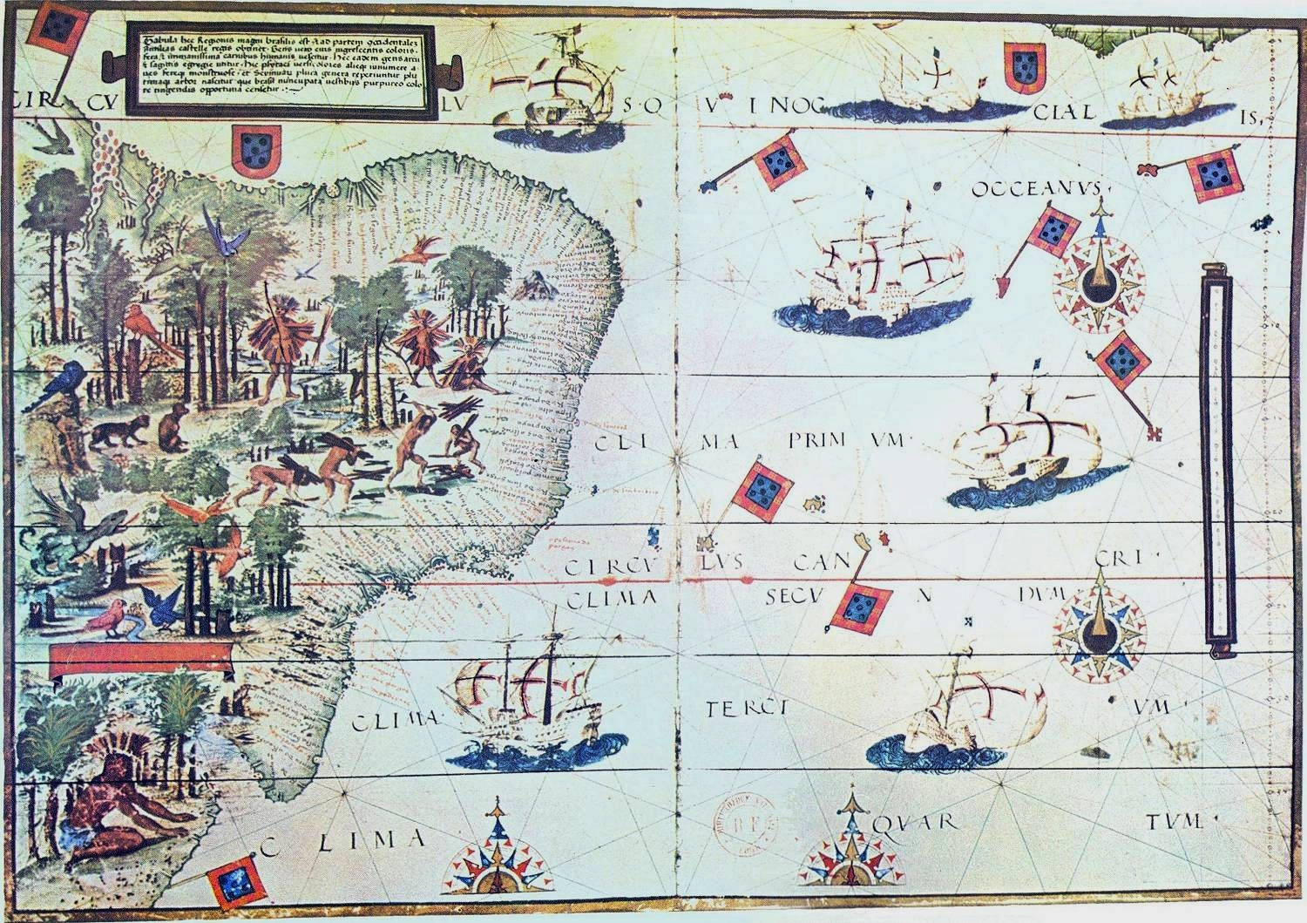
1519 Portuguese map showing coast of North-East Brazil; Portuguese ships; natives harvesting brazilwood

Slide 6
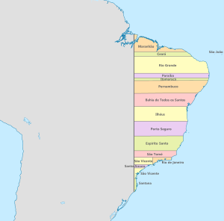
Donatary captaincies

Slide 7
Economy: Sugar Cycle (17th century)
Portuguese already have experience growing sugar
Earliest Brazilian society is North-East sugar plantations
Indian labour unsatisfactory → Africans imported (2000 per year by 1580s)
1600-1650: Sugar provides 90-95% of Brazil’s export earnings
1680s: Decline in productivity; Caribbean competition

Slide 8
Economy: Eighteenth-Century Mining Cycle
Sugar declining by end of 17th century
Gold discovered 1693 in Minas Gerais; diamonds later
Brazil is world’s biggest gold producer by early eighteenth century
Shift of power, wealth, population to South-East
Mining also based on slave labour
Mining wealth flows to Portugal but spent on lavish building projects/ dependent trading relationship with Britain and northern Europe
Mercantilism: Brazilian wealth does not mainly lead to economic diversification within Brazil itself

Slide 9
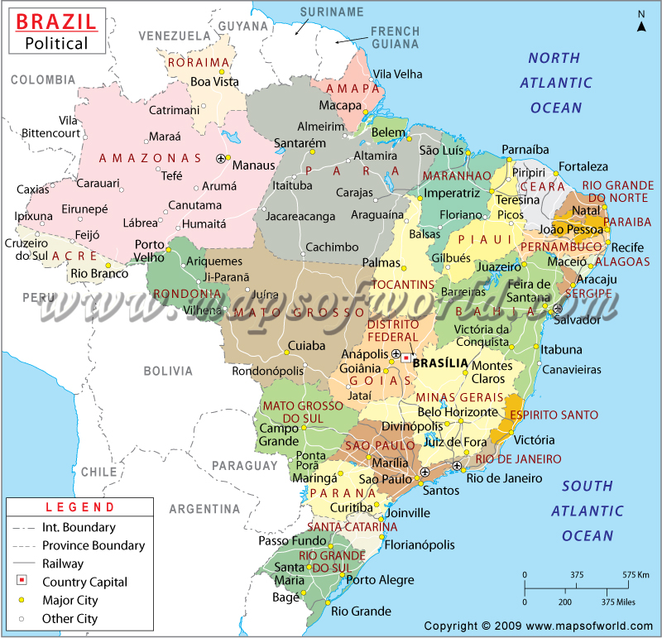

Slide 10
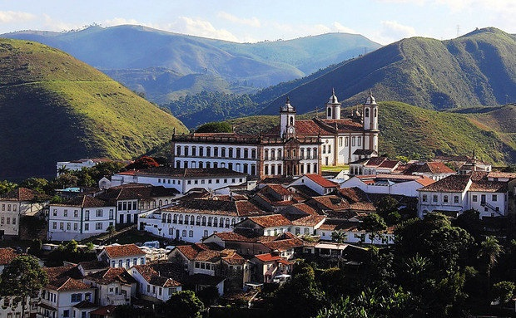
The town of Ouro Preto (“Black Gold”) in Minas Gerais

Slide 11
Society
Hierarchy based on race, ethnicity, gender: white men at top, black slaves at bottom
Elite women: cloistered, subject to authority of patriarch along with servants/ minors
Miscegenation: growing sector of free people of colour
Opportunities for manumission (the acquirement of legal freedom) and social advancement despite prejudice
But: treatment harsh, life expectancy low, slave population does not reproduce naturally
A “slave society”: slavery dominates economic, social, political structures
Brazil imports over 3.5 million slaves by 1850

Slide 12
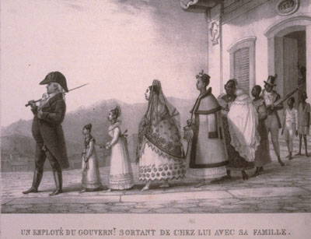
Notes:
Debret, 1822.

Slide 13
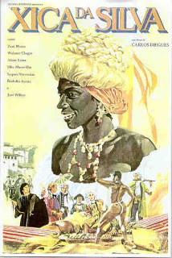
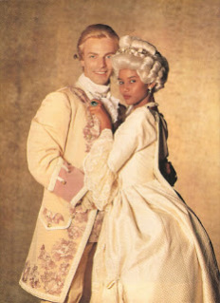
Notes:
Media portrayals of racial democracy. Chica da Silva in 1976 film and 1996 telenovela remake.

Slide 14
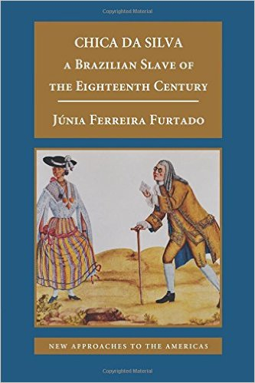

Slide 15
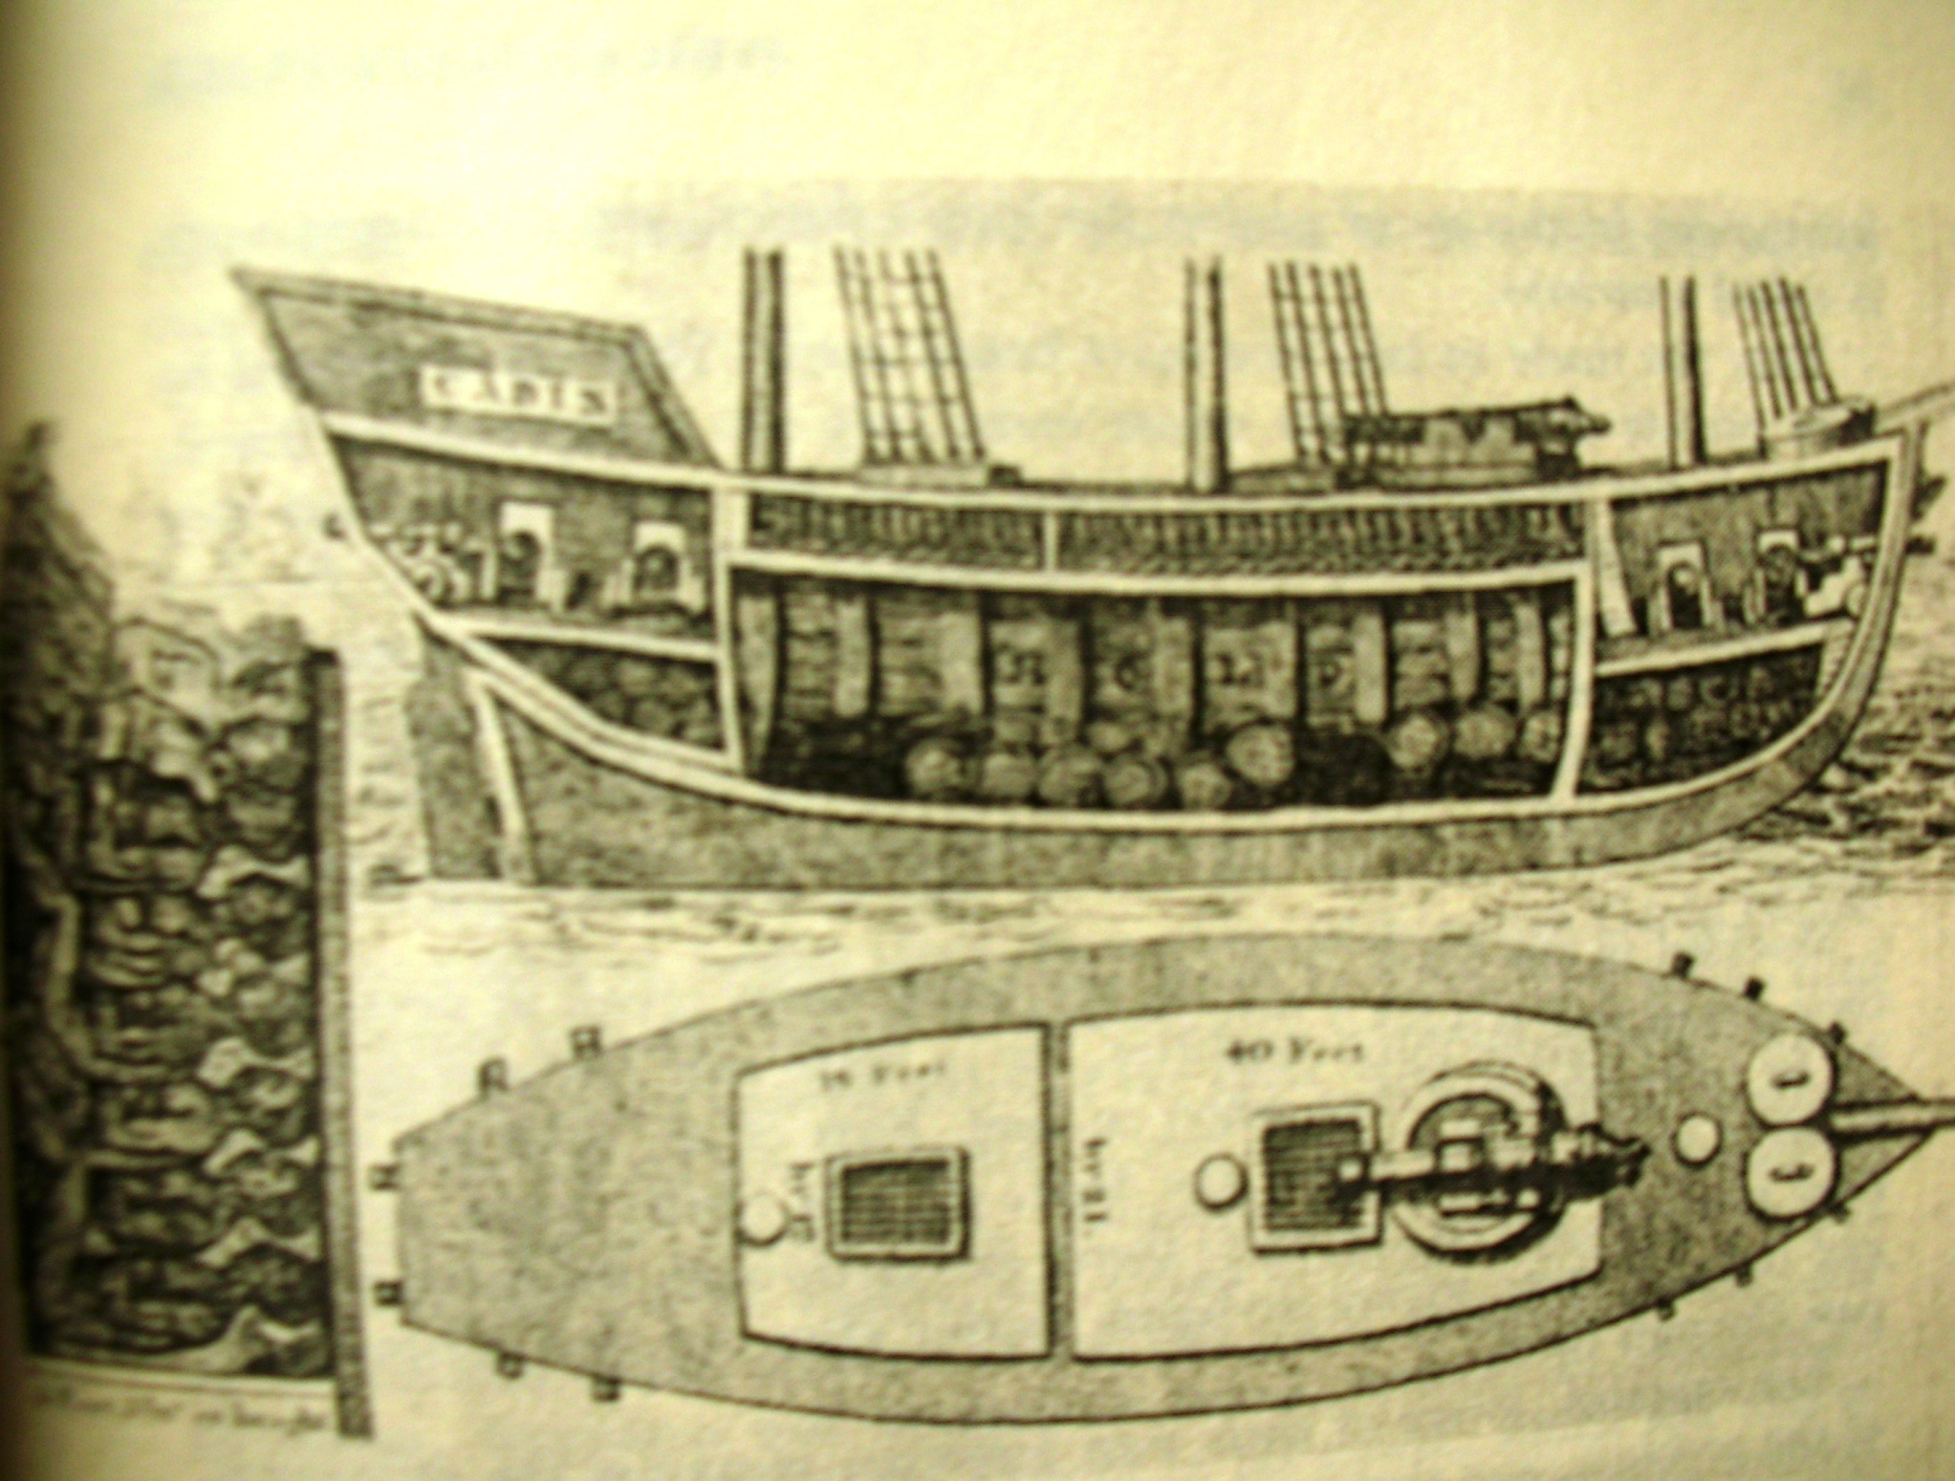
Notes:
Inside of slave ship 2

Slide 16
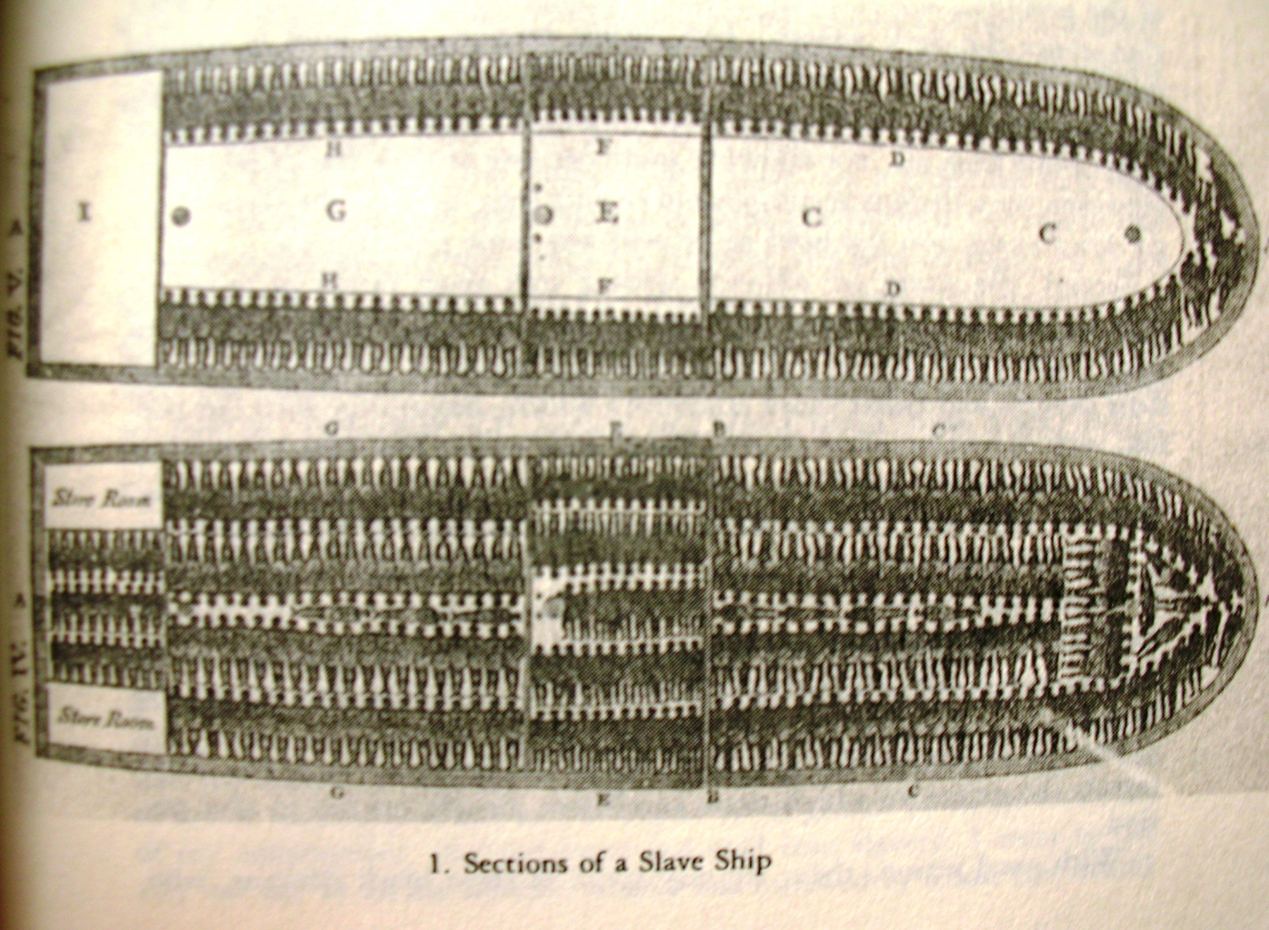
Notes:
Slave ship 1 (Conrad, Children of God’s Fire)

Slide 17
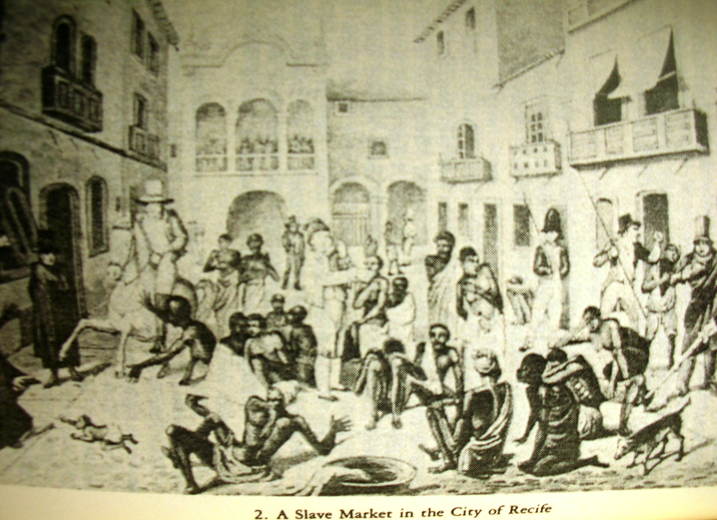
Notes:
Slave market, Recife (Conrad, Children of God’s Fire)

Slide 18
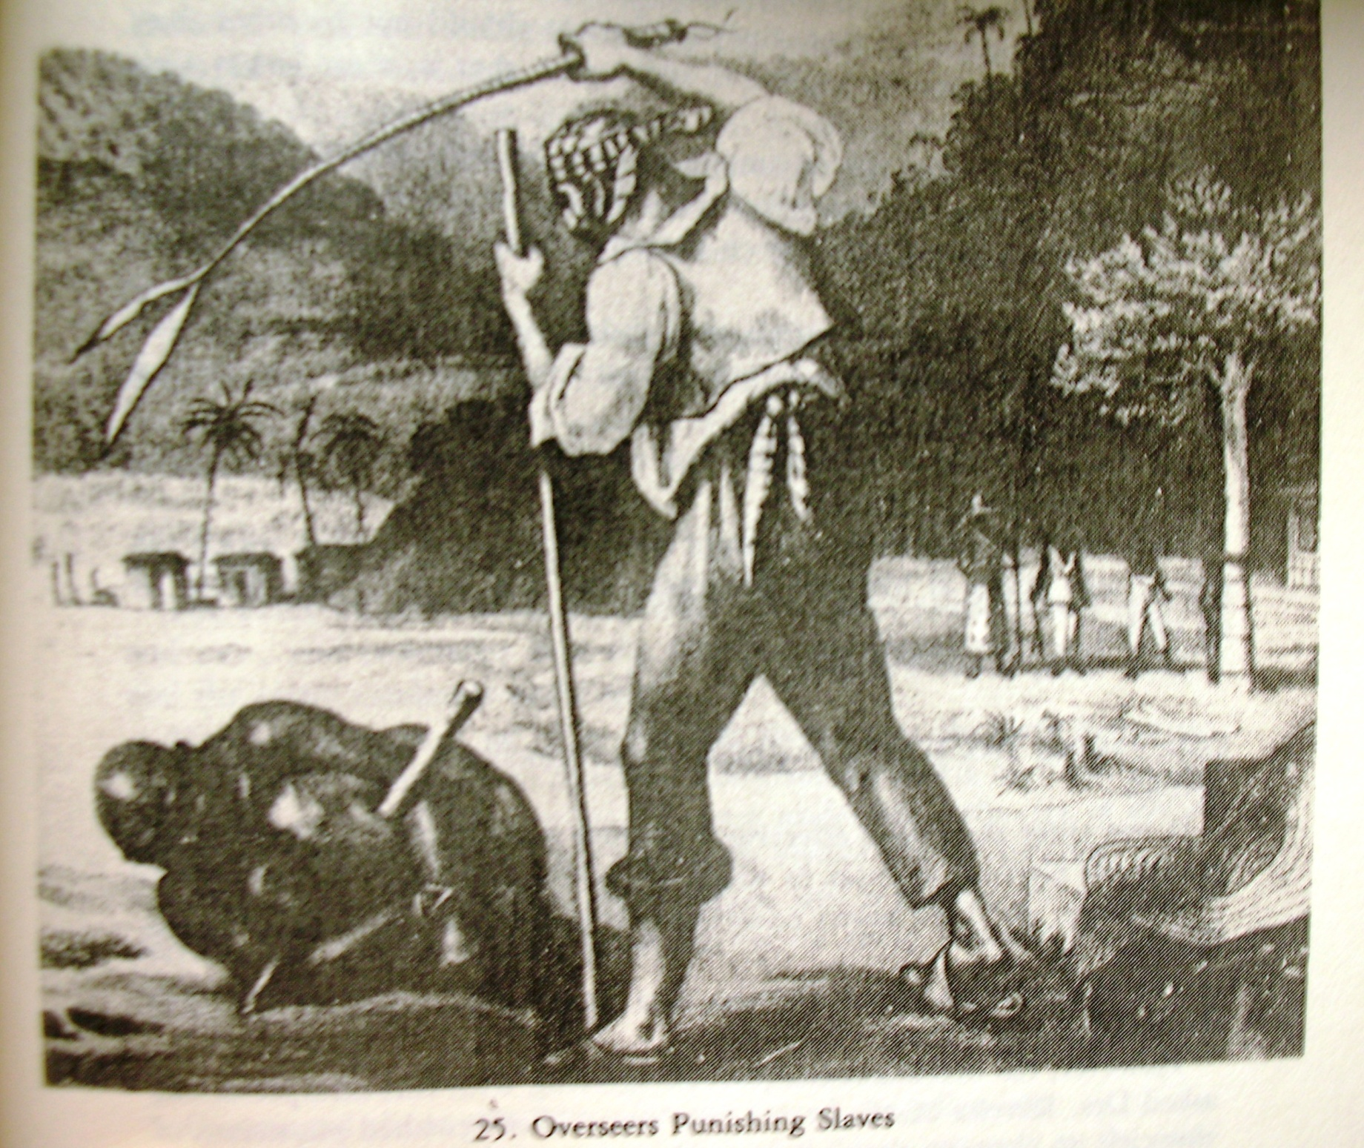
Notes:
Slave punishments (from Conrad, Children of God’s Fire)

Slide 19
Brazil by 1750
Powerful local families (seeds of future oligarchies) dominate local affairs but also linked closely to Portugal
No universities or printing press, although development of some seeds of “Brazilian” culture & identity
Elite men are hence educated together in Portugal (especially the University of Coimbra)
Meanwhile: Brazil has become richer & more important than mother country: “Without Brazil, Portugal is an insignificant power.”

Slide 20
Portuguese problems by 1750
Dependence on Brazilian income (sugar and mining)
Dependent trading relationship with Britain: Portugal imports British manufactures in exchange for Portuguese wool and wine and Brazilian goods
No manufacturing sector in Brazil either
November 1755 earthquake destroys Lisbon: national soul searching; quest for solutions becomes more urgent
Gold wealth becoming exhausted
Expensive wars with Spain in 1760s-70s over Brazil’s southern frontiers

Slide 21
Portuguese solutions
Series of reforms implemented by 3 men:
1: Sebastião José de Carvalho e Melo (Marquis of Pombal) 1750-1770
2: Martinho de Melo e Castro, 1770-95
3: Rodrigo de Sousa Coutinho, 1796-1803
“Enlightened despotism”
Mercantilism

Slide 22
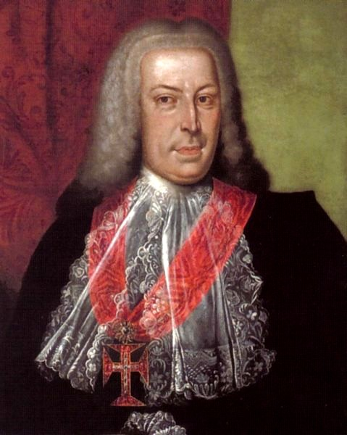
Notes:
Marquis of Pombal

Slide 23
Pombaline Reforms
ADMINISTRATIVE: ruled by one viceroy from Rio; town councils weakened; tax collection improved
TRADE: monopoly trading companies replace old fleet system of trading
ECONOMIC: new Brazilian agricultural products and demand for Portuguese manufactures
RELIGIOUS: Expulsion of Jesuits 1759

Slide 24
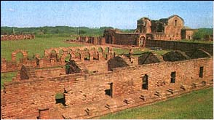
Notes:
Ruins of Jesuit Guarani mission, Asuncion, Paraguay

Slide 25
Results of reforms
Economic recovery for Brazil and Portugal by 1790s
Coffee exported from Brazil for first time; sugar recovers; new products: rice, wheat, indigo...
Portugal’s trade deficit reduced by 70%, 1751-1775
Brazil supplies 61% of Portugal’s trade surplus: dependence on Brazil increases

Slide 26
Tensions in late eighteenth century
Material resentments: tax increases; dominance of Portuguese merchants; growing anti-Portuguese sentiment; awareness of Brazil’s greater economic power
Influence of Enlightenment ideas among elite (via Coimbra) . Influence of Enlightenment-inspired revolutions: United States; France

