Slide 1
Week 1: Lula and the PT in office, 2002-2010: New solutions or old problems?

Slide 2
Weeks 1-2 next term
Week 1: Conclusions
A brief look at Brazil since Lula: Dilma Rousseff and impeachment (2011-16); World Cup and Olympics; riots
A look back at themes and trends in Brazilian history
Seminar readings are detailed on course website as usual
Week 2: Revision and exam practice
12-1 lecture slot: one question from the sample paper, in exam conditions
Seminar: revision techniques, discuss answers to sample paper questions, anything else you want to go over?

Slide 3
Last time…
Politics in the 1980s: “abertura” process initiated by military eventually brings a new generation of democratic politicians into power
Into 1990s: does anything improve as result of democratic transition?

Slide 4
Improvements
Military retire from politics fairly conclusively in 1985
Since 1985, democratic and generally fair elections are held regularly; by 2002, Brazil is 4th largest democracy in the world, electorate > 115 M, voting 100% electronic
Significant influence of new social movements in democratic era – MST, women’s movement, indigenous, or black movement
“Brazil has become more pluralistic, with a greater array of actors entering the public arena, making heretofore marginal demands suddenly central, stretching the … body politic in ways that were unpredictable a few decades ago…” [Brian McCann, The Throes of Democracy: Brazil Since 1989 (2008)]

Slide 5
Ongoing problems
Major political corruption is ongoing (e.g. Sarney, Collor)
Young, volatile electorate with little experience of democracy
High illiteracy → major role for TV campaigns: large media corporations (especially Globo)
Multiple political parties with shifting platforms
Hyper-inflation remains major problem (especially for the poor) until mid-90s
Brazil becoming yet more socially/ economically unequal

Slide 6
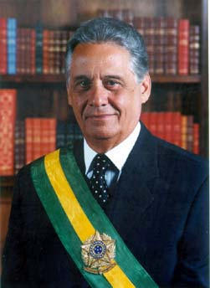
Fernando Henrique Cardoso (PSDB), 1995-2002

Slide 7
Cardoso: achievements
Stabilises economy via the 1994 Real Plan; inflation from 1094% to 15% in 1 year
Measures for social justice (later expanded under Lula): racial quotas in diplomatic and judicial corps; gradual land reform (although MST not satisfied); Bolsa Escola (School Grant) to keep kids in school (precursor to Bolsa Familia under Lula)
Privatisation of state assets. Some successful e.g. steel, fertilizer, iron
Others fail e.g. electricity industry: major blackouts in 2000-2001; all are very politically divisive

Slide 8
Cardoso: limitations
Huge energy expended to amend constitution to second term (re-elected 1998)
seen as pushing through constitutional change purely in own interest; allegations of corruption e.g. cash for votes; damages his political reputation
Plano Real undermined in late 90s by world currency panic; hike in interest rates declared (40% in 1997-8); second austerity package; crisis avoided but growth very slow
Economic problems → lack of investment in public services; increasing economic and social inequality; urban crisis

Slide 9
In sum: FHC’s legacy
Crucial legacy of price stability
Brazil weathers international economic crisis better than e.g. Argentina (defaults on loans);
No return to hyperinflation
But: virtually no growth; little real poverty reduction; growing inequality

Slide 10
Lula and the rise of the PT
Lula: migrant to S Paulo, humble origins in Pernambuco (North-East): Brazil’s first non-elite president
rises to prominence in UNION POLITICS towards the end of 1970s: leads major strikes in S Paulo 1978-80 that challenged the military’s economic policies.
Significant prejudice against Lula as non-elite, poorly educated
Fears of international banking sector about foreign investment (e.g. in 1998 election): PT much more conservative in power than anticipated
Hopes on Left: PT has not lived up to either

Slide 11
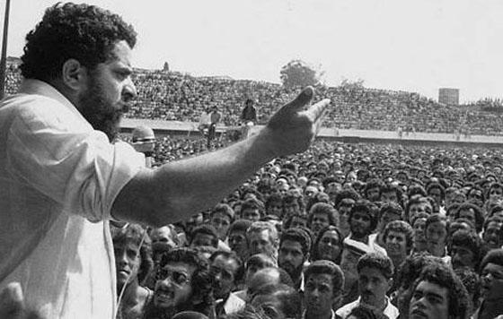
The Workers’ Party: Union organising in Sao Paulo, 1980
Luiz Inacio “Lula” da Silva, later President of Brazil

Slide 12
The Workers’ Party (Partido dos Trabalhadores), PT
Founded in late 70s S Paulo: opposition to dictatorship; workers’ rights
decentralised style of organising: no major funders – party funded by members’ contributions
close links with MST, Base Communities (Liberation Theology movement).
traditional base among working class in south-east; plus major support from middle-class left
Major electoral force since 1989.
Lula was main contender against Collor in 1989, and FHC in 1994 and 1998
E.g. 1998: FHC elected with 53% of the vote, Lula gets 32%

Slide 13
A change of image
from fiery socialist labour leader to better presented and less radical
“Letter to the Brazilian People” (June 2002):
denounces failures of neoliberalism under Cardoso & economic injustice; introduces idea of “Brazil, a country for all,” which later becomes a PT government slogan;
But: reassures Wall St: contracts will be respected, no expropriation
Globo media channel: savagely anti-Lula in 1989 election (backs Collor); but favours Lula in 2002
Significant SHIFT on the Brazilian political scene

Slide 14
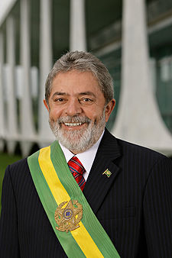
Luiz Inácio “Lula” da Silva

Slide 15
…but how much really changed?
“The hour has come to transform Brazil into that nation we have always dreamed of: a sovereign and worthy nation that is aware of its own importance on the international scene and, at the same time, able to house, clothe, and treat with justice all its children.”
(Inaugural address, January 2003)

Slide 16
The PT in power: symbolic importance of new faces
Benedita da Silva, first black woman senator, brought up in Rio favela, active in women’s movement
Marina Silva, PT senator from Amazonas, indigenous & black ancestry, formerly a maid, linked to environmental movements, becomes minister for environment.
Gilberto Gil, Afro-Bahian singer prominent in tropicalismo of 1960s, becomes minister for culture.
First black judge, Joaquim Barbosa, heads Supreme Court

Slide 17
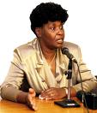
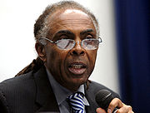
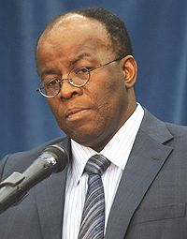
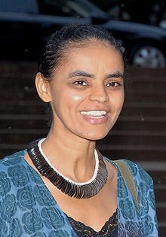
Notes:
Benedita da Silva; Gilberto Gil; Marina Silva; Joaquim Barbosa

Slide 18
But… alliances with the “old” politicians…
PT lacks majority in congress; needs to compromise; impact is watered down
Criticised for reliance on “political barons” – e.g. José Sarney, Fernando Collor; Renan Calheiros (head of senate, later impeached on corruption charges
These figures represent the “old” style of doing politics…

Slide 19

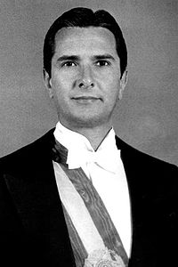
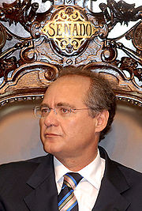
Notes:
Jose Sarney, Fernando Collor, Renan Calheiros

Slide 20
Economic policies
Need to reassure international markets (prevent investors from pulling out) → economic policy is as conservative as that of FHC
High interest to discourage inflation; sticks to the IMF plan negotiated by Cardoso.
Brazil doing well economically as result of FHC reforms: inflation under control; real strengthens; exports flourishing
Brazil becomes world’s second biggest soya exporter; is on way to energy self-sufficiency; pioneers flex cars (ethanol and petrol) in 2004; develops sugar industry to produce ethanol; produces 40% of the world’s sugar by 2006

Slide 21
Social reforms
Fome Zero (Zero Hunger) programme: combat hunger (still significant problem)
More significant “Bolsa Família” (“Family Purse”) programme: based on “Bolsa Escola” under FHC; basic nutrition to women and children if children stay in school.
Especially significant in north-east: boosts PT’s popularity in NE
By 2011, 26% of the Brazilian population were covered by the programme.
But: high unemployment; wages fall 14% from 2002-2003.
Huge income differences
Afro-Brazilians: 45% of population but 65% of poor

Slide 22
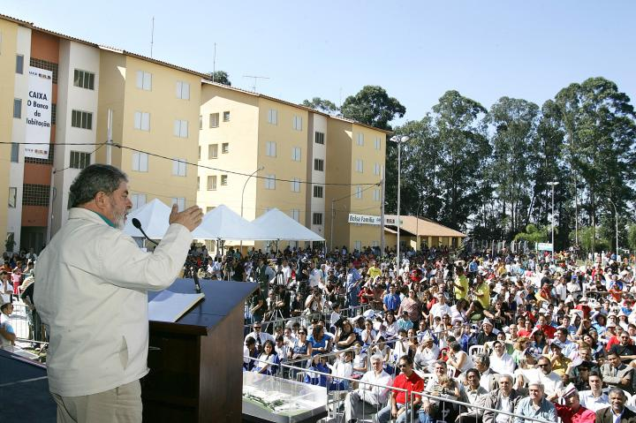

Slide 23
Corruption: the 2005 “mensalão” scandal
Massive “big monthly payment” scandal: PT congressional leaders systematically buy votes for cash
Every member of Lula’s close circle indicted:
José Dirceu, Lula’s chief of staff, resigns 2005, expelled from politics until 2016
Antonio Palocci, finance minister, also forced to resign
High profile trials
Several politicians are serving prison sentences (unprecedented in Brazil)

Slide 24
The mensalão and old-school politicians
PT needs to cosy up even more to regional political machines( political cartels, controlled by local bosses, aim to get access to power and state resources – “physiological” rather than “ideological”
Regional machines prospered under military and FHC, still v powerful.
1988 constitution: disproportionate weight to small states: e.g. Roraima has one deputy per 26,000 citizens, state of SP has one deputy per 336,000.
Lula courts unsavoury old-school politicians
Ratings temporarily affected but mensalão scandal never “stuck” to Lula himself.

Slide 25
Meanwhile, other splits in the PT…
Left is dissatisfied with pace of social change
New party, PSOL, headed by former PT member Heloisa Helena, competes with PT from 2005
Marina Silva (environment minister) resigns in 2008 over failures on green issues; joins Green Party, runs for president against Dilma Rousseff in 2010 and gets 20% of votes; will run against her again in 2014.

Slide 26
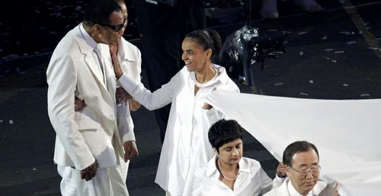

Slide 27
The PT: Raising Brazil’s world profile
Lula criticised for travelling a lot while in office
Significant achievements in raising Brazil’s international profile
Brazil positions self as leader of the third world; one of the BRICs Brazil, Russia, India, China
Active within Latin America, e.g. MERCOSUR (trade organisation, counterweight to US)
Role of moderate: interaction not alignment, with more radical new left in Lat Am (Chávez, Morales...); good relations with both Bush and Chávez, plus Raúl Castro too; mediation in Colombia/ Venezuela;
Obama at 2009 G20 summit: Lula is “the man”, “the most popular leader on the planet”
Role in peace keeping e.g. Haiti
High-profile sporting events: 2014 World Cup, 2016 Olympics

Slide 28
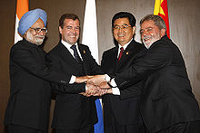
BRIC leaders

Slide 29
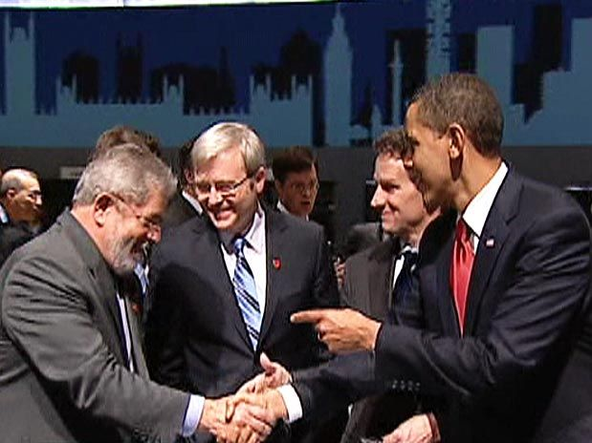
Notes:
G20 summit in London April 2009. Obama: “Esse eh o cara” ; “o politico mais popular da Terra”

Slide 30
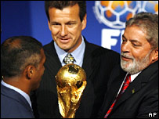
2007 announcement that Brazil will host 2014 World Cup
Notes:
Lula with Romario (player) and Dunga (2010 coach and former Brazil player)

Slide 31
Lula’s second term: successes
Despite problems, PT and Lula still pretty popular; comfortable win in 2006 second round
Economy continued well: growth; inflation under control
Brazil weathered 2008 global crisis well (diversified economy)
Major global commodities boom –mining, agricultural products e.g. soya, sugar, oranges, coffee…
Inherited stable economy from FHC, who also reformed the banking system;
Declining birth rates: net annual population increase fell from 2.7% per year in 1980, to 1.9% in 2005.

Slide 32
Lula’s second term & beyond: challenges
Education remains huge challenge:
13% Brazilians still completely illiterate by 2009; one of the lowest rates of literacy in Latin America, only Haiti and four Central American countries (much smaller and poorer) do worse
Major social inequality continues. Brazil in the upper 50s and lower 60s of Gini index; most Lat Am countries in mid-to-upper 50s; “developed” countries are in 30s and 40s.

Slide 33
Seminar questions: Brazil since Fernando Henrique Cardoso
Were Lula’s successes all thanks to FHC?
Did the election of Lula and the PT represent a new departure for Brazilian politics and national life?
Did electoral victory change the PT itself? How?
How has Brazil’s international profile shifted in the last 20 years or so? Is this significant?

Slide 34
Reading
Skidmore, Brazil, Chapter 9 (in the newer edition)
Bryan McCann, The Throes of Democracy: Brazil since 1989, chapter 1, "The Rise of the Left“
Richard Bourne, Lula of Brazil: The Story So Far (2008), chapters 1 (“A Tough Start in Life,” 3 (“The PT, the Workers’ Party”, 5 (“Overview of the First Term”).

