Slide 1
Week 1: New challenges, old problems: from the return to democracy to Lula in office (1985-2011)

Slide 2
Last time
End of dictatorship: gradual process of “opening” / abertura
Initiated by the military leadership but shaped by organised civil society
E.g. Catholic Church and Liberation Theology
Economic context: initial “economic miracle,” then massive external debt (oil crises of the 1970s)
Political process that brings Tancredo Neves as first civilian president since – but dies suddenly before taking office

Slide 3
Today’s lecture…
Political story of 1980s and 1990s: how much changed/ improved as a result of democratic transition?
Fernando Henrique Cardoso: Plano Real in 1994 and presidency from 1995-2003: a turning-point?
Lula in office, 2003-2011: new solutions or old problems?
Through your own reading:
New ways of doing politics; new groups make claims for rights: Black Movement; indigenous; MST (Landless Workers’ Movement)
See fuller PPT lectures for weeks 9-10 also.

Slide 4
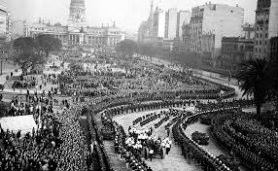
Funeral procession for Tancredo Neves

Slide 5

Jose Sarney (1985-1989)

Slide 6
1988 Constitution
Constituent Assembly formed 1986
Result of lobbying efforts by civil society groups
Broad range of citizen rights – e.g. land rights for Afro-Brazilian communities
But: no agrarian reform (landowners mobilise: Uniao Democratica Rural)
Corporatist features e.g. absolute tenure for civil servants; protection for Petrobras (Vargas legacy)
Swing back from centralisation to regionalism: state / municipal budgets increased, federal budget decreased
How far can radical constitution really be implemented?

Slide 7
Two failed attempts to stabilise the economy…
The Cruzado Plan 1986 (Sarney): stabilisation, then wage increases; initial success, but return to crisis by 1987; economy out of control by 1989
“Shock treatment” for inflation under Fernando Collor (1989-92): very harsh measures; crisis deepens
Impeached, 1992, for extreme corruption
Itamar Franco (Collor’s vice-president) in charge from 1992
Unremarkable figure, but under his presidency the Plano Real is introduced…

Slide 8
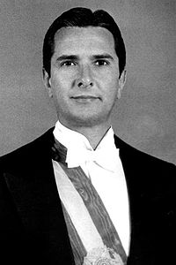
Fernando Collor

Slide 9
The “Plano Real”
Itamar Franco’s finance minister, Fernando Henrique Cardoso, institutes “Plano Real” (1994)
New currency (the real)
High interest rates to fight inflation
Success: inflation from 1094% to 15% in 1 year

Slide 10
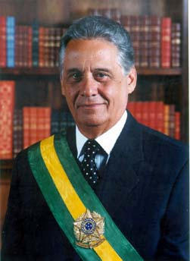
Fernando Henrique Cardoso (PSDB), 1995-2002

Slide 11
Fernando Henrique Cardoso (FHC), 1994-2002
Success of Real Plan → elected 1994
Neoliberalism…
cut state spending; sale of state assets; reduce deficit
Achieves stable economy but price is: very low growth
Ever-growing social inequality
Some limited measures for social justice: (later expanded under Lula): racial quotas in diplomatic and judicial corps; gradual land reform (although MST not satisfied); Bolsa Escola (School Grant)

Slide 12
Socioeconomic problems of 80s and 90s
Widening gap between rich and poor
Rise in urban crime and police violence
Hardening of attitudes towards poor, street children massacred at Candelaria church in Rio…
Growth of drug traffic
Dismal record in public education and health care: illiteracy nearly 20% in 1980s

Slide 13
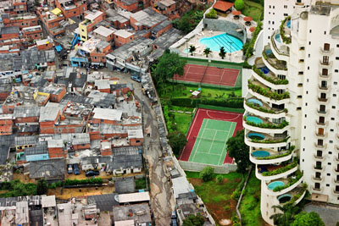
Morumbi neighbourhood, São Paulo, with Paraíso favela next door

Slide 14
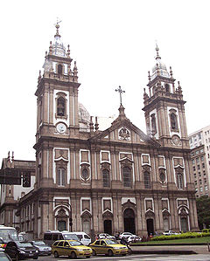
Notes:
Igreja da Candelaria, site of July 1993 massacre of street children

Slide 15

Major films about urban social realities…
City of God (2002)
City of Men (2007)
Elite Squad (2007)
Carandiru (2003)
Bus 174 (2002)

Slide 16
Lula and the rise of the PT
Lula: migrant to S Paulo, humble origins in Pernambuco (North-East): Brazil’s first non-elite president
rises to prominence in UNION POLITICS towards the end of 1970s: leads major strikes in S Paulo 1978-80 that challenged the military’s economic policies.
Significant prejudice against Lula as non-elite, poorly educated
Fears of international banking sector about foreign investment (e.g. in 1998 election): PT much more conservative in power than anticipated
Hopes on Left: PT doesn’t live up to either

Slide 17
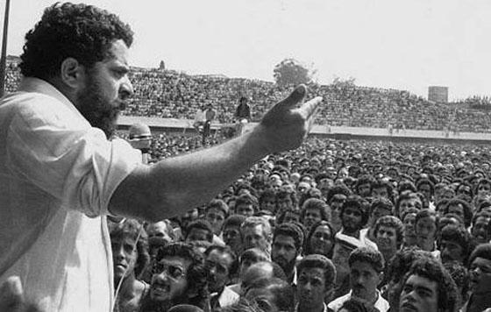
The Workers’ Party: Union organising in Sao Paulo, 1980
Luiz Inacio “Lula” da Silva, later President of Brazil

Slide 18
The Partido dos Trabalhadores (Workers’ Party), PT
Founded in late 70s S Paulo: opposition to dictatorship; workers’ rights
decentralised style of organising: no major funders – party funded by members’ contributions
close links with MST & Liberation Theology movements
traditional base among working class in south-east; plus major support from middle-class left
Major electoral force since 1989.

Slide 19
A change of image
from fiery socialist labour leader to better presented and less radical
denounces failures of neoliberalism under Cardoso & economic injustice; introduces idea of “Brazil, a country for all,” which later becomes a PT government slogan;
But: reassures Wall St: contracts will be respected, no expropriation
PT shifts rightwards, but pulls middle ground of politics leftwards.

Slide 20
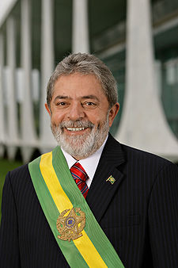
Luiz Inácio “Lula” da Silva

Slide 21
The PT in power: symbolic importance of new faces
Benedita da Silva, first black woman senator, brought up in Rio favela, active in women’s movement
Marina Silva, PT senator from Amazonas, indigenous & black ancestry, formerly a maid, linked to environmental movements, becomes minister for environment.
Gilberto Gil, Afro-Bahian singer prominent in tropicalismo of 1960s, becomes minister for culture.
First black judge, Joaquim Barbosa, heads Supreme Court

Slide 22
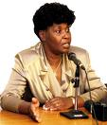
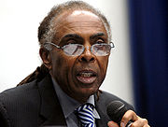
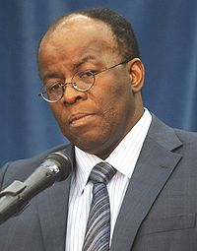
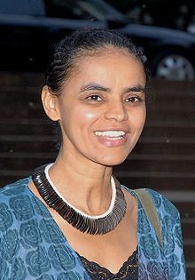
Notes:
Benedita da Silva; Gilberto Gil; Marina Silva; Joaquim Barbosa

Slide 23
Economic policies
Need to reassure international markets (prevent investors from pulling out) → economic policy is as conservative as that of FHC
High interest rates to discourage inflation; sticks to the IMF plan negotiated by Cardoso.
Economy flourishes: partly thanks to FHC reforms: inflation under control; real strengthens; exports flourishing
Global commodities boom coincides with Lula years: Brazil exports soya, oranges, sugar; pioneers flex cars (ethanol and petrol) in 2004; 40% of the world’s sugar by 2006

Slide 24
Social reforms
Welfare initiatives especially “Bolsa Família” (“Family Purse”) programme: based on “Bolsa Escola” under FHC; basic nutrition to women and children if children stay in school.
Especially significant in north-east: boosts PT’s popularity in NE
By 2011, 26% of the Brazilian population were covered by the programme.
But: high unemployment; low wages; huge socioeconomic inequalities…
Afro-Brazilians: 45% of population but 65% of poor
Brazil has one of worst literacy rates in Latin America by 2009 (13% totally illiterate; only Haiti and 4 small Central American countries do worse)

Slide 25
Corruption: the 2005 “mensalão” scandal
Massive “big monthly payment” scandal: PT congressional leaders systematically buy votes for cash
Every member of Lula’s close circle indicted
High profile trials
Several politicians (from other parties too) are serving prison sentences (unprecedented in Brazil)
Ratings temporarily affected but mensalão scandal never “stuck” to Lula himself.

Slide 26
The PT: Raising Brazil’s world profile
Brazil positions self as leader of the third world; one of the BRICs Brazil, Russia, India, China
Active within Latin America, e.g. MERCOSUR
Role of moderate: between radical new left in Lat Am (Chávez, Morales...); and Bush; mediation in Colombia/ Venezuela;
Obama at 2009 G20 summit: Lula is “the man”, “the most popular leader on the planet”
Role in peace keeping e.g. Haiti
High-profile sporting events: 2014 World Cup, 2016 Olympics

Slide 27
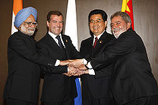
BRIC leaders

Slide 28
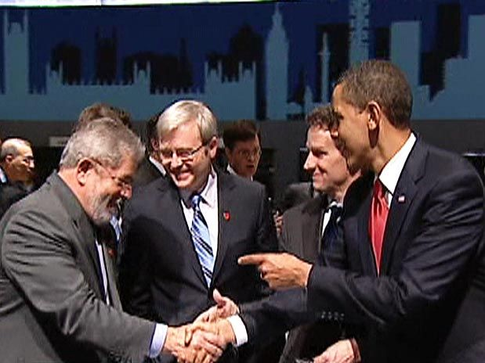
Notes:
G20 summit in London April 2009. Obama: “Esse eh o cara” ; “o politico mais popular da Terra”

Slide 29
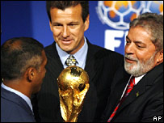
2007 announcement that Brazil will host 2014 World Cup
Notes:
Lula with Romario (player) and Dunga (2010 coach and former Brazil player)

Slide 30
Lula’s second term & beyond: challenges
Education remains huge challenge:
13% Brazilians still completely illiterate by 2009; one of the lowest rates of literacy in Latin America, only Haiti and four Central American countries (much smaller and poorer) do worse
Major social inequality continues. Brazil in the upper 50s and lower 60s of Gini index; most Lat Am countries in mid-to-upper 50s; “developed” countries are in 30s and 40s.

Slide 31
Seminar questions
Did the election of Lula and the PT represent a new departure for Brazilian politics and national life?
Did electoral victory change the PT itself? How?
Do you agree with Bryan McCann that the left has triumphed in Brazil?
How has Brazil’s international profile shifted in the last 20 years or so? Is this significant?

Slide 32
Reading
Skidmore, Brazil, Chapter 9
Bryan McCann, The Throes of Democracy: Brazil since 1989, chapter 1, "The Rise of the Left“
Richard Bourne, Lula of Brazil: The Story So Far (2008), chapters 1 (“A Tough Start in Life,” 3 (“The PT, the Workers’ Party”, 5 (“Overview of the First Term”).

