Slide 1
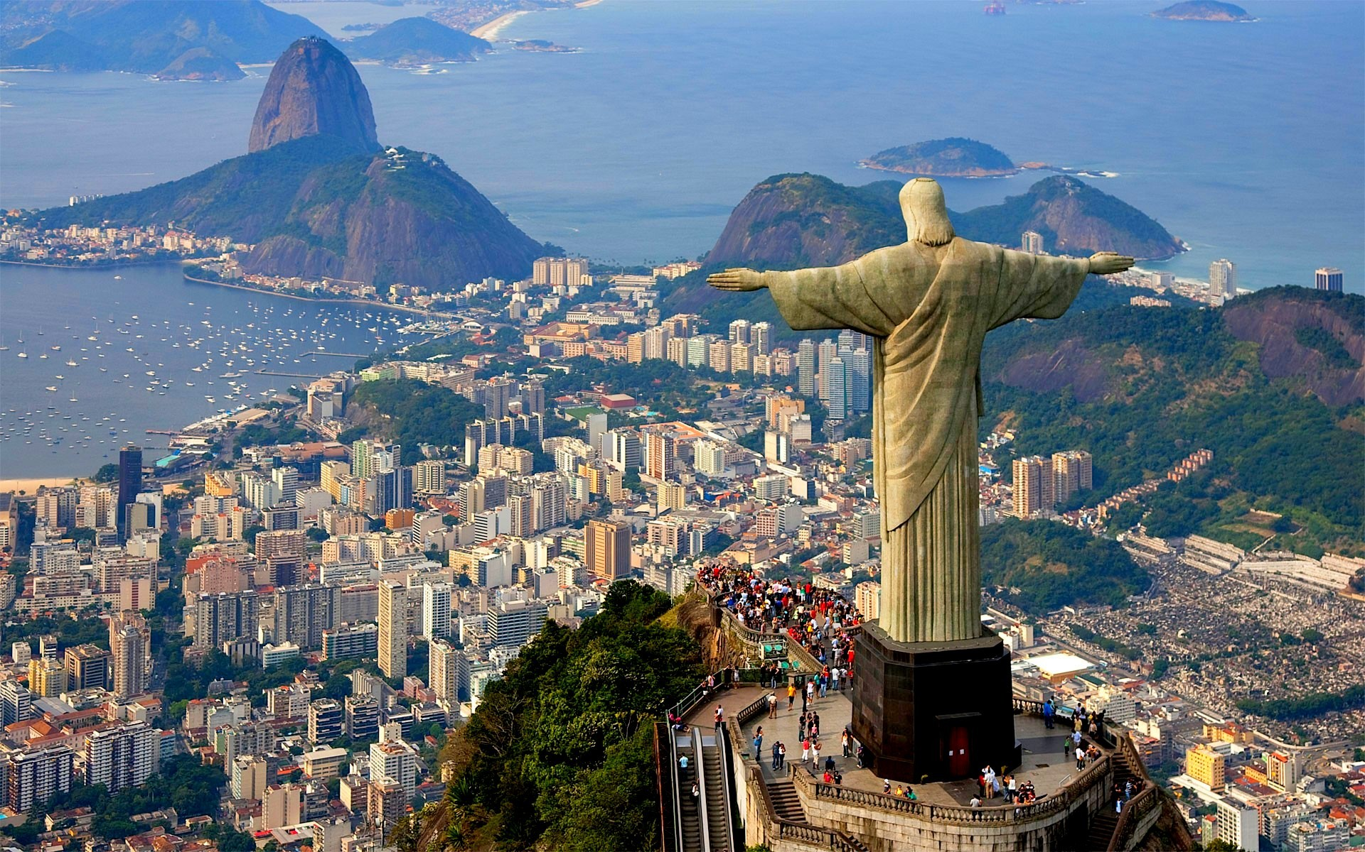
Week 2: Revision and Conclusions:
Brazil, “a country for all”?

Slide 2
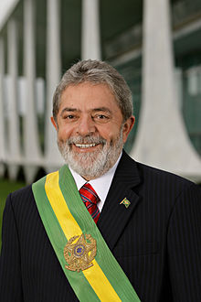
Change or continuity under Lula, 2002-2010?

Slide 3
Change and continuity…
New faces in politics, but older ones also influential behind the scenes
Similar economic policies to FHC, e.g. IMF-negotiated plans, encouraging external investment
Exports boom, fuelled by China.
Growth = 7% by 2010
Income gap remains high, but falls slightly: income of the poorest tenth grows at 8% per year; richest tenth grows at 1.5% per year
Expanded (precarious) lower middle class in Brazil: from 44% to 52%
Partly luck and legacy of stable growing economy (FHC)
But, social programmes, esp Bolsa Familia, play a significant role.
Minimum wage x 2.5

Slide 4
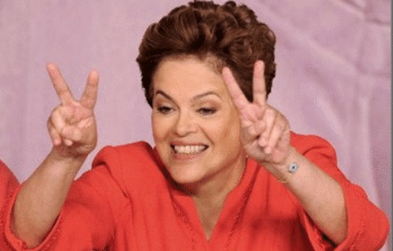

Slide 5
Dilma Rousseff (2010-present)
Middle-class background
History of struggle against the dictatorship: part of a Marxist student group; arrested in early 1970s; several years’ jail; torture
Minister for energy under Lula; after 2005 mensalão scandal, José Dirceu resigns, Dilma becomes chief of staff;
Lula’s hand-picked successor for the 2010 election
Election in Oct 2010: run-off, but then 56% of total votes.

Slide 6
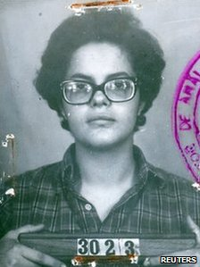
Notes:
Dilma: jailed for 3 years in early 70s and tortured

Slide 7
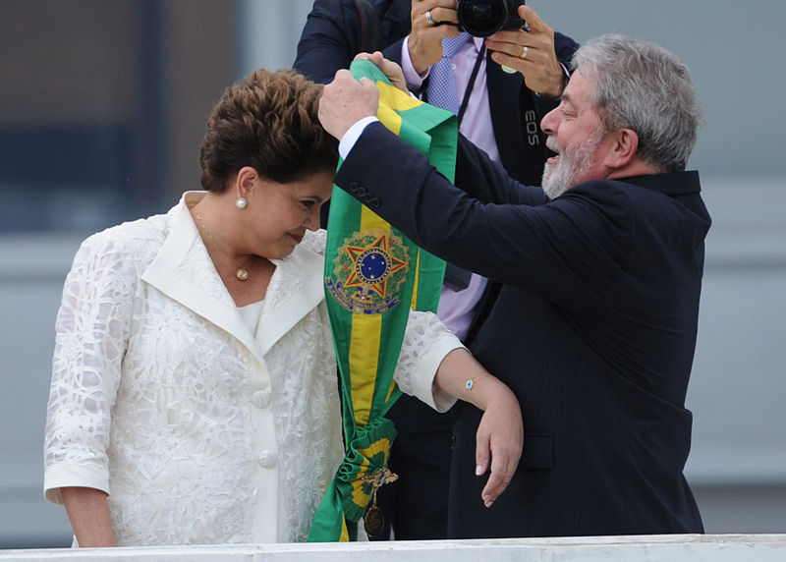

Slide 8
Dilma in office
Continues economic and social policies of Lula, e.g. Bolsa Família
Reduces of household taxes on food and energy: popular with poor
Champions state companies in economy, especially Petrobrás
Becomes tainted by Petrobrás corruption scandal
Dilma drafted legislation about the exploitation of Brazil’s major offshore oil fields (discovered during Lula’s presidency)
Sacks several ministers for corruption
Environment /social criticism of hydroelectric projects in the Amazon

Slide 9
Dilma’s declining fortunes
Personal approval ratings: 66%-79% before 2013 riots; then fell to around 40%
Wins on 5 October 2014 but by narrow margin
Economic conditions worsen (partly result of Dilma policies, but mainly global economic conditions)
Slower growth under Dilma: 7% until 2010; 2% after that; followed by recession

Slide 10
The riots
Started 6 June 2013 in São Paulo over a 20-cent hike in bus fares
Heavy-handed policing of peaceful demo in SP : sparks largest demonstrations since Collor impeached
Spreads across Brazil; 65.000 took part in S Paulo; diverse constituency (women; elderly); demos mainly PEACEFUL
mainly middle class and white; Demands about better public services, lower inflation, less corruption
Huge spending on world cup: 7 B reais up to 2014 (x3 S. Africa)
HEAVY HANDED POLICING before world cup: “pacification” of favelas; 1.5 M people will be moved

Slide 11
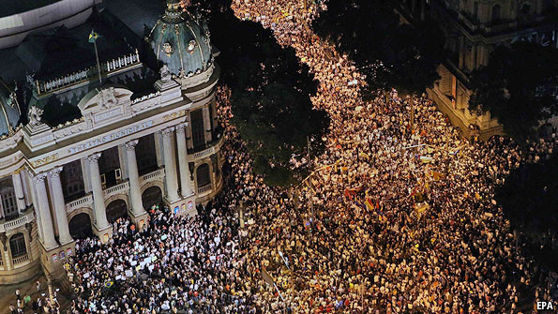
Notes:
Protests in Rio, from 6 June 2013 onwards.

Slide 12
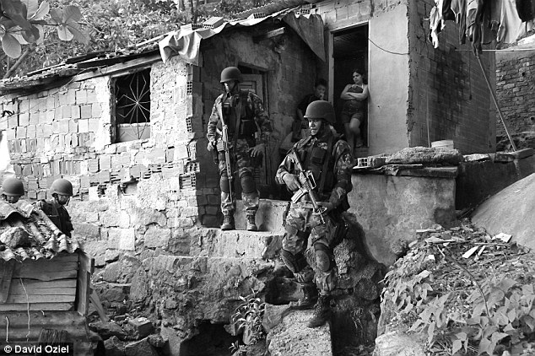
Notes:
Favela “pacifications” in 2010 (Vila Cruzeiro and Complexo do Alemao, 5-day battle)

Slide 13
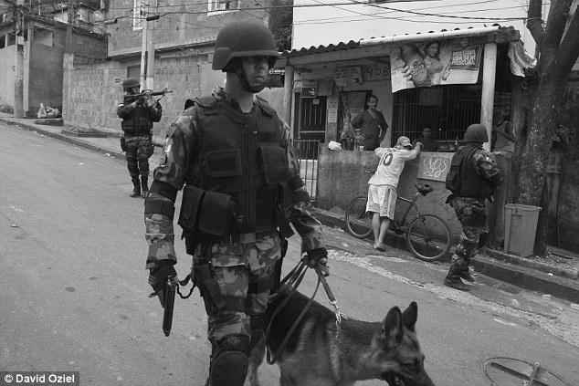

Slide 14
Other gripes
Brazilians pay among highest taxes in world (35% of income) but have awful public services
Long history of URBAN RIOTS - city spaces designed only for the rich –1880 Vintém Riot in Rio over hike in transport costs; vaccination riot of 1904 (slum clearances)
Recent inflation rise – 6% by 2013(historic problem of inflation…)
Caused by growth of the middle class (by 40M people under Lula)? Precarious existence, but see selves as citizens with right to make demands on the state?

Slide 15
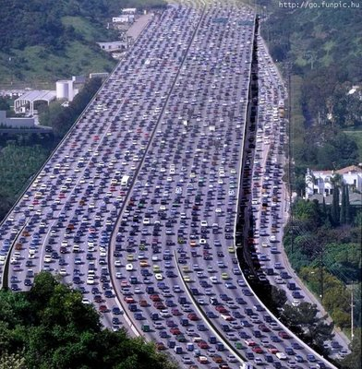

Slide 16
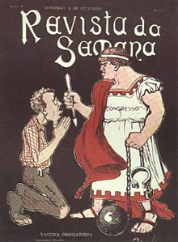
Historical parallels: e.g 1904 vaccination riots in Rio…

Slide 17
Brazil today
Still extremely unequal, but inequality falling slowly
Education a major problem for future equality or growth
Much slower growth than other BRIC countries
Overall, economically stable despite recent problems? natural resources, high tech investment, falling birthrate…
at peace with its neighbours
Corruption still huge problem…
Return to total political crisis since the 2016 impeachment of Dilma Rousseff…

Slide 18
Theme 1: city and countryside
Today, Br overwhelmingly URBAN: 80% population live in CITIES; 23M in SP, 11M in Rio…
But, historically an agricultural country, until well into the C20
Pattern of very high land concentration; power and wealth rooted in the COUNTRYSIDE in colonial Brazil [unlike Spanish America].
Basic social institution in colonial Brazil is the large rural plantation – mainly producing SUGAR - and with it slavery.
Wealth & population moves from NE to SE by C19; coffee replaces sugar - but, agricultural exports still dominate
This continues under Republic, 1889 – 1930s (though some industrialisation)

Slide 19
Land and cities in the twentieth century
Land concentration and rapid urbanisation are LINKED: difficulty of making living on land pushes people to cities
Plus, booming industries – promoted by Vargas - IMPORT SUBSISTUTION INDUSTRIALISATION and ECONOMIC NATIONALISM
massive, uncontrolled, internal migration (esp from NE to SE) and urbanisation
Hence today’s urban problems: violence, lack of control by state
Meanwhile agrarian reform not tackled – (attempts in the 60s, scotched by military coup in 1964
Land reform taken up by MST under the dictatorship and opening (abertura)

Slide 20
Theme 2: race and race mixture
wealth based on slave labour; Brazil imports over 40% of all Africans ever traded to the Americas; last country to abolish slavery in 1888
Former slaves: little access to land, education etc; poverty & social exclusion have a colour in Brazil.
Abolition coincides with “whitening” and “scientific” racism: link with Africa severed in favour of “white” European migrants.

Slide 21
Brazil: a “racial democracy”?
associated with sociologist Gilberto Freyre, 1930s;
notion of comparatively harmonious race relations
based on interpretation of Br slave past as “milder” or more benign
Rethinking of RACE MIXTURE: not pathological but POSITIVE –acknowledge African and indigenous contributions to Brazilian culture
Negates racism: Black Movement combats this from 60s and 70s….
Centenary of abolition, May 1988: celebrations replace “benevolent” princess Isabel with Zumbi (runaway slave leader)

Slide 22
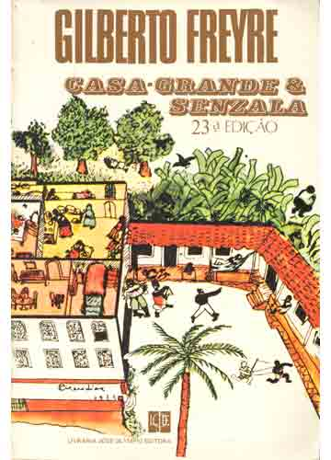
Casa-grande e senzala (Big House and Slave Hut), 1933 (Gilberto Freyre)

Slide 23
Theme 3: democracy and mass politics
C19: comparatively broad suffrage, no genuine democracy
peaceful taking in turns of 2 political parties (Liberals and Conservatives); Emperor at head exercising “poder moderador”
Electoral reform in 1880 disenfranchises illiterates, who only get the vote properly after 1988 constitution –electorate shrinks, from 1M to 150,000.
Rule by wealthy coffee-planter families under the Republic; dominance of S Paulo (with Minas and Rio).
Dissatisfaction of other states with this arrangement (RGS)
dissatisfaction of new political/ social groups, e.g. urban middle class → Vargas to power by 1930.

Slide 24
Politics since Vargas…
Vargas pursues industrialisation; urban workforce grows; main political problem is how to incorporate demands of urban masses, while remaining in power.
→ uses corporatism and (after WW2) populism.
But, also uses the heavy hand of dictatorship, 1937-45 (Estado Novo)
MILITARY back him: military have major role in politics throughout the C20 (behind the scenes of “civilian” governments, or in government themselves 1964 to 1985)
Military help shape Brazilian politics from Paraguayan War (1860s) right up to 1985

Slide 25
FHC on corruption:
“there is no right in Brazil, in the classic sense of the term. Conservative thought allies itself to a Western tradition that establishes as its pillars family, property, customs. Our conservatism has none of that. It is all to do with clientalism… the untoward use of the resources of the state. Why has the Brazilian ‘right’ supported every administration? In recent history, it supported the military regime, it supported Sarney, it supported Collor, it supported me, and it supports Lula. Because its members are not of the right. These people just want to be close to the state and extract advantages from it.”

