Slide 1
Week 3:
Independence and aftermath

Slide 2
Last week: growing apart?
Effects of the Pombaline reforms of the second half of C18 (economic; political; social)
Was there a “national” identity?
Evidence of tensions: late-eighteenth century conspiracies against the Portuguese
Potential flash points, but also close elite ties to Portugal (1,700 Brazilians educated at Coimbra in C18)
Colonial slave society: origins in European ideas of hierarchy AND American conditions (indigenous and African workers); social role of the SUGAR PLANTATION
So: WHO benefits from political independence? What about the risk of social revolution from below?

Slide 3
The Inconfidência Mineira (Ouro Preto, Minas Gerais, 1789)
Context is Minas Gerais: wealthiest part of country; elites chafe at taxation of mining wealth;
Relatively large numbers attend university in Coimbra (exposure to Enlightenment ideas)
Prominent members of Ouro Preto elite involved
Correspondence with Thomas Jefferson
Aim to assassinate the governor and proclaim an independent republic
Ringleader was Joaquim José da Silva Xavier (“Tiradentes”)
Some support among non-elite sectors
Tiradentes hung, drawn, quartered

Slide 4
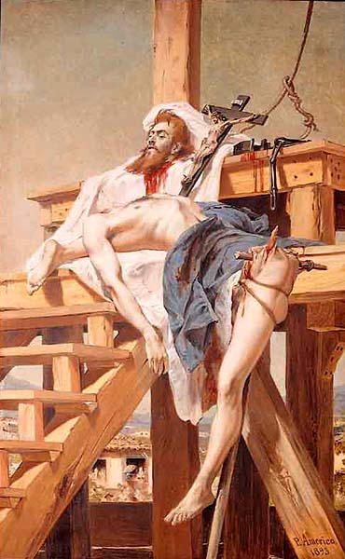
Notes:
“Tiradentes desquartejado,” Pedro Americo, 1893

Slide 5
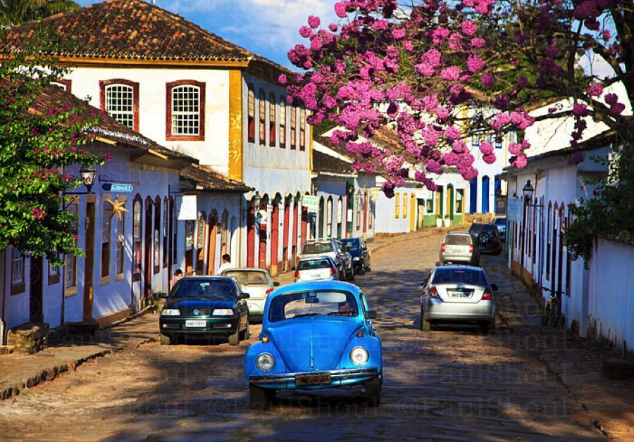
Notes:
Town of Tiradentes

Slide 6
The “Tailors’ Revolt,” Salvador, 1798
Different social profile from Tiradentes rebellion
Conspirators mainly middling free people of colour
But, some elite participation
Some slave participation → fear of slave rebellion and example of HAITIAN REVOLUTION 1791-1804
Rebels seek independence from Portugal AND the end of racial discrimination among free people
Rebellion also viciously CRUSHED by the Portuguese
Revolts clearly provoked considerable fear among colonial authorities

Slide 7
The Portuguese Court Comes to Rio, 1808
Napoleon invades Iberian Peninsula, 1807
British give safe passage to Portuguese court
Rio’s ports opened to free trade; good for Brazil, bad for Portugal
Rio’s population doubles from 50,000 to 100,000 (1808-1822)
New institutions; medical faculties in Bahia / RJ; first printing-press

Slide 8
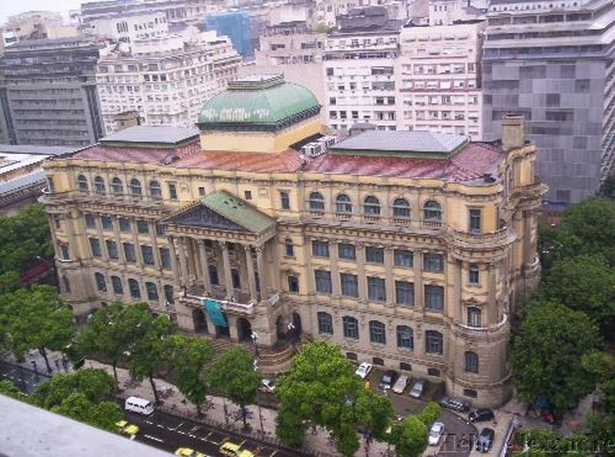
Notes:
Brazilian National Library, Rio de Janeiro

Slide 9
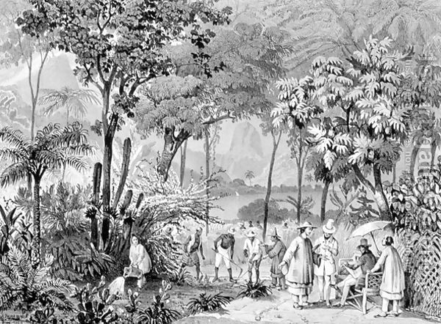
Notes:
Johann Moritz Rugendas, “The Chinese Tea Plantation in the Botanic Gardens at Rio de Janeiro” c. 1835

Slide 10
Growing apart
1814: Napoleon defeated, Portuguese nobles want king’s return
1815: Compromise, “United Kingdom” with Estado do Brasil as equal partner
1816 Queen Maria dies; João VI crowned
1817 military revolt, Recife (Pernambuco) establishes “Republic”; liberal and nationalist ideas within the military; defeated

Slide 11
Separation
1820: Liberal revolution triumphs in Portugal, forms Cortes, calls for king’s return
1821: João leaves; son Pedro named Regent
Cortes tries to force Brazil back to previous subordinate status; Brazilian elite furious
7 September 1822: Pedro refuses to obey Cortes’ order to return
Recognition from BRTISH is key; start of crucial relationship between Brazil and Britain

Slide 12
Brazilian Independence: Change or Continuity?
Change
Continuity
Political and administrative ties to Portugal are severed
Brazil assumes Portugal’s debt to British, beginning of long dependence on Britain
No questioning of socioeconomic order. Elites firmly in charge
Still a monarchy (though a constitutional one)
Slavery not abolished; it GROWS (2M Africans imported 1800-1850)
Regional separatism/ republicanism remains unresolved

Slide 13
“para inglês ver”
(for the English to see)

Slide 14
The monarchical system
Monarchy survives independence; important unifying factor
Liberalism influences both economics and politics
Constituent Assembly drafts a constitution ; Pedro I replaces with his own version
2 houses of parliament (Senate, Chamber of Deputies)
Strong “moderating power” for Emperor (can dissolve parliament and call elections; has a right of veto over all legislation)
18 provinces - presidents appointed by Emperor; greater centralization

Slide 15
Problems of the First Empire, 1822-1831
Regional revolts: 1824 Pernambuco (again) ; declaration of a republican “Federation of the Equator”, support of other NE provinces
1825 War with Argentina over Cisplatine Province (becomes Uruguay)
Military weakness: reliance on British naval support
Economy doing badly; exports decline (except coffee); over-dependence on the British
Strong anti-Portuguese sentiment; March 1831 “noites das garrafadas” (5-day riot in Rio)
Conflict between elite factions and D. Pedro; Portuguese monarchists force his return, 1831

Slide 16
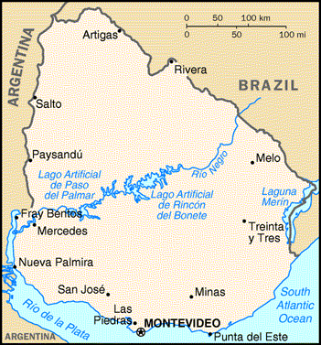
Notes:
Map, Uruguay

Slide 17
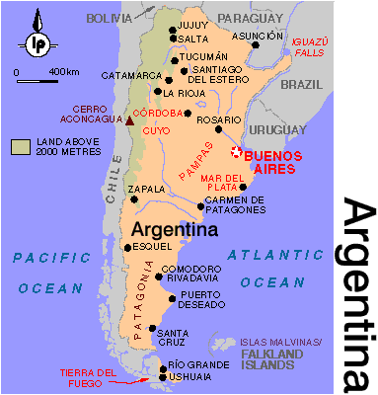

Slide 18
The Portuguese Court Comes to Rio, 1808
Napoleon invades Iberian Peninsula, 1807
British give safe passage to Portuguese court
End of mercantilism: Rio’s ports opened to free trade; good for Brazil, bad for Portugal
Rio’s population doubles from 50,000 to 100,000 (1808-1822)
New institutions; medical faculties in Bahia / RJ; first printing-press

Slide 19
Notes:
Brazilian National Library, Rio de Janeiro

Slide 20
Notes:
Johann Moritz Rugendas, “The Chinese Tea Plantation in the Botanic Gardens at Rio de Janeiro” c. 1835

Slide 21
Growing apart
1814: Napoleon defeated, Portuguese nobles want king’s return
1815: Compromise, “United Kingdom” with Estado do Brasil as equal partner
1816 Queen Maria dies; João VI crowned
1817 military revolt, Recife (Pernambuco) establishes “Republic”; defeated

Slide 22
Separation
1820: Liberal revolution triumphs in Portugal, forms Cortes, calls for king’s return
1821: João leaves; son Pedro named Regent
Cortes tries to force Brazil back to previous subordinate status; Brazilian elite furious
7 September 1822: Pedro refuses to obey Cortes’ order to return
Recognition from British

Slide 23
Brazilian Independence: Change or Continuity?
Change
Continuity
Political and administrative ties to Portugal are severed
Brazil assumes Portugal’s debt to British, beginning of long dependence on Britain
No change to socioeconomic order; elites firmly in charge
Slavery not abolished (2M more Africans imported, 1800-1850)
Regional separatism & republicanism remain unresolved

Slide 24
“para inglês ver”
(for the English to see)

Slide 25
The monarchical system
Monarchy survives independence; important unifying factor
Liberalism influences both economics and politics
Constituent Assembly drafts constitution ; Pedro I replaces with his own version
2 houses of parliament (Senate, Chamber of Deputies)
Strong “moderating power” for Emperor
18 provinces - presidents appointed by Emperor; greater centralization

Slide 26
Problems of the First Empire, 1822-1831
Regional revolts: 1824 Pernambuco (again)
1825 War with Argentina over Cisplatine Province
Economy doing badly; over-dependence on the British
Strong anti-Portuguese sentiment; March 1831 “noites das garrafadas” (5-day riot in Rio)
Conflict between elite factions and D. Pedro; Portuguese monarchists force his return, 1831

Slide 27
Notes:
Map, Uruguay

