Slide 1
Week 5: The “Regresso” and the Heyday of the Second Empire, 1840-1864

Slide 2
Last week: regional revolts and turbulence in the 1820s-30s
Independence from Portugal in 1822, but no consensus about direction to take
Contrasting political views: absolutism (pro-Portugal); moderate liberalism; radical liberalism
Little economic or cultural unity between the regions
Pedro I proves divisive, then abdicates (1831)
Series of major regional revolts (1820s/ 1830s), thanks to:
Political vacuum created by monarchy AND experiment in liberal decentralisation (1834 Additional Act)
Role of ordinary people and “popular politics”

Slide 3
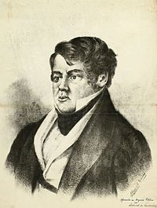
“ O regresso” – the return
Bernardo de Vasconcelos, Brazilian statesman who coined the term
A “return” to centralized rule, away from the liberal experiments with decentralisation of the 1820s and 1830s

Slide 4
Re-centralization, 1840-1850
Key elite groups in Rio (led by Vasconcelos) begin to turn away from the liberal experiment by 1837
1840 Additional Act revoked
1840 Pedro II crowned
Three further revolts in 1842 (quelled easily)
1848-1850: Praieira revolt, Pernambuco:
- Conservative / Liberal rivalry
- anti-Portuguese rioting
- demand for federalism, end to “moderating power,” expulsion of Portuguese
- crushed 1850; last of big challenges to nation-state

Slide 5
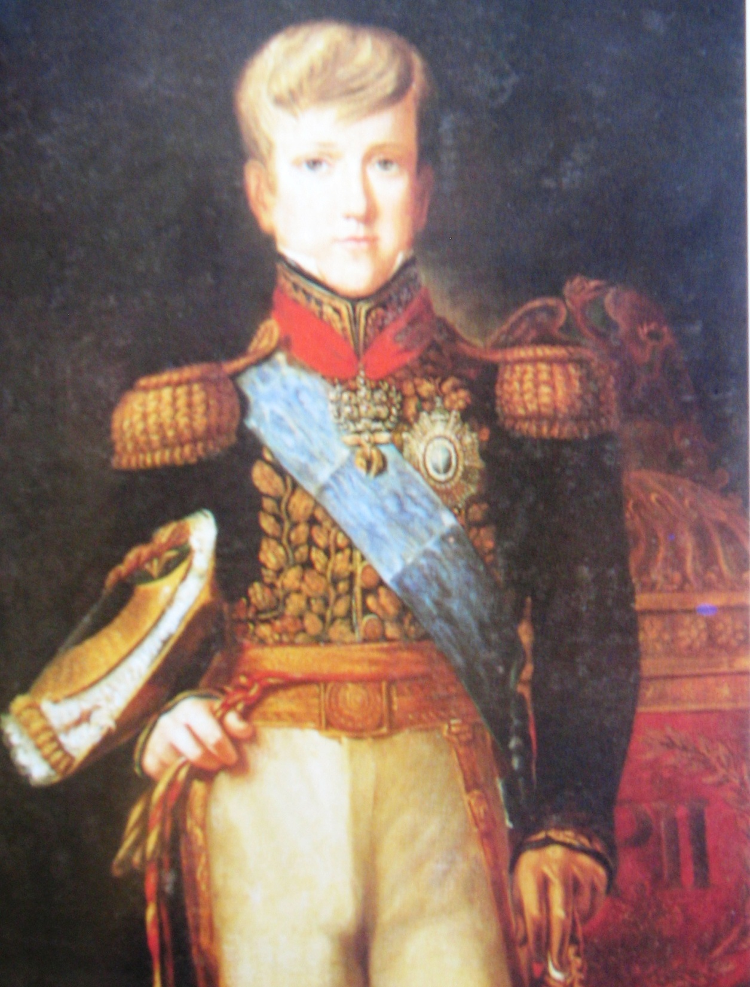
Notes:
D. Pedro II in 1837

Slide 6
Politics in the Second Empire
Moderating power: emperor can name senators and dissolve governments/ call new elections
Politics based on patronage: flows from regions to centre and vice versa; ability to nominate friends for political office and the rewards of state employment
Personal flair of Pedro II: fair, objective; supports culture, sciences...
1840-1870: peaceful alternation between Liberals and Conservatives

Slide 7
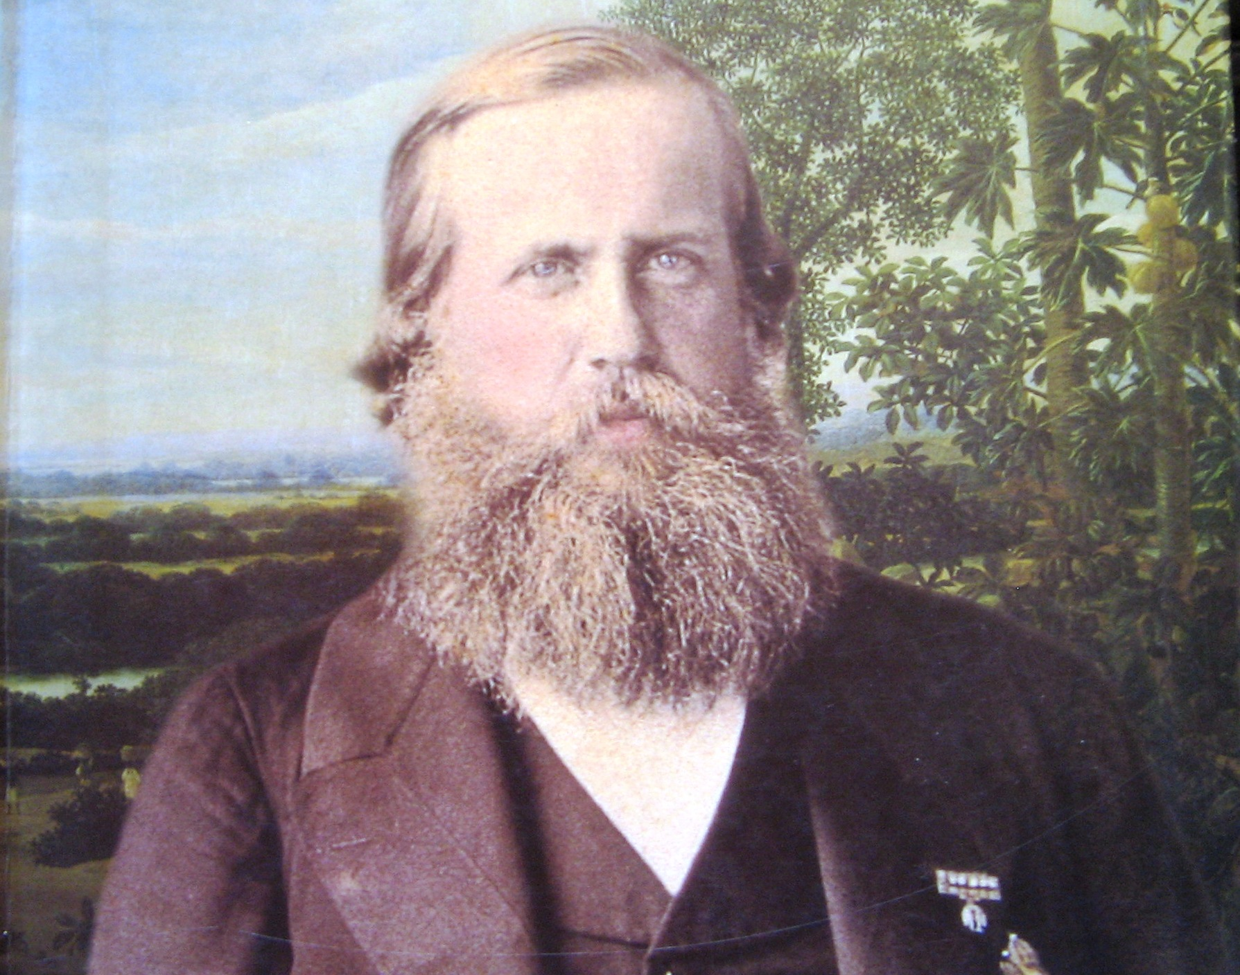

Slide 8
Coffee
Replaces exhausted MINING wealth
Brazil’s main export, 1830s-1970
Wealth/ power follow coffee; dominance of South-East and Rio de Janeiro province and city
Movement Rio de Janeiro → São Paulo province (gradual soil exhaustion)
Dependent on slave labour
1850 land law increases dominance of great estates

Slide 9
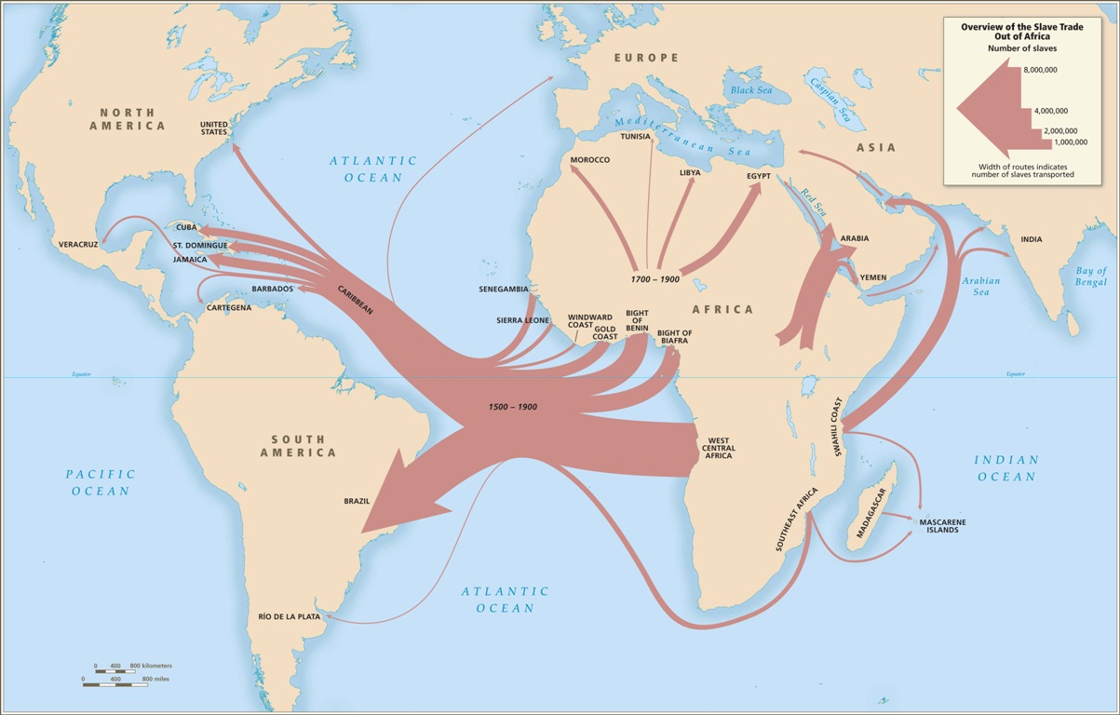

Slide 10
Slavery and the slave trade
Economically essential; politically gets less viable over time
Ideological contradictions, liberalism/ slavery
Brazil receives 60% all Atlantic slaves, 1811-1870
British pressure: treaties, 1826/ 1831 “para inglês ver”; 712,000 imported 1830s/40s.
no natural reproduction

Slide 11
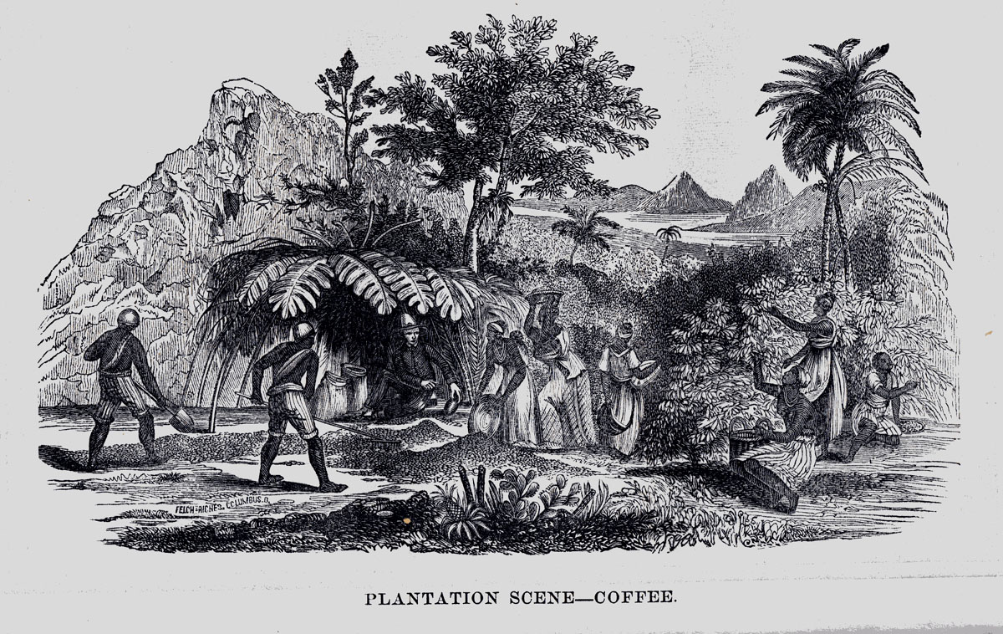

Slide 12
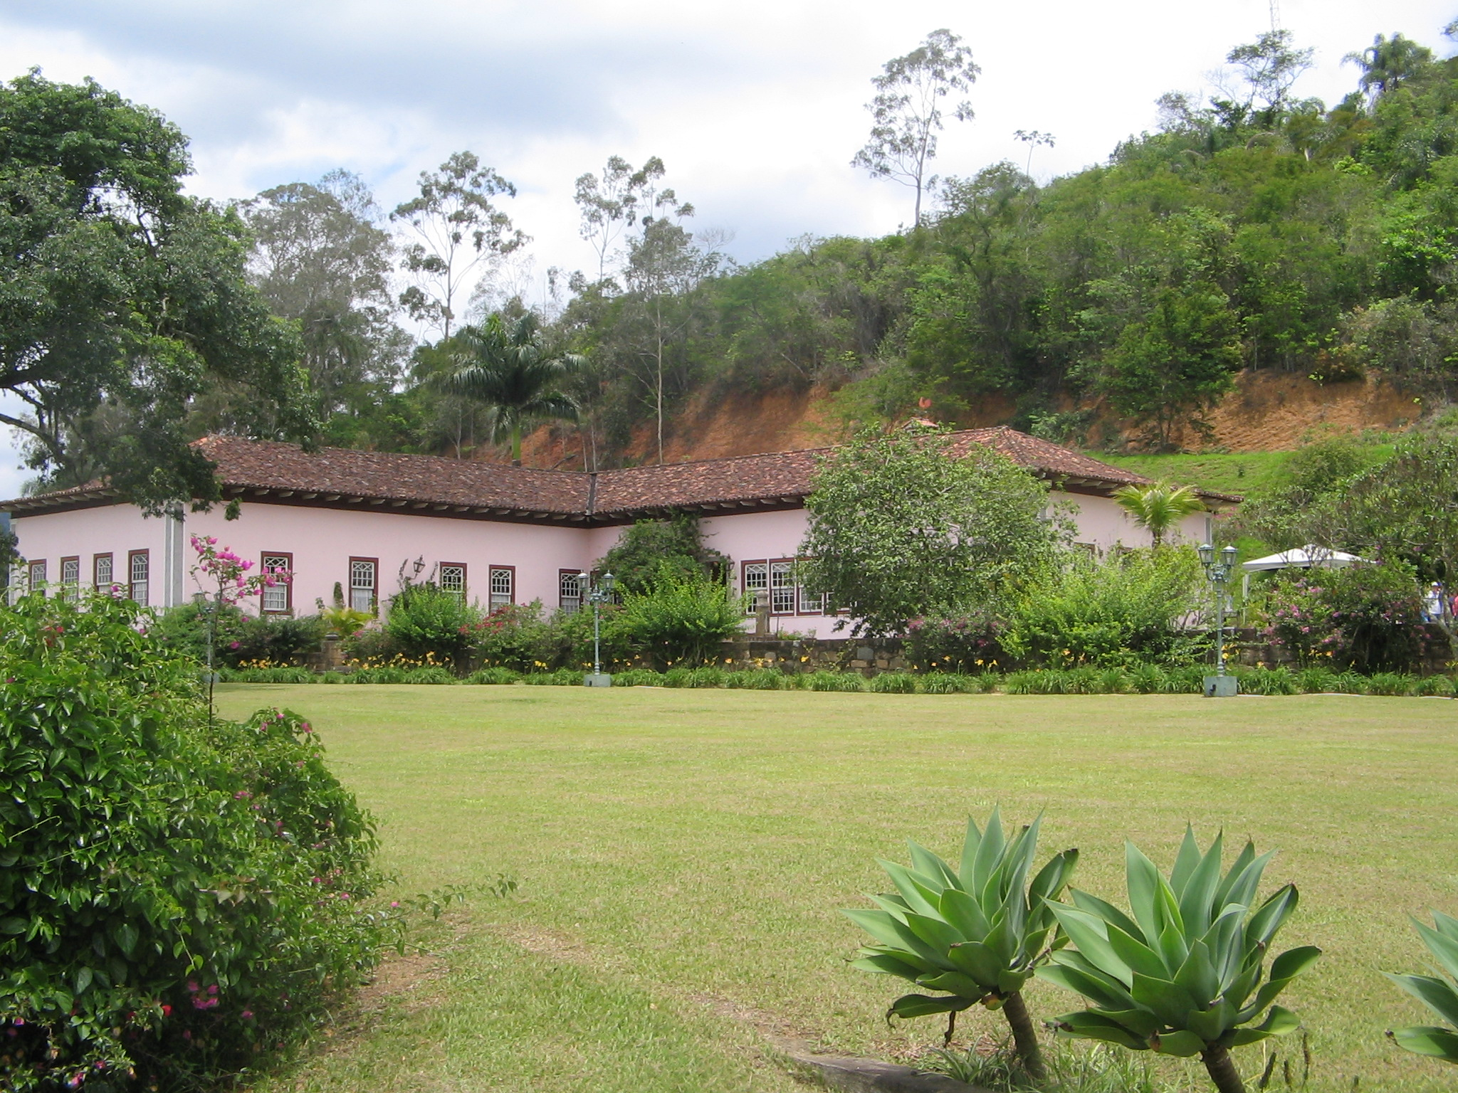

Slide 13
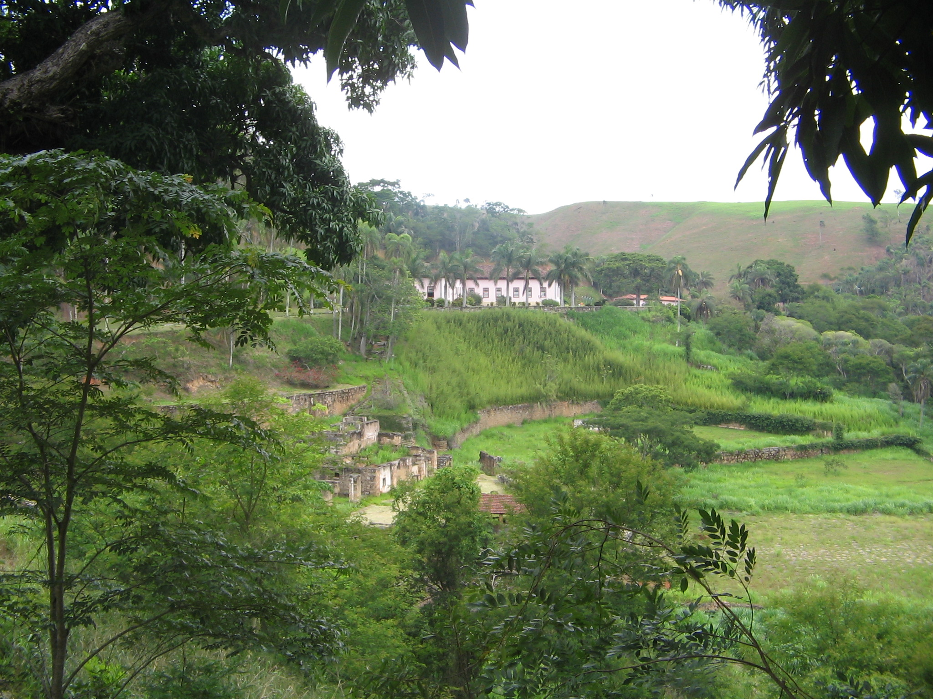

Slide 14
Abolition of the slave trade in 1850: why?
British naval threat and political pressure [Bethell; Jeffrey Needell]
Revolt of Malês, Bahia 1835, and slave resistance [Joao Jose Reis; Dale Graden]
Fear of disease [Sidney Chalhoub]
Eusébio de Queiroz law ends trade, 1850
Major INTERNAL trade from 1850, NE→ SE; big regional political differences over slavery by the early 1870s
Slavery ends in United States 1865; Brazil / Cuba/ Puerto Rico are isolated; Brazilian elites worry about looking “backward”

