Slide 1
Week 7: From the 1840s “Regresso” to Challenges to Stability in the 1860s

Slide 2
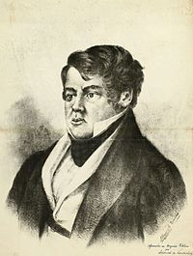
“ O regresso” – the return
Bernardo de Vasconcelos, Brazilian statesman who coined the term
A “return” to centralized rule, away from the liberal experiments with decentralisation of the 1820s and 1830s

Slide 3
Re-centralization, 1840-1850
1840 Additional Act revoked
1840 Pedro II crowned
1848-1850: Praieira revolt, Pernambuco:
- Conservative / Liberal rivalry
- anti-Portuguese rioting
- demand for federalism, end to “moderating power,” expulsion of Portuguese
- crushed 1850; last of big challenges to nation-state

Slide 4
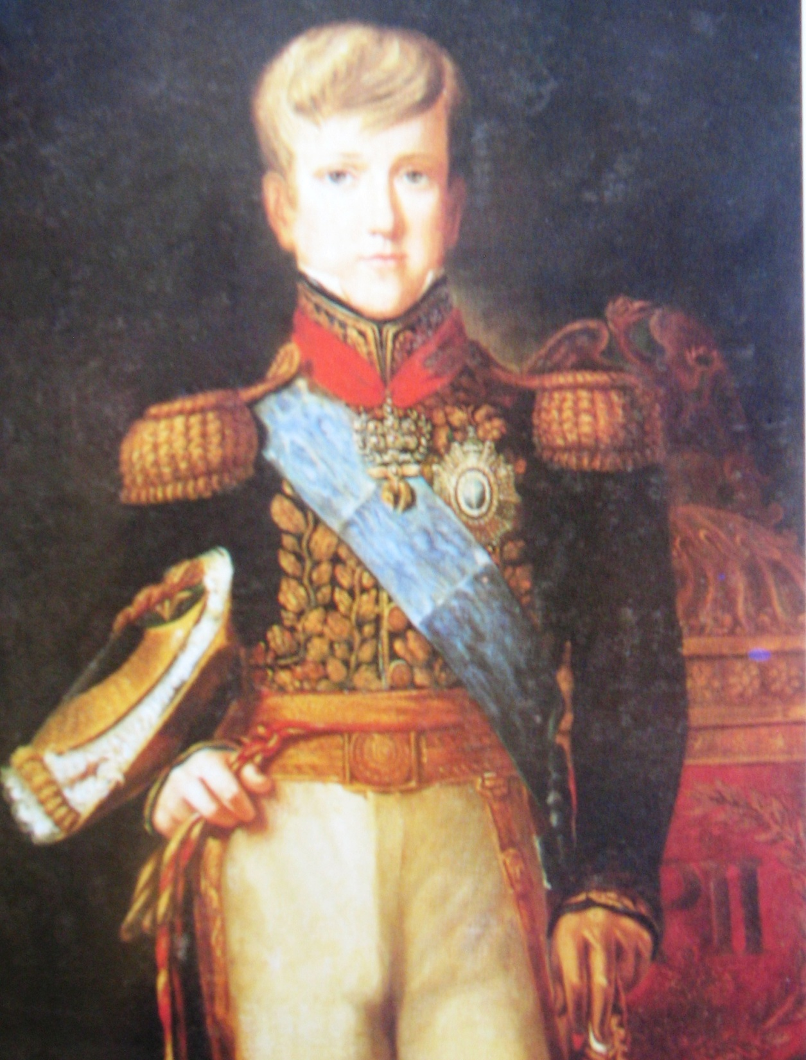
Notes:
D. Pedro II in 1837

Slide 5
Politics in the Second Empire
Moderating power
Politics based on patronage [see Richard Graham’s book in wk 5 readings]
Patronage: key C19 concept: flows between top and bottom and between region and centre
Personal flair of Pedro II: fair, objective; supports culture, sciences...
1840-1870: peaceful alternation between Liberals and Conservatives

Slide 6
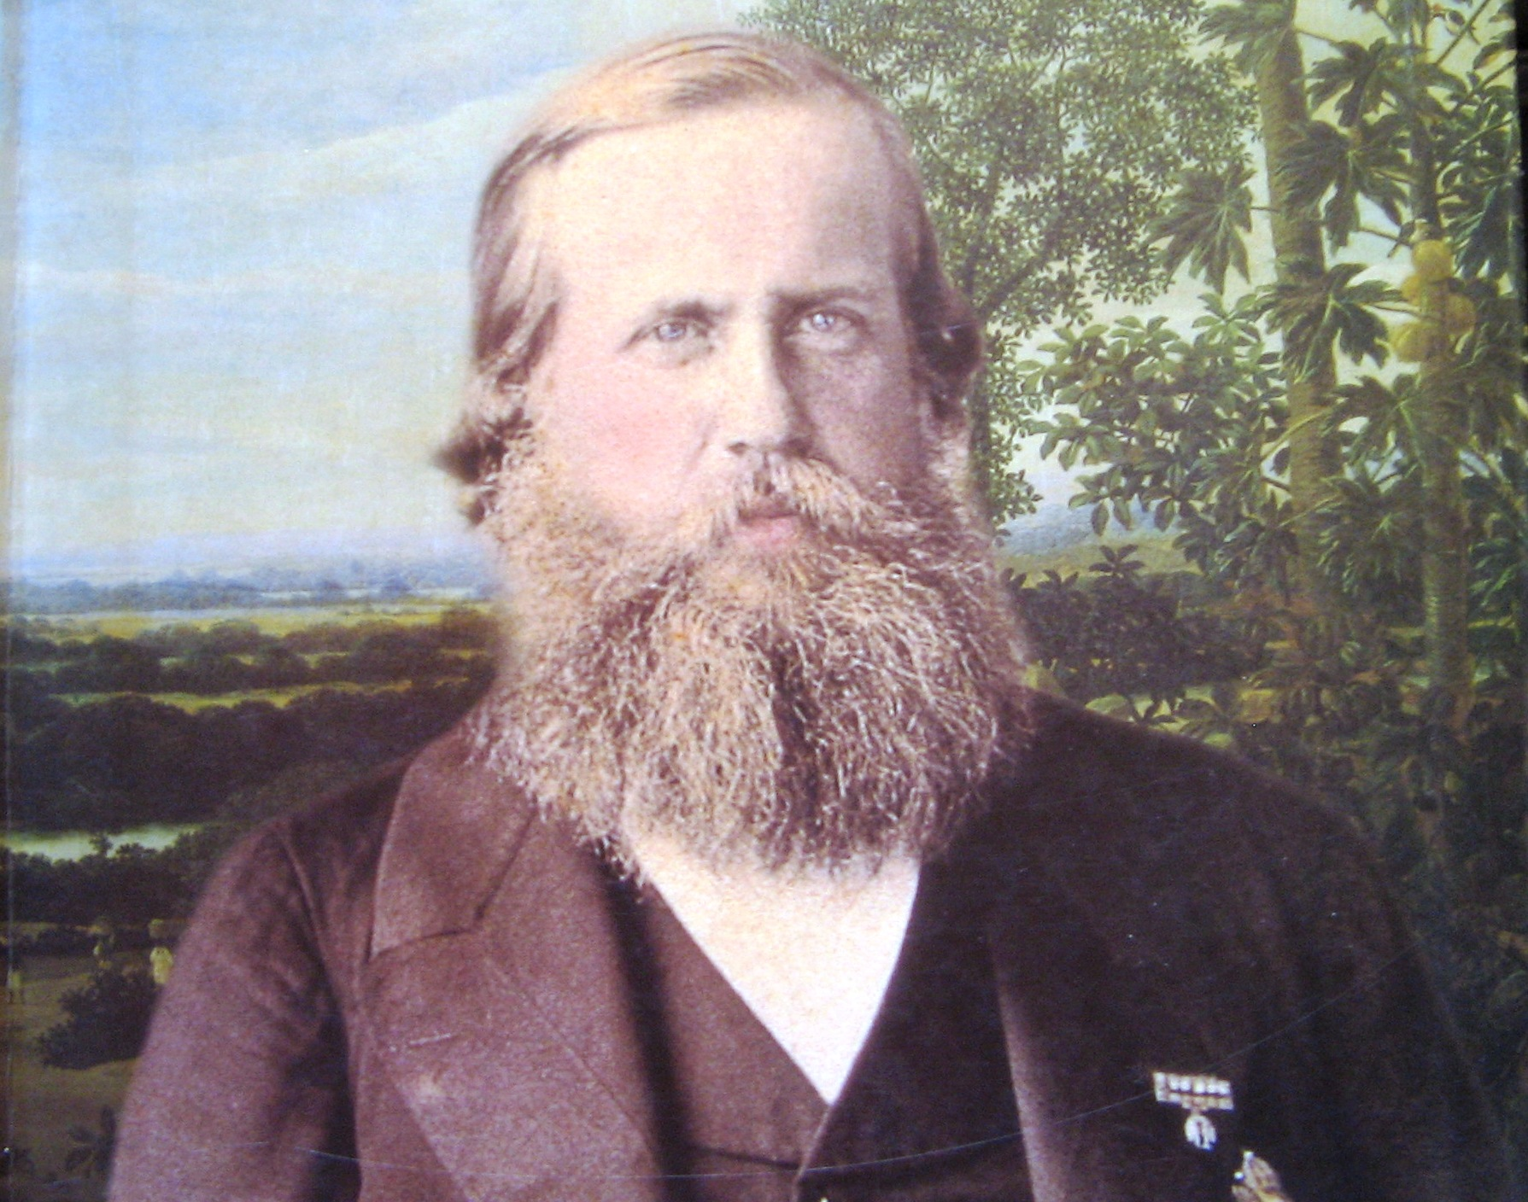

Slide 7
Coffee
Brazil’s main export, 1830s-1970
Wealth/ power follow coffee; dominance of South-East and Rio de Janeiro city
Coffee society described in Stanley Stein’s classic, Vassouras (reading-list)
Movement Rio de Janeiro → through Paraiba Valley → São Paulo province (gradual soil exhaustion)
Dependent on slave labour
1850 land law increases dominance of great estates

Slide 8
Slavery and the slave trade
Economically essential; politically gets less viable over time
Ideological contradiction, liberalism/ slavery
Brazil receives 60% all slaves, 1811-1870
British pressure: treaties, 1826/ 1831 “para inglês ver”; 712,000 imported 1830s/40s
no natural reproduction

Slide 9
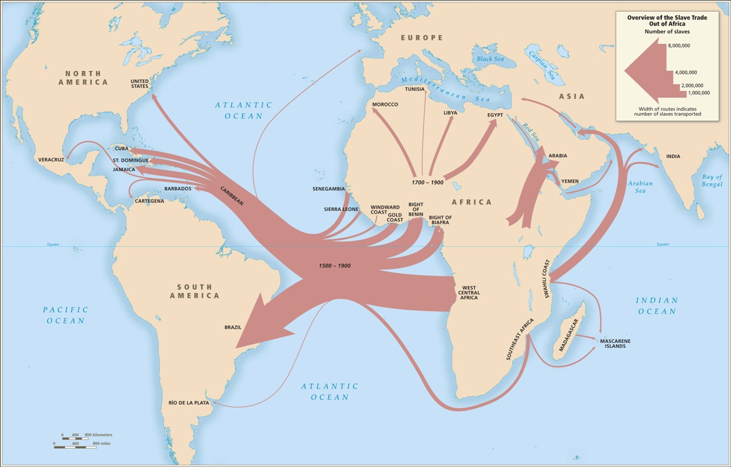

Slide 10
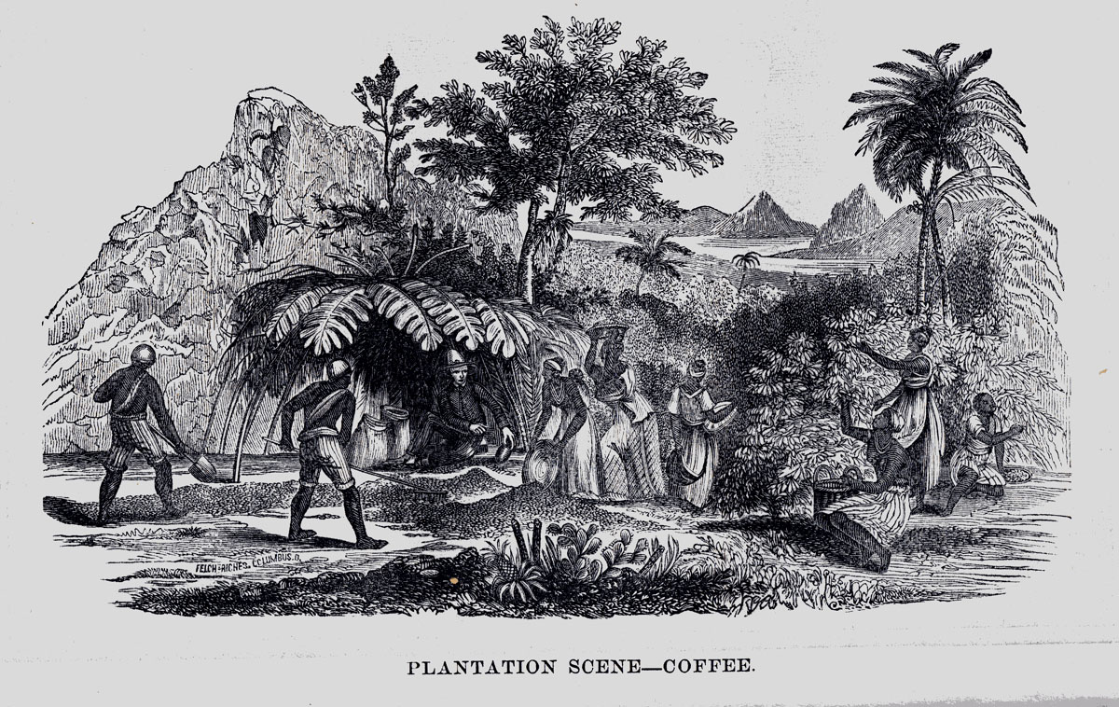

Slide 11
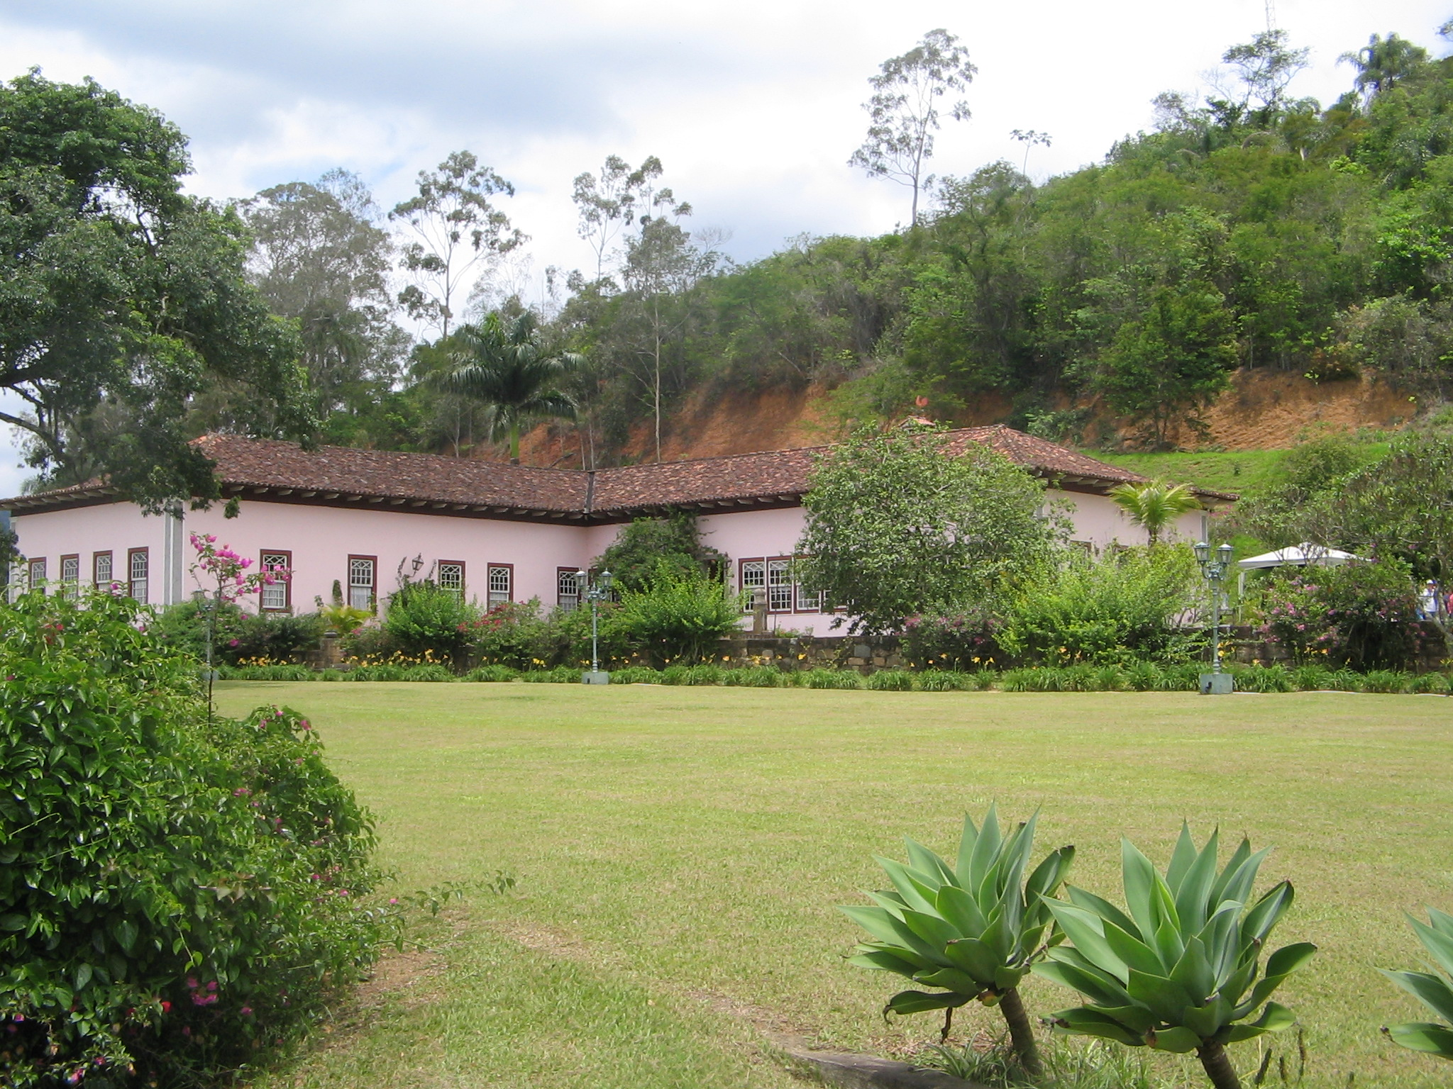

Slide 12
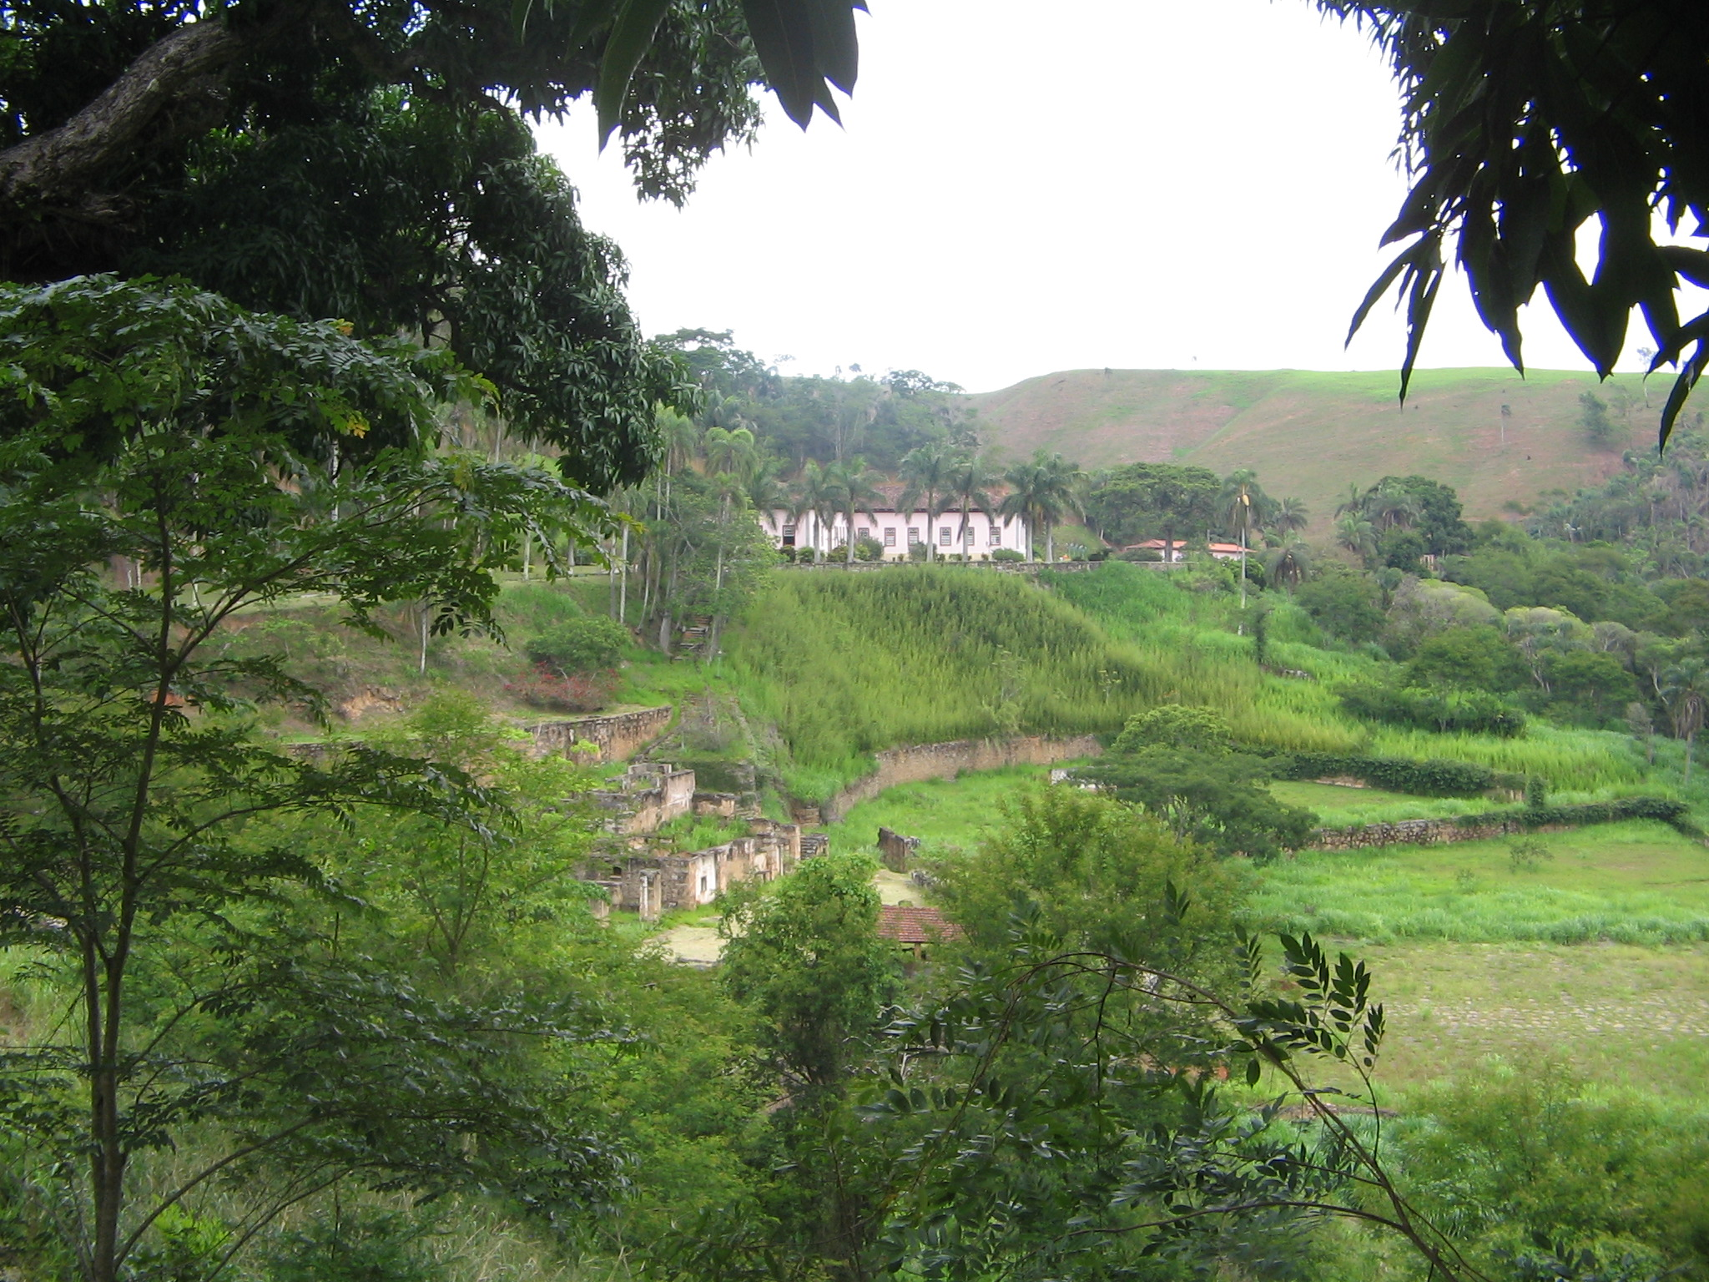

Slide 13
Abolition of the slave trade
Historians offer three main explanations:
British diplomatic & naval pressure
Slave resistance: Revolt of Malês, Bahia 1835
Fear of disease
Eusébio de Queiroz law ends trade, 1850
Major INTERNAL trade from 1850, NE→ SE
Slavery ends in United States 1865; Brazil / Cuba isolated

Slide 14
The Paraguayan War, 1865-1870
Strategic importance of Plata River and Uruguay
Early Paraguayan victories
Badly trained Brazilian troops, not enough volunteers
Slow, extremely costly victory over small, poor nation
Use of slaves as soldiers

Slide 15
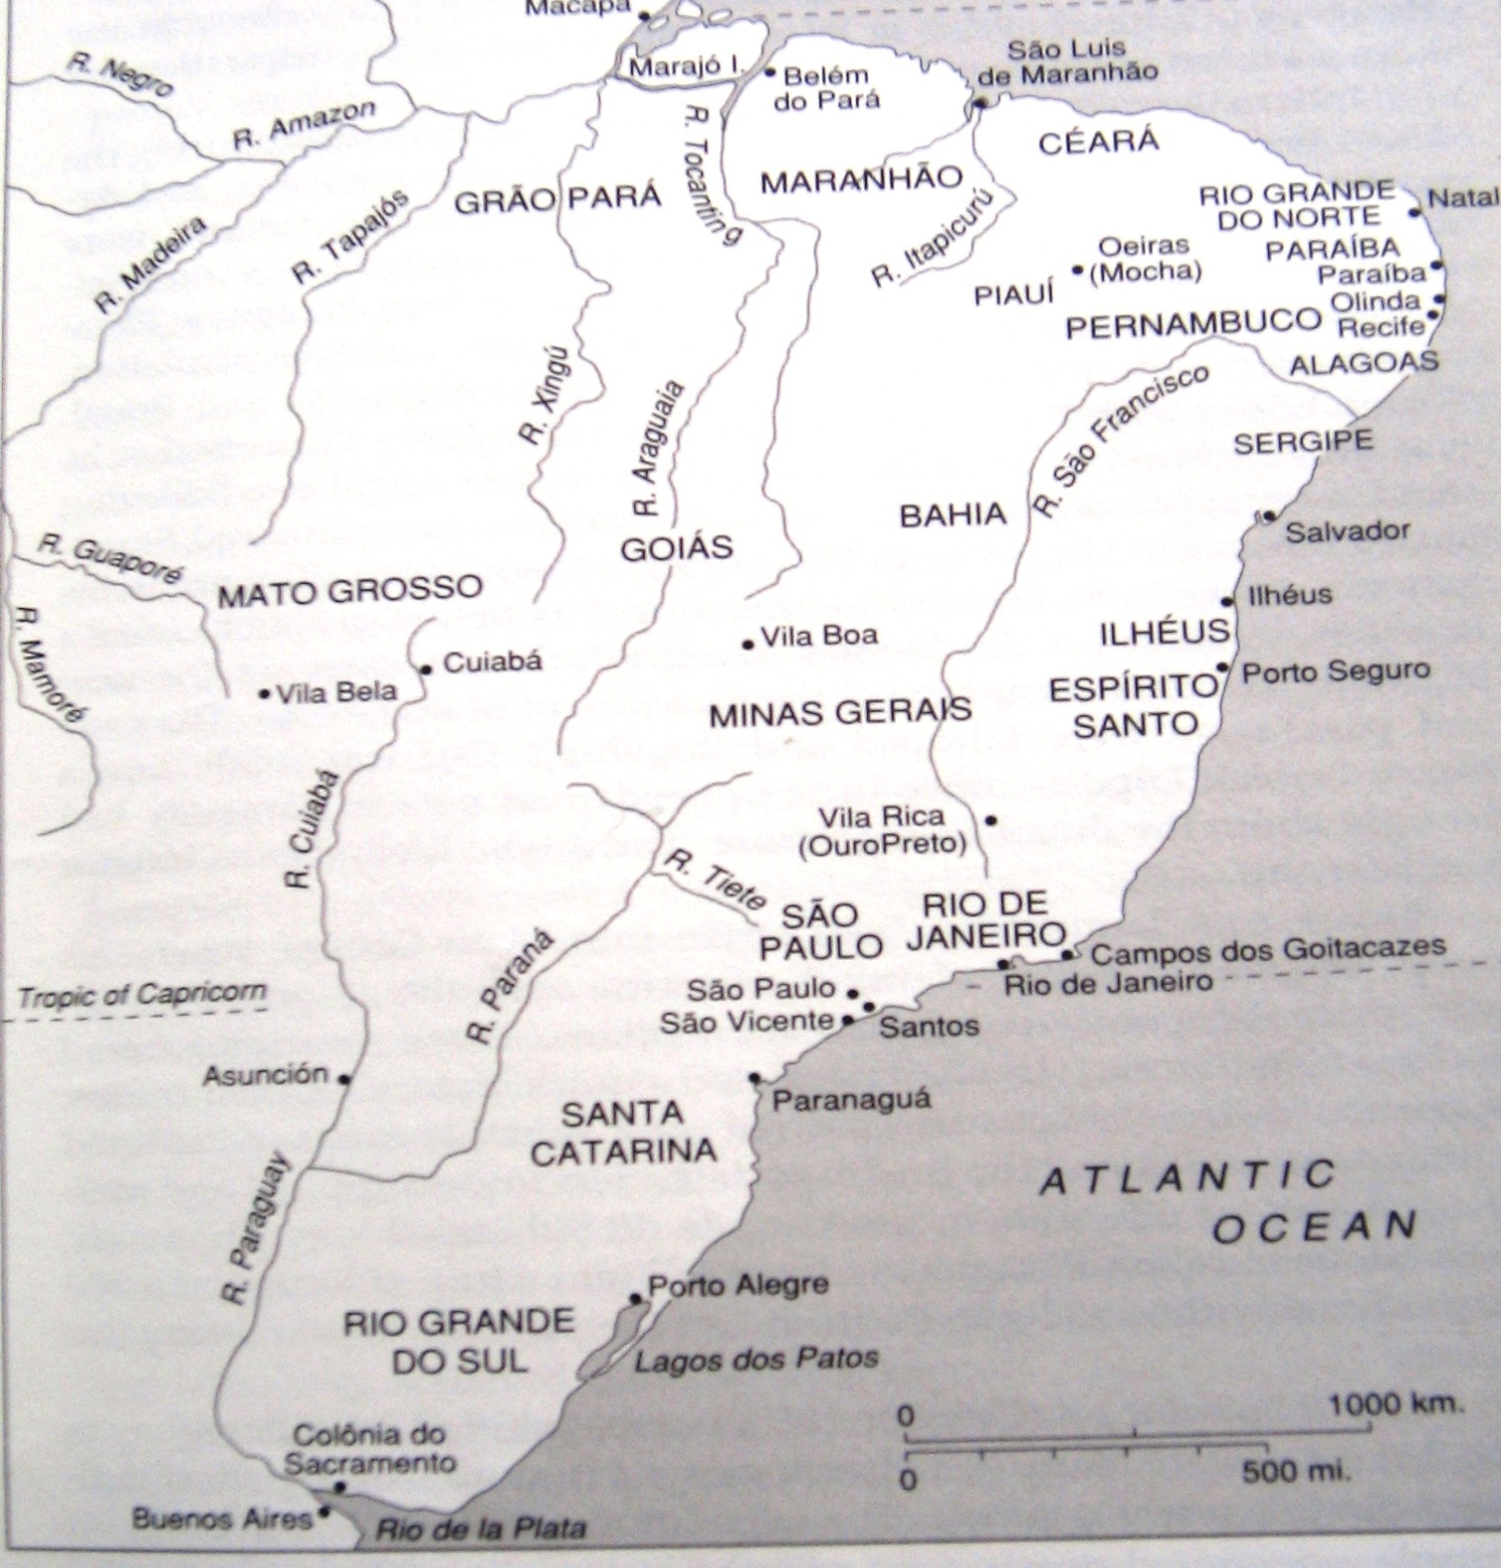
Notes:
“Colonial Brazil,” from Bethell, Empire & Republic

Slide 16
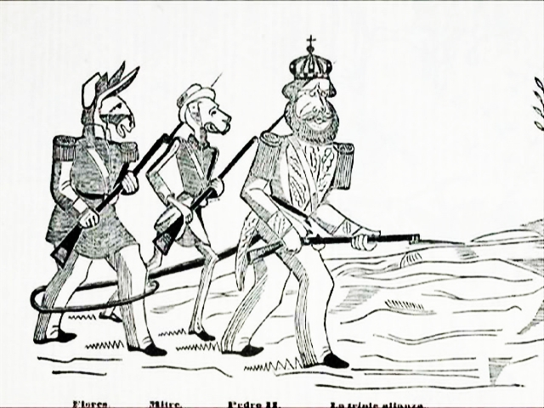
Notes:
Paraguayan cartoon showing the three main allies in the triple alliance, pedro II as “el macacon”

Slide 17
Consequences of Paraguayan War
Major casualties, exhaustion/ frustration
Brazil back in debt to Britain
Slavery undermined
Emperor loses credibility
Provokes political crisis in Brazil
Split of Liberals to form Republican Party, 1871

