Slide 1
Week 8: Abolition of Slavery and Post-Emancipation Realities

Slide 2
Effects of Paraguayan War (arguably…)
Major casualties, national exhaustion and frustration
Brazil back in debt to Britain
Slavery shown to be unviable (?)
Emperor loses credibility (?)
Provokes political rupture in Brazil (?)
Split of Liberals to form Republican Party, 1871

Slide 3
Intersecting factors in late C19 Brazil
War in Paraguay
Gradual emancipation, and eventual abolition of slavery
Breakdown of old political consensus
New ideas about both race and politics (positivism; republicanism)
Demographic/ social changes (urbanisation; immigration)
Downfall of monarchy

Slide 4
Context: Brazilian slave society up to 1850
Most deeply-rooted slave society in Americas
Sugar (C17) then mining (C18); then coffee (C19)
But also slaves employed in wide variety of urban and other occupations
At same time, high numbers of FREE PEOPLE OF COLOUR
Racial mixing; manumission (does not mean not “racist” society; but different from e.g. US)
Slaveholding is fairly accessible; many Brazilians own e.g. 1-2 slaves (including former slaves and free people of colour)
Close economic & cultural connections to Africa

Slide 5
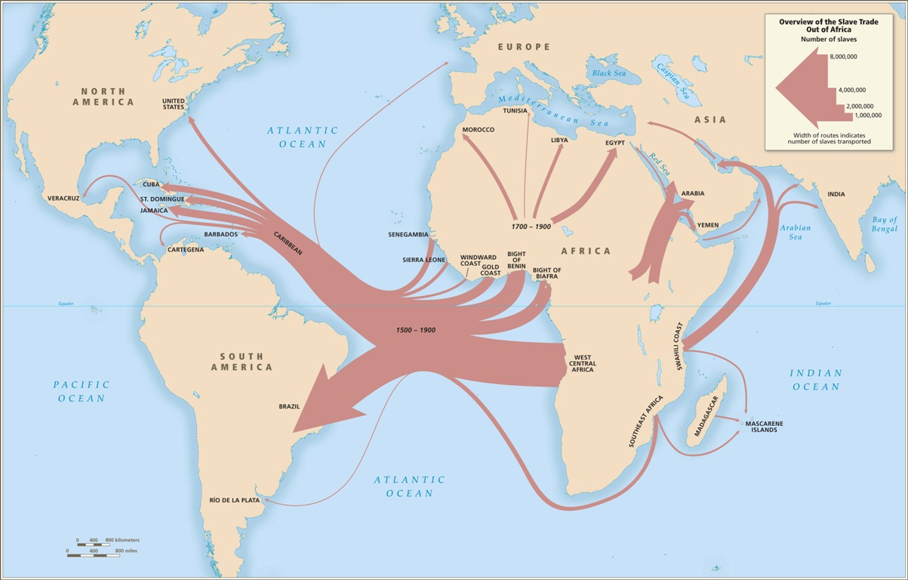

Slide 6
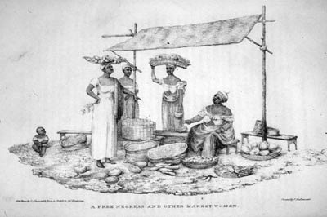
“A free negress and other market women” (Brazil 1821)
James Henderson, A History of the Brazil. . . (London, 1821), facing p. 71.

Slide 7
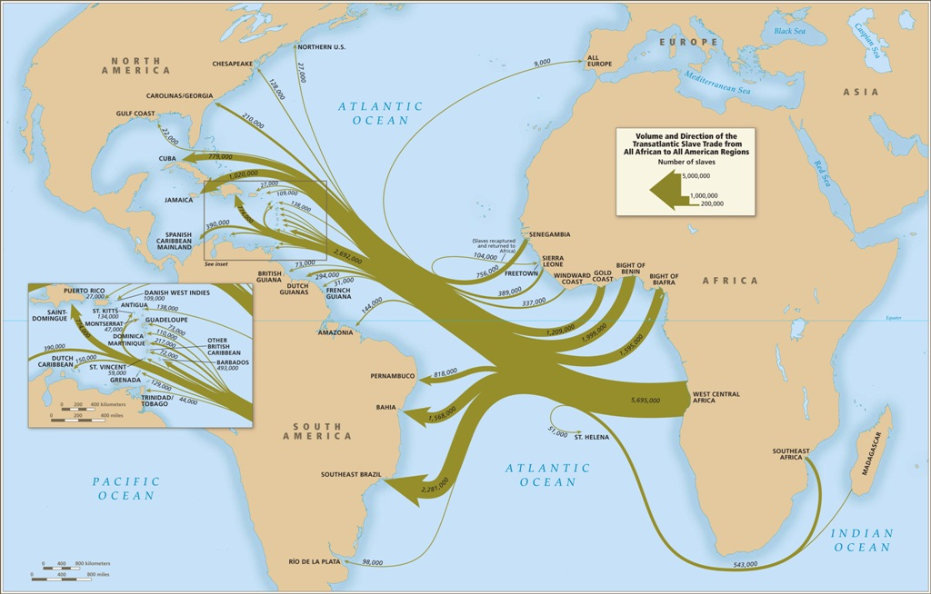

Slide 8
Slave society after 1850
Closing of Atlantic trade in 1850
Slave prices x 3 between 1855-1875: from one conto de reis to 2.5 or 3 contos de reis; slaveholding becomes more concentrated (although still widespread) (see Zephyr Frank, Dutra’s World - in the library)
Gradual decline of North-East; slaves sold SOUTH in major internal trade
Provinces end up with different degrees of investment in institution of slavery (Ceará in Northeast abolishes on 25 March 1884)

Slide 9
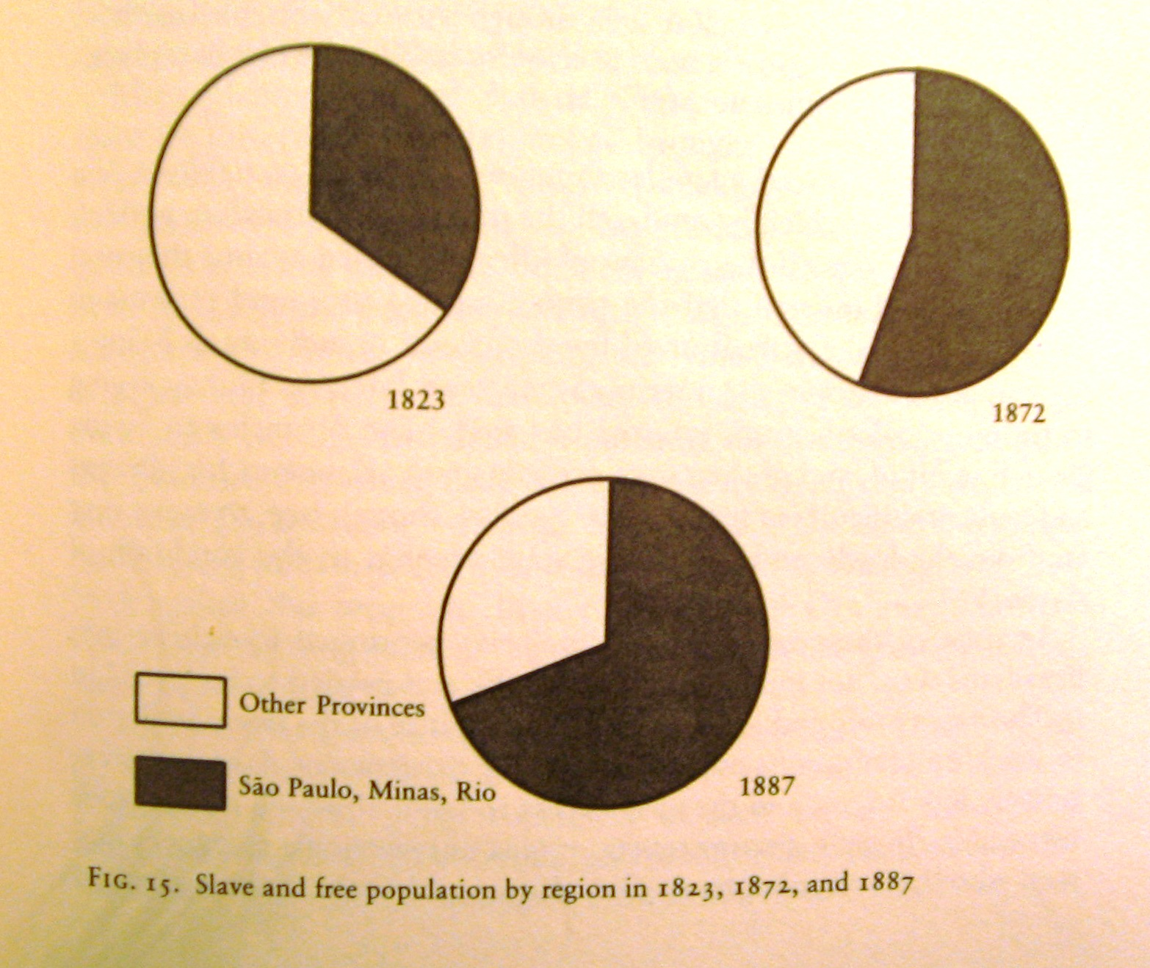
Notes:
From Viotti, Empire.

Slide 10
Arguments for the abolition of slavery
Abolitionist arguments since start of C19
Contradiction between liberalism and slavery
Economic rationalist / modernity arguments (slavery backward/ unproductive/ not “modern”/ need for free labour/ immigration);
Less explicit racial rationale for slavery than Anglophone world; but, “scientific racism” develops from 1860s (quest for whitening)
Humanist arguments: cruelty of slavery; fundamental human equality; some religious rhetoric

Slide 11
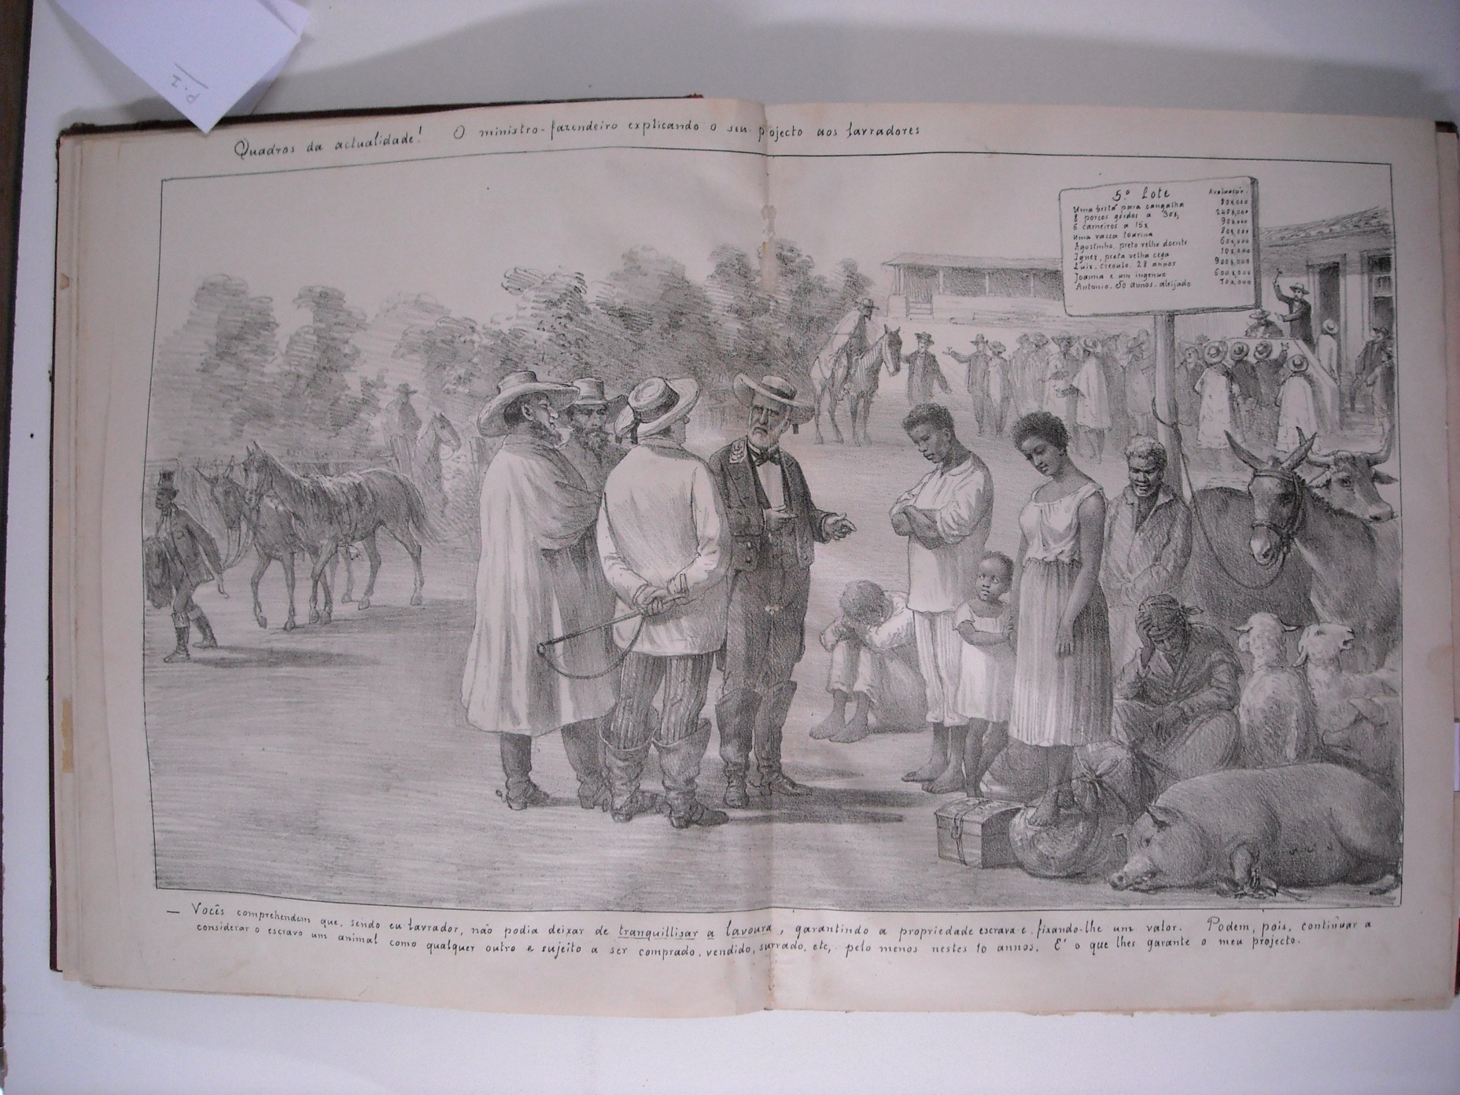

Slide 12
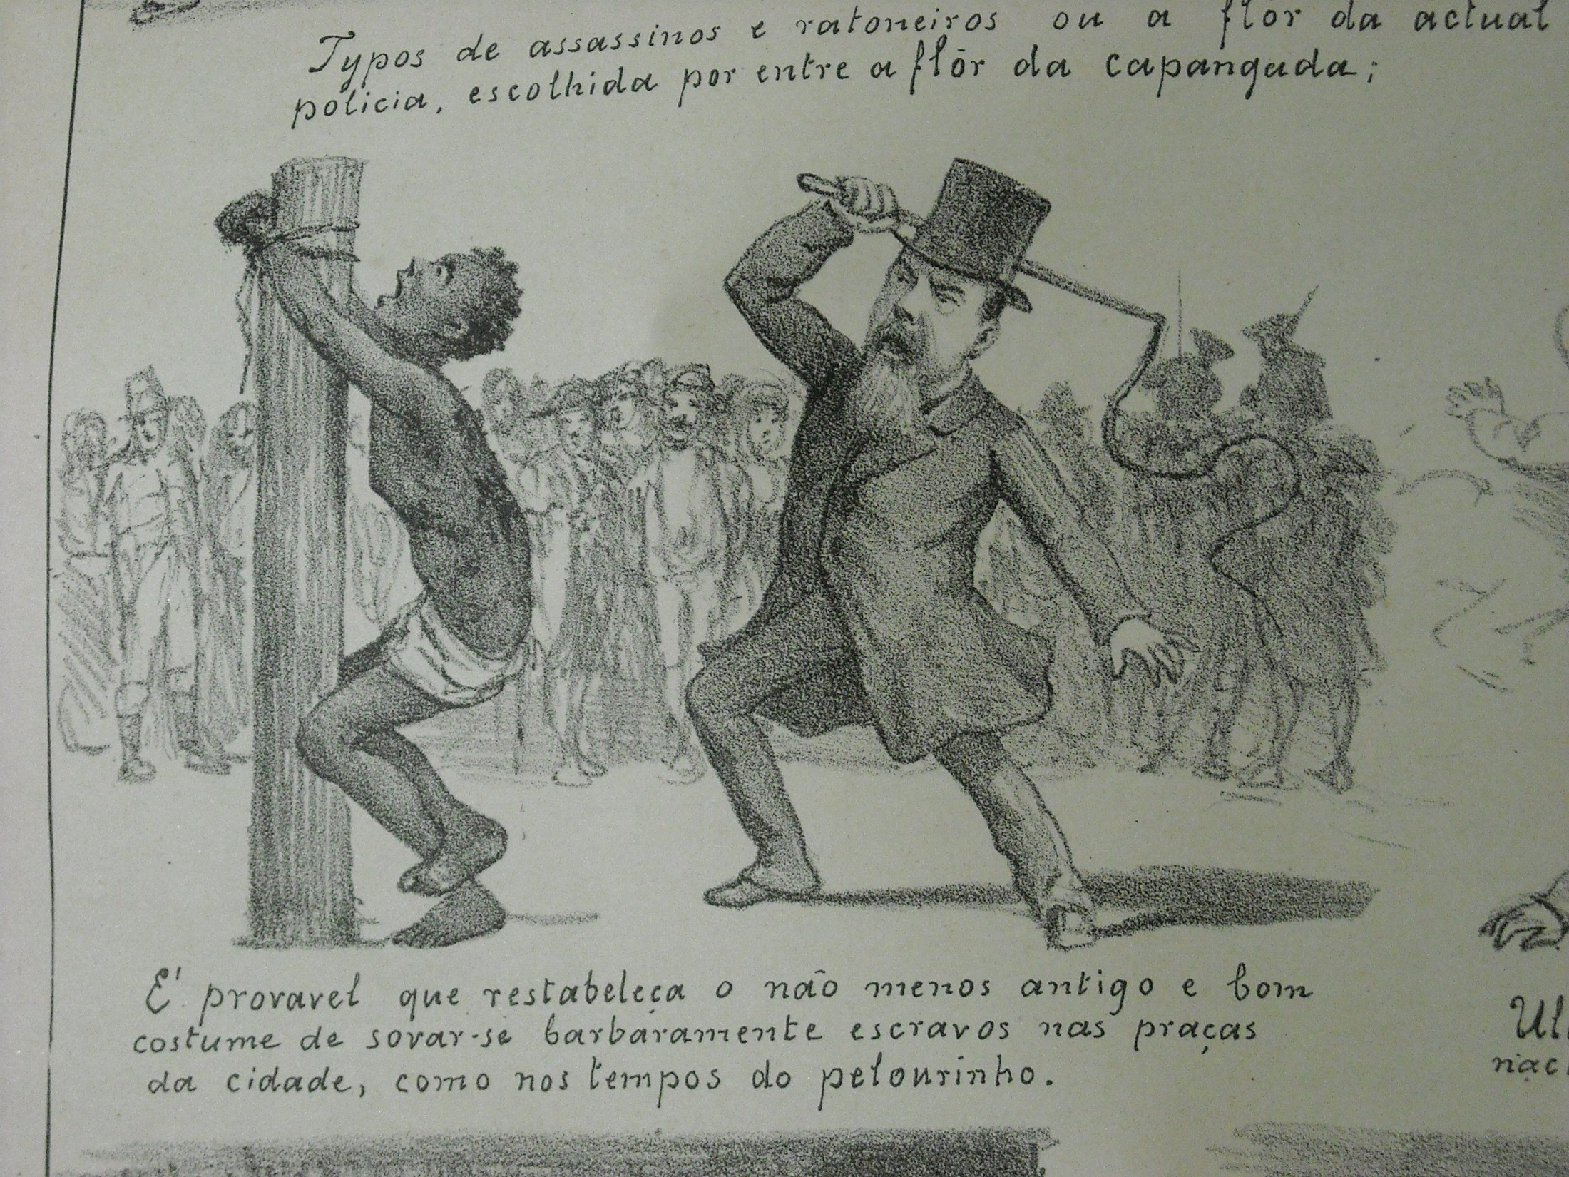

Slide 13
The legal path toward abolition
1871 “Free Womb Law” (Rio Branco Law) frees children born to enslaved women
1885 Saraiva-Cotegipe Law frees the elderly, facilitates self-purchase by slaves
1886 abolition of the whip
1887 mass flights by slaves from fazendas in Sao Paulo and other areas; army refuses to pursue them
13 May 1888 “Golden Law” abolishes slavery

Slide 14
Who abolished slavery?
Abolitionists? - Elite political figures e.g. Joaquim Nabuco?
Abolitionists? Non-white radical public figures e.g. Jose do Patrocinio, Andre Reboucas, Luiz Gama?
Broader popular abolition movement, including non-elite sectors, urban dwellers, women?
Imperial Family?
The enslaved themselves? (mass flight; rebellion; manumission through legal struggles)

Slide 15
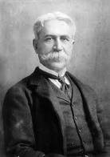
Notes:
Joaquim Nabuco

Slide 16
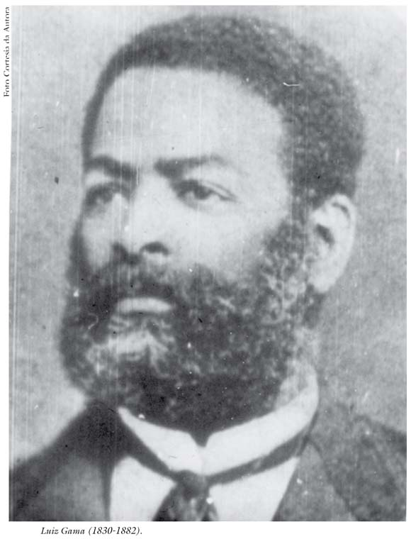
Notes:
Luiz Gama

Slide 17
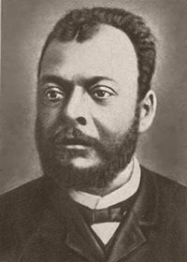
Notes:
Jose do Patrocinio

Slide 18
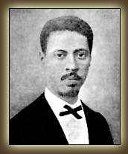
Notes:
Andre Reboucas

Slide 19
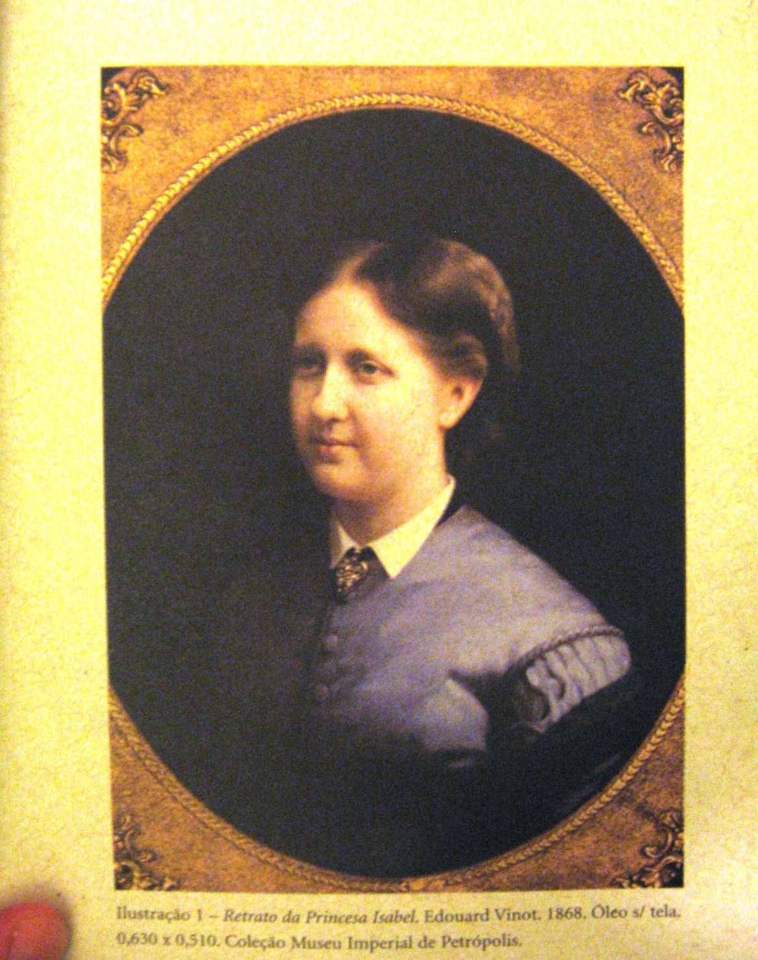
Notes:
Princess Isabel. From Daibert Junior’s book.

Slide 20
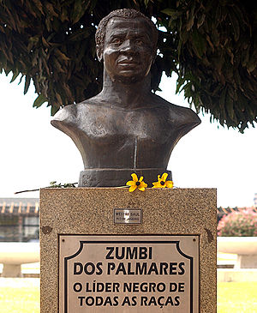
Zumbi, last leader of quilombo of Palmares

Slide 21
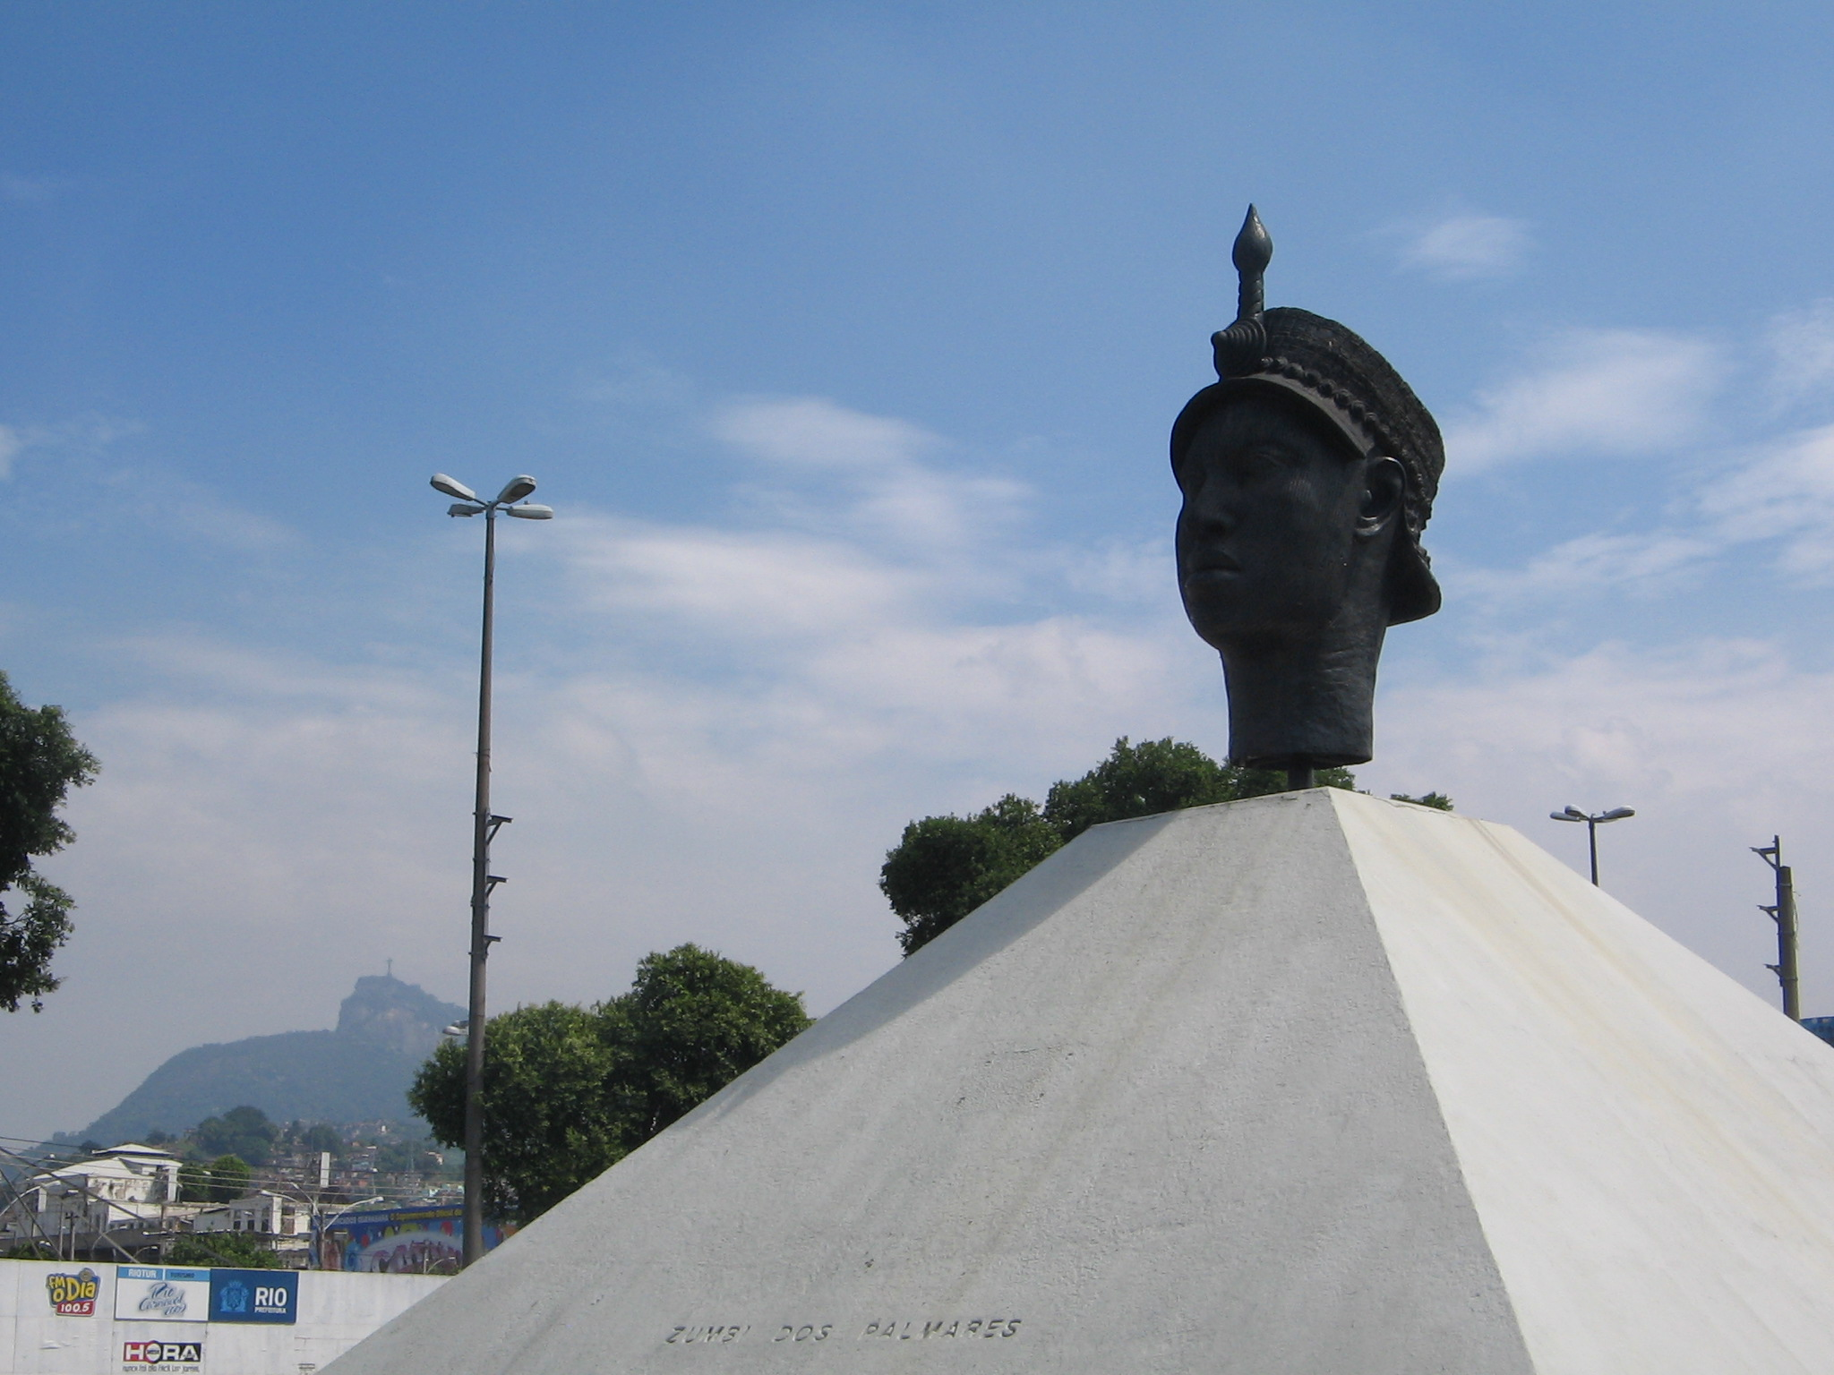
Notes:
Zumbi monument Rio

Slide 22
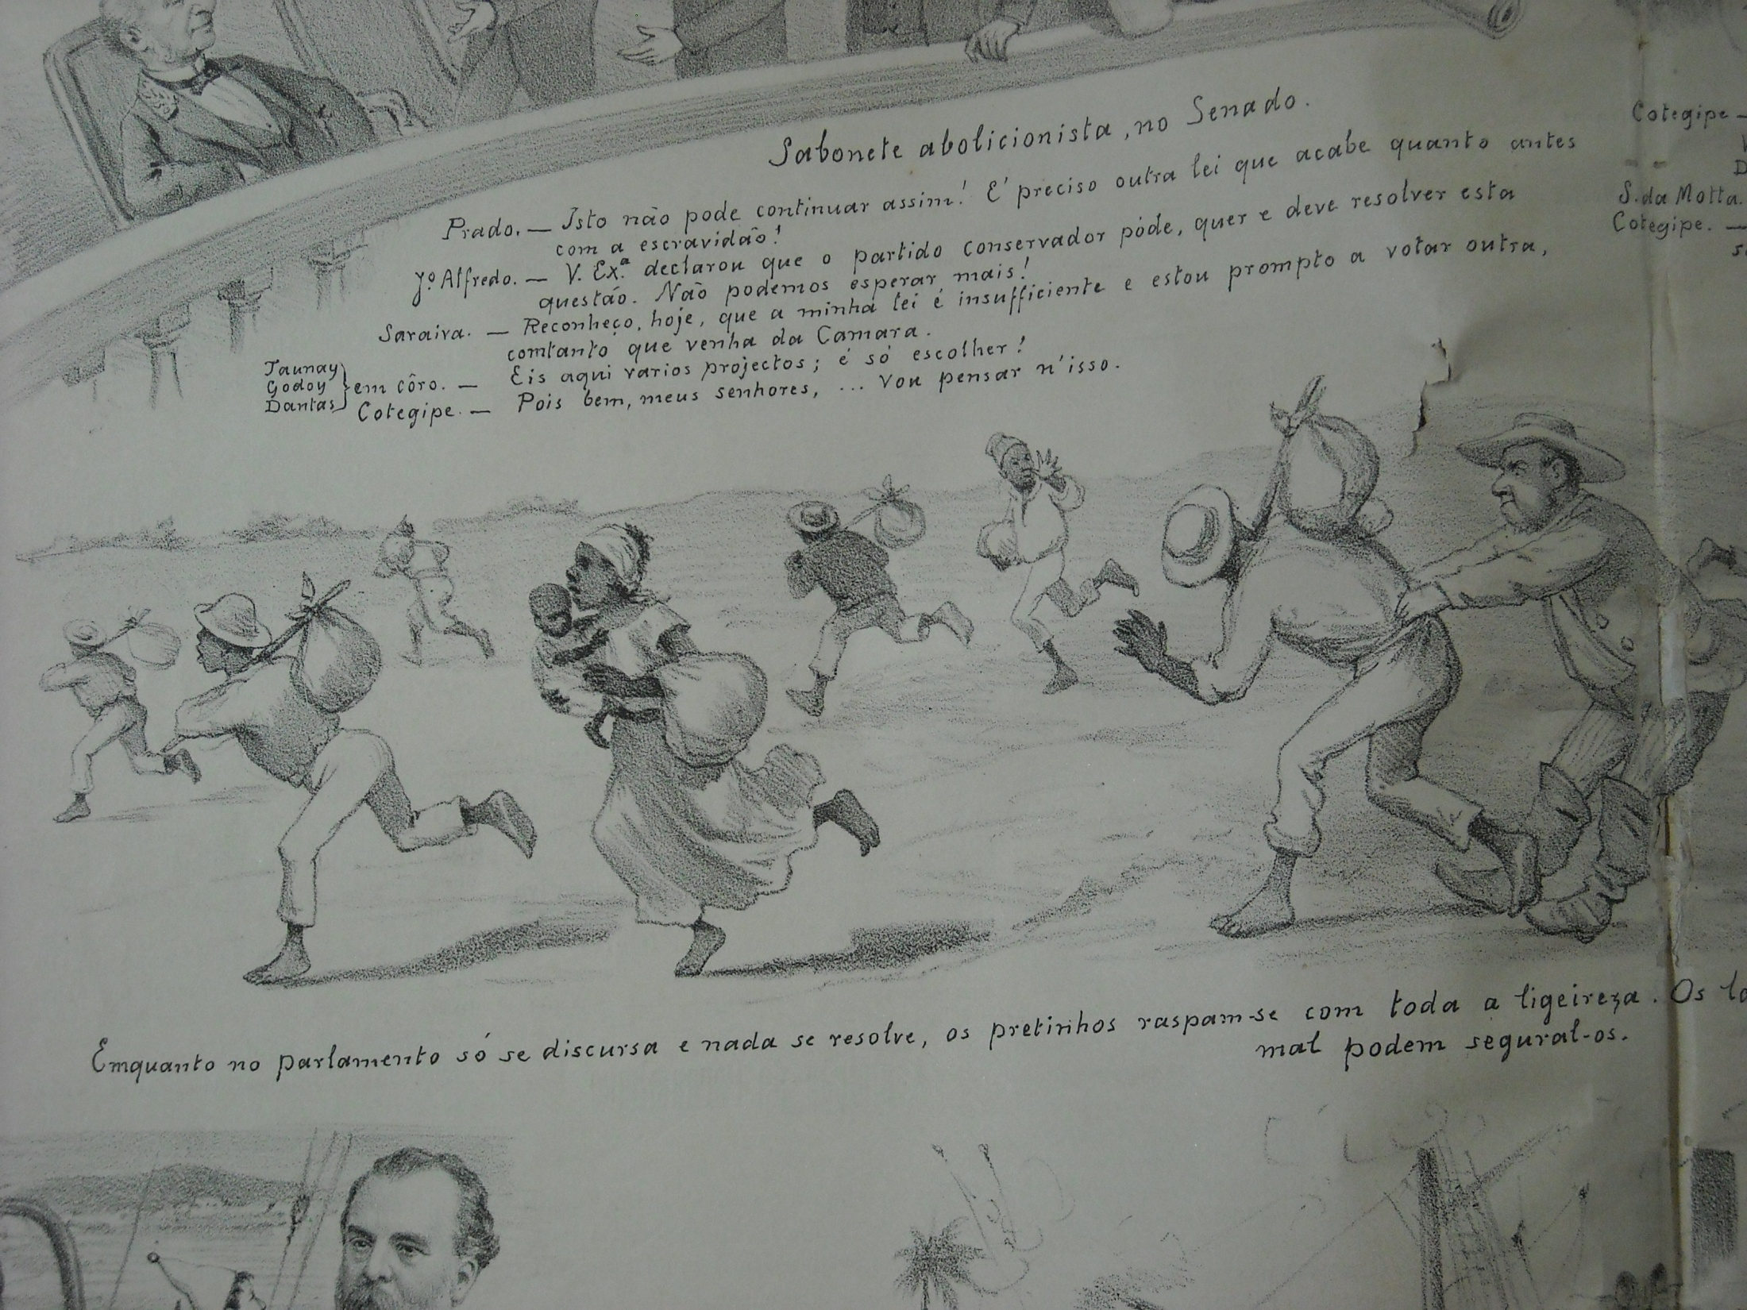

Slide 23
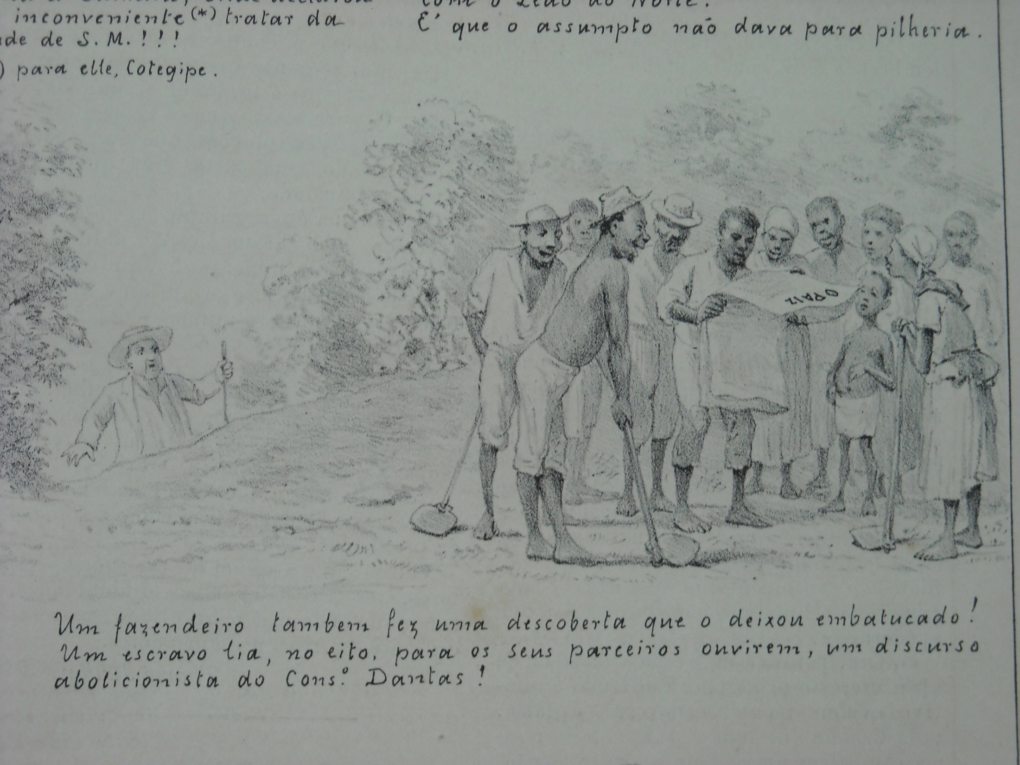

Slide 24
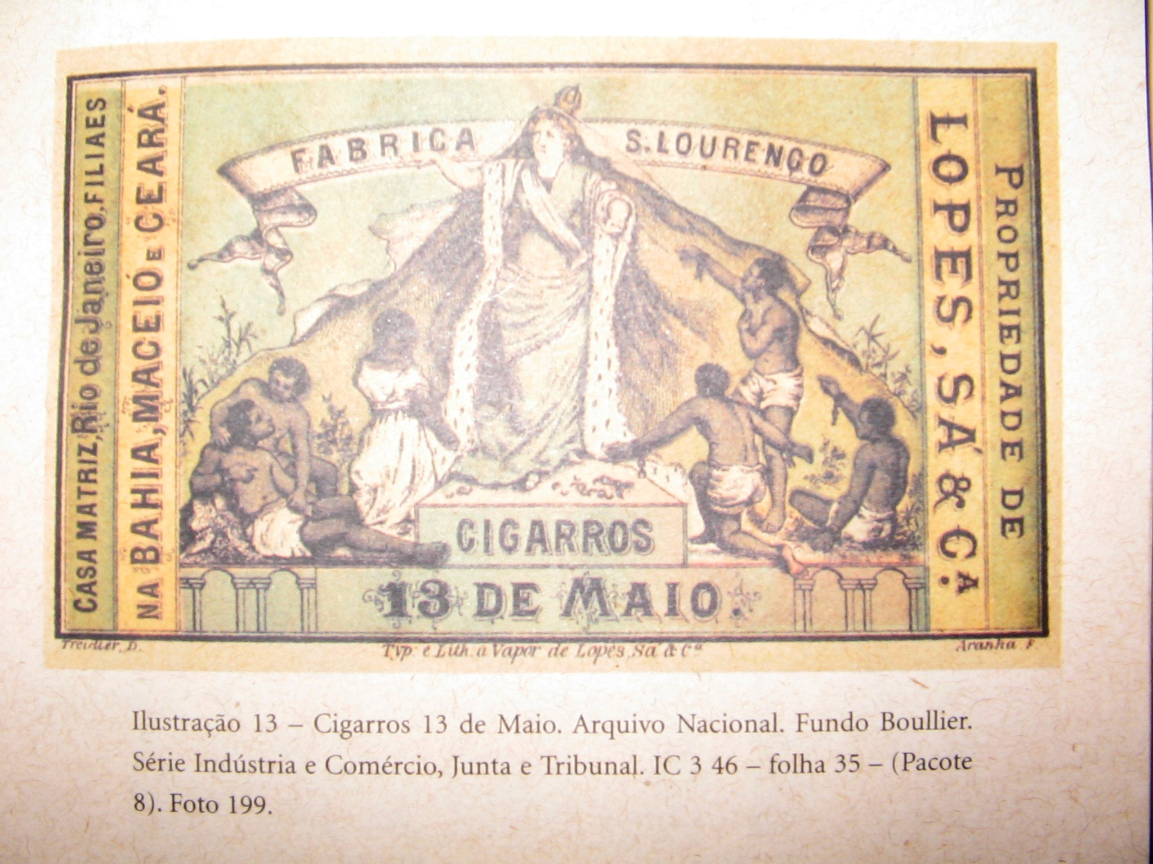
Notes:
Commemorative box of cigars for abolition with Isabel as “Redeemer” of slaves

Slide 25
Consequences of abolition
Despite celebrations, no SOCIAL REFORM – former slaves denied access to land or education; elite political dominance continues, franchise much SMALLER after 1881 Reform Act
Decline of older coffee regions (Rio de Janeiro), some regional elites feel betrayed, elsewhere coffee economy thrives (S Paulo)
Paves way for mass immigration schemes: Italians, Portuguese, Spaniards...

Slide 26
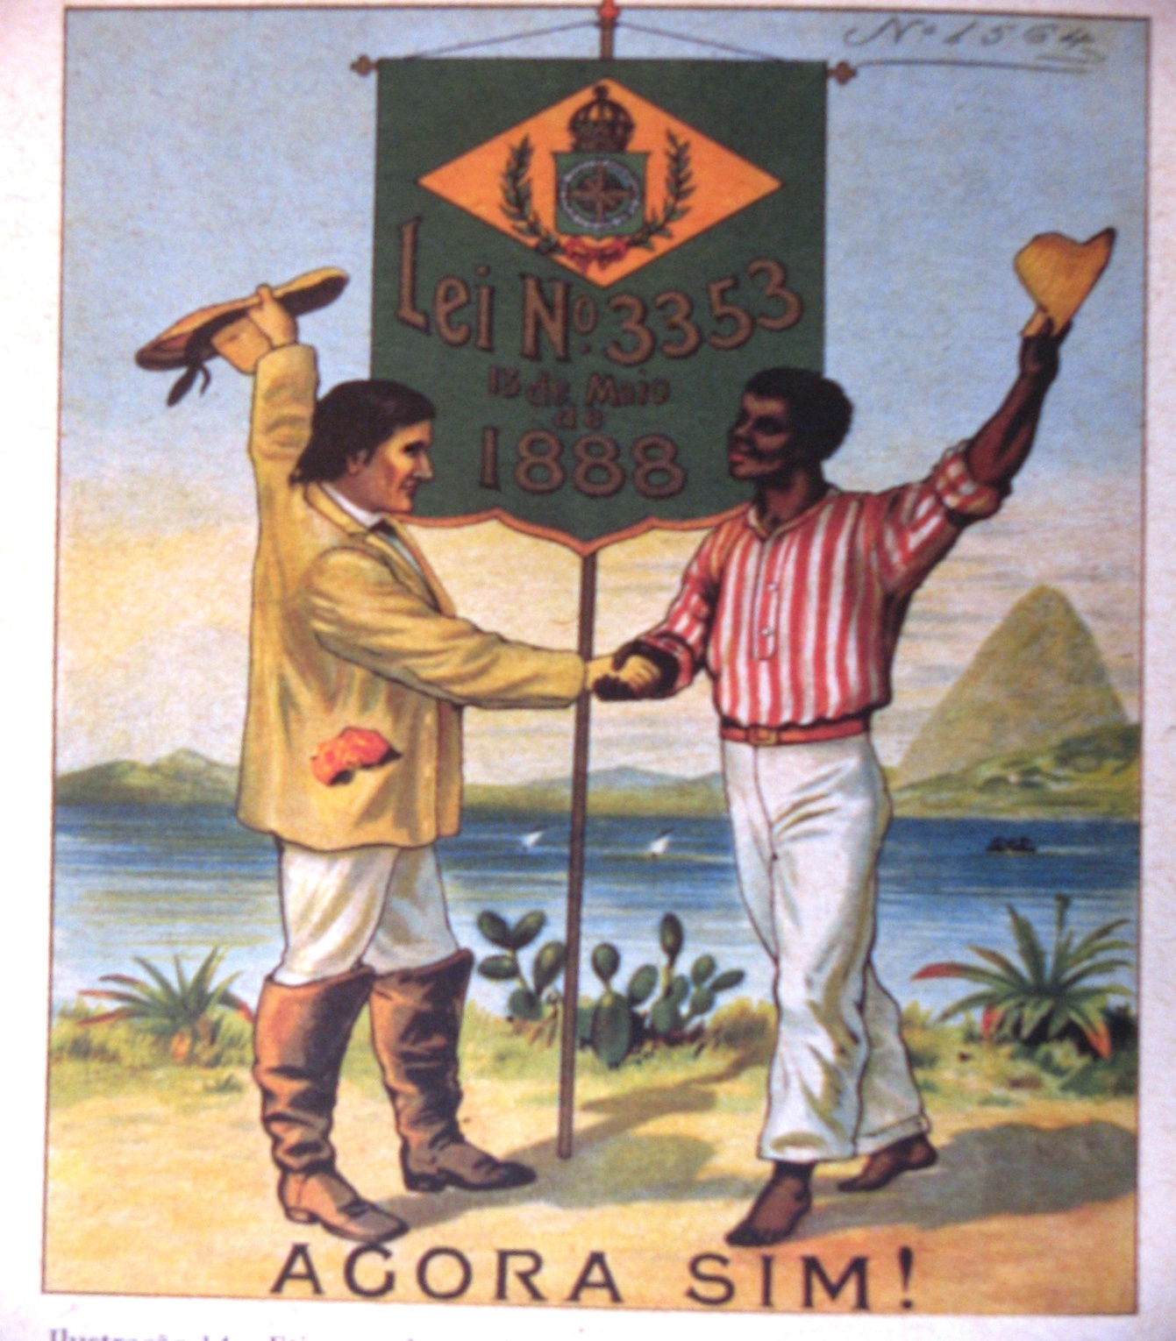
Notes:
Etiqueta de tecido, commemoration of abolition, from Daibert Junior’s book

