Slide 1

Week 10:
The Advent of the Republic
Notes:
[from wikipedia] Brazil's current flag was inspired by the flag of the former Empire of Brazil (see above).
On the modern republican flag, the green background represents the forest, the yellow rhombus stands for mineral wealth, and the blue circle, which replaced the coat of arms of the original flag, depicts the sky over Rio de Janeiro on the morning of November 15, 1889, the day the Republic of Brazil was declared. It is shown as seen from outside of the celestial sphere (i.e. the view is mirrored).
The stars, whose position in the flag reflect the sky above Rio de Janeiro on November 15, 1889, represent the union's member-states - each star representing a specific state. The number of stars changes with the creation of new states and, since the early days of the republic, has risen from an original 21 stars to the current 27, standing for the 26 states and the Brazilian Federal District. The star that represents the Federal District is Sigma Octantis, a star whose position near the south celestial pole makes it visible across almost the whole country, all year round. In addition, given its polar position, all the other stars depicted on the flag trace appear to rotate around Sigma Octantis. Choosing this star to represent Brazil's capital is therefore particularly apt (although it is a much fainter star than any of the others).
The motto Ordem e Progresso ("Order and Progress") is inspired by Auguste Comte's motto of positivism: L’amour pour principe et l’ordre pour base; le progrès pour but ("Love as a principle and order as the basis; progress as the goal"). It was inserted because several of the people involved in the military coup that deposed the monarchy and proclaimed Brazil a republic were followers of the ideas of Comte's thought.

Slide 2
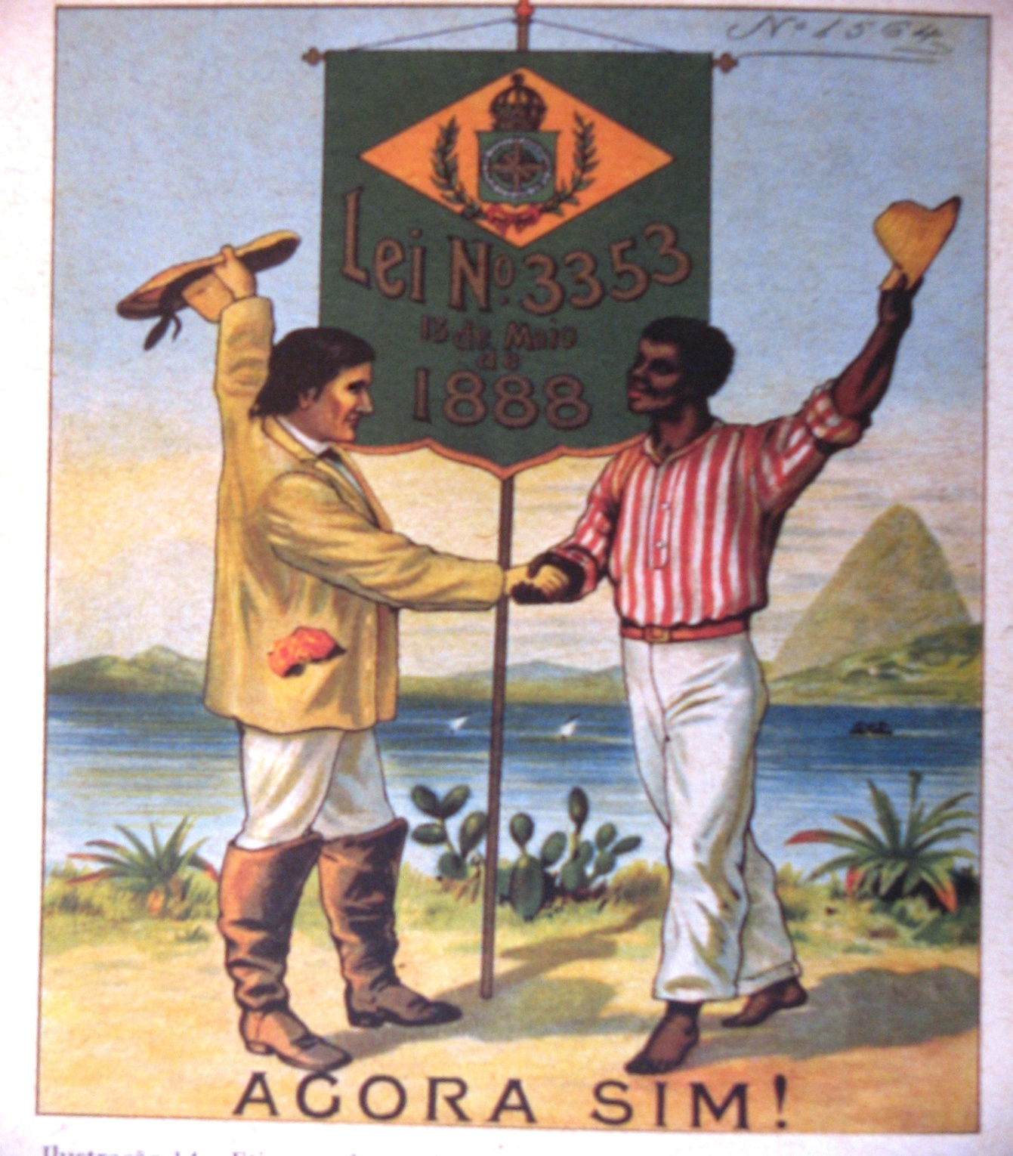
Notes:
Etiqueta de tecido, commemoration of abolition, from Daibert Junior’s book

Slide 3
Abolition in official and popular memory
Major celebrations; several days’ holiday; struggle of the enslaved for legal freedom over hundreds of years is realised
13 May celebrated by Afro-Brazilians for 100 years (later mainly replaced by 20 November, Zumbi’s day)
Elites successfully inscribe public memory of abolition with gratitude (notion of “freedoms given” by generous “Redeemer” Princess Isabel, beneficent owners, or “heroic” [white] abolitionists
See e.g. Marcus Wood, The Horrible Gift of Freedom (2010; in library)
From 1970s (e.g. Abdias do Nascimento): new focus on “freedoms won”: see e.g. Kim Butler, Freedoms Given, Freedoms Won: Afro-Brazilians in Post-Abolition Sao Paulo and Salvador (1998 – in library)
On these issues see “Funding Freedom,” Castilho and Cowling 2010.

Slide 4
Racial conceptualisations of Brazil’s future
Notions of “redemption” among abolitionists: if slavery abolished, all the ills of the past will be healed
Some calls for broader social reform (e.g. by mulatto engineer and abolitionist, André Rebouças) but not heeded
Many abolitionists are also racists (anti-slavery but also anti-slave)
Whiteness is equated with social and economic progress; “whitening” remains the aim until the 1930s; embarrassment/ confusion about how to deal with Brazil’s history of race mixture.

Slide 5
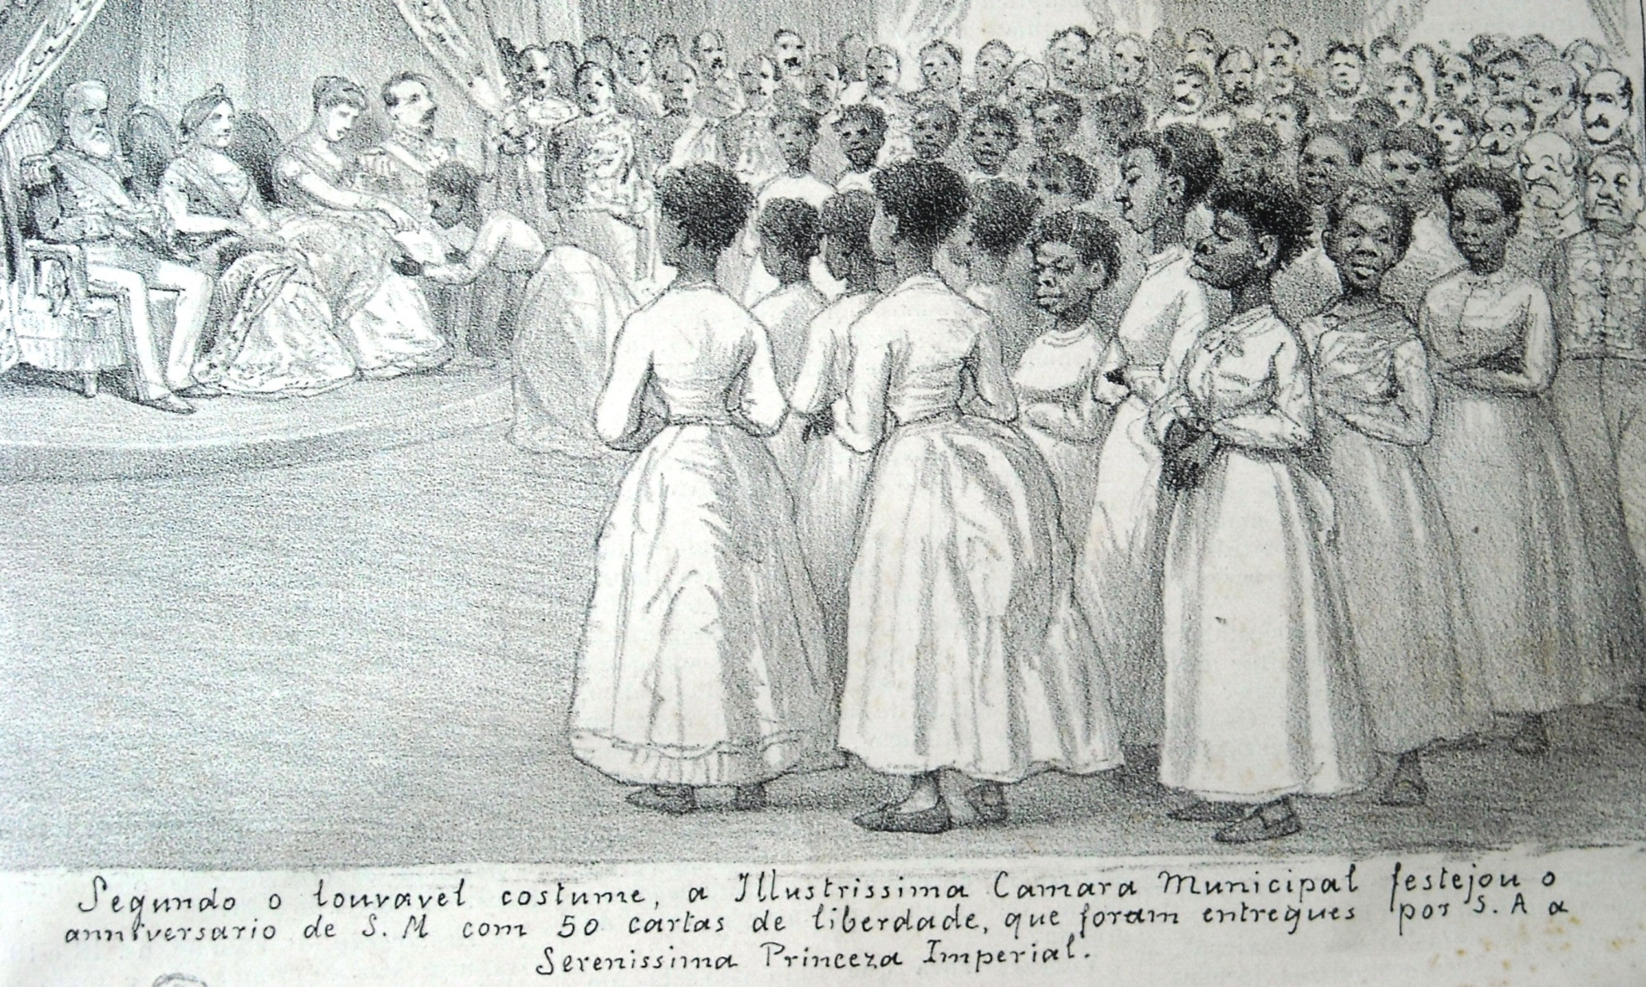
Emancipation ceremony held through “Livro de Ouro” municipal emancipation fund, 2 December 1886.
A Revista Illustrada, 8 dezembro (no. 444): p. 8

Slide 6
Liberal Silvio Romero, writing in 1880:
“...future victory in the life struggle among us will belong to the white. ... the white type will continue to predominate by natural selection until it emerges pure and beautiful as in the old world… when it has totally acclimatized on this continent. Two factors will contribute to this process: on the one hand the abolition of the slave trade and the continuous disappearance of the Indians, and on the other hand European immigration!”
[quoted in Skidmore, Black into White, 36-7]

Slide 7
Useful reading about positivism
Todd Diacon, Stringing Together a Nation: Candido Mariano da Silva Rondon and the Construction of Modern Brazil, 1906-1930 (Duke University Press, 2004) Introduction & chapter 4 (library scans page)

Slide 8
Aftermath of abolition
No land or education for former slaves
Decline of older coffee regions (Rio de Janeiro)
Popularity of monarchy among many popular sectors, but some regional elites feel betrayed
elsewhere coffee economy thrives (S Paulo especially)
Paves way for mass immigration schemes…
194,000 immigrants arrive in the 1870s, 454,000 in the 1880s.
Sao Paulo’s population is 1.4 M by 1890, 4.6M by 1920, mainly due to immigration.
Economic recession between 1885 and 1888, but recovery and growth again by 1889

Slide 9
Electoral reform, 1881
1878 Liberals return to power after 10 years in opposition
They propose electoral reform: direct elections to eliminate the distinction between voters and electors
Aim is partly to remove rural “barons” from power; replace corporate patriarchal household voting with urban independent votes
BUT: they also aim to exclude the poorest and former slaves
propose a literacy requirement…

Slide 10
Ideas about voting and literacy
“…a notion, then widespread among Brazilian elites, that literacy was a skill needed for the exercise of civil rights and in order to participate in political life… Similarly, the perfecting of the electoral system allegedly depended on the enlightenment of voters, to be achieved through proper schooling.” Sidney Chalhoub, “The Politics of Silence: Race and Citizenship in Nineteenth-Century Brazil.”
“…literacy clearly separated the few who conducted elections from the many who merely voted” Richard Graham, Patronage & Politics, 115-6

Slide 11
Results of Electoral Reform law (passed 9 January, 1881)
During the Empire: about 50% of all free males are on the electoral register
23.43% of free men, 13.43% of free women, and of 15.75% of overall population were literate in 1872
The law reduced the number of voters from over a million to 150,000
Former slaves were illiterate and excluded by property qualification
Franchise fell from 10% of the total population (1872) to less than 1% (1886)
Pre-1881 levels of voting not seen again until the 1940s
Meanwhile: little was done to EDUCATE the poor and particularly former slaves
Influence of patronage and of rural barons continued

Slide 12
From Empire to Republic
Military dissatisfaction: budget of whole empire increases by 70%in 1870s, but military budget only by 7%
Growing rifts between military and civilian politicians; influence of Rio’s Military Club; army refuses to pursue runaway slaves in 1888
Dissatisfaction of new urban groups. In 1830s, law schools produce only 710 graduates; in 1880s they produce 1,966. They want JOBS and POLITICAL REPRESENTATION
Aging Emperor; successor is female and Catholic
Growth of Republican Party (although still very small) and republican sentiment; strong federalism

Slide 13
The fall of the monarchy
Military coup, 15 November 1889, led by Marshall Deodoro da Fonseca; Imperial Family exiled to France
Coffee planters in Sao Paulo are first to assume leadership; other landowners do nothing (some don’t care; others oppose D. Pedro due to abolition of slavery)
Most Brazilians don’t know it has happened
One of the first measures is to double the size of the military

Slide 14
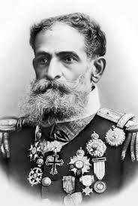
Marshall Deodoro da Fonseca

Slide 15
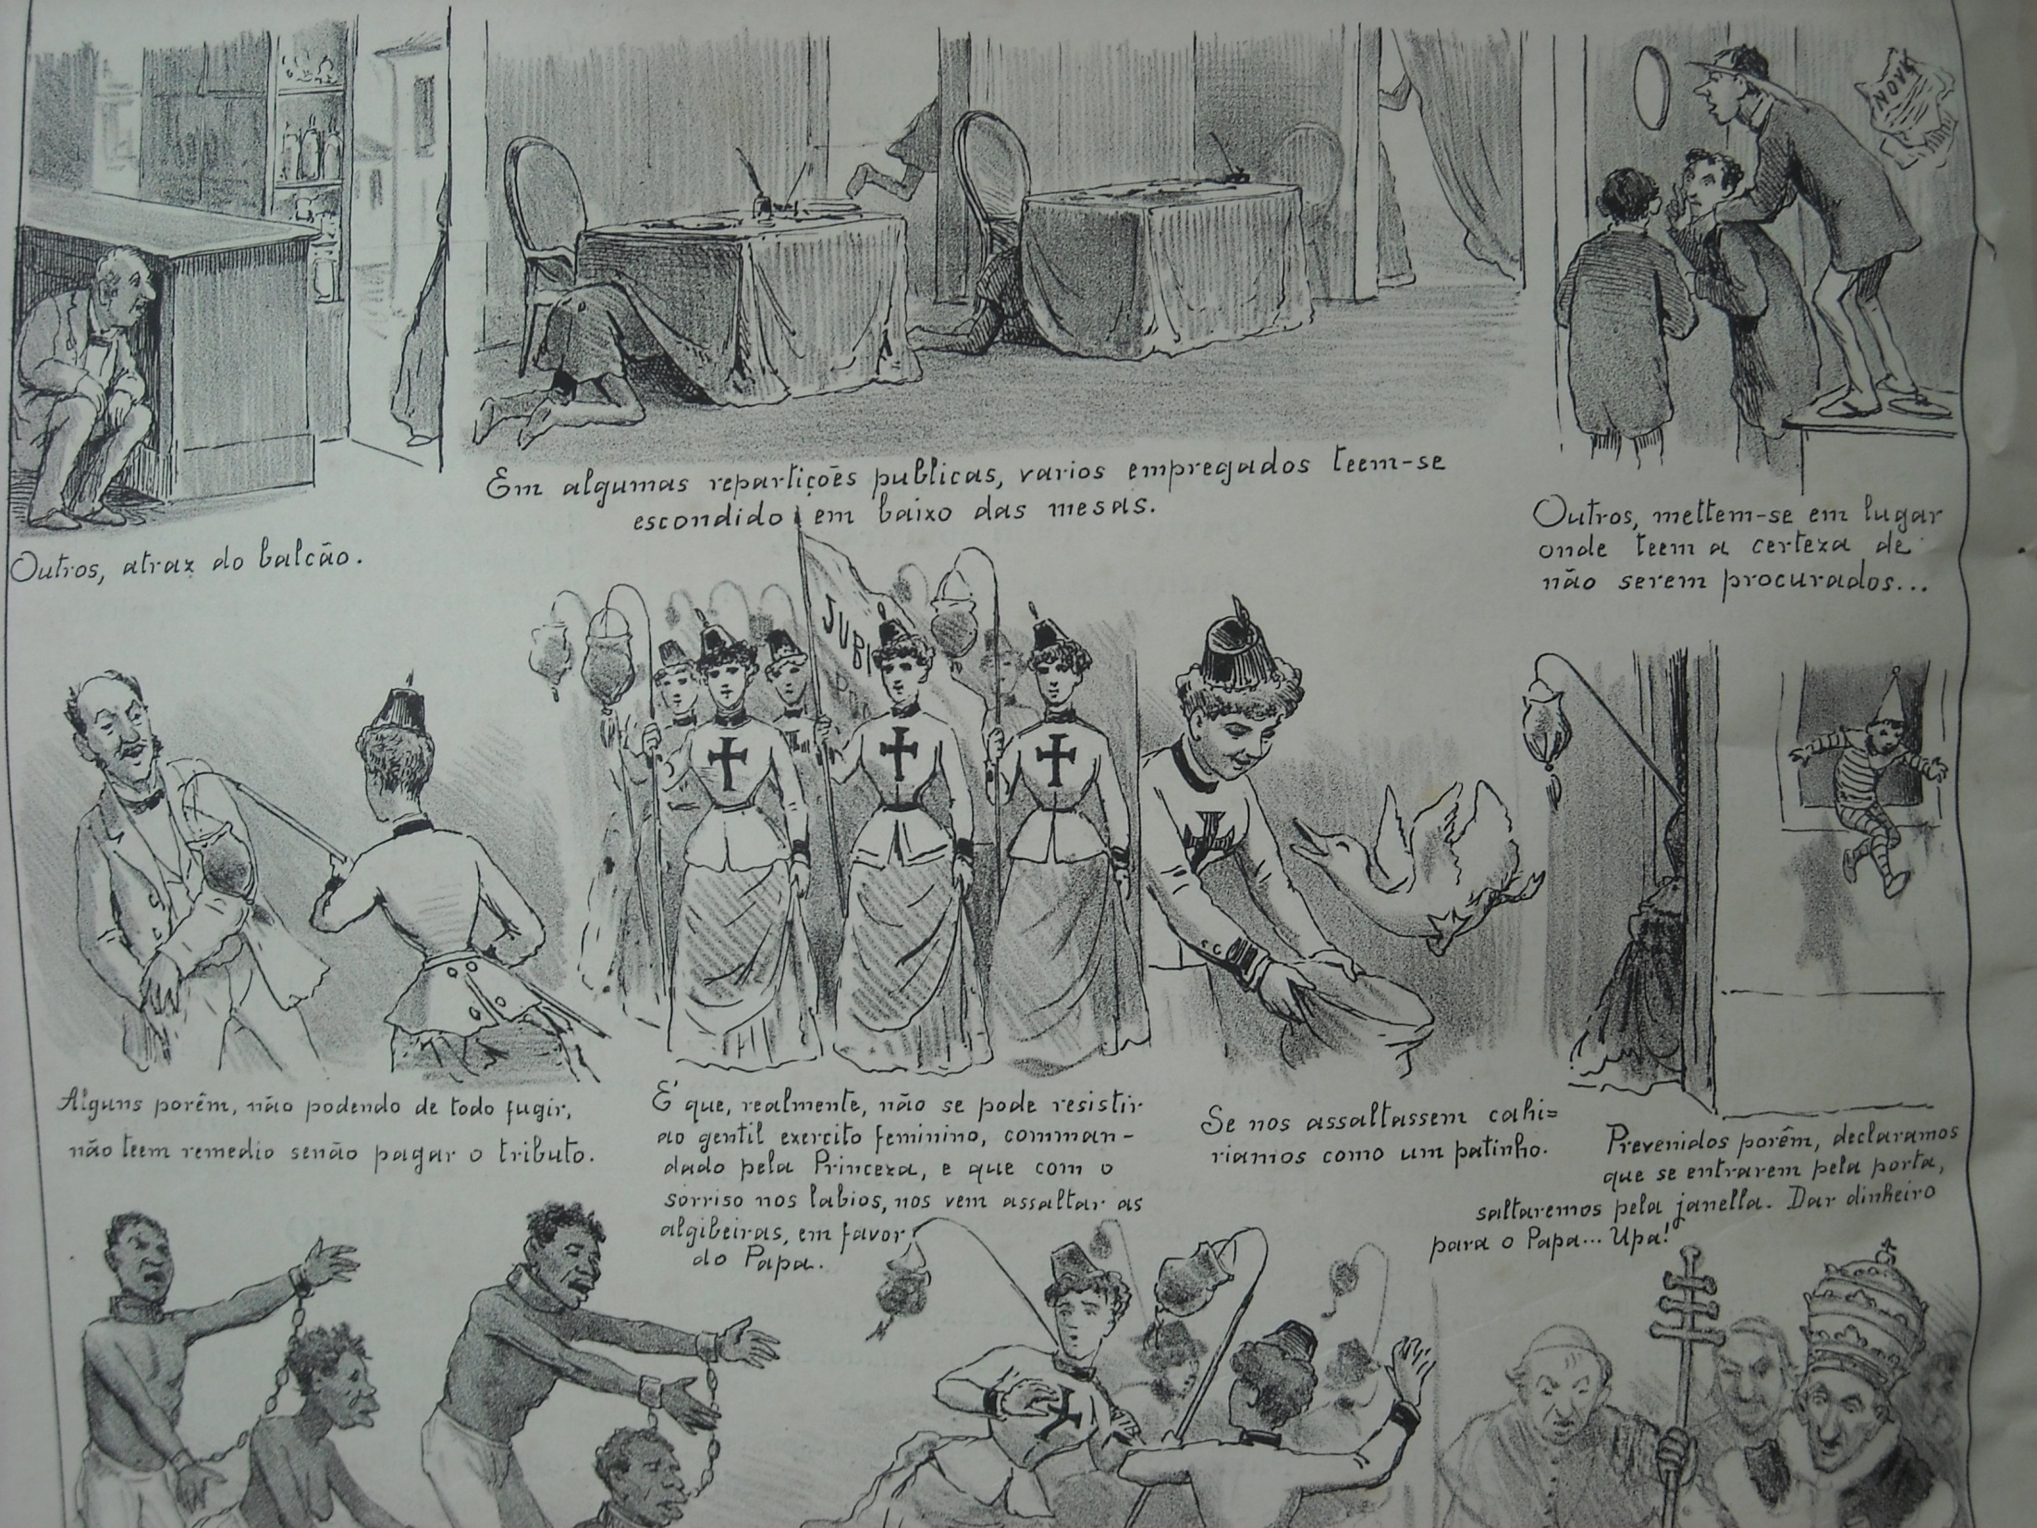

Slide 16
Revolts against the Republic: Canudos
Was the Republic disliked or supported by ordinary people?? Jose Murilo de Carvalho / Maria Tereza Chaves de Mello
Canudos War: millenarian, monarchist religious community in Bahian sertão led by clergyman Antônio Conselheiro
Bloody war against local then national troops,; all male inhabitants killed
Euclides da Cunha Os Sertões (Rebellion in the Backlands) 1902
Struggle between civilization and barbarism and between backwardness/ racial “progress”

