Slide 1
Introduction to Impact
Classics
Wednesday 31 January 2024

Slide 2
What is ‘Impact’?
Research Excellence Framework (REF) Definition:
“An effect on, change or benefit to
the economy, society, culture, public policy or services, health, the environment or quality of life, beyond academia.”

Slide 3

The essential ingredients for impact:
Underpinning Research
+
Engagement with Non-Academics
+
Demonstrable Effect on Audience/Partners
(with Evidence)
=
IMPACT

Slide 4











Areas where researchers can have an impact:
 | production
practitioners and delivery of professional services, enhanced performance or ethical practice
 | environment
understanding, learning and participation

Slide 5






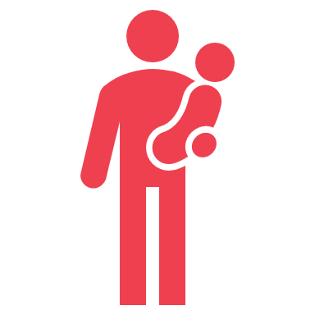






health and wellbeing of people, animal welfare
 | creativity, culture and society
social welfare
 | commerce and the economy
public policy, law and services

Slide 6
Impact and Engagement: Why Bother?
Benefits to you as an individual:
Develop new skills and raise academic profile
  Feed into your teaching
Career progression and research funding
  Promotional criteria
  Impact is increasingly important part of research funding applications, UKRI grant applications
Early and agile feedback
  Shape research enquiries and improve your methodologies
Personally rewarding!
Wider benefits:
Positive effect on society
Raise the public profile of subject disciplines
Impact is assessed by the REF
  Results important to the University for ££ (QR funding) and reputation (league tables)
Core mission of the University
  Tackle big problems

Slide 7

Engagement and Impact – what’s the difference?
Engagement
Impact
Examples of impact from research:
Changes in policy and practice
Changes in understanding and actions
New technologies or methodologies are sold and used
Changes in regulation or guidelines
Engagement:
Sharing ideas and knowledge with people and groups outside of academia
Two-way engagement
Co-creation and collaboration
Engagement with non-academic stakeholders as a way to create measurable change

Slide 8

Impact and the REF
REF assesses the quality of research in HEIs
  Determines the amount of quality-related research funding (QR funding) awarded by UKRI
Impact has been a REF requirement since 2014
Submitted in Units of Assessment – broadly aligned to departments and disciplines
Warwick was 15th in REF2021 and 7th in REF2014
  7th position equates to approximately £35m in QR each year for that 7-year REF period
Notes:
2014 results for Warwick
Overall, 7th position
With 87% research 3* or 4* ('world-leading' or 'internationally excellent‘)
Four of our departments were ranked as the top in the UK in terms of output
35-40million pounds of QR funding per year for that 7 year period

Slide 9

REF submission also comprises data on:
  Outputs
  Environment
Impact weighted at 25% of a submission in 2021 and 2029 (in 2021: 60% for Outputs and 15% for Environment)
  An increase from 20% in 2014
Impact case studies are financially lucrative:
  In REF2014, it was estimated a 4-star worth on average £46,311; a 3-star £10,704*
* Reed & Kerridge 2017, Fast Track Impact
Notes:
2014 results for Warwick
Overall, 7th position
With 87% research 3* or 4* ('world-leading' or 'internationally excellent‘)
Four of our departments were ranked as the top in the UK in terms of output

Slide 10

Impact submitted as Case Studies
Robust evidence to corroborate impact must be submitted with each case study
Impact assessed according to reach and significance and given a star rating (1* to 4*)

Slide 11
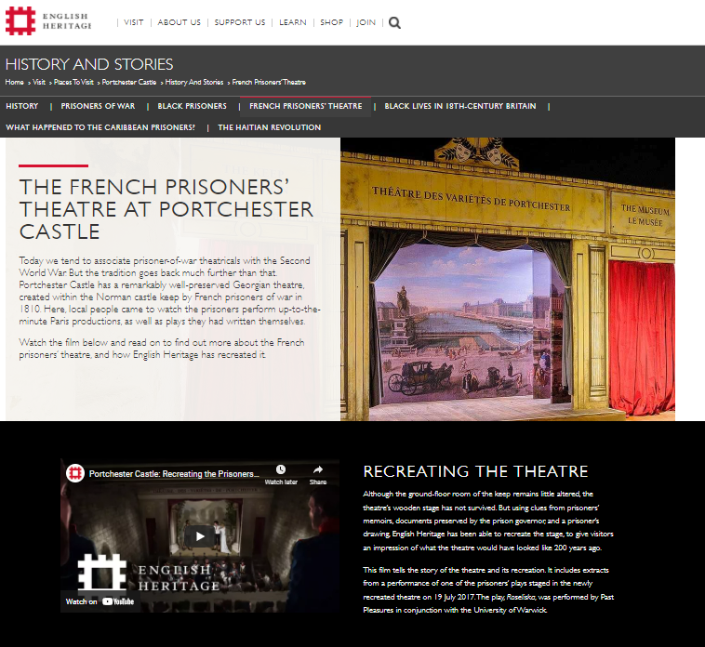
Potential audiences and/or partners:
Examples from Arts & Humanities
Museums and galleries
  consultation, staff training, co-curation, resources
Schools
  workshops, resources, training for teachers, enrichment
Interested public
  public lectures, exhibitions, events and performances
Digital media
  blogs, websites, Twitter, podcasts https://europeanconversionnarratives.wordpress.com
Artists and theatre companies
  consultation on costume, co-production
Heritage – local, national

Slide 12

Examples from Social Sciences
Policymakers
  Influencing Parliamentary debate, informing the development of new Government policies
Businesses
  influencing organisational practices; efficiencies and innovation
Charities
  informing campaigns or improving services
Local authorities
  informing service provision

Slide 13
Examples: Classics at Warwick

Slide 14

Alison Cooley: Inscriptions in the Ashmolean Museum
The research explored Latin Inscriptions held at the Ashmolean Museum, leading to the design of new gallery displays of the inscriptions, making them accessible to the public
Held events for museum professional and the public, including adults with learning disabilities
Education:
  Delivered sessions in schools
  Developed teacher training and resources
  Designed a session for the Education Team at the Ashmolean to use
Advised on a documentary
Evidence and Evaluation: testimonial letter, event and workshop feedback, evaluation reports
https://results2021.ref.ac.uk/impact/ec169aab-8ee1-4cc3-ad93-e577dbd888f2?page=1

Slide 15
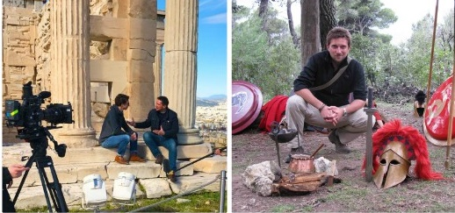
Michael Scott: Changing public perceptions of the Ancient Greek World
Research on lived experiences of Ancient Greek landscapes and spaces to understand Greek society
Television documentaries inform public understanding (reach: 5.5m+)
Influenced commissioning
Changed the way that TV and digital professionals represent antiquity
Evidence types: testimonial letters, viewing figures, public feedback and letters, press articles, teacher feedback
https://results2021.ref.ac.uk/impact/ad8a6062-5bc9-44f1-87e5-8379d600d772?page=1

Slide 16
Other Examples:
Creating Ancient Fragments: changing theatrical practice – Laura Swift- The Open University
Research deals with the methodology of working with fragmentary poetic texts
Collaborated with Potential Difference Theatre over 6 years, impacting their creative processes and leading to new ways of working and creative outputs
Explored how fragmentation relates to everyday human experience and how this can be represented artistically
https://results2021.ref.ac.uk/impact/3ed35200-00d7-4318-a01c-9155dddc41b1?page=1
Delivering transformational Relationships and Sex Education through creative methods: The Sex & History Method – Rebecca Langlands, Kate Fisher, Jen Grove and Jana Funke
Interdisciplinary research into sex and history led to the development of the Sex & History method for delivering sex education based on historical objects
Produced resources that have been widely used by teachers
Informed the development of curricula and requirements around RSE provision
Curated an exhibition at Royal Albert Museum
https://results2021.ref.ac.uk/impact/cf06105a-b2eb-4fbe-966e-7142e11ca09d?page=1

Slide 17
How can you generate impact from your research?

Slide 18
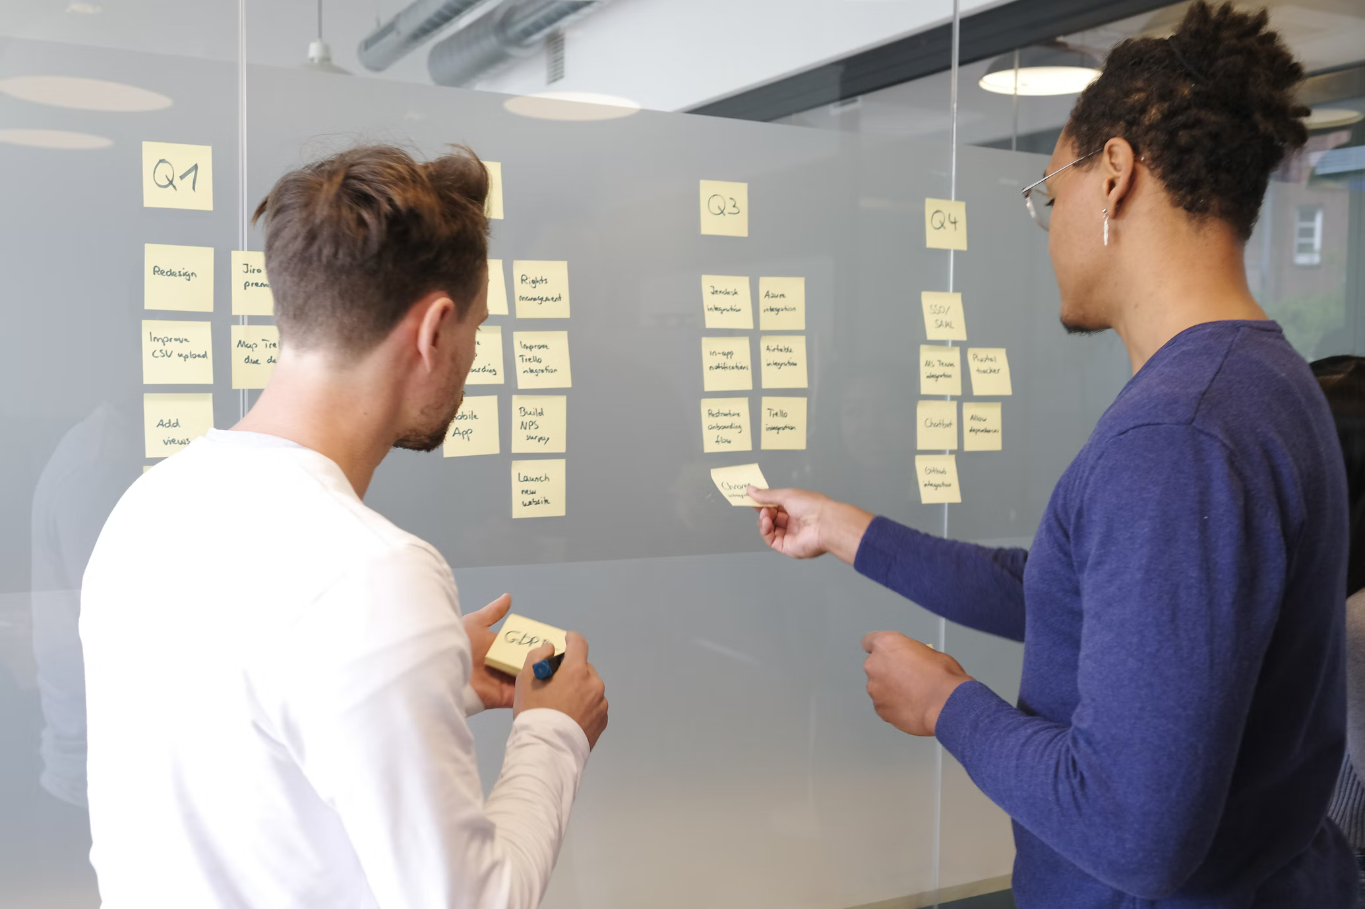
7 Steps to Impact:
*TOP TIP*
“There is no such thing as the ‘general public’.”
Think carefully and specifically about your intended audience
Identify and target specific audiences
Set objectives. E.g.:
  Increase public understanding of…
  Influence change in creative or curatorial practice
Develop your message
Choose communication channels
Plan activities/interventions/engagement
Allocate resources
  time and budget
Build in evidence-gathering process
  include baseline data where possible

Slide 19
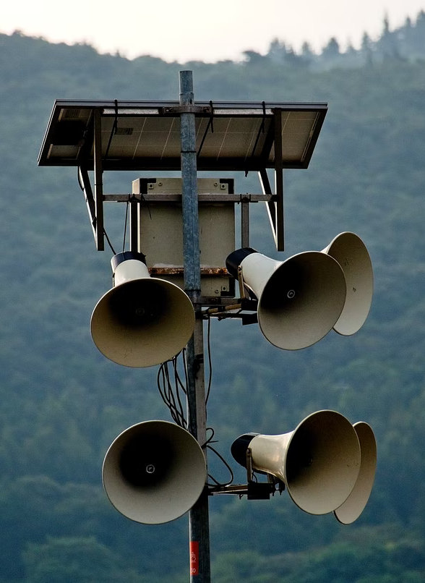
Communication Channels
No ‘one-size-fits-all’ solution
Think about the language you need to use for your audience
  Blogs, The Conversation, podcasts, vodcasts
Find out what’s going on in your Faculty/Dept. & join in
Get involved with Warwick Institute of Engagement
Keep an eye out for key dates/anniversaries relating to your research
  World TB Day
Speak to your central support services
  Impact Team, Press & Marketing, WIE, Schools Outreach

Slide 20
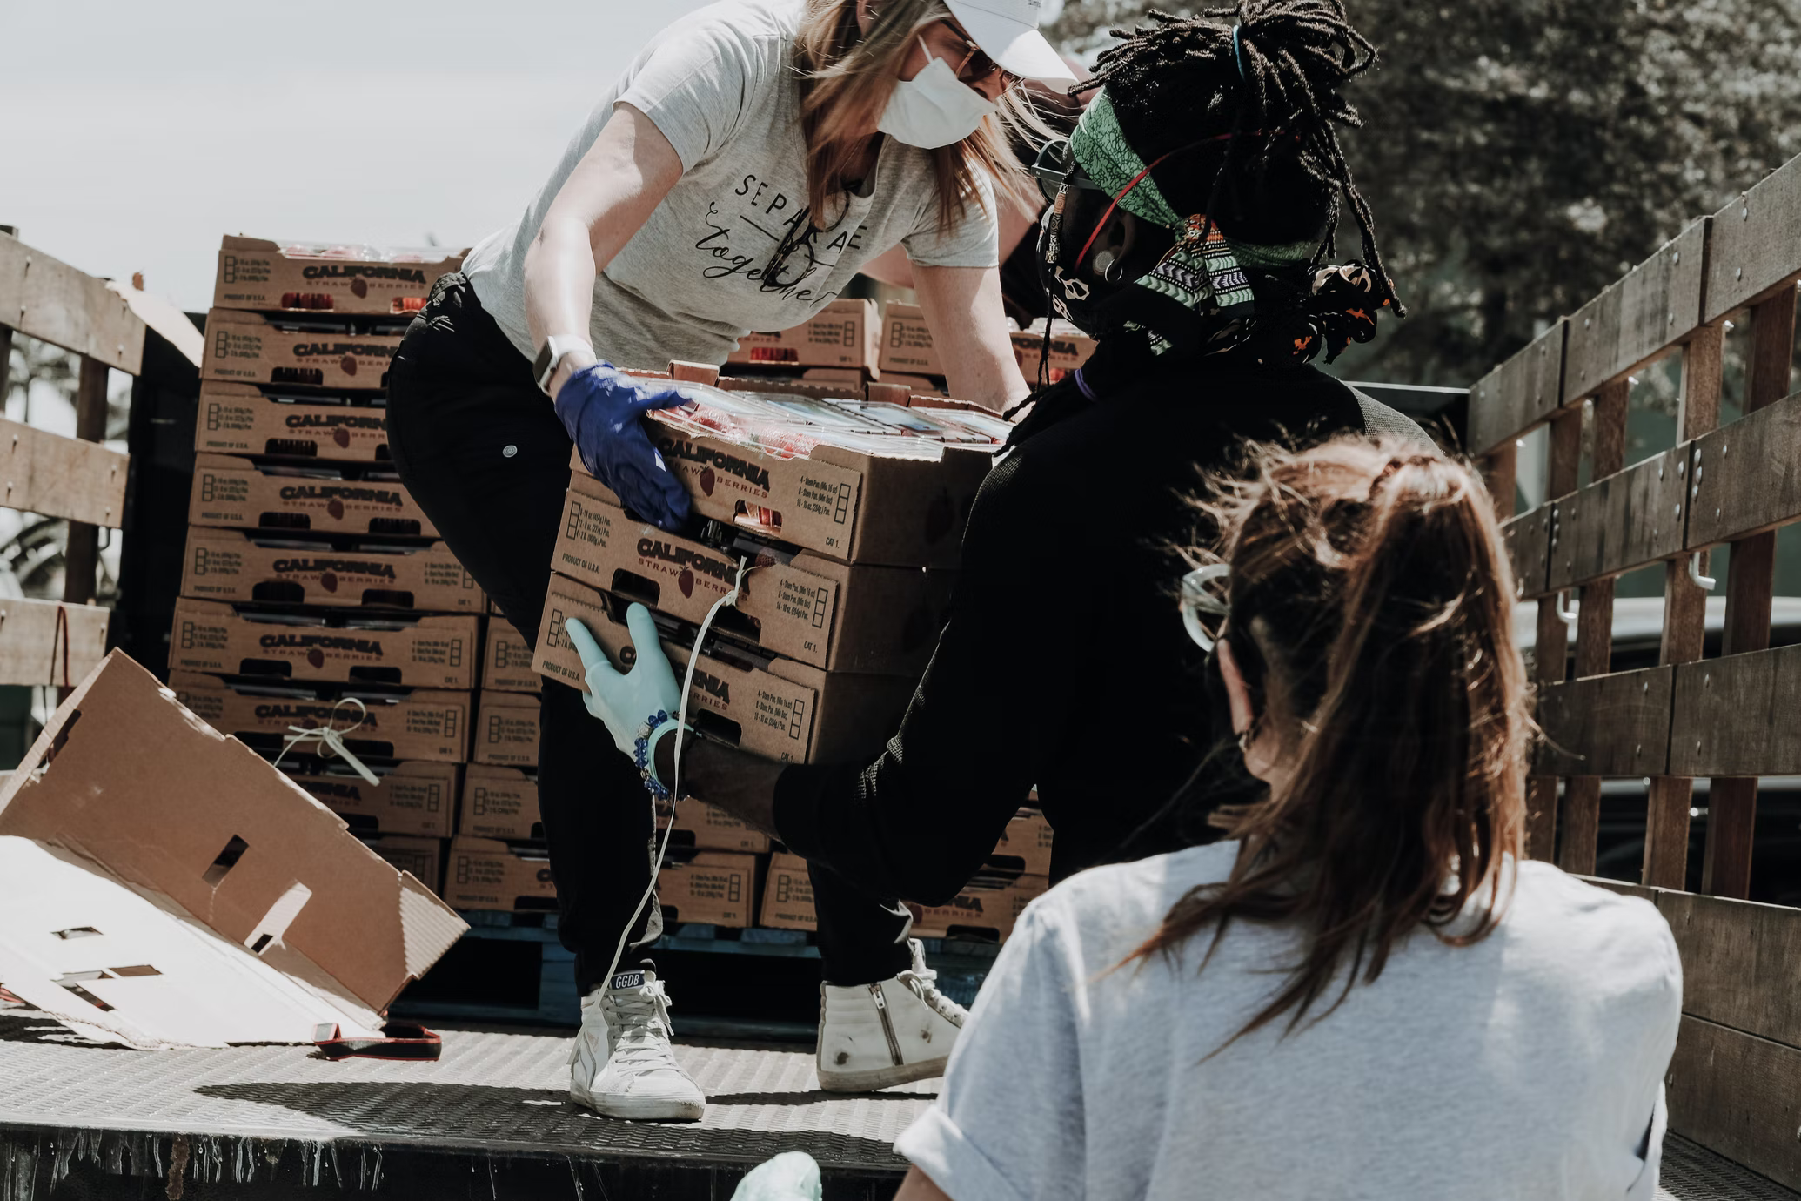
Working with External Organisations
Reach existing audiences
  Gatekeepers to secondary beneficiaries
  Specificity and clear needs
Think about impact on the organisation itself
  New ways of working, new understanding of their work, mutual benefit
E.g.: working with a gallery
  impact on curators and the visiting public

Slide 21

Measuring Impact – Why?
Requirement for end of award UKRI reports (ResearchFish)
Successful REF case studies require robust evidence to back up claims of impact
Valuable feedback on:
  the content of your research
  the efficacy of your engagement methods

Slide 22

Measuring Impact – How?
Dependent on nature of activities and
change/benefit to be measured and assessed
Quantitative:
Visitor/audience numbers; gallery footfall
Website hits, tweets
Economic impact (e.g., ticket sales)
Qualitative:
Questionnaires (online or paper – e.g. Qualtrics)
Testimonials from external partners
Press reviews
Online comments (e.g., on press article; social media analytics)

Slide 23

Measuring Impact - Tips
Gather EVERYTHING!
Try to establish baseline data at the beginning
Collect data as you go along
  Save all correspondence (emails as files)
  Store data systematically in one place (WICS)
Regularly review evidence
  Is it useful? How could it be more effective?
Get feedback and support from the Impact Team

Slide 24

Storing Impact - Considerations
Personal records
  GDPR
  Be aware of ethical implications of certain types of info
  Interviews, photos – classed as human data
Best practice – ask for help if unsure
Requirement for REF
Can also be used for promotion/other funding applications
  Redaction may need applying

Slide 25

Resources and Support:
Every department is different, but likely to have:
  Impact Director - responsible for developing impact culture within their department and leading the development of REF case studies.
  Pipeline of impact case studies, at varying stages of development and risk. Impact case studies generally led by 1 or 2 academics but sometimes encompass different strands of related work.
Central support
  Impact team
  Press team
  Warwick Institute of Engagement
Funding for impact activities (more details to follow)
Notes:
Caveat new PVC approach

Slide 26
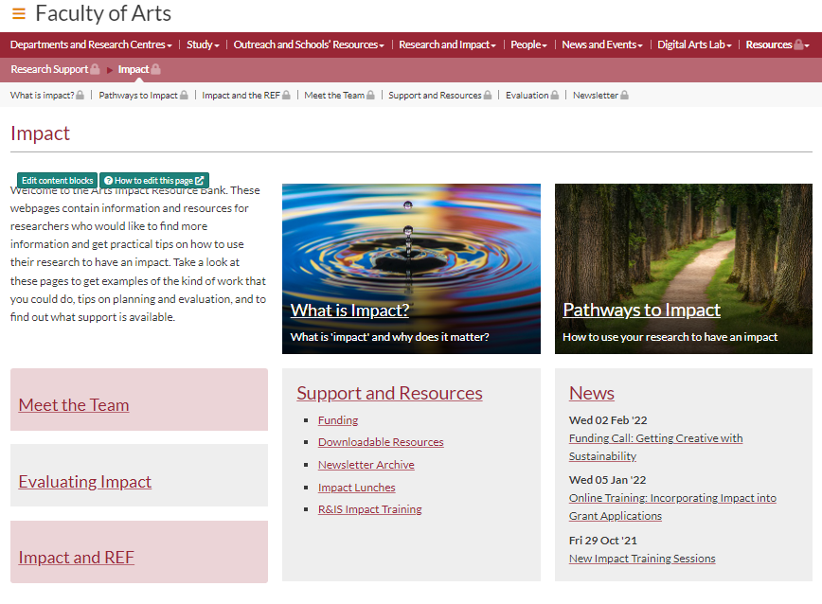
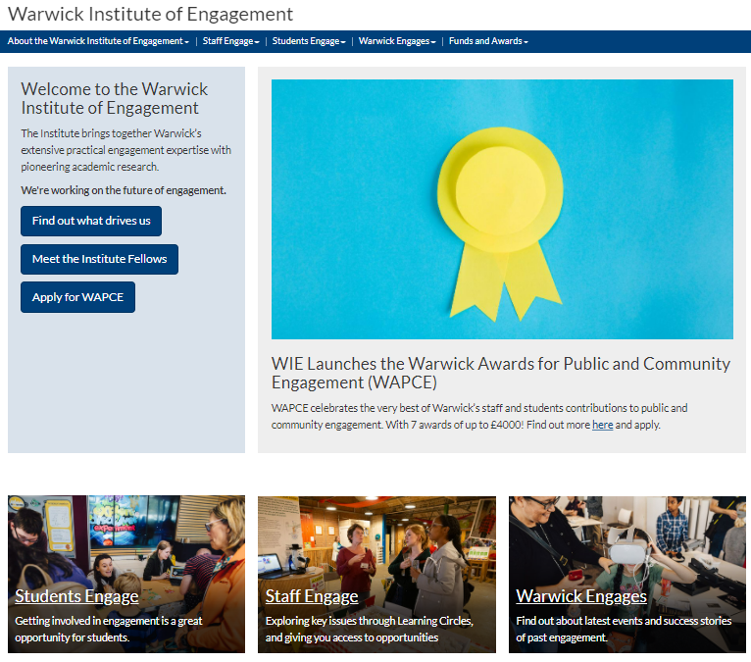
Faculty impact resource pages
  Arts: https://warwick.ac.uk/fac/arts/staffintranet/rss/impact/
  Social Science: https://warwick.ac.uk/fac/soc/staffresources/impactresourcebank/
University Research & Impact Webpages: https://warwick.ac.uk/services/ris/impactinnovation/impact/
Faculty Impact Newsletters
Twitter - @UoWFoA_Res_Imp
WIE - Learning Circles

Slide 27
Internal Funding:
WIE Collaboration and co-production fund
One-off annual funds (Enhancing Research Culture, Place-Based Research and Culture Fund, Participatory Research Fund, Policy Support Fund)
Staff only (students could be involved in project):
IAS Awards
Arts and Humanities Impact Fund
Notes:
Talk with your IM to identify best approach
Funds have dif spend periods and eligibility reqs which is why conversation essential

Slide 28



External Resources & Support:
UKRI – grants, training, online resources
NCCPE (National Co-Ordinating Centre for Public Engagement) – training, online resources
Fast Track Impact – training, resources, professional development

Slide 29

Questions?
Arts & Humanities Research Impact Team:
Impact Manager
Emma Roberts: emma.roberts.1@warwick.ac.uk
Impact Support Officer
Josh Allen: Josh.P.Allen@warwick.ac.uk

