Slide 1
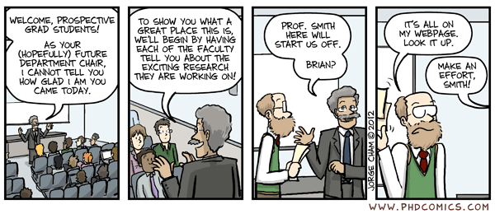
Welcome!

Slide 2
Introductions
Introductions (topic, why grad school, random fact)

Slide 3
Questions, fears and anxieties… ?

Slide 4
PGR life
Monthly supervisions (logged on Tabula: https://tabula.warwick.ac.uk)
Personal tutor
Research/reading/writing – find a structure that works for you!
Progress reports (MAR) / Upgrades (PhD)
Some classes
Each journey and topic is unique
Everyone thinks they are a fraud (truly)
Fighting perfectionism. ;-)

Slide 5
Monitoring Points
Important: Postgraduate research Student Visa sponsored students who are in the UK require monthly physical face-to-face contact, so you must meet with your supervisor IN PERSON once a month.
October - attendance at induction on 4/10/23
October: Attendance at WIP Seminar (Wed 25th Oct 2023)
Nov: Monthly supervision
Dec: Monthly supervision
Jan: Monthly supervision
Feb: Attendance at WIP Seminar (Wed 7th Feb 2024)
March: Monthly supervision
April: Monthly supervision
May: Colloquium
June: Monthly supervision
July: Monthly supervision
Aug: no point.
Sept: Monthly supervision

Slide 6
Work in Progress + Colloquium
Wednesday 2-3.30pm
Colloquium in May each year.
Classical Association Conference 22-24 March 2024

Slide 7
SSLC (Staff Student Liaison Committee)
One from each degree: MAR, PhD, part time?

Slide 8
The PG handbook/web pages
https://warwick.ac.uk/fac/arts/classics/intranets/postgrads/
Monitoring points
Upgrades/annual reviews
MAR – course of the year and submission
Study spaces (Wolfson research exchange/ PG hub, department, FAB)
Web presence
Book purchase suggestions
Department research funds
Mitigating circumstances/reasonable adjustment

Slide 9
Warwick H-Drive
https://warwick.ac.uk/services/its/servicessupport/datastorage/itssharedfilestore/accessfilestore/

Slide 10
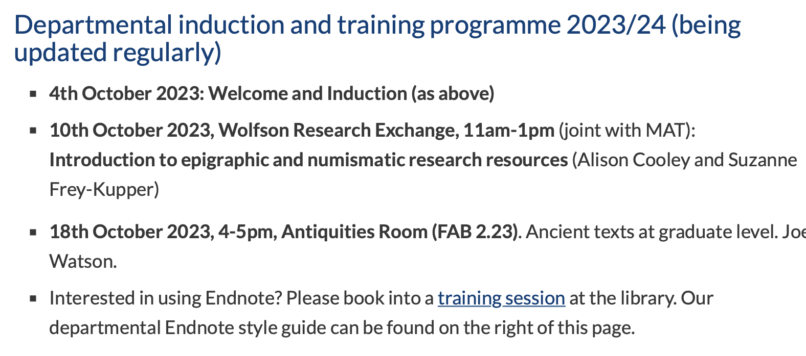
Research Training Programme
https://warwick.ac.uk/fac/arts/classics/intranets/postgrads/training
Masters courses / Languages (German) / Other modules

Slide 11
CADRE
https://warwick.ac.uk/fac/arts/cadre/
DOCTORAL COLLEGE
https://warwick.ac.uk/services/dc/
Skillsforge
https://skillsforge.warwick.ac.uk/warwick/#common/main/welcome

Slide 12
Other requirements/requests?
German – 2 only signed up so far.

Slide 13
Travel Funds
https://warwick.ac.uk/fac/arts/classics/intranets/postgrads/handbook/
Application form to DGS
Combine with Humanities Research Fund for conference participation - https://warwick.ac.uk/services/ris/researchstrategy/researchfunding/rdf/hrf
International travel may require a risk assessment

Slide 14
PGR Hardship Funds
https://warwick.ac.uk/services/dc/schols_fund/current/hardship_fund/
Postgraduate research students are eligible to submit an application for funding at any point during their registration period, including during a period of temporary withdrawal. Priority will be given to cases where an award will assist on-time thesis completion during the standard registration period. Awards will not normally be made to students more than three months into an extension period or following thesis submission.
Payments from the Fund will usually cover a maximum period of three months with the level of funding being half of the research council stipend rate. However, additional funding may be available in exceptional circumstances.

Slide 15
Holidays, sick leave etc
Full-time PGR students are expected to study at their normal place of work/study for 37-40 hours per week. Annual leave is important to maintain a work/life balance, as well as to maintain your stamina over your degree! It is anticipated that research students will not take more than 4 weeks annual leave at a time. Full-time PGR students are entitled to take a maximum of eight weeks/40 days holiday in the year (incl. the statutory (i.e. Bank Holidays) and customary University holidays). For part-time students this will be pro rata. Students on visas must refer their plans to the immigration team prior to requesting a leave of absence, since this may affect your visa.
Temporary withdrawal over extensions at end of thesis. International students need to consult Doctoral College and our visa people.
Funded PGR policy: https://warwick.ac.uk/services/dc/schols_fund/current/funded_pgr_policy/
1st vs. 31st of the month for stipend payments

Slide 16
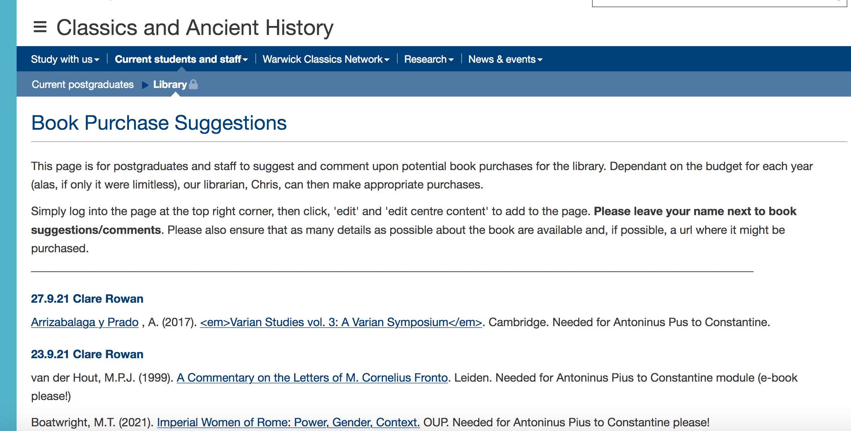
Book requests
https://warwick.ac.uk/fac/arts/classics/intranets/postgrads/booksuggestions/

Slide 17
PG study space
Academic studio (keys for lockers available from the administrative office, fridge/hot water/microwave available on the floor)
FAB 2.08 for quiet space
PG Hub, Wolfson research exchange
PGR desks in the FAB (CADRE)

Slide 18
Other tips
There will be times of loneliness and despair – invest in peer relationships. (And the bad times will pass).
Also – enjoy this time!!
The ‘Banbury’ split
Look at previous theses

Slide 19
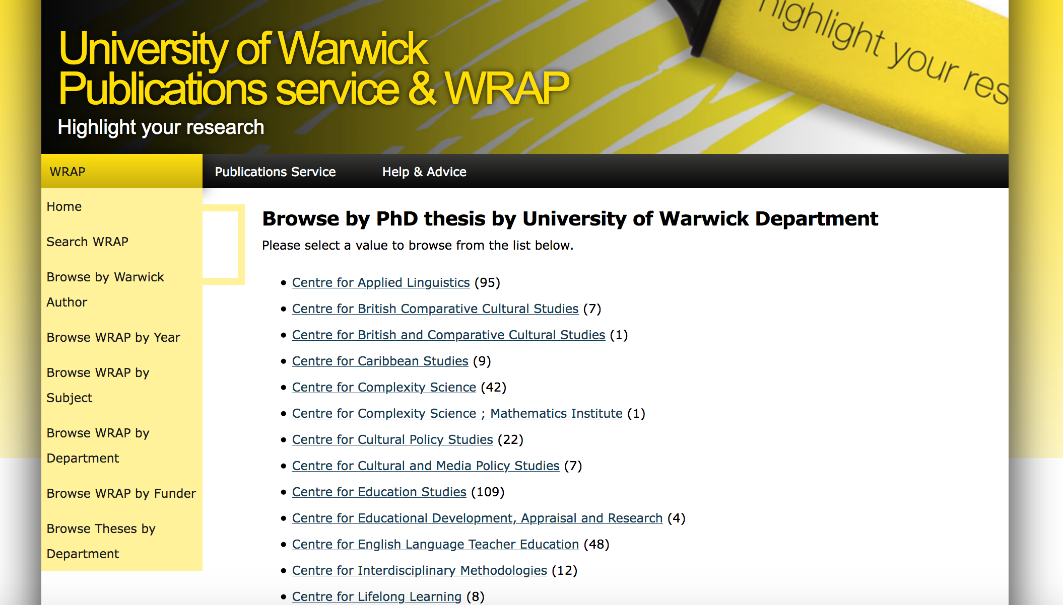
Previous work (PhD/MAR)

