Slide 1
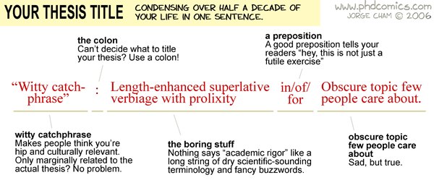
PGR Induction

Slide 2
ADMIN ☺
SSLC: One from each degree: MAR, PhD, part time?
WiP, 14.00 Wed, FAB 5.01
Colloquium: Elena and Shekinah. - 22nd May (Week 5 of term 3? Please check with M4C!)

Slide 3
PRES (9 responses)
Supervision: 94%
Resources: 68% (working space when studying remotely, appropriate access to library/IT resources)
Research Culture: 61% (range of research seminars, discuss research with others)
Progression: 81% (final assessment procedures clear)
Responsibilities: 89% (understand responsibilities as a PGR)
Support: 85%
Research Skills: 81% (confidence to be creative or innovative)
Professional development: 61% (ability to manage projects, communicate effectively to a diverse range of audiences, transferable skills, career options)
Overall: 72%
Covid 19 pandemic: 88%

Slide 4
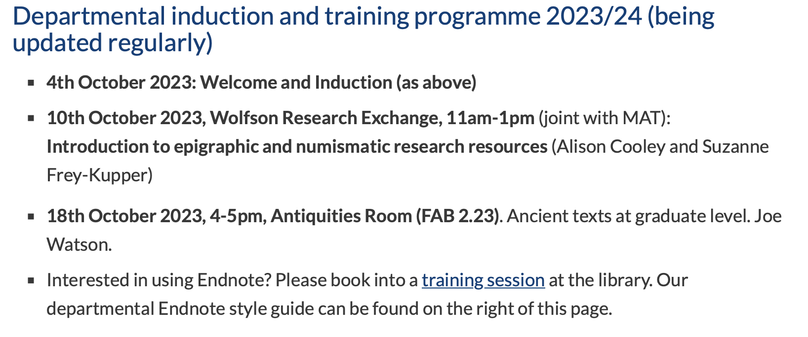
+ teaching support
+ ‘submission’ session
German reading??

Slide 5
PG study space
Academic studio (keys for lockers available from the administrative office, fridge/hot water/microwave available on the floor)
Also, for this year FAB 2.08 + ‘closet’ for quiet space if needed.
PG Hub, FAB space, Wolfson research exchange

Slide 6
Monitoring Points
Important: Postgraduate research Student Visa sponsored students who are in the UK require monthly physical face-to-face contact, so you must meet with your supervisor IN PERSON once a month.
October - attendance at induction on 4/10/23
October: Attendance at WIP Seminar (Wed 25th Oct 2023)
Nov: Monthly supervision
Dec: Monthly supervision
Jan: Monthly supervision
Feb: Attendance at WIP Seminar (Wed 7th Feb 2024)
March: Monthly supervision
April: Monthly supervision
May: Colloquium
June: Monthly supervision
July: Monthly supervision
Aug: no point.
Sept: Monthly supervision

Slide 7
Travel Funds
https://warwick.ac.uk/fac/arts/classics/intranets/postgrads/handbook/
Application form to DGS
Combine with Humanities Research Fund for conference participation - https://warwick.ac.uk/services/ris/researchstrategy/researchfunding/rdf/hrf : CLASSICAL ASSOCIATION CONFERENCE (18th October)
International travel may require a risk assessment

Slide 8
PGR Hardship Funds
https://warwick.ac.uk/services/dc/schols_fund/current/hardship_fund/
Postgraduate research students are eligible to submit an application for funding at any point during their registration period, including during a period of temporary withdrawal. Priority will be given to cases where an award will assist on-time thesis completion during the standard registration period. Awards will not normally be made to students more than three months into an extension period or following thesis submission.
Payments from the Fund will usually cover a maximum period of three months with the level of funding being half of the research council stipend rate. However, additional funding may be available in exceptional circumstances.

Slide 9
Holidays, sick leave etc
Full-time PGR students are expected to study at their normal place of work/study for 37-40 hours per week. Annual leave is important to maintain a work/life balance, as well as to maintain your stamina over your degree! It is anticipated that research students will not take more than 4 weeks annual leave at a time. Full-time PGR students are entitled to take a maximum of eight weeks/40 days holiday in the year (incl. the statutory (i.e. Bank Holidays) and customary University holidays). For part-time students this will be pro rata. Students on visas must refer their plans to the immigration team prior to requesting a leave of absence, since this may affect your visa.
Temporary withdrawal over extensions at end of thesis. International students need to consult Doctoral College and our visa people.
Funded PGR policy: https://warwick.ac.uk/services/dc/schols_fund/current/funded_pgr_policy/
1st vs. 31st of the month for stipend payments

Slide 10
Update from UCU (Warwick MAB deal)
(stipends last year)
Warwick: fractional contracts for GTAs, working group addressing PGR as staff issues.
1. Fractional contracts
2. Higher wages
3. More hours
4. Paid training
5. Timely written contracts
6. An end to Unitemps outsourcing
7. Parity across departments
8. Greater support
9. Departmental Reps & Committee Groups
10. Financial help parity

Slide 11
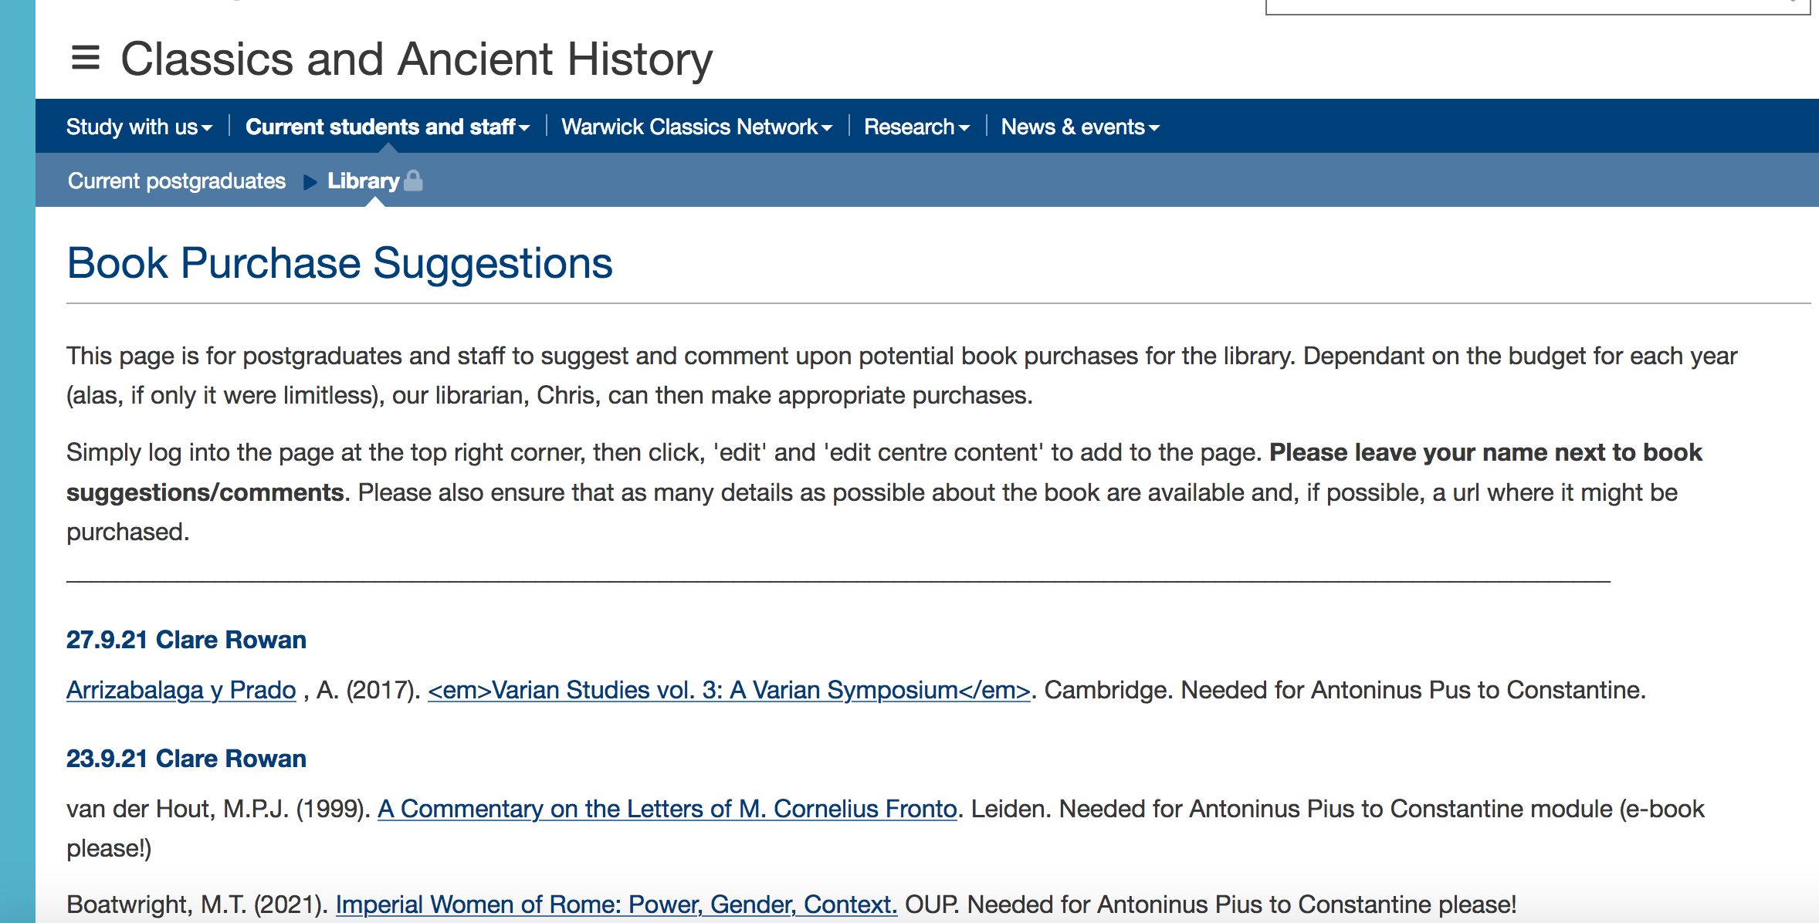
Book requests
https://warwick.ac.uk/fac/arts/classics/intranets/postgrads/booksuggestions/

Slide 12
Blogs
Material Musings – Jacqui and Matt

Slide 13
Humanities Research Centre
https://warwick.ac.uk/fac/arts/hrc/
Conference funding (apply with supervisor)
Visiting speakers fund (apply with supervisor)
Doctoral fellowship competition (a research budget of £300 and a conference budget of £1,000 to organise a one-day interdisciplinary Post-Graduate Conference (to be held at Warwick, UK) during the academic year 2023/24.)

Slide 14
Professional Development and Training
RDO online Autumn Programme: https://warwick.ac.uk/services/dc/pgr/#:~:text=Researcher%20Development%20Programme%202022%2D2023 (including Twitter for researchers, preparing for your viva, etc).
CADRE - https://warwick.ac.uk/fac/arts/cadre/current_students/artspgrevents/ (PhD survival guide, libraries and reference management, developing a critical voice, your research in a digital world, getting published, impact and engagement, careers outside academia)
Postgrad hub (library) activities: https://warwick.ac.uk/services/library/pghub/
IT services training sessions - https://warwick.ac.uk/services/its/servicessupport/training (image editing with Gimp, Google analytics, MS Access and Excel training, Sitebuilder…)
Warwick Institute of Engagement - https://warwick.ac.uk/wie/studentsengage/skillsfestival-pg/

Slide 15
Other possible sources of funding for projects…
IATL - https://warwick.ac.uk/fac/cross_fac/iatl/funding/ for teaching/workshops
Royal Numismatic Society (https://numismatics.org.uk/grants/) for coin related topics!
Keep an eye on other academic societies as well (Liverpool list - https://listserv.liv.ac.uk/cgi-bin/wa?A0=CLASSICISTS).

Slide 16
Classical Association Conference
Friday 22 – Sunday 24 March 2024

Slide 17
Questions?

