Slide 1
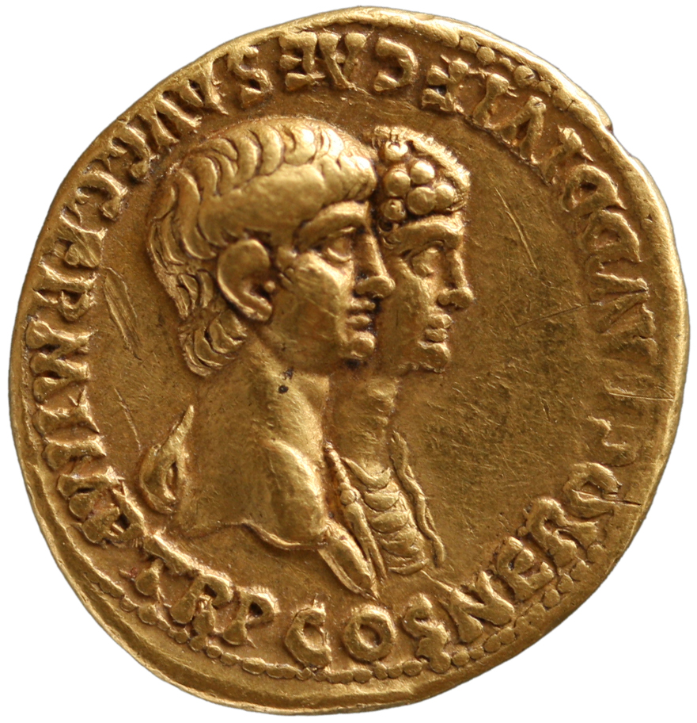
Agrippina the Younger: The Numismatic Evidence
Clare Rowan
C.Rowan@warwick.ac.uk

Slide 2
Three main numismatic sources
Imperial Coinage: released by imperial government in mint of Rome and others, in different denominations (gold, silver, bronze – audience targeting). Reflects contemporary, official view of how the imperial family wished to be portrayed, survives in bulk. Don’t know how imagery was received/interpreted, variation in circulation (volume, geography).
Provincial Coinage: coinage (mostly bronze) struck by provincial cities or political groupings, carrying (elite) imagery connected to local culture. Offers an insight into imperial cult and how different cities viewed the imperial family / reception of ‘central’ ideology. A local currency which we think largely circulated in the issuing city.
Tokens of Rome and Ostia: mostly lead, created by individuals and groups of different classes/social groupings. Allows us to see a diversity of viewpoints within Rome itself. Objects probably only used for one occasion in a very closed group/context. Do not survive well (lead).

Slide 3
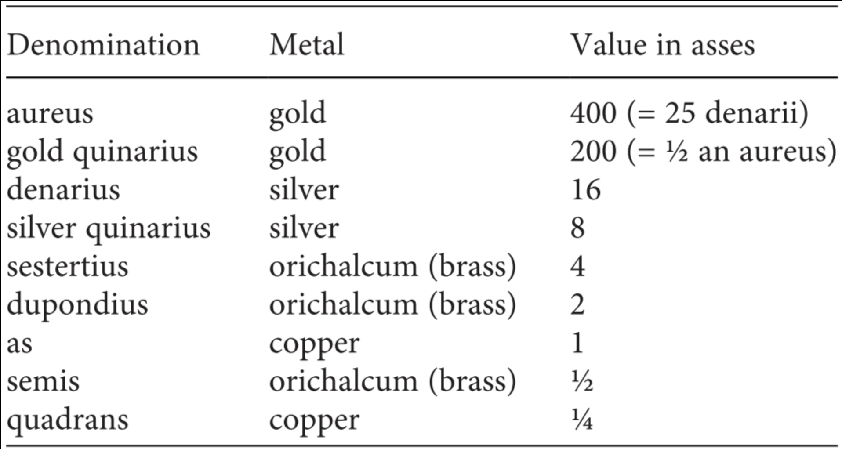
Annual pay of a legionary soldier – 225 denarii
Quadrans – bath entrance
Loaf of bread - semis
Notes:
Annual pay of a lergionary soldier – 300 denarii
Quadrans – bath entrance
Loaf of bread - semis

Slide 4
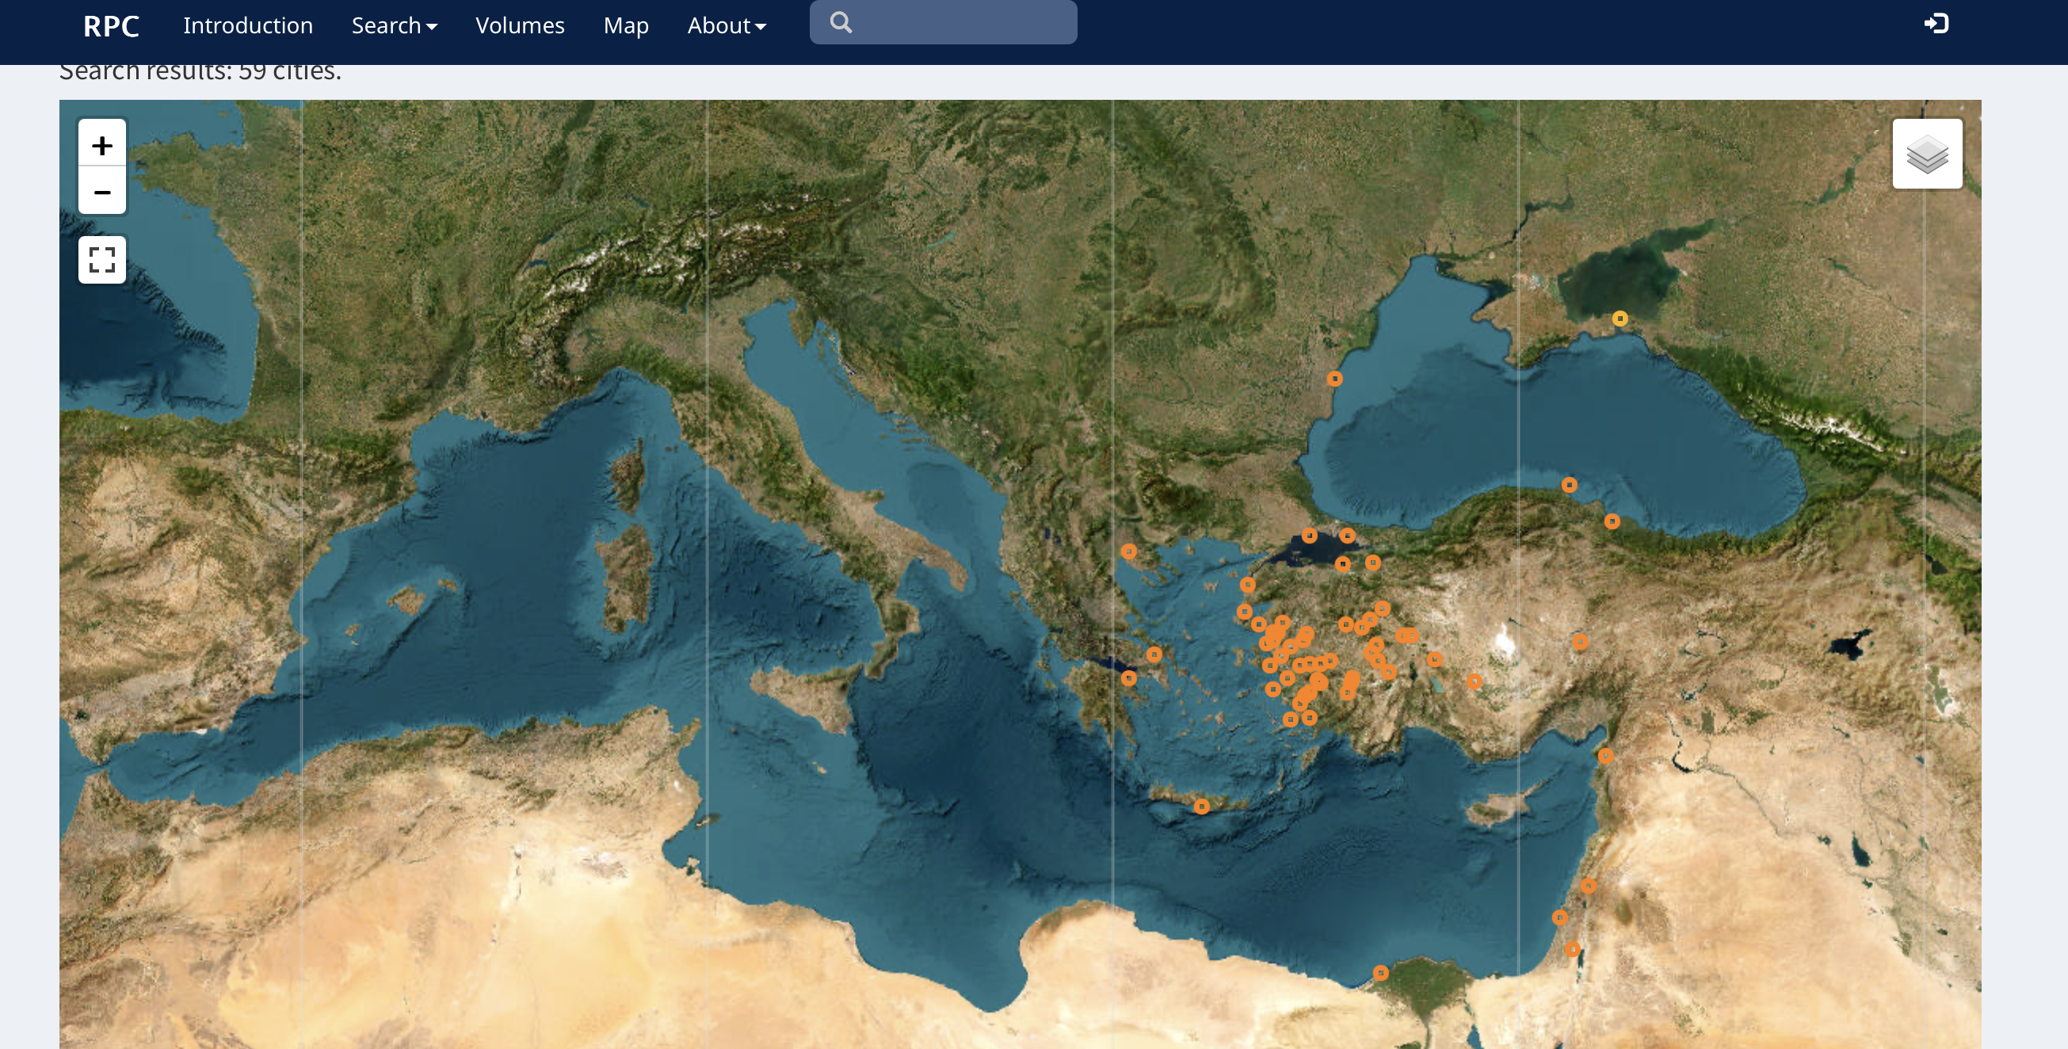
Provincial cities striking coins showing Agrippina II

Slide 5
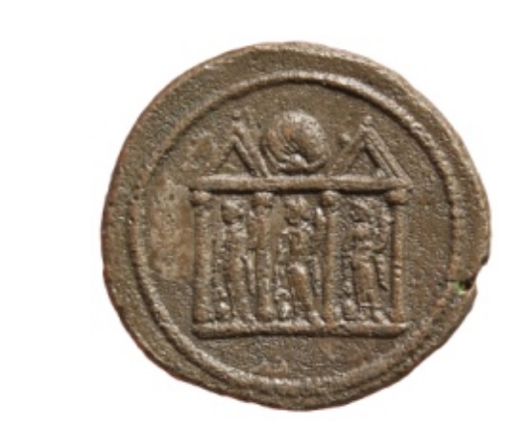
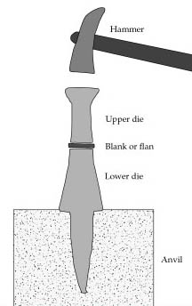
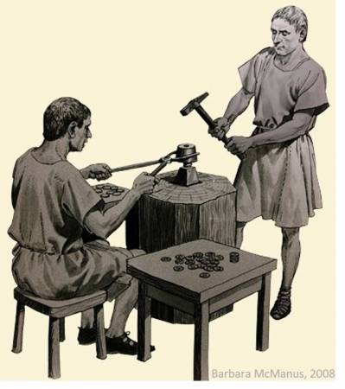
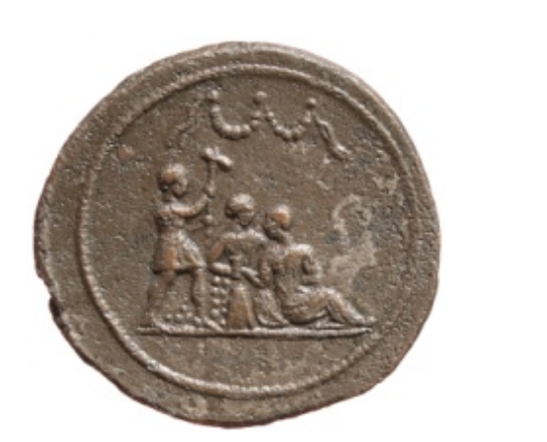
Bronze token, Kunsthistorisches Museum Vienna.

Slide 6
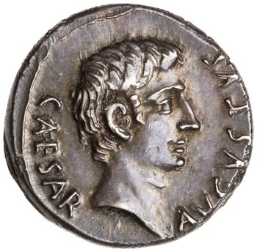
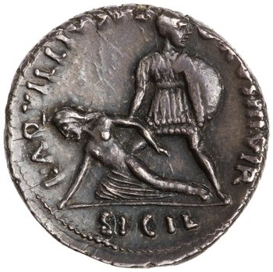
obverse
the design struck from the anvil or lower die
reverse
the design struck from the held or upper die
field
the empty space on a coin
type
The design that appears on a coin
legend
the inscription that appears on a coin
exergue
The area on a coin below the ground-line of a design

Slide 7
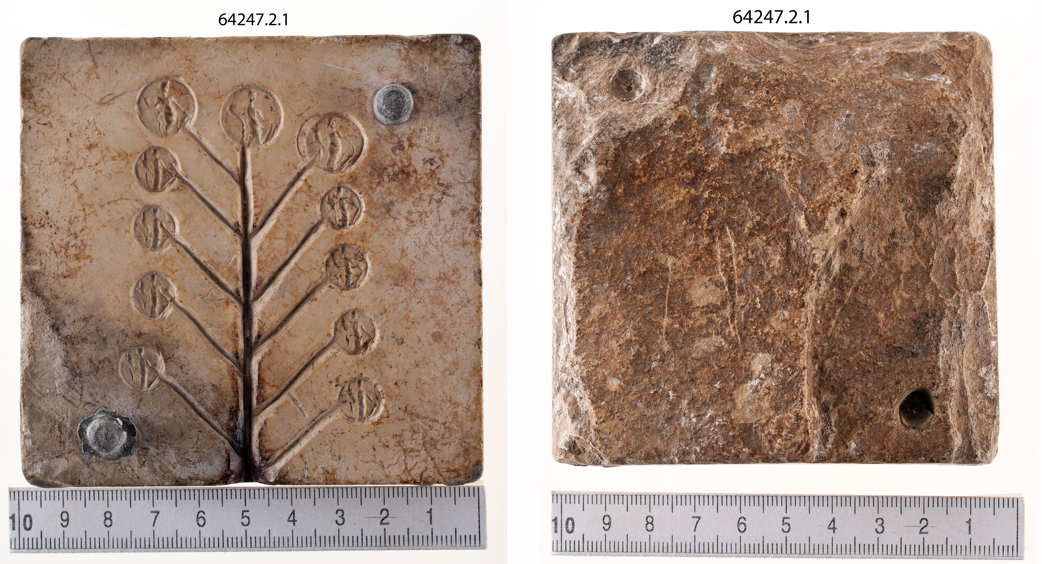
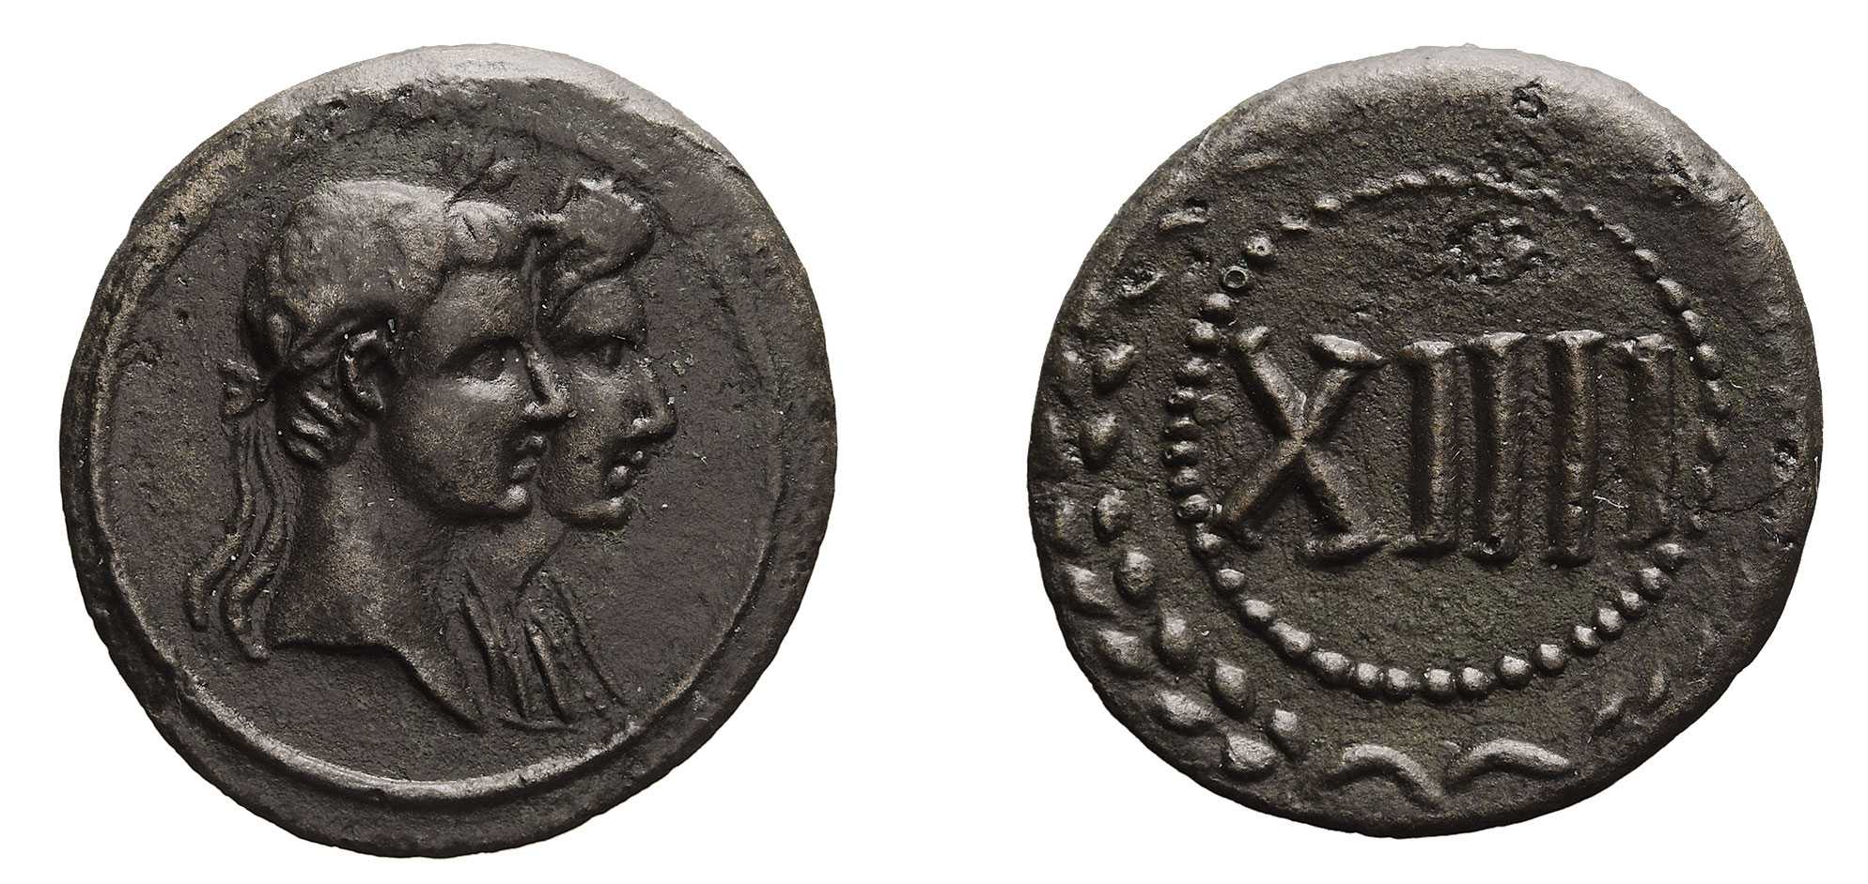
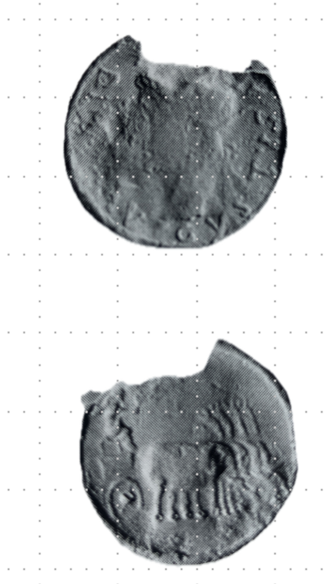
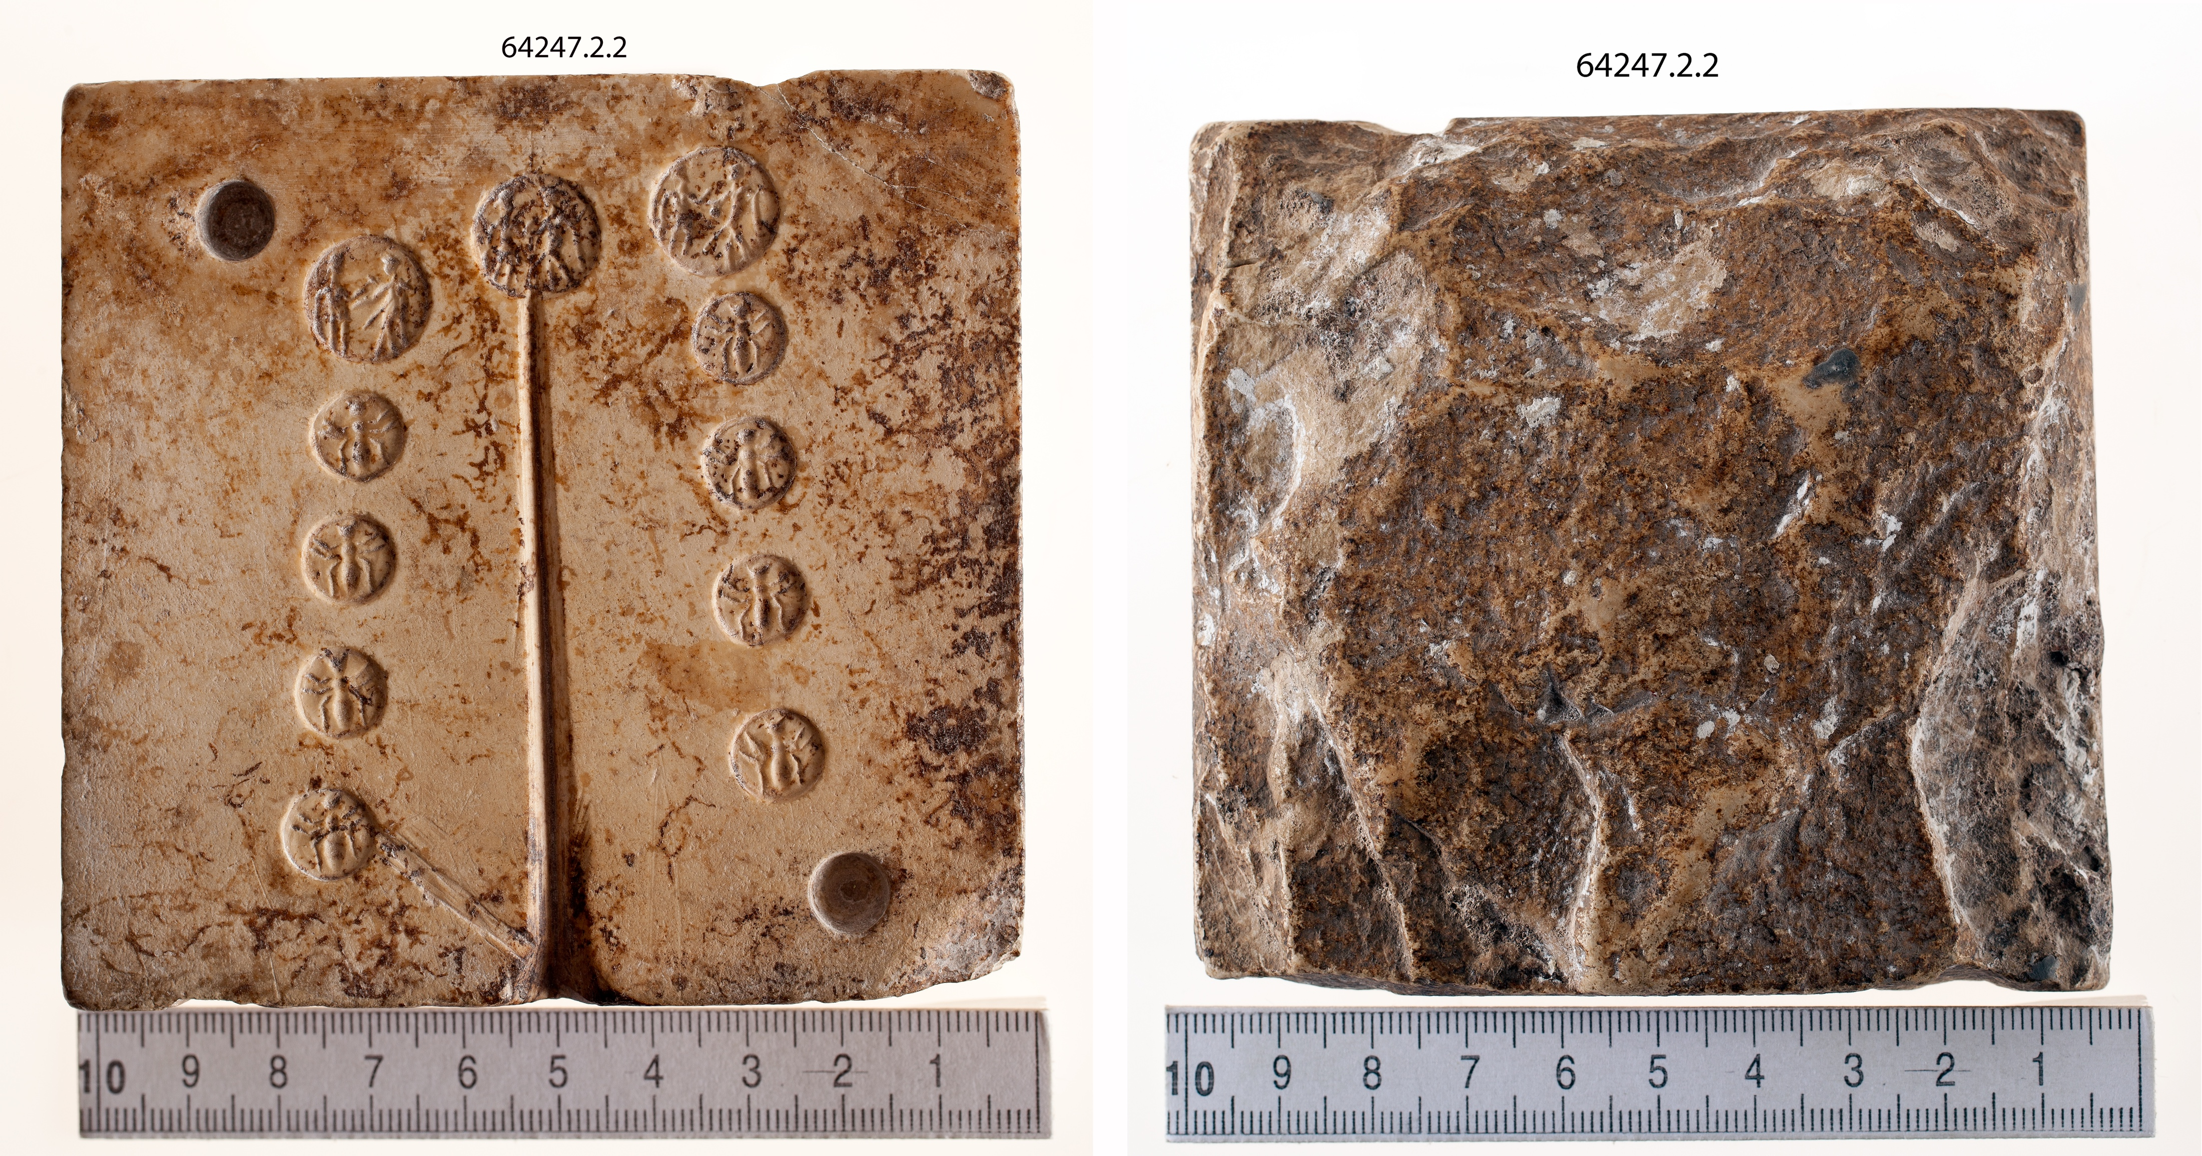
Tokens
Struck bronze token, Augustus and Livia jugate
Cast lead token with radiate head of Augustus, DIVVS AVGVSTVS and Augustus seated in elephant quadriga.
Notes:
Show Roman tokens. Lead.
Livia and Augusts Caesar.

Slide 8
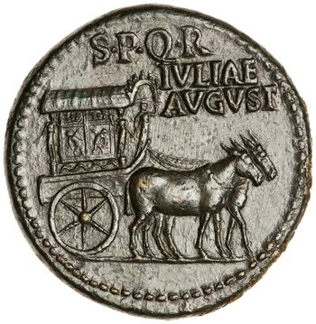
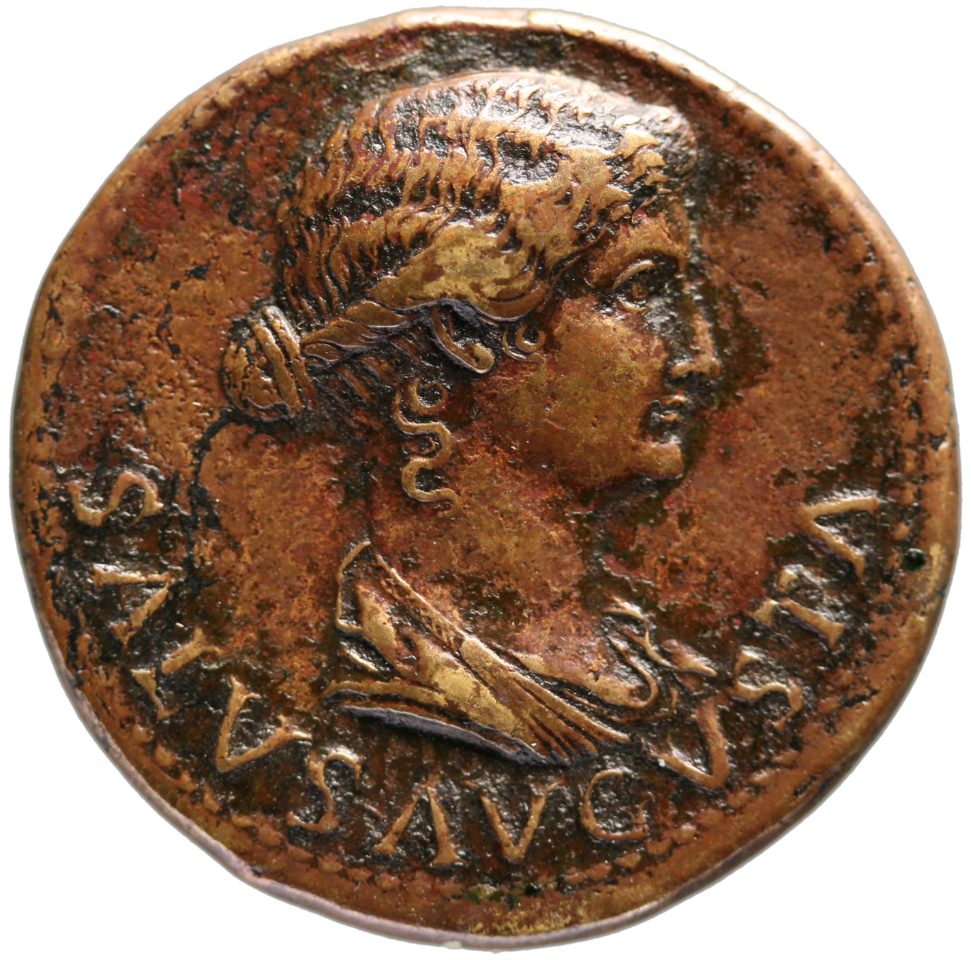
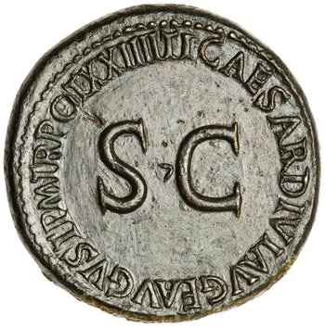
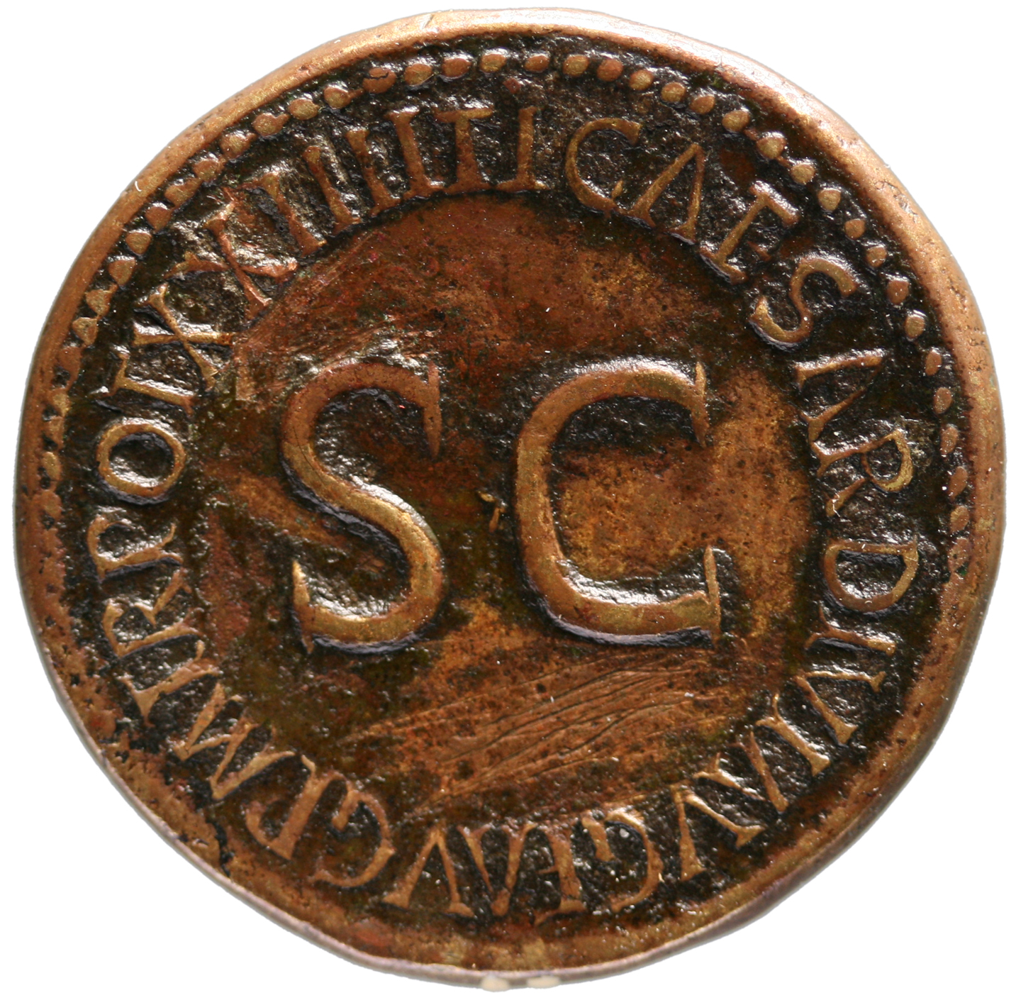
Changing public role of empresses on coins
AD 22-23 (honour of carpentum granted) and recovery from illness
References to Livia on the coinage of Tiberius

Slide 9
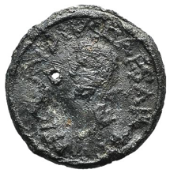
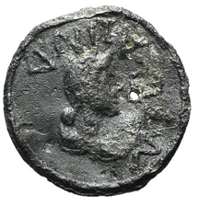
Lead token, 19mm, AD 41–8, 2.16g.
Side a: Bare head of Claudius left, TI CLAVDIVS CAESAR around.
Side b: Bust of Messalina right, MESSALINA around.
London Ancient Coins 60 (14 February 2017) lot 362.

Slide 10
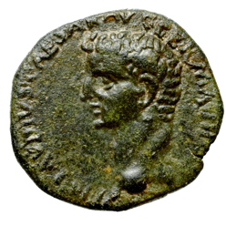
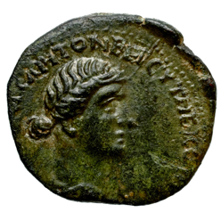
Bronze coin of Cnossus, 21mm, 4.24g, before AD 48.
Obverse: Bare head of Claudius left, TI CLAVDIVS CAESAR AVG GERMANICVS around.
Reverse: Draped bust of Messalina right, VALERIA MESSALINA CAPITONE ET CYTHERO IIVIR
RPC I, 1001. BnF Paris, Armand-Valton 384

Slide 11
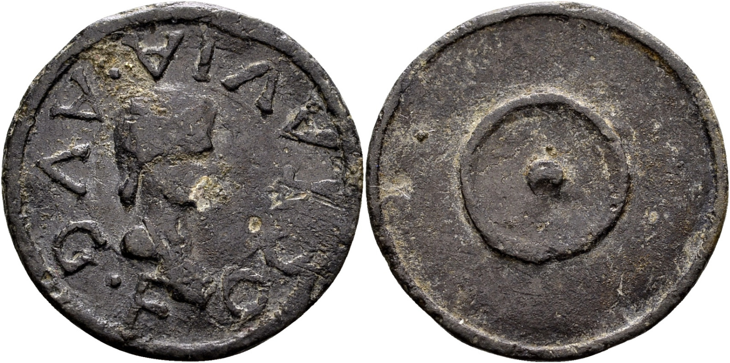
Claudia Octavia
Lead token, 19mm, 1.99g, AD 41–54.
Side a: Bust of Claudia Octavia right, hair in plait (?) at back, OCTAVIA · AVG · F (Octavia, daughter of Augustus) around.
Side b: Patera seen from above
Notes:
Daughter of Claudius –i.e. still a young girl.

Slide 12
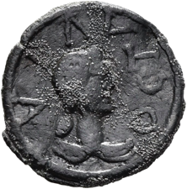
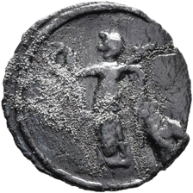
Lead token, 19mm, 2.44g.
Side a: Bust of Claudia Octavia right, hair in plait (?) at back, OCTAVIA around.
Side b: Victory standing left holding a wreath in outstretched right hand and palm branch over left shoulder

Slide 13
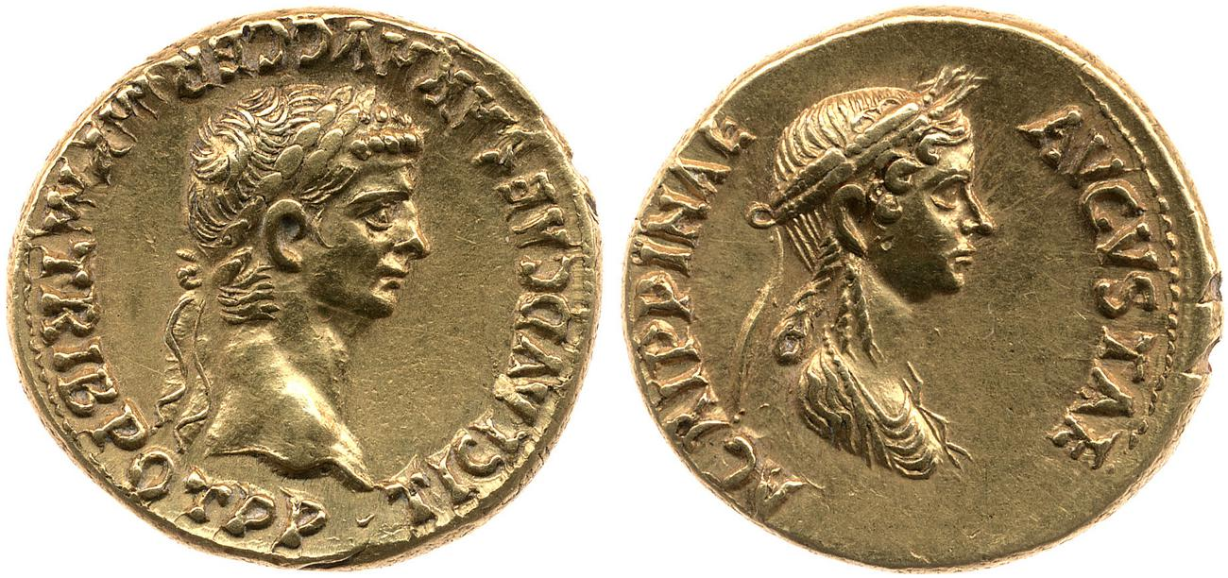
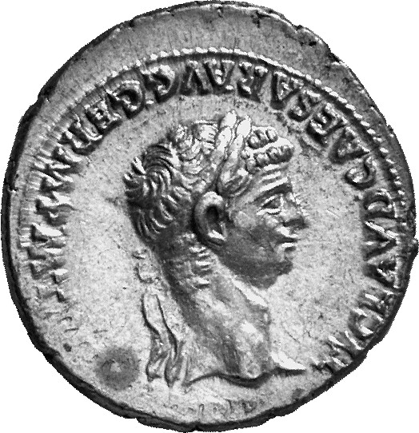
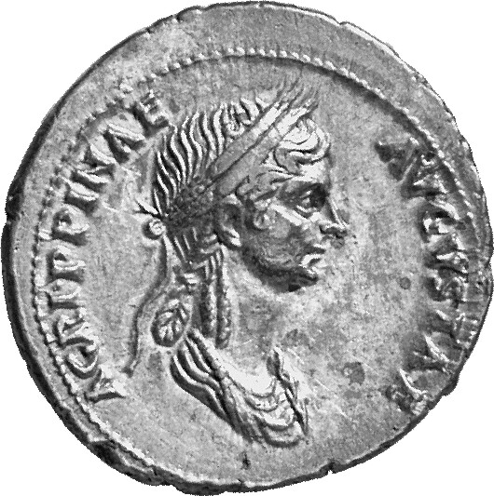
A living empress’ portrait with name on imperial coinage for the first time: Agrippina the Younger (AD 50)
AVG = Augustus
GERM = Germanicus
P M = pontifex maximus or chief priest
TRIB POT (T P) = tribunician potestas or power
P P = pater patriae or father of his country
AD 50-54, gold aureus, RIC I (second edition) Claudius 80
Obverse: Head of Claudius, laureate, right, TI CLAVD CAESAR AVG GERM P M TRIB POT P P
Reverse: Bust of Agrippina the Younger, draped, right, wearing a crown of corn-ears; hair in a long plait behind, AGRIPPINAE AVGVSTAE

Slide 14
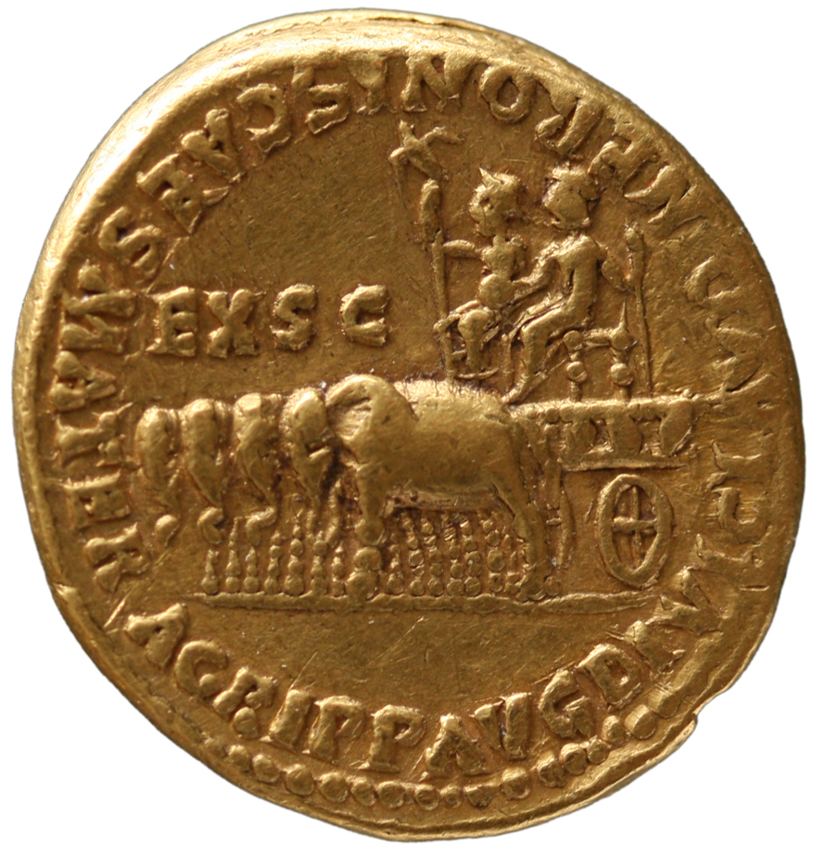
DIVI F = divi filius or ‘son of the god’
IMP = imperator
COS = consul
MATER = mother
EX S C = ex senatus consultum or ‘by decree of the Senate’
AD 55, gold aureus, mint of Rome, RIC I (second edition) Nero 6
Obverse: Jugate busts, right of Nero (in forefront), bare-headed and draped at back of neck, and Agrippina the Younger, draped and bare-headed , NERO CLAVD DIVI F CAES AVG GERM IMP TR P COS
Reverse: AGRIPP AVG DIVI CLAVD NERONIS CAES MATER EX S C (‘Agrippina Augusta, (wife) of the deified Claudius, mother of Nero Caesar’.) Quadriga of elephants, left, bearing two chairs with figures of Divus Claudius and Divus Augustus, both radiate
Notes:
Nero and Agrippina descendants of Augustus – Claudus was not.

Slide 15
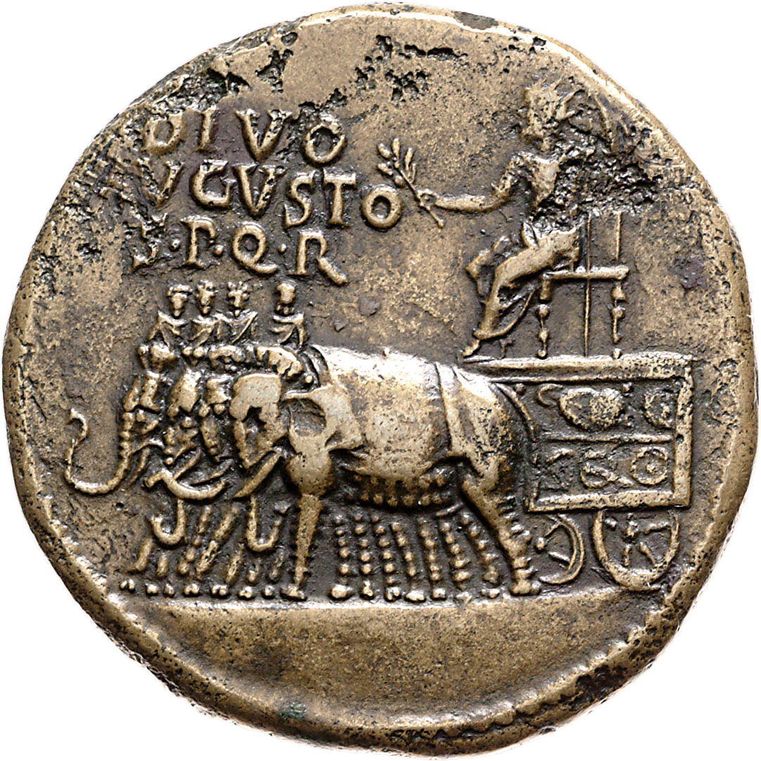
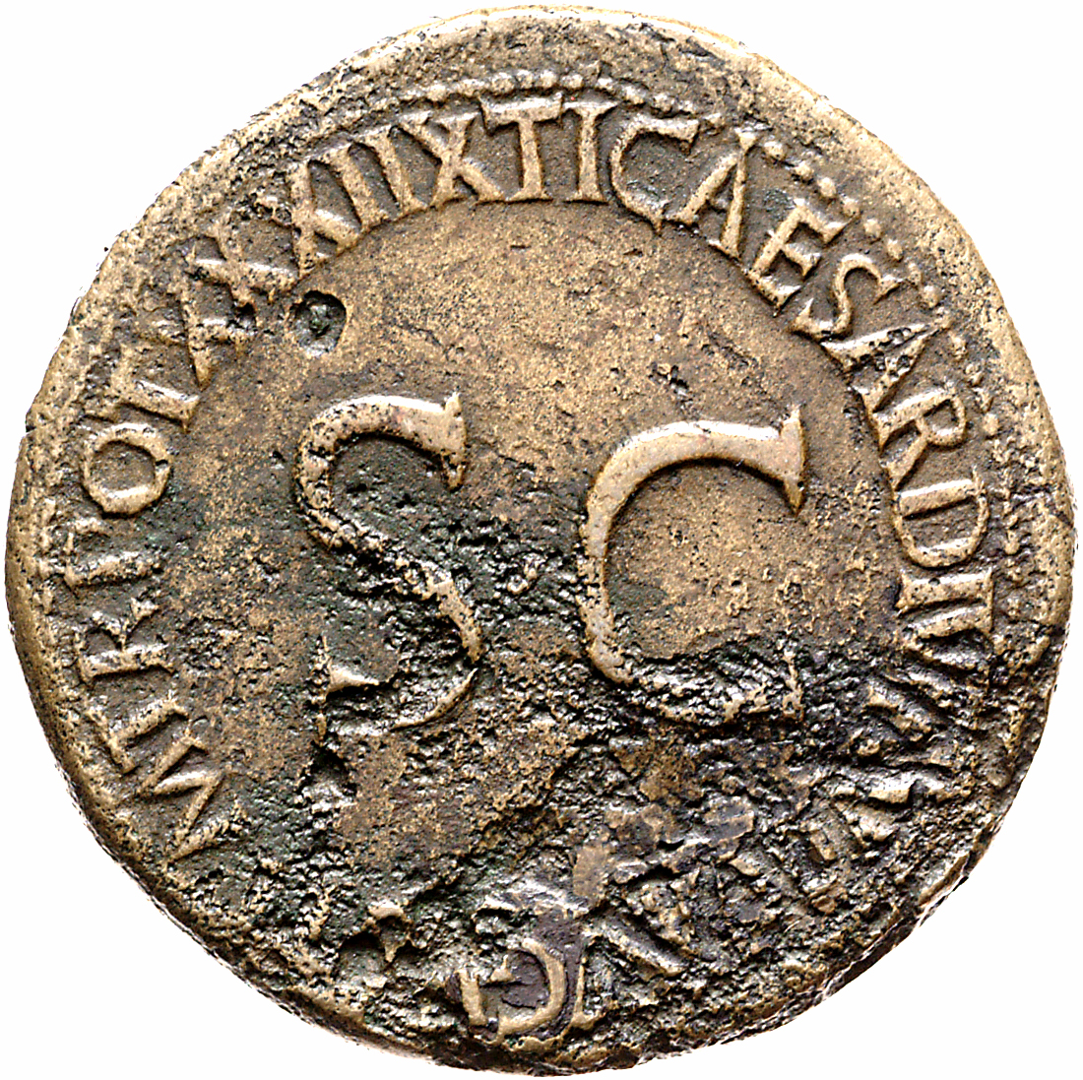
AD 36-37, ,mint of Rome, sestertius, RIC I (second edition) Tiberius 68
Obverse: Augustus, radiate, right, holding laurel branch and sceptre, in quadriga with elephants and riders, DIVO AVGVSTO S P Q R
Reverse: TI CAESAR DIVI AVG F AVGVST P M TR POT XXXIIX around S C
https://numismatics.org/ocre/id/ric.1(2).tib.68

Slide 16
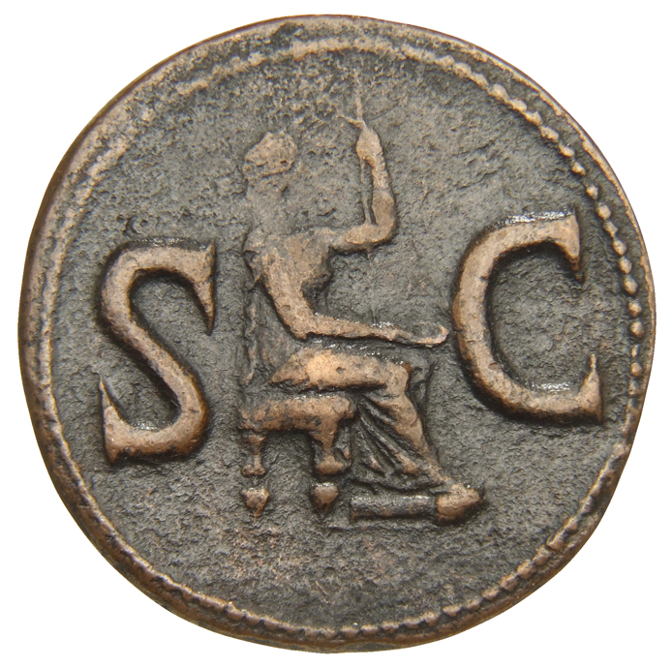
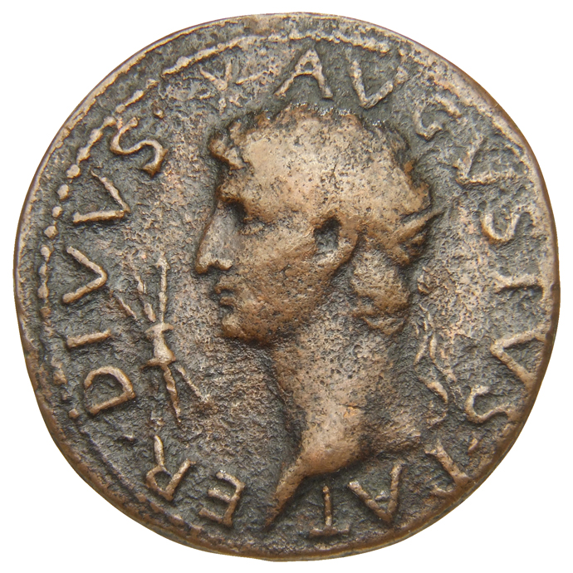
Impact of the death of Augustus
AD 15-16, mint of Rome, As, RIC I (second edition) Tiberius 73
Obverse: DIVVS AVGVSTVS PATER, Head of Augustus, radiate, left; above, star; in front, thunderbolt
Reverse: Female figure, veiled, draped, seated right, holding patera in right hand and long sceptre in left, S C
https://numismatics.org/ocre/id/ric.1(2).tib.73
Notes:
Mints are Rome (bronze) and Ludgunum (silver and gold)

Slide 17
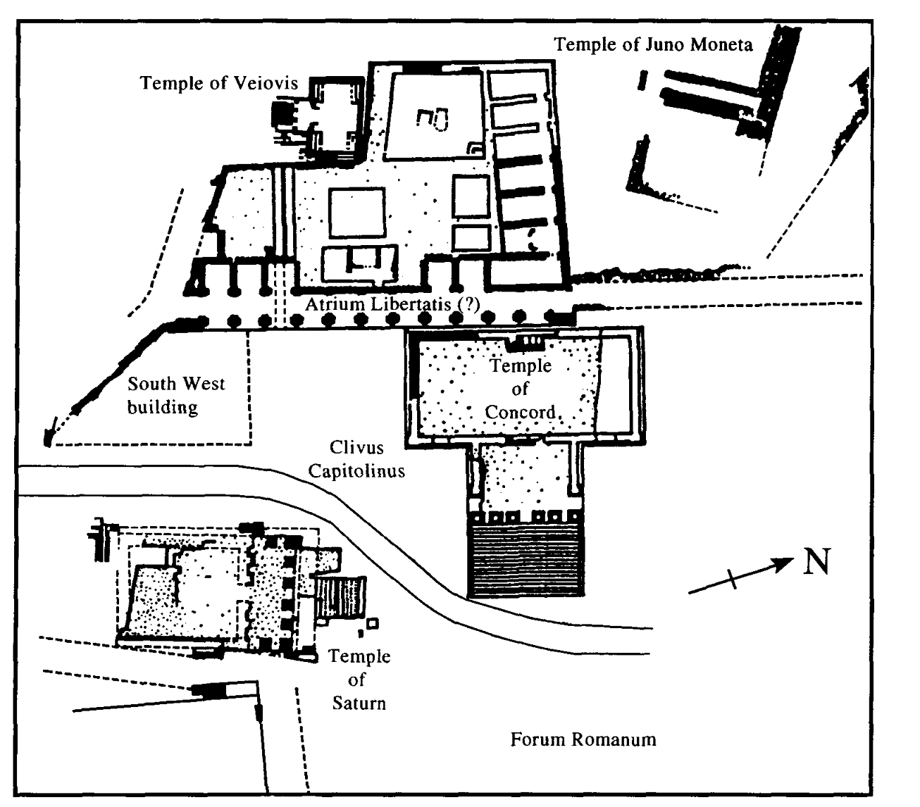
The Roman attitude to Moneta
moneo
Temple of Juno Moneta on the Arx, Capitoline Hill in Rome
Linen rolls
Moneta = Mnemosyne (goddess of memory)
Meadows, A. and J. Williams (2001). Moneta and the Monuments: Coinage and Politics in Republican Rome. Journal of Roman Studies 91: 27-49.
Notes:
Moneta – from moneo, to remind.
Temple of Juno Moneta on the Arx on the Capitoline in Rome.
Money is a medium of exchange, but also a medium of memory – it remembers our transactions with others.
Coins are ‘monuments in miniature’, and monuments that travel.
Almost complete contemporary record!

Slide 18
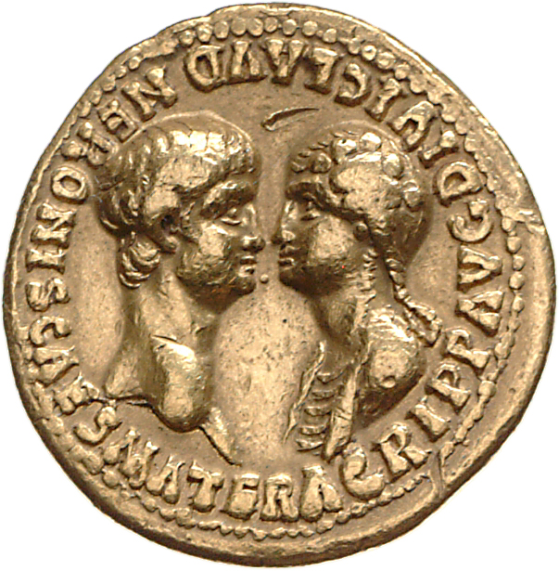
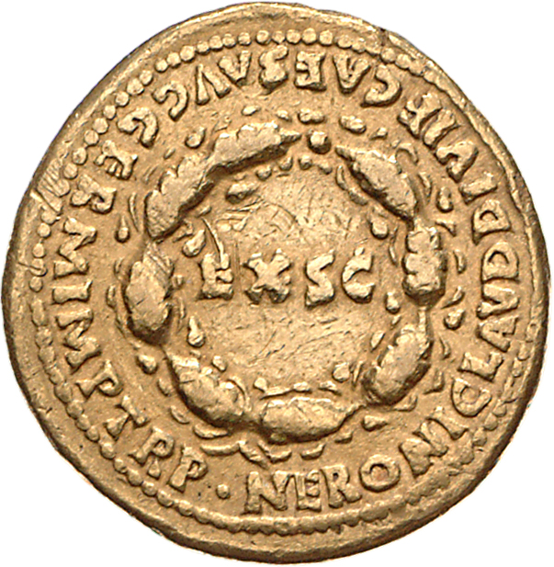
Under Nero
AD 54, gold aureus, RIC I (second edition) Nero 1
Obverse: Bust of Nero, bare-headed, right, bust of Agrippina the Younger, draped, hair in long plait, left, facing one another, AGRIPP AVG DIVI CLAVD NERONIS CAES MATER (Agrippina Augusta, (wife) of the deified Claudius, mother of Nero Caesar).
Reverse: NERONI CLAVD DIVI F CAES AVG GERM IMP TR P surrounding oath wreath enclosing S C
https://numismatics.org/ocre/id/ric.1(2).ner.1
Notes:
Again gold and silver
Agrippina on obverse, Nero in dative in reverse- Agrippina or Senate responsible for the cin issue.

Slide 19
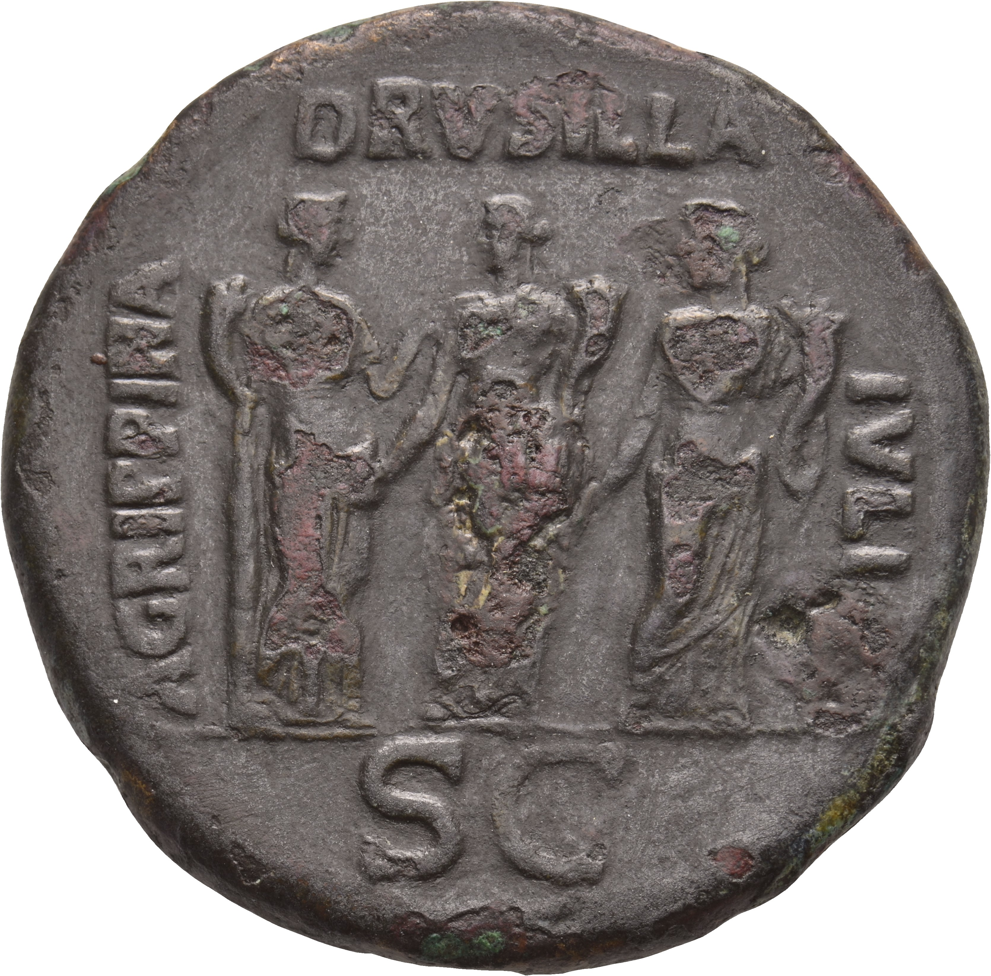
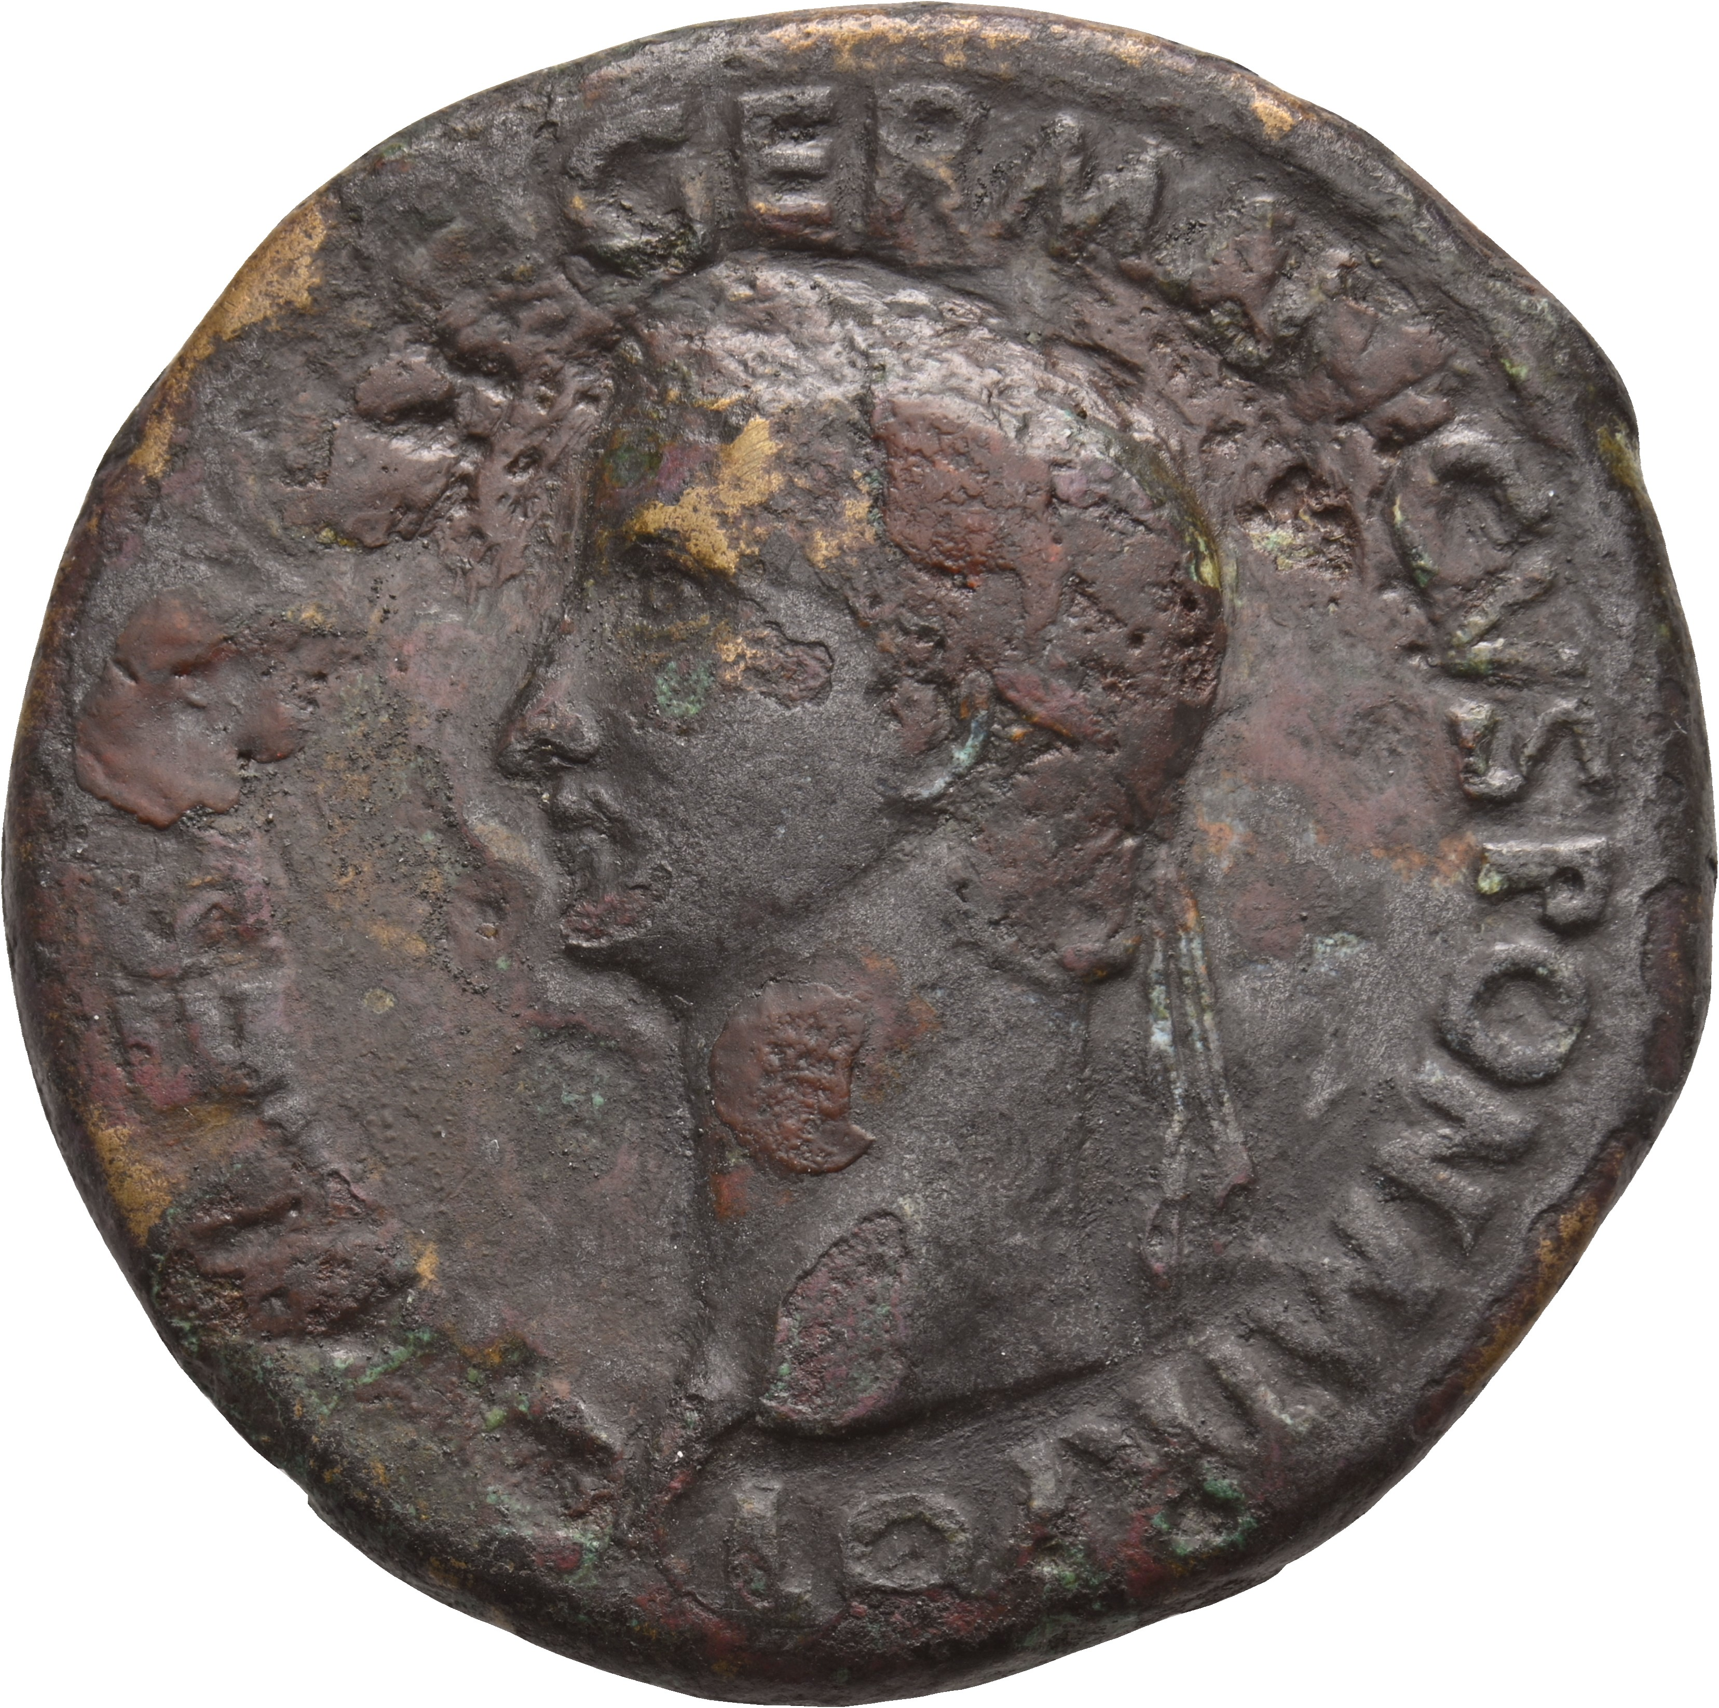
Agrippina on bronze coins
Caligula, Sestertius, AD 37-8, RIC I (second edition) Gaius/Caligula 33
AGRIPPINA DRVSILLA IVLIA S C: Three sisters of Caligula in guise of Securitas (Agrippina)), Concordia (Drusilla)), and Fortuna (Julia), standing side by side to front
Notes:
Great honours given to Caligula’s sisters at this point in his reign, before Drusilla died and the conspiracies began.

Slide 20
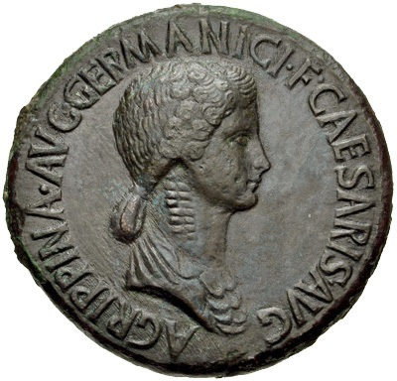
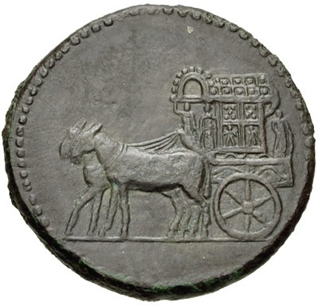
Agrippina, too, continued to exalt her own dignity; she would enter the Capitol in a carpentum, a practice, which being allowed of old only to the priests and sacred images, increased the popular reverence for a woman who up to this time was the only recorded instance of one who, an emperor's daughter, was sister, wife, and mother of a sovereign.
Tacitus, Annals 12.42
Claudius, Sestertius, AD 50-54
Obverse: AGRIPPINA AVG GERMANICI F CAESARIS AVG (‘Agrippina Augusta, daughter of Germanicus, [wife] of Augustus Caesar’): Bust of Agrippina the Younger, bare-headed, draped, right; hair in long plait
Reverse: Carpentum right
Notes:
Tacitus, Annals, 12.42

Slide 21
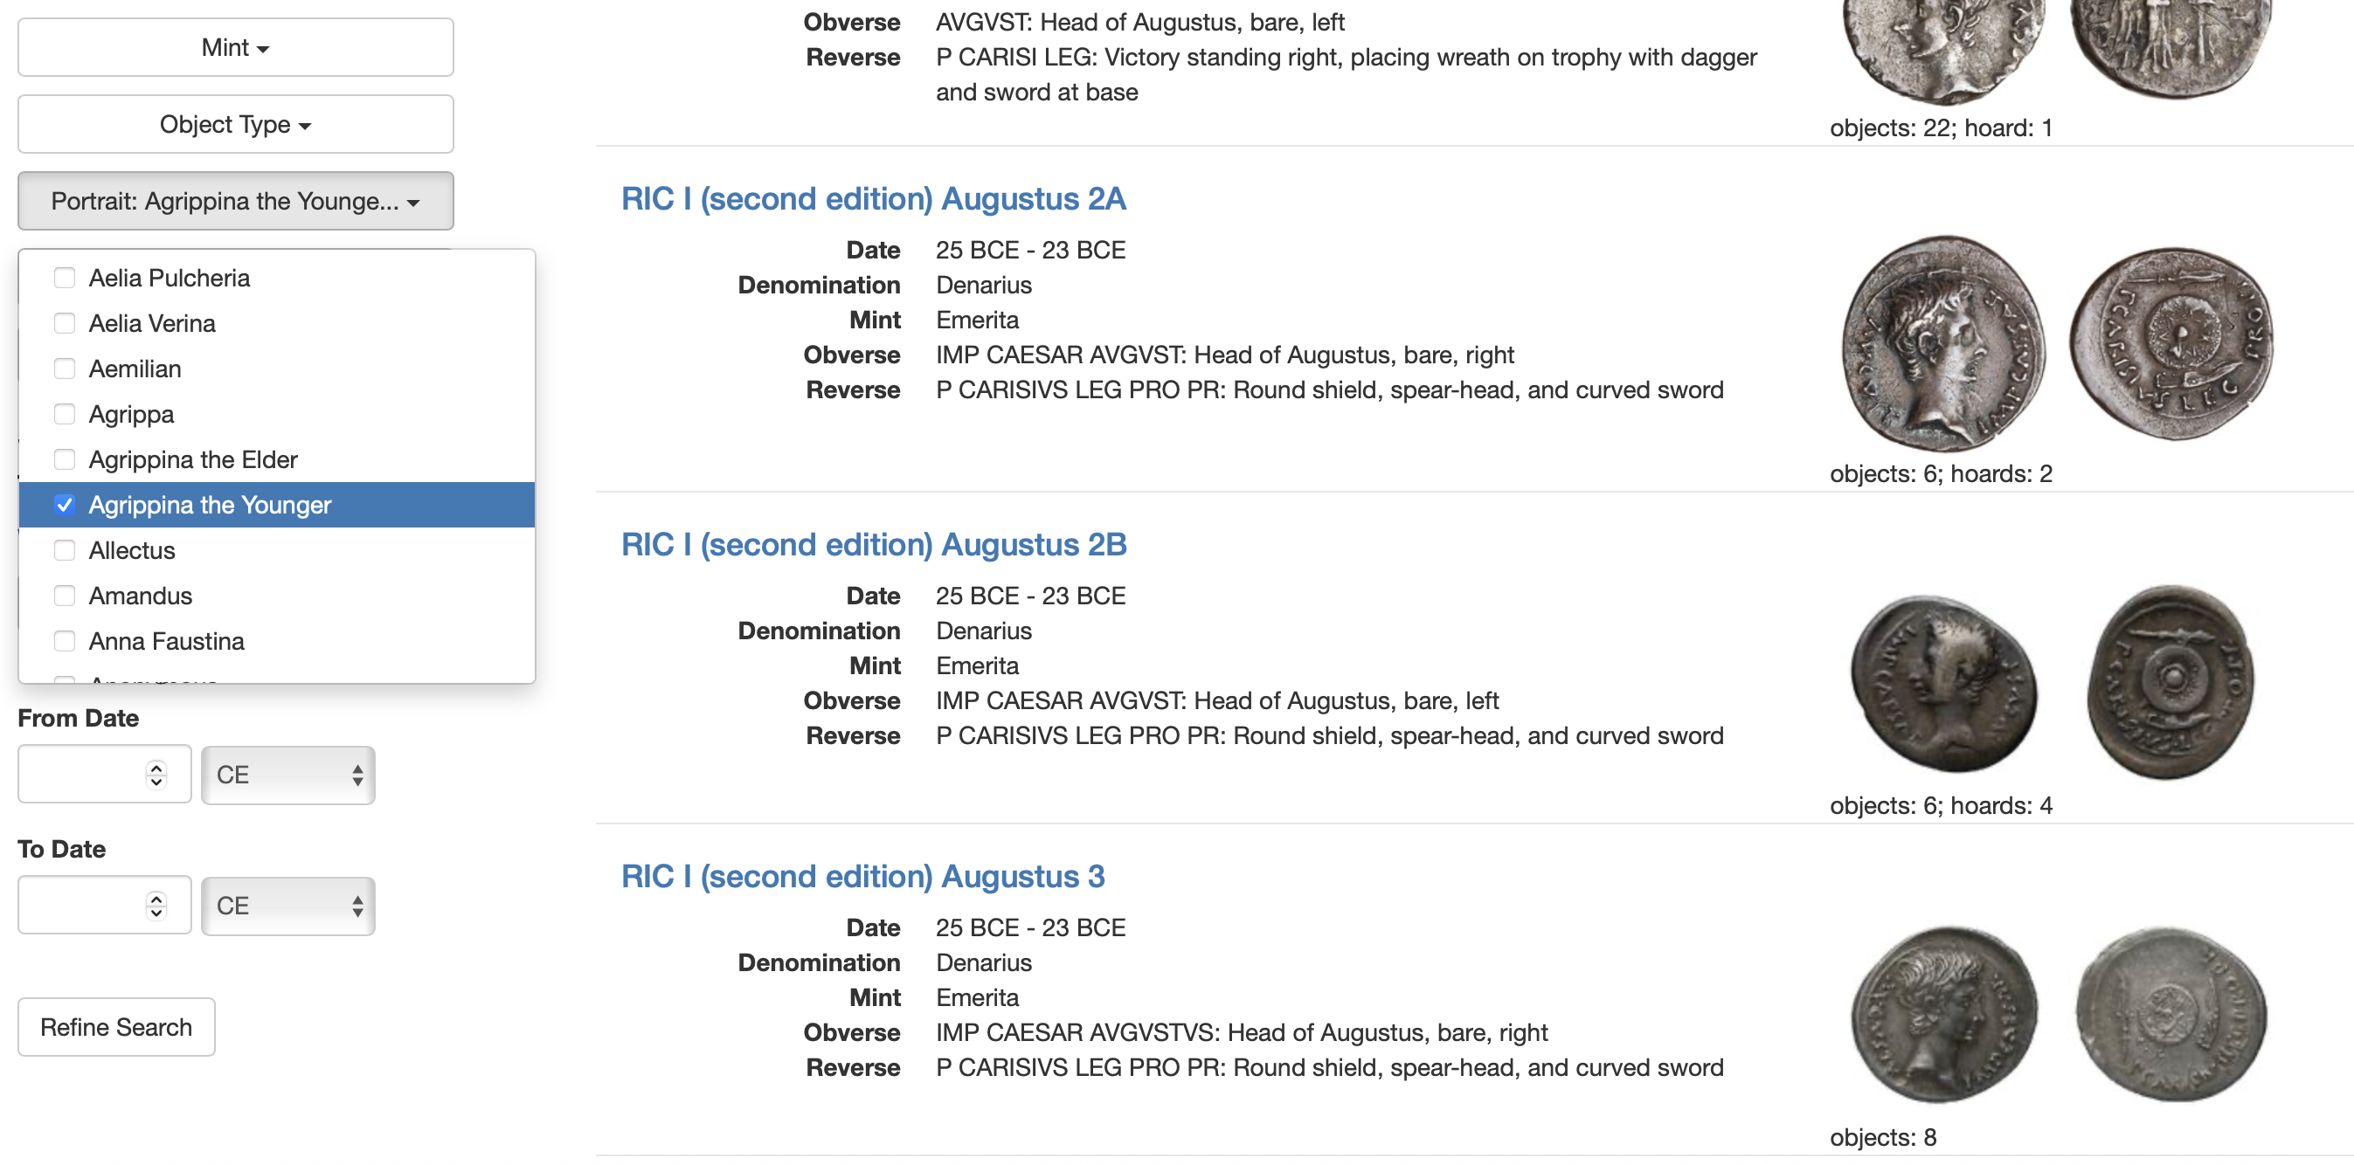
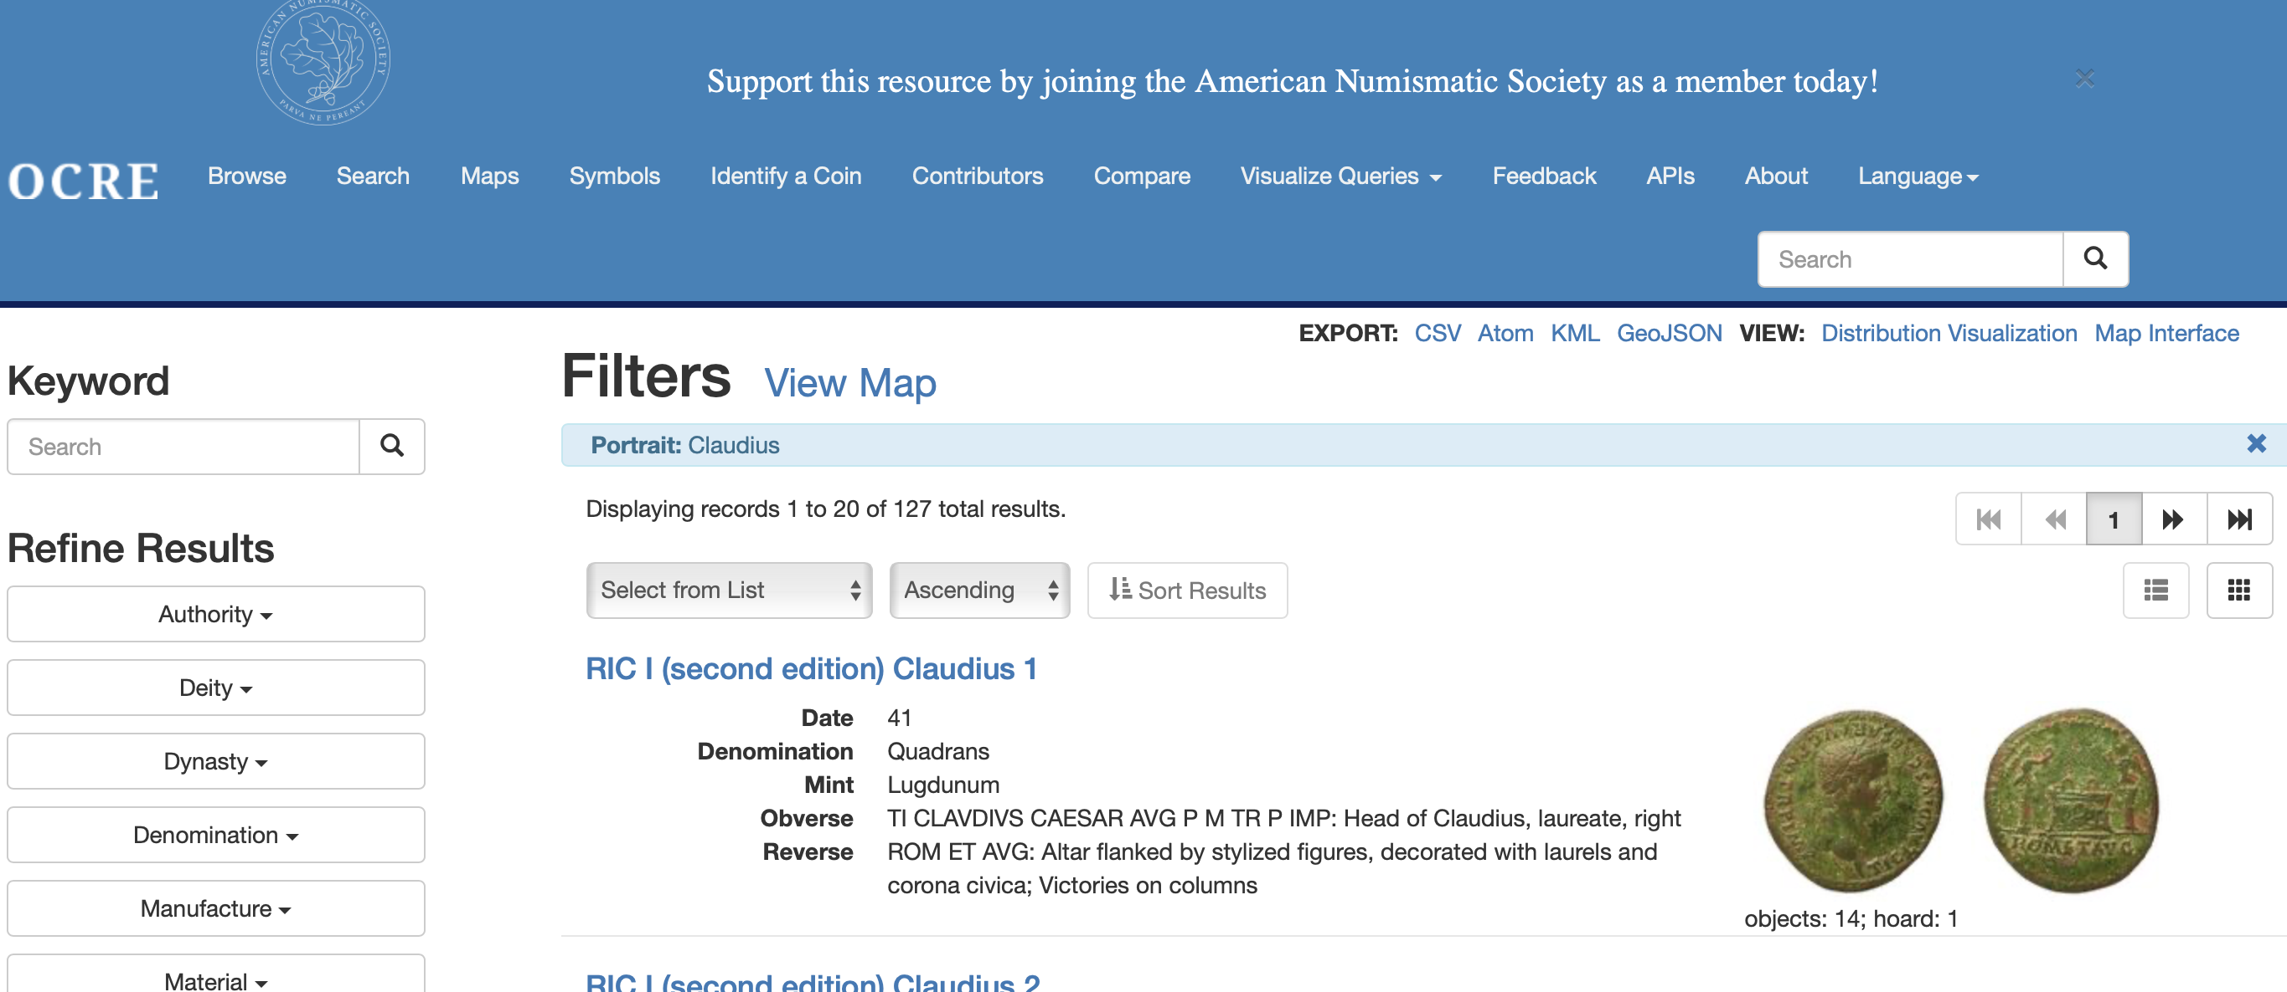
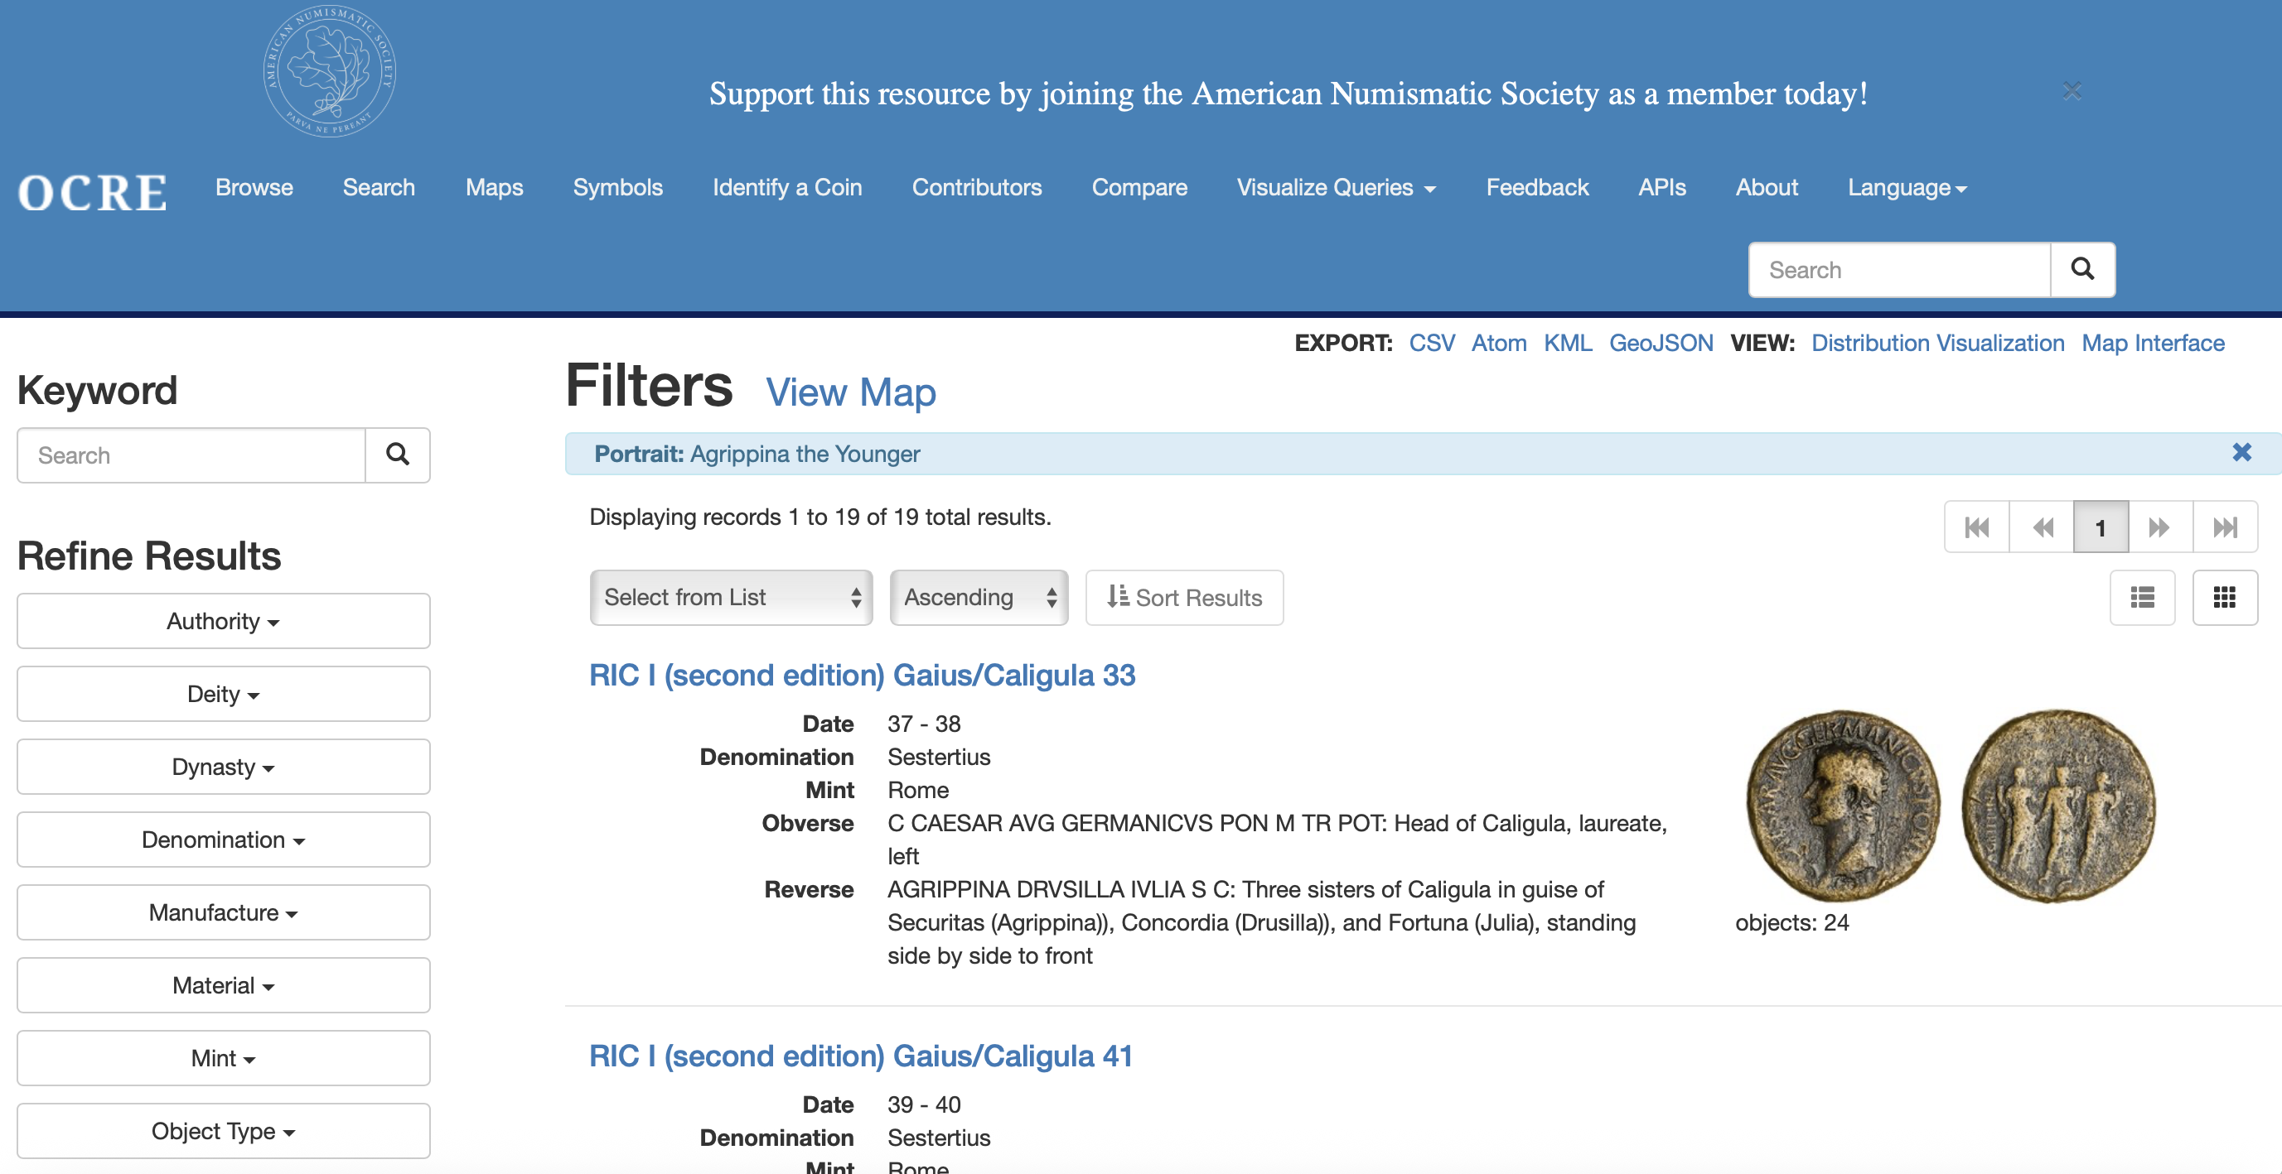
Student activity
Numiswiki
https://www.forumancientcoins.com/numiswiki/view.asp
https://numismatics.org/ocre/

Slide 22
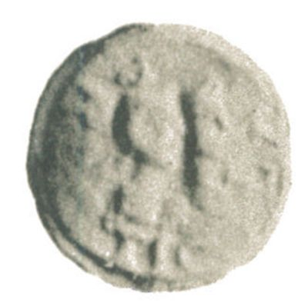
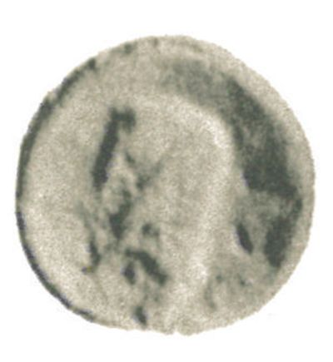
Lead token, TURS 530
Side a: TIC LA PROC (Ti. Cla(udius) proc(urator) ?). Jugate, laureate busts of Nero and Agrippina, right.
Side b: Bare male head left.
Notes:
Agrippina the Younger’s portrait never appears on tokens alone, but always alongside a portrait of Nero
Ti. Cla(udius) proc(urator) or pro c(uratore).

Slide 23
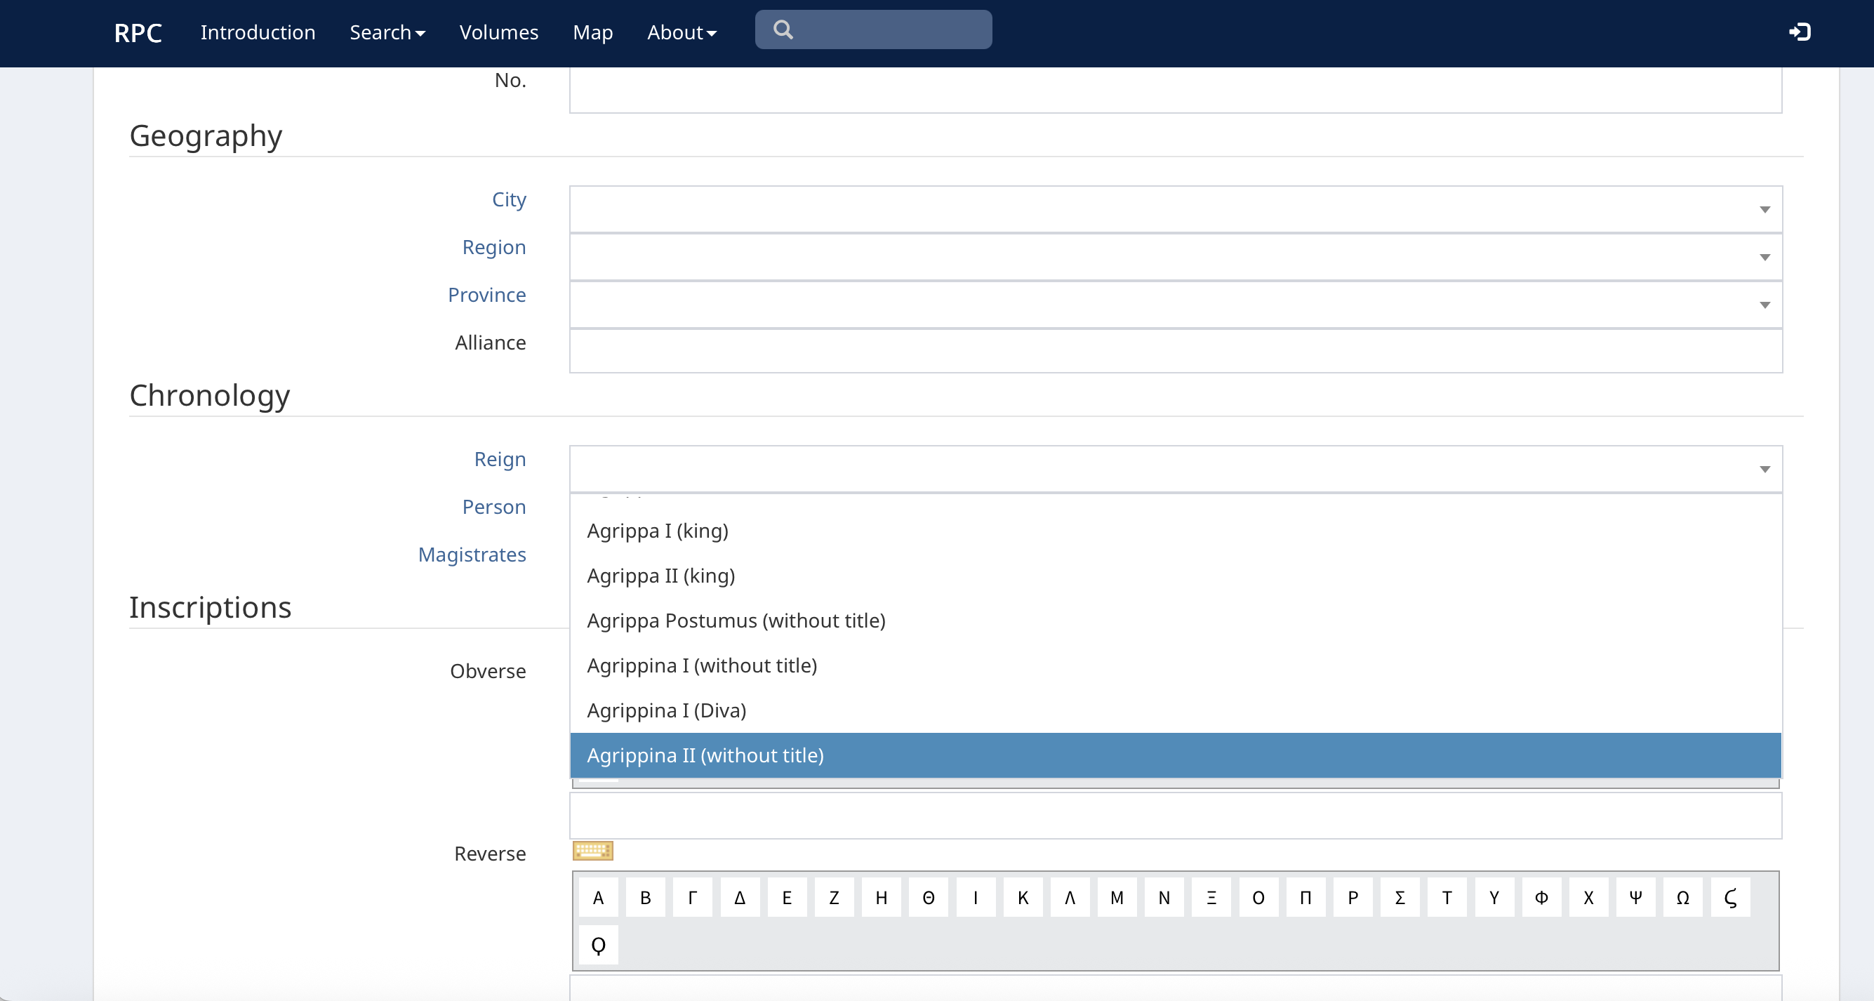
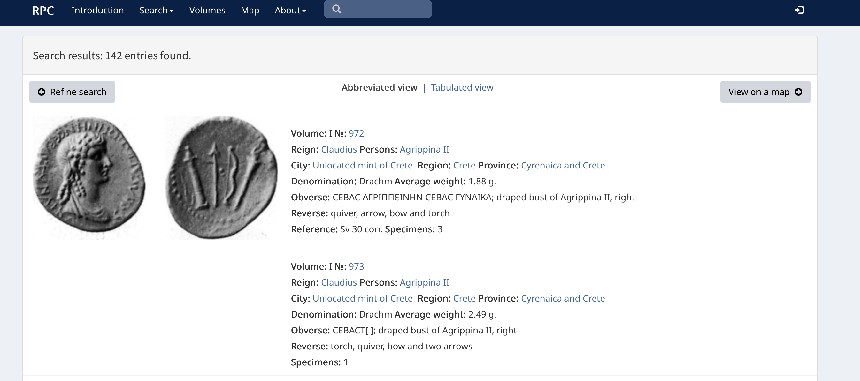
Notes:
OR – what would you create for your local area?

Slide 24
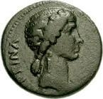
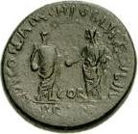
Corinth, AD 50/51
AE 21mm, RPC I, 1184
Obverse: AGRIPPINA CAESARIS (Agrippina, wife of Caesar), bust of Agrippina Minor, right
Reverse: L PAC(O)(NIO) FLAM (or FLAM) CN PVBL(I)(CIO), NE BR (in exergue) with Lucius Paconius Flam— (and) Gnaeus Publicius (duovirs), Nero, Britannicus, Nero and Britannicus, standing face to face
https://rpc.ashmus.ox.ac.uk/coins/1/1184

Slide 25
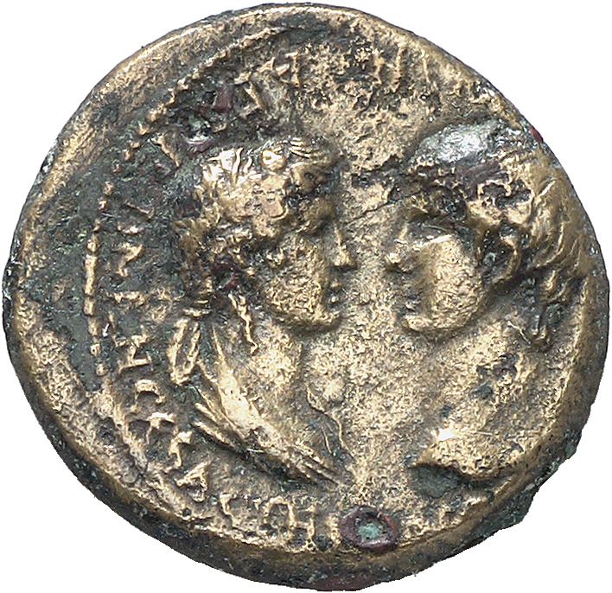
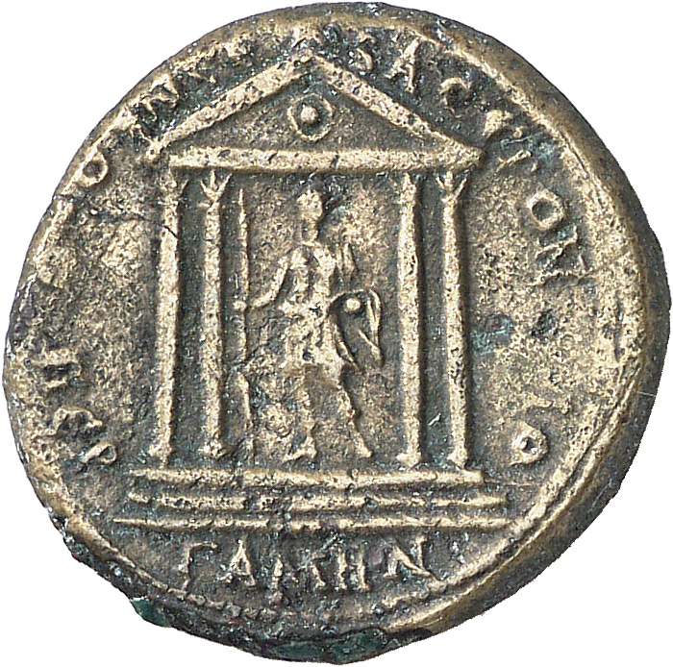
Pergamum, c. AD 55
AE 19mm, RPC I, 2372
Obverse: ΑΓΡΙΠΠΙΝΑΝ ϹΕΒΑϹΤΗΝ ΝΕΡΩΝΑ ϹΕΒΑϹΤΟΝ (For Agrippina Augusta (and) Nero Augustus), draped bust of Agrippina II facing bare head of Nero
Reverse: Temple with four columns enclosing statue of Augustus, resting on spear with his right hand, ΘΕΟΝ ϹΕΒΑϹΤΟΝ ΠΕΡΓΑΜΗΝΟΙ (the Pergamenes (honor) the divine Augustus),
https://rpc.ashmus.ox.ac.uk/coins/1/2372

Slide 26


Hierocaesarea (Lydia), AD 54-59
AE 17mm, RPC I 2388A
Obverse: draped bust of Agrippina II, right, ΑΓΡΙΠΠΙΝΑΝ ΘΕΑΝ ϹΕΒΑϹΤΗΝ (for Agrippina Divine Augusta)
Reverse: Artemis pulling down stag by antlers, ΙΕΡΟΚΕϹΑΡΕΩΝ ΕΠΙ ΚΑΠΙΤΩΝΟϹ (of the Hierocaesareans, under Capito)
https://rpc.ashmus.ox.ac.uk/coins/1/2388A

Slide 27


Mostene (Lydia), AD 50/4
AE 20mm, RPC I 2461
Obverse: laureate head of Claudius and draped bust of Agrippina II, jugate, right, ΤΙ ΚΛΑΥΔΙΟΝ ΚΑΙϹΑΡΑ ΘΕΑΝ ΑΓΡΙΠΠΙΝΑΝ (for Tiberius Claudius Caesar, for the divine Agrippina)
Reverse: hero on horseback, right, with double axe, ΕΠΙ ΠΕΔΑΝΙΟΥ ΚΑΙϹΑΡΕΩΝ ΜΟϹΤΗΝΩΝ (under Pedanius, of the Caesarean Mostenans)
https://rpc.ashmus.ox.ac.uk/coins/1/2461

Slide 28


Samos (Ionia)
AE 20mm, RPC I 2686
Obverse: draped bust of Agrippina II, right ΑΓΡΙΠΠΙΝΑ ΘΕΟΜΗΤΩΡ (Agrippina, mother of the god)
Reverse: peacock standing on caduceus, right; behind, sceptre. ΣΑΜΙΩΝ (of the Samians)
https://rpc.ashmus.ox.ac.uk/coins/1/2686

Slide 29


Acmonea (Phrygia), c. AD 55
AE 16mm, RPC I 3173
draped bust of Agrippina II with ears of corn and poppy, right, ΑΓΡΙΠΠΙΝΑΝ ΣΕΒΑΣΤΗΝ (for Agrippina Augusta)
Artemis, right, drawing arrow and holding bow; before, small figure of Nike with palm and wreath. ΕΠΙ ΣΕΡΟΥΗΝΙΟΥ ΚΑΠΙΤΩΝΟΣ ΚΑΙ ΙΟΥΛΙΑΣ ΣΕΟΥΗΡΑΣ ΑΚΜΟΝΕΩΝ (under Servenius Capito and Julia Severa, of the Acmoneans)
https://rpc.ashmus.ox.ac.uk/coins/1/3173

Slide 30


Thessalonica (Macedonia) under Nero
RPC I, 1605, 16mm
bust of Agrippina, left, ΑΓΡΙΠΠΙΝΑ ΣΕΒΑΣΤΗ, Agrippina Augusta
horse trotting, left; above, star and crescent
https://rpc.ashmus.ox.ac.uk/coins/1/1605

Slide 31



Further classroom ideas https://warwick.ac.uk/fac/arts/classics/warwickclassicsnetwork/stoa/classroom/imperialindulgence

Slide 32

Resources
Roman Republican Coinage: http://numismatics.org/crro/
Roman Imperial Coinage: https://numismatics.org/ocre/
Roman Provincial Coinage: https://rpc.ashmus.ox.ac.uk
Ancient Tokens: https://coins.warwick.ac.uk/token-types/
Caligula and his sisters (Kevin Butcher): https://www.youtube.com/watch?v=3uZMF69W8fA
Nero and Agrippina (Kevin Butcher):
https://www.youtube.com/watch?v=as3owbZw82E
- Warwick Classics Sketchfab account: https://sketchfab.com/warwickclassics

