Slide 1
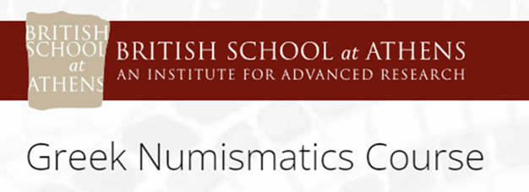

Overstrikes and Countermarks
Dr. Mairi Gkikaki

Slide 2
Overstrikes are a great source for the numismatist. In a world of research which rarely allows one to be 100% confident in any proposal, they offer this kind of intellectual comfort since what is below is also before.

Slide 3
Why overstrike coins?

Slide 4
Why overstrike coins?
The necessity of altering the area of circulation of a certain coinage could be the main factor
Local shortages of small change
Wear

Slide 5
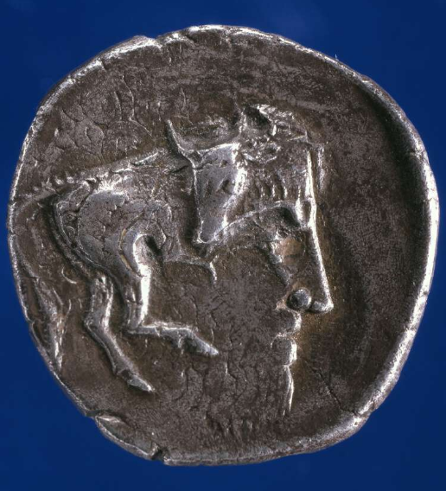
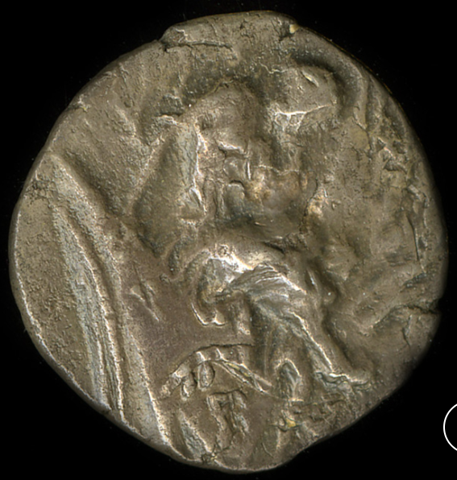
British Museum, 1858,1124.35
Gortyna on a coin of Cyrene

Slide 6
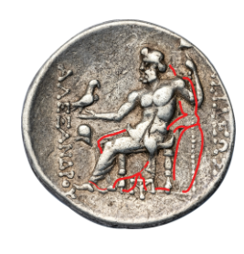
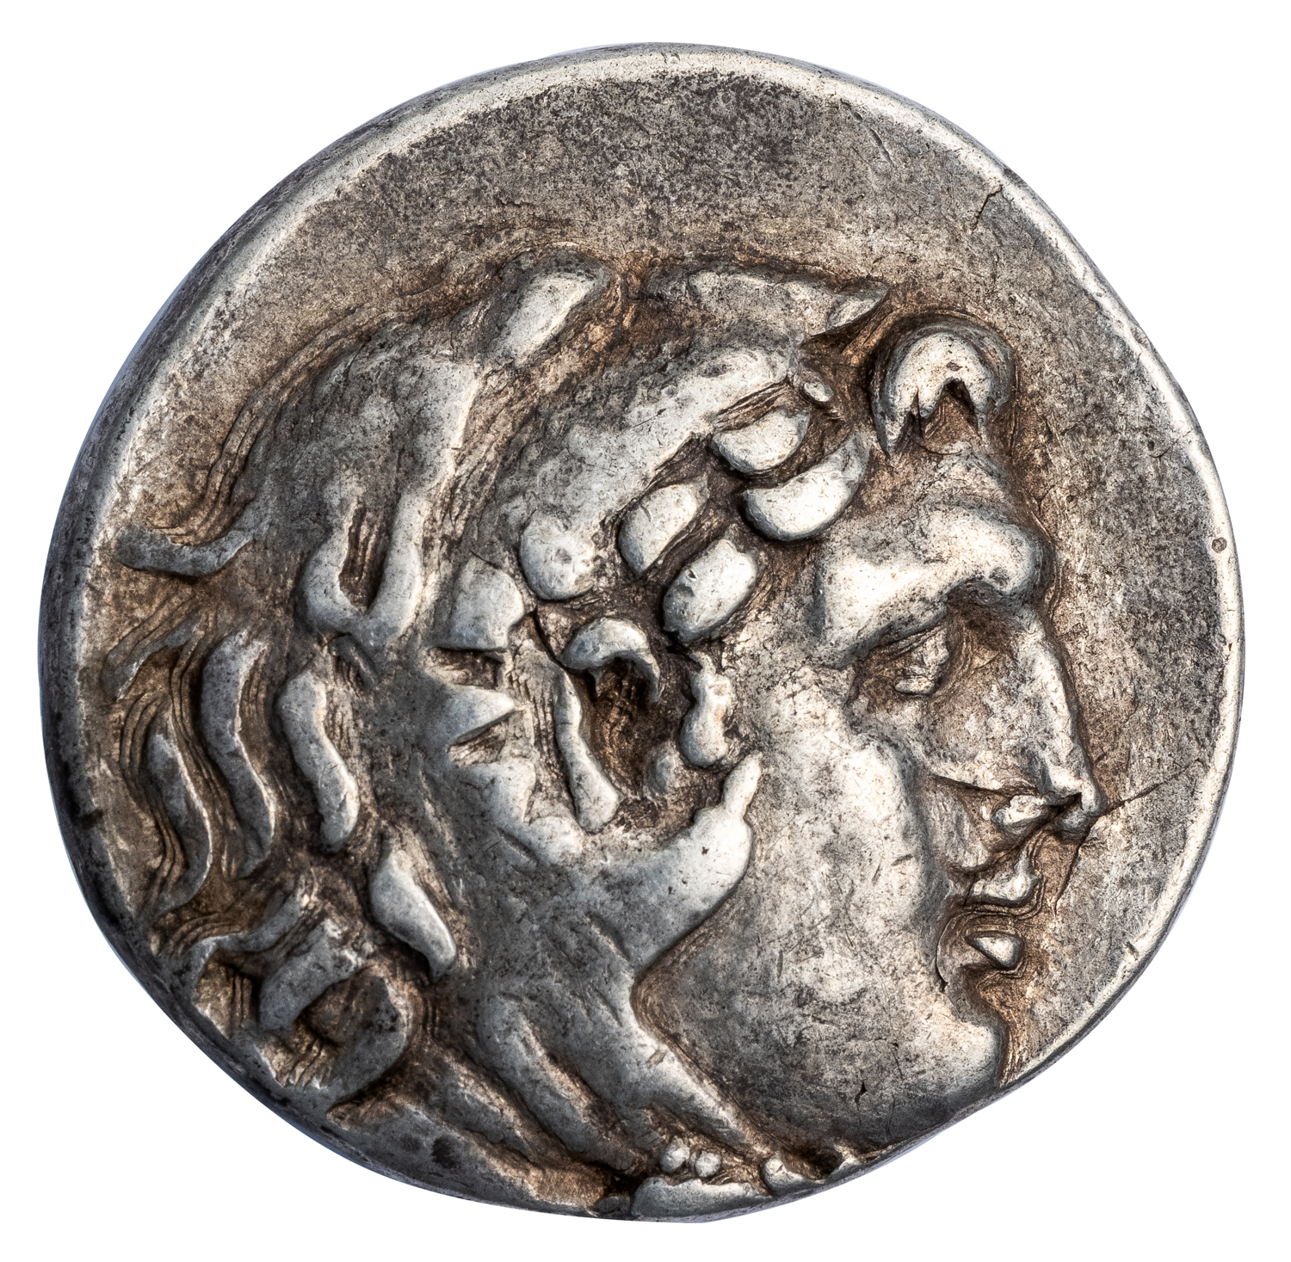
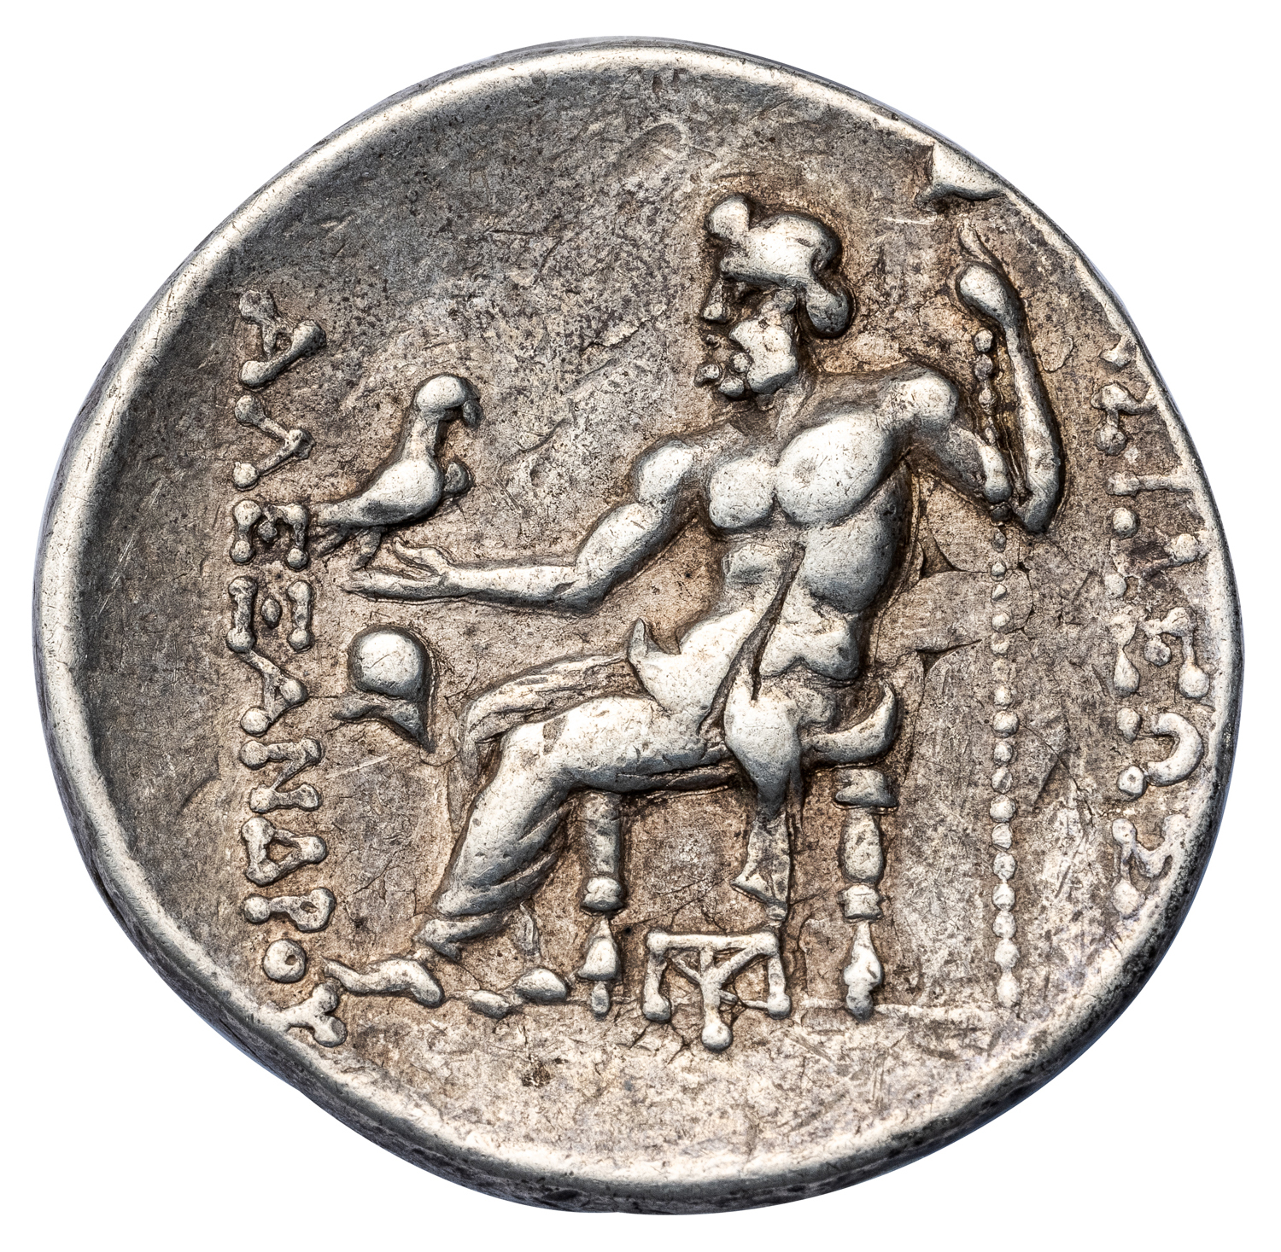
Late Alexanders of Mesembria, overstruck on Lysimachus
Late Alexanders of Mesembria, overstruck on Lysimachus
https://vilmarnumismatics.com/product/alexander-the-great-silver-tetradrachm-extremely-rare-emission-of-mesembria-overstruck-on-a-lysimachus-tetradrachm-vf-ngc-graded-greek-coin-inv-18132/

Slide 7
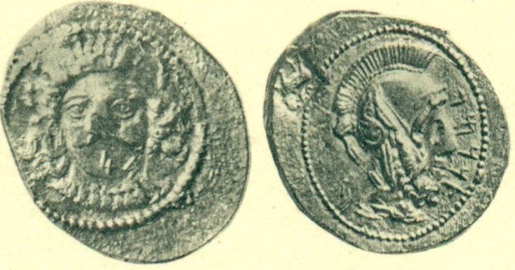
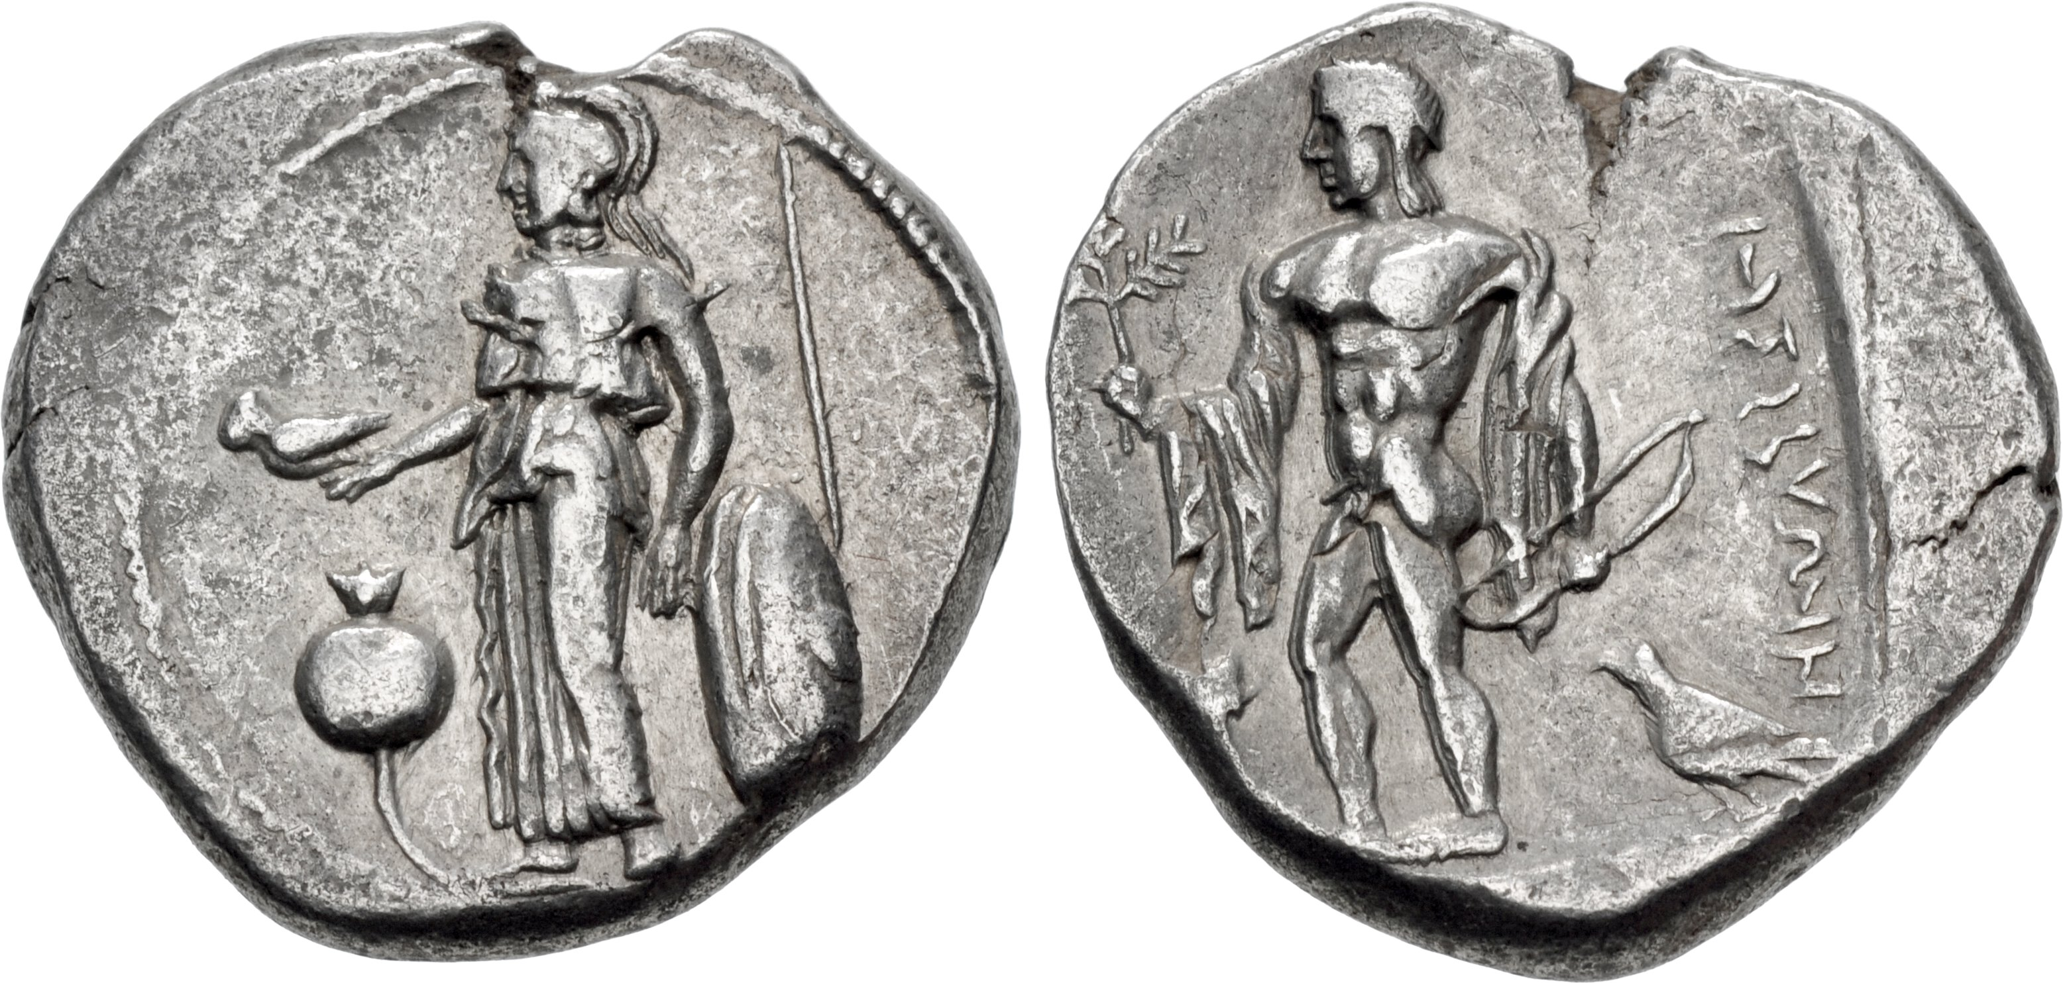
Tarsus, Cilicia,
Siglos in the name of Tarkumuwa, overstruck on Side
SNG Berry, n° 1294; Classical Numismatic Group, 27, 29 Sept. 1993, 683

Slide 8
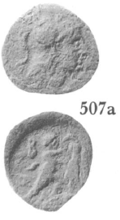
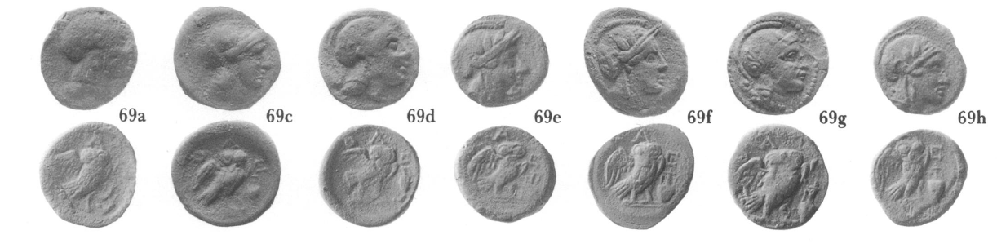
AE of Athens overstruck on Macedonian Regal bronzes
Kroll 1993

Slide 9
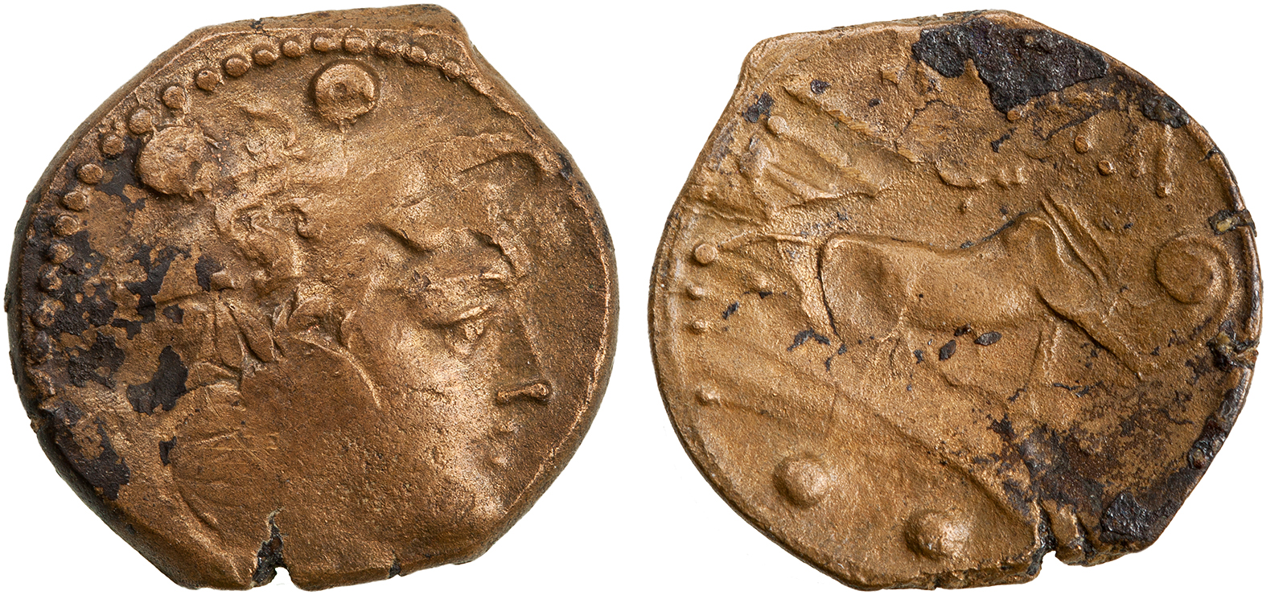
Roman Sextans on Napolitan Bronze coin
ANS 2015.20.2032.
Second Punic War, mint of Minturnae
While the weight of these pseudo-Roman issues differed from the official Roman production,
the types on them made their value immediately recognizable to users.

Slide 10
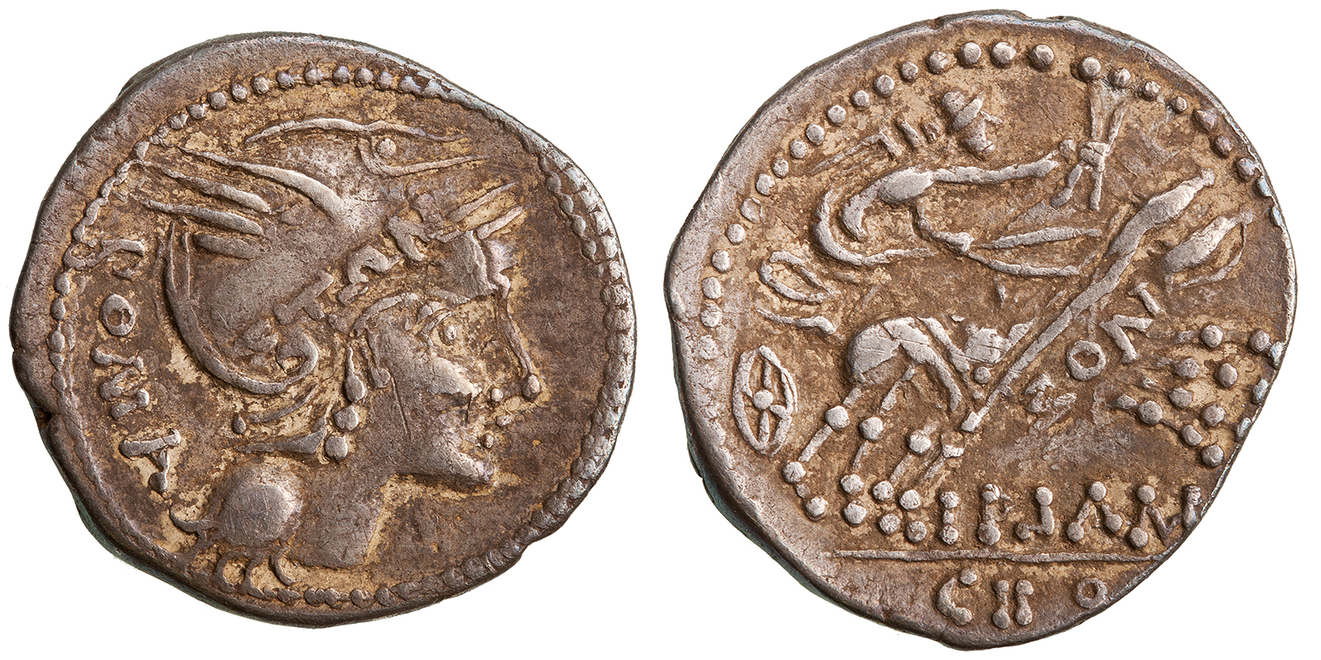
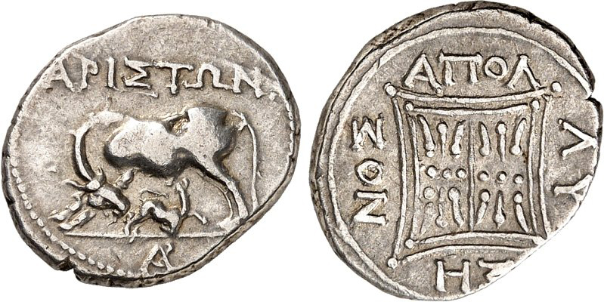
ANS 2015.20.2393
as in the case of a Dacian imitation
of a denarius (issued by L. Flaminius Chilo
in 109/8 BC)
struck
over a drachm from Apollonia
Illyria, Apollonia. Silver drachm. Early second century BC.
3.13 g. SNG Cop. 387.
Münzzentrum Rheinland 191, 3 June 2020, lot 32.

Slide 11
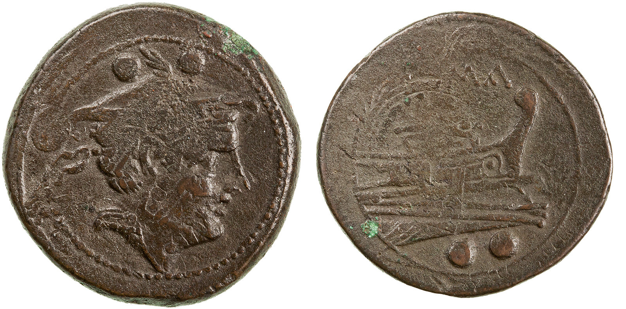
Sudden decreases in
weight standard
Rome. Bronze sextans (RRC 41/9). 215–212 BC. Head of Mercury, right. Prow, right; below, denominational mark (two pellets). Above, ROMA. 11.03 g. 26.5 mm. RRC 41/9. Hersch 1953, p. 51, n. 39d. ANS 2015.20.1791. Struck on semilibral uncia RRC 38/6)

Slide 12
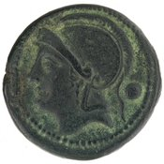
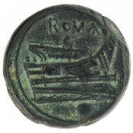
Rome. Bronze sextans (RRC 41/9). 215–212 BC. 11.03 g. 26.5 mm. RRC 41/9. Hersch 1953, p. 51, n. 39d. ANS 2015.20.1791. Struck on semilibral uncia RRC 38/6)
Sudden decreases in
weight standard
Bronze Coin, Rome, 217 BC - 215 BC ANS 1941.131.29. 13.66g

Slide 13
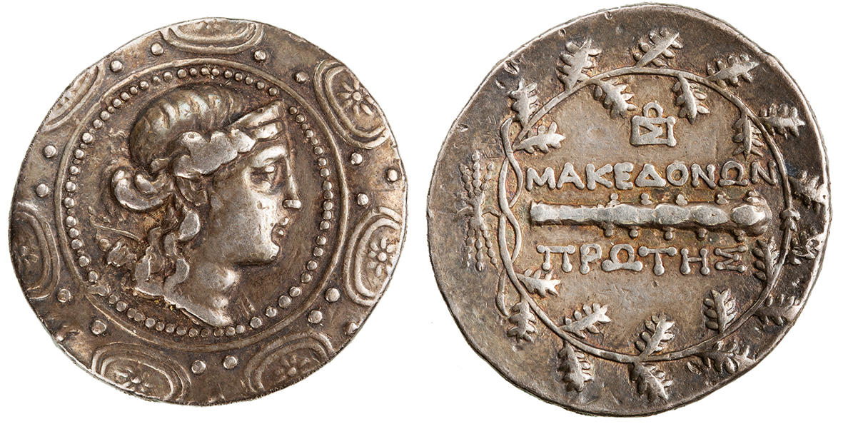
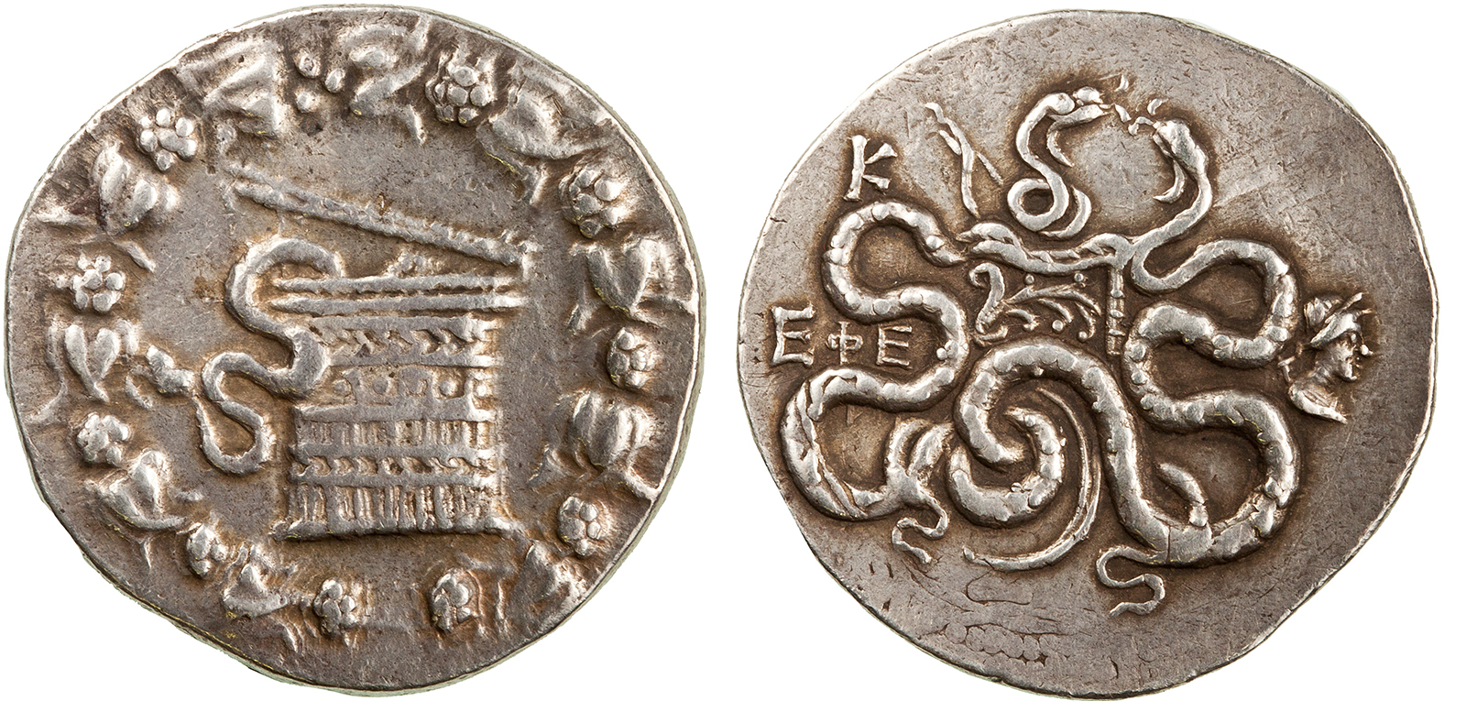
Cistophorus of Ephesus struck over a Macedonian I Meris
ANS 2015.20.1273.
ANS 2015.20.2135.
de Callatay AJN 2011

Slide 14
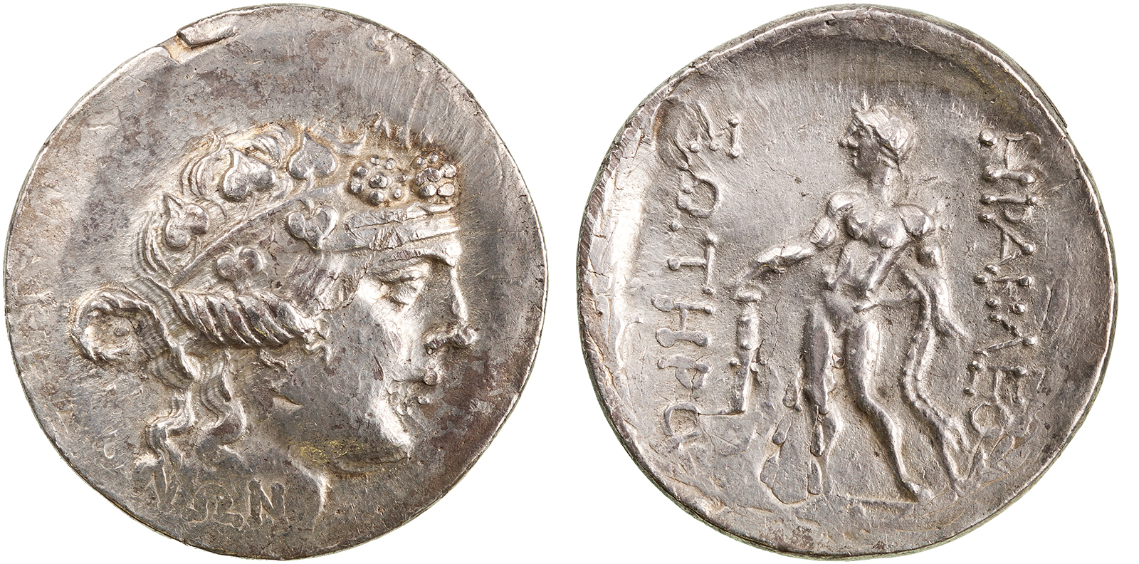
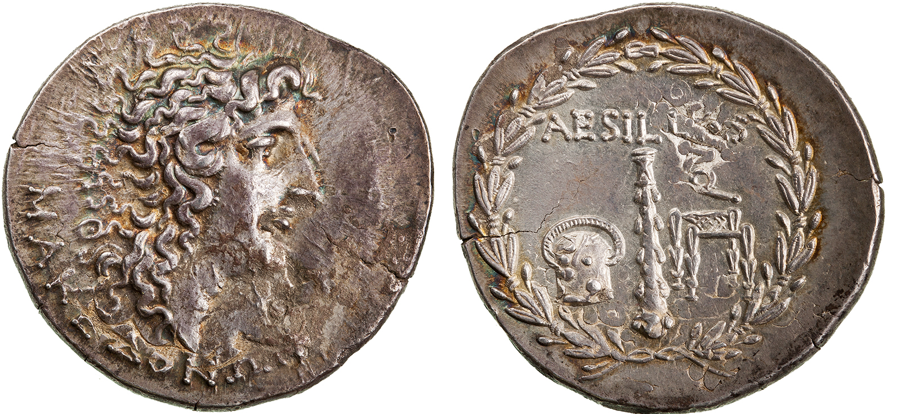
Quaestor Aesilas struck on a Thasian Tetradrachm
1,000 tetradrachms with 102 obverses
ANS 2015.20.2662.
ANS 2015.20.2196.

Slide 15
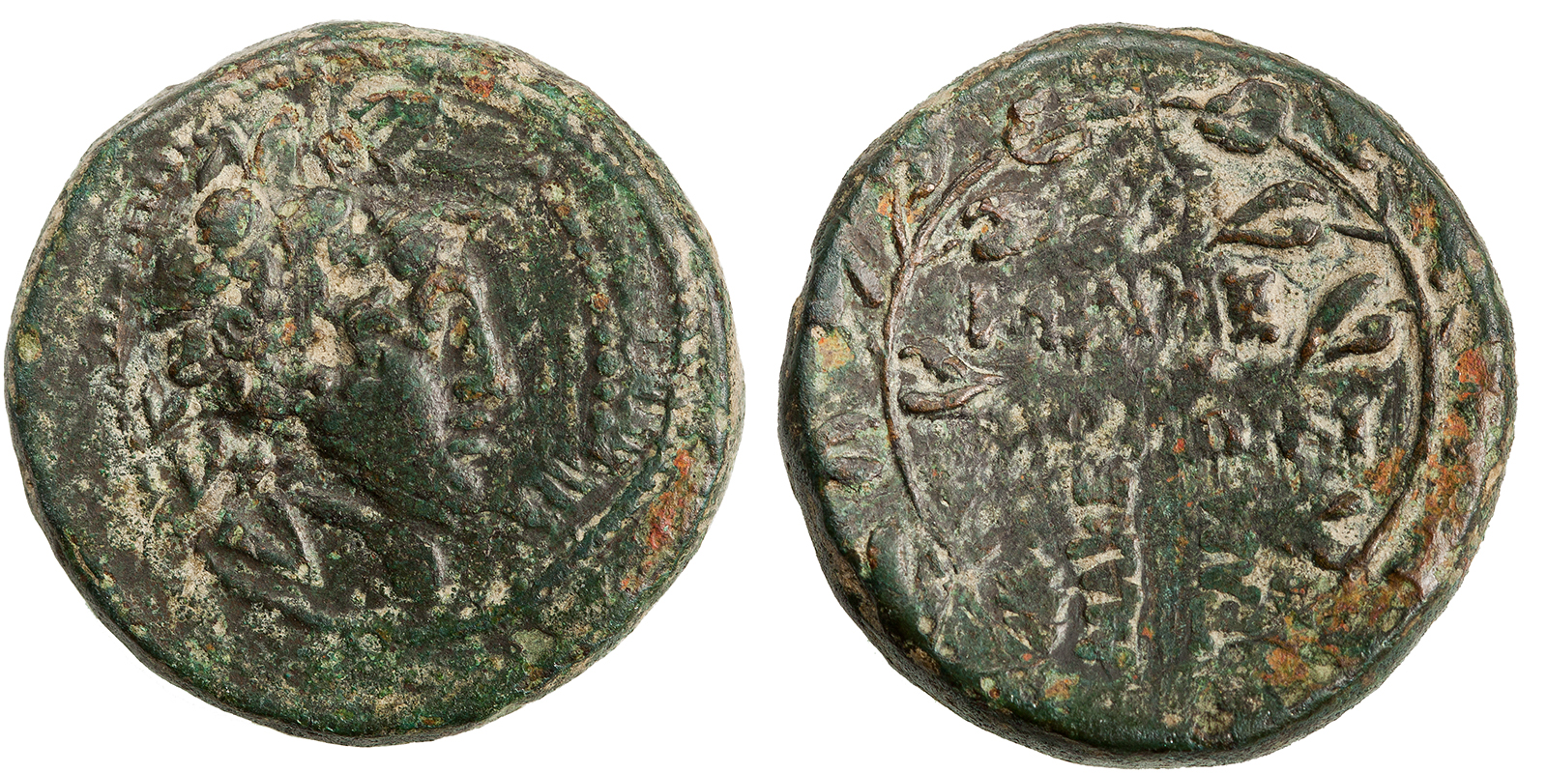
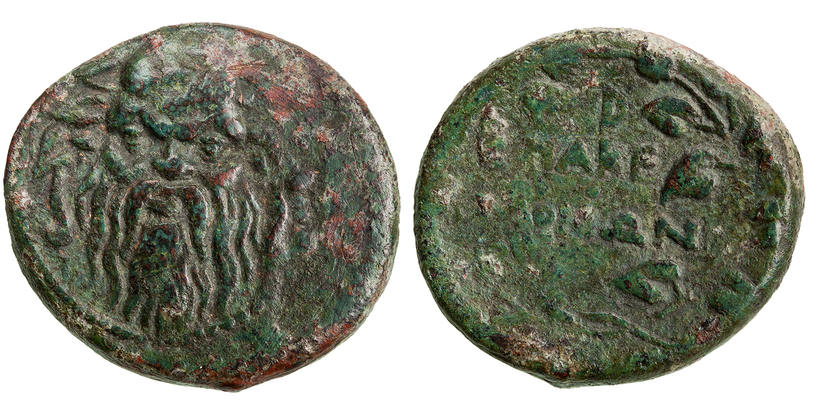
Issued by the Roman quaestor Gaius Publilius either after 168 BC either after 148 BC, is clearly struck over a Silenus/ D ΜΑΚΕΔΟΝΩΝ issue.

Slide 16
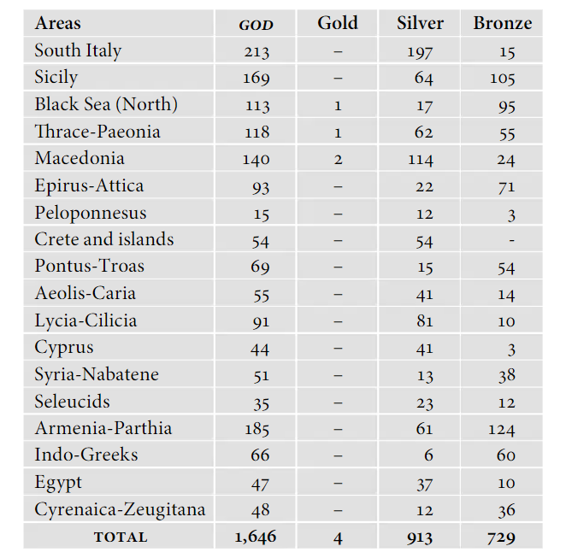
Greek Overstrikes
Database by F. de Callatay and D. McDonald:
The GOD database

Slide 17
Definition by D. McDonald, Overstruck Greek Coins: overstruck coins are coins that have been ‘recoined’ by striking them with new and different dies, whether by the original minting authority or by a different one, without having the original design completely removed beforehand

Slide 18
Overstrikes on silver, overstrikes on bronze
Overstrikes on silver were usually unprofitable for the mintmaster and only occurred when he was unable to produce the right number of coins with the allotted silver. A marginal phenomenon.
Overstrikes on bronze: more numerous. They were carried out in order to succeed a financial benefit through revaluations.

Slide 19
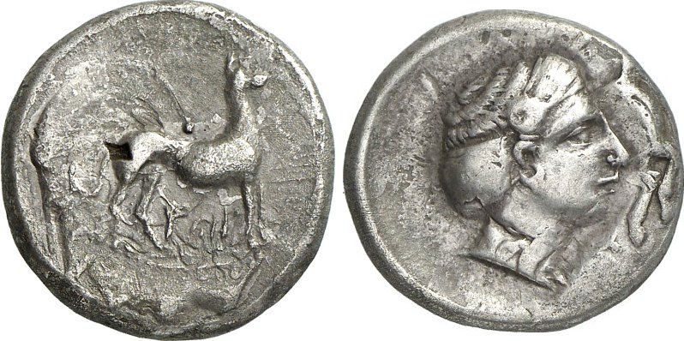
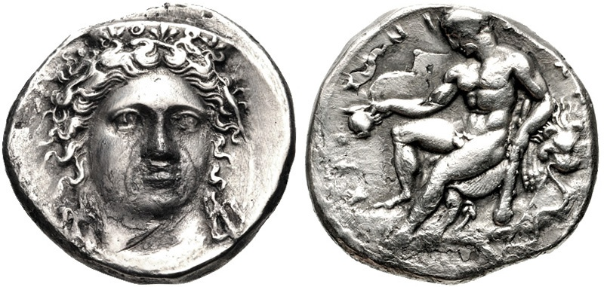
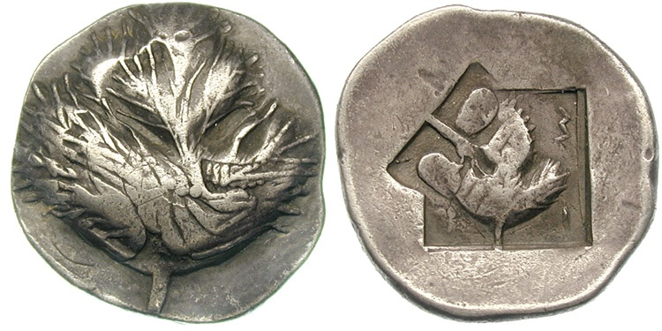
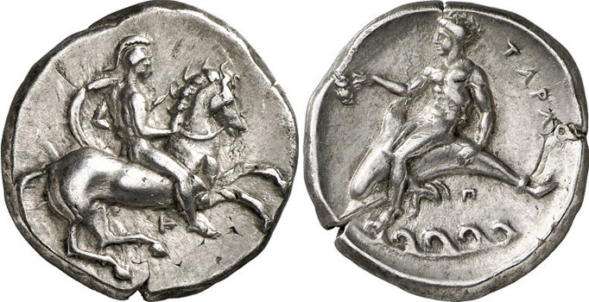
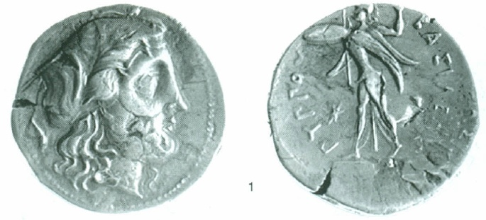
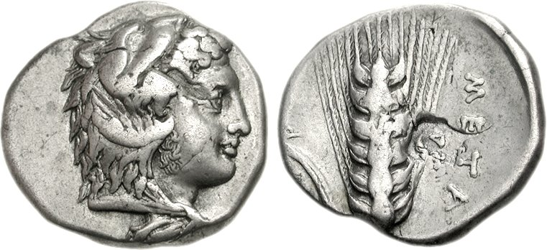
Coins from Sicily (left) and Magna Graecia (right) all overstruck on Corinthian staters

Slide 20
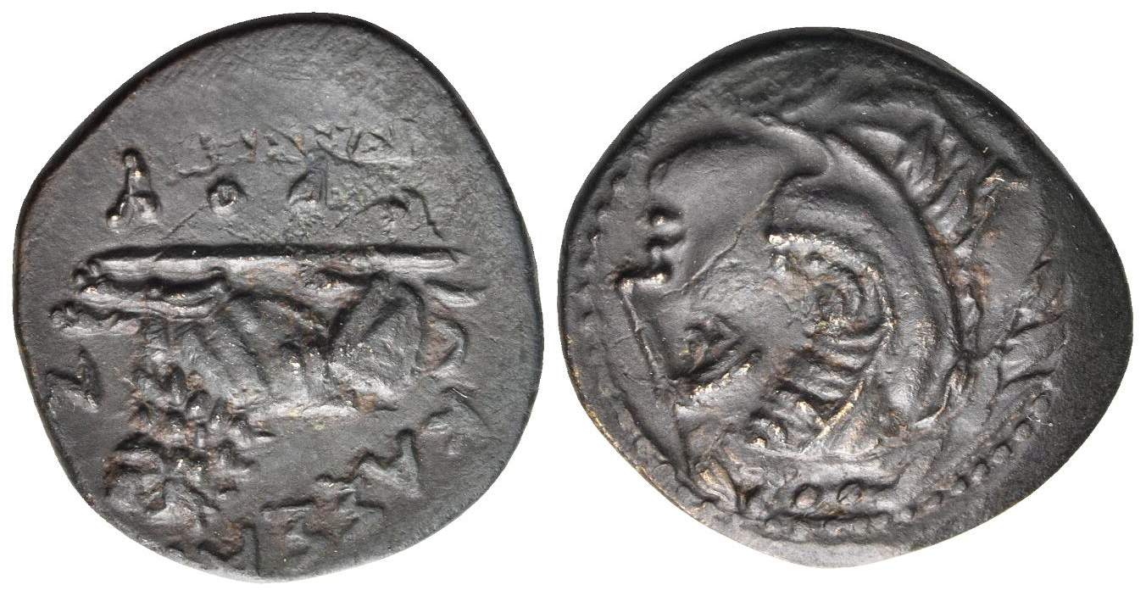
Bronze of Cassander, overstruck on an earlier Herakles/Bow in bow-case and club issue of Alexander III.
Nomos AG > obolos 27, lot 136

Slide 21
On Overstrikes
https://numismatics.org/pocketchange/overstrikes/
F. De Callatay and D. McDonald, Greek Overstrikes Database, Taormina 2015 PPT Presentation
https://donum.numismatics.org/cgi-bin/koha/opac-detail.pl?biblionumber=202132
G. Le Rider, “Contremarques et surfrappes dans l’Antiquité grecque”, in J.-M. Dentzer, Ph.Gauthier and T. Hackens (eds.), Numismatique antique. Problèmes et méthodes, Nancy-Louvain, 1975, 27-56
https://journals.openedition.org/ashp/1700?lang=fr
François de Callatay, « Histoire monétaire et financière du monde grec », Annuaire de l'École pratique des hautes études (EPHE), Section des sciences historiques et philologiques [En ligne], 146 | 2015, mis en ligne le 30 septembre 2015, consulté le 29 mars 2023. URL : http://journals.openedition.org/ashp/1700 ; DOI : https://doi.org/10.4000/ashp.1700

Slide 22


Slide 23
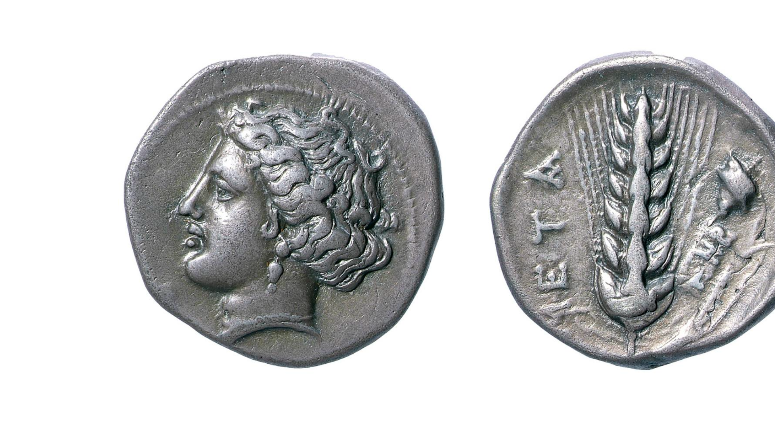
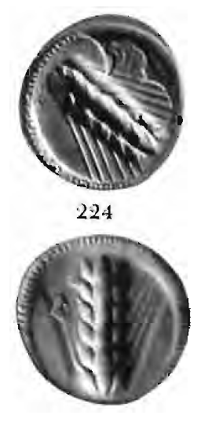
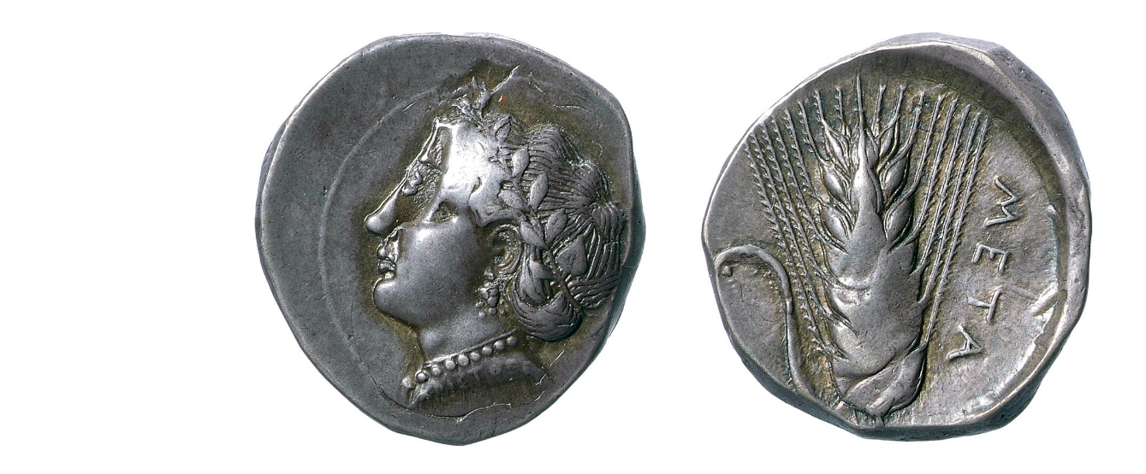
Metapontum overstruck on Corinth after Kraay 1976
Metapontum overstruck on Corinth
BM 1946,0101.365 and BM RPK,p277A.28.Met

Slide 24
Athenian tokens overstruck on foreign coins
Agora B1564
Muenzkabinett Berlin
Fourth Century BCE bronze jurors tokens overstruck on Suracusan bronzes of the Hippocamp series, the same as Svoronos 19

Slide 25
Why countermark coins?

Slide 26
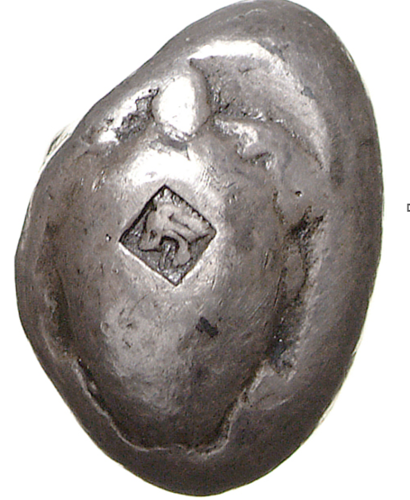
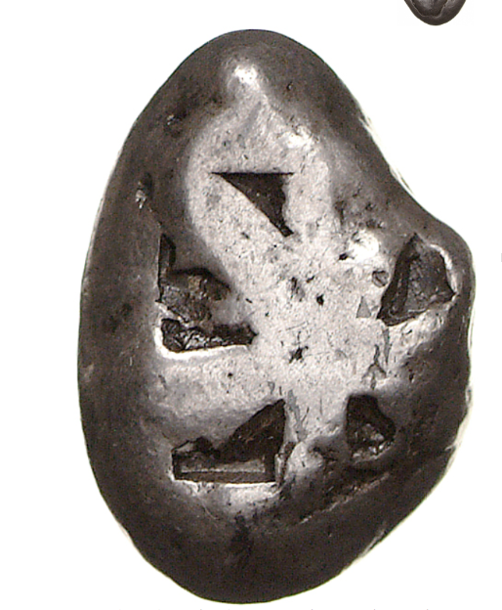
Aigina, 580-540
Berlin https://ikmk.smb.museum/object?id=18203108

Slide 27
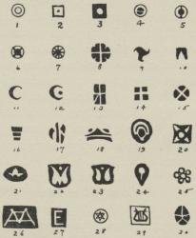
Countermarks on Aiginitan coins

Slide 28
Countermarks on Persian sigloi
Hoard published by Noe 1956: mixed hoard of 255 coins: 254 sigloi and one croesoeid
Large numbers of coins from the same die-combinations and therefore at a close distance of the mint in which they were struck.
Most of the coins bear no countermark: The coins would have been recognized as acceptable without the guarantee of the countermark.
Of the 254 sigloi in this hoard, only 40 are countermarked. Some of these forty bear more than one countermark, and occasionally the same countermark occurs on more than one of them.
If the accepted interpretation of the cause for these countermarks as bankers' signets is the correct one, they must have either a local or personal significance. There seems no good reason why they may not also have been a small-scale "international" banker's signets. But even then they would have had a limited recognition and acceptance, and whatever the signet guaranteed would have been given recognition within a well-defined area. In another hoard a siglos has been found which bore not less than seven of these marks.
Many of the punches: Triskeles, which is the parasema of Lycia
Cf. http://numismatics.org/digitallibrary/ark:/53695/nnan22025

Slide 29
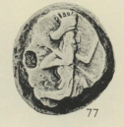





Hoard of 255 coins (254 sigloi and one Croesoeid) (Noe, ANSMNM 136, 1956)

Slide 30
Countermarks: The case of Hellenistic Cyclades by P. Tselekas and Ch. Papageorgiadou (2008)
Series of countemarked coins surviving in large numbers and bearing multiple punches
Countemarking of their own bronzes, countermarking of foreign silver
Providing them the status of ‘legal tender’
Quick method of ‘re-striking’ coins and putting them ‘afresh’ into circulation
Re-validating the fiduciary coinage as a means of increasing public revenue

Slide 31
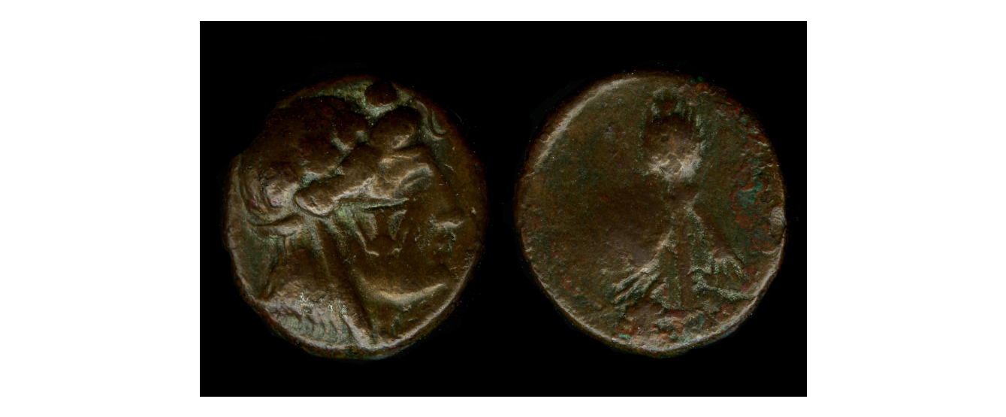
Andros
BM 1922,1020.164

Slide 32
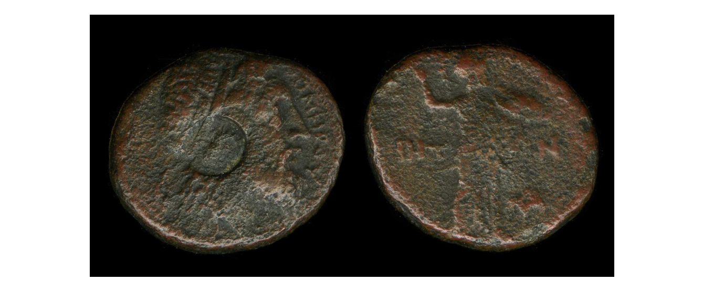
Ios
BM1840,1226.92

Slide 33
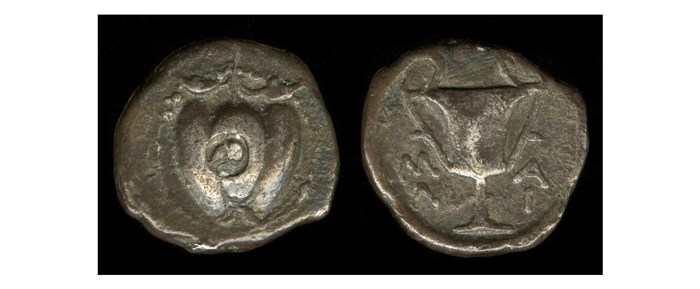
Melos
The British Museum: BNK,G.377

Slide 34
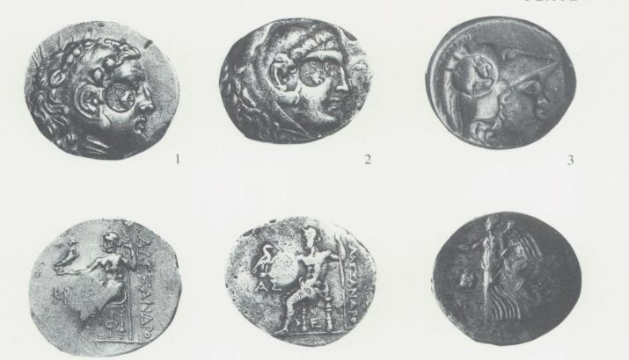
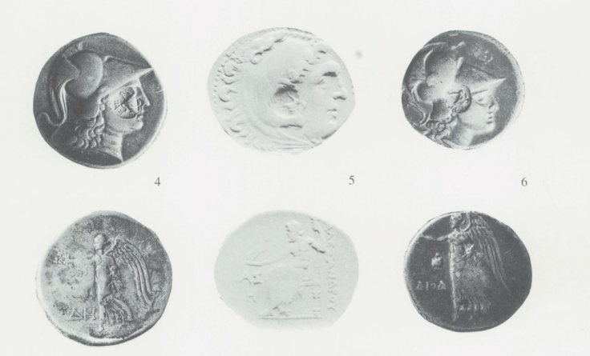
Cistophoric countermarks on Pamphylian coinage
Bauslaugh 1990
Phaselis Aspendus Side
Side Aspendus Side

Slide 35
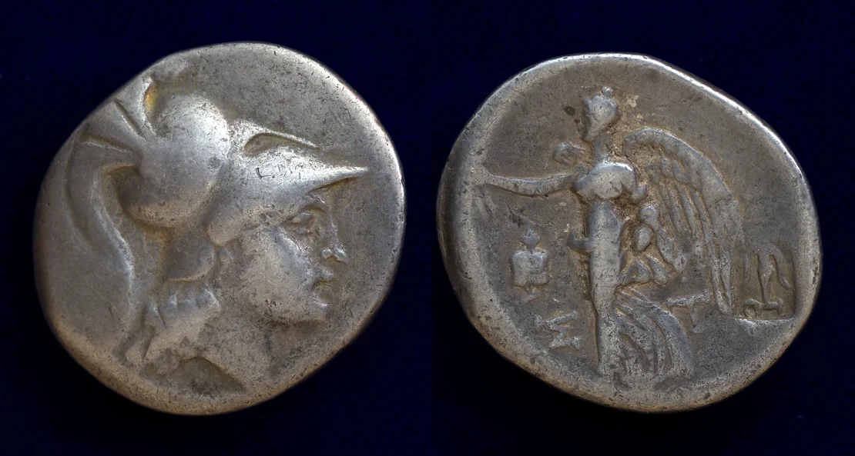
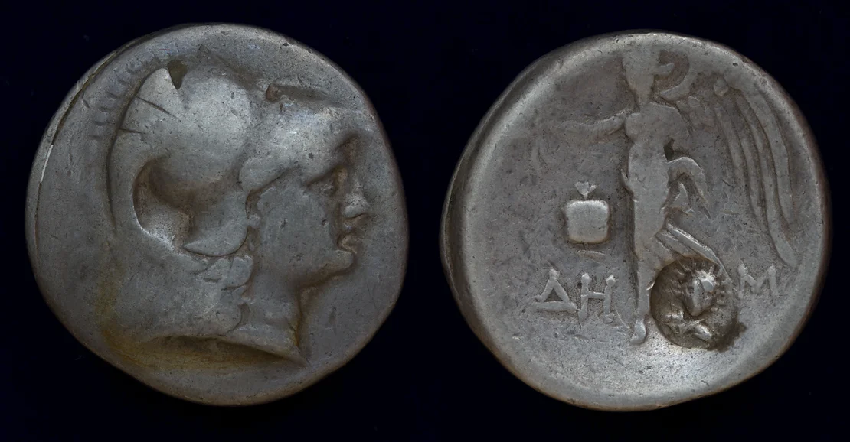
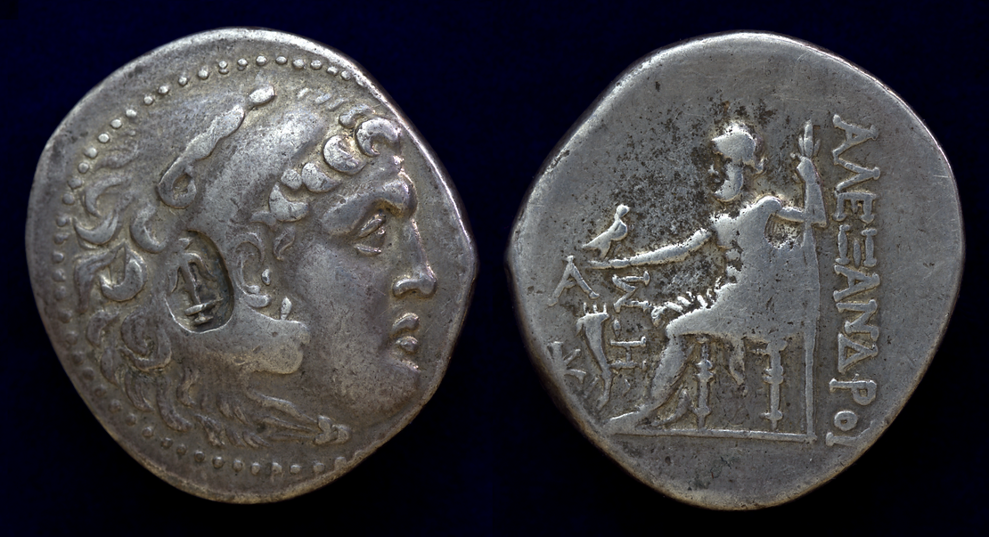
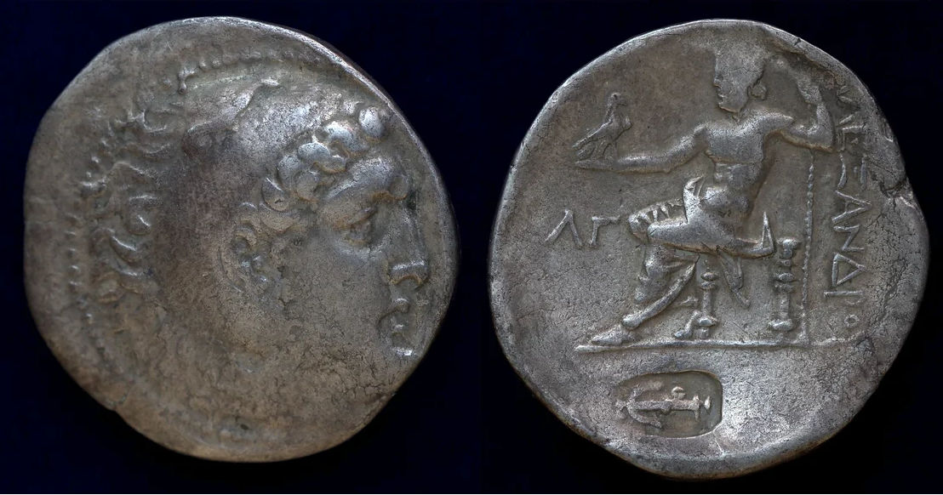
Seleucid Countermarks on civic coinages
PAMPHYLIA, Side, c.205-175 BC
AR Tetradrachm, ST–, magistrate. Seyrig, Side 20
Pamphylia, Side, circa 205-175 BC,
AR Tetradrachm, SNG France 684
Pamphylia, Aspendos, circa 212/11-184/3 BC,
AR Tetradrachm (29mm, 16.70 g, 12h) Price 2909, dated CY 27 (circa 186/5 BC)
Pamphylia, Perge, 221/0-189/8 BC, AR Tetradrachm
(30mm, 16.0g, 1h), dated CY 33 (ΛΓ = 189/8 BC)

Slide 36
188 BC: Peace of Apamea; Antiochus III is forced to pay tribute to Rome (1000 silver talents annually), and his son Antiochus IV Epiphanes is given as a hostage to Rome
Seleucid countermarks
Countermarked coins found in the Seleucid Levante
Countermarks granted Pamphylian tetradrachms the right to circulate in the Seleucid Kingdom
https://www.sullacoins.com/post/between-the-seleucid-and-attalid-kingdom

Slide 37
Countermarks: the case of Roman Provincial Coins by C. Howgego (1985)
800 different varieties of countermarks
Necessity to re-validate worn, obsolete or unusual coins for circulation in areas where regular coinage was scarce
Changing political realities were expressed by making revisions to the circulating coinage: countermarks applied during the tumultuous reign of Nero and subsequent civil unrest and the politically motivated re-validations of the Severan period in the struggles for legitimacy of family members or power usurper

Slide 38
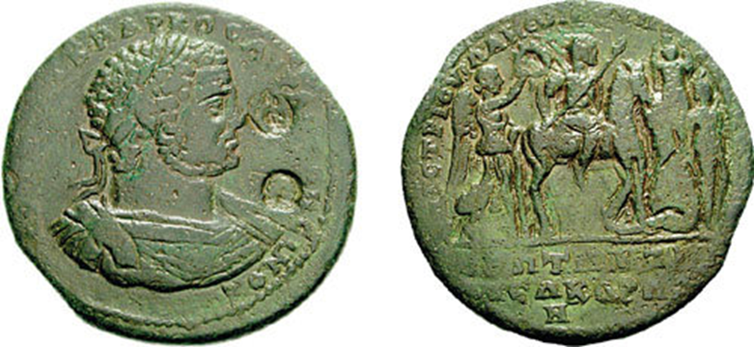
MYSIA, Pergamum. Caracalla. 198-217 AD. Æ Medallion (44mm, 43.27 g, 6h). Julius Anthemus, magistrate. Laureate and cuirassed bust right; 2 c/m: animal suckling child in oval and wreath in circle / Caracalla on horseback advancing right, holding lance, crowned by Nike; before him a trophy with two bound Parthian prisoners. For coin: SNG France 2225; SNG Copenhagen -; for c/m: Howgego 318 and 480.

