Slide 1


Ptolemy I and Ptolemy II
Coinage and Politics
Mairi Gkikaki

Slide 2
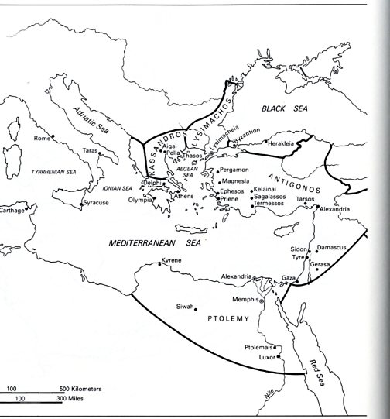
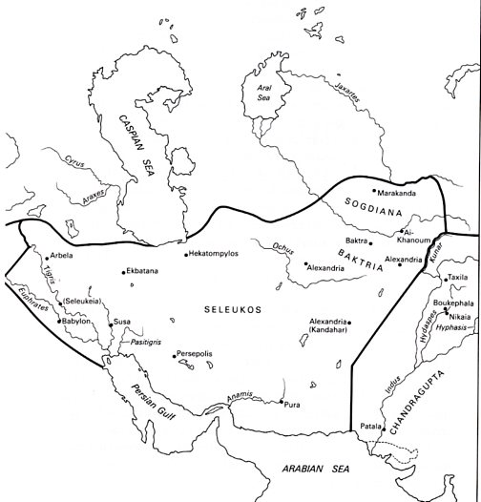
The Diadochs

Slide 3
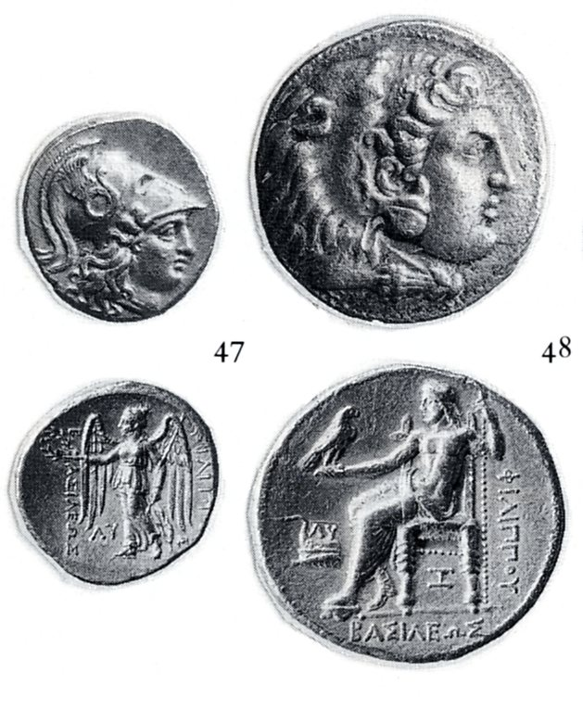
Philipp III Arrhidaeus
Babylon
Aradus

Slide 4
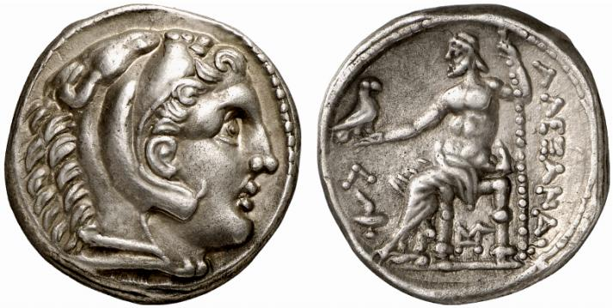
Amphipolis, Alexander III
Posthum Issue

Slide 5
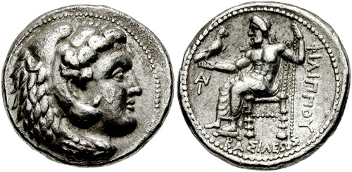
AR – Tetradrachme
Seleucus I in Babylonia
Seleucus I Nicator, 320 – 315 BCE

Slide 6
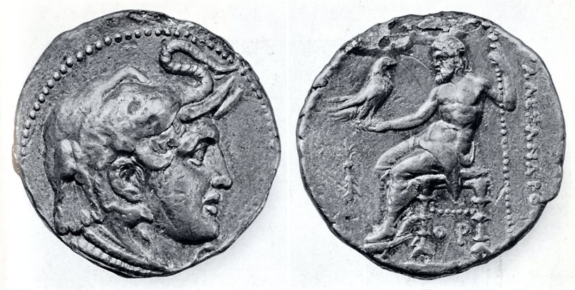
Ptolemy, Satrap
Ca. 321 BCE
Partition of Triparadisus
Repartition of power

Slide 7
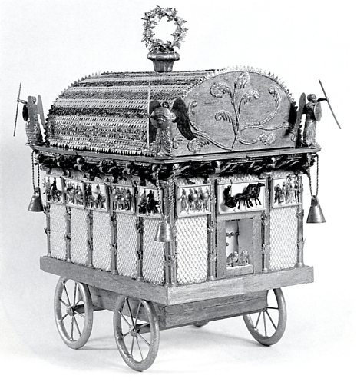
Funerary Procession for Alexander the Great
Diodor, Bibliotheke historike XVIII. 26. 1-28. 4

Slide 8
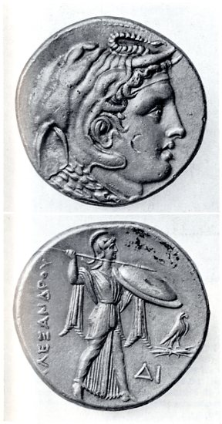
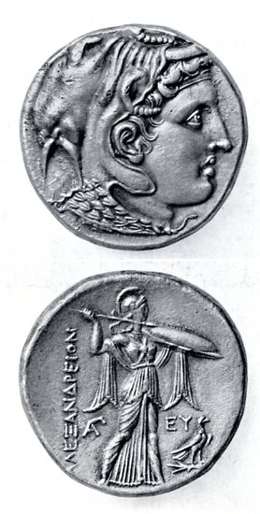
Introduction of a new reverse: ca. 314BCE

Slide 9
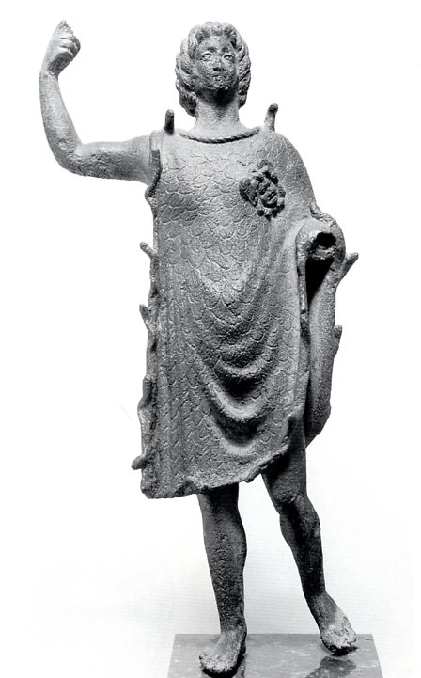
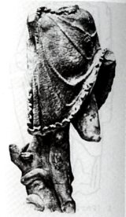

Alexander Aegiochos
Ca. 305/ 4 BCE
Louvre
London

Slide 10
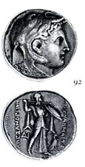
ΑΛΕΞΑΝΔΡΕΙΟΝ ΠΤΟΛΕΜΑΙΟΥ =
Ptolemy’s coin in Alexandreia or Ptolemy’s coin of Alexander

Slide 11
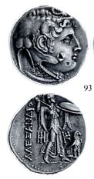
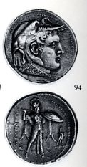
Ca. 310 BCE
Financial Reform in Egypt: 9 % reduction in weight
Sidon: Struck still in 312/11 BCE
(the 22nd year of the Sidonian era)
in the Attic Weight standard
Ca. 17,20 g
“New” Tetradrachm
Ca. 15,70 g

Slide 12
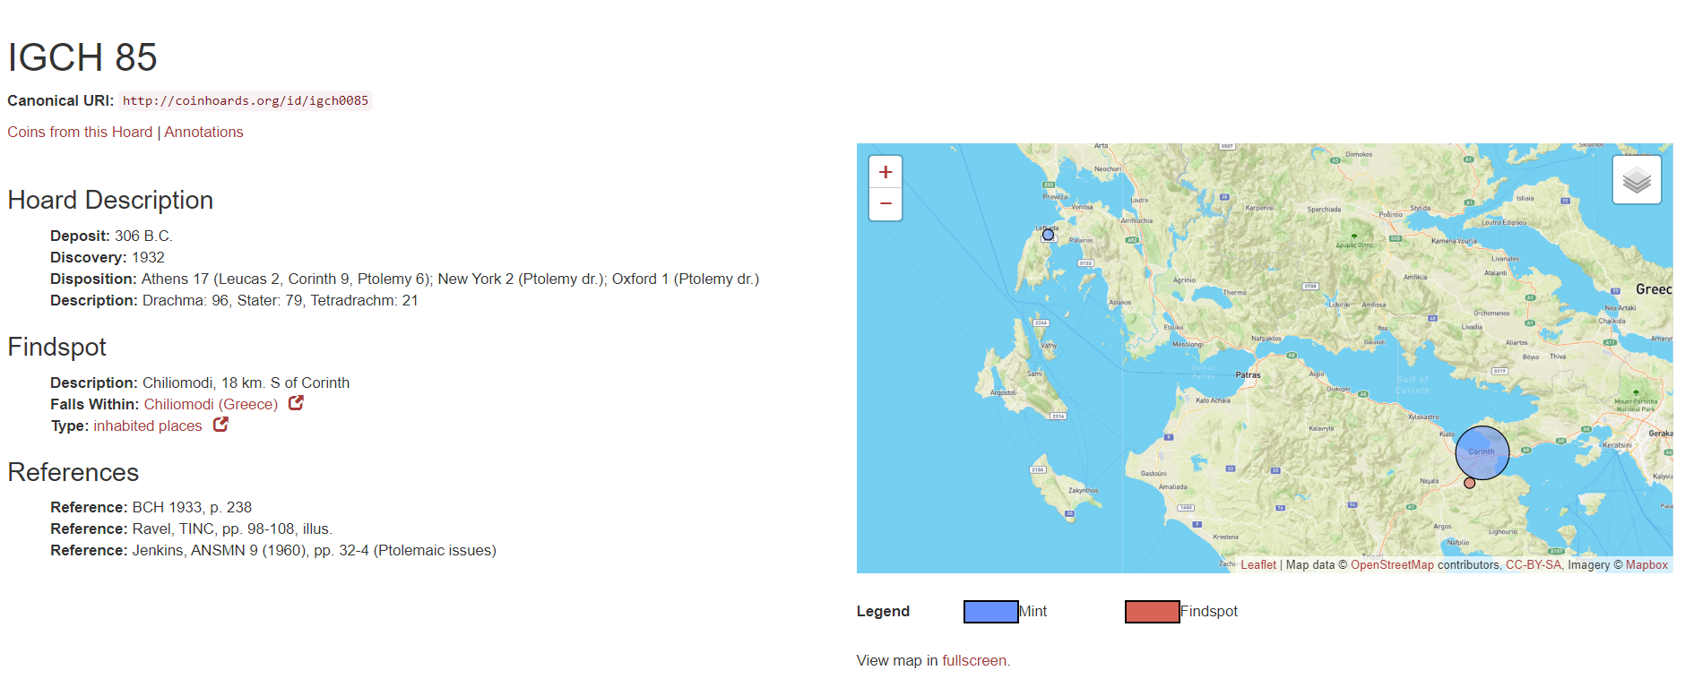
The Chiliomodi Hoard (IGCH 85) date of deposit: 306 BCE

Slide 13
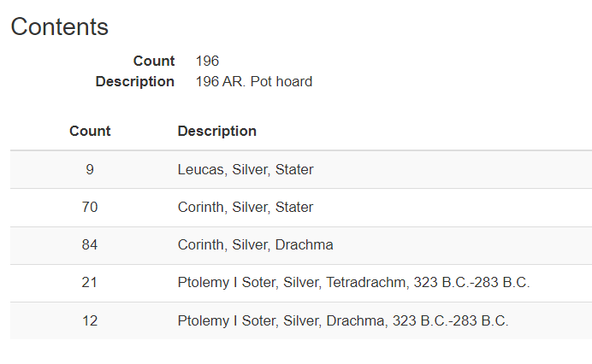

Slide 14
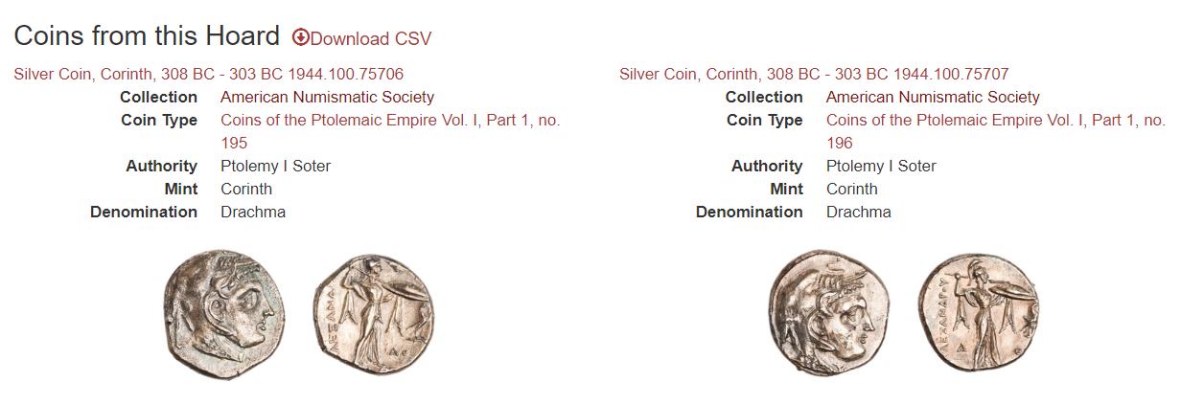

Slide 15
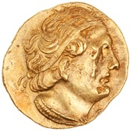
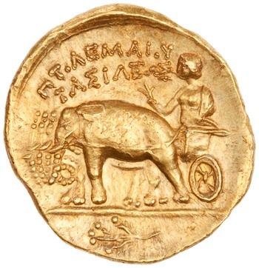
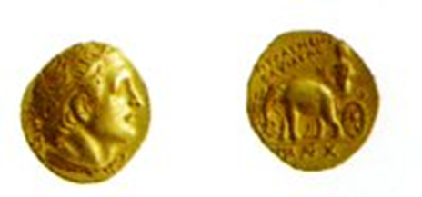
Ptolemy I, after ca. 304 BCE
ANS 1944.100.79526
8.60g > 7,12 g : Reduction of 17 %

Slide 16
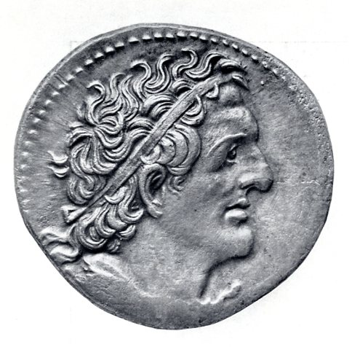
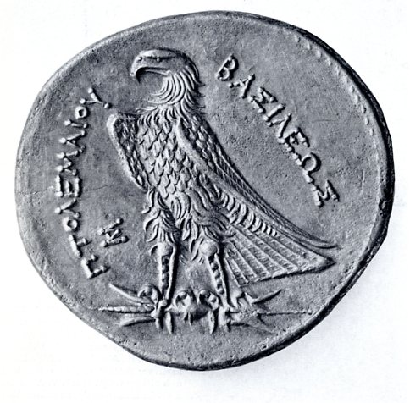
The final changes: after 300 BCE

Slide 17

Ptolemy I

Slide 18
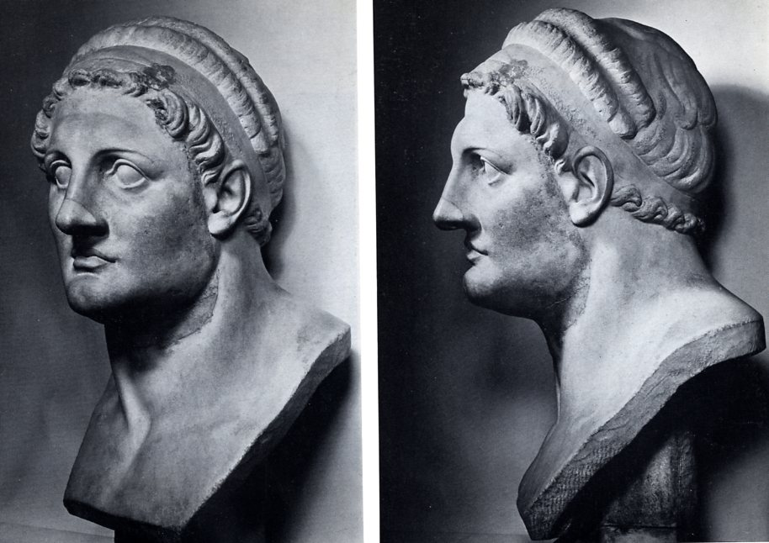
Portrait: Ptolemy I
Paris Louvre A1

Slide 19
Ptolemy’s monetary policy
Growing autonomy against the prevailing weight standard / curreny
From ca. 310 BCE onwards a separate circulation area is created
Down to 305 BCE attic weight currency was freely imported. Afterwards: establishment of a monopoly for the Ptolemaic currency as a result of deliberate monetary manipulation

Slide 20
Some explantions
Gold to silver at a ratio of 1 to 10 (during Alexander’s reign)
During 320-300 this rose to 1 : 12
A gold pentadrachm (5-drachms piece) of 17.85 equalled 60 silver drachms or 15 silver tetradrachms of 14.25g each
During Alexander’s reign one gold stater equalled 20 silver drachms
Therefore the gold Ptolemaic stater was called trichryson (thrice gold)

Slide 21
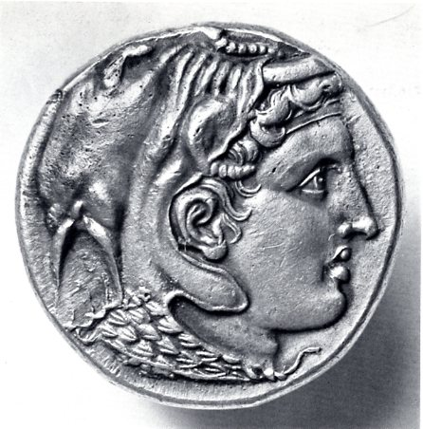
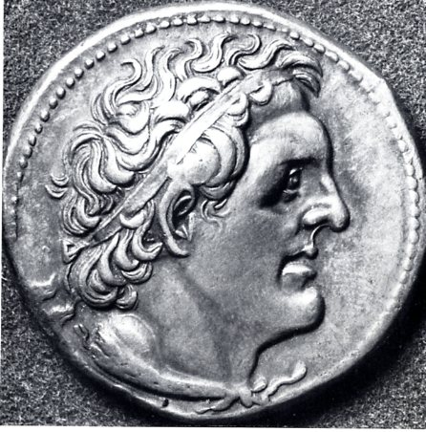

Slide 22
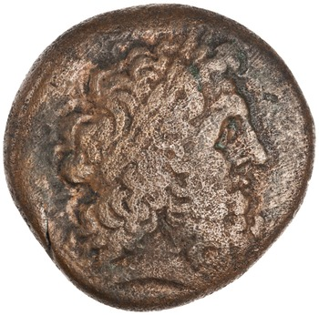
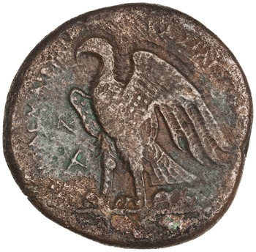
Bronze coinage of Ptolemy I
Alexandria, 294 BC 1925.176.130, 14.6g, 27mm

Slide 23
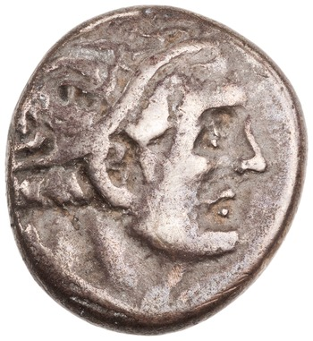
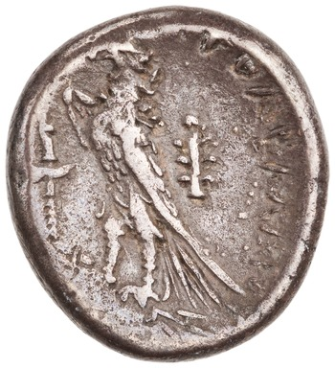
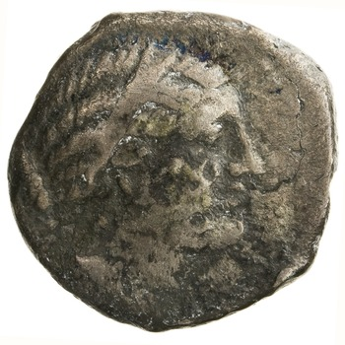
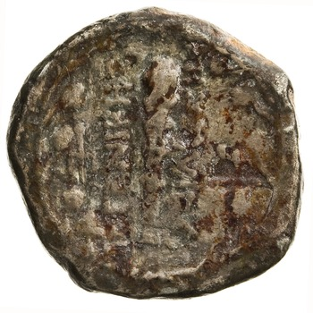
Magas, governor of Cyrenaica
Cyrene, AR, 6.76g, 282 BC - 261 BCE 1944.100.79528
Cyrene, AR, 6.31g, 282 BC - 261 BCE, ANS1944.100.79531

Slide 24
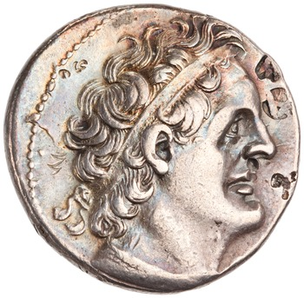
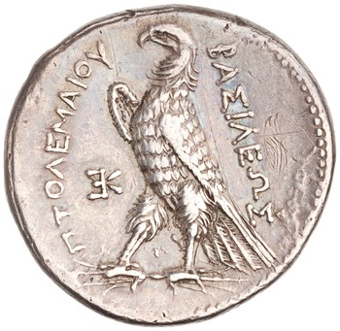
Ptolemy II
Silver Tetradrachm of Ptolemy II Philadelphus, Alexandreia, 285 BC - 246 BC. 1974.26.5422

Slide 25
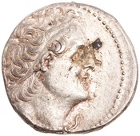
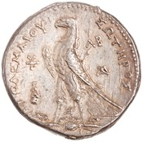
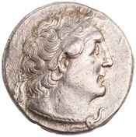
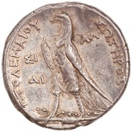
Ptolemy II in Tyre and Sidon from 261/0 BCE onwards (regnal year 25 onwards)
Silver Tetradrachm of Ptolemy II Philadelphus,
Tyre, 254 BC - 253 BC. 1944.100.76126
Silver Tetradrachm, Sidon,
255 BC - 254 BC 1944.100.76179
Change in the legend: ΠΤΟΛΕΜΑΙΟΥ ΣΩΤΗΡΟΣ

Slide 26
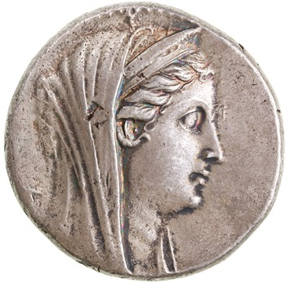
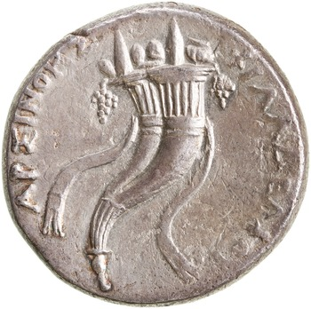
In the name Arsinoe II under Ptolemy II
Minted in Alexandria
AR decadrachms 35,50
AU octadrachms 27.80
AR Tetradrachms with the
Same dies as the AU
Silver Coin, Alexandria, 261 BC - 252 BC 1935.117.1087
Decardracm, 34.27g, 35mm, 12mm

Slide 27
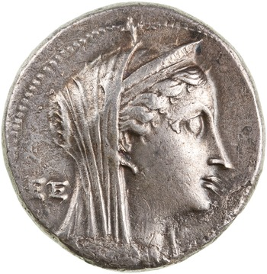
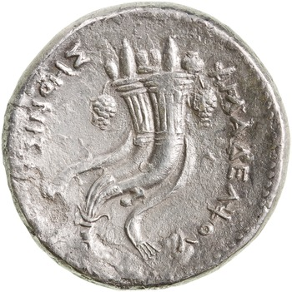
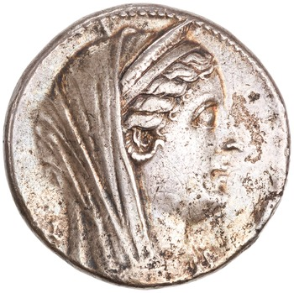
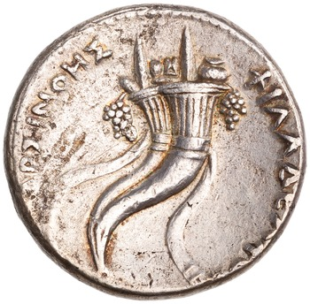
Decadrachms in lettered series
Α, Β, Γ, .... ΑΑ, ΒΒ, ΓΓ ...
ANS1964.79.61 and ANS1960.170.412

Slide 28
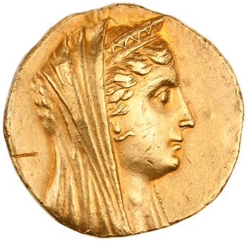
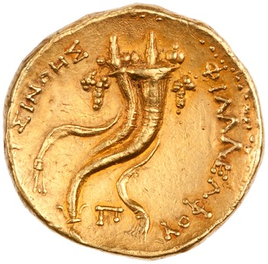
Gold Octadrachm of Ptolemy II Philadelphus, Paphos, 285 BC - 246 BC. 1944.100.76008
27.73, 30mm, 12h

Slide 29
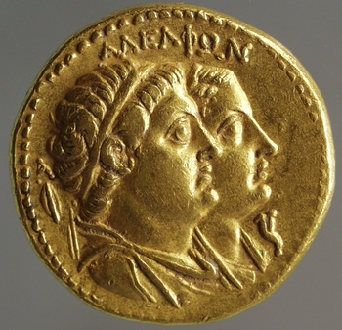
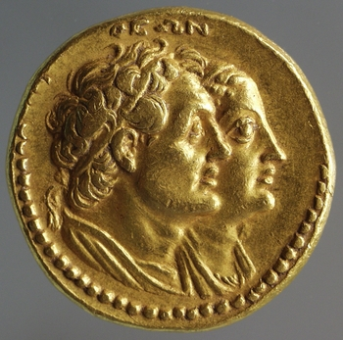
The coinage of the Brother Gods
AU octadrachm, 27,81, 28mm
Alexandria, 282 BC - 272 BC 1956.183.28
Called a mnaeion because of the ratio 1:12.5, the mnaion equalled a mna of 100 drachms and consequently the gold octadrachm was called a pentekontadrachmon

Slide 30
Zenon Papyrus: a letter, part of a correspondence
Persons involved
Demetrius: Mintmaster in Alexandria
Apollonius: dioiketes, minister of finance, of Ptolemy II Philadelphus
Philaretus (another mintmaster)

Slide 31
Zenon Papyrus
Re:
Difficulties by the implementaion of the king‘s decree Umsetzung eines königlichen Dekrets
The Trichrysa must be withdrawn from circulation and replaced by a new gold issue

Slide 32
The letter is dated:
15th of the month Gorpiaeus of the year 28 (Ptolemy II regnal year) =
258/7 BCE

Slide 33
Termini Technici
Prostagma
Epichorion nomisma = The state coinage
Ta trichrysa = gold coins of ca. 18 g
katergazesthai

Slide 34
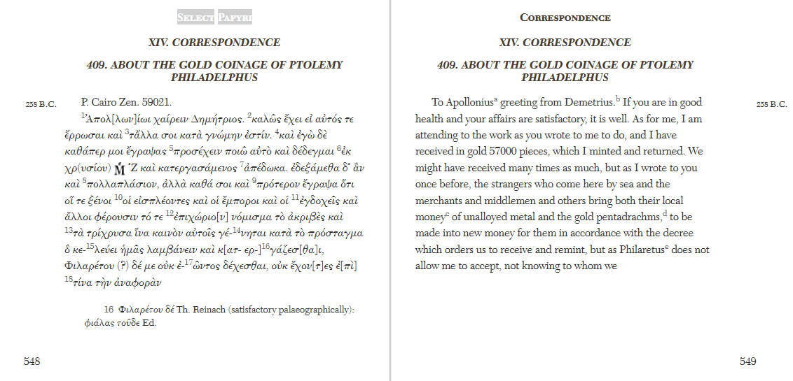

Slide 35
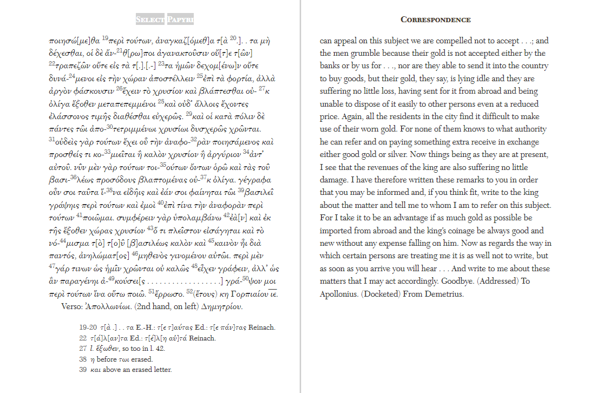

Slide 36
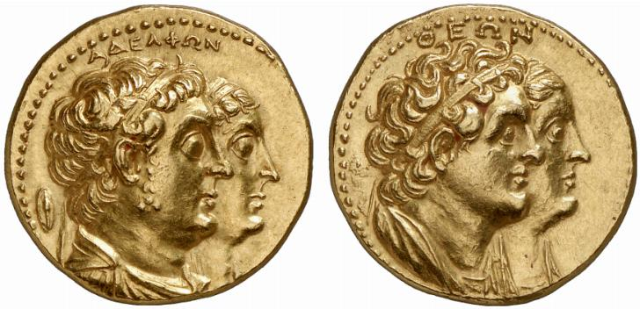
Mnaion

Slide 37
Bronzes of Ptolemy II in eight denominations
Theoretical weights
92 (approximates the deben)
68
46
22
11
6.8
5.2
3.4
1: 1 ½ : 2 : 3: 6 :12 : 18 : 24

Slide 38


Ptolemy III Euergetes in the name of Berenice II
AU decadrachm, 246 BC - 222 BC, ANS 1967.152.562,
12h, 42,75g, 33mm

Slide 39


Slide 40


Slide 41
The hoard of Gülnar in Meydancik Kale in Cilicia Tracheia
5.000 pieces
2,553 Alexanders
2,158 Ptolemies
504: Lysimach, Antigonides, Seleucides
Deposition date: ca. 240 BCE
Graffitti of proper names

