Slide 1
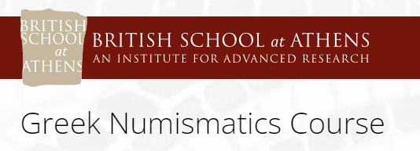

Money before coinage
Dr. Mairi Gkikaki
University of Warwick

Slide 2
‘money is one of the most timeless, all-pervading, and arbitrary inventions in human history’ (Haselgrove and Krmnicek 2012)
‘Coinage is money but
money is not necessarily coinage’

Slide 3
Defining money functions of money
Means of exchange (Carl Menger 1909) and because of this it becomes a standard of value (cf. the double coincidence of wants formulated by Jevons 1875)
Means of payment and standard for storing wealth have precedence over the means of exchange
>> most specialists agree that any form of money should have the above three functions (North 1994)
A way of canceling out social and ritual obligations, a way of determining and recording debt
a means of constructing social relationships and the value of money is the outcome of these relationships
A technology that communicates (value is the information communicated , a given monetary system is a language of value (Monroe 2005)

Slide 4
The origins of money
Primitive money
Also called ‘special purpose money’ or ‘social currency’
Some examples: the ndap shells shell money of the Rossel island (Yela) in Melanesia (SW Pacific) and the tugundu clothing of the Tiv of Central Nigeria

Slide 5
Specific material requirements
For a commodity to function successfully as money it would have to be valuable, portable, indestructible, homogenous, divisible stable in value and cognisable, cf. Jevons 1875, Maurer 2006

Slide 6
Money and the state
Money primarily arose and functioned by virtue of being guarranteed by state authority [Knapp 1905]
‘A money transaction differs from barter in that the burden of trust is removed from the participants in the actual transaction and placed on a third party - the issuer of money’ [Ingham 2004]
‘Money circulates within the control of a sovereign authority’ [Douglas 1982²]
Heads or tails: token or commoditiy, a fundamental opposition [Hart 1986]

Slide 7
Three phases of monetary use and estimation of value
Adscription of value to prized things
The discovery of weighing around 3000 BC and the emergence of weighed metals as the common denominators of value
Pre-weighed metals stamped with a guarantee of the issuing authority: coins
[More on the three phases: Rahmstorf 2016]

Slide 8
Exchange
Generally considered as a condition related to the appearance of money
Practicing exchange is the key to assessing the precise value of commodities
When did exchange begin? In an uncertain date in the Stone Age

Slide 9
Weighing metals
The discovery of weighing metals: enabled a nexus between mass and value
The weighing of metals: created a highly precise medium for exchange, as a method of payment and a standard of value

Slide 10
The first stage of monetary developments: exchange
Objects desirable to humans
Scarcity
Expenditure
Circulation
Context
>> Value is not inherent in things but it is a cultural constructed property

Slide 11
The emergence of valuables
Impracticality, social markers, their use was socially regulated, objects of exchange, having been brought from a great distance
Their context > evidence for relations to the upper echelons of society
On occasions the appearance of identical pieces in great numbers and on other occasions their uniqueness
E.g. Spondylus shell ornaments from the Aegean in the graves of Palaeolithic and Neolithic periods in Central Europe

Slide 12
Valuables in the Copper period (5th and 4th millennium BCE) in Central and Western Europe
Valuables become more visible > For the first time it is metal, copper and gold, that play a role
Its low volume and high portability, storability, preservability (with no maintenance costs) and malleability
Axes in graves of the Eastern Karpathian basin, second half of the 5th millennium BCE: no monetary value, instead objects of prestige
In the richly furnished cemetery of Varna in Bulgaria (c. 4600–4400 BCE) spondylus, gold and copper artefacts all occur together in the richest burials (Krauß 2010, 294)
Eight gold and electrum rings found at the Nahal Qanah Cave, Cisjordan from a context of the second half of the fifth millennium BCE may be considered as aes formatum with the purpose to give an approximation of value ratios

Slide 13
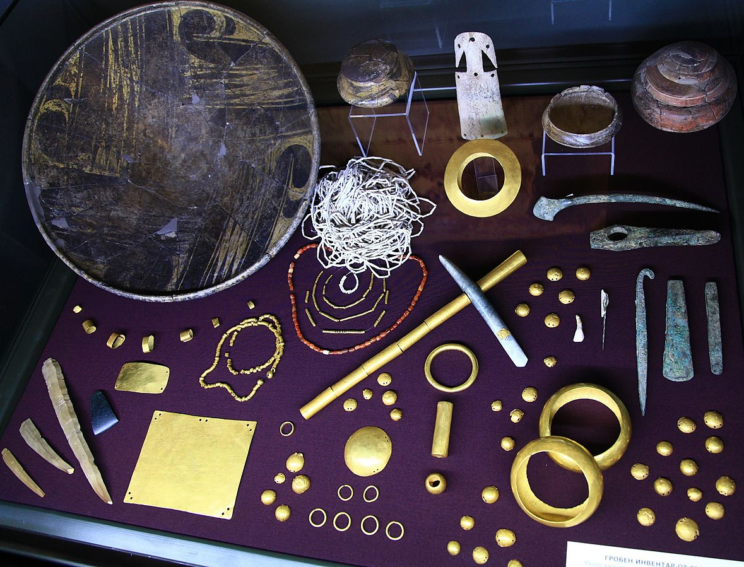
Varna necropolis, grave goods of a male burial, c. 4.600-4.200 BCE
Source: Wikimedia commons

Slide 14
Gold and electrum rings from the Nahal Qanah Cave, Cisjordan, late fifth millennium BCE source: Rahmstorf 2016

Slide 15
Early Bronze Age – third millennium BCE
A new Era marked by travelling for the desire to have come commodities in a vast Geographical Era incl. Caucasus, Mesopotamia, Egypt, Near East and the Levante, the Aegean
The concept of standard of value
The notion of weight: scales and weights were implemented in order to assess the weight ratio of things in relation to one another
Only with the idea of weighing did it become possible to measure value and equivalences in a precise way

Slide 16
The expansion of weights
Weights made of stone are first observed around 3000 BCE and increase in the early third cent. BCE > standard forms of weights for certain regions
Overlaps in the geographical expansion of standard forms: Aegean weights found in Cilicia (Tarsus)
Indus weights found as far west as Southern Mesopotamia (Ur)

Slide 17
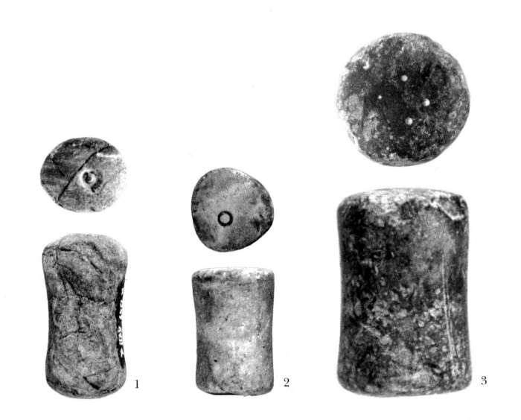
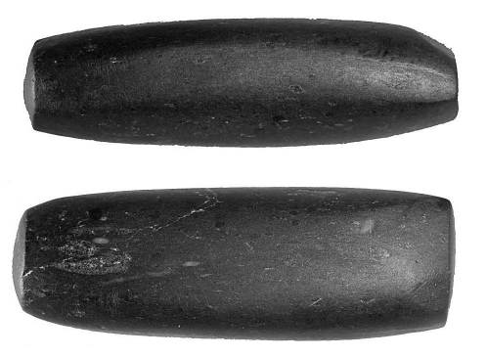
Stone weight found in Çukuriçi Höyük
no. Cuk 08/520/3/7
Source Horejs, B. 2009.
Spool-shaped stone weights
with incisions from Tiryns
Rahmstorf 2003

Slide 18
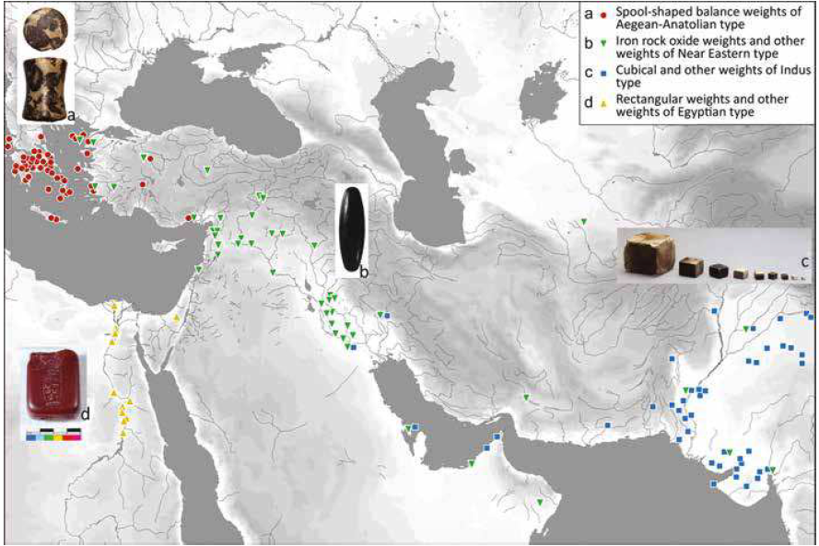
The expansion of weights
Source: Rahmstorf 2016

Slide 19
The report of Wenamun
Pap. Moscow 120: Egyptian text written in hieratic, known from a single copy
It describes the voyage of Wenamun, a priest of Amun at Karnak, who is sent by Smendes, the ruler of lower Egypt, to Byblos in order to acquire lumber for the barge of Amun
‘in-text dating’ to the early eleventh century
Only when Wenamun provides payment in cash, does the ruler of Byblos order for the trees to fell

Slide 20
Appearance of weight metrology
Early third millennium BCE weight metrology makes its first appearance. It appears simultaneously to seals for administrative purposes
Expertise and physical experience linked to weighing, it required some apprenticeship
Weights are always linked to value: In Mesopotamia the weight unit shekel is always used in relation to silver
In the Bible there is no special term for money. However, the same term applies to silver and money ‘kesep’
Mainly Silver (but also barley) was an equivalent of value, a medium for exchange and payment and a store of value as documented by hoards of silver rings and silver coils (either scrap or finished objects) in temples and palaces of the third and second Millenia BCE in Syro-Mesopotamia
In Babylonia of the third and second centuries BCE silver is linked to payments and measuring of value: the laws of Ešnunna – similar to the code of Hammurabi – list all the goods which silver can buy

Slide 21
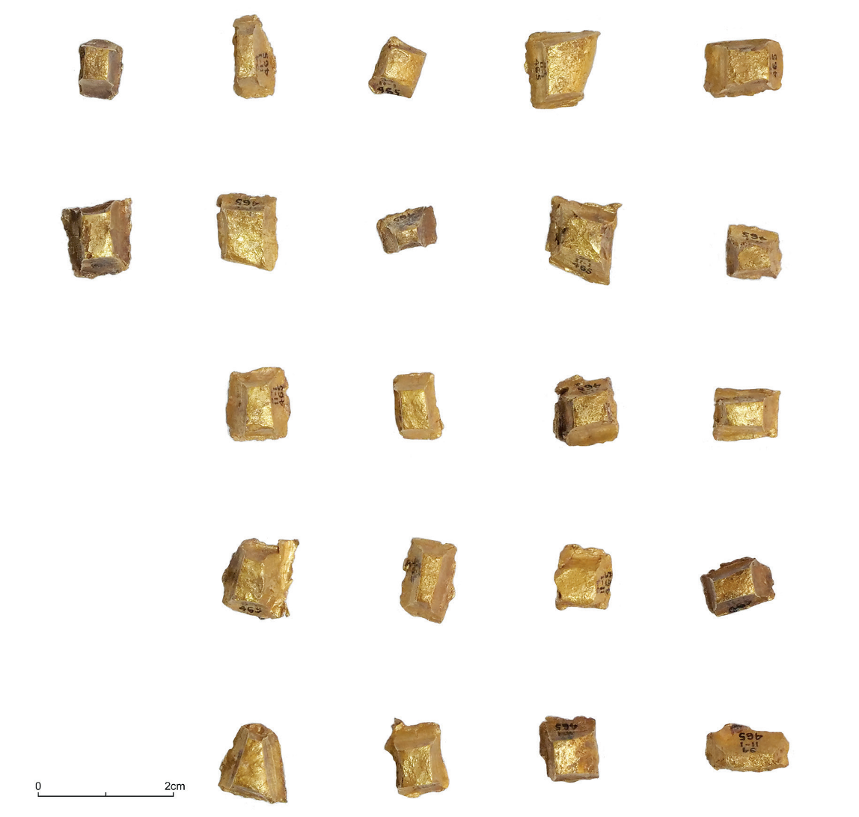
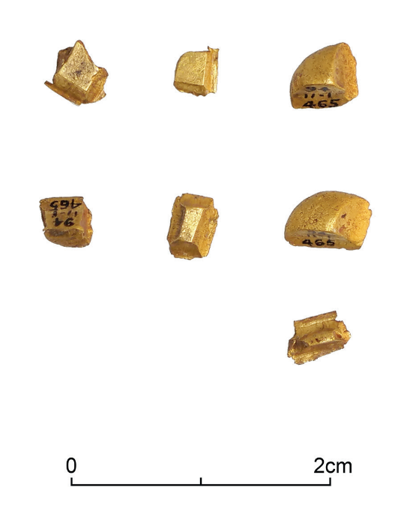
Hackgold from Amathous, Cyprus (tomb 198)
Seven smaller pieces of
hackgold from Amathus tomb 198
(BM 1894,1101.465). © The Trustees
of the British Museum

Slide 22
Weighed silver in the Biblical record
In the Old Testament the term kesep is used for silver as well as money
A wergeld function for kesep is attested in numerous instances in the Biblical record
The formula ‘amount-silver’ or ‘weight-silver’ indicates that the silver was measured by means of its weight
Jeremiah buys the field in Anatot from his cousin Hanamel: signed the contract and weighed out 17 shekels of silver in front of witnesses (Jer 32:9-10)

Slide 23
Literary sources on the use of silver
2 Kings 12.10-17: during the reign of King Jehoash of Judah (836-798 BCE): Kesep kept in a chest, specifically for repairs of the Temple
Herodotus 3.89-96: on the yearly tribute collected by the King Darius I (522-486 BCE), kept in ceramic containers, when the vessel is filled, the clay is broken away. When money is needed, the King cuts off a portion

Slide 24
Hacksilber Hoards from the S. Levant from the final stage of Egyptian rule to the end of the Iron Age (12th cent to early 6th cent. BCE)
a total of 33 hoards
the collapse of state control gave the impetus for the use of precious metal as a means of exchange and of storing wealth
the objects of value may adhere to different weight standards
the precious metal objects in the hoards were valued neither as a token nor as a commodity but both at the same time

Slide 25
Basic trends for the IAPMH
Deposited under floor levels and under regular circumstances and not as a response to crisis and an impeding danger
Ornamental objects (jewelery) of the LBA and Iron I hoards vs ingots in fragmented state for the Iron IIA and B hoards
The objects of the late LBA-Iron I transition hoards are heavier and their weights are randomly distributed, while the hoards of the Iron I-IIB (incl. Eretria Hoard) contain mainly low-weight fragments up to one gram (gradual distribution of weights)

Slide 26
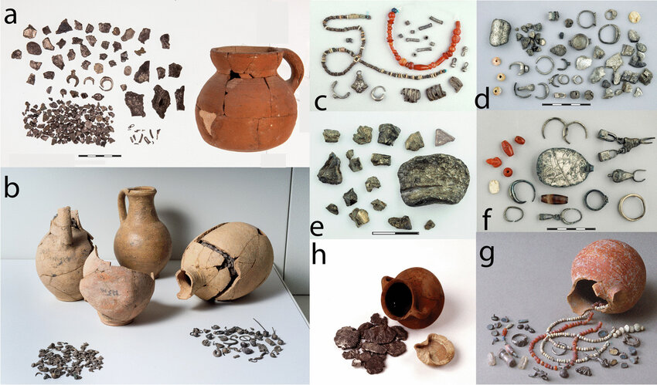
Images from the Hoards1-6 of Tel Miqne and of the En Gedi Hoard
© The Israel Museum, Jerusalem and © Israel Antiquities Authority
Source: Eshel, T. et al 2022,
‘From Iberia to Laurion. Iinterpreting Changes in Silver Supply to the Levant in the Late
Iron Age Based on Lead Isotope Analysis’, Archaeological and Anthropological Sciences
14 (6).

Slide 27
IAPMH: Typology
Rough ingots
Globules
Rods
Finished ingots
rings,
Bracelets
Wires
sheets
ource: Heymans 2021

Slide 28
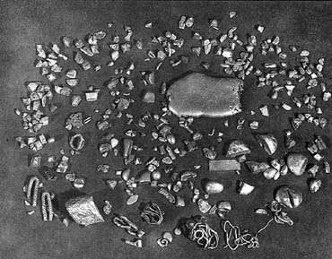
The Iron Age Eretria Hoard
Irregular fragments of talents and unfinished gold jewellery.
They were found inside a skyphos hidden beneath
the floor of an apsidal building in Eretria, cf. Themelis 1992
Image source: http://www.ime.gr/CHRONOS/03/en/gallery/eph16.html

Slide 29
IAPMH: Metrology
Weight: high prevalence of objects with a low weight, mostly between ca. 0.1 and 0.2g.
The values range between 0.1 to 1-2 grams
Mean weight: 0 and Median weight

Slide 30
IAPMH: Circulation
The small weights: small change, small denominations, small scale transactions
Only few objects are found to belong to the same artefact
Traces of wear notable on the objects

Slide 31
Understanding Iron Age Precious Metal Hoards
Scholars focus usually on the possible weight standard of the objects contained in the Iron Age precious metal hoard, with the underlying premise that monetary used can only be confirmed when the objects of value individually adhere to a weight standard
However, since scales and weights were used there was no absolute need to produce objects in set weights
The objects were fragmented in order to balance the specific weight in the scale cf. Heymans 2021

Slide 32
Iron Age Precious Metal Hoards
The precious metal of the Hacksilber hoards is guaranteed by weight and composition
The problemis again that there is no conclusive evidence that they were proportioned precisely according to weight (Kletter 2004, 207)
Some of the hoards of the Early Iron Age: size distribution of the individual pieces of silver, most of which weigh less than one gram.
The strong Near Eastern influence in the Aegean and western Anatolia during the seventh century BCE (Orientalizing period) resulted in the invention of coinage
Ideas from the Near East brought about the impulses for the emergence of silver bullion as a currency in Archaic Greece (Kroll 2008)

Slide 33
Iron Age
Coinage should be placed ‘within the continuum of development of monetary instruments’ because it was ‘a development from an existing Near Eastern tradition rather than a fundamentally new technology’ (Meadows 2008).
The invention of coinage around 600 BCE: ‘a stamped piece of metal of standard weight, certified by an authority with marks of identification’ (Haselgrove and Krmnicek 2012)
This innovation was to ‘save men the trouble of determining the value on each occasion’, as long ago described by Aristotle (Politics 1257a; Kroll 2008, 13).

Slide 34
The advent of coinage
No linear development to the development of money
Multifactorial phenomenon

Slide 35
The hackgold and -silver from the grave at Amathus
Gift to the dead as an expression of a cosmopolitan identity
Currency as a provision for the dead predates coinage

Slide 36
Iron roasting spits, ‘obeloi’
Deposited in Greek graves of the 8th cent. BCE
Believed by some scholars to have functioned as a currency because they are connected etymologically to the later obol coins
Ancient tradition preserved by the Orion of Thebes, brobably constructed in the 4th c. BCE that Pheidon of Argos recalled all iron spit money and dedicated to the Heraion of Argos
Systematic survey of the finds proves that the spits were used in roasting activities in sanctuaries. This does not exclude their functioning as prestige objects
Therefore, placed in the grave as a reference to a particular discourse and the association with a specific group

Slide 37
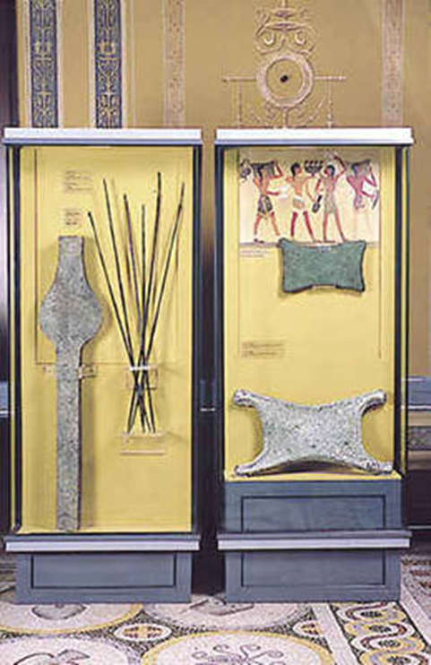
Iron spits in the Numismatic Museum, Athens

Slide 38
The advantages of coinage
It enabled differentiation between the face value and the intrinsic value of this specific piece of metal
It allowed the dissemination of power, influence and propaganda through the circulation of the coins and the images

Slide 39
References
Haselgrove, C. and Krmnicek, S. 2012. ‘The archaeology of money’, Annual Review of Anthropology 41, 235–50.
Heymans, E. D. 2019, Pre-Coinage Money in the Grave? The Case of Amathus T. 198, JAN, pp. 45–66.
Heymans, E.D., 2021, The Origins of Money in the Iron Age Mediterranean World, Cambridge.
Jevons, W. S. 1875. Money and the Mechanism of Exchange. New York: D. Appleton and Co.
Kraus, R. 2010. Zur Akkumulation von Prestigegutern im Westschwarzmeerraum wahrend des 5. Jahrtausends v. Chr., in C. Theune, F. Biermann, R. Struwe and G. H. Jeute (eds) Zwischen Fjorden und Steppe. Festschrift für Johan Callmer zum 65. Geburtstag. Internationale Archaologie – Studia honoraria 27. Rahden/Westfalen: Marie Leidorf, 289–300.
Kroll, J. 2008. The monetary use of weighed bullion in Archaic Greece, in W. V. Harris (ed.) The Monetary Systems of the Greeks and Romans. Oxford: Oxford University Press, 12–37.
Kroll, J.H. 2022, Monetary Instruments before Coinage, in M. Alram, J. Bodzek, A. Bursche (eds) Survey of Numismatic Research 2014-2020, 101-102.
Maurer, B. 2006, ‘The Anthropology of Money’, Annual Review of Anthropology 35 (1), 15-36.
Menger, C. 1909. Geld, in J. Conrad (ed.) Handwörterbuch der Staatswissenschaften, Vol. 4 (3rd edn). Jena: Fischer, 555–610.
Monroe, C. 2005. Money and trade, in D. C. Snell (ed) A Companion to the Ancient Near East. London: Blackwell, 155–68.
North, M. 1994. Das Geld und seine Geschichte: vom Mittelalter bis zur Gegenwart. München: C. H. Beck.
Rahmstorf, L., From ‘Value Ascription’ to Coinage: a Sketch of Monetary Developments in Western Eurasia from the Stone to the Iron Age, Haselgrove, C., and Krmnicek, S. (eds), The Archaeology of Money: Proceedings of the Workshop ‘Archaeology of Money’, University of Tübingen, October 2013, Leicester Archaeology Monograph 24 (Leicester, 2016), pp. 19–42.

