Slide 1
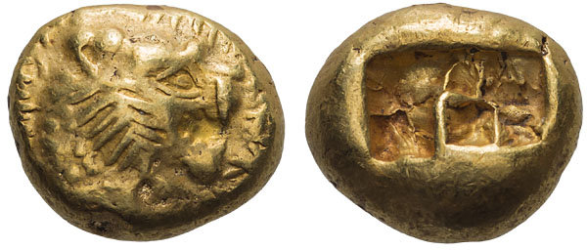
The Beginnings of Coinage in Asia Minor

Slide 2
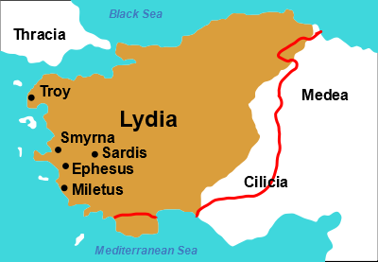
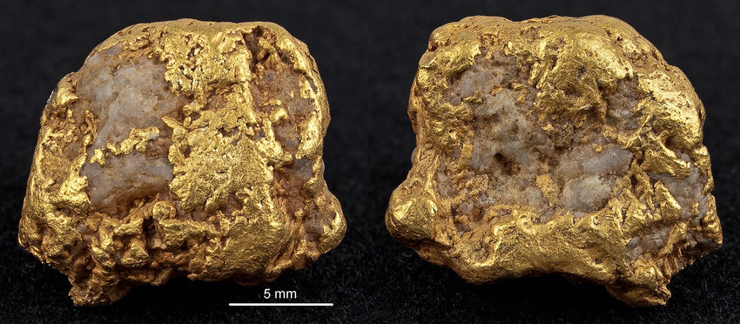
Introducing…… electrum (EL)
Alloy of gold (AV) and silver (AR) that naturally occurs in riverbeds in the ancient kingdom of Lydia.
elektron = amber
Notes:
Quantity of extraction from the rivers was such that for Lydia and its Greek neighbours, it was more abvundant than gold or silver.
Mixed gold/silver ratios from rivers, could also be adulterated by the adding of silver.
Touchstones – becomes impractical as quantity/size of the transaction increases.
Don’t know whether they knew how to separate silver and gold before the 6th century BC – so couldn’t use this as a solution.
Solution then was stamped ingots of uniform weight. Value set and guaranteed by the authority they bore.

Slide 3
Early Electrum Coins (c. mid 7th century BC)
Value of naturally occurring Lydian electrum: c. 73 % gold, 27% silver
Electrum in the lion’s head coins:
54% gold, 44% silver, 1 or 2% copper
Weight of the coins, however, very standard.
Electrum stater, c. 610-550 BC
Lion’s head right / Incuse
Notes:
Lion most common design – symbol of the kingdom of Lydia. But different cities in Ionia struck electrum coins, each with different designs.
Coins valued as if made out of naturally occurring electrum, so making the coins gave a profit of 15-20% for the Lydian state.
Eventually replaced by pure gold and silver – probably because people lost faith in electrum, now had ability to separate the metals. Lasts around 80 years.
Very first coins minted in the capital Sardis.
New research indicates that electrum coins were struck from a de- liberately mixed alloy of almost pure gold to which silver was added, not from natural electrum to which silver was added. Wartenberg, White Giold.

Slide 4
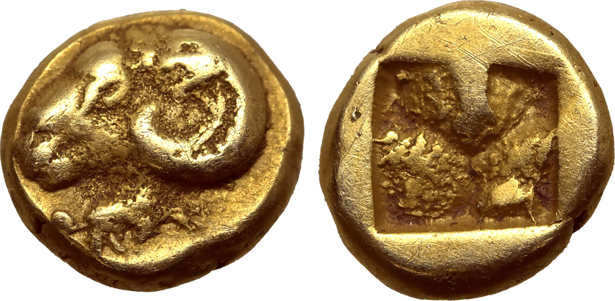
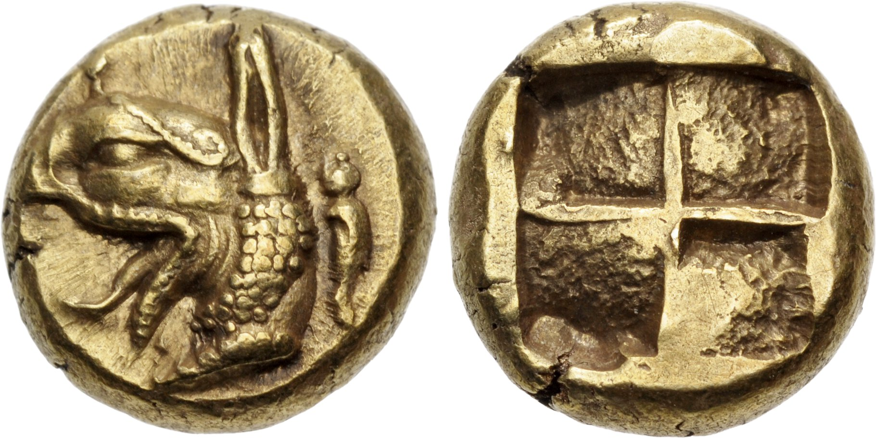
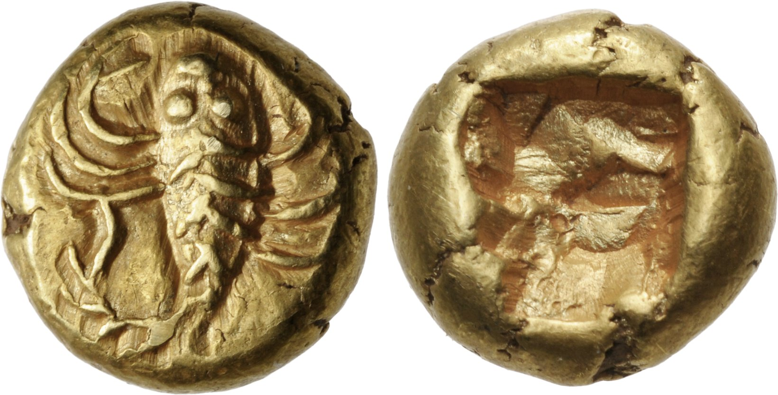
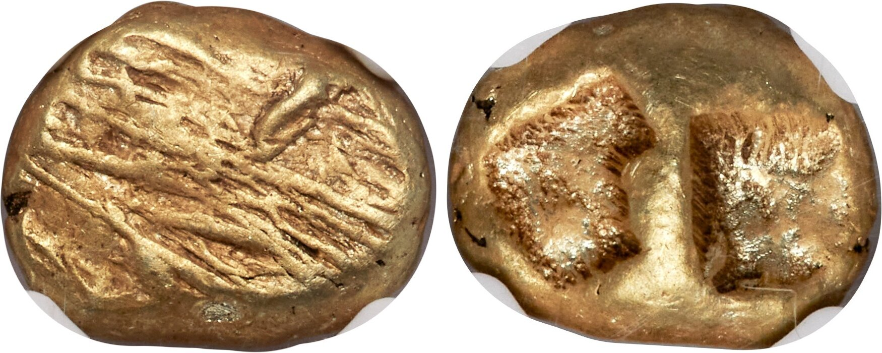
Designs (c. 400 types from 7/6th centuries)
Notes:
Wild and domestic animals are most frequently represented, often just foreparts, heads, or body parts (lion paws); lions (figs. 3.2, 3.8, 3.12, 3.13, 3.15) were especially popular in the electrum bestiary, which included rams, goats (fig. 3.3), stags (fig. 3.11), boars, bulls (fig. 3.15), horses (fig. 3.4), hares, foxes, dogs, tortoises, various birds, fish, seals, octopus (fig. 3.9), crabs, dolphins, insects such as bees (fig. 3.7), and beetles. Fantastic animals (winged horses, griffins, the Chimaera), monsters (gorgons, sirens, winged men), objects (fibulae, thunderbolts, shields), human depictions (fig. 3.5), geometric patterns and irregular markings (fig. 3.6) also adorn the obverse of these coins (Spier 1990: 111). Close to a hundred different devices have been identified, and new ones continue to surface.
Ram w/ seal mark beneath,
Griffin w/ seal (Phocaea)
Scorpion
Fischer Bossert – 7th and 6th centuries – some 400 types. How can we explain this?
Te fact that we still do not fully understand why electrum was used for the earliest coinage leads to the assumptions that electrum coins were awkward to use, their value hard to determine, and when technology advanced to a higher level allowing for mass production of pure gold and silver coins under Croesus, electrum coins rapidly became all but obsolete. Electrum briefy reemerges, if one believes accounts in most handbooks, as an emergency currency during the Ionian Revolt and then becomes a special coin- age, issued with few exceptions only by Cyzicus, Mytilene, and Phocaea, probably for trading in the Black Sea region.
Te assumption that each coin type represents a single mint or civic authority is based on later Greek coinage, where coin types were ofen the badges of a city, either in the form of a civic deity, the civic seal, or some other associated symbols. However, two mints that are usually credited with being among the earliest in Greece, Athens and Corcyra, produced early series using a variety of types. Te frst coinage of Athens was the so-called Wappenmünzen series, which began ca. 540 BCE and featured over a dozen diferent types including a bull head, a human leg, and a wheel, among others. For roughly 30 years, until ca. 510 BCE, when Athens introduced her famous Athena/ owl design, which remained unchanged for centuries, the city’s coinage showed these many dif- ferent types, none of which were readily attributable to Athens as a civic device. A similar case is found with the early coinage of Corcyra, which, until ca. 510 BCE or so, minted silver coins, both as fractions and larger denominations, with several types, before settling on the city’s distinctive cow/calf design.61 Tus it is clear that a single mint or authority could choose to produce (silver) coins with a multiplicity of types, the meaning of which escapes us today.

Slide 5
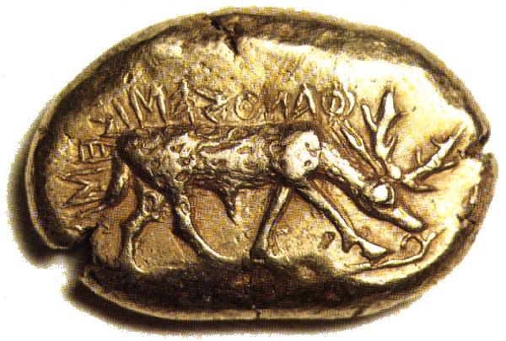
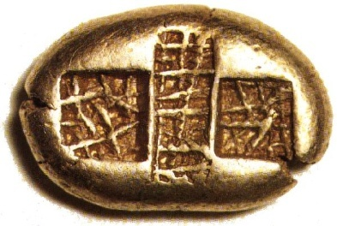
“I am the badge (or seal) (sema) of Phanes” (ΦΑΝOΣ ΕΙΜΙ ΣΗΜΑ)
Ephesus (?), Electrum Stater, c. 630 BC
Deutsche Bundesbank; 14.3 g; 24 mm
http://www.moneymuseum.com/moneymuseum/coins/search/coin1.jsp?i=0&m=207&c=&t=&p1=-3000&p2=3000&pi=0&ps=10
Notes:
Retrograde. Who responsible for these early coins? Officials? Individuals? Moneyers? Then carries the name and ethnic of the city – later.
Only 4 specimens known, the third to appear just has the legend “phaneos emi.”
Mint suggested to be Ephesus. Struck a series of denominations. the thirds have simply “phaneos,” “of Phanes,”
a fraction was discovered in a hoard from Ephesus (Spier 1998: 330) and that the “phaneos emi” stater reportedly came to light near the modern town of Torbalı (not far from Ephesus) strengthens an attribution to Ephesus, where the stag associated with Artemis was a long-standing civic coin type.
The Phanes inscription derives from an earlier tradition of seal inscriptions (Seaford 2004: 115–124), and it has been pointed out (Spier 1990: 117) that the word sema does not refer to the device of the stag alone but rather to both the device and the inscription taken together as a means of identifying the issuer of the coin (perhaps an official of Ephesus responsible for the issue). Rather than badge or emblem, sema would be better translated as “seal” or “signature.”

Slide 6
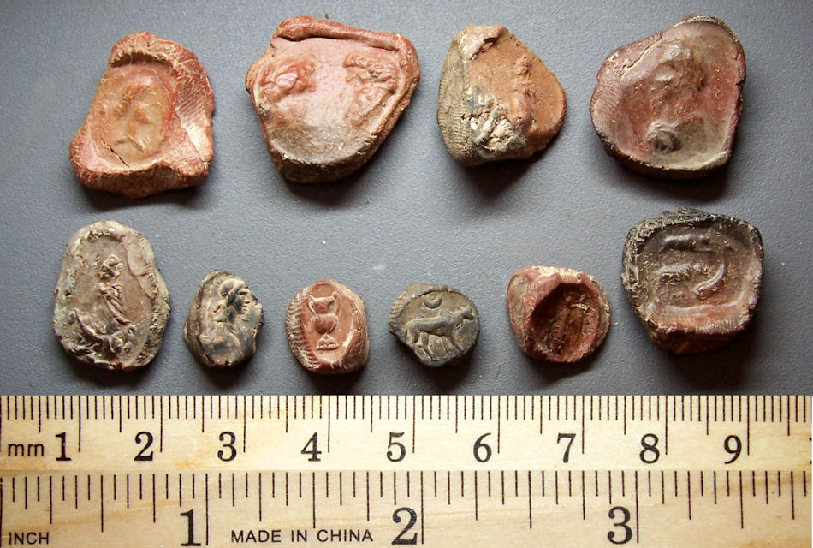
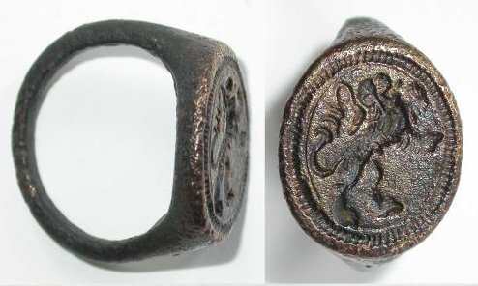

Slide 7
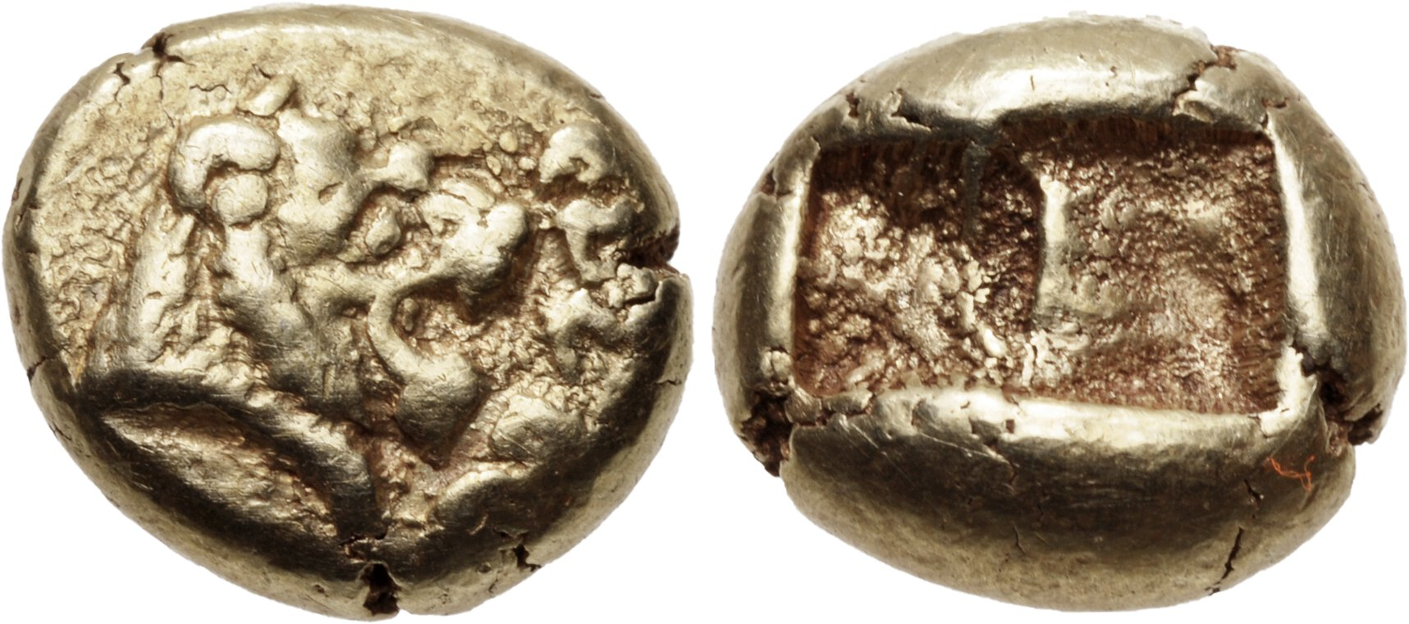
EL Hekte (1/6 stater), 10mm, 2.28 g, Sardis mint. Confront heads of roaring lions; WALWE[L] (in Lydian) downward between (= King Alyattes (c. 610–560), SNG Ashmolean 754.
Notes:
Classical Numismatic Group > Triton XXVAuction date: 11 January 2022Lot number: 260
WALWET could be transliterated into Greek as Alyattes
Also issues bearing the legend in Lydian “I am of Kukaś” or “I belong to Kukaś, presumably also connected somehow to the royal house.

Slide 8
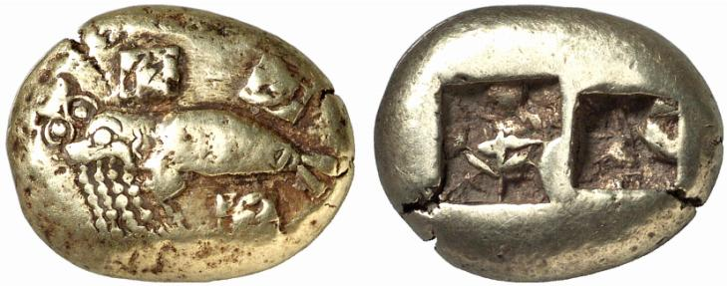
‘Phoke’
EL stater, 17mm, 16.46g, c.620-600 BC. Seal swimming l., devouring octopus in its mouth; phi on body before tail / two incuse squares. (Sale TRITON, New York VI (2003), 361)
Notes:
Fwkh – seal.

Slide 9
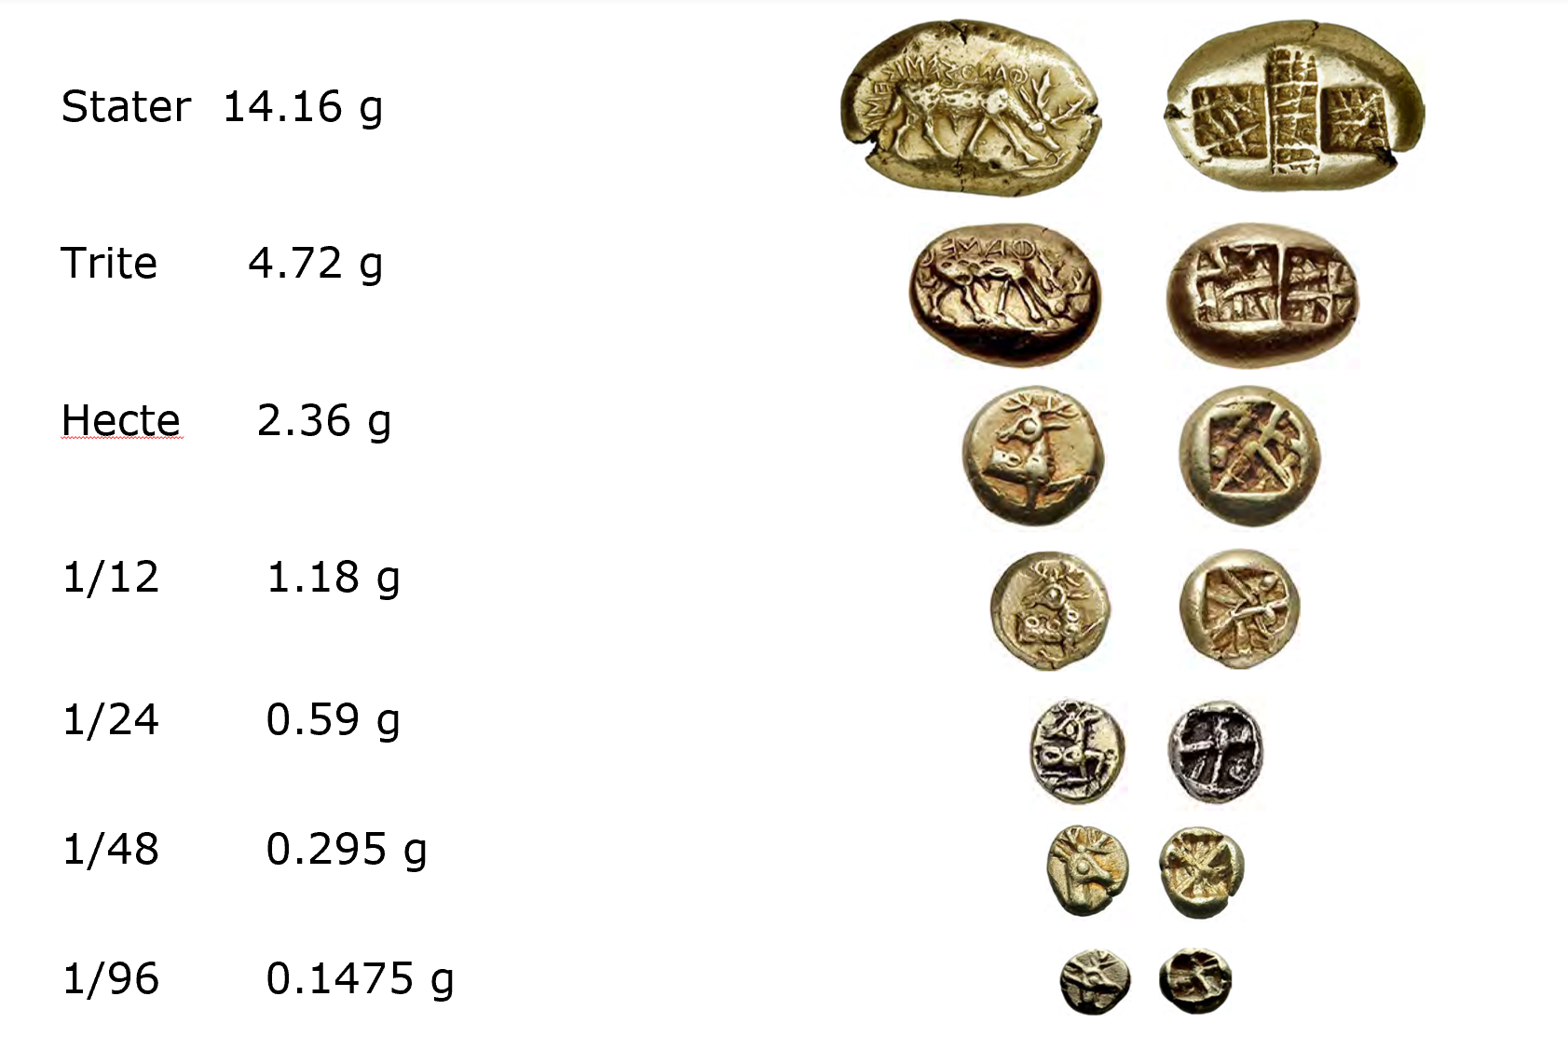

Also known is 1/192 of a stater (= 0.08)
Notes:
1/192nds of a stater
The shape and number of these punches varied according to their denomination and weight standard

Slide 10
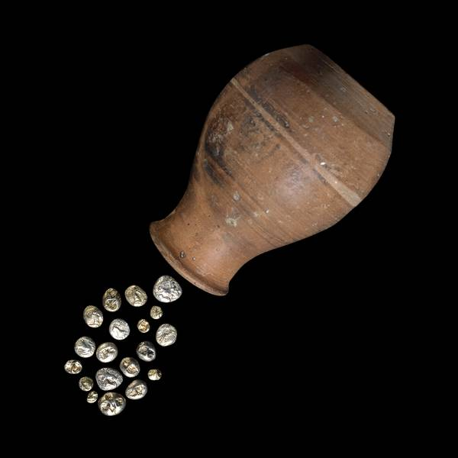
Ephesus Artemision
108 EL coins excavated to date, die links between them.
Also unstamped nuggets
Jewellery and other artefacts
Most recent archaeological work suggests c. 650 BC for the electrum coins.
‘Pot hoard’
From Ephesos, temple of Artemis
London, British Museum (coins are electrotype)
Notes:
punch-sharing has also been noted between a typeless coin and a lion type coin
The majority of the Artemisium coins are Lydian issues of the lion head type and lion paw fractions.

Slide 11
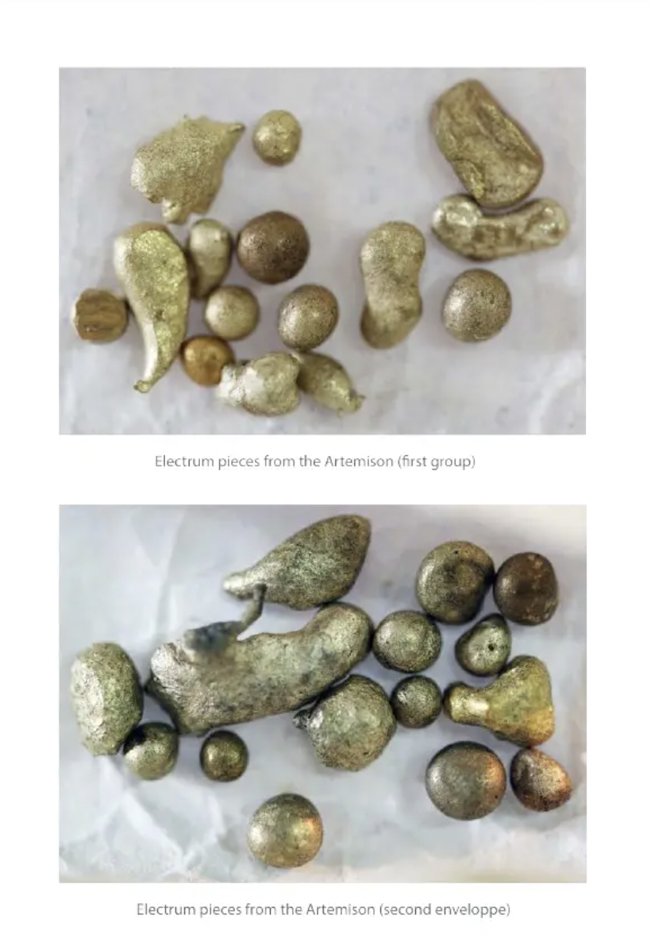
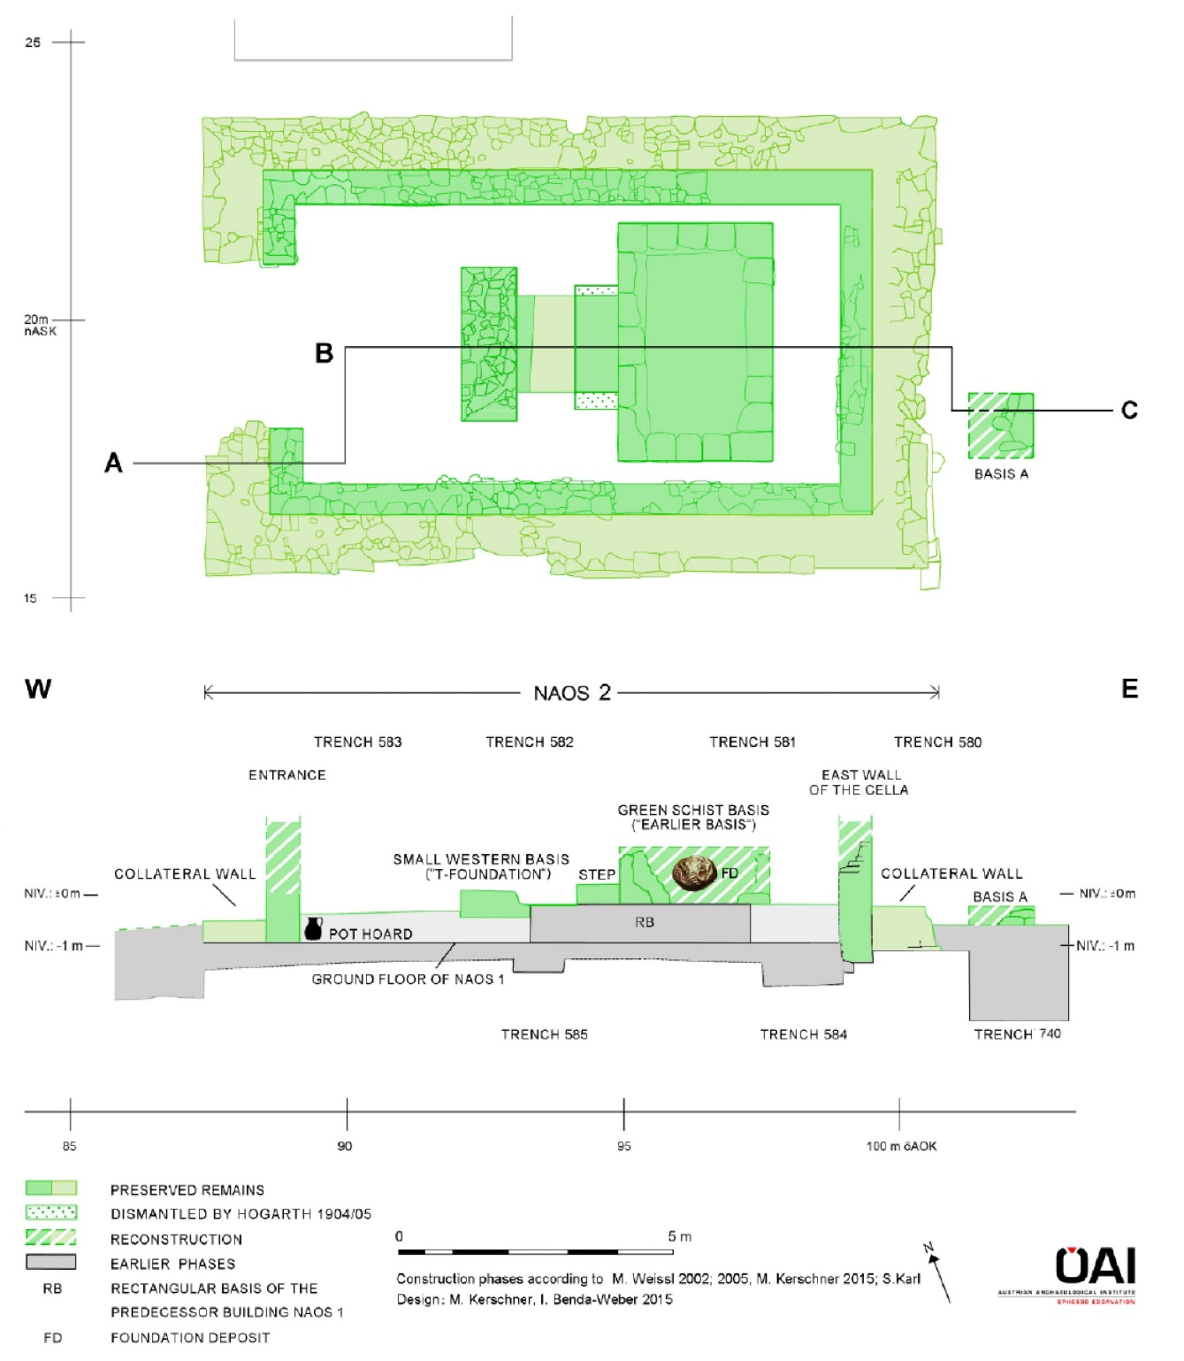
Notes:
24 electrum coins in this ‘Green layer’ – Green schicht. Many small rich objects as well, e.g. from ivory. Place beneath which where we think the cult statue went – so another offering, to the goddess who would be placed above the layer.
In total 108 coins have been excavated from the Artemision so far, Known die links between them.
A third-stater, which belongs to the Lydian lion head group inscribed kukalim (inv. ART 94 K 277), was found in the earliest layers: “Opferschicht G or F,” which can be dated to around 630/620 (Kerschner 1997: 100, 226).
These new stratigraphical data provided by the Austrian excavators are consistent with a dating that had been proposed for the olpe of the pot hoard (Williams 1991–1993).
The vessel was reckoned to have been buried between 650 and 625, and the beginning of electrum coinage was therefore placed around 650. It appears that in the light of the latest stratigraphical evidence from the Artemisium, the middle dating should gain further support, with perhaps an adjustment on the upside of a decade or two

Slide 12
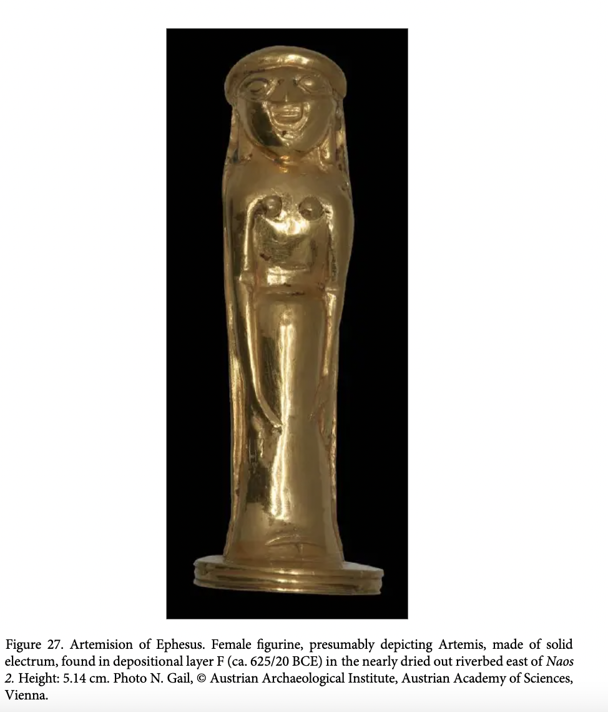
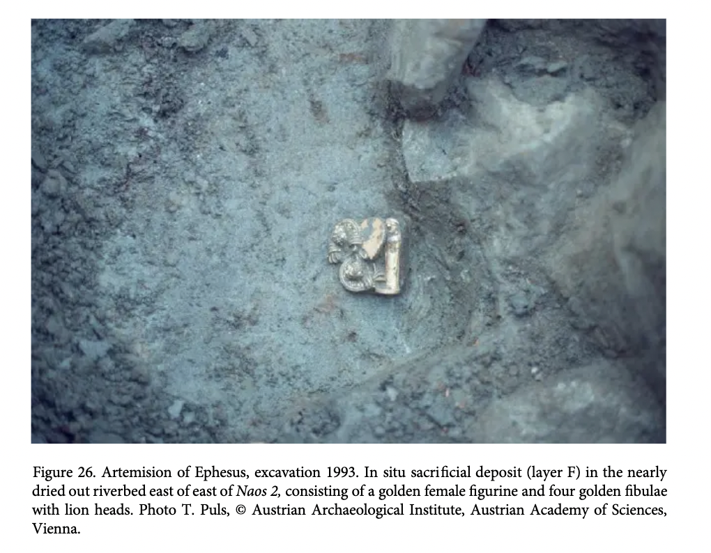
Notes:
Found with 4 fibulae with lion’s heads
Fibulae presumably linked to a piece of material that wrapped around the statue which has now decayed.
Stratigraphy, 625/620 BC and contextual finds
5.14cm high the statue is

Slide 13
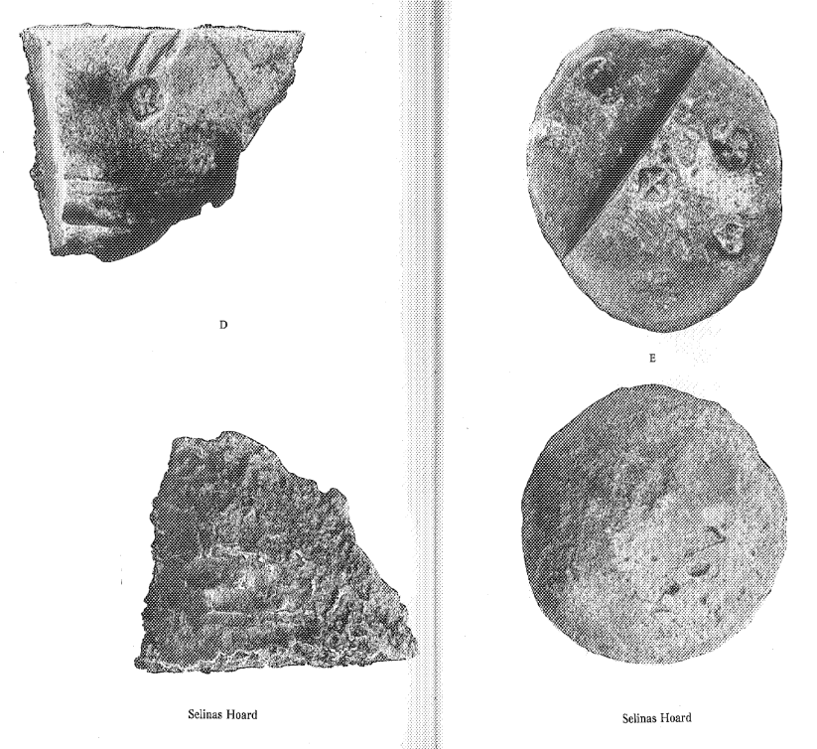
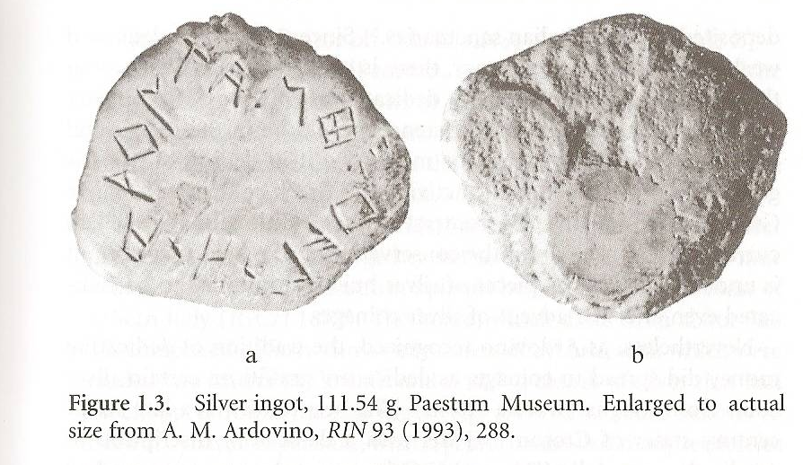
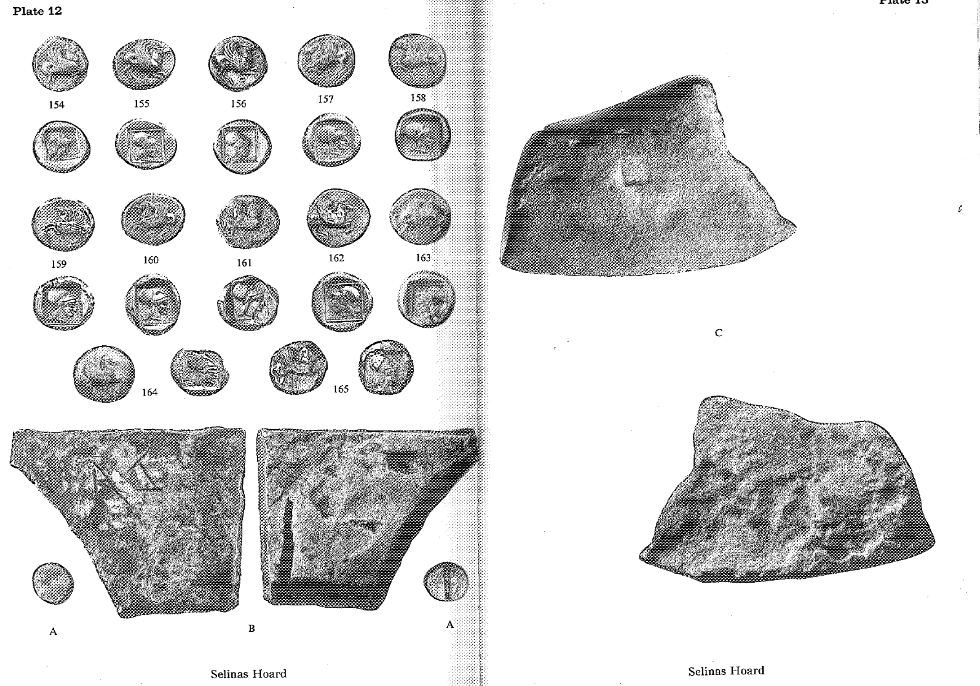
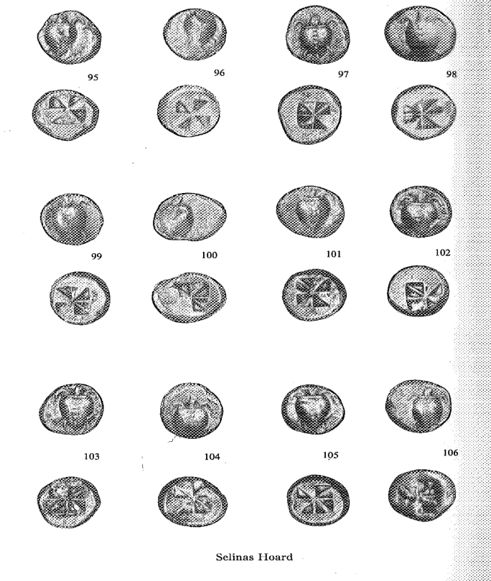
Selinous Hoard
Notes:
p 1: 1985, hoard containing 165 silver coins, 4 fragmentary silver ingots and a small silver dump was reportedly found in the vicinity of ancient Selinus (Selinunte) on the SW coast of Sivily.
Meatpontum - 2
Poseidonia 1
Sybaris 5
Selinus 35
Abdera 1
Aegina 81
Corinth 39
Dump 1
Ingots 4

Slide 14
Notes:
Dedicated in an extra mural sanctuary in Paestum. Inscription ‘I am sacred to Hera’.

Slide 15
Croesus (561–546)
“So far as we have any knowledge, they [the Lydians] were the first people to introduce the use of gold and silver coins, and the first who sold goods by retail.”
Herodotus 1.94
Excavated at Sardis: a large workshop for refining electrum into pure gold and silver, dated by the archaeologists to c. 560-550 BC.
Notes:
Gold and silver coins only, struck at Sardis, no more multiplicity of designs.
Furthermore, the discovery at Sardis of a large workshop for refining electrum into ingots of pure gold and pure silver, dated independently by the diggers to around 560–550, helps us to understand how the precious metal for coinage was obtained (Ramage and

Slide 16
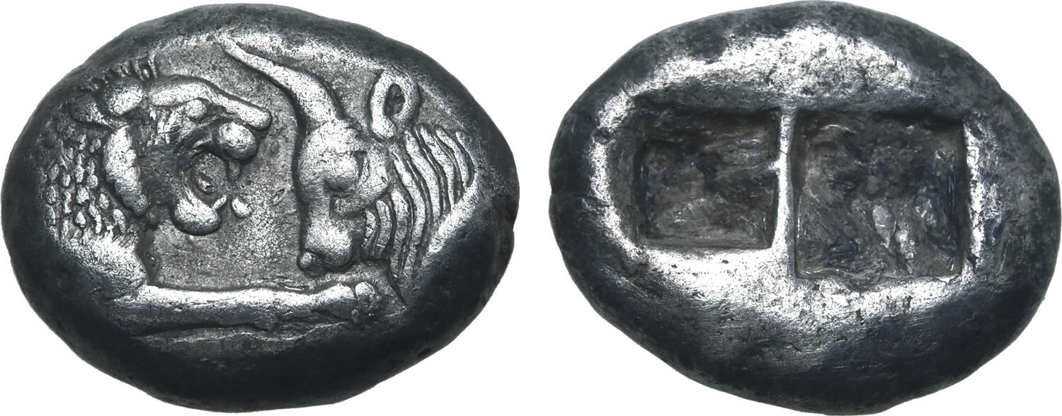
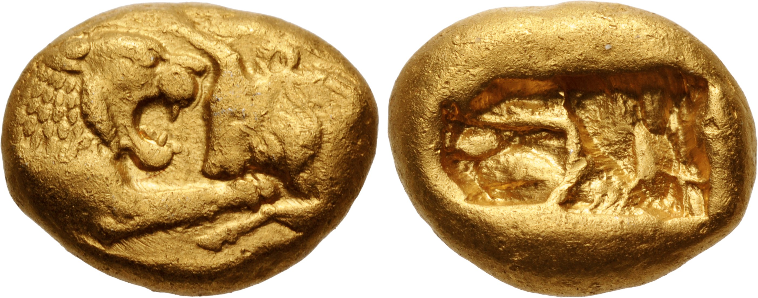
Gold staters 10.8g pure gold.
kroiseioi stateres
Silver staters also 10.8g
Silver fractions also struck.
Later a lighter weight standard of 8.1 g was struck.
Notes:
Same design for gold and silver
Analyses of the gold fragments found in this workshop and of the gold used for coins attributed to Croesus produced similar results (Cowell and Hyne 2000). No doubt part of the gold and silver purified in that workshop was used under Croesus to strike coins.
Heavier weight standard at the beginning perhaps intended to get the electrum coins back so they could be melted down and restruck.
Kroll has suggested that the Lydian state first used this heavy standard to recall old electrum coins at a 1:1 bullion ratio between pure gold and electrum at its natural intrinsic value (70–80% gold, which was probably the face value of electrum coins;
Lighter standard probably reflected the ACTUAL amount of gold present in any electrum coins that were still in circulation.

Slide 17
Herodotus 1.50
50. After this, he strove to win the favour of the Delphian god with great sacrifices. He offered up three thousand beasts from each kind fit for sacrifice, and he burnt on a great pyre couches covered with gold and silver, golden goblets, and purple cloaks and tunics; by these means he hoped the better to win the aid of the god, to whom he also commanded that every Lydian should sacrifice what he could. When the sacrifice was over, he melted down a vast store of gold and made of it ingots of which the longer sides were of six and the shorter of three palms’ length, and the height was one palm. These were a hundred and seventeen in number. Four of them were of refined gold, each weighing two talents and a half; the rest were of gold with silver alloy, each of two talents’ weight. He bade also to be made a figure of a lion of refined gold, weighing ten talents. When the temple of Delphi was burnt, this lion fell from the ingots which were the base whereon it stood; and now it lies in the treasury of the Corinthians, but weighs only six talents and a half, for the fire melted away three and a half talents.
Notes:
One can only be amazed by Croesus's largesse toward Delphi, for what he sent weighed about four and a half tons of pure gold.
‘white gold’ in Greek – trhe idea of gold with silveer alloy, i.e. electrum.

Slide 18
Herodotus 1.54
54. When the divine answers had been brought back and Croesus learnt of them, he was greatly pleased with the oracles. So, being fully persuaded that he would destroy the kingdom of Cyrus, he sent once again to Pytho and endowed the Delphians with two gold staters apiece, according to his knowledge of their number. The Delphians, in return, gave Croesus and all Lydians the right of first consulting the oracle, freedom from all charges, the chief seats at festivals, and perpetual right of Delphian citizenship to whosoever should wish.

Slide 19
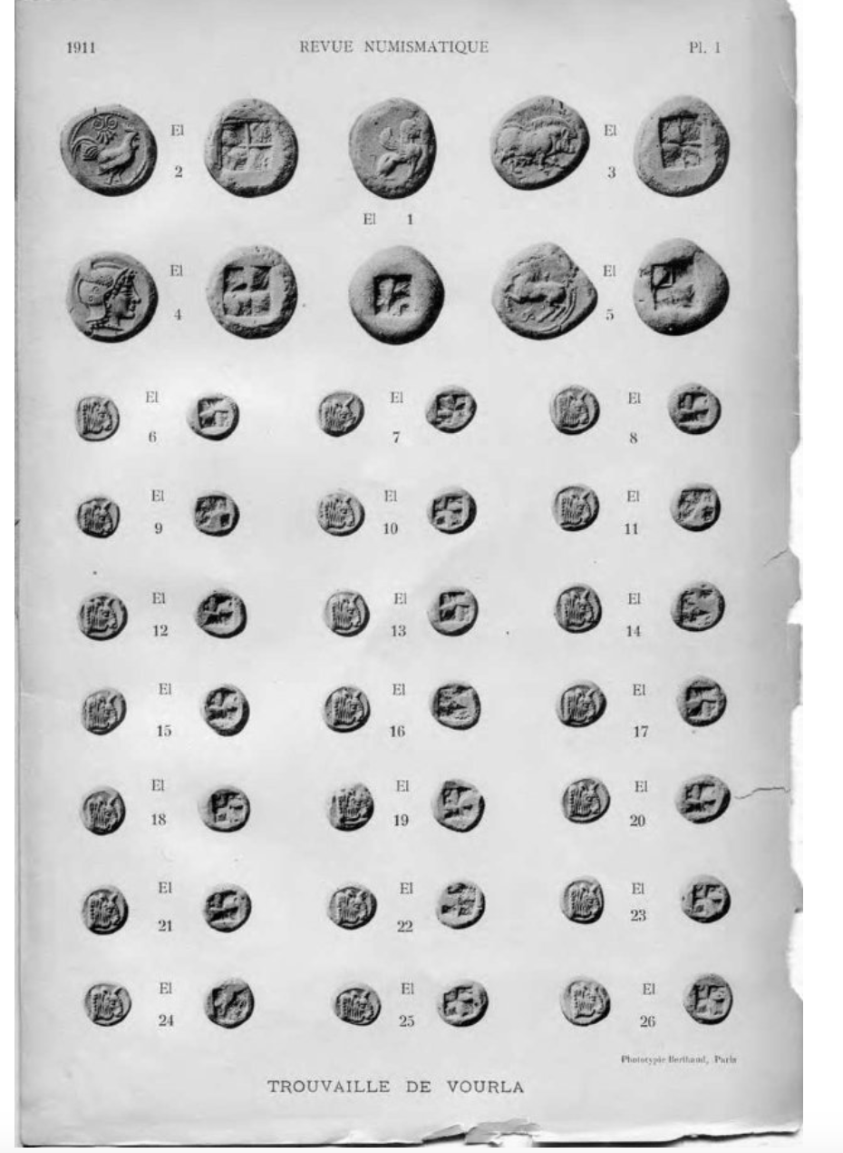
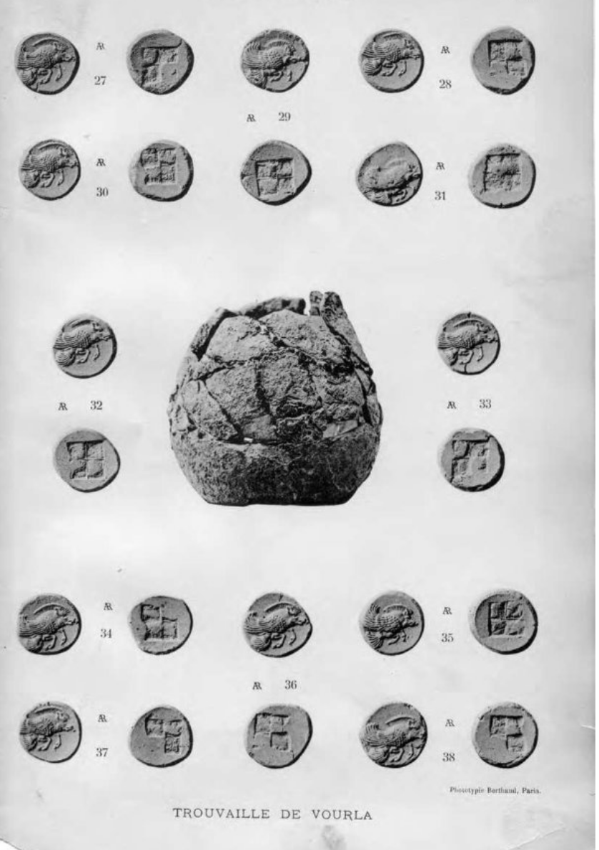
Continued use of Electrum. Vourla hoard
Dengate, J. A. 1967. The Coinage of Klazomenai. PhD dissertation. Ann Arbor: shared punch dies between electrum and silver.
Notes:
Dengate published the frst observed die-link between electrum and silver coinage in his study of the early winged- boar issues of Clazomenae.74 More recently, Wolfgang Fischer-Bossert, in his re-examination of an early coinage with a bee, probably of Ephesus, has likewise noted what appears to be concurrent silver and electrum issues.75
Electrum and silver, presumably in many diferent denominations, must have circulated alongside each other once silver coins became more common afer 550/40 BCEm Wartenberg, hoards.
Electrum coins somehow fulflled diferent needs than silver, used either for diferent kinds of payment or as a storage of wealth.
Its continued use from around 650 BCE until the time of Alexander the Great’s demise in 323 BCE implicitly points toward widespread and continued ac- ceptance by the ancient producers and users, who must have known exactly what the coins were worth and how and where to use them—and it is this popularity, along with the confounding aspects of its very existence, that makes electrum coinage even more mysterious to us today.
Te oddity of these types stands out in the repertoire of coin types, in which two foreparts of animals are joined by connecting the backs and the legs, a phenomenon for which we fnd parallels in jewelry and sculpture.
As is the case with a few other hoards, this hoard contains both electrum and silver coins and provides additional evidence for dating the hoard to a period afer Croesus’ reign.
Vourla hoard – silver and elkectrum coinage found togewtrerr.

Slide 20
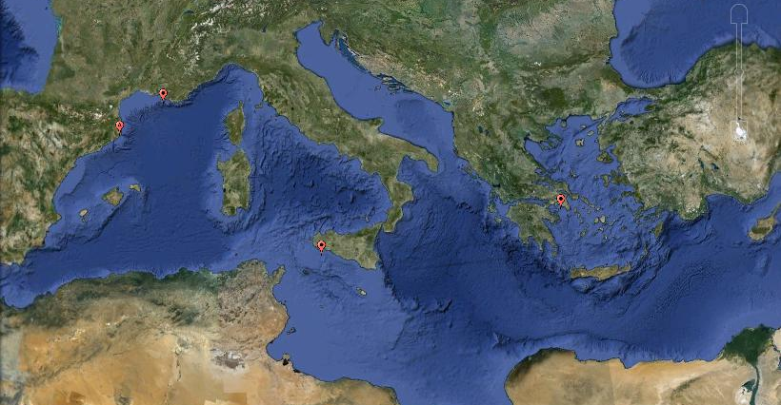




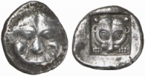

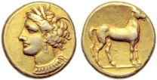
The spread of coinage
Notes:
Lydian – 7-6th century. Bimetallic mid 6th century BC.
Greece: 550-500
Sicily and Sth Italy: 550-500
Massalia c. 530-460
Emporion: c. 475 BC-450 BC
Persian Kings: 5th century BC
Carthage in Africa: 4th century BC
Spread – Rome, the Phoenicians, the Egyptians did not adopt until 4th century BC. So its about networks, cultural frameworks, political/social hierarchies also.

Slide 21
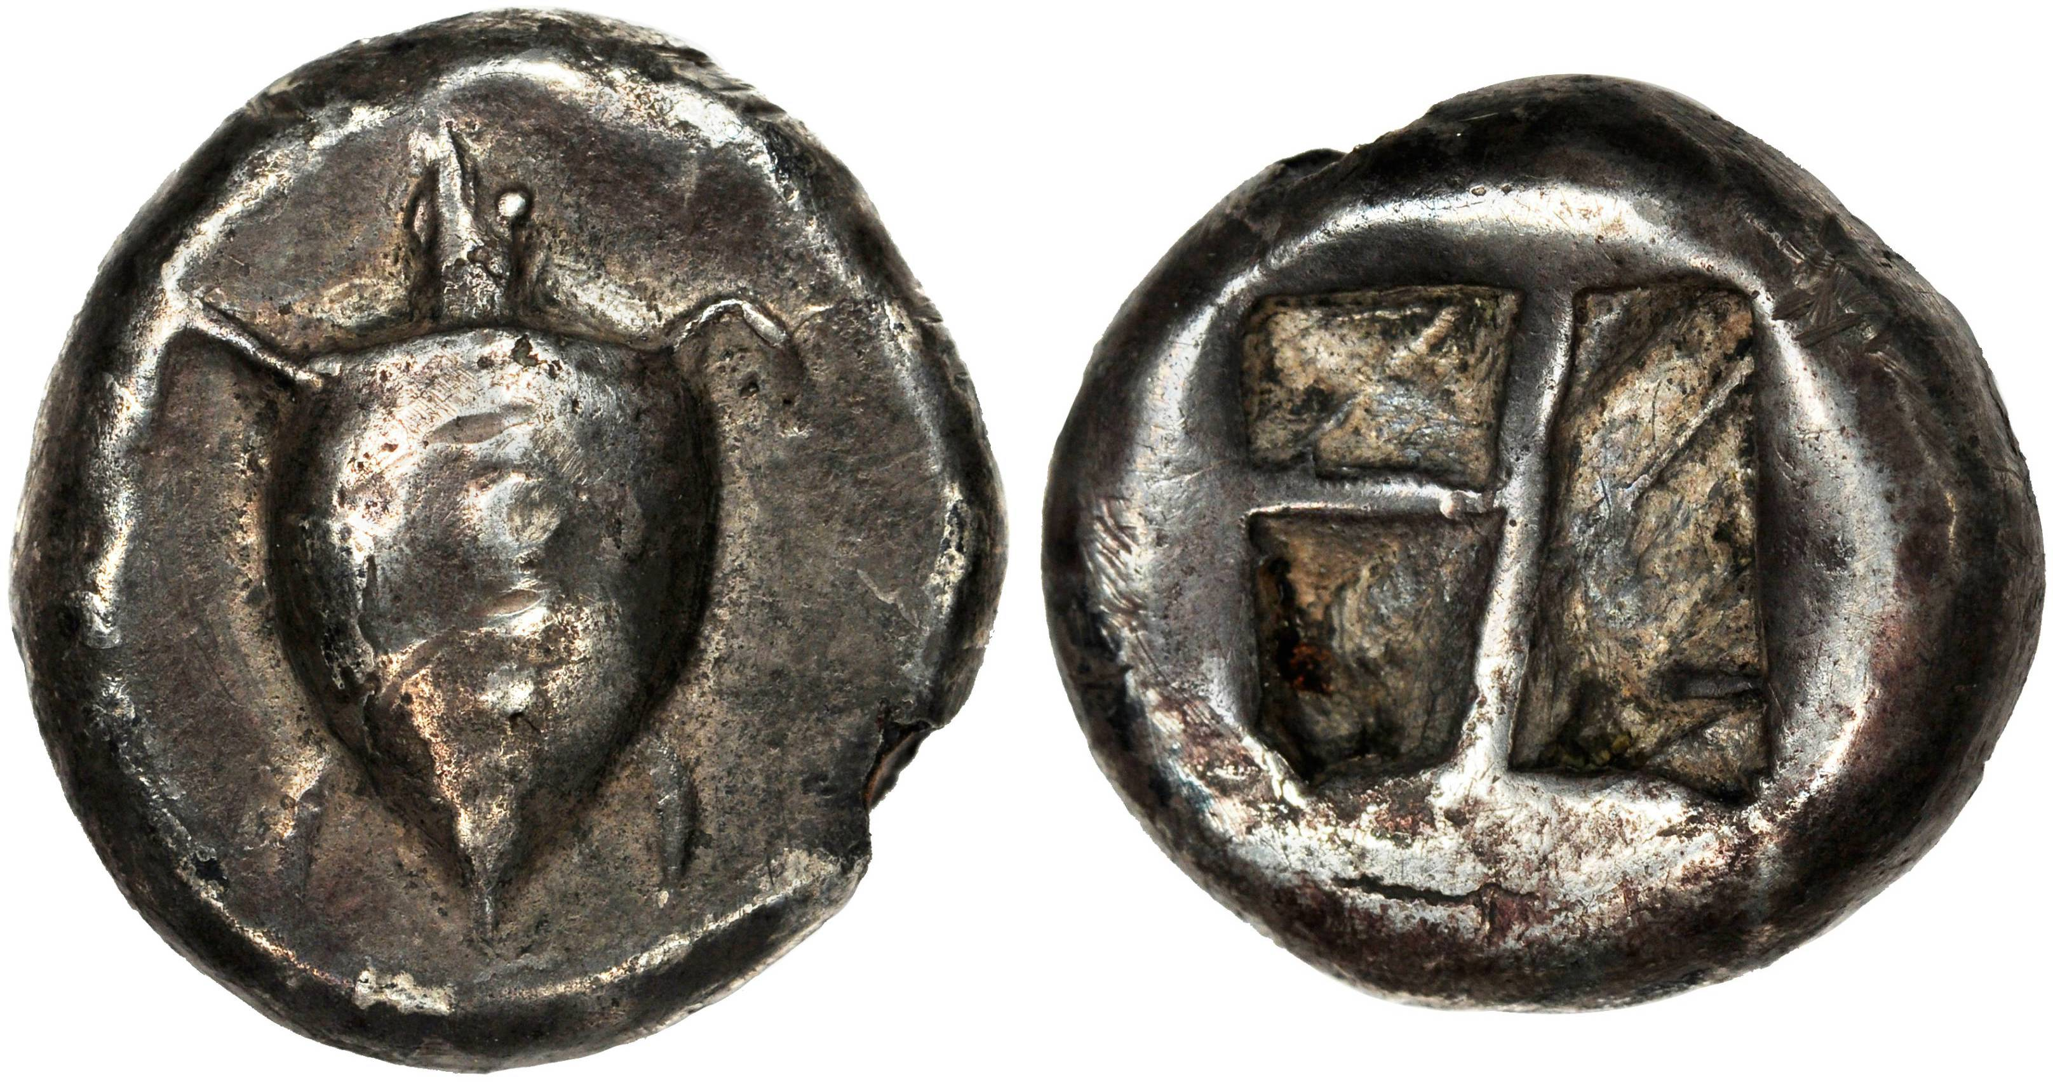
Aegina
Aegina, AR stater, c. 550-525 BC (11.81g). Obv: Turtle. Rev: incuse pattern.
SNG Delpierre 1502.
Notes:
Suggested Aegina the first to mint coinage in Greece. Irregular incuse design – Corinth and Athens are more regular. Key trade commodity was silver from Siphnos. Perhaps then position as first mint is understandable.
Difference in weight and then perhaps purpose?
Mint
Distribution.

Slide 22
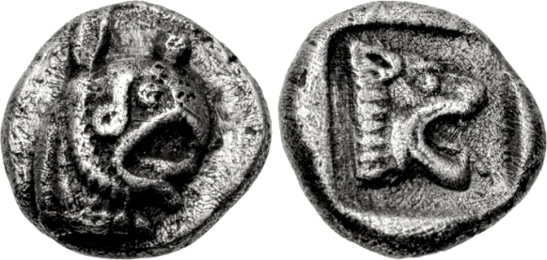
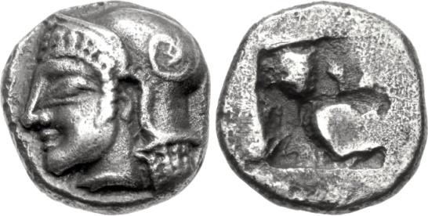
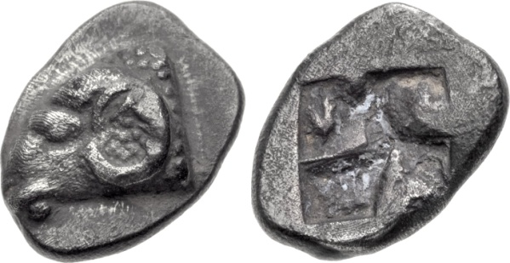
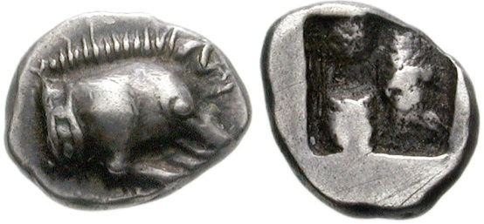
Massalia (Marseille)
AR hemiobol, 9mm, 0.92g, c. 475 BC. Head of griffin / head of lion within incuse square. SNG Stockholm 1.
AR obol, 8mm, 0.85g, 475-465 BC. Head of Athena / incuse. Furtwängler pl. II, 7-13.
AR obol, 10mm, 0.87g, c. 525-470 BC. Ram’s head / incuse. Furtwängler Group Qa.
AR hemiobol, 8mm, 0.56g, 5-4th century BC. Forepar t of boar, r. / incuse. Furtwängler V11.

Slide 23
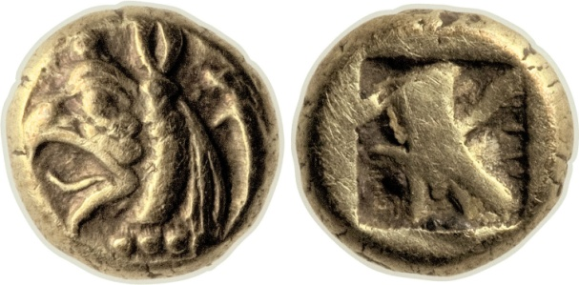
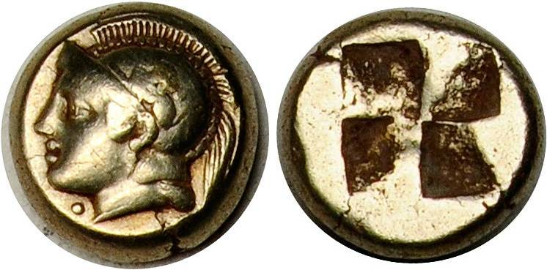
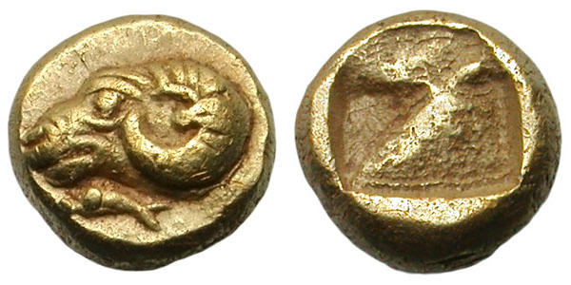
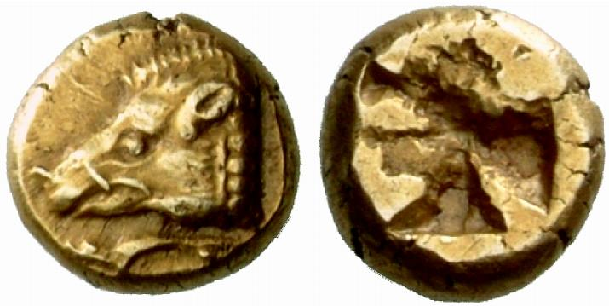
Phocaea
EL ¼ stater, 7mm, 0.39g, c. 625-600 BC. Head of griffin with seal behind / incuse. SNG von Aulock 7781
EL Hekte, 2.53g, c. 478-387 BC. Head of Athena / incuse. Bodenstedt 91.
EL 1/24 hekte, 0.65g, 600-550 BC. Head of ram, seal swimming l. Below / incuse. Bodenstedt 8.
EL 2.63g, 521-478 BC. Head of boar, seal below / incuse. Bodenstadt 14b.

Slide 24
Further Reading
Fischer-Bossert. W. (2018) ‘Electrum Coinage of the Seventh Century BC’, in O. Tekin (ed.), Second International Congress on the History of Money and Numismatics in the Mediterranean World, 5-8 Jan. 2017 Antalya. Proceedings (Istanbul: AKMED), 15–23 (available on academia.edu)
Fischer-Bossert. W. (2020) ‘Phanes’, in (eds) Wartenberg U., van Alfen, P. Fischer-Bossert, W., Gitler, H. Konuk, K. Lorber, K., White Gold. Studies in Early Electrum Coinage (New York and Jerusalem: American Numismatic Society and The Israel Museum), 423–476
Haselgrove, C. and Krmnicek (2012) ‘The Archaeology of Money’, Annual Review of Anthropology: 235–250
Kim, H. (2001) ‘Archaic Coinage and the Use of Money’, in Money and it's Uses in the Ancient Greek World eds. A. Meadows and K. Shipton (Oxford: Oxford University Press) 13–19.
Kerschner, M. and Konuk, K. (2020) ‘Electrum coins and their archaeological context. The Case of the Artemision in Ephesus’ in (eds) Wartenberg U., van Alfen, P. Fischer-Bossert, W., Gitler, H. Konuk, K. Lorber, K., White Gold. Studies in Early Electrum Coinage (New York and Jerusalem: American Numismatic Society and The Israel Museum), 83–190
Konuk, K., (2012) ‘Asia Minor to the Ionian revolt’, in The Oxford Handbook of Greek and Roman Coinage ed. W.E. Metcalf (Oxford: Oxford University Press) 43-60
Kroll, J.H. (2012) ‘The monetary background of early coinage’, in The Oxford Handbook of Greek and Roman Coinage ed. W.E. Metcalf (Oxford: Oxford University Press) 33–42
White Gold: Revealing the World’s Earliest Coins: https://museum.imj.org.il/exhibitions/2012/WhiteGold/index.html

