Slide 1
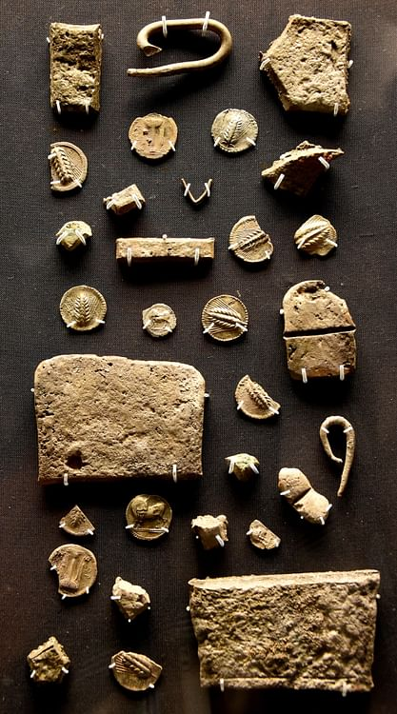
Hoards

Slide 2
What is a hoard?
‘For practical purposes the minimum size for a hoard is just two coins and the qualifying factor which creates a hoard is that the coins should have been brought together in a deliberate manner’. Casey p. 51
‘A group of coins deposited together in antiquity, and thus forming a single archaeological context for multiple objects. The reasons for deposit are varied, and they are rarely recoverable with certainty from the deposits themselves. The two main categories are savings hoards and emergency hoards’.
Kallet and Kroll 2020
‘Categories of hoard include (but are perhaps not limited to) savings hoards, emergency hoards and ritual deposits’
Thonemann 2016
Notes:
Understanding ancient coins: an introduction for archaeologists and historians
by Casey, P. J
Taken from Kallet and Kroll – Athenian Empire Using coins as sources
Single gold coin?
Svaings vs Emergency – can we actually tell the difference?
Cassey – excludes associations of coins associated in archaeological strata by loss or chance.
value is of course relative depending on one’s wealth
Your own hoards? eg Foreign coinage hoard?
Apart from votive hoards intention is to recover
Hoards with exact sum of money- to make a payment
Purse hoard also
Wear on coins in the hoard

Slide 3
What can we learn from hoards?
Notes:
Social, political/ideological and economic significance of coin circulation, use and deposition
Social and symbolic significance of coin iconography
Production and metallurgy of coins
Dates (relative) of various issues
Where coins travelled and what they circulated alongside.
Politics/war disturbances

Slide 4
Motivations, frequency and discovery of hoards
Notes:
Economic – safe keeping
Ritual
Savings
‘purses’
Reasons for burial and non-recovery

Slide 5
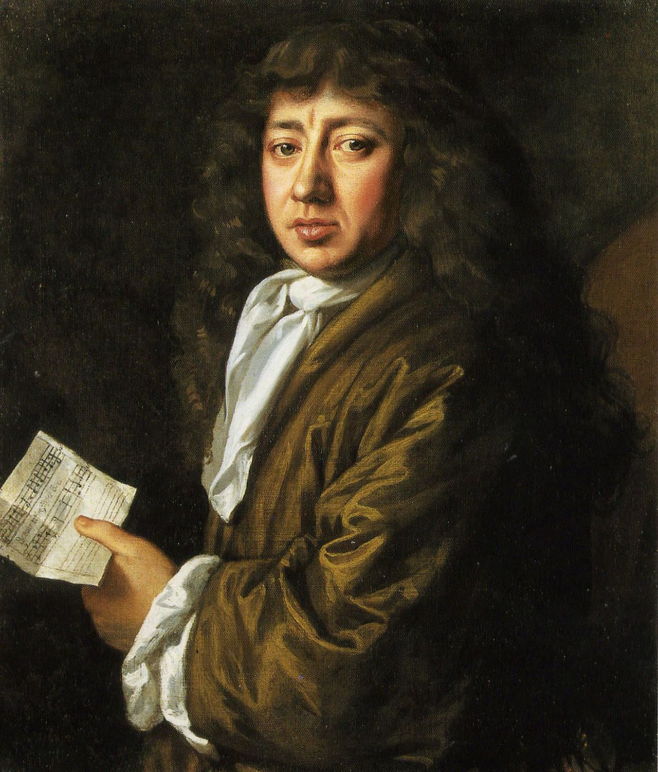
Samuel Pepys, 1667
Early June 1667 Dutch fleet penetrated the Medway and destroyed the English fleet
Pepys feared an attack on London so gathered his wealth and sent it to his country house at Brampton
En route the money bags (£1300 in gold) flew out of the coach and split open on the public highway
Pepys’ wife and father receive this money and £3000 more sent by a different messenger.
“Neither was equipped by nature or temperament for hard physical labour nor were they equipped with any large measure of common sense, though their unique situation may have contributed to their subsequent actions”.
Buried the gold in broad daylight in the front garden of the house (Sunday when neighbours at church) and then promptly forgot where they buried it

Slide 6
Samuel Pepys, 1667
4 months later Pepys felt it was safe enough to recover the money. Furious to discover it was in the front garden. Decided to dig it out on a dark night. (Father also deaf so was worried about shouting questions at him in case the neighbours overheard)
Lantern digging/probing with a spit
Eventually found the bags but digging them out meant the coins spread all over, bags had also rotted during interment.
Had to sieve and wash lumps of souls in a bucket of water
All but £20 recovered
Notes:
“Emergency hoard”
£20 still about- a sub hoard to be uncovered. Either on highway or still in the garden
Brompton not his house at London
Front garden- city abandoned?
Ie as archaeologists if the hoard was found intact what would we deduce?

Slide 7
Taranto 1911 hoard (IGCH 1874)
http://coinhoards.org/id/igch1874
Babelon 1912, Vlasto, Nuovo Borgo, Taras, Paolo Orsi (1927).
Holloway – hoard consists of a series of different ‘parcels’ which need not have been in circulation at the same time.
Notes:
Is this a hoard or not?
Known to us only through the market, not excavation.
Tells us nothing about what circulated in magna Graecia – but something about the way coinahge funcionted in archaic Greece.
Not a single coin of Taras in this hoard. Holloway – none of these coins ever circulated in Tarentum. Hoard created as a store of silver value. Silver from outside not used as currency – kept separate.
Kroll: wo thirds of the silver by weight was in the form of chopped up ingots and silver scrap, making it the largest assemblage of silver bullion known from the ancient Greek world. 600 coins, mostly from south italian cities but including over 100 from Sicily andf Aegean Greece, made up the remaining third of the deposit. Since coins from Tarentum itself are conspicusouly absent, deposit appears to have been the stock of a trapezites, or money changer, who received this foreign currency in exchange for local coinage, presumably the sole legal tender for transactions in the city.
1012 – Babelon published an account in which he quoted an unnamed by distinguished numismatist (Vlasto) who hads sent him a letter to say that on 22 June 1911 a mass of silver coins, jewellerty, silver ingots and miscellaneous silver items had been found in a broken vase in the district of Nuovo Borgo, at a depth of c. 3m, by people digging the foundations of a factory (in the ancient settlement of Taras). The source was able to purchase the greater part (but not all) of the hoard.
Italians ordered an inquest, which declrared that the hoard, which was unparalleld, must have been an archaeological fiction, created by coin dealers who gave false information to deceive Vlasto. Investigation by the Italian authorities was fone by Paolo Orsi. Argued the fiction was made of of hoards found elsewhere ein the city. View may have fed into the proposal that thewre were two separate finds, one of western Greek coins and one of mainland and northern Greece, found in two jars.
Holloway – probably evidence of exchange of silver for local Tarentine coinage.
IGCH – Kraay – argued that Vlasto’s opinion should hold weight. Probably knew about the other letters sent to Noe.
H

Slide 8
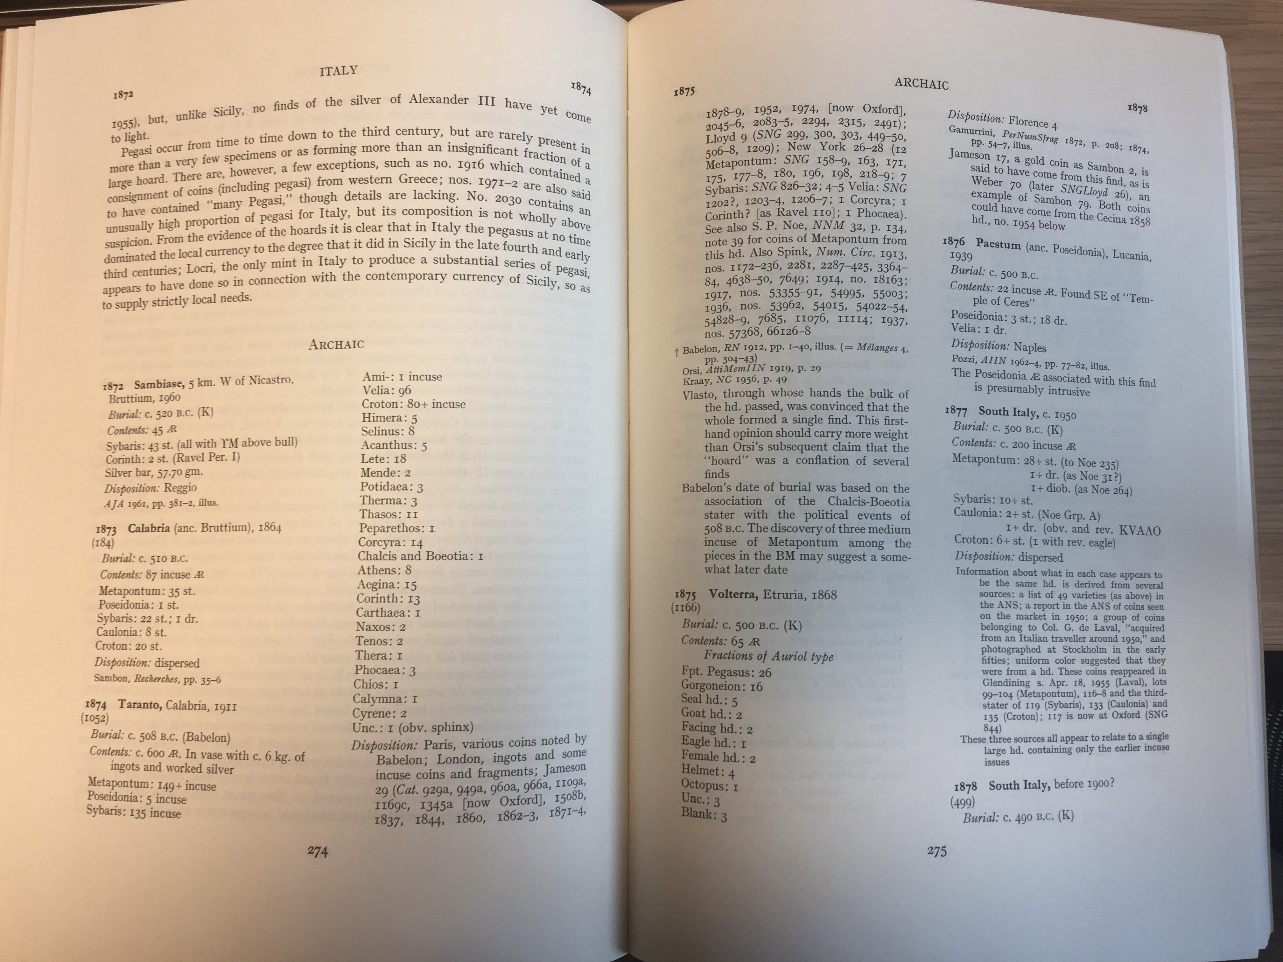
Notes:
Image of hoard from IGCH

Slide 9
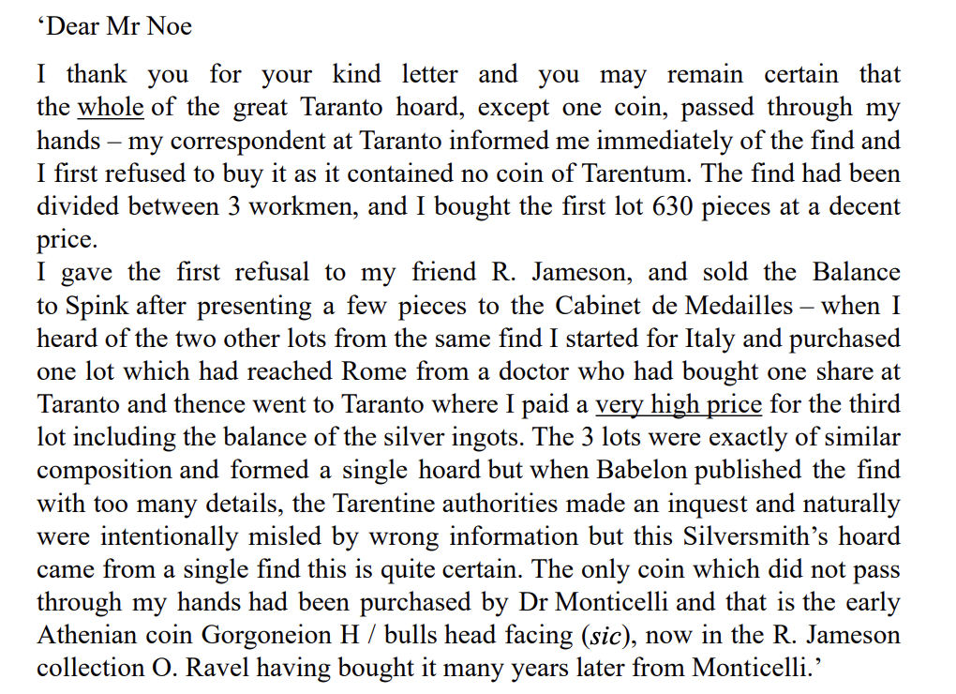
Letter to Noe from Vlasto 12/9/1920

Slide 10
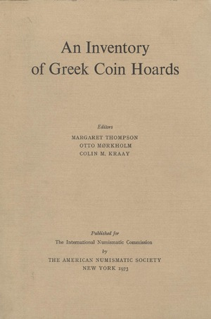
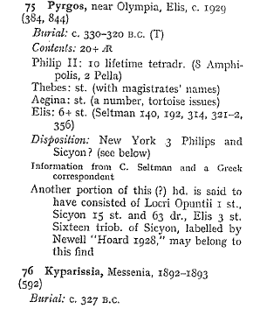
IGCH 75
Notes:
India – Hellenistic coinage goes east – influences Indian coinage, etc.
ONLINE

Slide 11
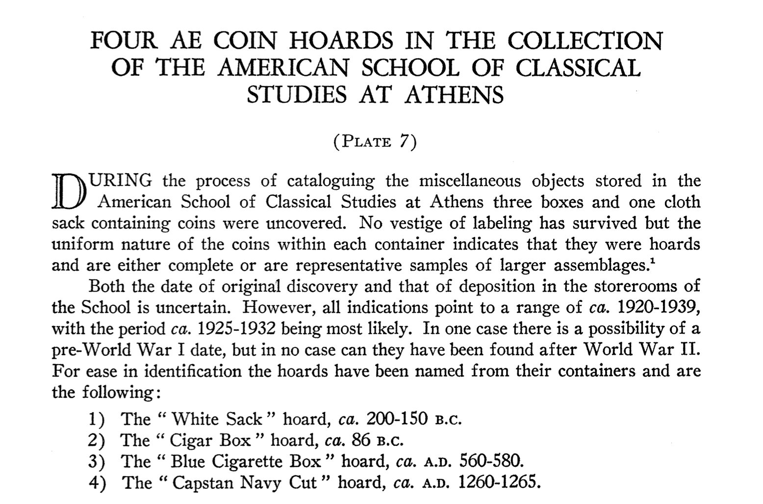
Notes:
The " White Sack" hoard (WS) was certainly found in Boiotia. This is the
only hoard with any intrusions (see below) and looks like a group of coins acquired
during a protracted stay in some area of Boiotia (or possibly in Euboia) on excava-
tion or during a survey
This sack contained two clearly distinct lots of coins: the first was composed of one hundred
and nineteen AE coins of Boiotia with the types Facing head of Demeter/Poseidon standing 1.; the
second lot contained twenty-four AE coins from a variety of mints in areas around Boiotia. It is
difficult to say whether any of the latter group was found with the former but they have been listed
here for the sake of completeness.
The "Cigar Box" hoard (CB) was certainly found in Attica, probably in
Athens or Piraeus.”
This hoard contains ninety-eight bronze coins all of which are corroded and rather overcleaned.
The type of corrosion is characteristic of coins found in Athens and is paralleled by thousands
found in the Agora Excavations. The coins also seem to have been burnt and are quite similar to
the coins in the 1973 hoard from the Pjraeus.7 It seems certain that these coins were found in either
Athens or the Piraeus and very likely from a level of Sullan Destruction.
Athenian bronzes, Thessalian League coin, and one Antigonos Gonatas. Nos. 89-98 – ‘uncertain Greek’

Slide 12
Dating hoards
Terminus post quem on the basis of latest coin in the hoard
Notes:
Could be a gap between the majority of the coins and the last coin
Some hoards could have been accumulated over a longer period of time

Slide 13
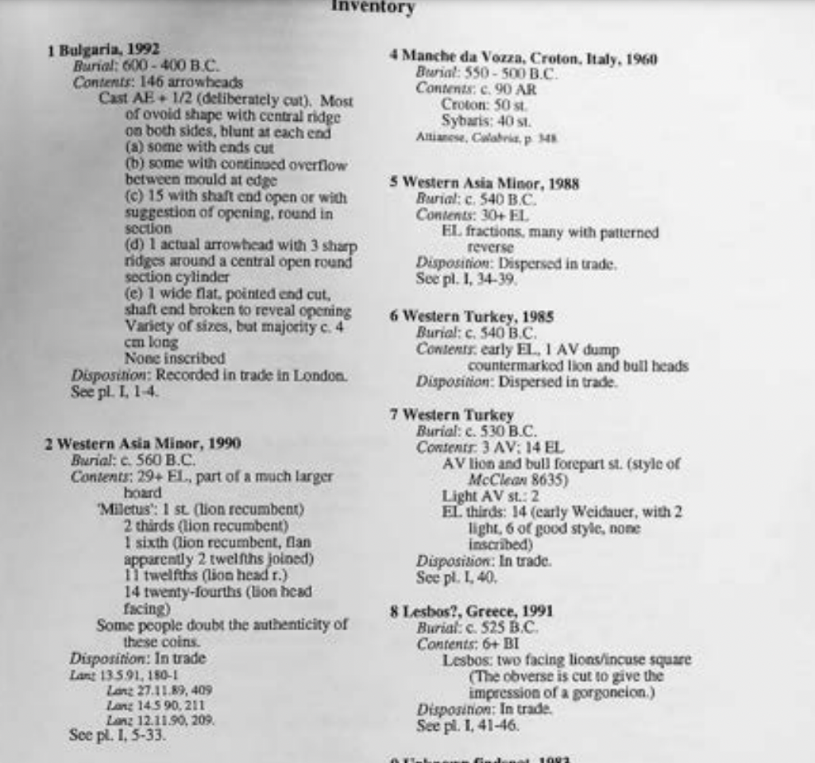
Coin Hoards (CH)
https://numismatics.org.uk/society-publications-2/special-publications-and-coin-hoards/
CH VIII.1

Slide 14
IGCH 353 (Corinth)
13 May 1931, 11 bronze coins found in the lower part of a thesaurus in the sanctuary of Asklepios at Corinth.
de Waele: “ for some curious reason, the date of this hoard falls either in the period of centennial desolation of the city or shortly after the rebuilding of the city by Julius Caesar’…. ‘was the sanctuary still in use?’
Roebuck: ‘the nature of the deposit would seem to indicate the sanctuary was being cleaned and the debris swept into convenient holes of which the receptacle provided one’.
Notes:
Corinth destroyed 146 BC by the Romans. Ancient texts say destroyed and left abandoned before refounded as a colony in 44 BC.
Lid (now lost) must have had a hole in it into which coin offerings could be dropped.
Roebuck – thought hoard must date to soon after the refoundation of the city, 44 BC.
Thesauri – not intended to stay there forever, but regularly emptied and money used for the functioning of the sanctuaries.

Slide 15
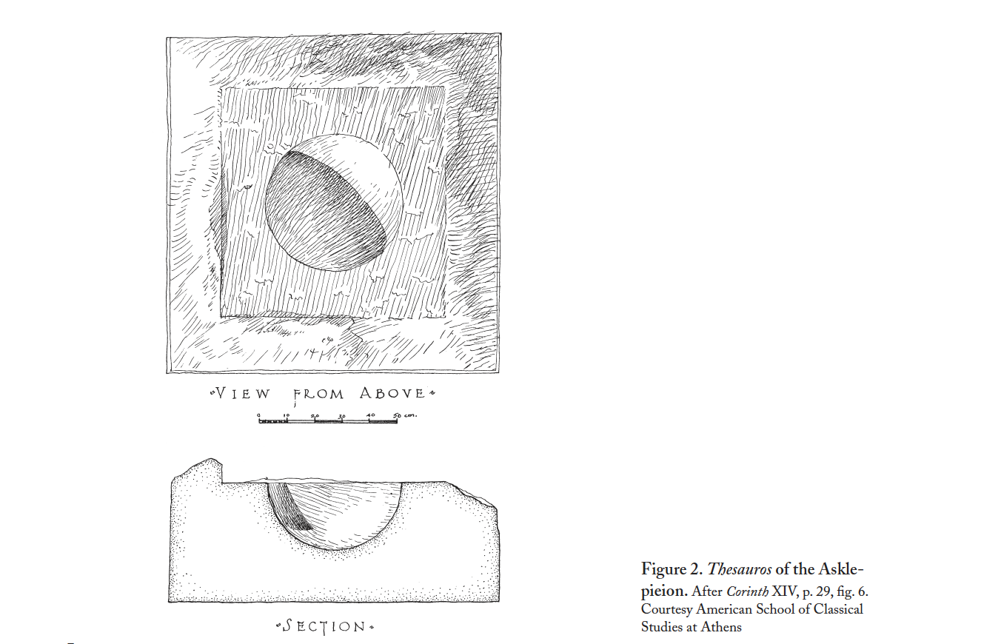

Slide 16
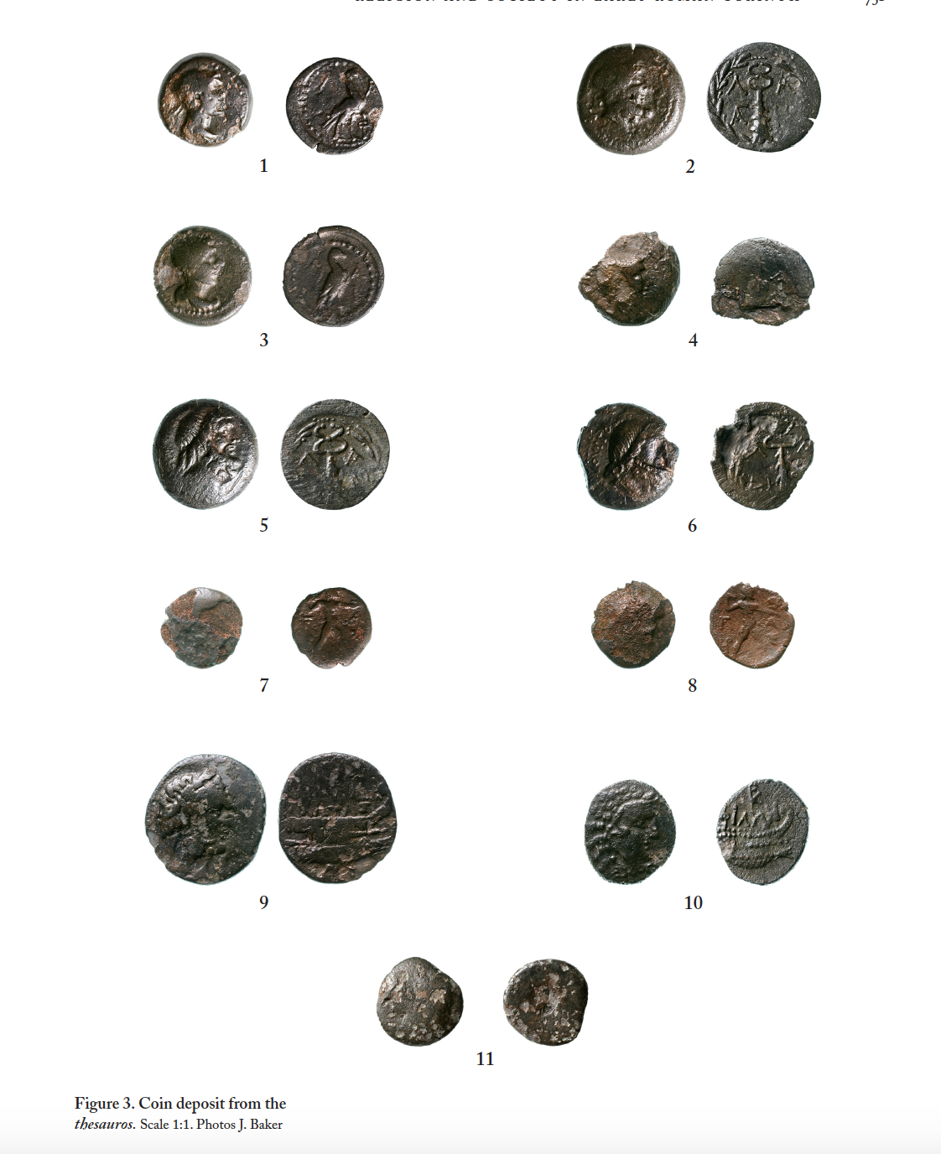
Nos. 1-6: Lakedaimon (3 1/3 obols, 2 hemibols, one assarion) dating from 42-31 BC
Nos 7-8: Elis (2 1/6 obols, 2nd century BC)
Nos 9-10: Corcyra (2x uncertain denomination, 229-48 BC)
No. 11: Uncertain, illegible, 1st century BC?
Notes:
Coins 7 and 8 might date later – countermarks use fulminating Zeus types, so might date to after 146 BC. But coins found in circulartion much later than second century BC. Much more worn here and elsewhere in Corinth – suggest in circulation for a long time.
9 and 10 – wide ranging date period – nothing more possible – justperiod when the city was under Roman protection. Other examples of this type or similar found in and around Corinth in c. 146 BC or after. Those layers. Heavy weights suggest adoption of Roman standard by Corcyra.
6 (possibly 7) of the 11 coins minted by the same authority in the same time period – cannot be the result of cleaning. Also not from Corinth (but Sparta) -0 suggests intentional deposition. Must have been deposited soon after strikinh as one action or several successive actions.
Earlier coins – seems unlikely they were deposited, left inside the thesaurus untouched during the sack, when the Spartan coins came along.
Compared to coins found at Corinth, seems to be an overrepresentation of coins from Sparta, only Greek civic bronzes (no Roman issues), coins appear to have been deposited in groups of two or multiples of two.

Slide 17
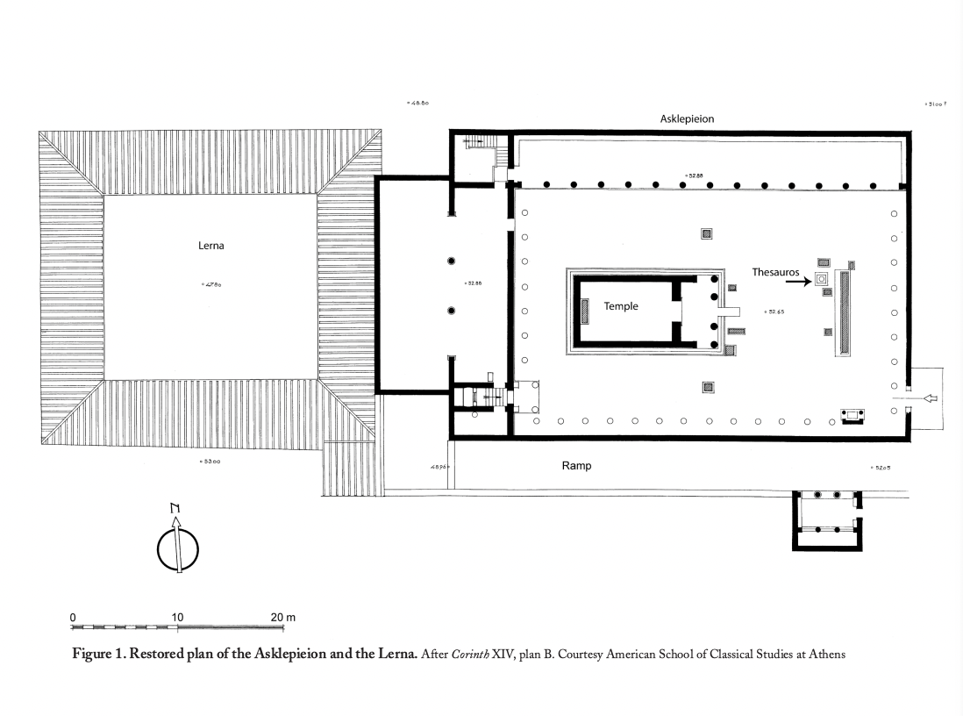
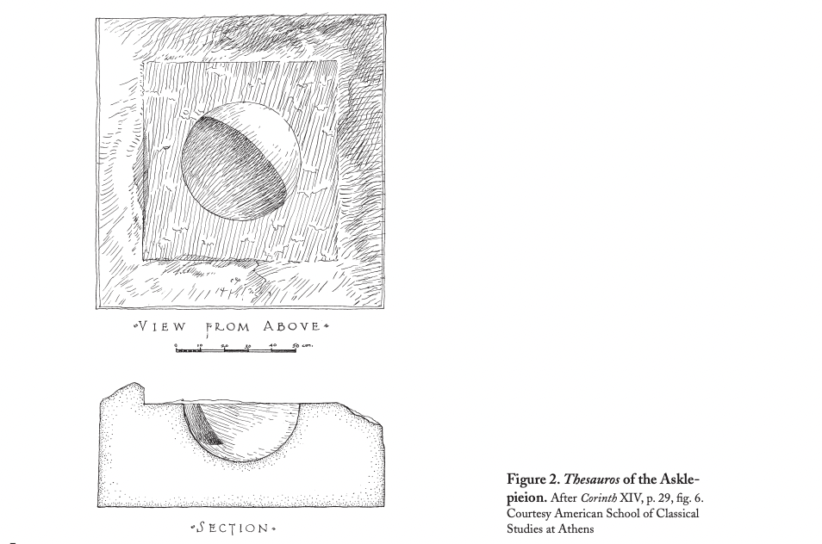
Notes:
42-31 BC – when Corinth was under Antony’s control. Sparta, coins of Antony’s general./
No Augustan coins – thesaurus muyst have been abandoned/went out of use after 31 BC. Therefore deposit represents a very short period of cultic activity. Votive offering pracrice in the temple had resumed.
Coins may have been offered in groups or multiuples of two – all of bronze and similar (low) value- similar to other known votive patterns (WHY LOW VALUE??!!)
Inswcriptions tell us worshippers often had to pay a fee to Asclepius to access healing rites.
No Roman coins – probably travellers then depositing the coins? Put out of town coinage in the box rather than having to go and exchange it for local currency for a fee. Officers or businessmen involved in the reognisations of the Peloponnese under Antony. Local people at the temple would have left local coinage.
Greek rather than Roman travellors – Greek civic bronzes, Greek method of paying these sums to Asclepius.
Perhaps deposition happened at the same time or just after the collapsed roof began to be repaired and the sanctuary came back to life.
Structural changes to the temple – raising of the floor, meant thesaurus was probably interred – this is how it fell out of use. Otherwise hard to explain an in situ coin deposit like this. Value of coins lefrt in the box porobably not worth the effort of collecting them. Especially if heavy lid remained on top.
Then under Augustan/Roman period the use of the coins and thesaurus seems to stop – a change in the ritual. Usew of thesauri in Greece seems to have disappeared by the end of the first century BC. Were in common use in the Hellenistic period. Roman colony and settlers = abandonment of practice?

Slide 18
IGCH and Hellenistic Egypt
Examine the collection of coin hoards published in IGCH for Greece and Egypt from the Hellenistic period onwards.
What trends do you notice? What are the differences between the regions?
Does anything else strike you?

Slide 19
Ptolemaic Kingdom
Battle between Ptolemy I and Demetrius Poliorcetes in 306 BC at Salamis. Destruction of Ptolemaic fleet.
Fiscal crisis
Attic weight coins pulled from circulation and reissued 1.5g less in weight (15.7g). Same types as previous coinage.
drachms and half drachms struck on a lighter metrology (3.5g instead of 4.3g)
But everyone else was issuing silver coins of 17.2g!

Slide 20
Solution: The closed economy
Foreign coin forbidden to be used in Ptolemaic possessions (Egypt, Cyrene, Cyprus and Coele Syria)
Merchants had to exchange their coinage for Ptolemaic coinage (paying a fee for this!)
1.5g silver per tetradrachm exchanged
Gresham’s Law (bad currency drives good currency out)
Closed economy also meant that future manipulations were possible (e.g. gold:silver ratio, use of fiduciary bronze coinage).
Tetradrachms later reduced again to 14.27g (Phoenician standard)
Money to rebuild fleet, and implement other programmes
Notes:
Lighter weight specimens - value comes from the stamp of the king rather than from the metal content. Change in monetary understanding. Later a reduction of the stater under Ptolemy I. Ptolemy’s need for money could not keep up with demand. No natural resources in Egypt.
Outside coin melted down and restruck into Ptolemaic coin. Fee charged for this exchange, c. 3g silver.
Hoards show the system was successful. C. 300 BC no outside coin found in Egypt. Ptolemaic coin prob. Rarely left Egypt as well.
Continued under Augustus and the Roman Empire.
Gresham’s Law - bad currency drives good currency out. Reduction of weight standard meant that people were hoarding foreign coins, response was the introduction of the closed currency system.
How could they get away with it – Egypt a centralised region, grain exporter – merchants couldn’t boycott it!

Slide 21
IGCH 1678 Phacous, 30 km. NE of Zagazig, 1956
Contents: 2400 AR. Two pots, containing groups a and b.
Burial: c. 283 BC Disposition: dispersed.
Group A | Group B
Alexander III: 408 lifetime and early posthumous tetradrachms (Amphipolis 69, Pella 10, Lytuus? 3, Lampsacus 1, Sardes 5, Miletus 10, Side 21, Tarsus 15, Salamis 2, Citium 10, Amathus 1, Myriandrus 11, Side 21, Tarsus 15, Salamis 2, Citium 10, Amathus 1, Myriandus 11, Damascus 17, Aradus 13, Byblus 14, uncertain Phoenicia 1, Sidon to 306/5 BC 11, Ace to 307/6 BC, Ace to 307/6 BC 46, Babylon 108, Susa 1, Alexandreia 20, uncertain 18.) Philip III: 48 tetradrachms (Pella 1, Salamis 1, Aradus 6, Marathus 4, Bablyon 33, Susa 1, uncertain 2) Ptolemy I: 21 tetradrachms (head of Alexander / Zeus) Ptolemy I: 37 tetradrachms (head of Alexander / Athena; Alexandreia 35, Cyprus 2) | Ptolemy I: 4 octadrachms, 341 tetradrachms (Soter type) Ptolemy II: 18 tetradrachms
Notes:
one jar ends c. 300 BC, the other c.279.
Jenkins, ANSMN 9 (1960), pp. 17-37, illus.
c. 2400 AR coins
Two jars
Jar 1: foreign coins, attic weight Alexander tetradrachms struck in Egypt, three reduced weight Athena tetradrachms
Jar 2: coins of the Ptolemy/eagle type

Slide 22
Taxation and Monetization
Salt tax in 266/5 BC (Ptolemy II)
Change in bronze coinage
Notes:
What is monetization? Discussion….
Widespread use and acceptance of one form of money
Initially money used by upper classes
large denominations.... up to 45 mm in size, something not seen before.
this poll tax, payable by both women and men, was payable in bronze.

Slide 23
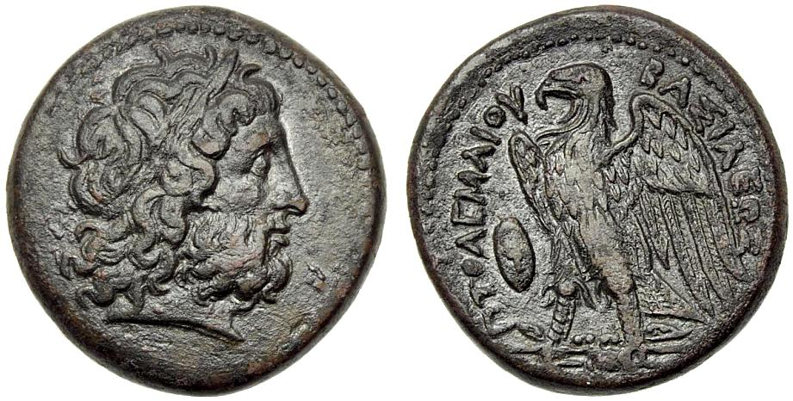
The bronze coinage of the Ptolemies
Ptolemy II, Egypt, Alexandria Mint, AE Obol, 285-246 BC, 27mm, 17.18g. SNG Cop 114
Obv: Laureate head of Zeus, r.
Rev: ΠTOΛEMAIOY BAΣIΛEΩΣ, Eagle on thunderbolt r., at l. shield.
Notes:
Ptolemy II increased the size and quantity - became the money of the countryside.
Bronze coins also struck in Cyprus, Cyrene and Coele Syria, and reached other areas through transport.

Slide 24
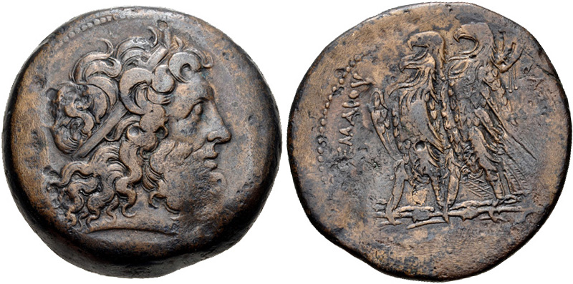
BIG coins....
Ptolemy II Philadelphos, Egypt, Alexandria Mint, 261-246 BC. AE triobol, 43mm, 73.71g, 12h. Svoronos 463.
Obv: head of Zeus Ammon, r.
Rev: two eagles with closed wings standing l. in thunderbolt, filleted cornucopia over wing of r. eagle. Θ between legs of l. eagle. ΠΤΟΛΕΜΑΙΟΥ ΒΑΣΙΛΕΩΣ.

Slide 25
Tax and Documentary Evidence
Hibeh, receipt for brewing tax (P.Hibeh 106)
Year 2, Athur 30. There has been paid to the office at Phebichis of the Koïte to the money changer Pason and to Stotoëtis the certifier, from Harendotes on behalf of Taëmbes from Talaë, for he brewing tax, for Athur, twenty drachmas in bronze at 24 (?1/4). In the presence of Dorion.
Notes:
c. 246/5 BC.

Slide 26
P. Rev
We sell the contract for (payment in) copper, and we shall accept 24 obols to the stater.
Regulations concerning the banks.
We sell the banks (? which are at Alexandria) and in the countryside.... ?silver-changing (?or royal) bank...
It is not permitted for anyone else to sell or to buy or to exchange silver on any pretext whatsoever, as.....
The royal banks in the cities or the villages are not to ?make deductions, but are to make a transfer to the aforesaid bank within ten days. And if they do not make the transfer, they are to pay a fine to the purchaser of the bank of .... per day...
Notes:
transactions taking place in bronze coinage, exchange rates
two kinds of bank: in and outside Alexandria
Right to change money was restricted to approved operators
network of royal banks: penalties if counterfeit coinage discovered.

Slide 27
Additional publications focused on hoards
IGCH = Inventory of Greek Coin Hoards
CH – Coin Hoards
TM - Trésors monétaires
Hoards section in the Numismatic Chronicle
Other journals also publish hoards

Slide 28
The task
Look at the hoards gathered in IGCH for the Hellenistic period.
Can you spot any broad patterns?
Are there any hoards of particular interest? What makes them interesting?
Notes:
Importance of also using the book in addition to the databases that exist these days.

Slide 29
Further Reading
Casey, J., (1986). Understanding Ancient Coins.
Holloway, R. R. (2000). "Remarks on the Taranto Hoard of 1911." Revue Belge de Numismatique 146: 1-8.
Kroll, J. H. (2008). The Monetary Use of Weighed Bullion in Archaic Greece. The Monetary Systems of the Greeks and Romans. ed. W. V. Harris. Oxford: 12-37.
Melfi, M., (2014). ‘Religion and Society in Early Roman Corinth: A Forgotten Coin Hoard and the Sanctuary of Asklepios’, Hesperia 83, pp. 747-76.
Sheedy, K., (2022). ‘The evidence for three Archaic Greek Hoards: IGCH 3, 1165 and 1874’, Numismatic Chronicle 182, pp. 17-27
Thompson, M., et al. (1973). An Inventory of Greek Coins Hoards. New York, American Numismatic Society.

