Slide 1
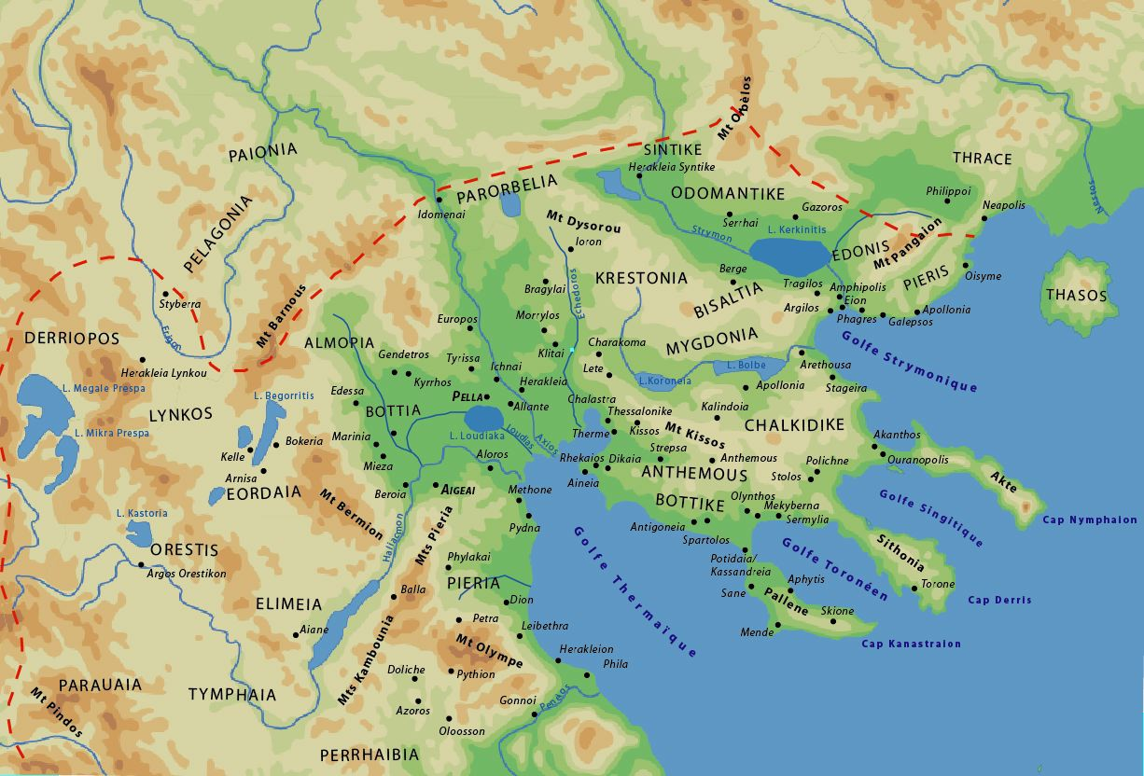

Slide 2
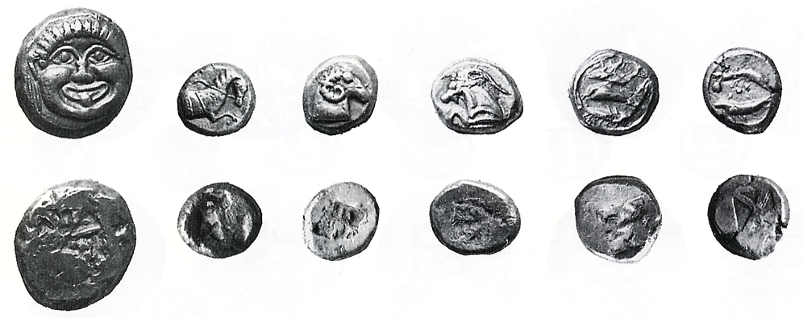
Notes:
Coin Hoard VIII, H. 37, nos 1-6

Slide 3
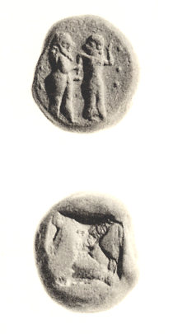

Slide 4
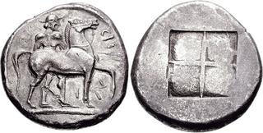

Slide 5
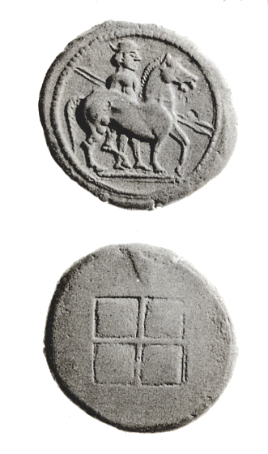

Slide 6
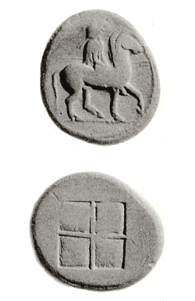
Notes:
Αλεξάνδρου Α΄
Βιβλιογραφία: C.M. Kraay, Archaic and Classical Greek Coins, London 1976, no. 492

Slide 7
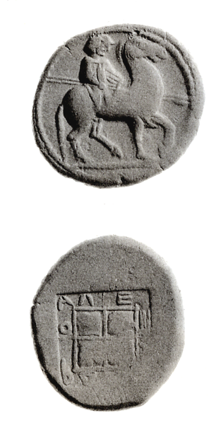
Notes:
Αλεξάνδρου Α΄
Βιβλιογραφία: C.M. Kraay, Archaic and Classical Greek Coins, London 1976, no. 494

Slide 8
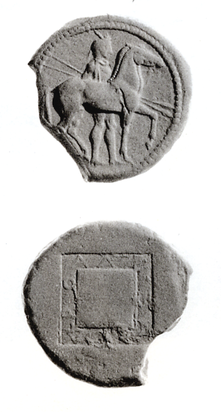

Slide 9
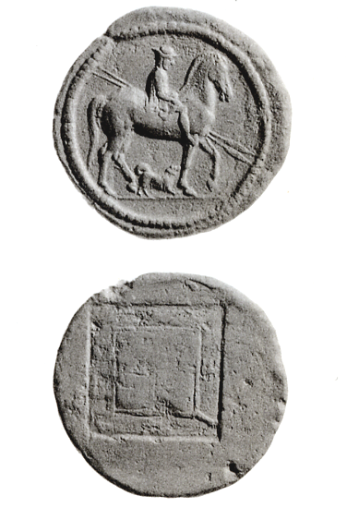

Slide 11
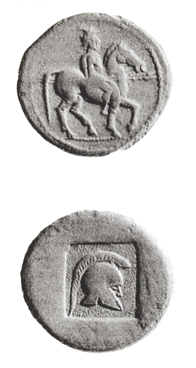

Slide 12
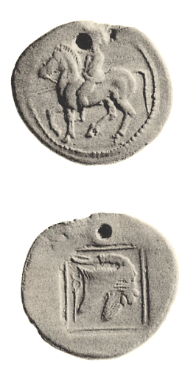

Slide 13
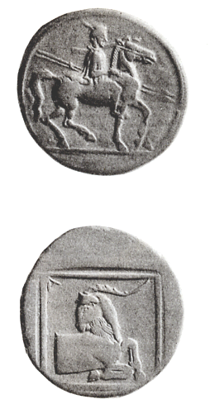

Slide 14
Hdt. 8.136
Mardonius read whatever was said in the oracles; and presently he sent a messanger to Athens, Alexander, a Macedonian, son of Amyntas; him he sent, partly because the Persians were akin to him; for Bubares, a Persian, had taken to wife Gygaea Alexander’s sister and Amyntas’daughter, who had borne to him that Amyntas of Asia who was called by the name of his mother’s father, and to whom the king gave Alabanda a great city in Phrygia for his dwelling; and partly he sent him because he learnt that Alexander was a protector and benefactor to the Athnenians.

Slide 15
Plut., Cim. 14.2
And after this, when the Thasians were in revolt from Athens, he (sc. Cimon) defeated them in a sea-fight, captured thirty-three of their ships, besieged and took their city, acquired their gold mines on the opposite mainland for athens, and took possession of the territory which the Thasians controlled there. From this base he had a good opportunity, as it was thought, to invade Macedonia and cut off a great part of it, and because he would not consent to do it, he was accused of having been bribed to this position by King Alexander, and was actually prosecuted, his enemies forming a coalition against him.

Slide 16
Athen. Deipn. 1.18a
Hegesander (FGH IV 419), too, says, that in Macedonia it was not customary for anyone to recline at dinner unless he had speared a wild boar without using a hunting-net. Until then they must eat sitting. Cassander, therefore, at the age of thirty-five continued to sit at meals with his father, being unable to accomplish the feat, though he was brave and a good hunter.

Slide 17
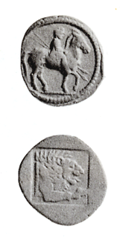
Notes:
Βιβλιογραφία: C.M. Kraay, Archaic and Classical Greek Coins, London 1976, no. 500

Slide 18
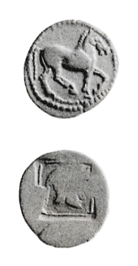
Notes:
Βιβλιογραφία: C.M. Kraay, Archaic and Classical Greek Coins, London 1976, no. 501

Slide 19
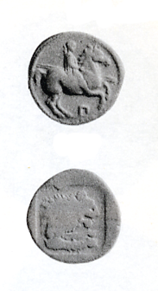

Slide 20
Notes:
Βιβλιογραφία: C.M. Kraay, Archaic and Classical Greek Coins, London 1976, no. 502

Slide 21
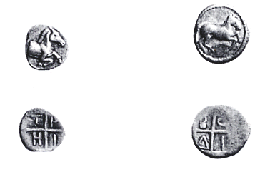

Slide 22
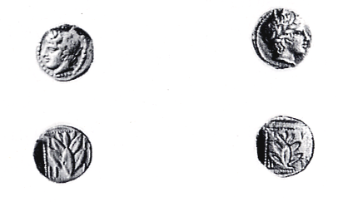
Notes:
Μνήμη M.J. Price, p. 103, nos 6471, 6474

Slide 23
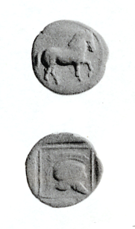

Slide 24
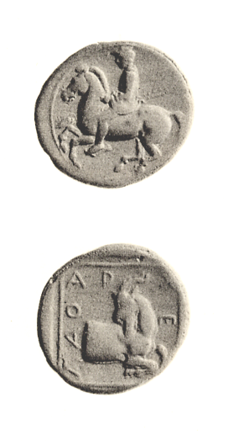

Slide 25
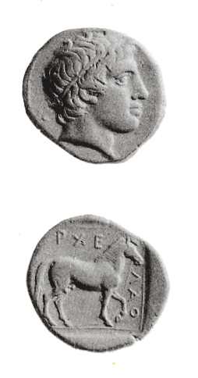

Slide 26
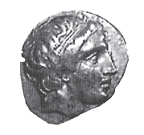
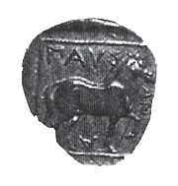
Notes:
To νόμισμα στον Μακεδονικό χώρο. Πρακτικά Β΄Επιστημονικής Συνάντησης.....Οβολός 4, σελ. 329, τμήμα εικ. 4

Slide 27
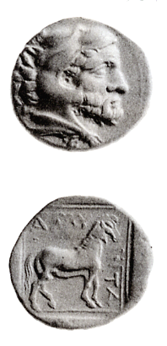
Notes:
Βιβλιογραφία: C.M. Kraay, Archaic and Classical Greek Coins, London 1976, no. 507

Slide 28
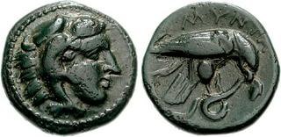
Amyntas III

Slide 29
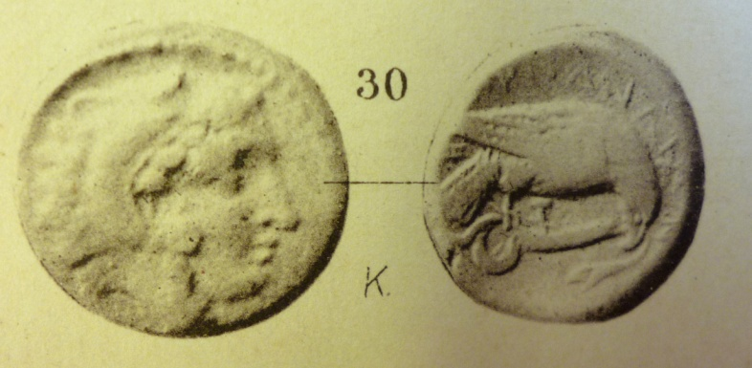
Pydna, bronze with Amyntas’types

Slide 30
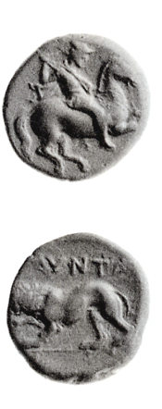
Notes:
Βιβλιογραφία: C.M. Kraay, Archaic and Classical Greek Coins, London 1976, no. 506

Slide 31
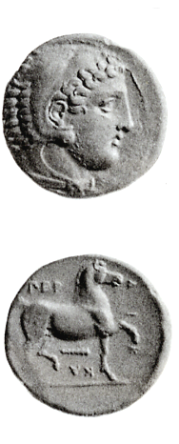
Notes:
Βιβλιογραφία: C.M. Kraay, Archaic and Classical Greek Coins, London 1976, no. 508

Slide 32
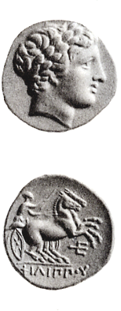
Notes:
Βιβλιογραφία: C.M. Kraay, Archaic and Classical Greek Coins, London 1976, no. 511 AV

Slide 33
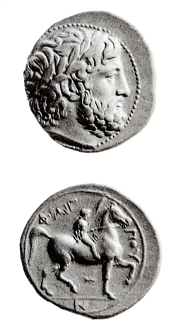
Notes:
Βιβλιογραφία: C.M. Kraay, Archaic and Classical Greek Coins, London 1976, no. 513

Slide 34
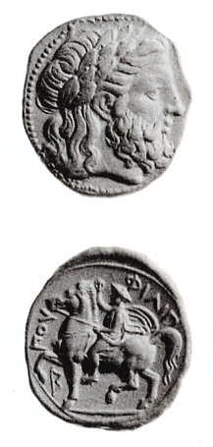
Notes:
Βιβλιογραφία: C.M. Kraay, Archaic and Classical Greek Coins, London 1976, no. 512

Slide 35
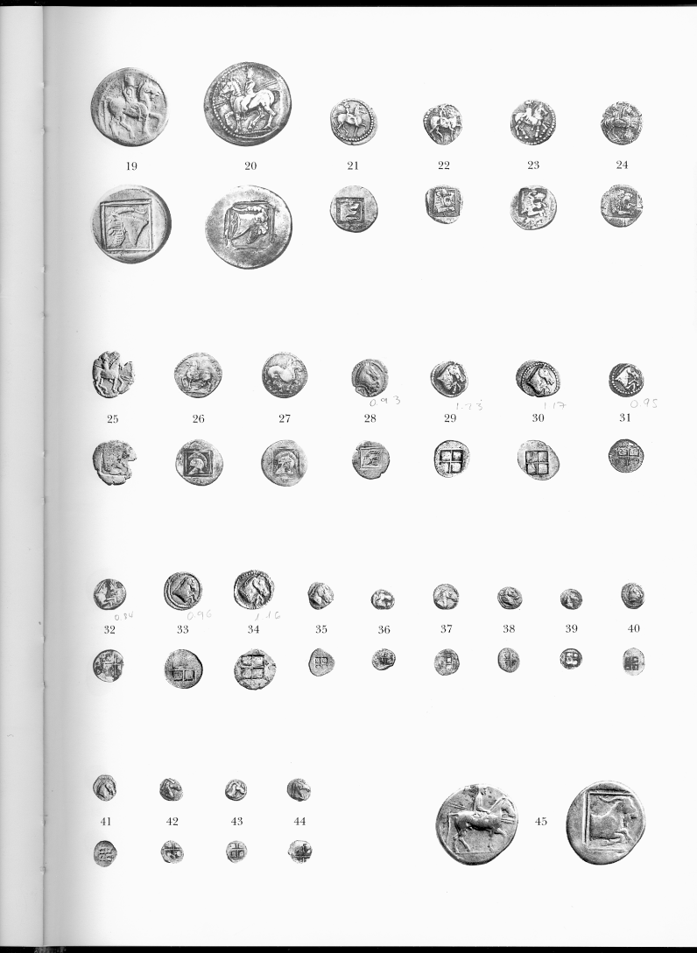
Alexander I

Slide 36
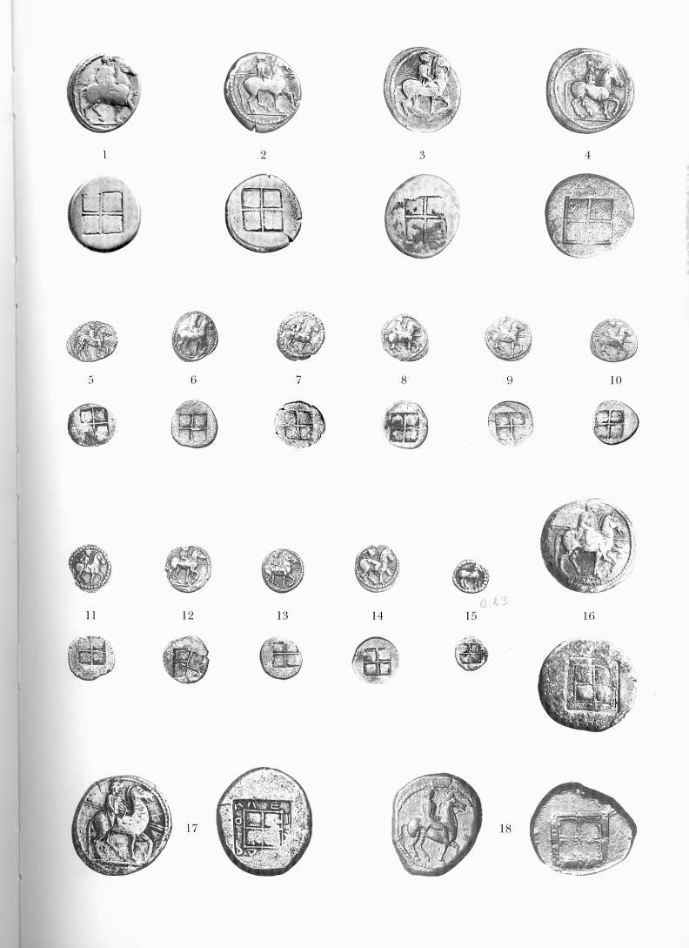
Alexander I

Slide 37
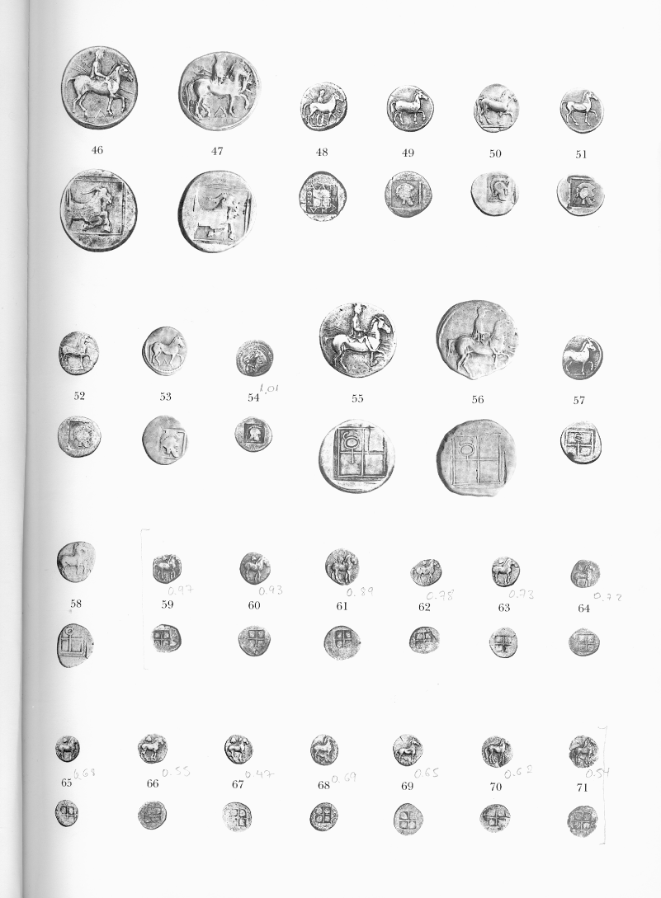
Alexander I

Slide 38
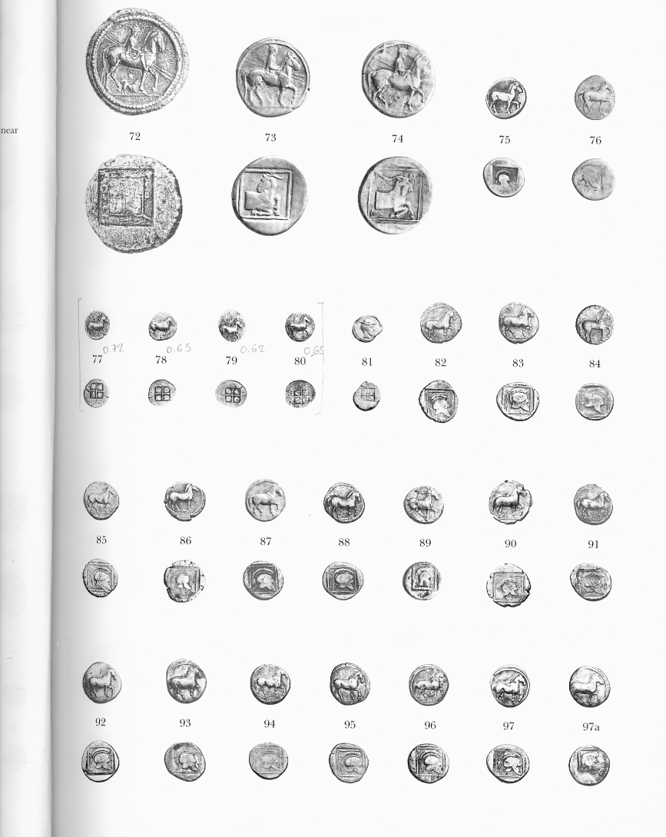
Alexander I / Perdiccas II

Slide 39
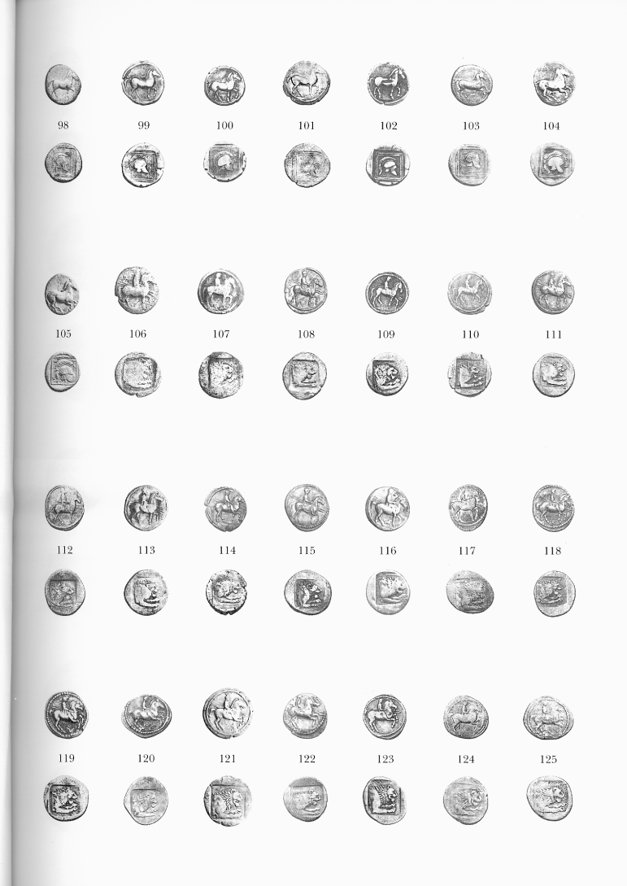
Perdiccas II

Slide 40
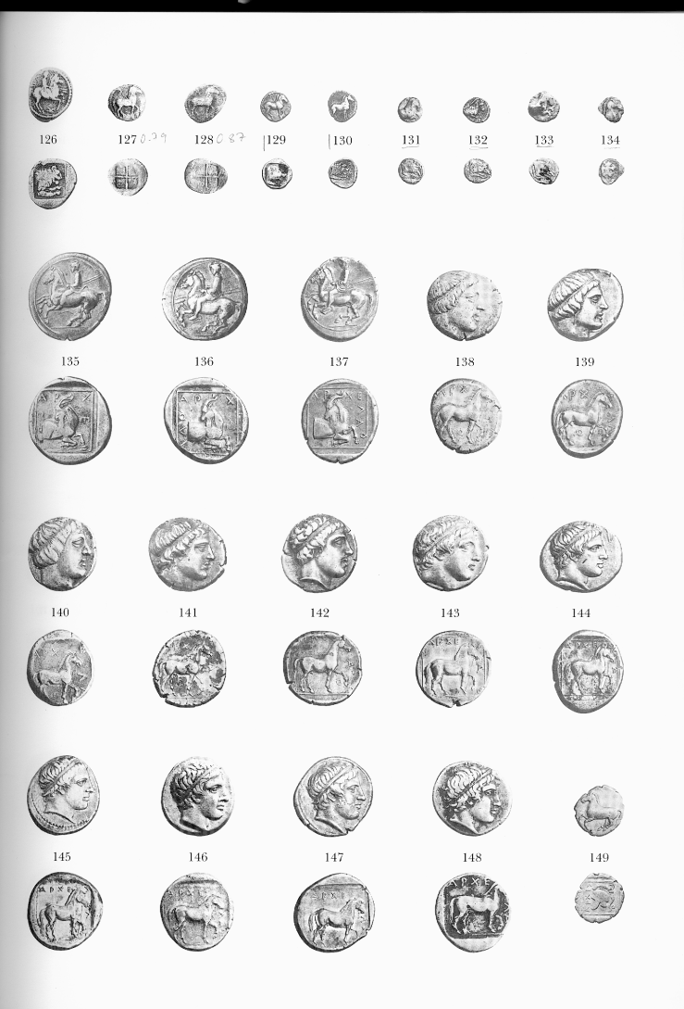
Perdiccas II / Archelaus

Slide 41
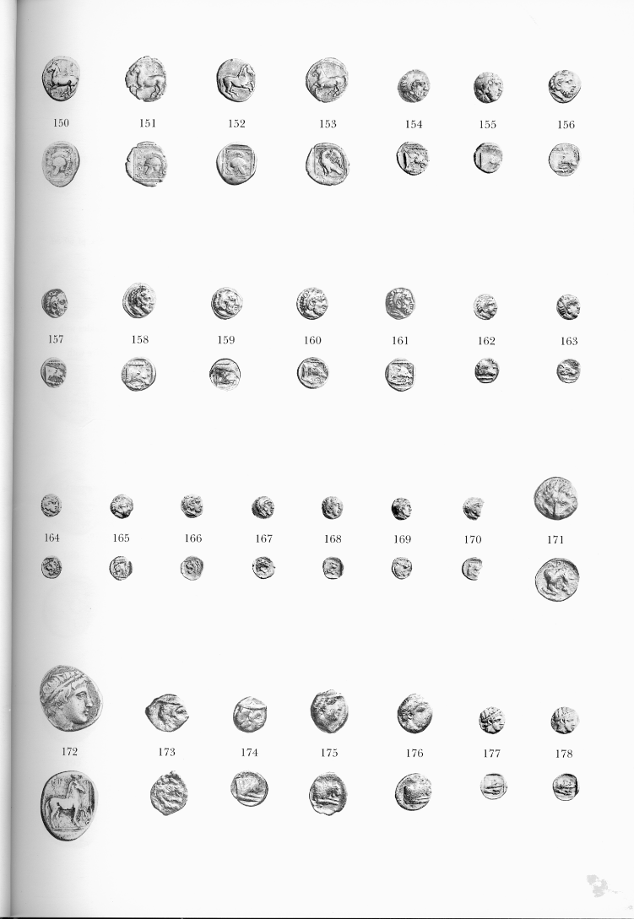
Archelaos / Aeropus / Amyntas II

Slide 42
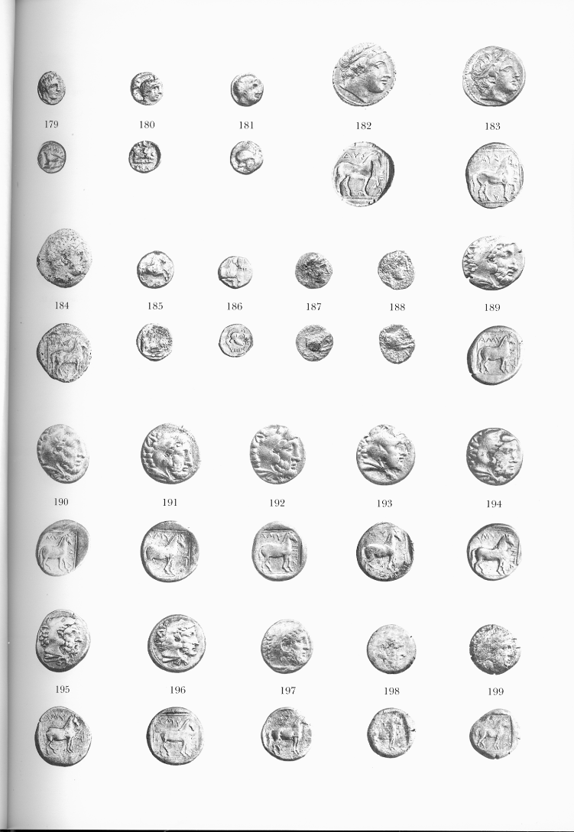
Amyntas II / Pausanias / Amyntas III

Slide 43
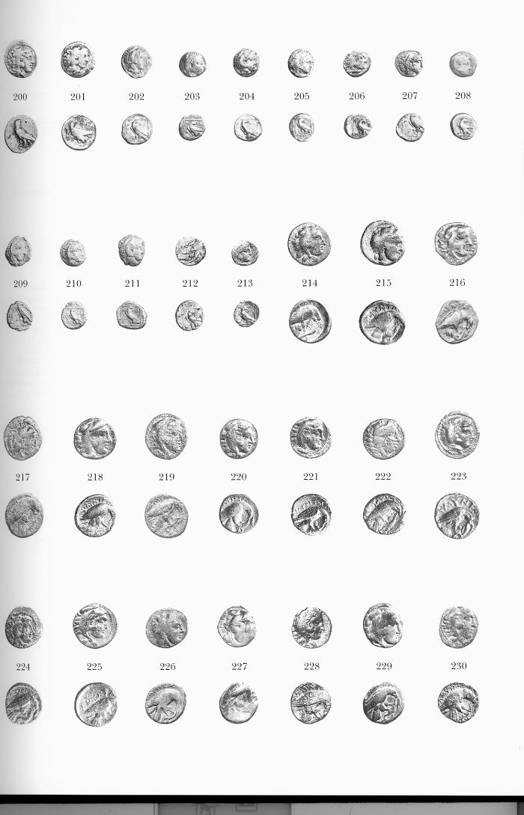
Amyntas III

Slide 44
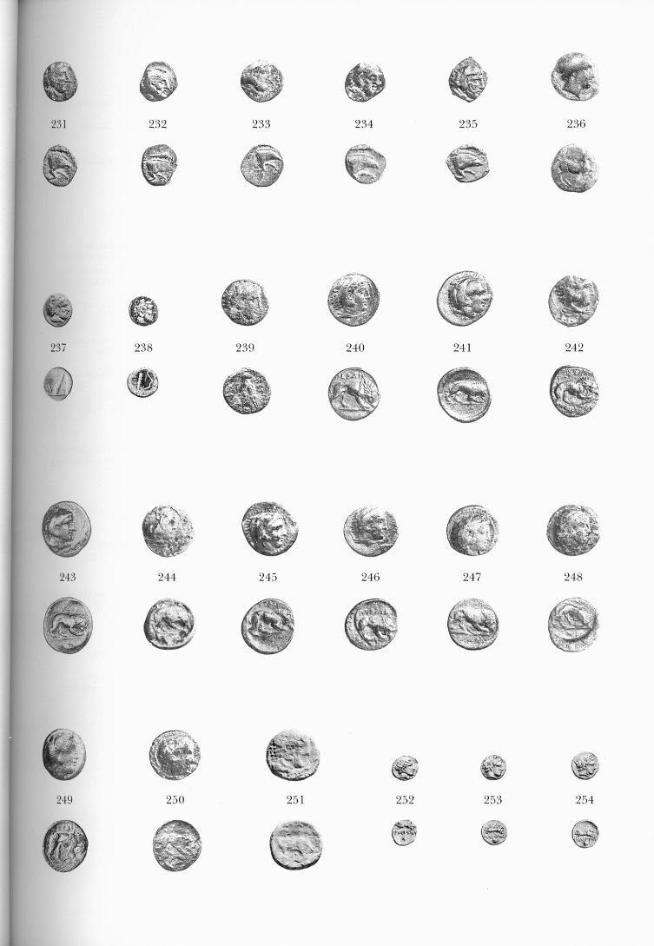
Amyntas III / Perdiccas III/ Philip II

