Slide 1
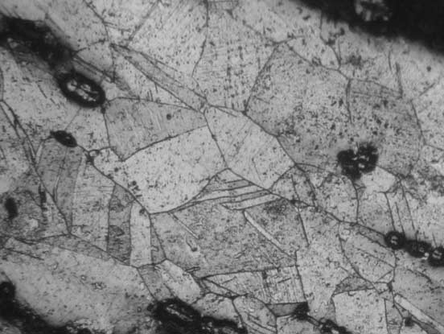
Metal Analysis

Slide 2
What might metal analysis reveal?

Slide 3
Metal Analysis: Why?
Identify sources of metal and changes in this over time (mines, mixing, etc)
Metal composition and purity (economy, debasement)
Coin making techniques (cultural and regional groups)

Slide 4
Methods
Accuracy vs expense
Destructive vs. non destructive
Method should be selected according to the goal one has.

Slide 5
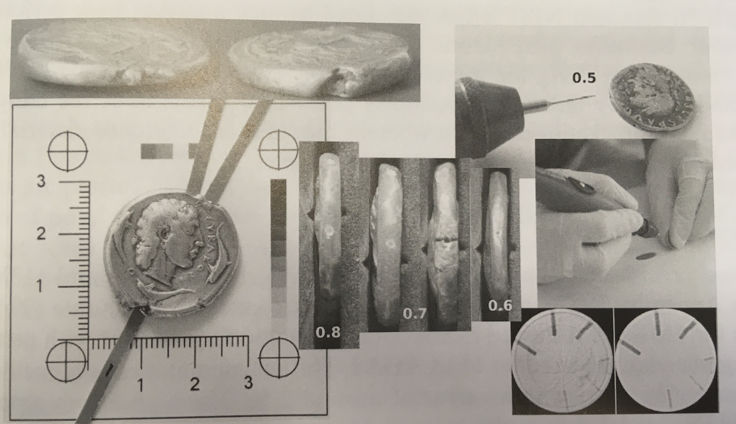

Slide 6
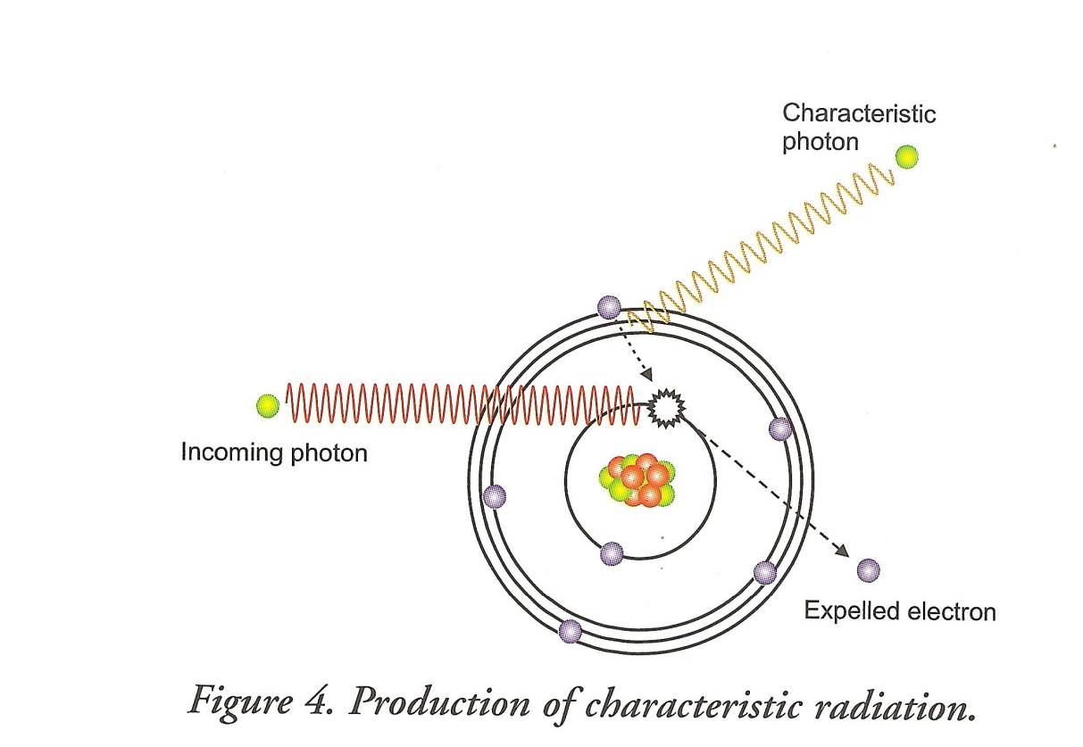
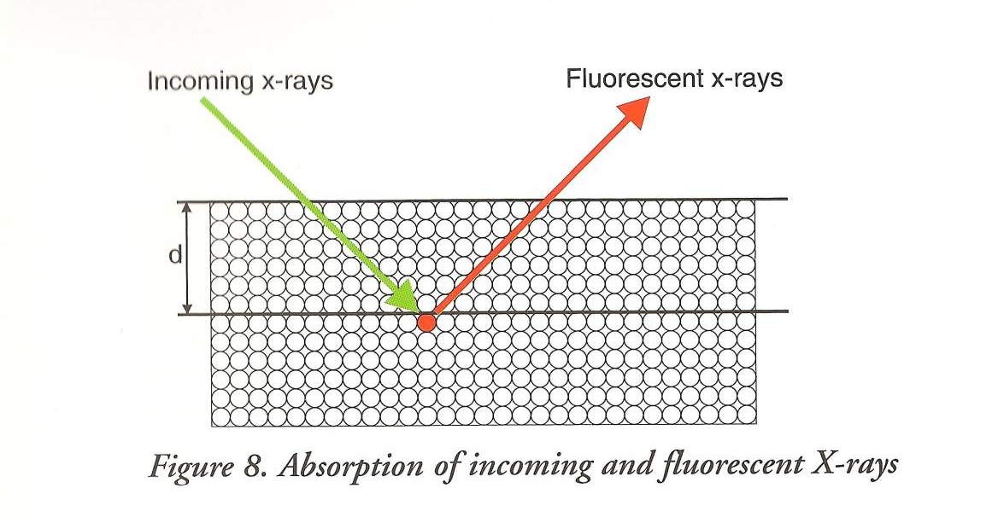
X-Ray Fluorescence (XRF)
Measures chemical composition
X-Rays used - different elements ‘reflect’ these X-Rays in different ways.
Notes:
Done for example on electrum coins to see the silver/gold/other composition.

Slide 7
XRF - Pros and Cons
Fast and non-destructive
Relatively cheap
Only measures the surface of a coin. And only a point on that surface - object needs to be homogenous in composition. (Issues with regards leeching or surface enrichment, but for pure or precious metals that don’t corrode, generally thought to be good.)
Good for chemical composition, but not so good for sources of metal.
Notes:
e.g. pure silver, pure gold. Corroding materials like iron or bronze based materials there is an issue.
Electrum coins – trying to see WHY they were struck in electrum. Able to sample a large amount from multiple mints.

Slide 8
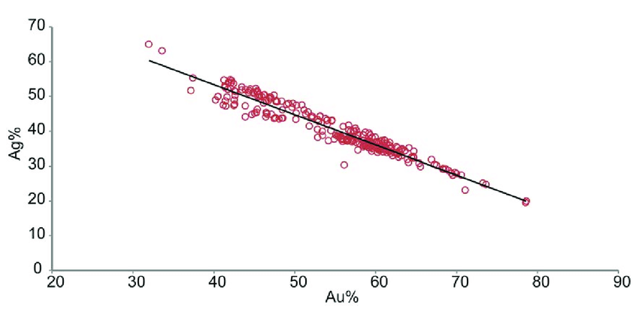
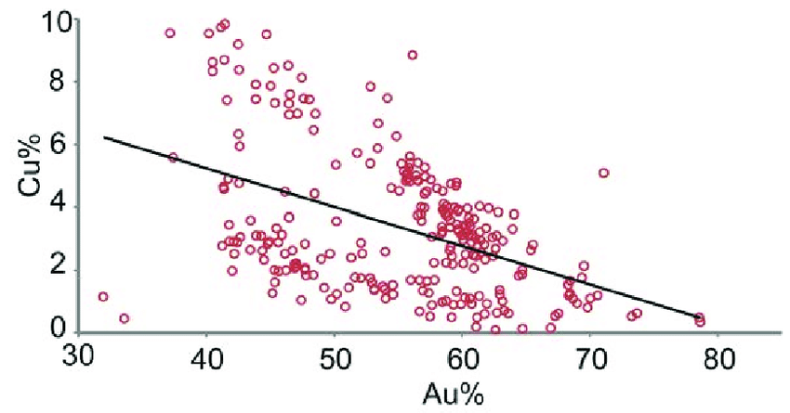
Gitler et al. 2020.
Analysis of electrum coins
Relation between gold and silver alloys in the analyzed coins.
Relation between gold and copper alloys in the analyzed coins.
Notes:
Gold and silver – ratio quite standard.
Copper to silver or gold – more scattered.
So was the metal composition the same? Doesn’t seem to be the case!

Slide 9
Lead isotope analysis
Measures the lead isotopes (²⁰⁴Pb, ²⁰⁶Pb, ²⁰⁷Pb, ²⁰⁸Pb) in the coin (how geologically old the metal is)
Matching the lead isotopes with those from known geological deposits tells us where the metal came from
Isotope mass spectrometry (MC-ICP-MS = plasma) or laser ablation (LA-ICP-MS=laser)

Slide 10
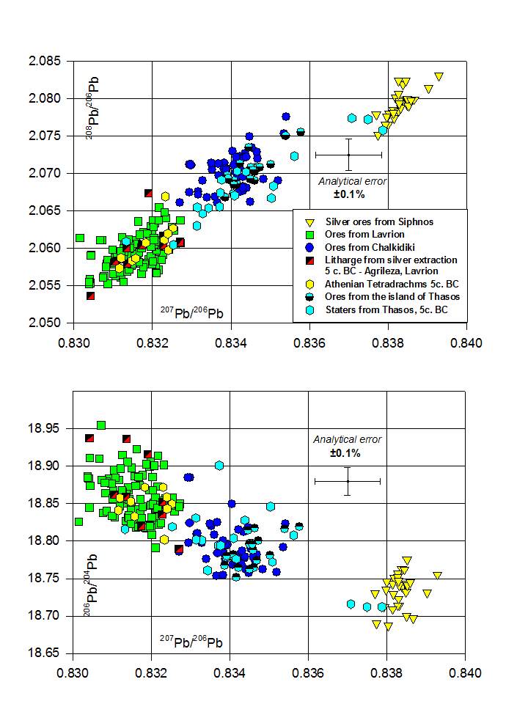
From ‘The interpretation of lead isotope data’, http://oxalid.arch.ox.ac.uk/Using%20the%20database/Using%20the%20database.htm

Slide 11
Lead isotope analysis - pros and coins
Destructive (a sample needs to be taken) and very expensive
But gives us a picture of the whole coin (sample taken from within the coin, not just the surface)
If the sample is from mixed sources, then the results are often inconclusive
Is dependent on matching the isotopes to known geological sources (v. little known in the early days of this technique)
Better for ruling places out than locating places, often dependent on archaeology.
Lead must be naturally occurring, not added after.
Normally confined to AR, but now copper isotopes are also being analysed (rare skill). This analyses what type of copper deposit the metal came from.

Slide 12
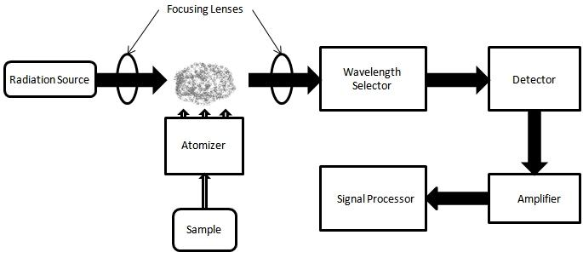
Atomic Absorption Spectroscopy (AAS)
Analysis of the elements in an object.
Analyses the light given off by different elements during a reaction.
One really needs to have an idea of the composition beforehand to measure them.
destructive

Slide 13
muonic X-ray emission spectroscopy
Non destructive analysis of the centres of (to date) gold coinage- i.e. goes beyond surface
Does not require cleaning
Requires use of a single facility atm (ISIS in Oxford)
Notes:
To date been done only for Roman coins

Slide 14
Scanning electron microscopy / Optical microscopy
A CLOSE CLOSE CLOSE UP of the coin.
Can reveal how the object was worked (e.g. hammered, heated, worked while cold, etc.) Can only see that last time the object was heated.
Can also identify inclusions in the metal

Slide 15
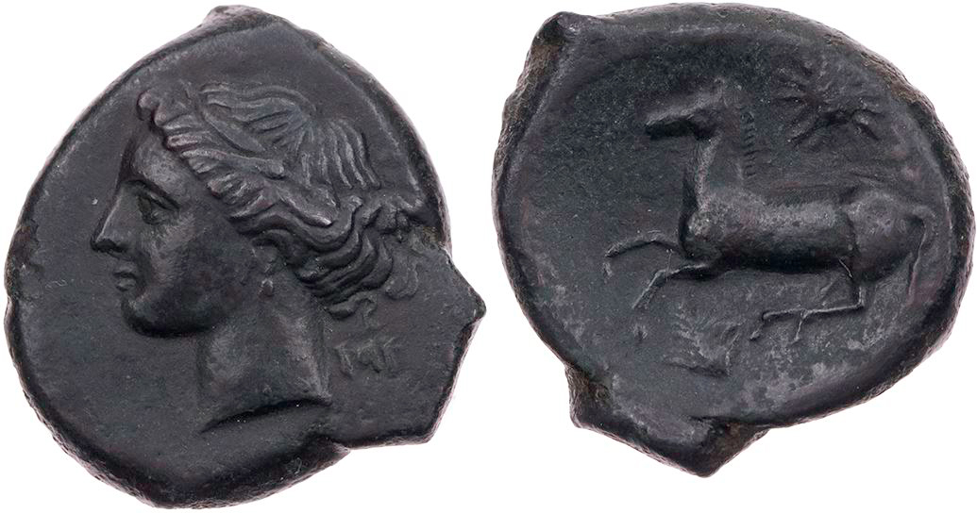
Punic bronzes at Tharros (Sardinia)
Lead isotope analysis of 42 excavation coins with low lead content
1/3 have a Cypriot signature
The rest could not be assigned, suggesting extensive mixing and recycling. (or an unknown source - many coins lie outside the known fields).
‘Free galloping horse’ type with head of Kore/Persephone on the obverse.

Slide 16
Punic Coins: Carthage
Silver from c. 410 BC (Attic-Euboean tetradrachms, i.e. mercenaries)
First in Sicily (Carthaginian eparchia = province),
local issues by cities
But also military issues by the Carthaginian state
From c. 375/360 AV staters, from 320 AV and EL shekel
Bronze from c. 350/340 BC
local issues by cities
Supra-regional issues, Carthage, Sicily, and Sardinia
Notes:
Sicily, a ‘miniature continent’, a Mediterranean koine, where several cultures mingled:
- Indigenous peoples (Siculi, Sicani and Elymians)
- Greek
- Carthaginian
- Roman

Slide 17
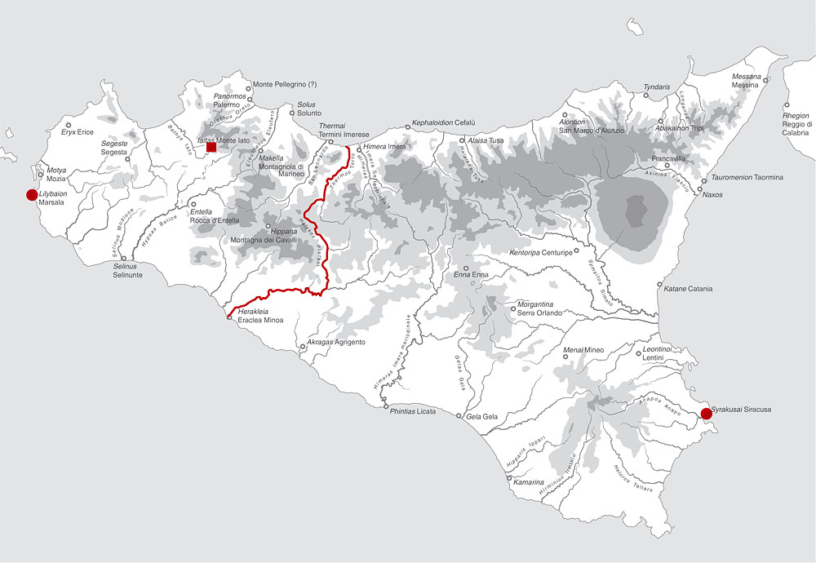
Western and Eastern Sicily after 339 BC
Monte Iato
Carthage
Lilybaeum
Syracuse
e
Syracuse

Slide 18
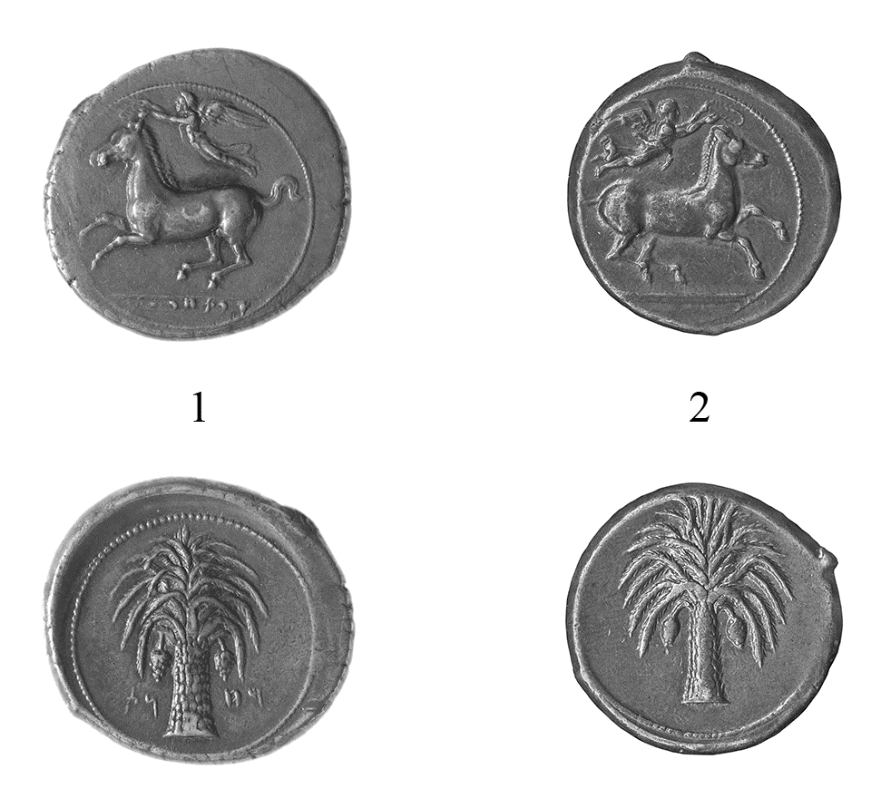
Carthaginian mint in Sicily, tetradrachm, c. 410/405-400 BC
Obv.: Prancing horse l. crowned by Nike; in exergue ‘QRTHDŠT’ (Carthage)
Rev.: Palm tree; (for no. 1) MHNT (‘camp’)
1. London, British Museum, BM 1867,1109.49 PCG (g. 16.80): die Jenkins O11
2. London, British Museum, BM RPK,p.220A.4.Pun (g. 17,16): die Jenkins O12

Slide 19
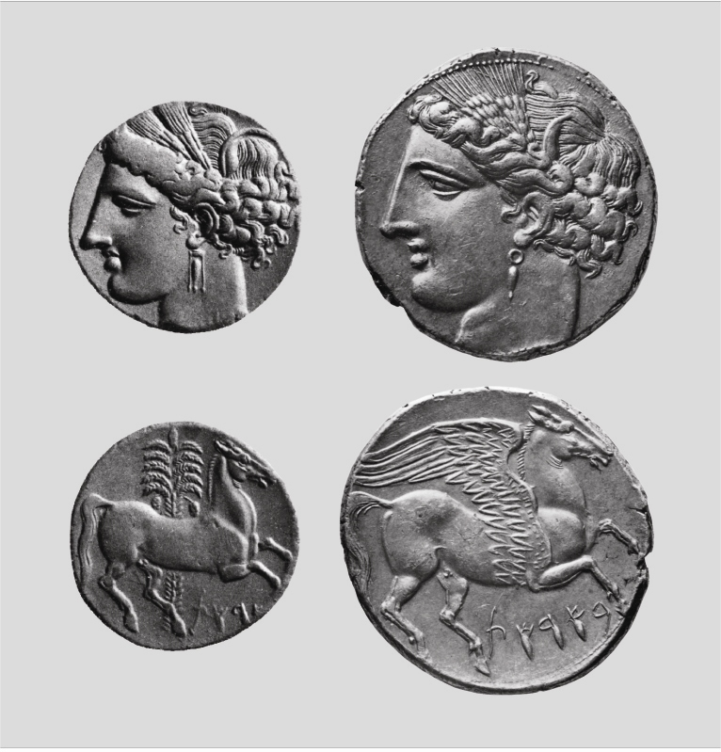
Sicily, c. 256/255 BC
Rev.: legend B’RST (‘in the land’, i.e. not Carthage, but Sicily)
Heavy coins, 3 electrum-shekel 22.8 g and 5 silver-shekel 38 g
struck on the occasion of the Roman expedition to Carthage

Slide 20
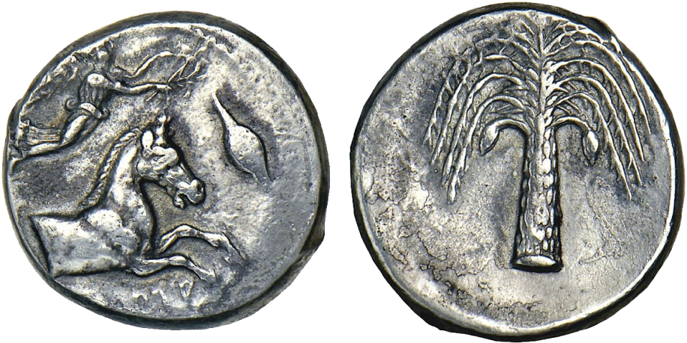
Punic
‘QRTHDŠT’, tetradrachm of Attic weight standard,
c. 405/400–392 BC, 17.18 g
Stack’s, LLC, New York, Auction 14 January 2008, no. 2134
‘Phoinix’ = Palm tree (pun for Punic)

Slide 21
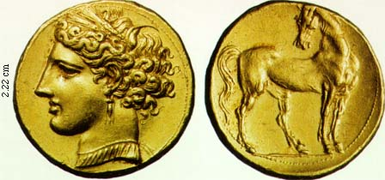
Carthage AV (gold)
Carthage, 1²/₃ shekel, 256/255 BC
Obv.: Head of Persephone l. with wreath of corn-ears and pendant necklace
Rev.: Horse standing r., head returned
Jenkins and Lewis 1963, p. 109, no. 394
AV 12.64 g 22 mm 360° - NAC 23 (2002) no. 1166

Slide 22
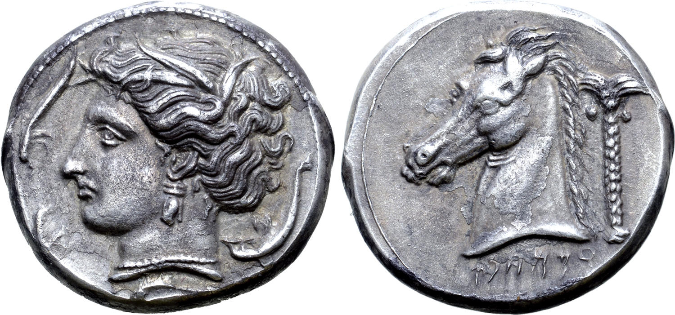
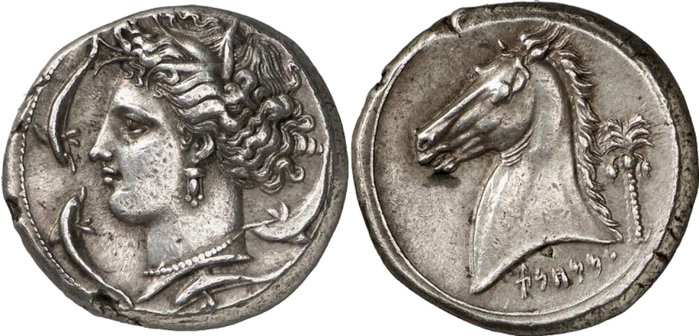
MMHNT
’ military’ (’People of the camp’)
Military mint of Sicily, tetradrachm, c. 320-310 BC
Obv.: Head of Persephone l. with corn-ears, triple pendant earring and
necklace; in field three dolphins
Rev.: ‘MMHNT; Horse’s head l., at r. palm-tree
AR 17.14 g 26 mm 180°
Jenkins 1977, p. 52, no. 186 (O55/R163)
Roma E-Sale 53, no. 66 (7.2. 2019); ex Peus 386 (26.4.2006)

Slide 23
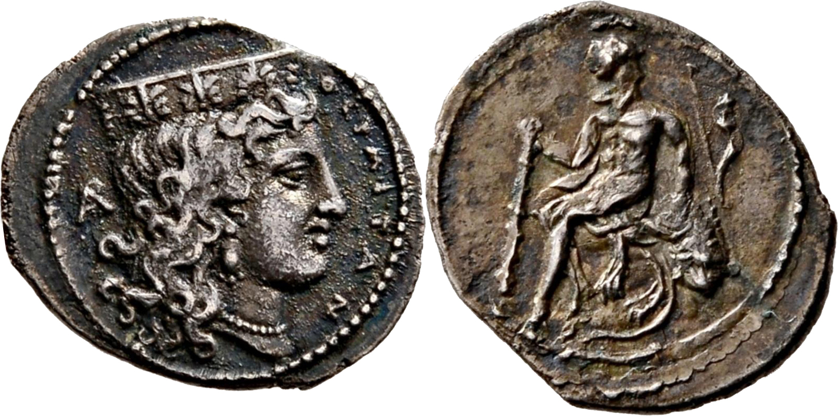
Thermai
‘civic’
Thermai, litra, c. 330-300 BC
Obv.: ΘΕΡΜIΤΑΝ; head of Hera r. with polos, at l. mongram AP
Rev.: Heracles l. seated on rock, holding club; behind bow and quiver
ex. Coll. Jameson no. 619 (this piece), Peus 427, no 181, auction 4.11.2020
AR 0.72 g
https://www.coinarchives.com/a/lotviewer.php?LotID=1727013&AucID=3933&Lot=181&Val=d439b279ce3502ac0fe960b836e5f8c2

Slide 24
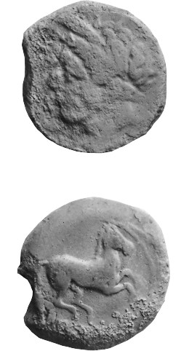
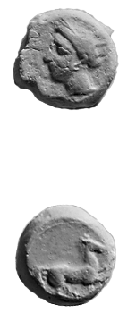
Punic AE (bronze) supra-regional
350-320 BC
SNG Cop. 94-97
SNG Cop. 98

Slide 25
RNS SP no. 56 (Sheedy and Davis eds): ‘Opportunistic minting’
Silver sources in the archaic period:
Siphnos
Lavrion
Northern Greece (Chalkidiki peninsula)
Thasos
Rhodope mountains (including Mt. Pangaion)
Troad Peninsula
Iran
Spanish silver
France (Massif Central) from the Roman period
Romania
Aristotle Ath. Pol. 15.2: Peisistratos derived resources to pay mercenaries from the neighborhood of Pangaion
Herodotus 7.112 (inland mines controlled by local tribes)
Thought then that Wappenmünzen struck from northern Greek silver, then Lavrion silver for the owls
Notes:
Revisited the study og 1978 – not as much known about lead ores. But now have much more lead isotope data.
1980a – lead isotope ores was only a few hundred
Now – more than 6,0000
Silver ores exploited on Siphnos in the Early Bronze Age and 1st millennium BC
More or less continuously in Laurion. From the early bronze age until the Roman period and later.
Archaic period -

Slide 26
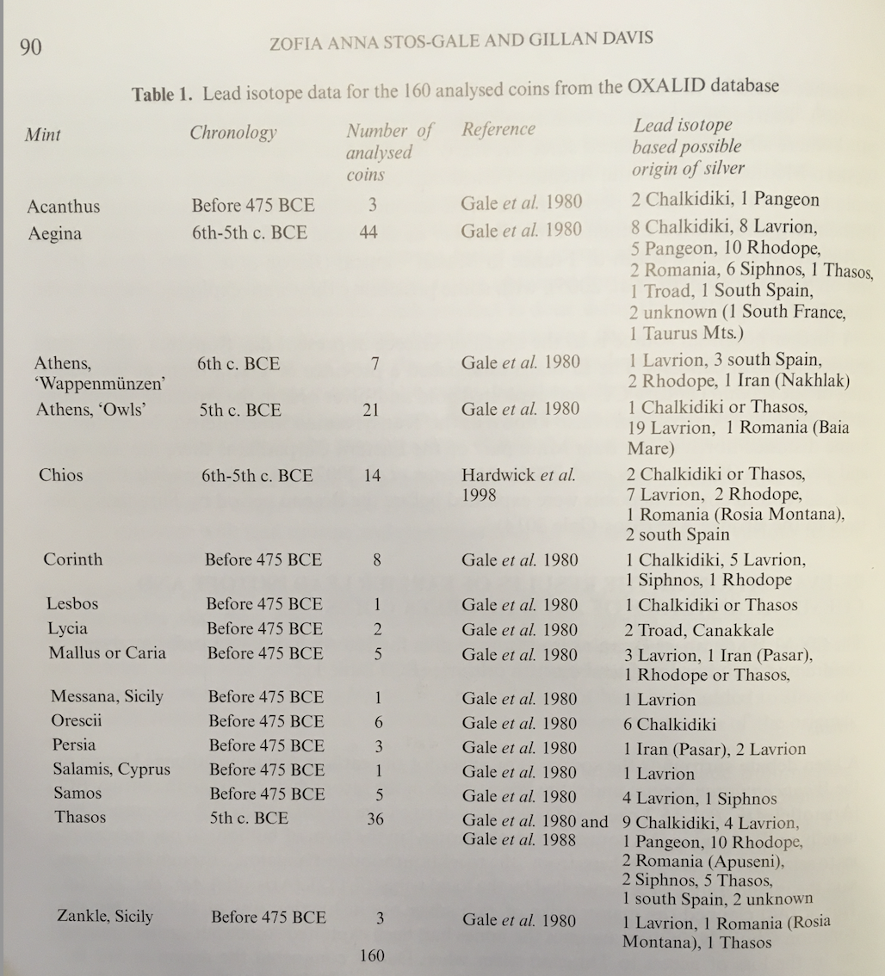
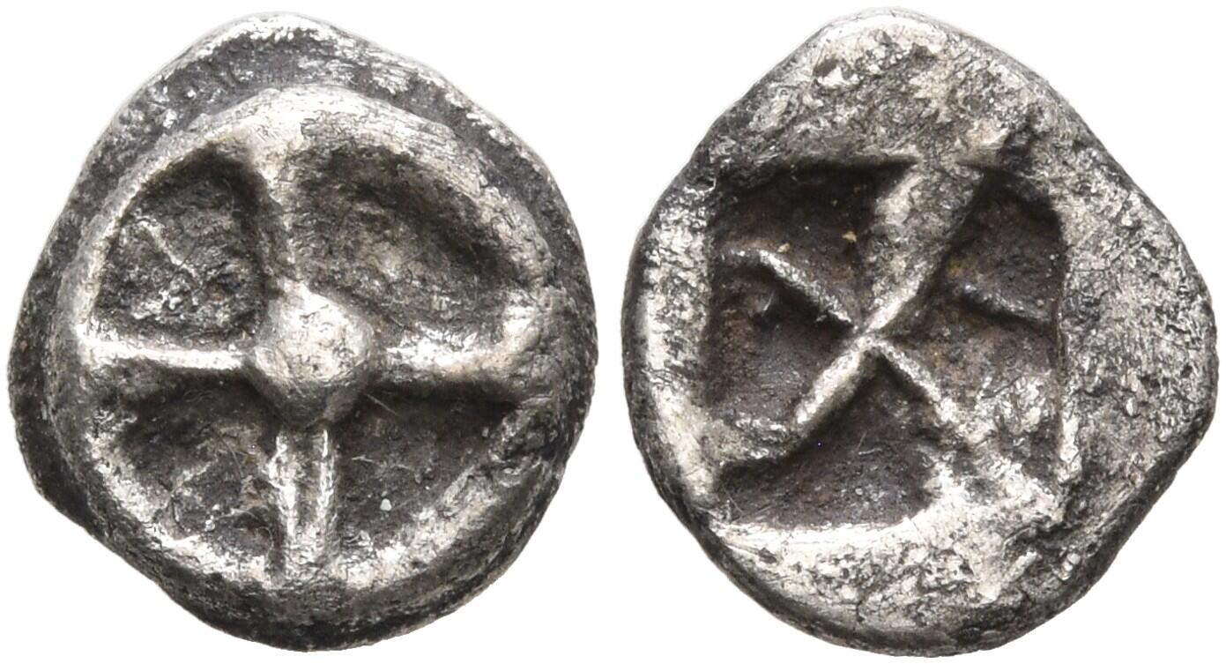
Wheel obol, Athens
Laurion silver matches to the sites:
- Agrileza in Lavrion
- Kamareza, Plaka, Esperanza
Notes:
One 1 Wappenmuenzen laurion, but it was a ‘wheel’ obol, which supports the independently derived conclusion that the wheel fractions do not belong to the wappenmusenzen series and instead are end of 6th, beginning of 5th century BC.
BMC 3 amphora and BMC 18 gorgoneion – northern Greece (the southern Rhodope-Macedonia or Thrace).
BMC 1 Histiaea matches ores from Nakhlak in Iran
Owls – Laurion – can also begin to match with specific deposits/mines. Agrileza
Wappenmuenzen in 6th century BC minted with any silver that was to hand from Spain to Iran
Aegina – only some from Siphnos, which changes our understanding from earlier publications. Also a remarkable amount from Laurion (5th century BC) – can’t be a direct source since Athens and Aegina were in a commercial rivalry. But acquired through other forms of trade?
Suggestoin now is that silver is largely coming from Northern Greece, then Lavrion, then Siphnos, with a trickle from other places, possibly reusing bullkion.
Little or no evidence for mixing of silver. Mints struck silver from discrete sources – maybe easier tyo overstrike, trim or fold to achieve the dsesired result rather than melting down.

Slide 27
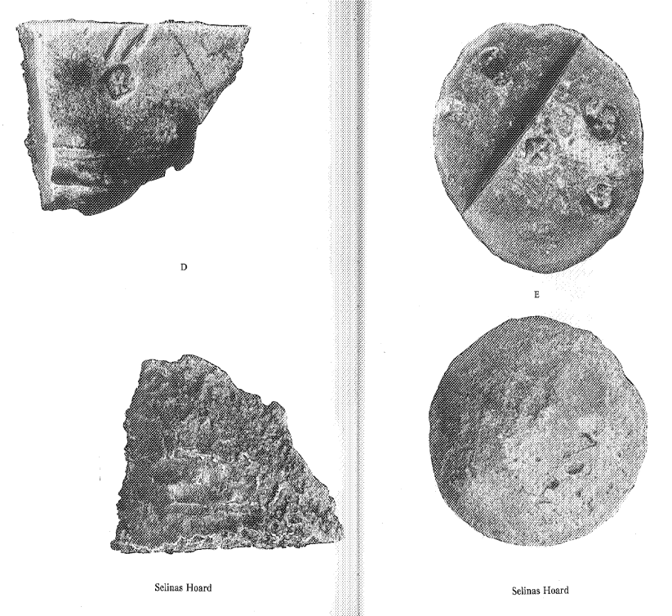
Selinous Hoard
Lead isotope analysis
Ingot E - close to Laurion
Ingots C and D - no known field, but
suggestion of mixed Aegean silver
(plots within the field).
Ingot B may have silver from Spain.
Notes:
Gale et. Al – lead isotope analysis of eastern Greek coinage reveals silver mainly came from Laurion and Siphnos and a third source, perhaps Macedonia or Lydia.
How silver acquired – trade, war bvooty, gifts, recycling of existing objects including old or foreign coinage.

Slide 28
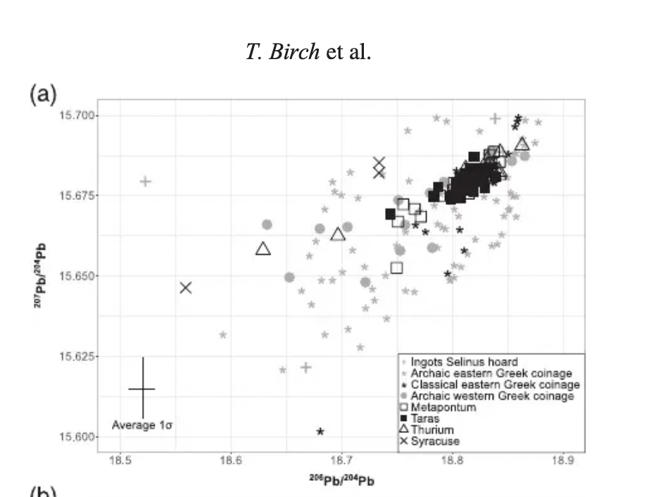
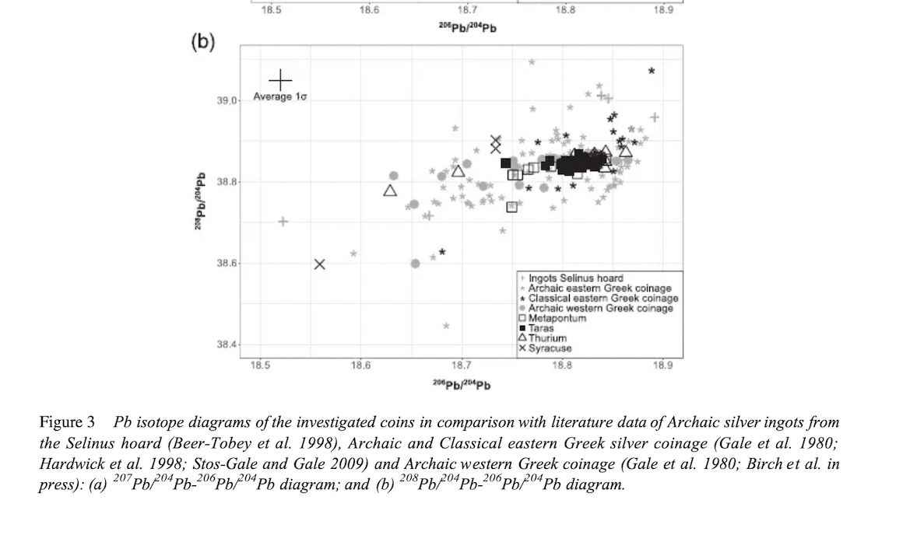
Birch et al. : Magna Graecia
Notes:
Overall, all studied mints apparently used very comparable raw material to produce their coinage,which primarily was almost exclusively derived from deposits in the broader Aegean region.
The Pb isotope data of the investigated coins clearly imply that Magna Graecia did not use localsources, that is, argentiferous mineralizations of the Italian mainland or Sardinia (
Of the coins investigated, however, only two poten-tially argue for a contribution of Iberian metal (see above) and hence the Iberian Peninsula doesnot seem to have been an important metal supplier for Magna Graecia. In fact, the metal sourcesof the colonial mints apparently were equal to those of mainland Greece

Slide 29
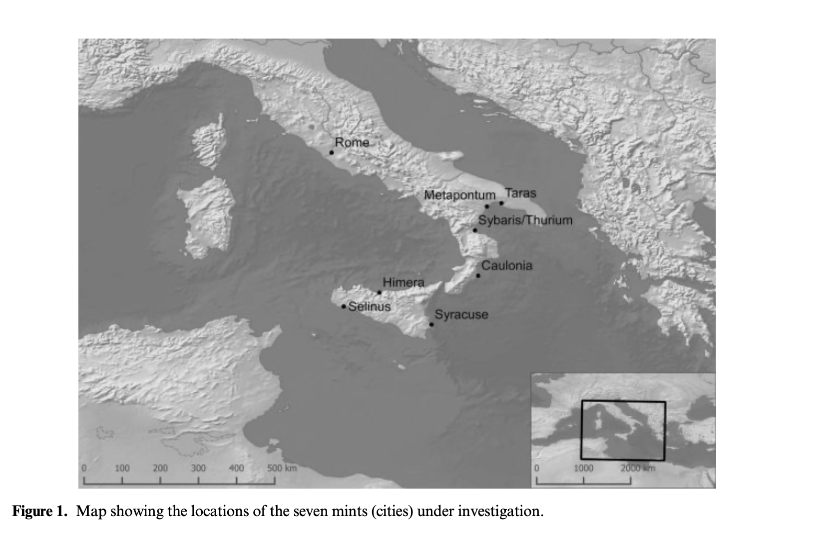
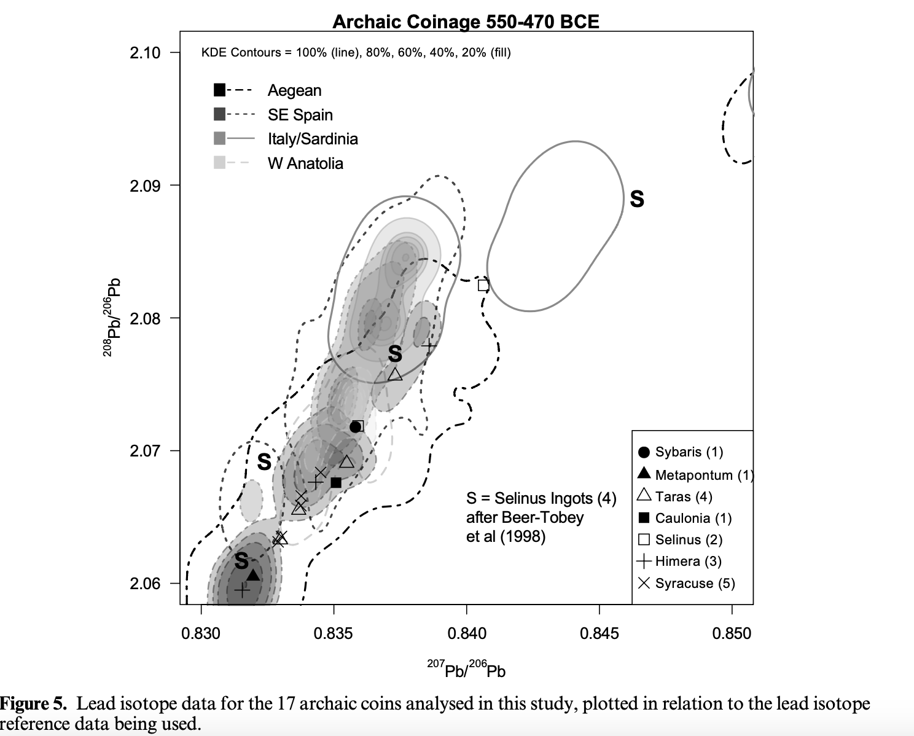
Magna Graecia: Birch and Kemmers 2020
Notes:
What role did the connectiojn with the mother city actually play, or did local sources of silver also happen?
17 coins tested
Reveals multiple silver sources
13 appear to relate to mining zones in the Aegean (Laurion, Macedonia, Eastern Rhodope mountains)
5 Laurion – Metapontum, Taras, Himera, Syracuse
3 coins from Macedonia, Chalkikidiki (Himera and Syracuse). One maytbe Siphnos.
Even on a mint by mint basis, different sources of silver being accessed in this early period of coining.
But essentially the silver is coming from the east.

Slide 30
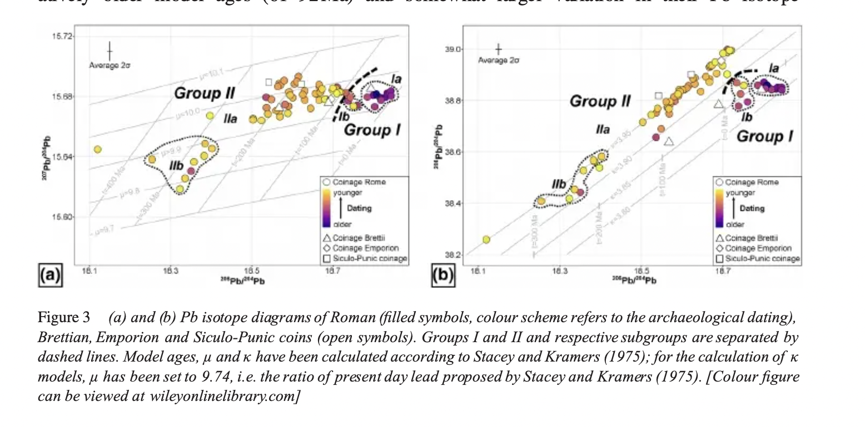
Westner et. al: Early Roman coins
Notes:
Group 1a: 310-212 BC
Group 1b: 211 and second century BC
Group 2: 209-101 BC
2a: Spain seems to be the source. History tells us Rome acquired the region towards the end of the second century BC. Indemnities in Carthage as well provided silver that may have originally come from Spain.
Parts of Group 1 – Aegean sources, similar to what was found in Magna Graecia. Bullion likely acquirted peacefully, nbefore Roman conquest of thew region, through trade etc with cities in Magna Graecia.
Second Punic war a turning point in Rome’s metal supply. Before the war Rome’s coins of varying fineness and have a signature close to the coins of Magna Graecia (who got their metal from the Aegean). After Second Punic War high fineness, signature from the Iberian peninsula. Booty/reparation payments before any mining.

Slide 31
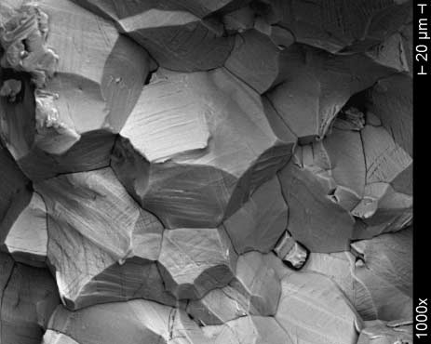
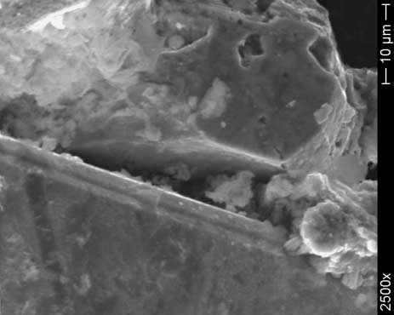
Incuse coins
Scanning electron microscopy (SEM)
Figure 7 SEM fractography of coin fragment M5.
Figure 8 The filling of open cracks by corrosion
products.
Notes:
Also to see how flans prepared – if folded etc.

Slide 32
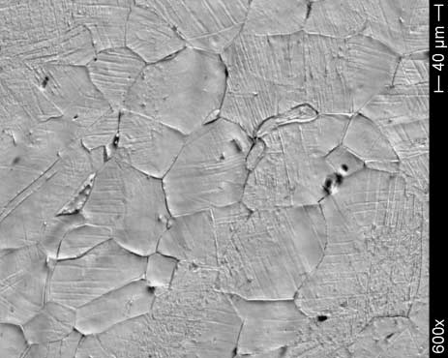
Figure 18 Fragment M5: a secondary electrons image of the etched sample.
Figure 17 Fragment M5: an optical microscopic image of the etched sample.
Scanning electron microscopy image of an incuse coin from Metapontum, demonstrating that the coin was struck at room (ambient) temperature. From Giovanelli et al. p. 830

Slide 33
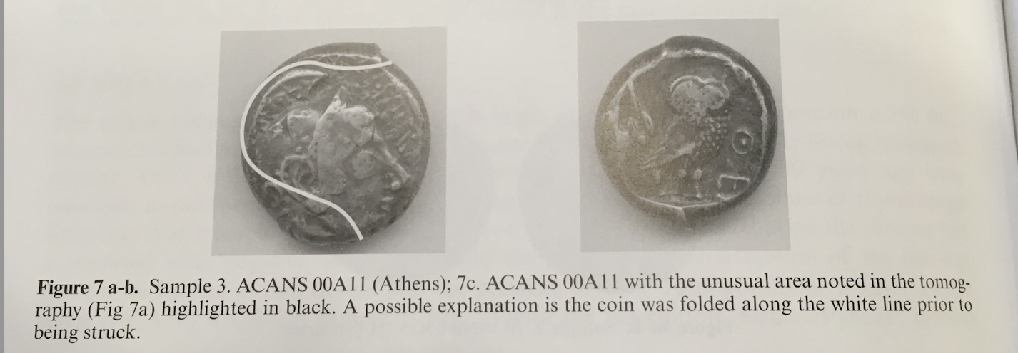
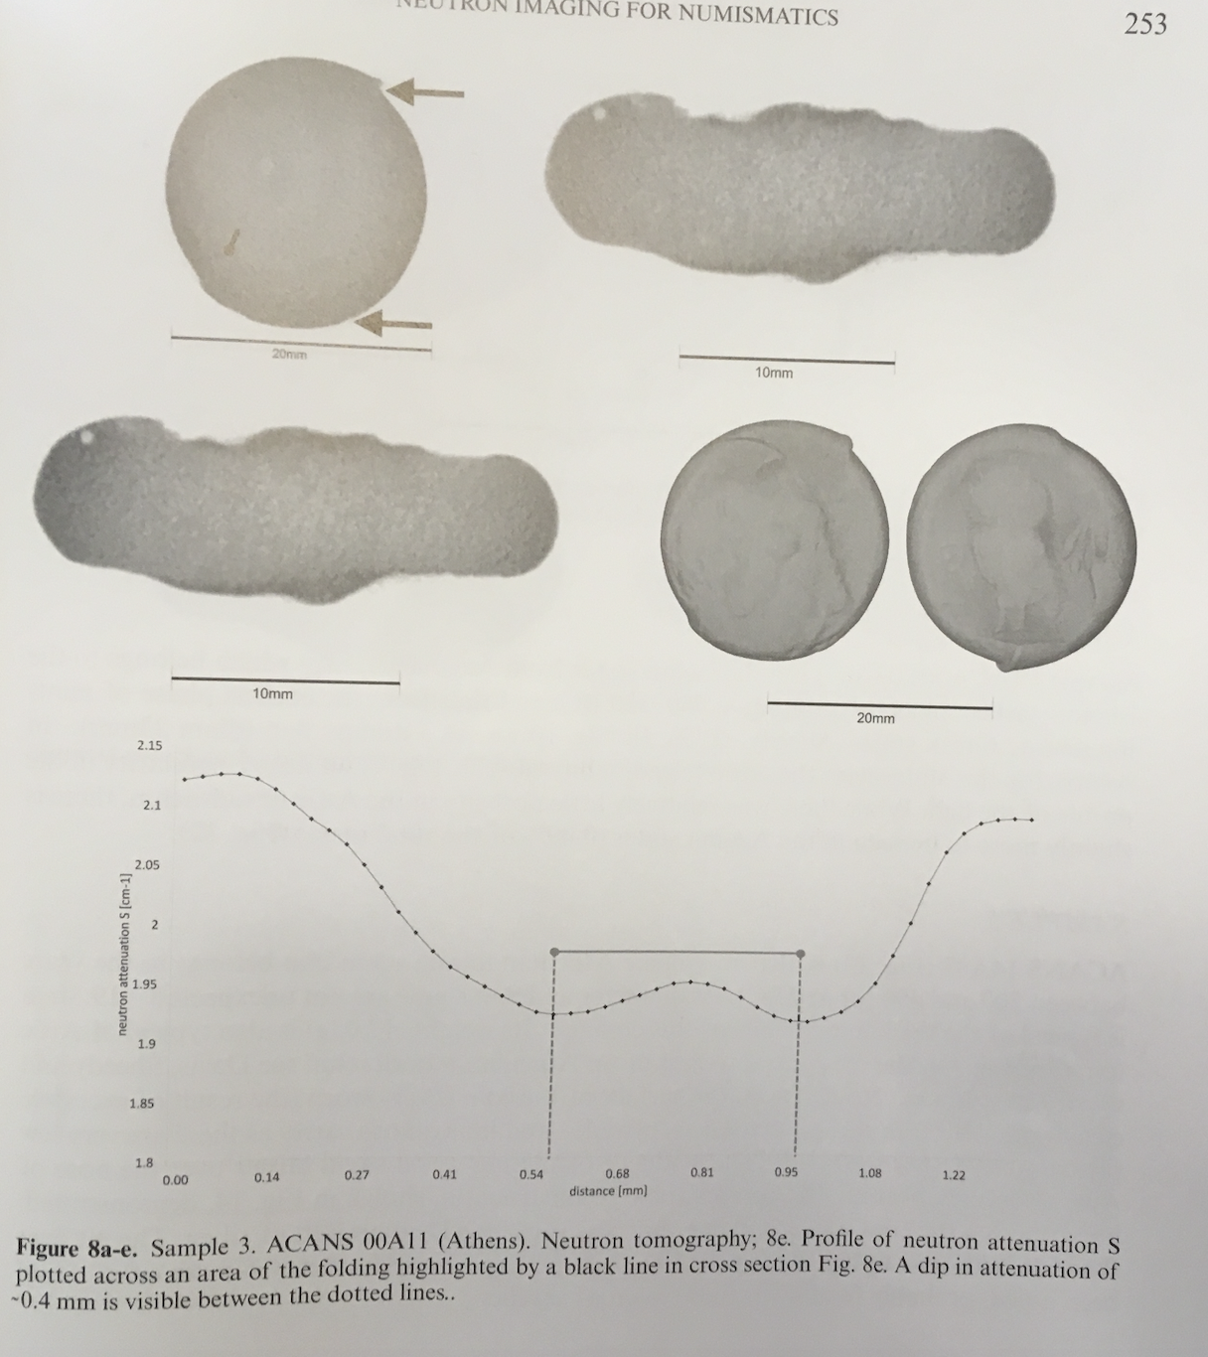

Slide 34
Further Reading
@ Attanasio, D., Bultrini, G., et al. (2001) 'The Possibility of Provenancing a Series of Bronze Punic Coins found at Tharros (Western Sardinia) using the Literature Lead Isotope Database', Archaeometry 43: 529-47.
Beer-Tobey, L., Gale, N. H., et al. (1998) 'Lead Isotope Analysis of Four Late Archaic Silver Ingots from the Selinus Hoard', in Metallurgy in Numismatics Volume 4, ed. A. Oddy and M. Cowell. London: 385-92.
Birch, T. et al. (2020). ‘Retracing Magna Graecia’s silver: coupling lead isotopes with a multi-standard trace element procedure’, Archaeometry 62, 81-108.
Birch, T., and Kemmers, F., 2020. ‘Silver for the Greek colonies: issues, analysis and preliminary results from a large-scale coin sampling project’, in Mines, Metals and Money (MiN 6), pp. 101-47
Frey-Kupper, Coins and their use in the Punic Mediterranean: case studies from Carthage to Italy from the fourth to the first century BCE in The Punic Mediterranean, Cambridge, Chapter 6.
Gale, N. H., Gentner, W., and Wagner, G. A., 1980, Mineralogical and geographical silver sources of archaic Greek coin-age, in Metallurgy in numismatics(eds. D. A. Metcalf and W. A. Oddy), 3–49, Vol. 1, The Royal Numismatic Society,London.
Gitler, H. et al. (2020). ‘XRF analysis of several groups of electrum coins’ in White Gold: Studies in Early Electrum Coinage, eds. P. van Alfen and U. Wartenberg, New York, 379-422.
@ Giovanelli, G., Natali, S., et al. (2005) 'Microstructural Characterization of Early Western Greek Incuse Coins', Archaeometry 47: 817-33.
Green, A., et al. ‘Understanding Roman Coinage Inside and Out’, Journal of Archaeological Science 134, https://doi.org/10.1016/j.jas.2021.105470
@ Rafel, N., Montero-Ruiz, I., et al. (2010) 'New approaches on the archaic trade in the north-eastern Iberian peninsula: exploitation and circulation of lead and silver', Oxford Journal of Archaeology 29: 175-202.
Sheedy, K, and Davis, G. (2020). Metallurgy in Numismatics 6: Mines, Metals and Moneys. London, RNS.
Stos-Gale, Z. A. (2001) 'The impact of the natural sciences on studies of Hacksilber and early silver coinage', in Hacksilber to Coinage: New Insights into the Monetary History of the Near East and Greece, ed. M. S. Balmuth. New York, American Numismatic Society: 53-76.
Westner, K.J. et al. (2020). ‘Rome’s rise to power. Geochemical analysis of silver coinage from the western Mediterranean (fourth to second centuries BC), Archaeometry 62.3, pp. 577-92.

