Slide 1


Ptolemy I and Ptolemy II
Coinage and Politics
Mairi Gkikaki

Slide 2
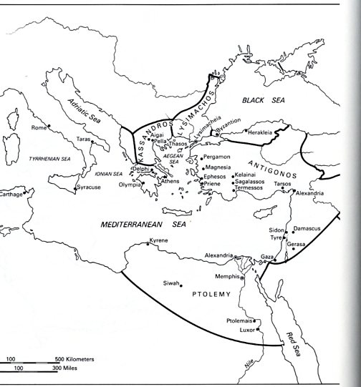
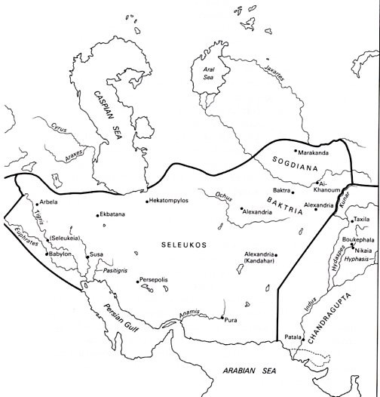
The Diadochs

Slide 3
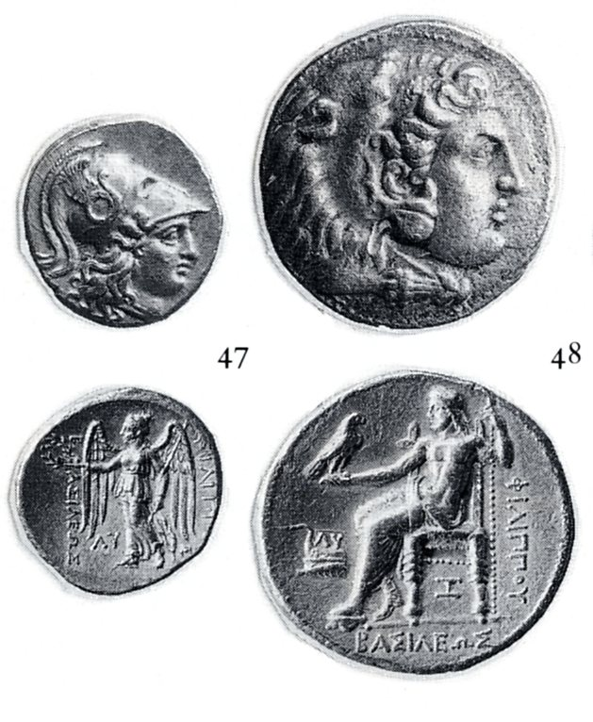
Philipp III Arrhidaeus
Babylon
Aradus

Slide 4
Antipater in Macedonia
Continuing the coinage of Philipp II for all internal transactions/purposes
In Amphipolis Alexanders are issued massively for the purposes of international trade

Slide 5
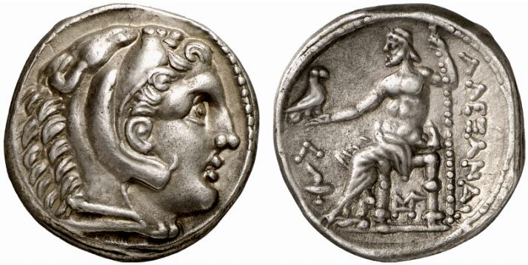
Amphipolis, Alexander III
Posthum Issue

Slide 6
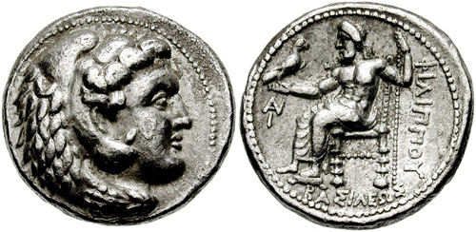
AR – Tetradrachme
Seleucus I in Babylonia
Seleucus I Nicator, 320 – 315 BCE

Slide 7
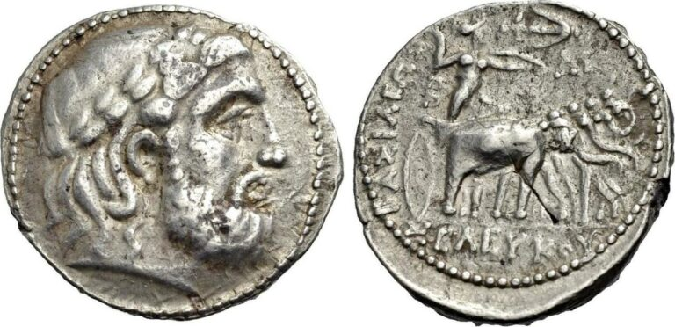
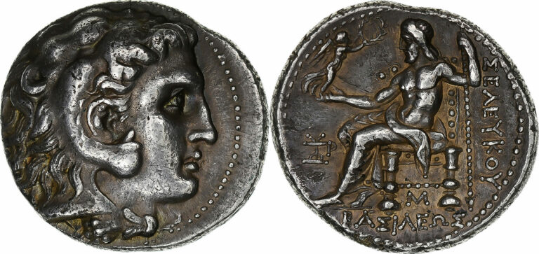
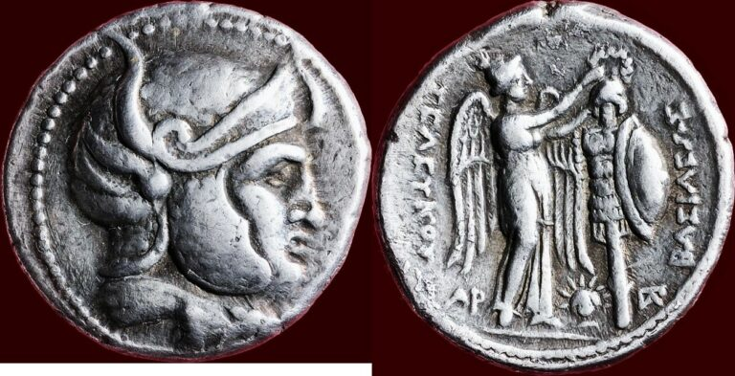
Seleucus I Nicator
Babylon mint issues Seleucos’ types
Alexanders for the international trade minted in all other mints

Slide 8
Alexander’s monetary heritage
The coins of Alexander: international currency for more than a century
The attic weight-standard
The establishment of a ratio of gold to silver, 1 to 10
Prestige, quality, purity

Slide 9
International coins before Alexander
Decree of Olbia
Nicophon’s Law , 375/4 BC

Slide 10
The Seleucids’ monetary compared to the Ptolemies’
Tolerance > innovation
Not imposing the royal Seleucid coinage
Vs
Closed economy of the Ptolemies

Slide 11
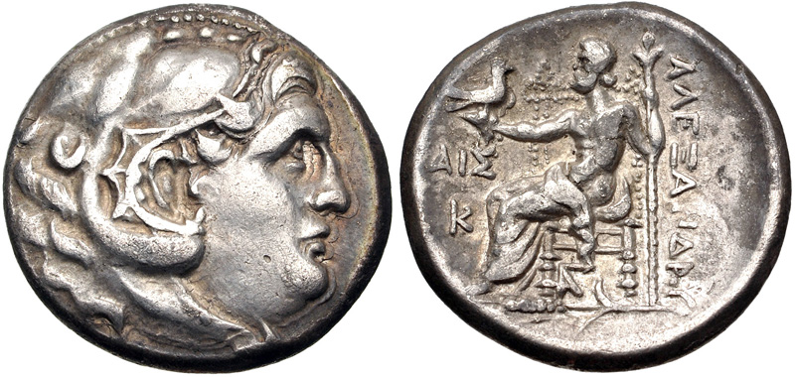
The testimony of the hoards
AR tetradrachm of the Kirazli hoard
https://www.numisbids.com/sale/3551/lot/152
Kirazli Hoard (near Amasya), 230 BC (IGCH 1369): the majority are tetradrachms and drachms of Alexander (150 out a total of 590)
Hoard in the Asklepieion of Pergamum (IGCH 1303: of the 22 tetradrachms, the 9 are of Alexander)
Cavalla IGCH 450, 275 BC

Slide 12
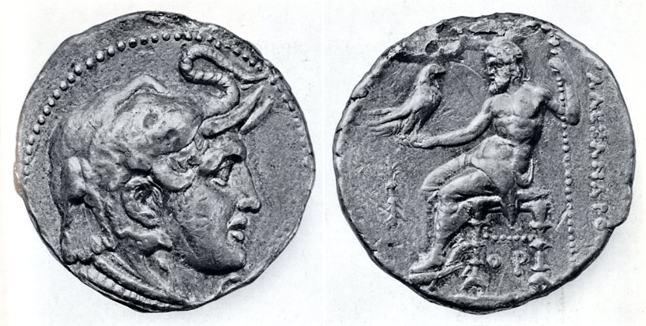
Ptolemy, Satrap
Ca. 321 BCE
Partition of Triparadisus
Repartition of power

Slide 13
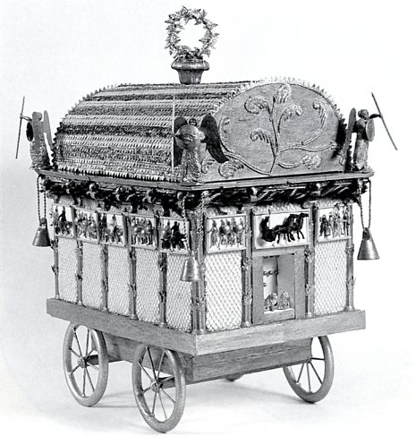
Funerary Procession for Alexander the Great
Diodor, Bibliotheke historike XVIII. 26. 1-28. 4

Slide 14
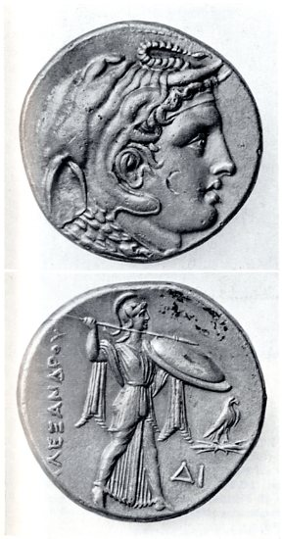
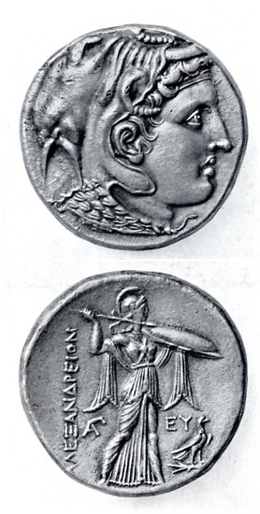
Introduction of a new reverse: ca. 315 BCE

Slide 15
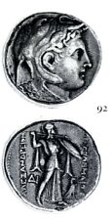
ΑΛΕΞΑΝΔΡΕΙΟΝ ΠΤΟΛΕΜΑΙΟΥ =
Ptolemy’s coin in Alexandreia or Ptolemy’s coin of Alexander

Slide 16
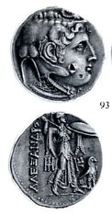
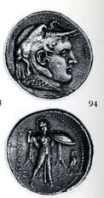
Ca. 310 BCE
Financial Reform in Egypt: 8.5 % reduction in weight
Sidon: Struck still in 312/11 BCE
(the 22nd year of the Sidonian era)
in the Attic Weight standard
Ca. 17,20 g
“New” Tetradrachm
Ca. 15,70 g

Slide 17
Closed monetary system
320: New types. Alexander in elephant head dress, Ammon’s horn, aegid, issued along the ‘traditional Alexanders’ (cf. 321 Alexander’s relics arrive in Egypt)
315: puts an end to the parallel emissions. New types: ‘Alexander in elephant headdress: Athena combatant’, ALEXANDROU, the weight remains the same
310: reduction, tetradrachm of 15.70 g, 8.5 % reduction of the attic weight standard, overevaluated at 8.5%. This is the equivalent of the attic tetradrachm > Obligatory to change, the testimony of the hoards
305: 14.25g, reduction of 17%

Slide 18
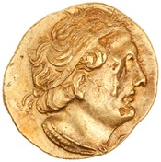
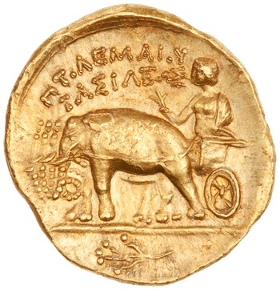
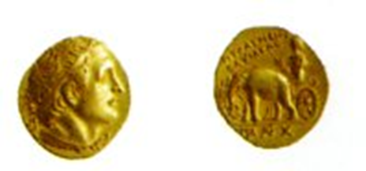
Ptolemy I, after ca. 304 BCE
ANS 1944.100.79526
8.60g > 7,12 g : Reduction of 17 %

Slide 19
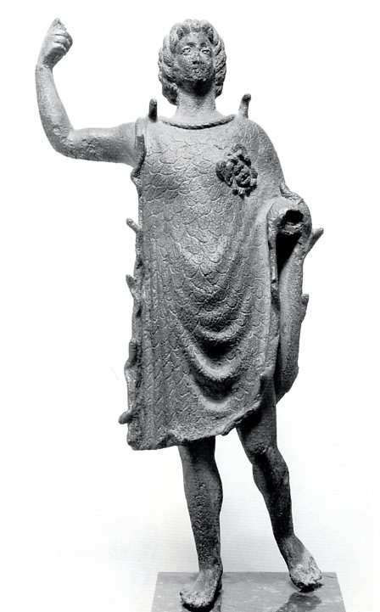
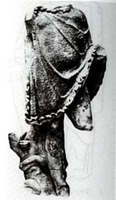

Alexander Aegiochos
Ca. 305/ 4 BCE
Louvre
London

Slide 20
Simultaneously and until 310, gold staters of the alexander’s types and in the attic weight standard (8.60g)
1:10, 8.60 g = 86 g of silver
In the Persian Empire, un daric oj 8.40g = 20 sicles of 5.60 g, 1:13 the ratio
New series of staters begins ca. 305 (the year when he assumes the royal title) : Ptolemy’s portrait: Alexander as charioteer in a cart driven by Elephants ‘ALEXANDROU BASILEOS’, between 7.10 to 7.16, 17 % reduced compared to the attic weight staters

Slide 21
Question: what is the ratio of gold to silver between 310 and 305 BC
The rule: one AU-stater = 5 4drs. or 20 drs. . 8.60 g of gold correspond to 78.50 g. of silver, therefore 1:9
Between 310 and 305 BC: 8.60 g AU correspond to 94 g of silver, the relation between them are at 1:11
Main preoccupation is the silver
305 BC: 7.10 to 7.16 g of gold become the eqivalant of 78.50 g of silver or 5 4drchs of 15.70g, 1:11, the value of gold im=ncreased

Slide 22
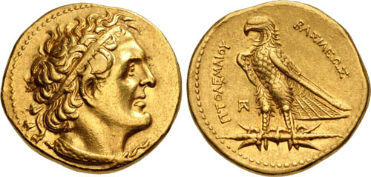
New gold coins created by Ptolemy I (300 BC)
AU Pentadrachms of 17.80g and half-drachms of 1.78g. The former is named ‘trichryson’ in the sources, meaning three ‘chrysoi’ or 60 drachms or 15 tetradrachms. Of 14.25g, therefore 17.80 of coined gold were the equivalent of 213-214 g of coined silver, therefore a ratio 1:12, unsual for the Greek world
https://www.cngcoins.com/Coin.aspx?CoinID=396695

Slide 23
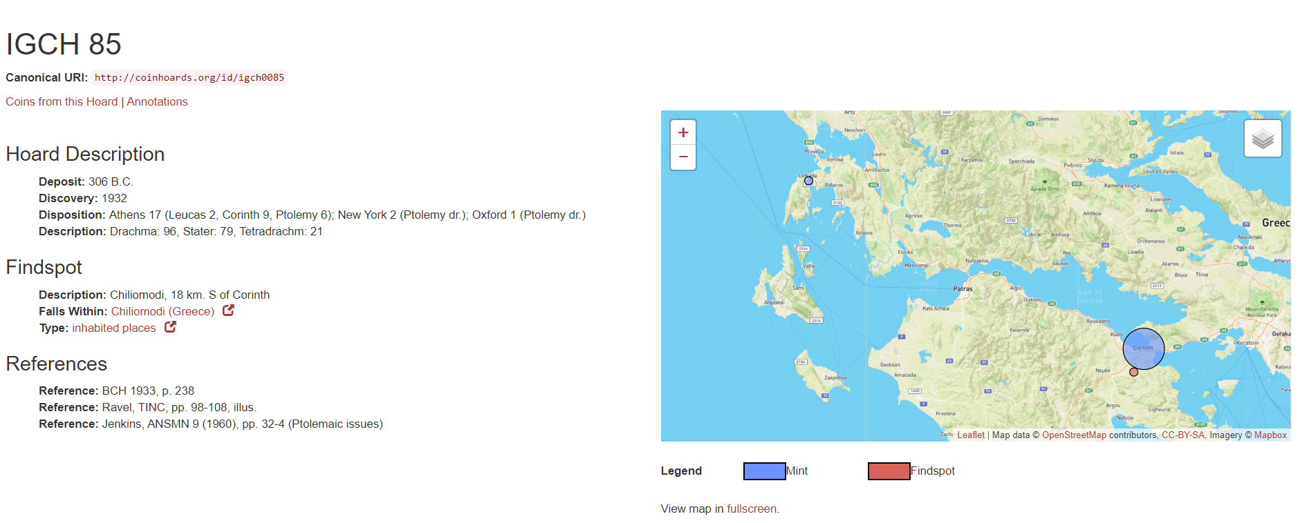
The Chiliomodi Hoard (IGCH 85) date of deposit: 306 BCE

Slide 24
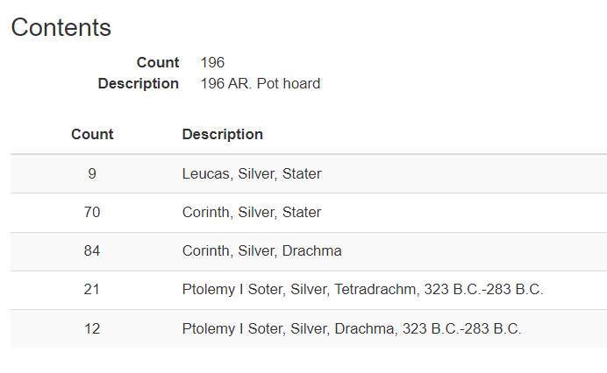

Slide 25
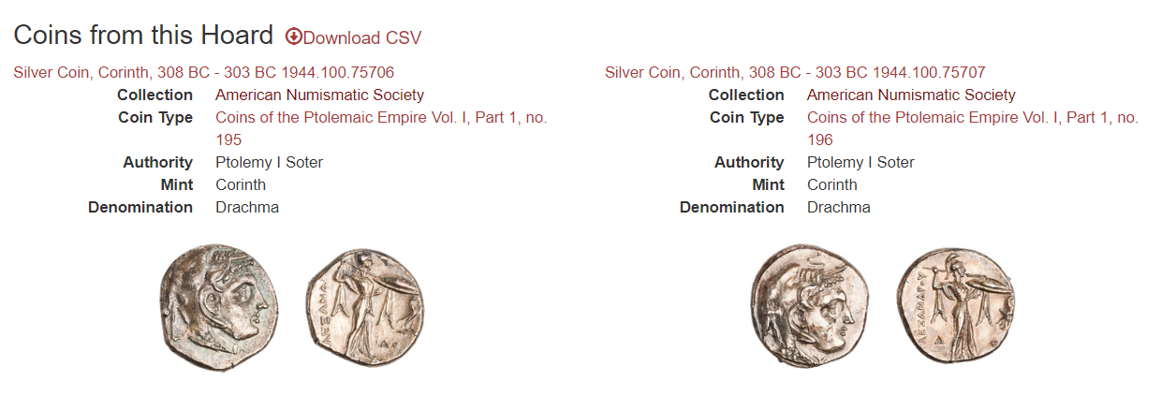

Slide 26
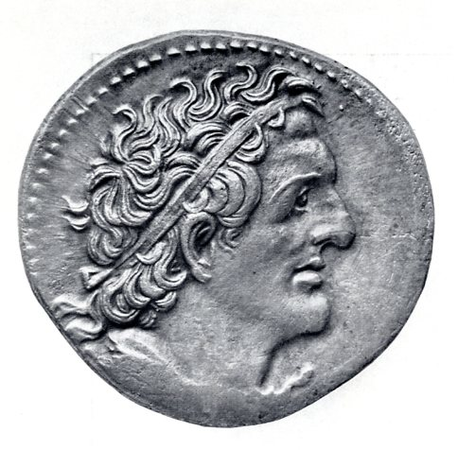
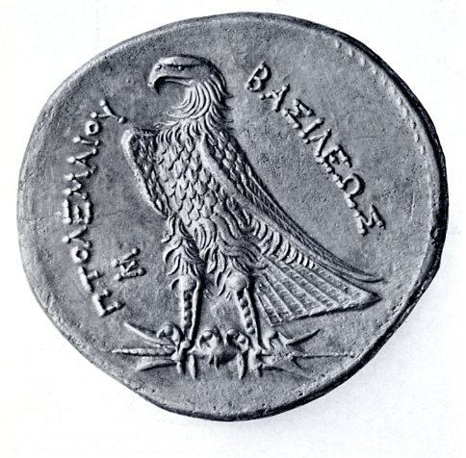
The final changes: after 300 BCE

Slide 27

Ptolemy I

Slide 28
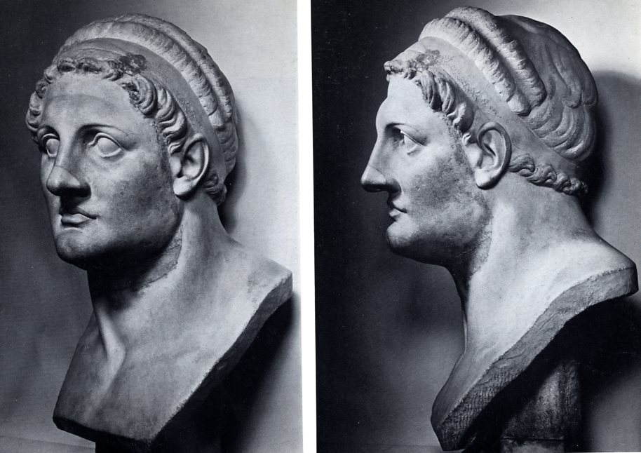
Portrait: Ptolemy I
Paris Louvre A1

Slide 29
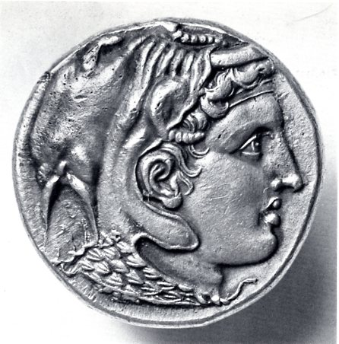
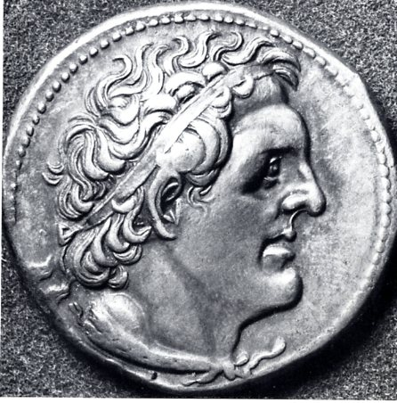

Slide 30
Bronze coinage of Ptolemy I
Almost No silver drachms (only Ptolemy II issued a few silver drachms)
Bronze takes up the role of silver
Every transaction in bronze
One ‘artabos’ of wheat (40 litrai of grain ) = 2 AE drachms

Slide 31
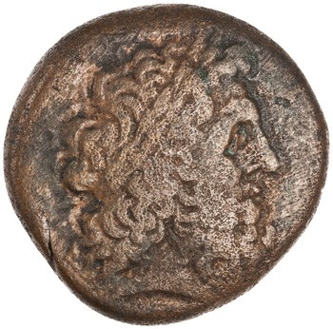
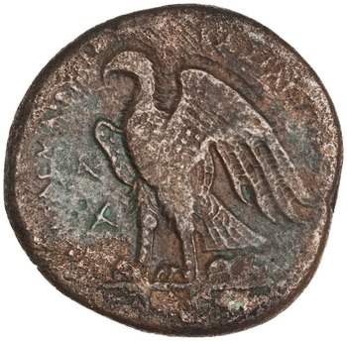
Bronze coinage of Ptolemy I
Alexandria, 294 BC 1925.176.130, 14.6g, 27mm

Slide 32
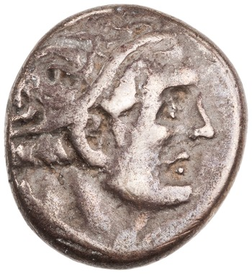
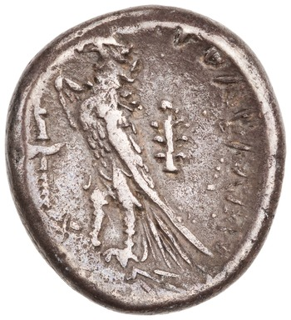
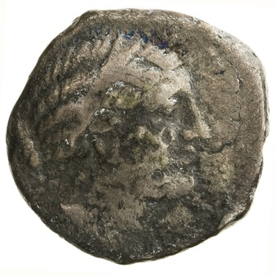
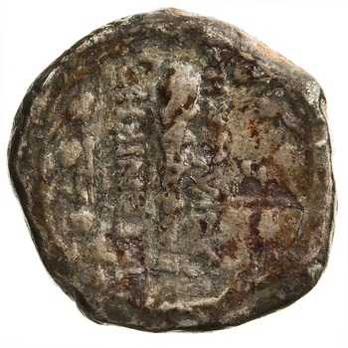
Magas, governor of Cyrenaica
Cyrene, AR, 6.76g, 282 BC - 261 BCE 1944.100.79528
Cyrene, AR, 6.31g, 282 BC - 261 BCE, ANS1944.100.79531

Slide 33
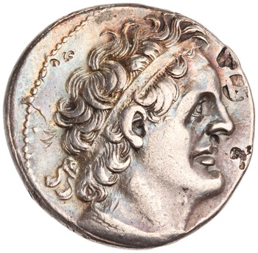
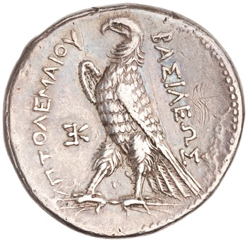
Ptolemy II
Silver Tetradrachm of Ptolemy II Philadelphus, Alexandreia, 285 BC - 246 BC. 1974.26.5422

Slide 34
Ptolemy II (285 to 246) monetary policy
Until 261/0 no changes
The same 4drs. The same trichrysa
Denominations in bronze: 17-18 g and of 8-9 g
From the beginning of 260s: decadrachmss commemorating his sister-wife: Arsinoe II , 35.50g, or 2 tertradrachms and a half

Slide 35
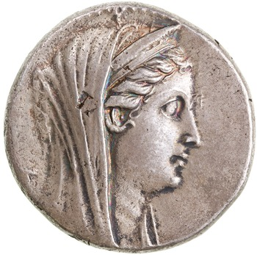
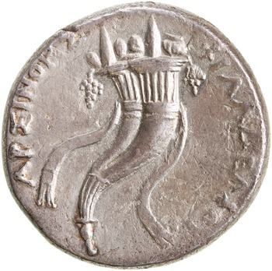
In the name Arsinoe II under Ptolemy II
Minted in Alexandria
AR decadrachms 35,50
AU octadrachms 27.80
AR Tetradrachms with the
Same dies as the AU
Silver Coin, Alexandria, 261 BC - 252 BC 1935.117.1087
Decardracm, 34.27g, 35mm, 12mm

Slide 36
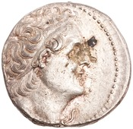
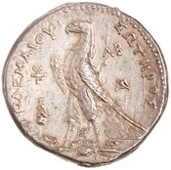
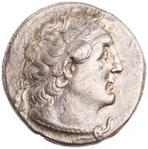
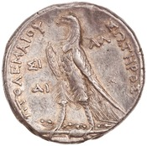
Ptolemy II in Tyre and Sidon from 261/0 BCE onwards (regnal year 25 onwards)
Silver Tetradrachm of Ptolemy II Philadelphus,
Tyre, 254 BC - 253 BC. 1944.100.76126
Silver Tetradrachm, Sidon,
255 BC - 254 BC 1944.100.76179
Change in the legend: ΠΤΟΛΕΜΑΙΟΥ ΣΩΤΗΡΟΣ

Slide 37
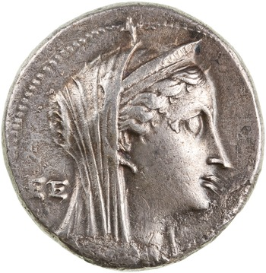
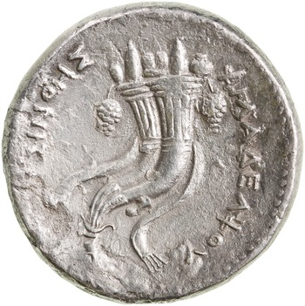
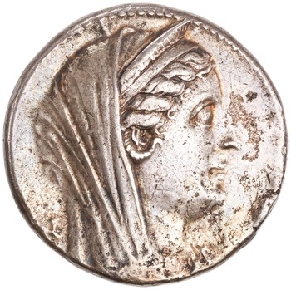
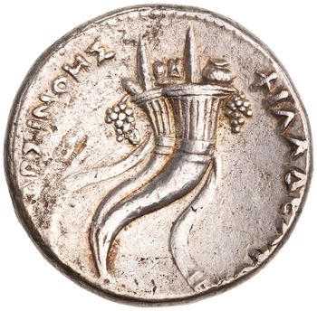
Decadrachms in lettered series
Α, Β, Γ, .... ΑΑ, ΒΒ, ΓΓ ...
ANS1964.79.61 and ANS1960.170.412

Slide 38
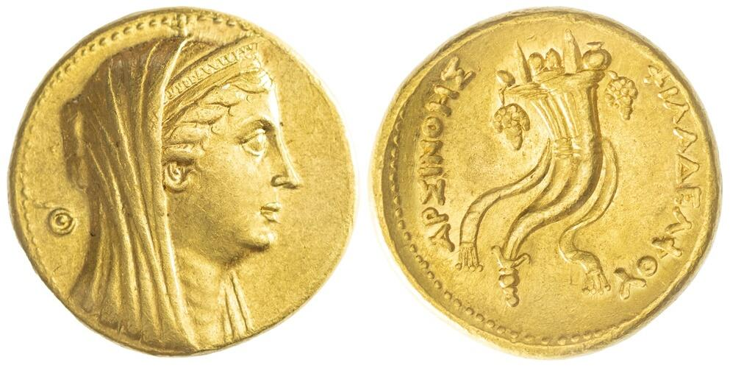
Spink > Auction 24125 Auction date: 26 March 2025
Lot number: 1267

Slide 39
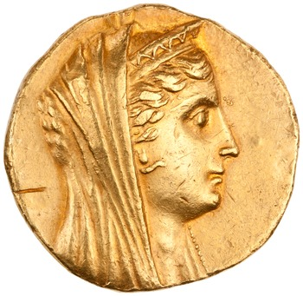

Gold Octadrachm of Ptolemy II Philadelphus, Paphos, 285 BC - 246 BC. 1944.100.76008
27.73, 30mm, 12h

Slide 40


The coinage of the Brother Gods
AU octadrachm, 27,80g, 28mm
Alexandria, 282 BC - 272 BC 1956.183.28
Called a mnaeion because of the ratio 1:12.5, the mnaion equalled a mina of 100 drachms of silver and consequently the gold octadrachm was called a pentekontadrachmon

Slide 41
Mnaieia
Legend: THEON ADELPHON
Ca. 27.80g.
Halves of 13.90g, quarts of 6.95g., eighths of 3.45g
> results to a new overvaluation of gold, the ratio 1:12 instituted by Ptolemy I, is now replaced by 1:12.8g, since 27.80 g now had from now on the value of 356g of silver

Slide 42
Zenon Papyrus: a letter, part of a correspondence
Persons involved
Demetrius: Mintmaster in Alexandria
Apollonius: dioiketes, minister of finance, of Ptolemy II Philadelphus
Philaretus (another mintmaster)

Slide 43
Zenon Papyrus (P. Zen. I 59 022)
Re:
Difficulties by the implementaion of the king‘s decree
The Trichrysa must be withdrawn from circulation and replaced by a new gold issue
The letter is dated:
15th of the month Gorpiaeus of the year 28 (Ptolemy II regnal year) =
258/7 BCE

Slide 44


Slide 45


Slide 46
Termini Technici
Prostagma
Epichorion nomisma = The state coinage
Ta trichrysa = gold coins of ca. 18 g
katergazesthai

Slide 47
37 AU mnaeia = 3.700 drachms of silver + plus valur (epallage) of 4%, therefore 104 drachms or 26 tetradrachms, ration 1:13.3

Slide 48

Mnaion terminus post quem is the Zenon Papyrus

Slide 49
Bronzes of Ptolemy II in eight denominations
Theoretical weights
92 (approximates the deben)
68
46
22
11
6.8
5.2
3.4
1: 1 ½ : 2 : 3: 6 :12 : 18 : 24

Slide 50


Slide 51


Slide 52
The hoard of Gülnar in Meydancik Kale in Cilicia Tracheia
5.000 pieces
2,553 Alexanders
2,158 Ptolemies
504: Lysimach, Antigonides, Seleucides
Deposition date: ca. 240 BCE
Graffitti of proper names

