Slide 1
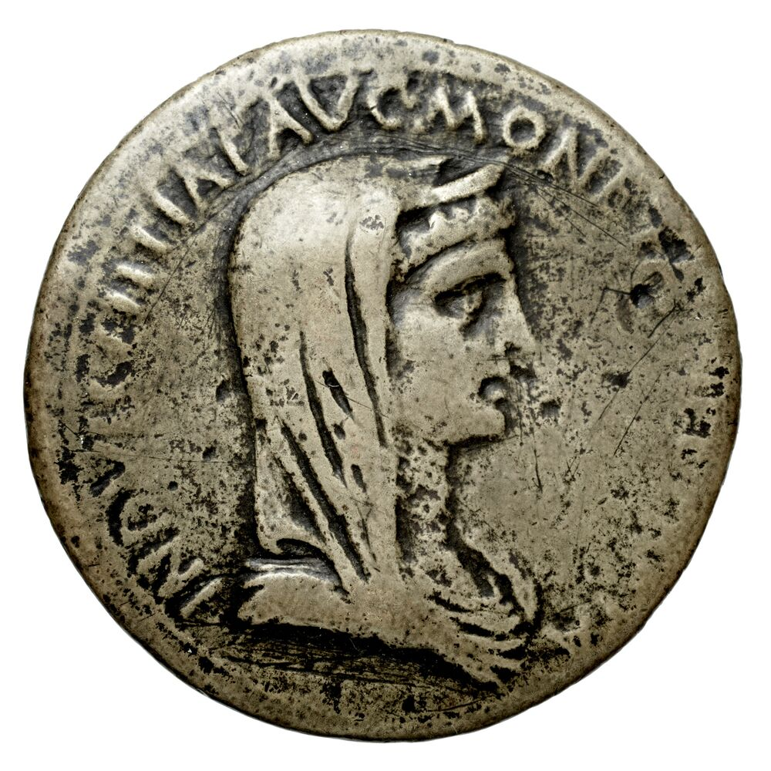
Roman Provincial Coinage

Slide 2
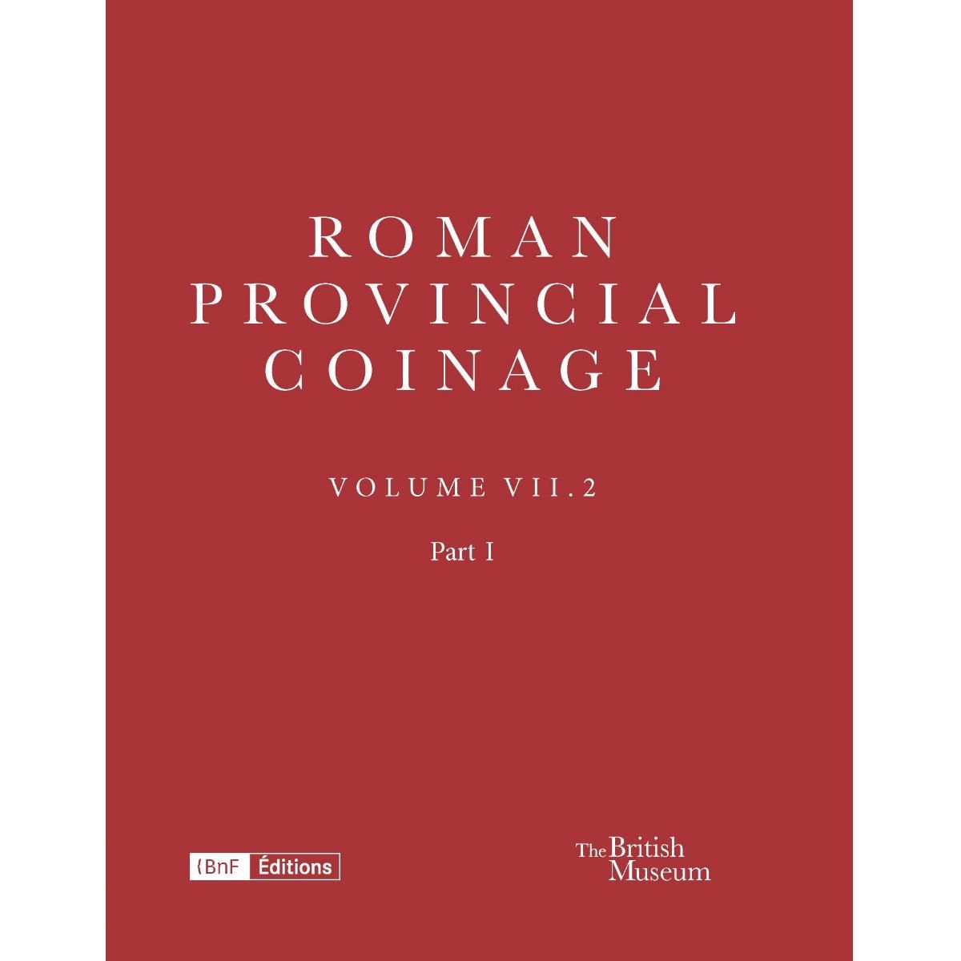
RPC
https://rpc.ashmus.ox.ac.uk/
RPC I, no. 124.
RPC VII.2.1, no. 134
Notes:
Always consult book –notes, discuission etc.

Slide 3
Roman Provincial Coinage: Production and Authority
Mints may have been temporary or located in unimpressive structures (quantities smaller, production intermittent). Athens mint in a converted building in SE corner of the Agora.
Proconsul sometimes named on provincial coins (may have had influence), some coins name the granting of imperial permission for coin production (permissu). Decision to mint coinage decision of local government, client king or advisors, a koinon or relevant local body.
Individuals named on provincial coins: may be eponymous magistrates, magistrates responsible for the production of coinage, or the citizen who bore the cost.
Egypt a special case
Language: Greek (Latin in colonies)
Notes:
Koinon – league of several states
Epnymous magistrate – give the year name.

Slide 4
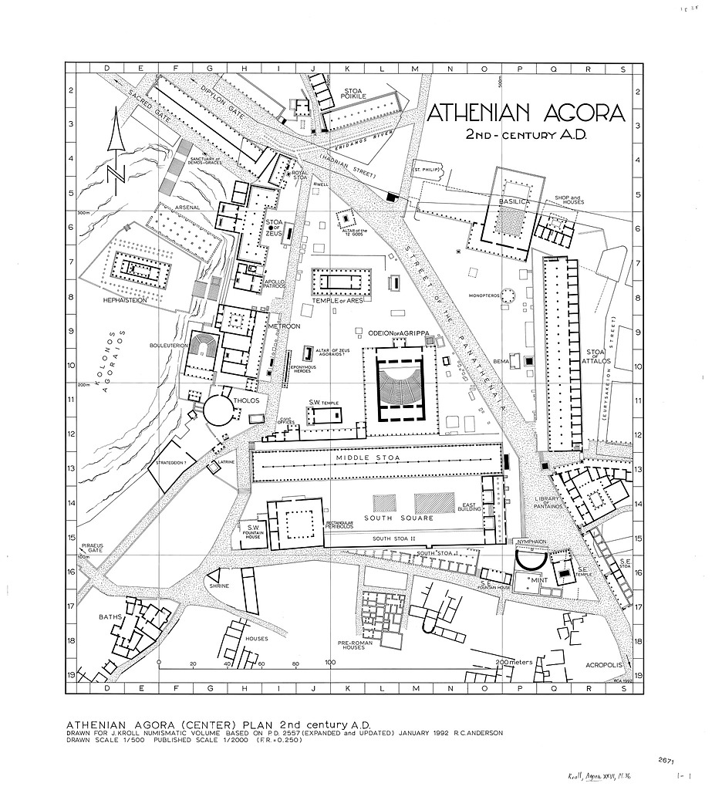
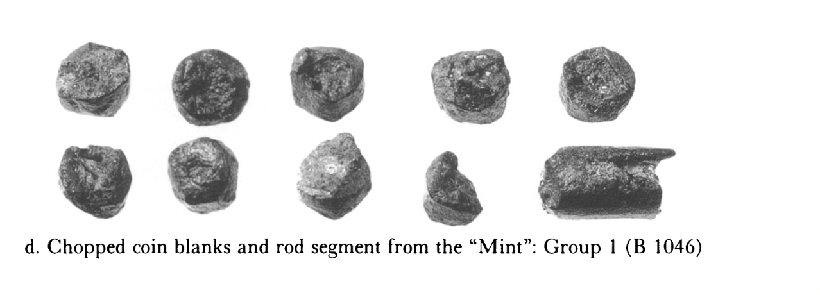
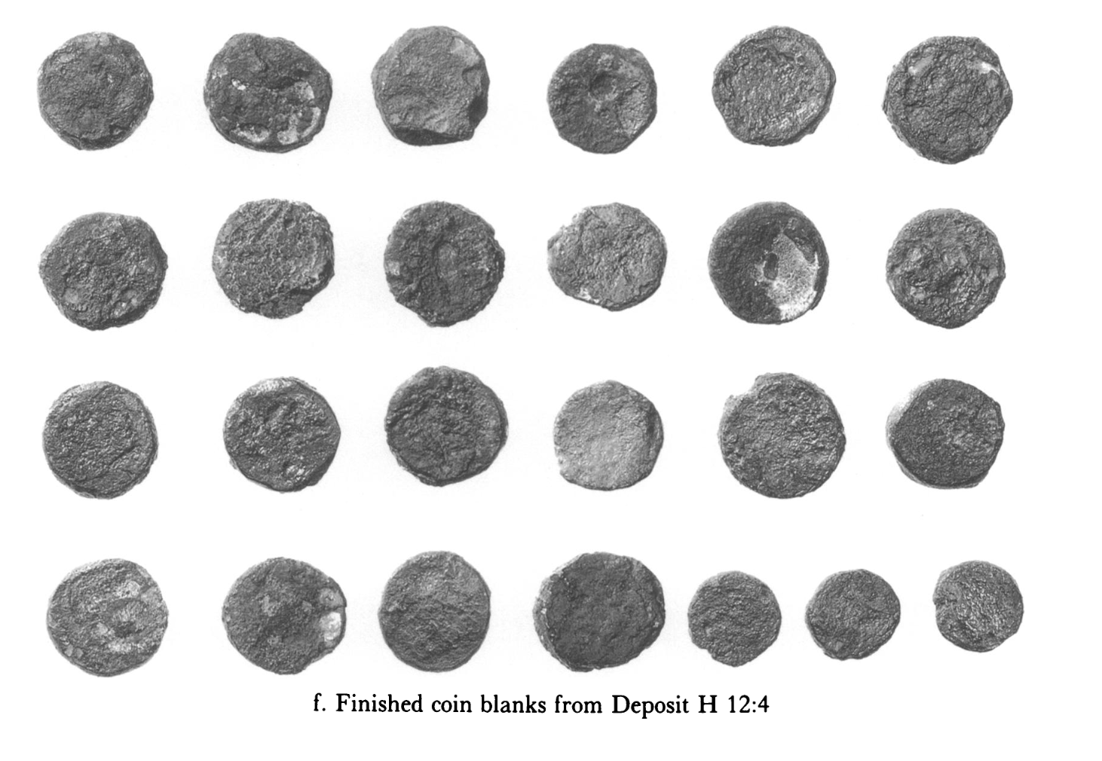
Mint in the Agora
Hundreds of coin blanks excavated from the floor of the structure
Bronze rod from which the blanks had been chopped
Notes:
p 292: unstruck blanks and the mints of the agora.
Building known as 'the mint' at the SE corne3r of the agora square (P-Q 16) owes its identification to the 160+ coin blanks excavated from its floors. Also remainder of a bronze rod from which they had been chopped.
None of the excavated bronze blanks appear to be earlier than the Period IVB coinage of 42/1-32 BC, by which time Athens had ceased to mint in silver.
p 294: present evidence suggests the building was prob. not converted into a mint until after the battle of Philippi in 42 BC.
PQ 16
No silver found. So a Roman period mint.
After being chopped from rod, hads to be heated and hammered before being struck.
Mint in second century AD lay outside the area, but in 3rd century had returned, but to a different area in rthe agora.

Slide 5
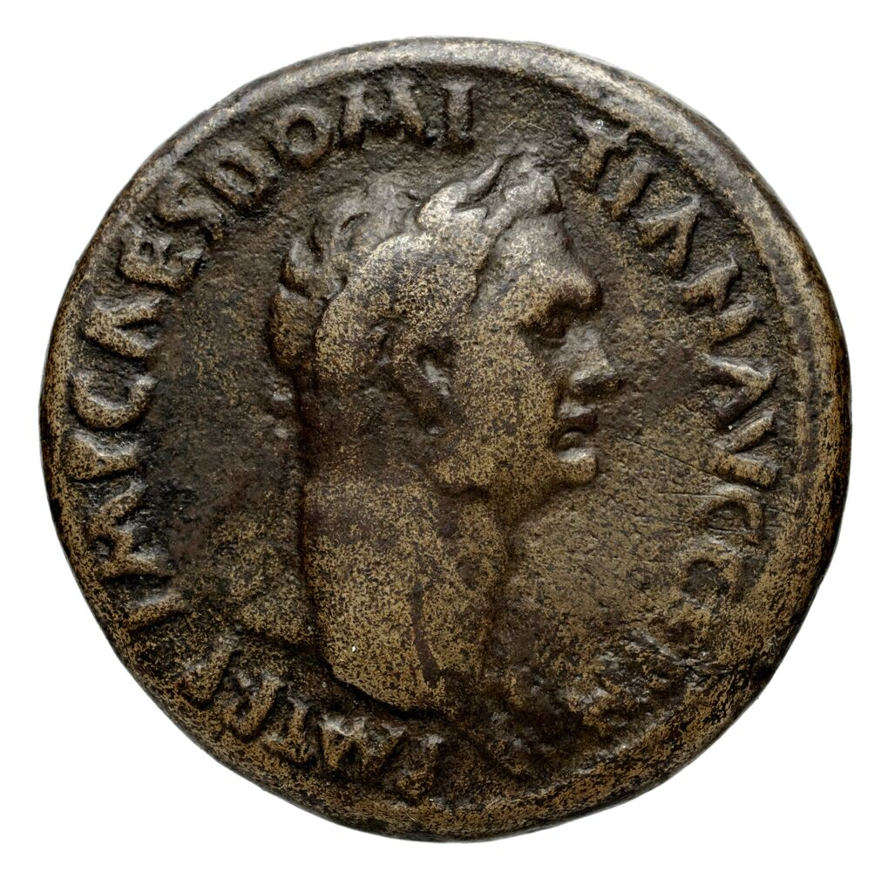
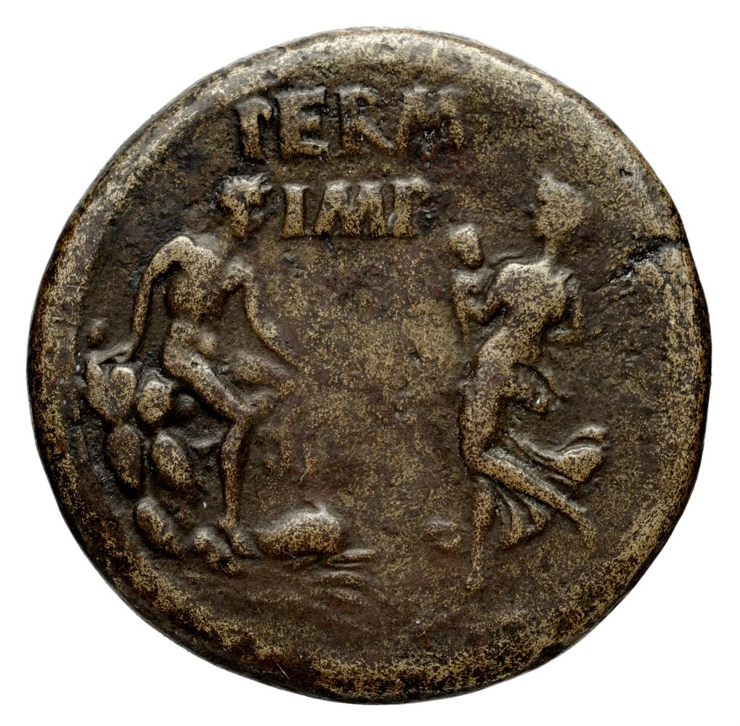
RPC II, 101, 30mm, Corinth.
Obv: laureate head of Domitian, r., with aegis. IMP CAES DOMI-TIAN AVG GERM - P M TR P
Rev: Ino, l., holding Melicertes in her arms; facing her, Isthmos seated, r., on rock; dolphin at feet. PERM IMP.
Notes:
Isthmian games – according to legend originally held in memoruyn of Melicertes (although other traditions ewxist). Held on Isthmus of Corinth.
Melicertes: In Greek legend the son of Athamas and Ino, and ch~nged, after his death by drowning, into the marine deity Palaemon, while his mother became Leucothea.
With the permission of the emperor. A cessation of coinage in Achaea under Vespasian who recalled the “freedom of the Greeks” that had earlier been proclaimed by Nero. Coinage begins again under Domitian.

Slide 6
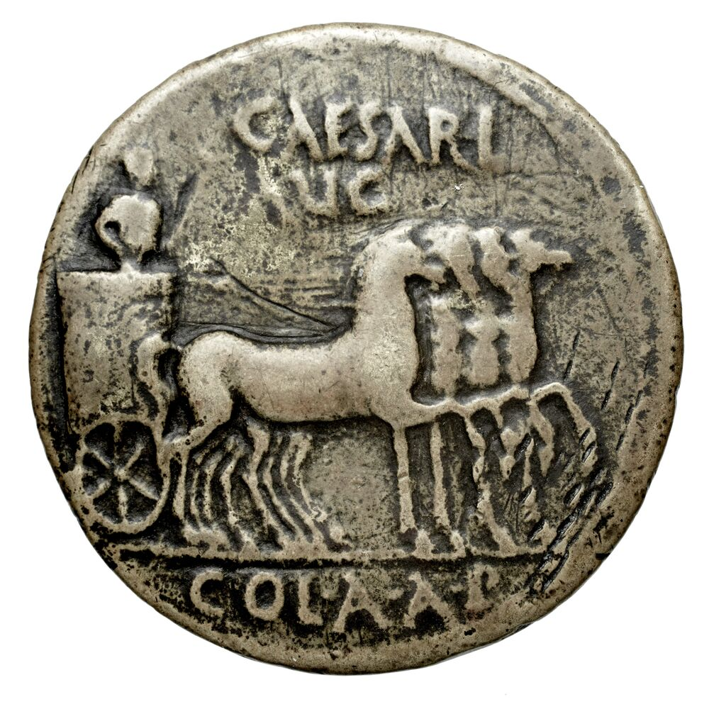
RPC II, 219, Patras, AD 85/6, 34mm.
Obv: bust of Indulgentia to r., draped, veiled and with stephane, INDVLGENTIAE AVG MONETA INPETRATA
Rev: slow quadriga to r. driven by triumphator with sceptre in l. hand, CAESARI AVGVSTO COL A A P

Slide 7
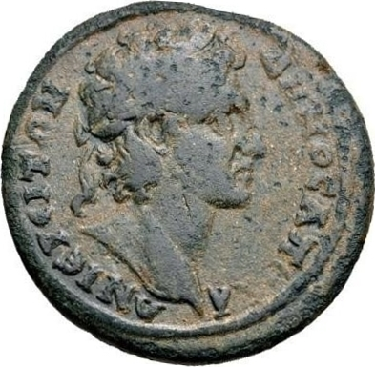
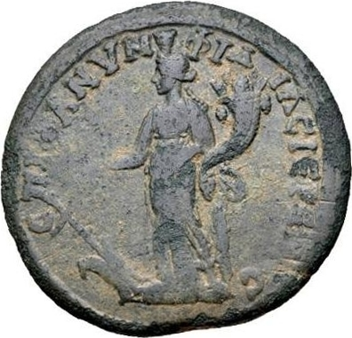
Fl(avia) Nymphidia
Priestess
RPC IV.2 11907 (temporary), Apollonoshieron, Asia, 32mm, reign of Commodus.
Obv: laureate head of the Demos (youthful), r. ΔΗΜΟϹ ΑΠΟΛΛΩΝΙƐΡƐΙΤΩΝ
Rev: Tyche standing, l., wearing kalathos, holding rudder and cornucopia. ƐΠΙ ΦΛ ΝΥΜΦΙΔΙΑϹ ΙƐΡƐΙΑϹ
Notes:
Date based on the style of the coin.
The emphasis on priesthoods is not surprising. The religious sphere had long been open to women, in a way that civil positions were not, and from the Hellenistic period the female priesthood came to play the most prominent liturgical role in the cities, though they were always outnumbered by men

Slide 8
Female coin issuers (thanks to Andrew Burnett)
Roman Provincial Coinage: over 2500 personal names which appear on coins, but only twenty-nine women (c. 1%)
In the context of:
Public benefaction (e.g. Mineia at Paestum, which includes her portrait, like Augustan in date)
Eponymous magistracies
Priestesses (e.g. Jucunda (ierea) at Prymnessus)
Husband and wife issue (e.g. Castoris sotira and Epigonos philopatris at Eumenea). NB: the case of the ‘widow’ Claudia Eugenetoriane at Colossai. (In some cases we can’t know for sure).
cluster in central Phrygia, first and second centuries AD
Notes:
Castortis smaller denomination, Epigonos larger denomination.
Widow – coins likely planned by her husband – hence the unique title here.
Priestesses –elite of the cities, Roman citizenship.

Slide 9
Problem of denominations
Weights can vary
Often amounts not specified
Diameters
Value/systems may differ between cities (even neighbouring cities)

Slide 10
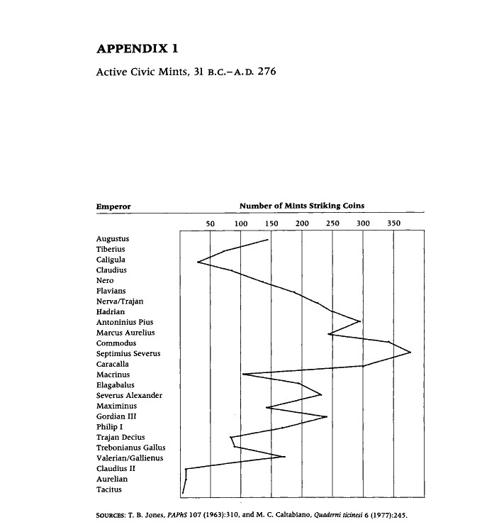
Production
Production of provincial coins falls away in the West under the Julio-Claudians
Notes:
Why the cessation in West? Hard to mknow – doesn’t seem to be an economic reason, but maybe the elite wanted to be as ‘Roman’ as possible, even using only Roman coins?
Cessation gradual – if it was a decree or intervention would have happened all at once.

Slide 11
What can provincial coins tell us
Local economies/exchange
Festivals + festival currencies
Local cult, myth
Local (elite) identities
Perception of Roman rule
Prosopography/local elite

Slide 12
Changes to Greek coinage under the Roman Empire
Some attempt at Roman intervention in terms of standardized types and metrology (short lived)
Spread of Roman denominations (chronology vague and extent hard to judge). An increase in larger sized coins being produced (perhaps inspired by the sesterius).
Names attached to portraits on coins – the anonymous portraits we see on coins under Augustus becomes increasingly rare
Nominative case used for rulers (taken from Latin models)
Imperial portrait (although no particular form of the emperor’s portrait and titles appear to have been imposed) increasingly comes to dominate the obverses
Increasing diversity of designs (likely due to the influence of Roman coins). Also appearance of depiction of structures (e.g. temples). Increased representation of mythology over time, as opposed to representations of deities.
Local level (not centrally imposed)
Notes:
What defines ‘Roman provincial’ coinage in relation to the earlier Greek and Hellenistic coinage we have been looking at?
After Augustus – having a name associated with a portrait a necessary part of imperial identity. Woolf – names inscribed more with the expansion of Roman society.
Roman coinage unique in terms of diversity of designs, coins as a medium of communication
Civic space = quite Roman, as opposed to the Greek preference for images drawn from the natural world.

Slide 13
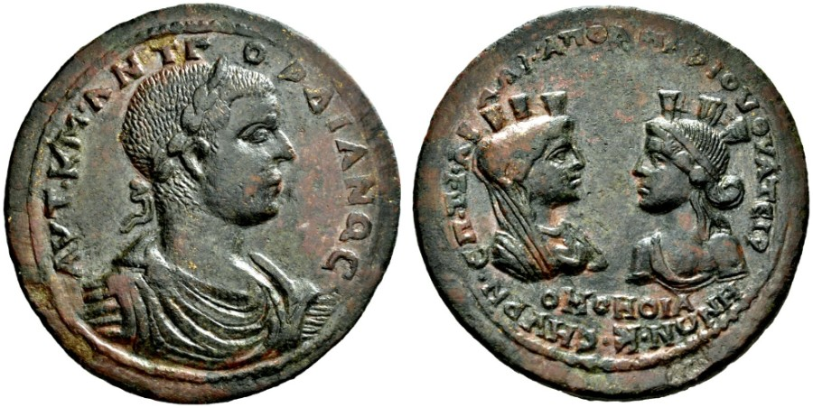
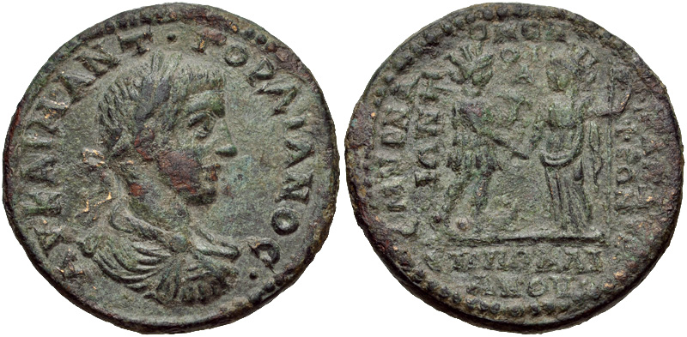
Homonoia Coinage: Smyrna under Gordian III
Perinthus
Nicomedia
Ephesus
Dokimeion
Cyzicus
Alexandria (Egypt)
Alexandria Troas
Ancyra
Harpasa
Neapolis of Harpasos
Pergamum
Philadelphia
Synnada
Thyatire
Tralles
Koinon of Asia
RPC VII.1 191 (second known specimen)
Æ 52.67 g. AYT K M ANT Γ − ΟΡΔΙΑΝΟC Laureate and cuirassed bust r. Rev. ΕΠ Τ ΦΑΒ – ΑΛΦΑΠΟΛΙΝΑΡΙΟV ΘVATEIP – ΗΝΩΝ ΚΑΙ CMVPN / OMONOIA Confronted busts of the Tyche of Thyatira and of the Amazon of Smyrna.
RPC VII.1 332, 29mm, 14.76 g, 12h
The Amazon Smyrna standing right, foot on prow, holding bipennis over shoulder and clasping hand of Tyche of Philadelphia standing left, holding scepter
Notes:
Coins of Homonoia. Homonoia implies an alliance, or more generally the affirmation of good relations. Generally homonoia coins are restrained to Asia Minor as well as Thrace.
p 40: gives a list of the homonoia coins.
Iconography and Monetary legends of the homonoia coins. Mostly two gods and heroes representing each city. More rarely, a sole divinity is represented on the reverse of the coin, characterising one or the other of the cities. This is because these are small coins, where there was not enough space for a more elaborate composition. Rare case of Thhyatira with one god on each side of the coin (legend split between both sides of the coin as well.)
p 41: Normally the city that was striking the coin came first, but some exceptions.
Interpretation of homonoia coins
Notes under Gordian III the many homonoia coins struck by Smyrna. (who struck homonoia coins with Perinthus, Nicomedia, Ephesus, Dokimeion, Cyzicus as well as Alexandria in Egypt, Alexandria Troas, Ancyra, Harpasa, Neapolis of Harpasos, Pergamum, Philadelphia, Synnada, Thyatire, Tralles and the koinon of Asia. A total of 16 cities, plus the koinon of Asia. Then separates this into cities that were striking the coinage and those partnering. A certain number of cities figure in both categories, which is mainly explained by the fact thjat the homonoia was celebrated monetarily on emmissions of both cities. If, under Gordian III, Smyrna found itself in the centre of an important network of unions, it is however Ephesus which precedes with a vast emission of coins of this type with Alexandria in Egypt.
Dating of homonoia issues. Dating of the homonoia issues rests here on the presence or abscence of issues with the bust of Tranquillina as well as the establishment of a chronological succession of emmissions of the coins of each city.
Reason for the Minting. For D. Klose, the coins of concord emitted by the city of Smyrna during this period were a result of the city's will to reinforce (or establish) commerical and economic ties with nearby cities and those further away. Those further away are situatied in the places that were visited between Europe and Asia Minor, stations for the passage of troops, but equally centres of commerce. More recently Kampmann, in an analysis of the homonoia coins of Pergamum, has questioned the sudden necessity that cities in Asia Minor felt to establish links with cities that are found in the rountes fundamental for armies on their way east. Kampmann cited Gordian's campaign against the Persians/Sassanians. She noted that the army was split into a series of petite units, who all went by different ways so as to lessen to difficult problem of providing and supplying the troops. This operation made necessary the preliminary harmony of different cities in order to settle all the questions of organisation, homonoia which can be traced through the coins. A certain number of the 16 cities which struck coins of concord under Gordian III are important ports (Perinthus, Nicomedia, Cyzicus, Alexandria Troas, Smyrna, Ephesus, Alexandria in Egypt.) The monetary iconography comes to highlight the importance accorded to this port function. In effect, in the case of coins of concord between Pergamum and Nicomedia or between Ephesus and Alexandria in Egypt, the two divinities (Asclepius and Demeter/ Artemis Ephesia and Sarapis) are each represented at least twice on a naval vessel. Moreover, Demeter of Nicomedia is depicted twice with a bow at her feet, an attribute that is otherwise unknown. This emblem is met, on the coins of Smyrna, as a systemic attribute of the Amazon of Smyrna, but equally as an attribute of Tyche on numerous partners in homonoia. Still to mention, in this context, the presence, on the homonoia coinage of Ephesus,

Slide 14
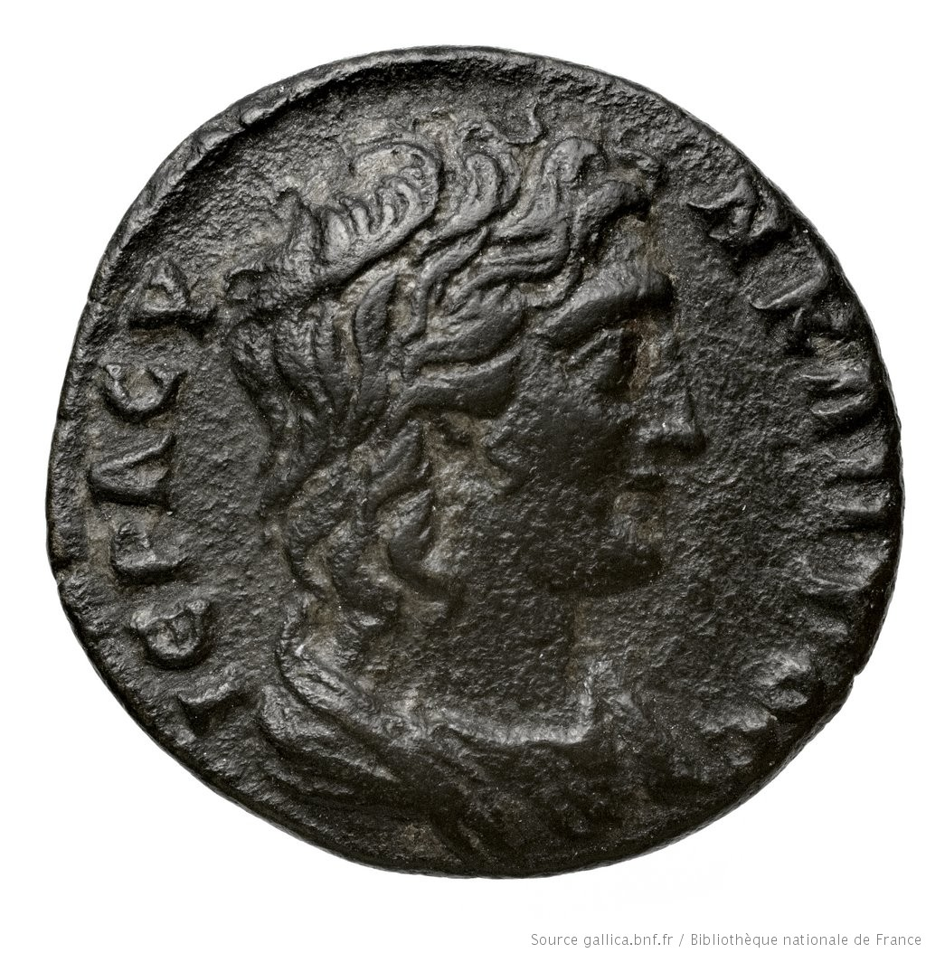
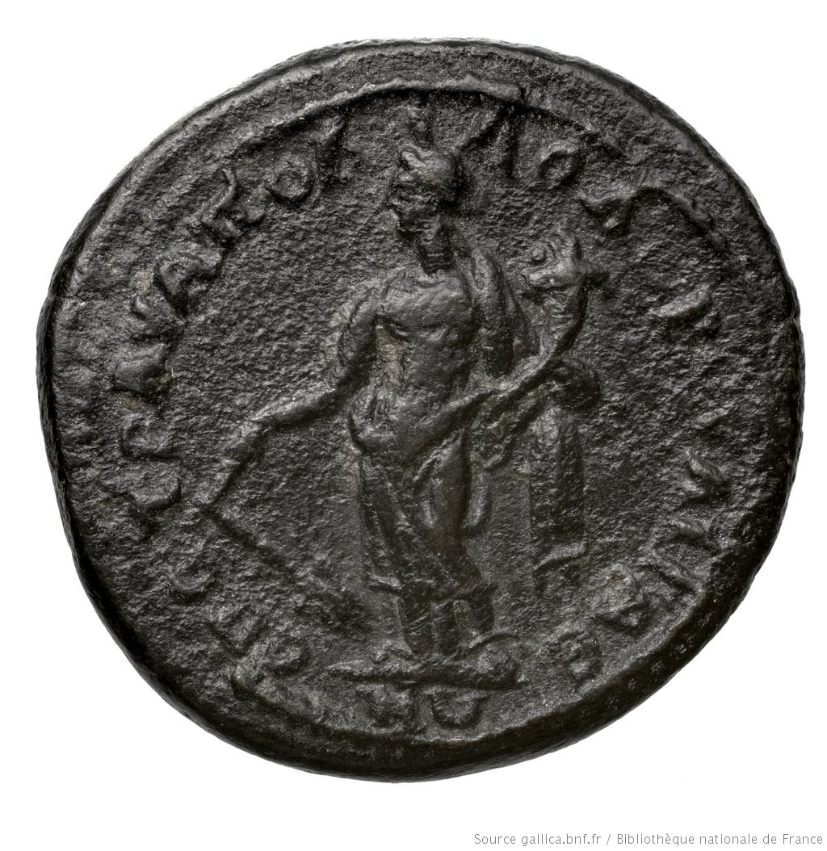
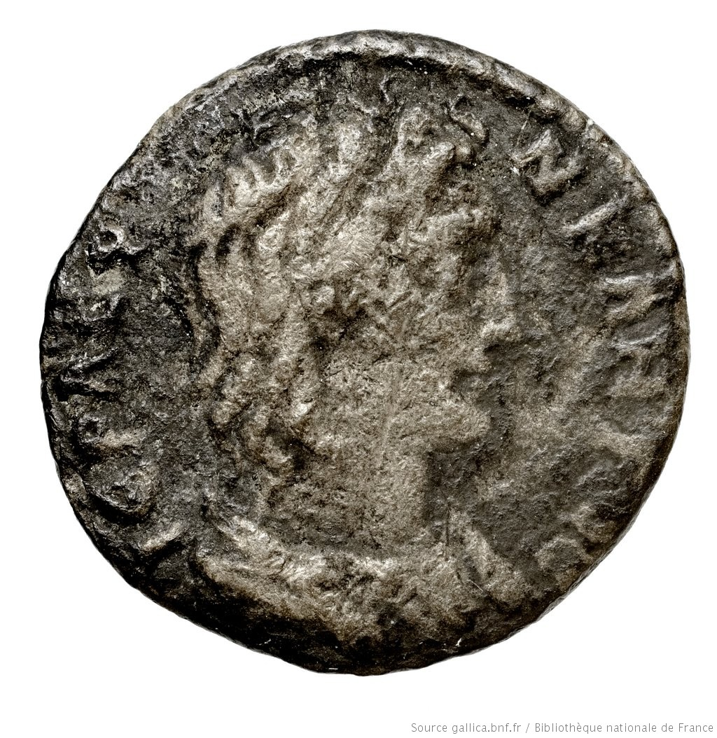
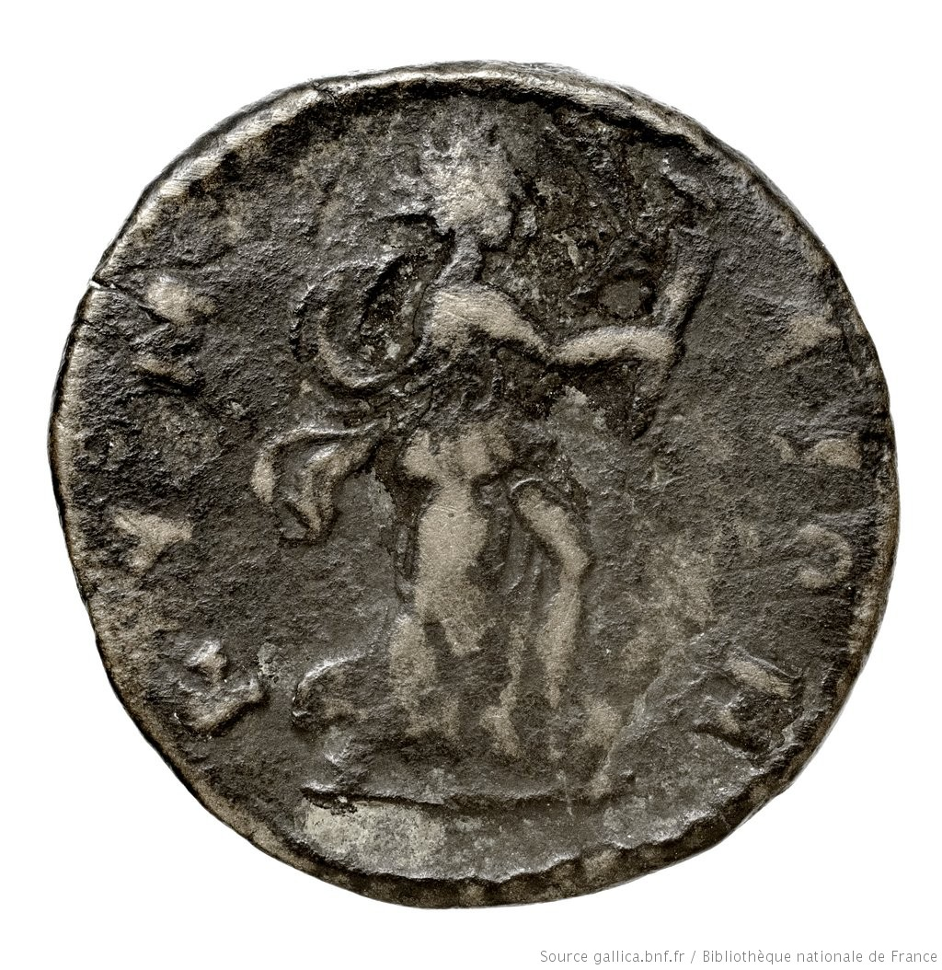
BnF Paris 27. Aegae, Aeolis, struck in the Severan period.
BnF Paris 178. Cyme, Aeolis, struck in the Severan period.
Notes:
Hiera Synkletos and Tyche
Sacred Senate

Slide 15
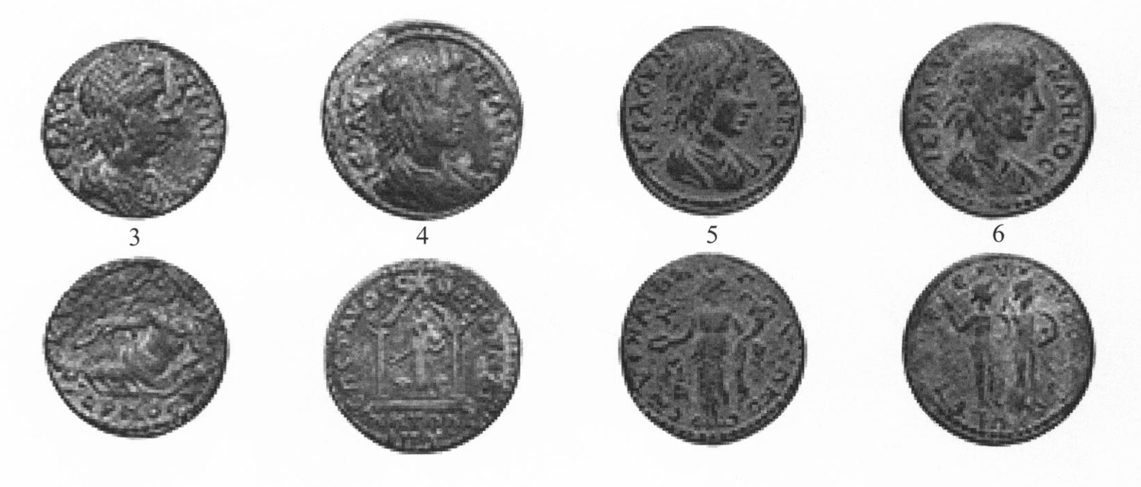
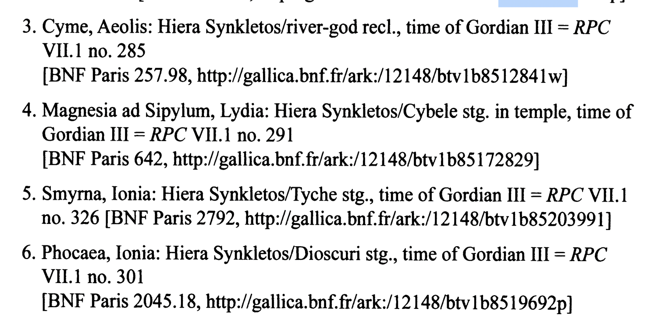
Kraft, Travelling Workshops and Die Sharing
Notes:
Die sharing stronger than comments on stylistic similarities
Watson – die sharing is best term. Kraft’s idea of tracelling die engraver’s with pattern books been heavily criticisewd. Died before completing the worlk.
Butrcher in Syria – one central mint producing for other cities. Antioch?
Watson – die engravers travelled, but the production was still with the city. CITIES may have chgosen to share the dies with another city after they finished using them. Means CAN’t be used to date pseudo-autonomous coins – die may have been moved at any point.
Pseudo-autonomous issues. WHY? Could be employed even when emperor changed?
Allows us to date them
ggestion
is therefore that the choice of 'pseudo-autonomous' types lay not with the cities themselves, but rather with the workshops that supplied the dies. Such

Slide 16
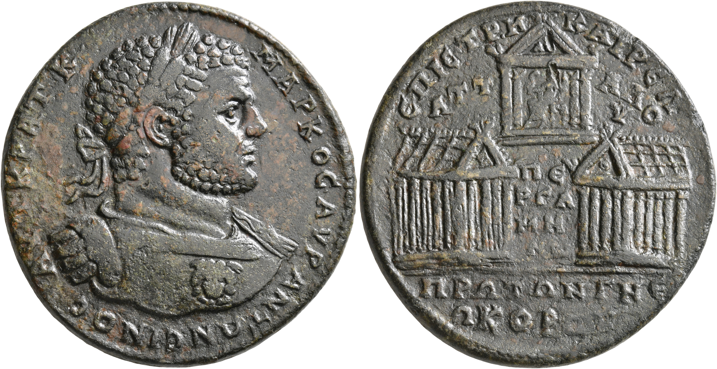
Neokoria
MYSIA. Pergamum. Caracalla, 198-217. Medallion (Orichalcum, 43 mm, 39.85 g, 6 h), M. Kairel. Attalos, strategos, 214. AYT•KPAT•K MAPKOC•AYΡ•ANTΩNЄINOC Laureate and cuirassed bust of Caracalla to right, breastplate decorated with gorgoneion. Rev. ЄΠI CTP M KAIPЄΛ / ATT-AΛO/Y / ΠЄ/PΓA/MH/NΩN / ΠPΩTΩN Γ NЄΩKOPΩN Three temples; two seen in perspective facing left and right; the one above seen from front with statue of Asklepios seated to left within, holding coiled serpent in his right hand and scepter in his left; in pediment of the temple of Zeus, AN. BMC 327 and pl. XXXII
Notes:
What makes the reverse particularly interesting is that the Temple of Asklepios carries the letters 'AN' in the pediment, and that the legend in the exergue proudly calls the city the 'first three times neokoros [of the Augusti]'. Other examples show the three temples side by side, where they carry the letters AYΓ, AN and TPA in their pediments
. Other examples show the three temples side by side, where they carry the letters AYΓ, AN and TPA in their pediments. Thus, we can conclude that the coins show the three Temples of Augustus, Trajan and Caracalla, the latter of which apparently was not a new construction, but a former Temple of Asklepios, which the god now shared with the emperor.

Slide 17
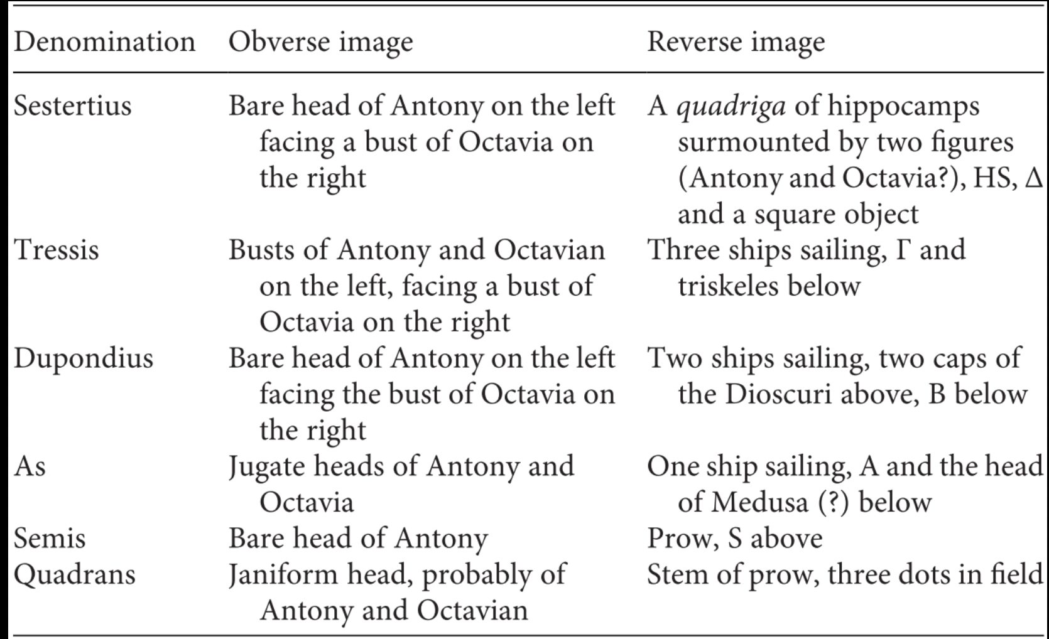
‘Fleet Coinage’ of Mark Antony (RPC I 1453-70)
Struck by Antony’s fleet prefects: Lucius Calpurnius Bibulus, Lucius Sempronius Atratinus, Marcus Oppius Cato
3 different mints but same design
Notes:
Coincides with the spread of denarius East – a Roman bronze system to accompany the silver.
Athenian Agora vol. 26 - argued that the denarius began to replace the stephanephoric silver drachm in Attica immediately after Philippi when Antony brought his forces to Athens to spend the winter of 42/1 and then continued to use Athens as a command center for much of the next five years.
No city names on the coins – does seem indicative of Roman control.
Greek letters to indiciate marks of value
- As to Sesterius (4 asses)
Sesterius – 4 asses, also a quadriga
Tressis: 3 asses – 3 ships and gamma
Dupondius – 2
As – one
Semis – half (prow)
Quadrans (1/4). - just the stem of the prow.
Alpha = 1
Also innovastive in terms of Roman coinage = sesterius now in bronze not silver, other denominations had not been struck since the third century BC.
Antony’s defeat meant abandoned, but we think it inspired the system Augustus eventually adopted in Rome.

Slide 18
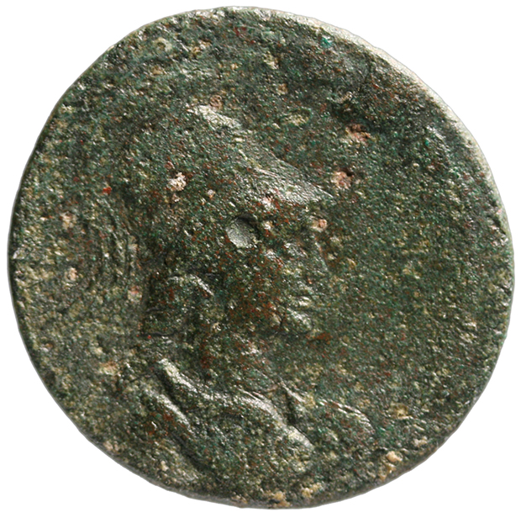
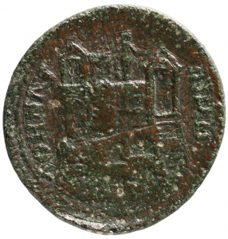
Temples and ‘Architectural Numismatics’
RPC IV.1 3510 (temporary). Athens, AD 120s-150s, 26mm
Obv: bust of Athena wearing aegis, r.; in laurel wreath, ΑΘΗΝΑΙⲰΝ
Rev:Acropolis-hill surmounted by temple (Erechtheium, on l.), colossal statue of Athena Promachos (in centre) and Propylaea (on, r.); descending from Propylaea, stairs; halfway up Acropolis-rock, cave enclosing statue of Pan.

Slide 19
Provincial Coinage under Athens
What impression does an overview of provincial coinage of Athens as found on the RPC online give us?
Notes:
Athens – quite a hold out with NOT adopting the emperor’s poratrit.
Ultimately the character of a city's bronze coinage was a matter of the city's degree of public identification with Rome, with cities with fuylly romanized bronze coinaghes located at one end of the spectrum, and those like Athens, with rigourously traditional, local coin types and denominations at the other. But Athens the greatest hold out.
One of several signs of the Athenians' pride in their uncontested heritage of cultural and historical pre-eminence, a kind of equality if not superiority to Rome, the Athena-head coinage of Roman Athens served as a tangible link to the glorious past. As an index of romanization, Athenian coinage would have us believe thaty Athens was never influenced by Rome at all.
Themistocles, prize tables, Theseus, Miltiades

Slide 20
The case of Egypt
Egypt a special province. Currency rarely left or came in.
Mint at Alexandria perhaps under the control of the idiologus or diocetes (officers attached to the prefect who were in charge of the province’s finances). i.e. mint under control of Roman government.

Slide 21
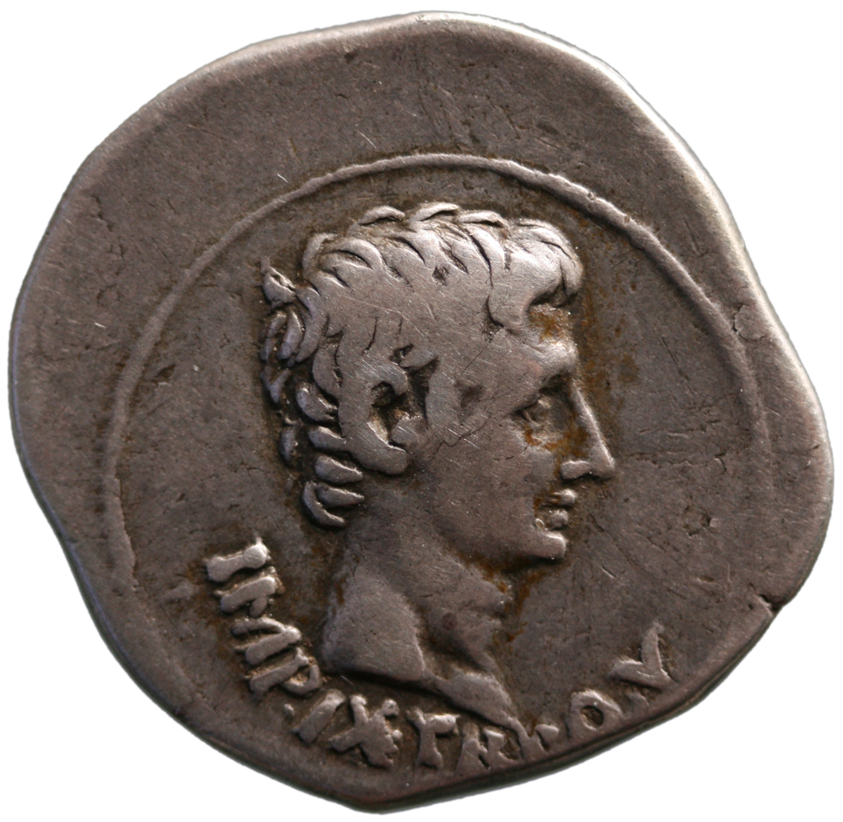
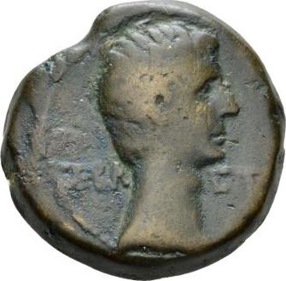
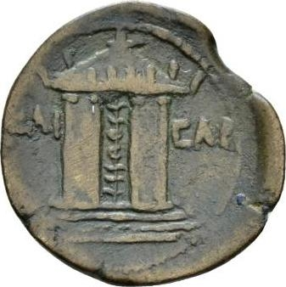
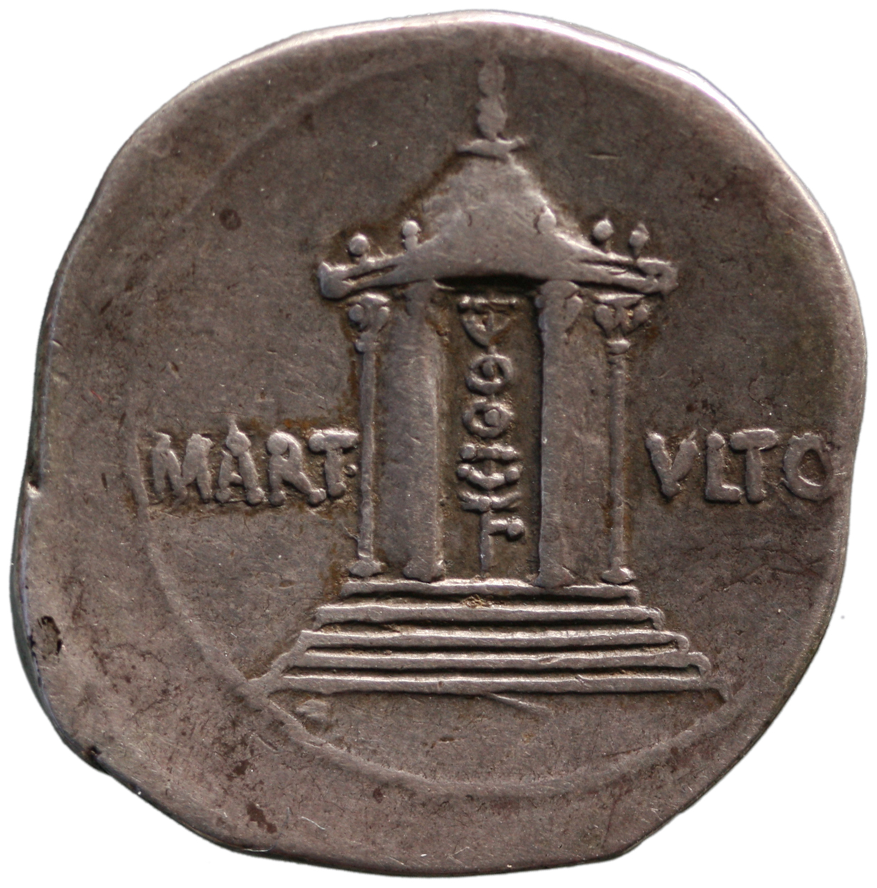
RIC 1² 507 (Silver cistophorus struck in Pergamum) 19-18 BC
RPC I 5003, Alexandria, 26mm, after 19 BC
Obv: bare head of Augustus, r. ⳞΕΒΑⳞΤΟⳞ.
Rev: temple of Mars Ultor, ΚΑΙⳞΑΡ.
Notes:
A vision for the temple before construction completed. (Augustan forum completed 2 BC)

Slide 22
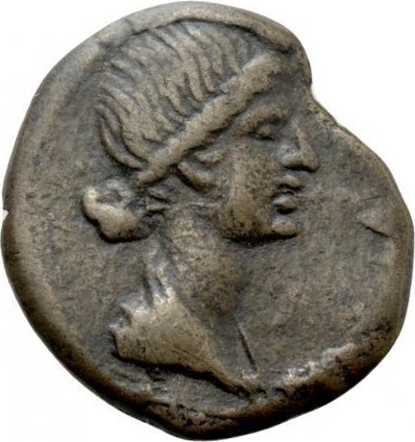
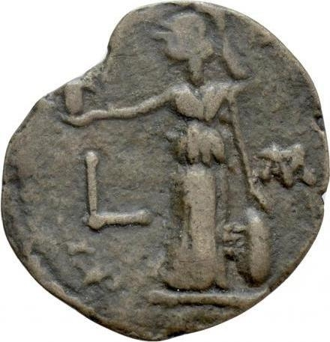
RPC I, 5055. Alexandria, AD 10/11, 24mm.
Obv: draped bust of Livia right.
Rev: Athena standing left. L M.
Notes:
Imperial family and imperial women on propvincial coinage.

Slide 23
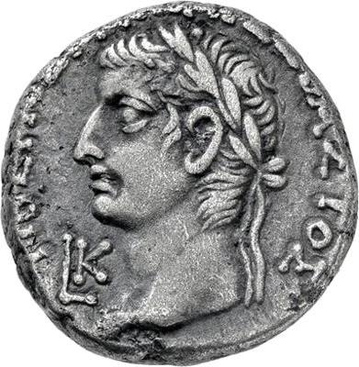
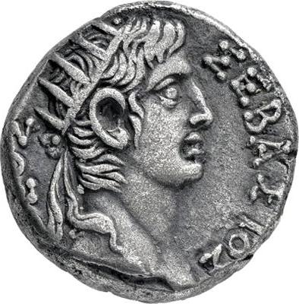
RPC I, 5096, AD 33/4. AR tetradrachm, Alexandria.
Notes:
LK = year 30.
Tiberius laureate, Divus Augustus radiate.

Slide 24
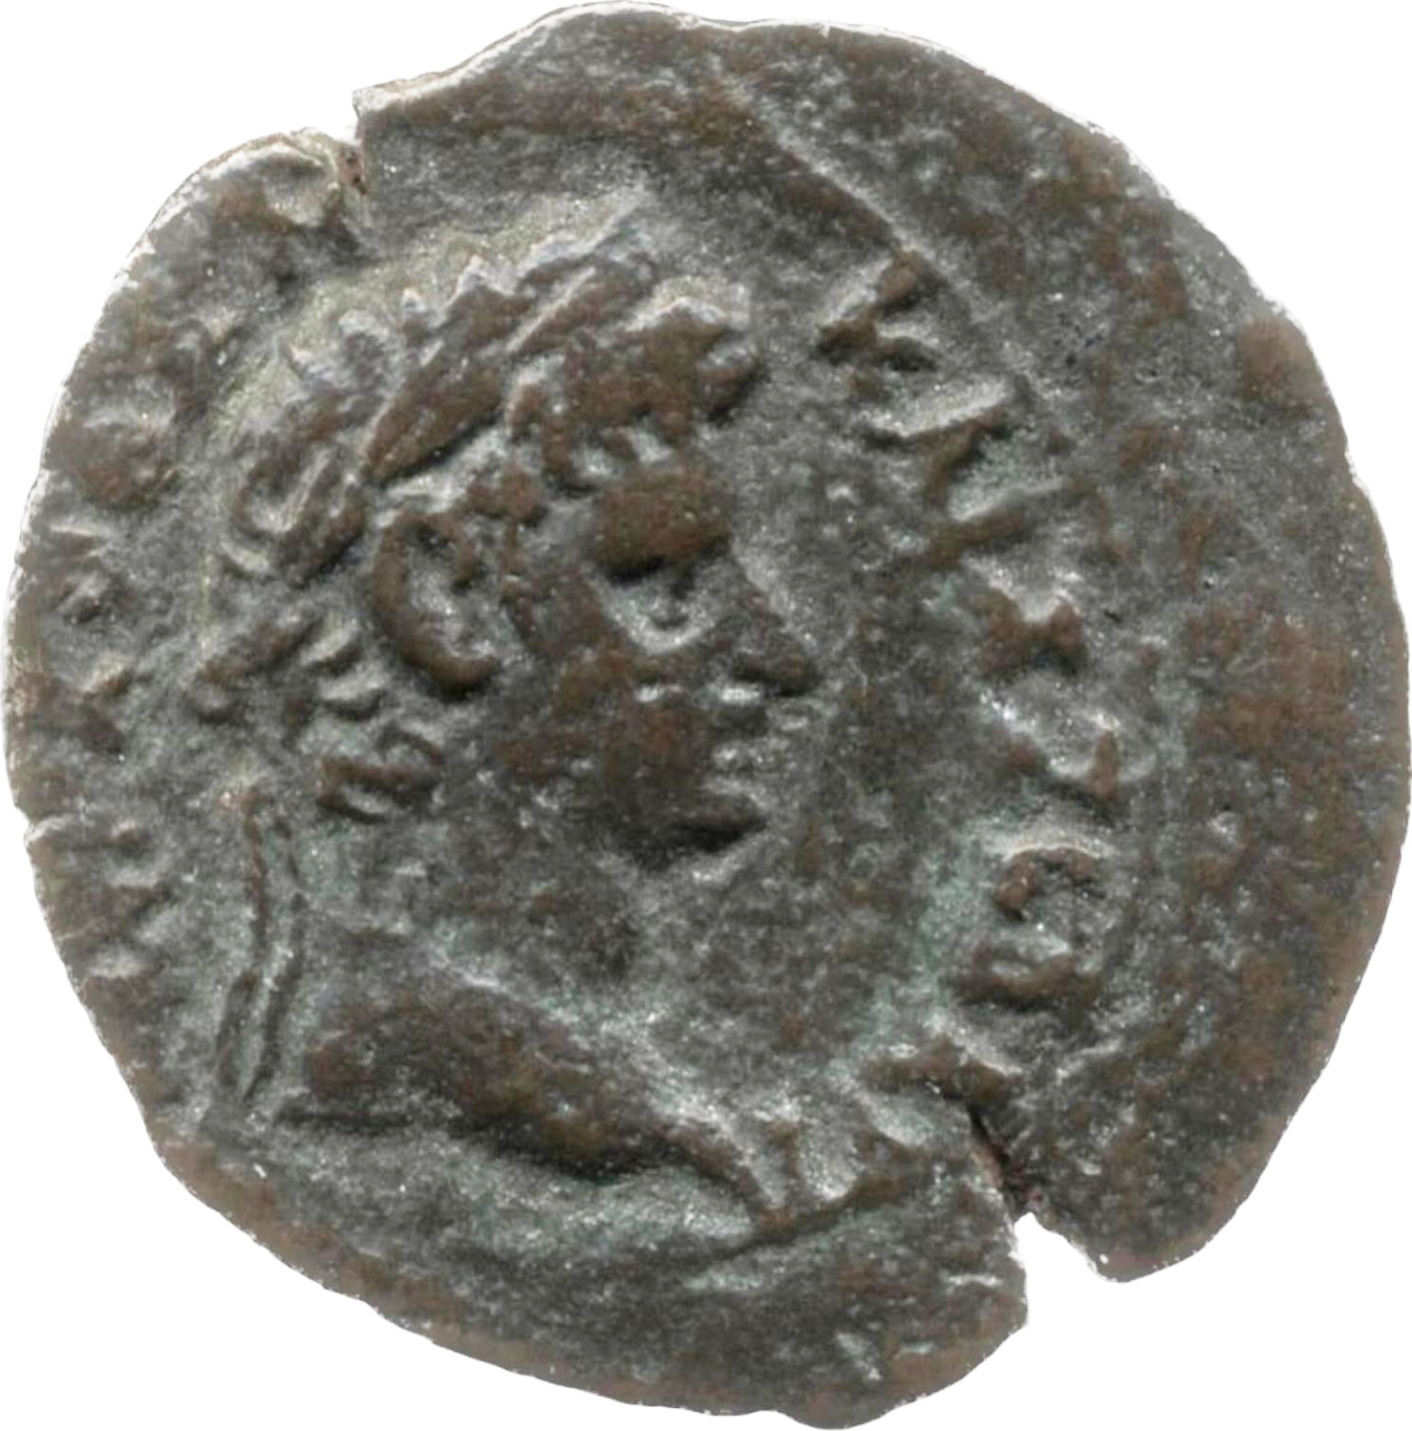
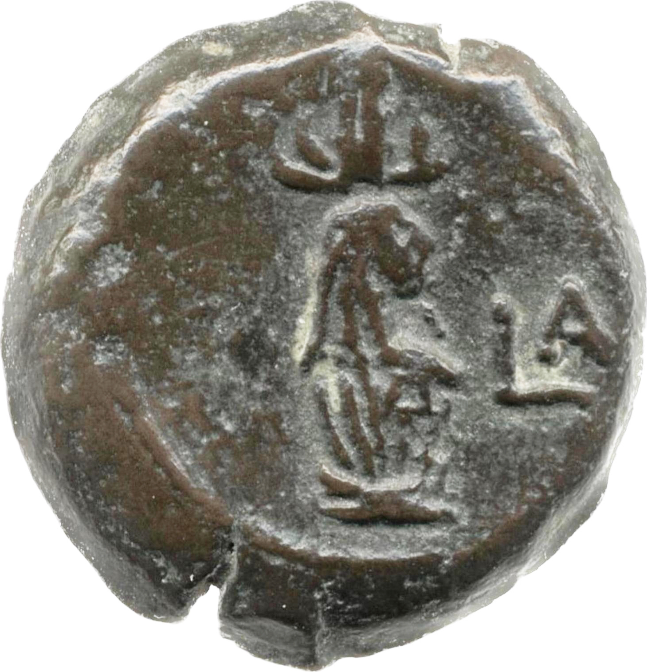
RPC I, 5370. AD 69, 21mm.
Notes:
Otho and canopic jar.

Slide 25
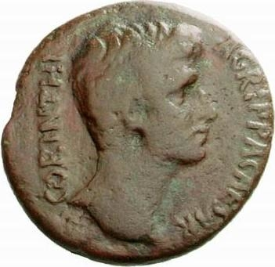
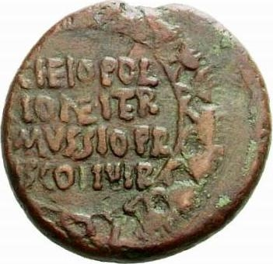
Coins from the BSA collection
RPC I, 1141b. Corinth, AD 4-5, AE 22mm.
Bare head of Agrippa Postumus right. CORINTHI AGRIPPA CAESAR /
C(aio) Heio Pollione iter(um) C(aio) Mussio Prisco IIvir(is) within a wreath of parsley
Notes:
with Gaius Heius Pollio for the second time (and) Gaius Mussius Priscus duovirs
Also Augustus, Tiberius, Germanicus, Drusus son of Tiberius,
C 292

Slide 26
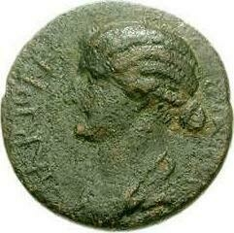
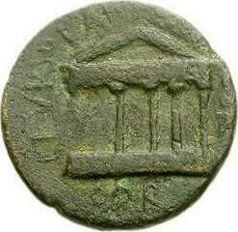
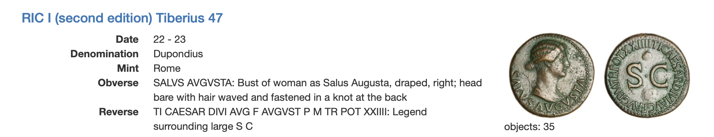
RPC I, 1154, Corinth, AE 21mm, AD 32-3?
Bust of Livia/Salus left, L ARRIO PEREGRIN IIVIR /
Temple with 6 columns, L(ucio) Furio Labeone IIvir(o) Gent(i) Iuli(ae) Cor(inthi)

Slide 27
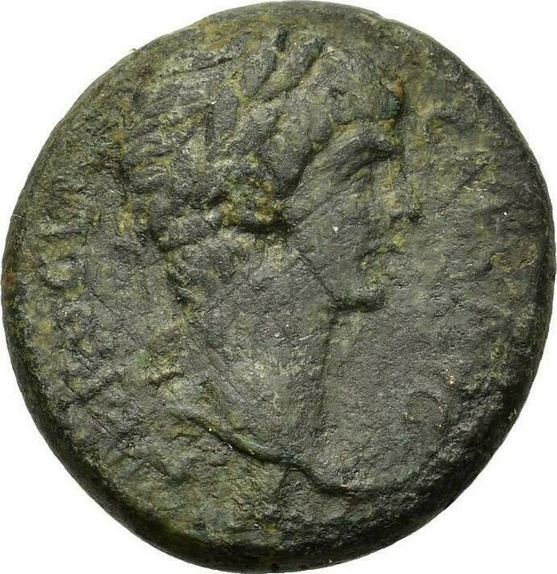
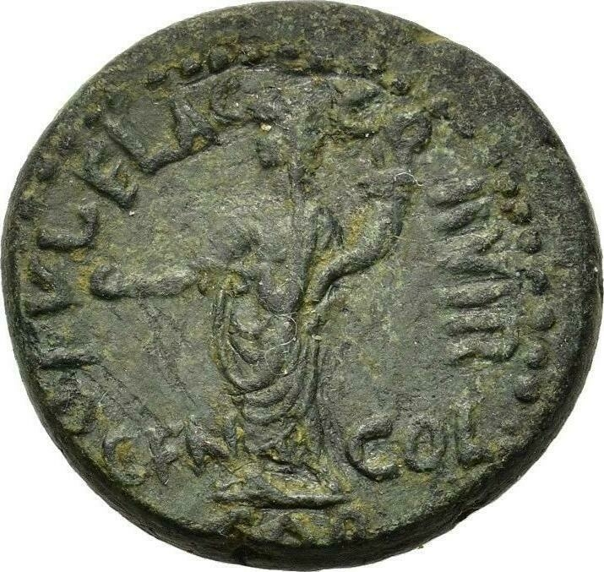
RPC I, 1889, AD 54-5, AE 20mm
Laureate head of Nero left, Nero Claud(ius) Caes(ar) Aug(ustus) /
Genius of the colony, standing left, holding patera and cornucopia, M(arco) Aci(lio) Candido IIvir(o) Cor(inthi) Gen(io) Col(oniae)
Notes:
with Marcus Acilius Candidus duovir, of Corinth, to the Genius of the colony
C 287

Slide 28
Further Reading
Amandry, M. (2012). ‘The coinage of the Roman provinces through Hadrian’, in W.E. Metalf, ed., Oxford Handbook of Greek and Roman Coinage, Oxford, pp. 391-404
Burnett, A. (2011). "The Augustan Revolution Seen from the Mints of the Provinces." Journal of Roman Studies 101: 1-30.
Elkins, N. (2015). Monuments in Miniature. Architecture on Roman Coinage. New York, American Numismatic Society.
Harl, K. W. (1987). Civic Coins and Civic Politics in the Roman East AD 180-275. Berkeley.
(2005). Coinage and Identity in the Roman Provinces. eds. C. Howgego, V. Heuchert and A. Burnett. Oxford, Oxford University Press.
Kraft, K. (1972). Das System der kaiserzeitlichen Münzprägung in Kleinasien. Berlin.
Kroll, J. (1993). The Athenian Agora XXVI: The Greek Coins. Princeton, American School of Classical Studies at Athens.
Kroll, J. (1997). "Traditionalism vs Romanization in bronze coinages of Greece, 42-31 B.C." Topoi: Orient Occident 7: 123-136.
Kroll, J. (1997). Coinage as an index of romanization. The Romanization of Athens. eds. M. C. Hoff and S. I. Rotroff. Oxford, Oxbow: 135-150.
Milne, J. G. (1971). Catalogue of Alexandrian Coins. Oxford.
Watson, G. (2017). ‘Die-sharing and pseudo autonomous coinages’, Numismatic Chronicle 177, pp. 201-211
Watson, G., (2020). Connections, Communities and Coinage: The System of Coin Production in Southern Asia Minor. New York.

