Slide 1
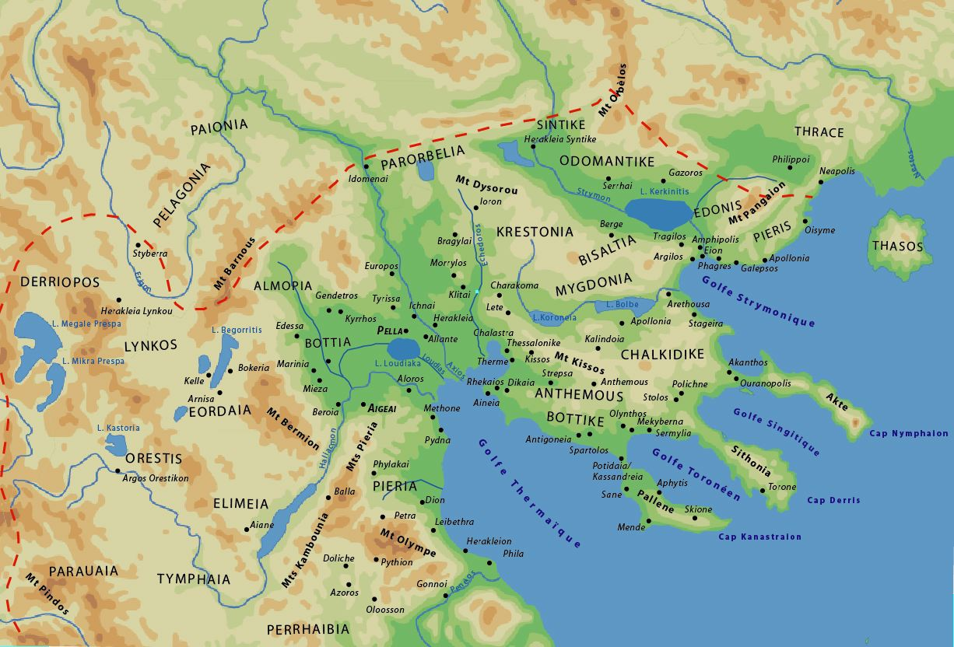

Slide 2
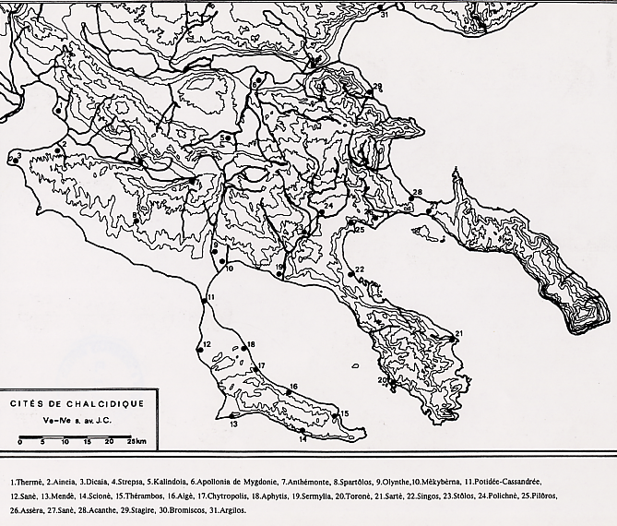

Slide 3
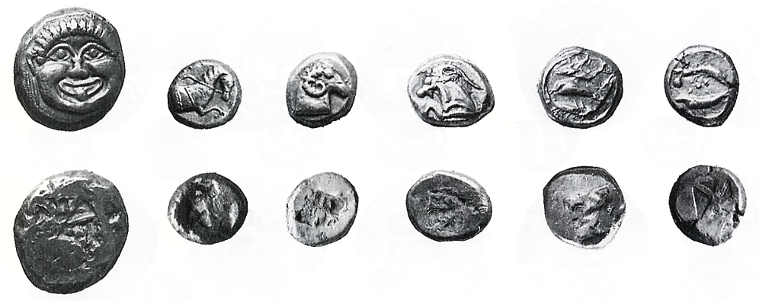
Notes:
Coin Hoard VIII, H. 37, nos 1-6

Slide 4
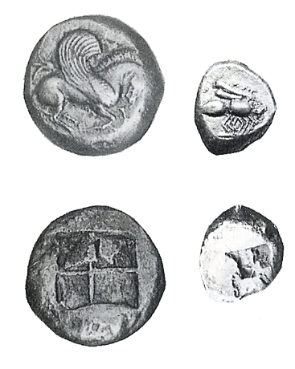

Slide 5
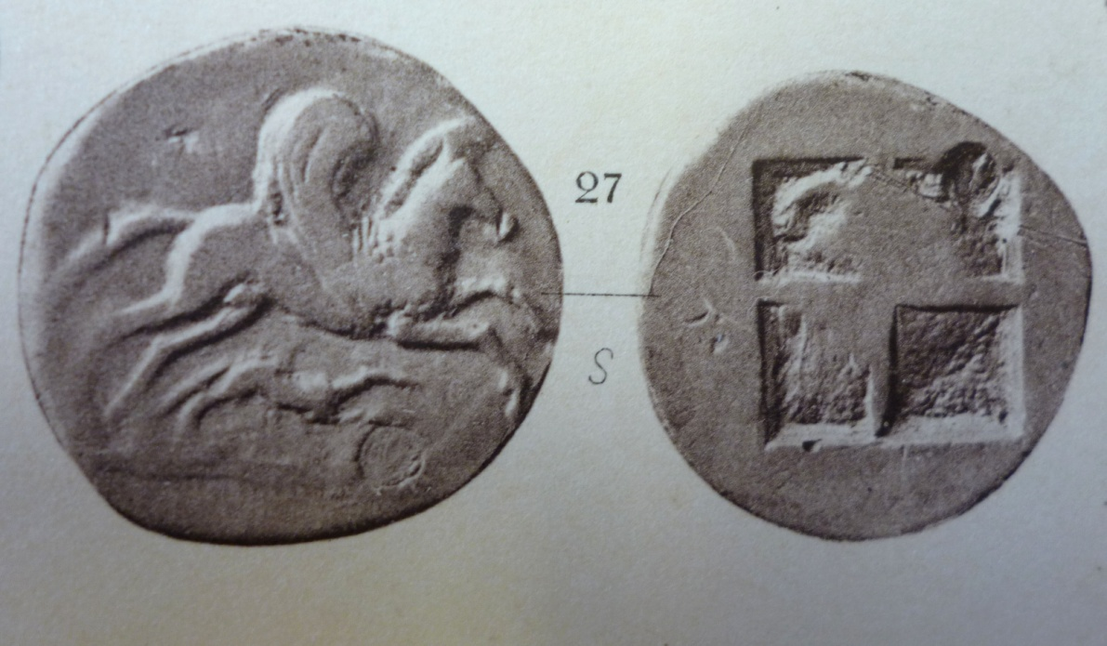
Argilos, stater on the Attic std?

Slide 6
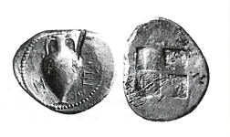

Slide 7
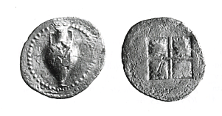

Slide 8
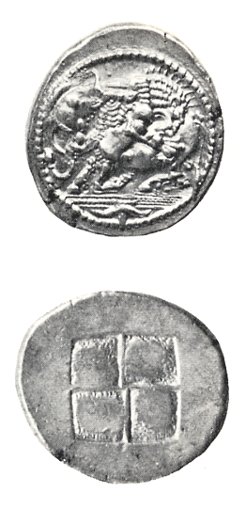

Slide 9
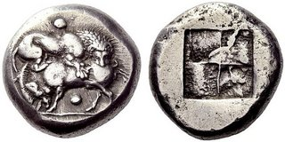
Stageira

Slide 10
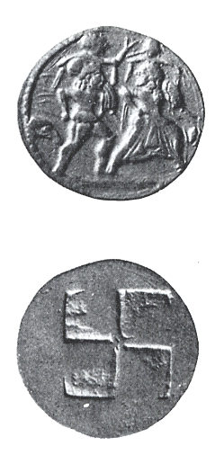
Notes:
Price and Waggoner, Archaic Greek Silver Coinage. The “Asyut Hoard”, no. 194

Slide 11
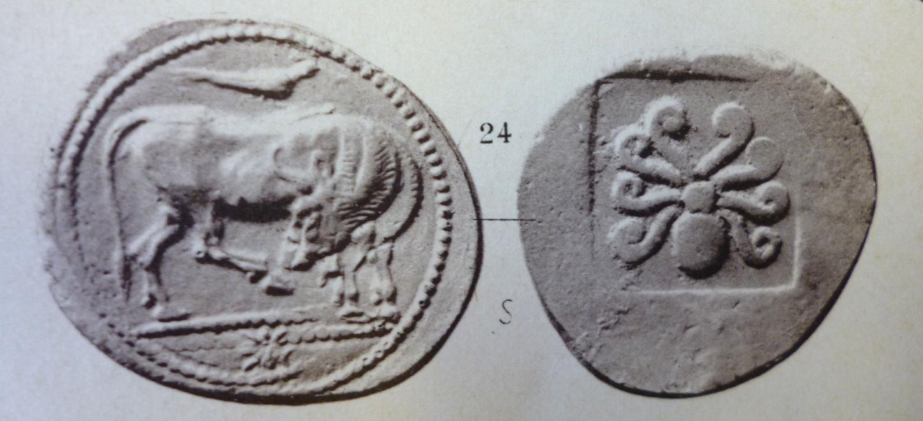
Dikaia, silver stater

Slide 12
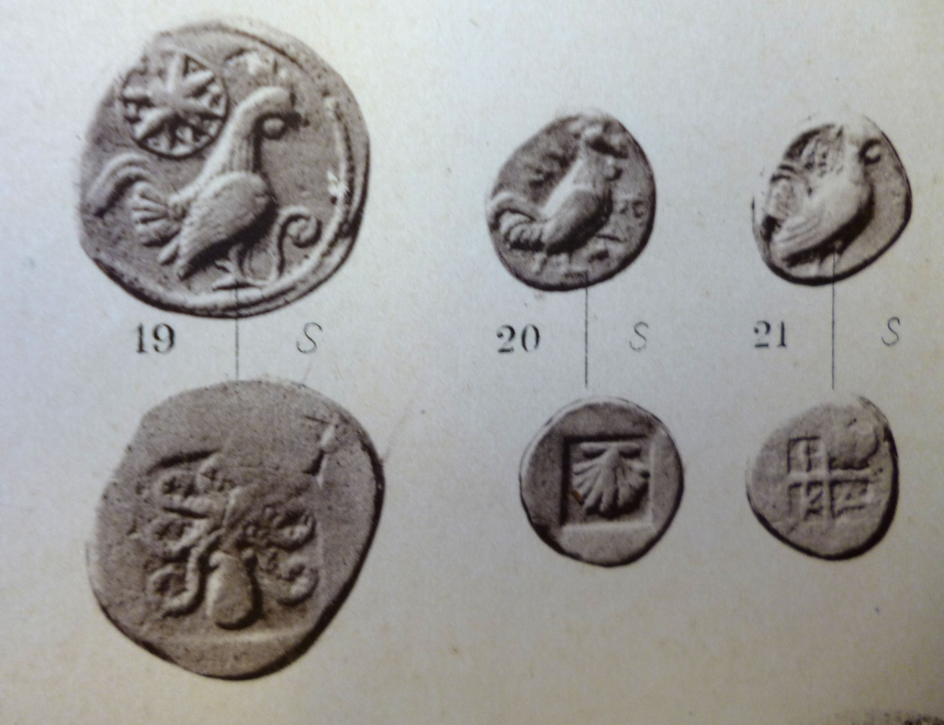
Dikaia, small fractions

Slide 13
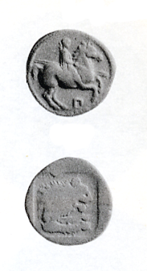
Notes:
Βιβλιογραφία: C.M. Kraay, Archaic and Classical Greek Coins, London 1976, no. 502

Slide 14
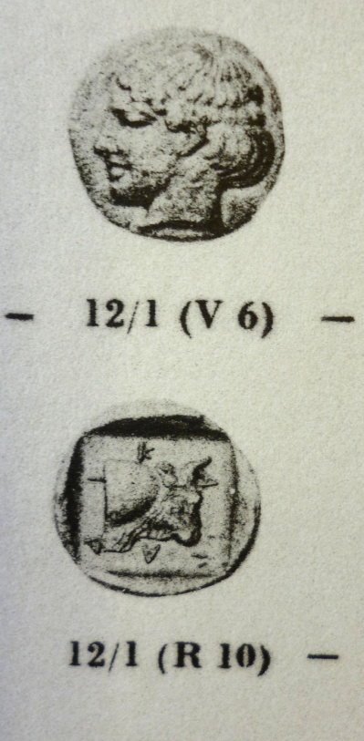
Dikaia, silver on the new std

Slide 15
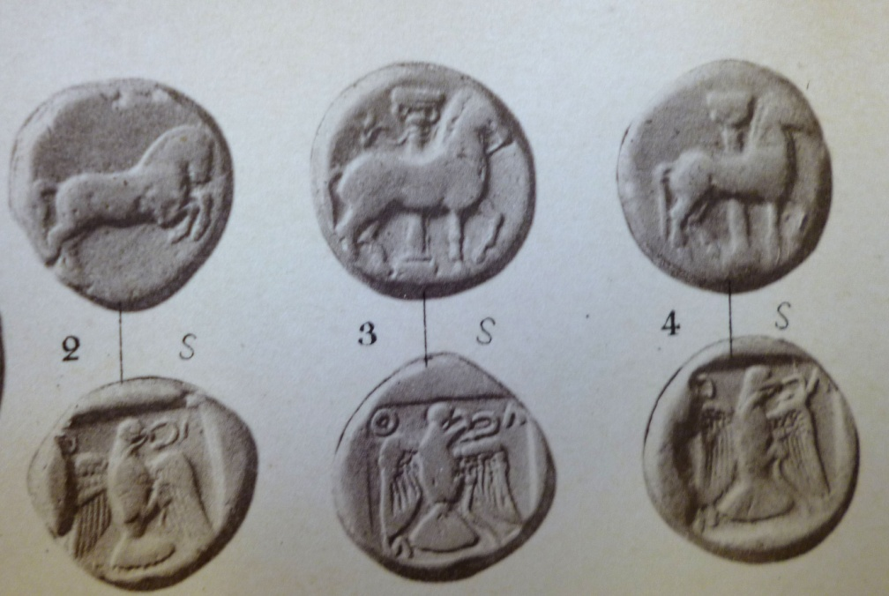
Olynthos, the earliest silver

Slide 16
Aristot. Fragmenta varia 1.15.98 (apud Plutarch. Erot. 17)
You know, of course, the story of Cleomachus of Pharsalia and the reason for his death in battle”.
“No, we don’t,” said Pemptidas and his party. “But we should be glad to hear it told.”
“It’s worth hearing” said my father. “Cleomachus came to help the Chalcidians when the Lelantine War against the Eretrians was at its height. The Chalcidian infantry was thought to have considerable strength, but they found it difficult to resist the enemy cavalry. Accordingly his allies requested Cleomachus, a man of splendid courage, to be the first to charge the horse. His beloved was there and Cleomachus asked him if he was going to witness the battle. The youth said that he was, embraced Cleomachus tenderly, and put on his helmet for him. Filled with ardour, Cleomachus assembled the bravest of the Thessalians about himself, made a fine charge, and fell upon the enemy with such vigour that their cavalry was thrown into confusion and was thoroughly routed. When subsequently their hoplites also fled, the Chalcidians had a decisive victory. It was, however, Cleomachus’bad fortune to be killed in the battle. The Chalcidians point out his tomb in the market-place with the great pillar standing on it to this day. Formerly they had frowned on paederastry, but now they accepted it and honoured it more than others did. Now Aristotle says that the circumstances of Cleomachus’death in victorious battle with the Eretrians were different and that the lover embraced by his friend was one of the Chalcidians from Thrace sent as an ally to the Chalcidians of Euboea. And this, he says, is the reason for the Chalcidian popular song:
Ye lads of grace and sprung from worthy stock,
Grudge not to brave men converse with your beauty:
In cities of Chalcis, Love, looser of limbs,
Thrives side by side with courage.”
(Translation by W. C. Helmbold, London and Cambridge, MA, 1961)

Slide 17
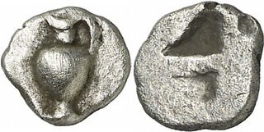
0.51 g

Slide 18
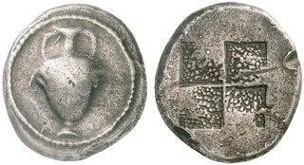
17.12 g

Slide 19
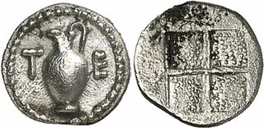
0.23 g

Slide 20
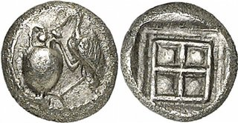
0.33 g

Slide 21
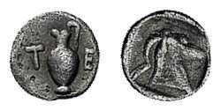
0.39 g

Slide 22
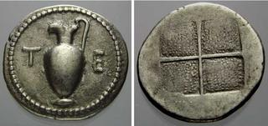
2.36 g

Slide 23
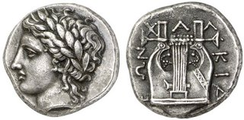

Slide 24
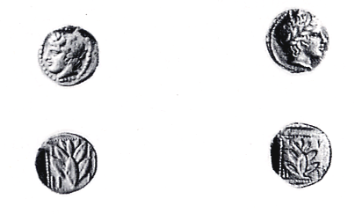
Notes:
Μνήμη M.J. Price, p. 103, nos 6471, 6474

Slide 25
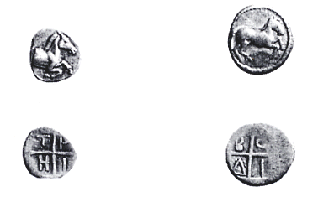

Slide 26
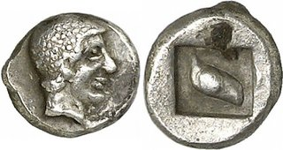

Slide 27
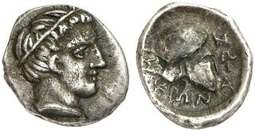

Slide 28
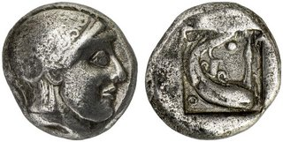

Slide 29
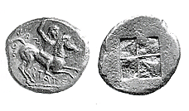

Slide 30
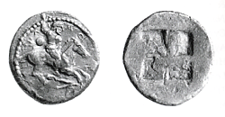

Slide 31
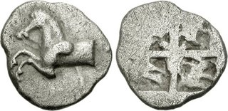
1.89 g

Slide 32
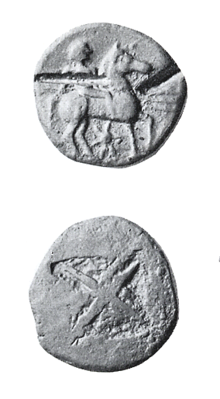

Slide 33
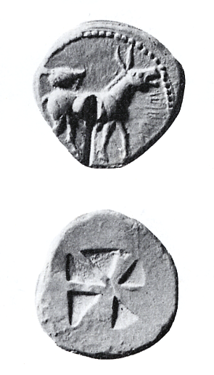

Slide 34
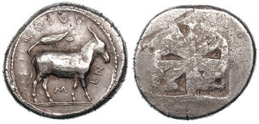
15.02 g

Slide 35
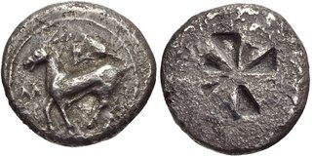
15.44 g

Slide 36
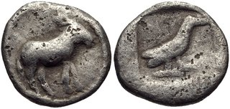
0.48 g

Slide 37
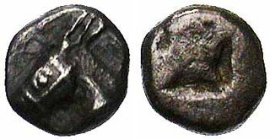
0.41 g

Slide 38
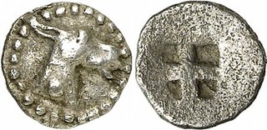
0.34 g

Slide 39
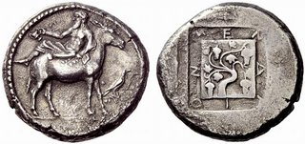

Slide 40
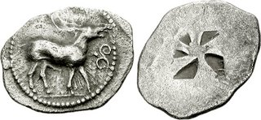
2.36 g

Slide 41

Notes:
SNG no. 373

Slide 42


Slide 43
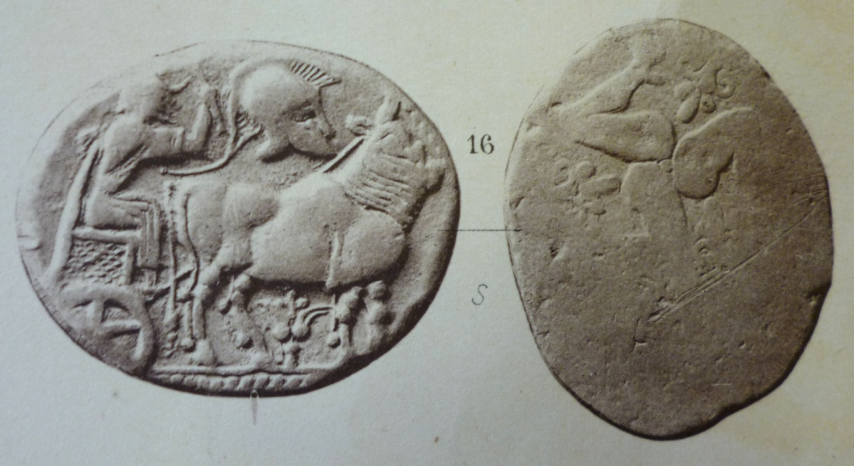
Derrones

Slide 44
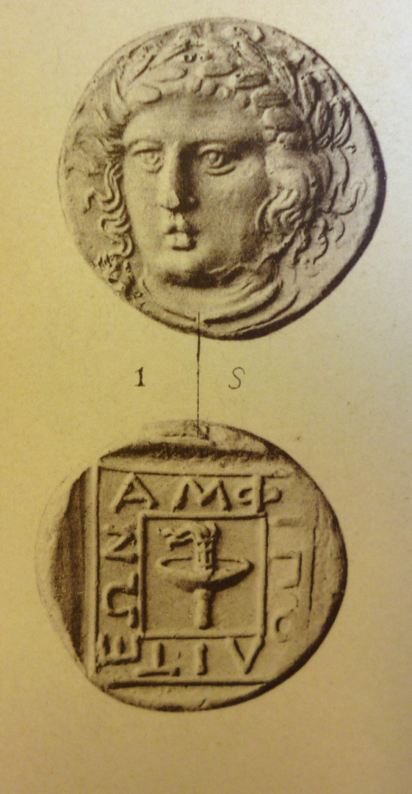
Amphipolis, stater

