Slide 1
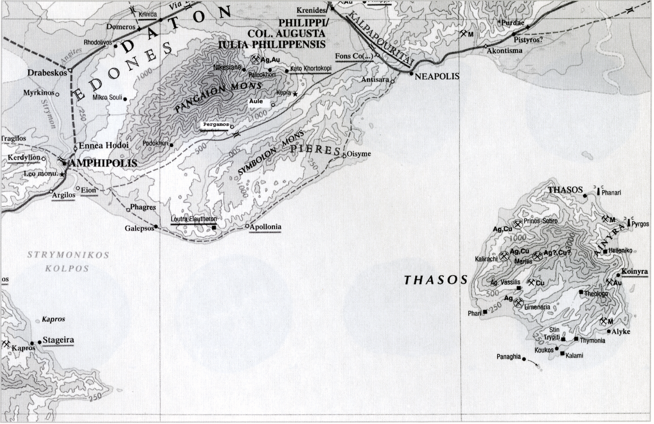

Slide 2
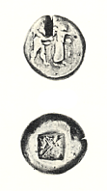

Slide 3
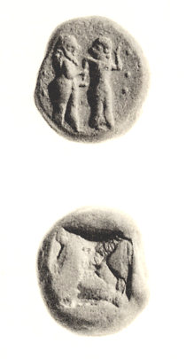

Slide 4
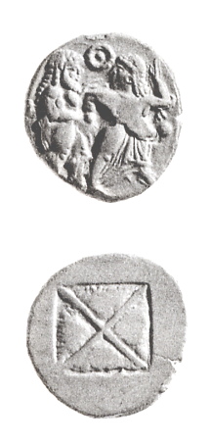
Notes:
Βιβλιογραφία: C.M. Kraay, Archaic and Classical Greek Coins, London 1976, no. 516

Slide 5
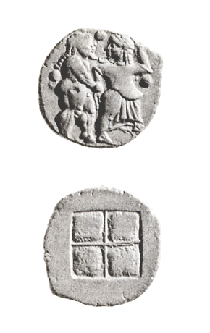
Notes:
Βιβλιογραφία: C.M. Kraay, Archaic and Classical Greek Coins, London 1976, no. 517

Slide 6
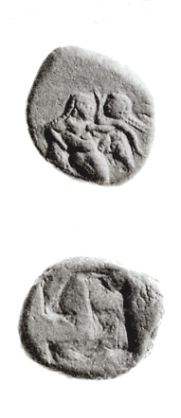
Notes:
Βιβλιογραφία: C.M. Kraay, Archaic and Classical Greek Coins, London 1976, no. 518

Slide 7
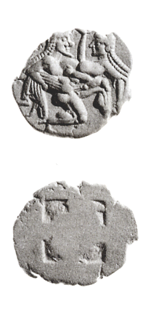
Notes:
Βιβλιογραφία: C.M. Kraay, Archaic and Classical Greek Coins, London 1976, no. 519

Slide 8
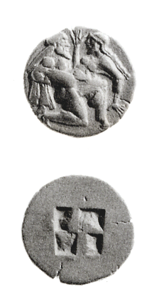
Notes:
Βιβλιογραφία: C.M. Kraay, Archaic and Classical Greek Coins, London 1976, no. 520

Slide 9
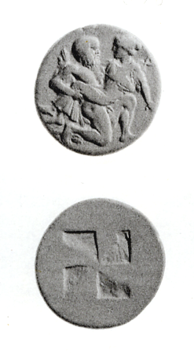
Notes:
Βιβλιογραφία: C.M. Kraay, Archaic and Classical Greek Coins, London 1976, no. 521

Slide 10
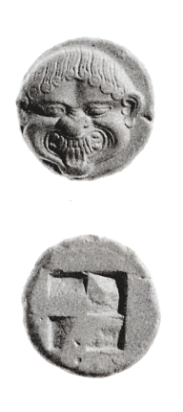
Notes:
Βιβλιογραφία: C.M. Kraay, Archaic and Classical Greek Coins, London 1976, no. 524

Slide 11
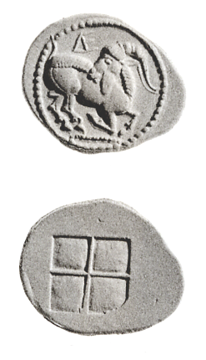
Notes:
Αιγές
Βιβλιογραφία: C.M. Kraay, Archaic and Classical Greek Coins, London 1976, no. 490

Slide 12
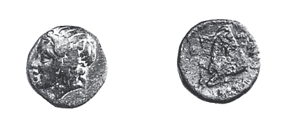

Slide 13
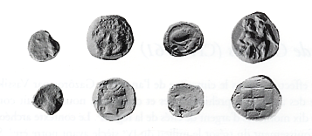

Slide 14
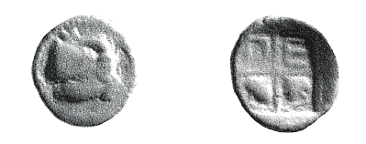

Slide 15
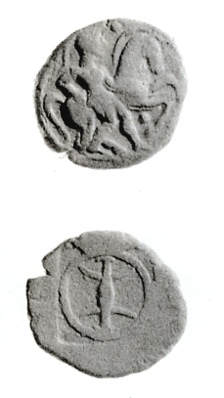
Notes:
Bisalti
Βιβλιογραφία: C.M. Kraay, Archaic and Classical Greek Coins, London 1976, no. 491

Slide 16
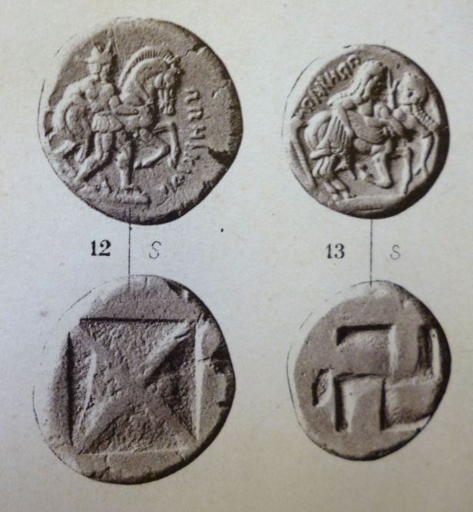
Orrescians, the two series of staters

Slide 17
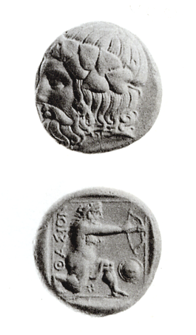
Notes:
Βιβλιογραφία: C.M. Kraay, Archaic and Classical Greek Coins, London 1976, no. 522

Slide 18
Notes:
BCH omada 2

Slide 19
