Slide 1
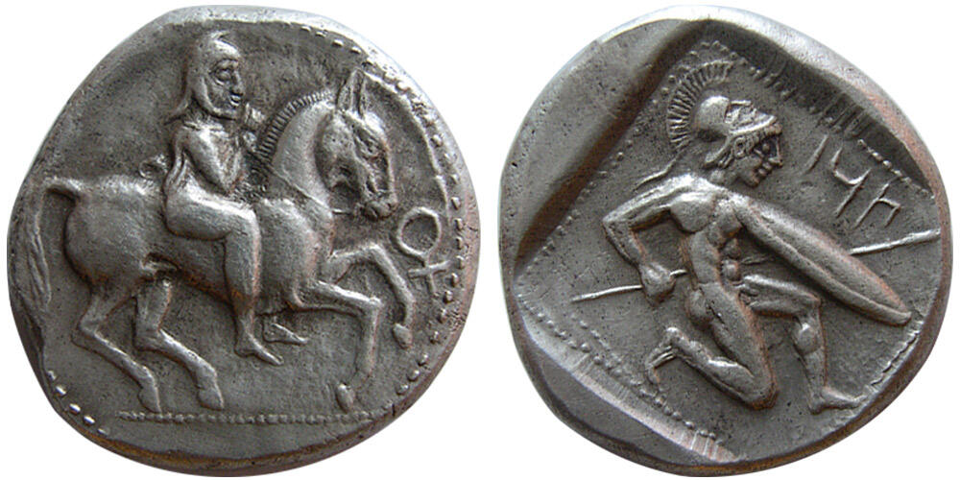
Why Strike Coinage?

Slide 2
Why go governments issue money? Why would governments of ancient Greece?
Notes:
Crawford 1970 – to make state payments

Slide 3
Strabo 15.3.21 (on the Persians)
Perhaps also the following, mentioned by Polycritus, is one of their customs. He says that in Susa each one of the kings built for himself on the acropolis a separate habitation, treasure-houses, and storage places for what tributes they each exacted, as memorials of his administration; and that they exacted silver from the people on the seaboard, and from the people in the interior such things as each country produced, so that they also received dyes, drugs, hair, or wool, or something else of the kind, and likewise cattle; and that the king who arranged the separate tributes was Dareius, called the Long-armed, and the most handsome of men, except for the length of his arms, for they reached even to his knees; and that most of the gold and silver is used in articles of equipment, but not much in money; and that they consider those metals as better adapted for presents and for depositing in storehouses; and that so much coined money as suffices their needs is enough; and that they coin only what money is commensurate with their expenditures.
Notes:
It is this quote thaty led Crawford to think its about state expenditure, but Howgego – why would they think tio comment and cast it as ‘other’ if this was also the common practice in the Roman world.

Slide 4
Why??? Scholarly development over time
Kraay 1964: facilitate state payments (internal/external trade, harbour dues, fines, hiring of mercenaries, building projects)
Crawford 1970: state payments (focused on Rome but said applied for ancient world as a whole)
Howgego 1990 responds to Crawford: expands to consider availability of bullion (windfalls need to be thought about differently), state payments (military expenditure, food for the populace, games/festivals, public building programmes, public pay, for use in foreign relations/enterprises), coinage/monetary reforms (retarrifing, closed currency systems), pride/new ruler, trade/economy (exchange, facilitate payment of taxes)
Since then: commemorate events (from 4th century BC, e.g. Olympic victories), anthropological approaches.
Notes:
Wealth/bullion p- e.g. Athens rich at Laurion and so had money to spare – decided to build ships, but its kind of a windfall situation. Also bullion coming from booty etc – wealth to spend.
Commemorate events – Melville Jones, Philip II of Macedon does seem to advertise his victory at the Olympic games.

Slide 5
Need to keep in mind:
wealth/bullion as a factor
Whether payments were made in new or existing coinage (or credit/bullion/other means)
Cultural context of different cities/peoples
Do the coins themselves actually tell us how they were used?
Many Greek cities never issued coins

Slide 6
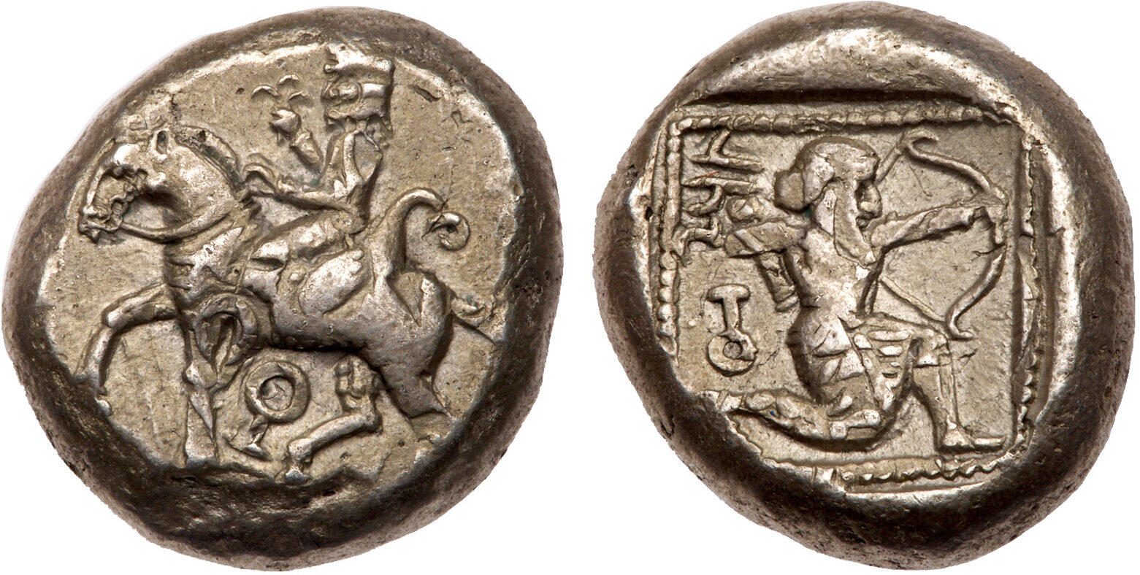
Tarsos, Cilicia, 420-410 BC
Obv: Horseman riding left, wearing kyrbasia, holding lotus flower, bow in bowcase on saddle; key symbol below horse.
Rev: TRZ (Aramaic), Archer in kneeling-running stance right, quiver over shoulder, drawing bow; key symbol behind; all within dotted border within incuse square.
Casabonne Type D2, pl. 2, 10
Tarsos, Cilicia, 410-385 BC
Obv: Persian satrap on horseback to right, wearing kyrbasia; 'key' symbol before
Rev: Hoplite kneeling to right, holding shield and spear; Aramaic script 'TRW' (= Tarsos) above, all within dotted border within incuse square.
SNG BN 219f
Notes:
Down to 4th century BC – showed Persian soldiers – whose pay it was we think. Local dynasts striking coins.
From 4th century BC – Greek hoplites shown – who served with the Persians after the Peloponnesian War.

Slide 7
(Pseudo-)Aristotle, Oeconomica II, 1349b (on the tyrant Dionysius of Syracuse)
On another occasion he had borrowed money from the citizens, promising to repay it. On their demanding its return, he bade each bring him, under pain of death, whatever silver he possessed. This silver when brought he coined into drachmae each bearing the face value of two: with these he repaid the <previous> debt and also what had just been brought in.
Notes:
Coinage reform – to make money.

Slide 8
Strabo 8.6.16 (Aegina)
“Ephorus says that silver was first coined in Aegina, by Pheidon; for the island, he adds, became a merchant-centre, since, on account of the poverty of the soil, the people employed themselves at sea as merchants, and hence, he adds, petty wares were called “Aeginetan merchandise.”

Slide 9
Demosthenes 24, 213-214 (Solon)
We are told that, after stating his other charges, he observed that in all, or nearly all, states there is a law that the penalty for any man who debases the currency is death. He proceeded to ask the jury whether they thought that a just and good law; and when the jury replied that they did, he said that in his opinion money had been invented by private persons for private transactions, but laws were the currency a of the State; and therefore if a man debased that currency, and introduced counterfeit, the jury had graver reason to abhor and punish that man than one who debased the currency of private citizens. By way of proof that it is a more heinous crime to debase laws than silver coinage, he added that many states that use without concealment silver alloyed with copper and lead are safe and sound and suffer no harm thereby; but that no nation that uses bad laws or permits the debasement of existing laws has ever escaped the consequence. Now that is the accusation to which Timocrates stands open to-day, and he may justly receive from you the punishment that is adequate to his guilt.
Notes:
Not about teruth of what happened in the beginning, but, based on the author’s knowledge of coinage in their own day, ideas that must have seemed reasonable to them.

Slide 10
Plato, Republic ii, 371 b
“Now what about this? In the state itself, how will they share with each other the produce they are each working at? Which is after all the reason we made a community and built a state.”
“Obviously by buying and selling,” he said.
“So we shall have a market place, and coinage as a token of exchange resulting from this?” (Ἀγορὰ δὴ ἡμῖν καὶ νόμισμα σύμβολον τῆς ἀλλαγῆς ἕνεκα γενήσεται ἐκ τούτου.)
“Certainly.”

Slide 11
Aristotle, Nicomachean Ethics V, v, 10-16 (1133a-b) (John-Melville Jones 11)
All things which can be exchanged need to be compared. For this purpose coinage has come into being, and is a medium, as it were. It measures everything, including the relative superiority and inferiority of things, such as the number of shows that are equal to a house or to a certain amount of food. In this case the relationship between a builder and a shoemaker is expressed by the relationship between the shoes and the house (or the food). If this is not so, there will be no exchange or relationship; and it will not be so, unless they are equated in some way. So as was said previously, everything must be measured by a single standard. This is in fact need, which holds everything together. If mankind needed nothing, or had different needs, there would either be no exchange, or a different kind; but in fact money exists by agreement, as an exchangeable form of need. This is the reason for us calling it nomisma, because it does not exist naturally but through custom (nomos), and it is in our power to change it or make it useless.

Slide 12
Aristotle, Politics I, iii, 12-17 (1257a-b) (Melville-Jones 13)
So, for the purpose of exchange, they agreed to give and receive from one another the sort of thing that was in itself useful and was also easy to handle for the requirements of life, such as iron and silver and other similar things, defined at first simply by size and weight, but finally by placing a stamp on them to save them from having to be measured; for the stamp was put there as a sign of value.

Slide 13
P. Cairo Zen. 59.021 = Austin no. 238 (c. 24 October 258 BC)
Demetrius to Apollonius, greetings. It is well if you are in good health and everything is as you wish. As for me, I am devoting myself to what you wrote me to do: / I have received 57,000 (drachmas?) of gold which I minted and returned. We would have received many times aas much, but as I have written to you before, the foreigners / who come here by sea, the merchants, the forwarding agents, and others, bring their fine local coins and the trichrysa, to get them back as new coins, in accordance with the ordinance which instructs / us to take and mint them….. As for the people in the city (Alexandria) they are all reluctant to use the worn / gold coins…..
Notes:
Trychsia – gold denomination of Pompey,

Slide 14
Decree of Sestos in Honour of Menas (OGIS 339 = Austin no. 215)
…. and when the people decided to use its own bronze coinage, so that the city’s coin type should be used as a current type / and the people should receive the profit resulting from this source of revenue, and appointed men who would safeguard this position of trust piously and justly, Menas was appointed and together with his colleague in office showed suitable care as a result of which the people thanks to the justice and emulation of these men has the use of its own coinage....
Notes:
Coinage – communicate prestige in the city, and make a profit.
City pride
Bronze coin = profit,
Piously – coins carried the heads of deities, so mint masters connected thus.

Slide 15
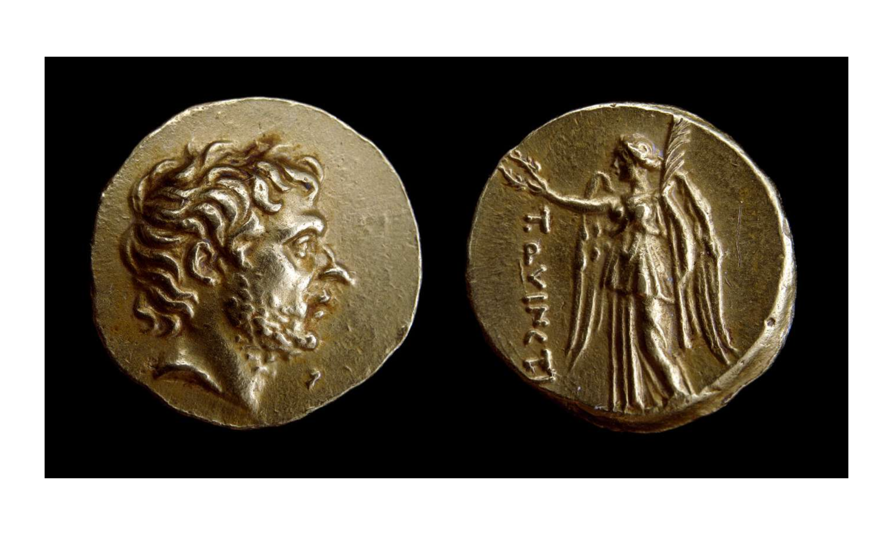
BM 1954,1009.1. Gold stater, 196 BC, struck in Greece. AV, 8.440g. RRC 548/1a
Notes:
This coin was probably issued in the wake of the victory of Cynoscephalae. It is modelled on the traditional gold coinage of Macedonia, initiated by Alexander the Great. From this is borrowed the image of Nike on the reverse. However in place of the name of Alexander, the name T. Quincti appears and, extraordinarily, in place of a head of the goddess Athena, a portrait of Flamininus is depicted on the obverse (front). This is the earliest coin portrait of a Roman.
Melville Jones – clearest example of commerative coinage in Greece.
Gold coin. (whole) (whole)Bearded head of T. Quinctius Flamininus right. (obverse) (obverse)Victory standing left, holding wreath in out-stretched hand right and palm-branch in left hand; on left, inscription. (reverse) (reverse)
So is it interqaction with the Romans that intensifies the situation/changes conceptualisations of money?

Slide 16
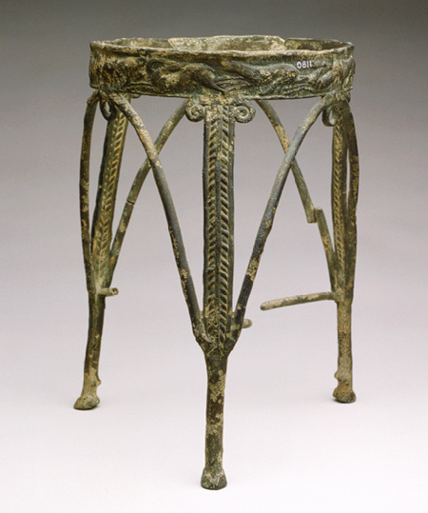
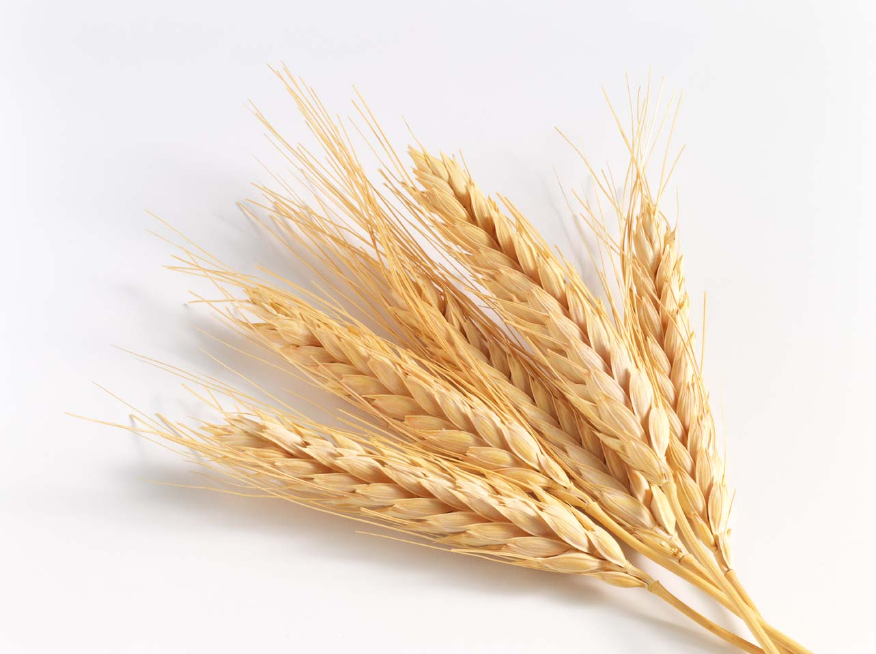
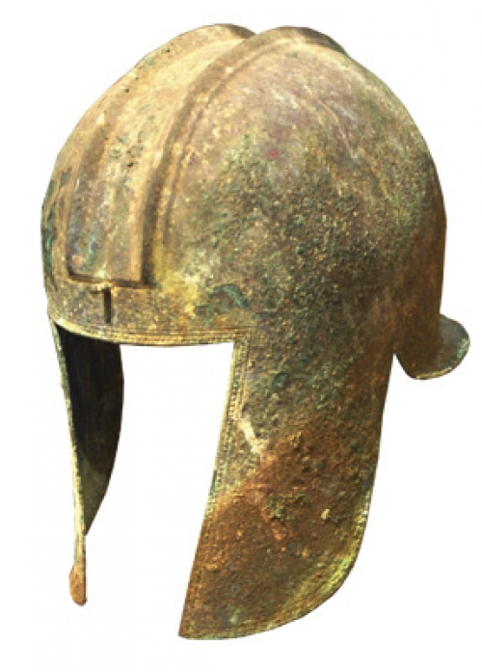
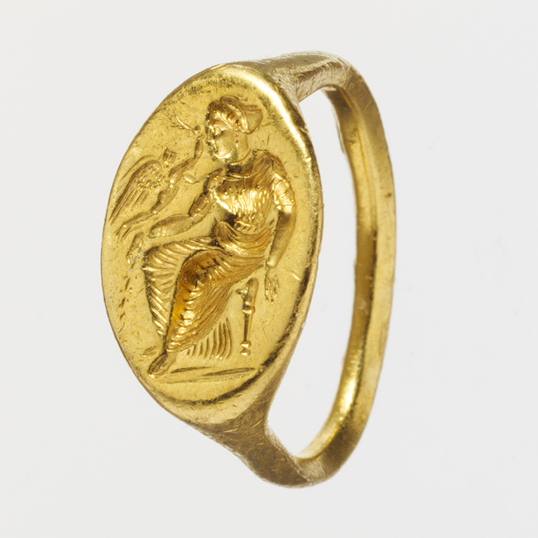
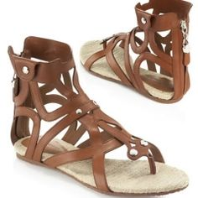
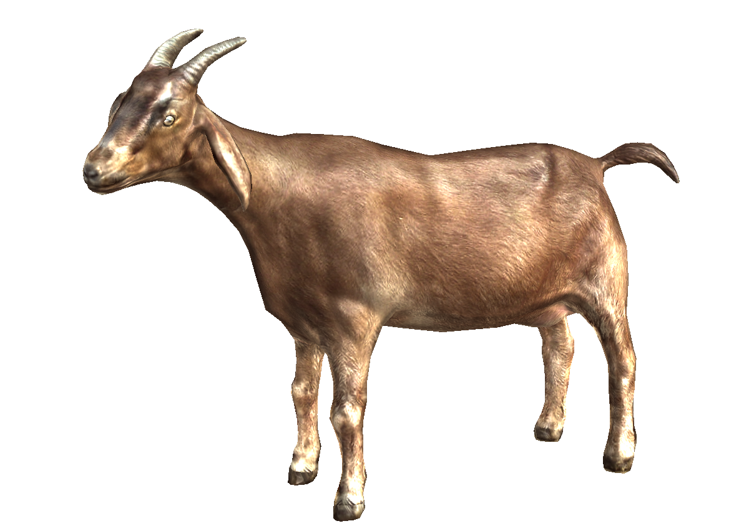
Notes:
Spheres of exchange

Slide 17
Anthropological approaches:
6th Century BC Athens
Spheres of exchange / transactional orders (Bloch and Parry, anthropological theory)
Movement from an elite gift exchange society (select items only available to the elite)
Coinage (everything now could be purchased)
Pre-Socratic Philosophy + tragedy (Seaford)
Democracy (language of metals)
      Gift Exchange + Hierarchy vs. coinage + polis
Invention of Greek tragedy (Seaford)
Silver an intentional choice as a reaction against elite ‘gold’
Notes:
Symbolic and abstract thought – Aristotle.
Money –prizes at festivals for individuals – hence development of tragedy and tragic representation of tyranny come out of the effects of monetization of Athenian ritual.
Aristocracy associated with gold in the language of metals.
Coinage is something to think with….

Slide 18
What does money/coinage DO?
Notes:
Point of translation / commensuration between language systems
Store of value / unit of account / offers items for purchase
An object in daily life that enables particular modes of thinking and society
Shapes identity and community

Slide 19
Beyond Greece: Early Rome
Bernard 2018: minting and use of coins in third century BC is primarily a social phenomenon.
Early coinage irregular and small in volume
Third century BC Rome – market production and maritime commerce created new types of impersonal wealth; individuals used this to access a political system previously monopolized by symbolic wealth and strong social ties.
Notes:
Coins sporadic – can’t have been a true fiscal motive
Rome building on a large scale and fighting wars before they made large amounts of coins.
Regardless of how coinage came to be used, what provoked the Romans to mint it in the first place?

Slide 20
Further Reading
Bernard, S. (2018). ‘The social history of early Roman coinage’, Journal of Roman Studies 108, pp. 1-26
Crawford, M.H. (1970) ‘Money and exchange in the Roman world’, Journal of Roman Studies 60: 40–48
Howgego, C. (1990) ‘Why did ancient states strike coins ?’ Numismatic Chronicle 150: 1-25
Kim, H. S. (2001). 'Archaic Coinage as Evidence for the Use of Money' in Money and its Uses in the Ancient Greek World. ed. A. Meadows and K. Shipton. Oxford, Oxford University Press: 7-21.
Kurke, L. (1999). Coins, Bodies, Games and Gold. The Politics of Meaning in Archaic Greece. Princeton.
Melville-Jones, J. (1993). Testimonia Numaria. Greek and Latin Texts concerning Ancient Greek Coinage. London.
Melville Jones, J.R. (2006) ‘Why did the Ancient Greeks strike coins?’, Journal of the Numismatic Association of Australia 17: 21–30
Seaford, R. (2004). Money and the Early Greek Mind. Cambridge

