Slide 1
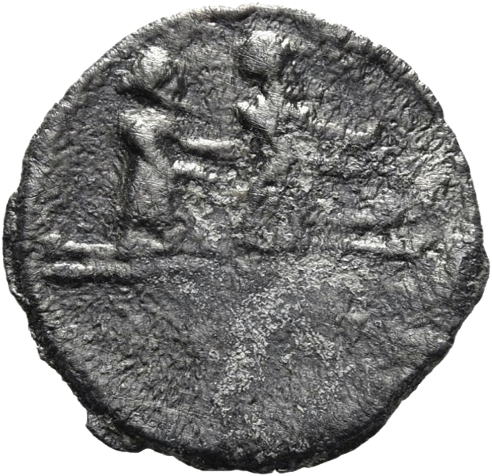

Enhancing and diversifying the curriculum using tokens
Clare Rowan
C.Rowan@warwick.ac.uk

Slide 2
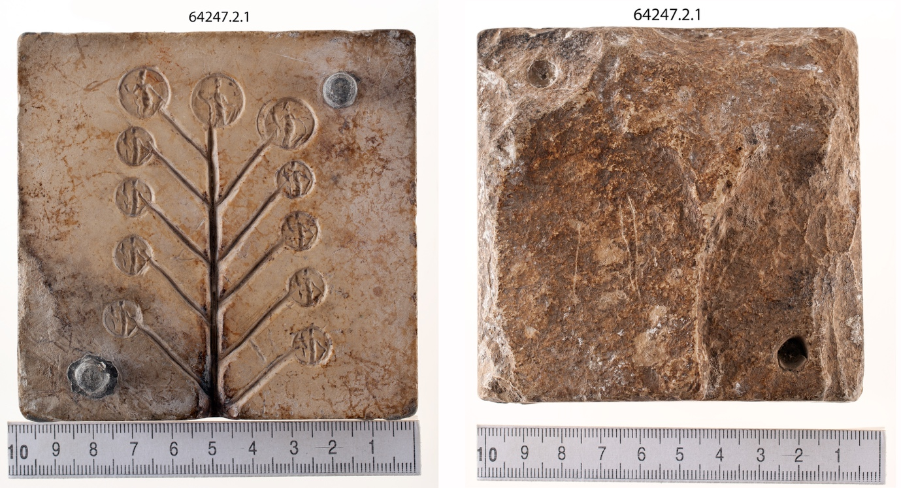
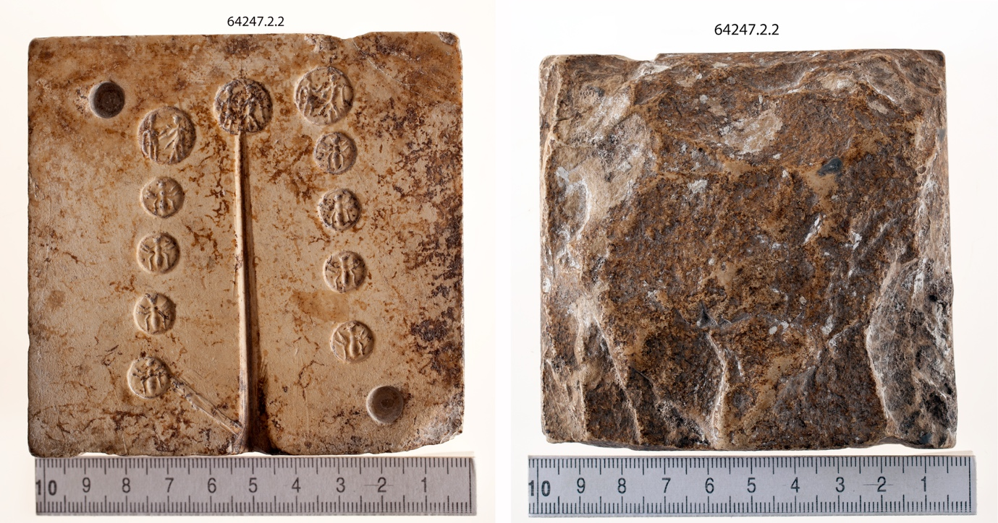
Tokens from Rome and Ostia (Rome’s harbour)
Made of bronze, brass and lead
Lead tokens cast from moulds
Made by a variety of groups and individuals from different economic and social levels
Used as vouchers, tickets and things to be exchanged for goods and services (euergetism, sponsored by an individual or group)

Slide 3
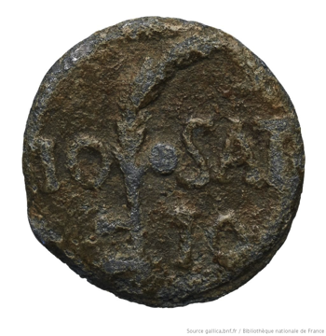
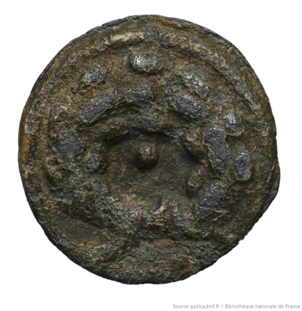
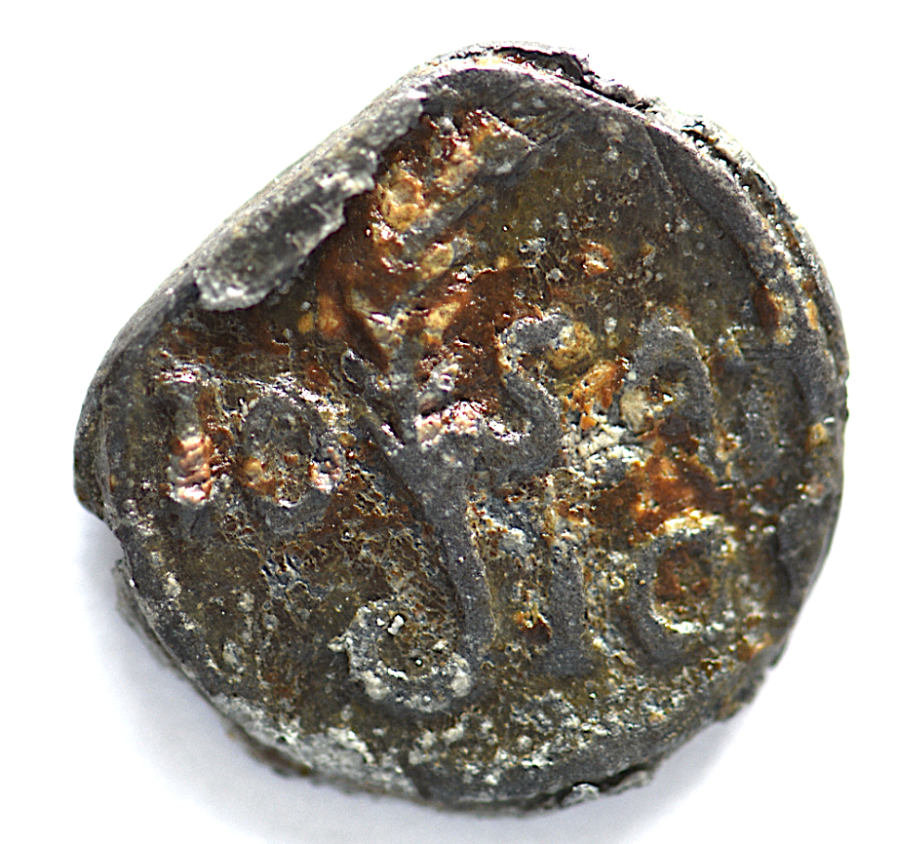
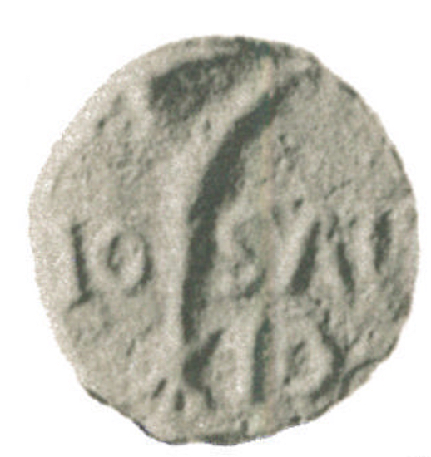
Io Saturnalia Io! The Saturnalia
Side a: Palm branch, IO SAT IO
Sibe b: wreath
Palm branch ends in upside down F (feliciter ?), a curve and a cross.

Slide 4
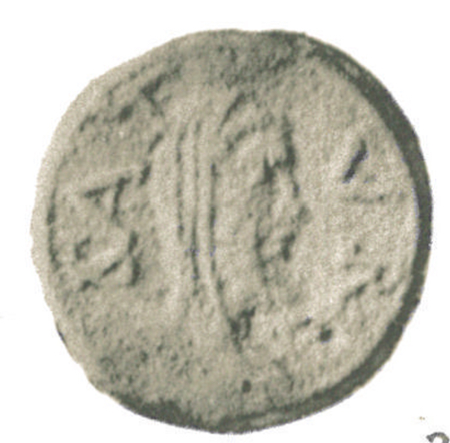
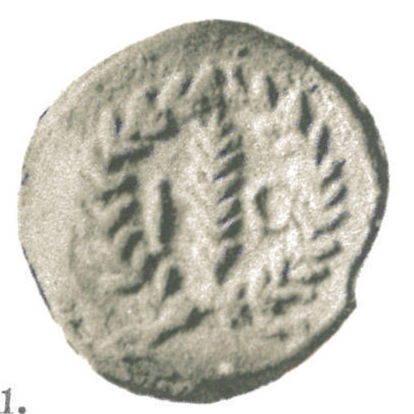
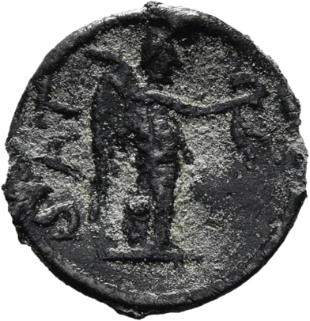
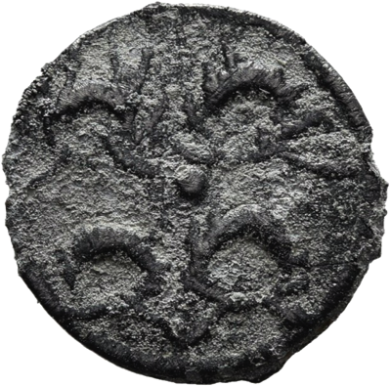
Side a: SAT VR - Bearded and veiled head of Saturn right. Legend to left and right.
Side b: IO - Palm branch with letter to left and to right; all within wreath.
Side a: Victory standing right with wreath in outstretched hand and palm branch over left shoulder; SAT in field left.
Side b: Four wreaths.

Slide 5
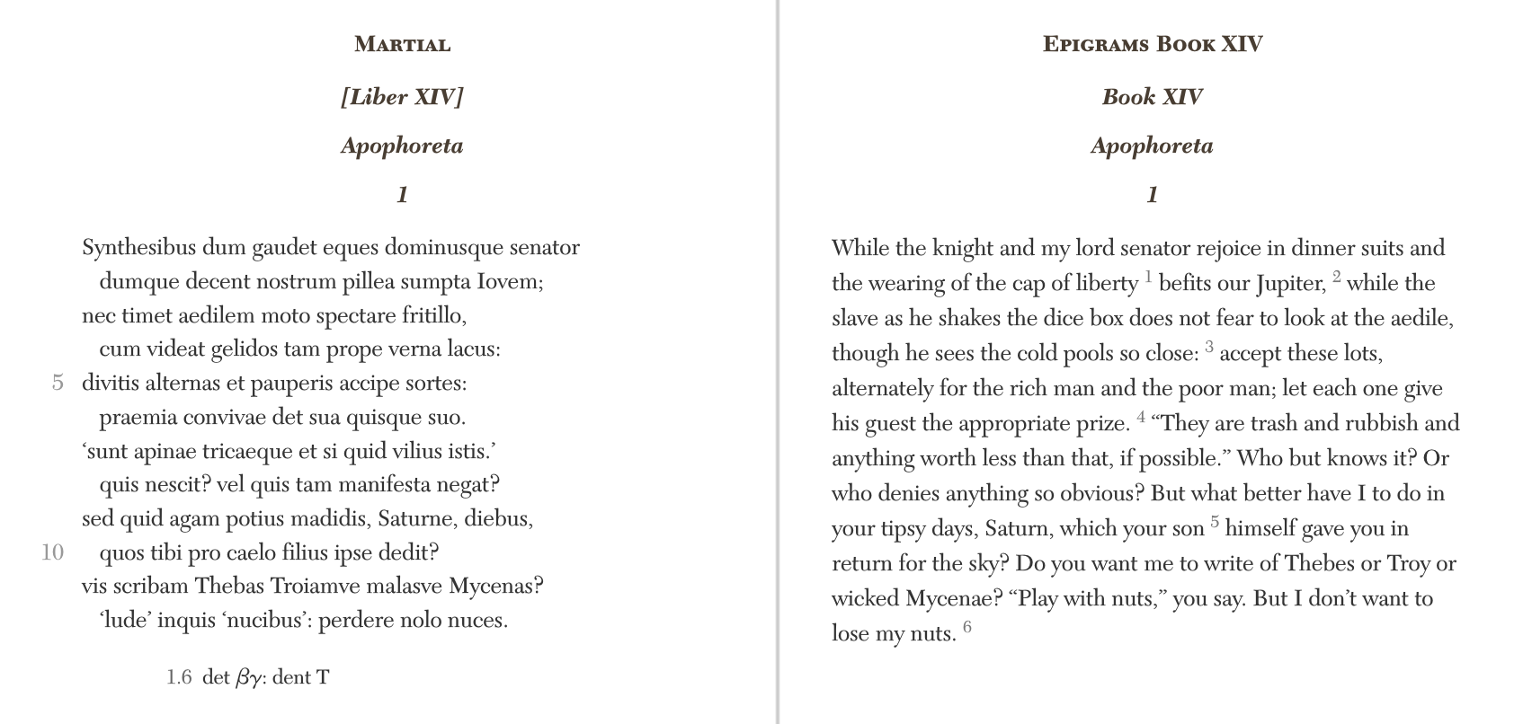
On the Saturnalia, and at any other time when he took it into his head, he would now give gifts of clothing or gold and silver; again coins of every device, including old pieces of the kings and foreign money; another time nothing but hair cloth, sponges, pokers and tongs, and other such things under misleading names of double meaning. (Suetonius, Augustus 75)
Notes:
Discuss Martial – first century AD, satire, focus on consumerism in Rome
nominally inscriptional tags for gifts to be given to dinner guests at a Saturnalia feast.
Issue of what to give whom. Uses the text to undermine/question what items are the most valuable.

Slide 6
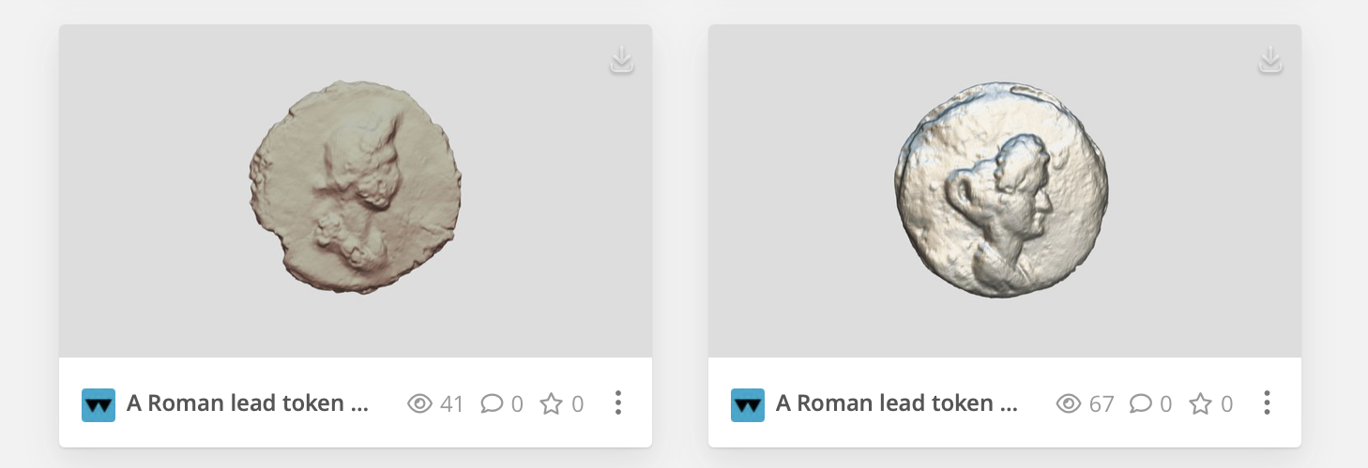
Women in the Ancient World
https://sketchfab.com/warwickclassics

Slide 7
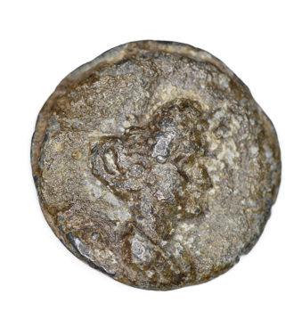
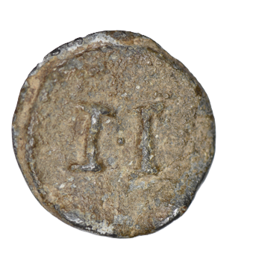
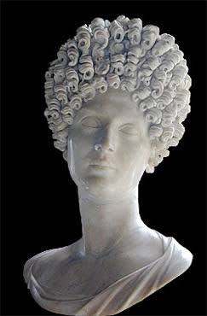
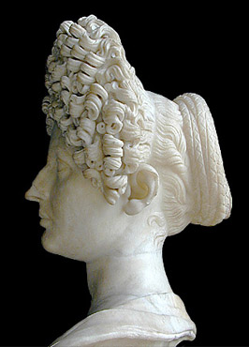
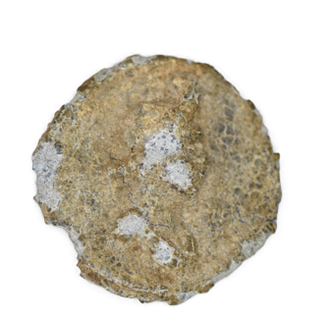
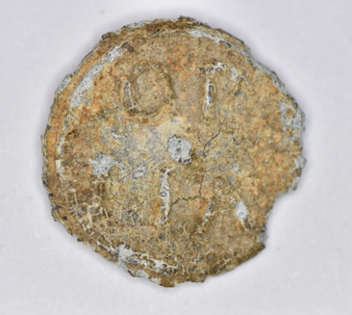
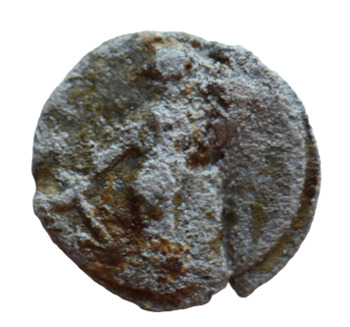
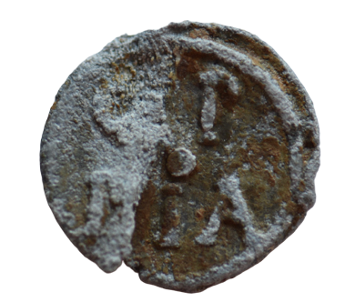
Side a: Female bust right (with Flavian hairstyle) (Julia Titi, daughter of Titus, or a ’private’ woman
Side b: II
Side a: Diademed female head right
Side b: OP|PIA.
Oppia also released a token series with her name (Oppia) and the goddess Fortuna

Slide 8
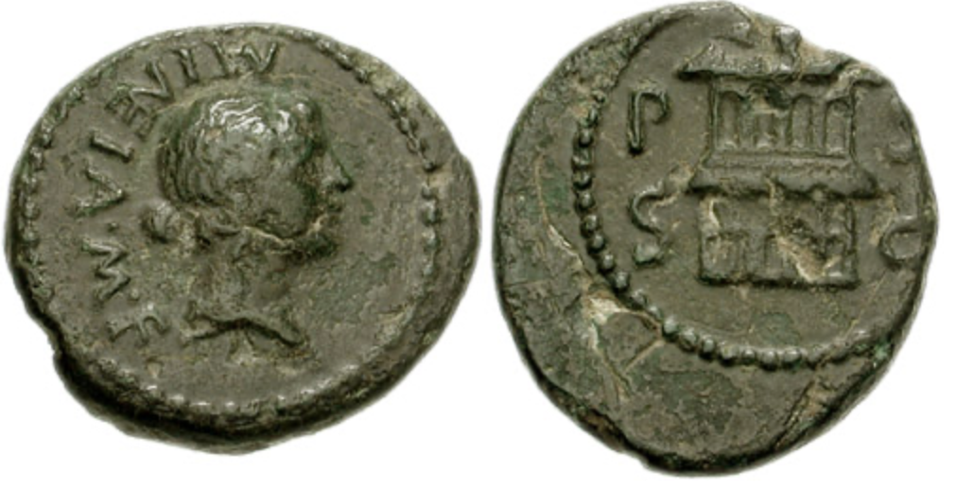
Mineia M.f. (Paestum, Italy)
Mineia daughter of Marcus, wife of Gaius Cocceius Flaccus, mother of Gaius Cocceius Iustus, built the basilica from its foundations and the portico and all the pavings in front of the basilica with her own money.
Trans. Cooley
Bronze coin from the first century BC (c. 15 BC?) 18mm, 3.26g.
Obverse: Female head right, MINEIA M.F. (daughter of Marcus)
Reverse: Two storied building (basilica?) P S S C (‘semis of Paestum, in accordance with the decree of the Senate (of Paestum)’.

Slide 9
Terentia in Ostia
Installed a well head in one of the sanctuaries of the Bona Dea.
also
An inscribed architrave:
Terentia, daughter of Aulus, wife of Cluvius, built the crypt and calchidicum on her own land at her own expense in accordance with a senatorial decree and decree of local councillors.
Notes:
Annex of a basilica

Slide 10
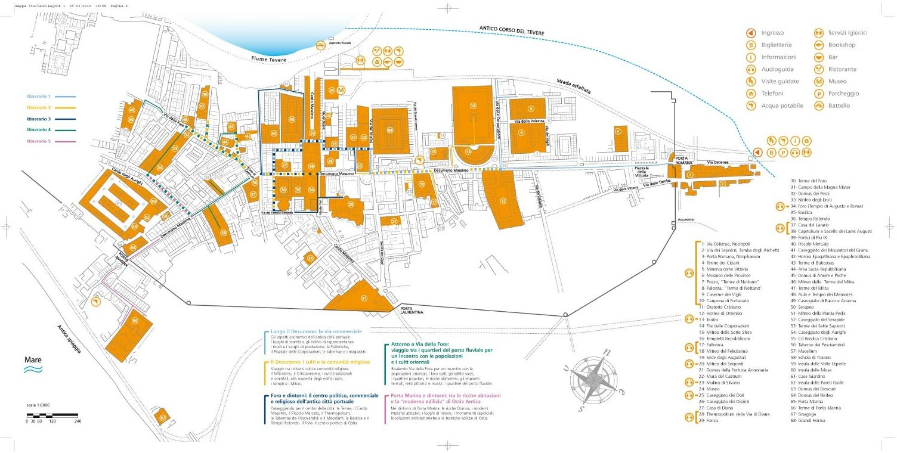
Baths of the Cisiarii

Slide 11
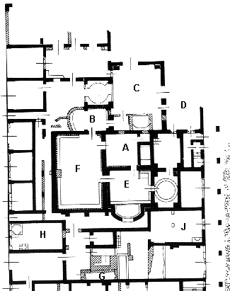
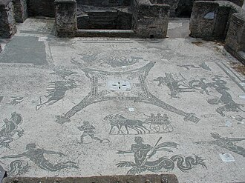
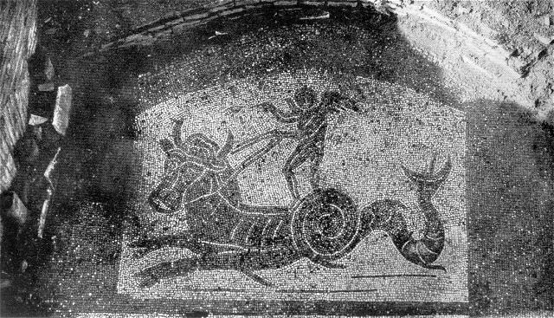

Slide 12
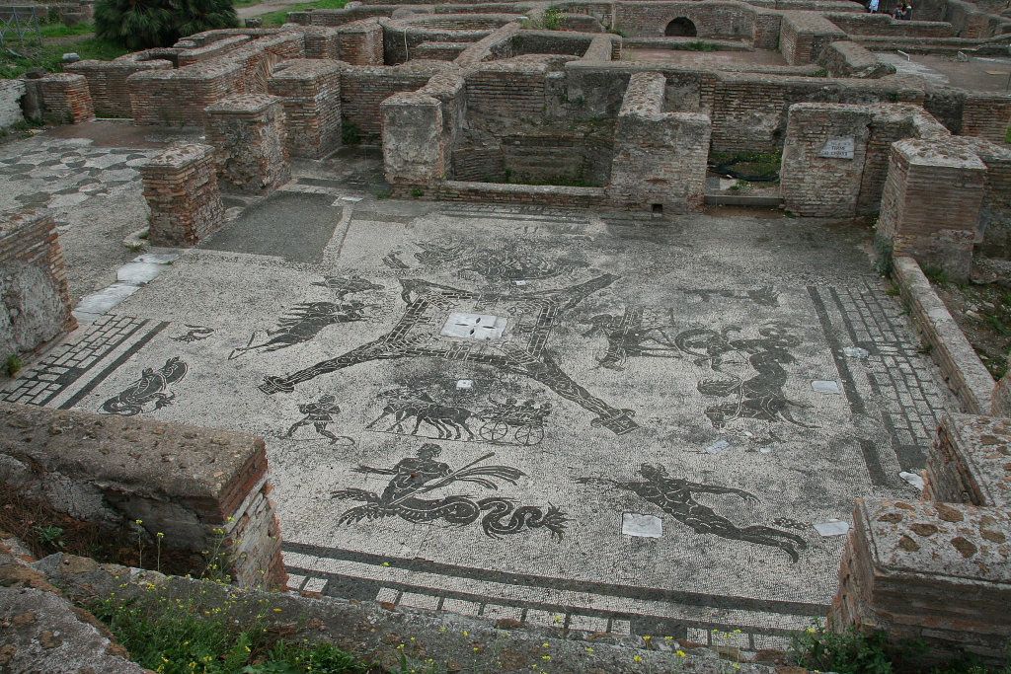
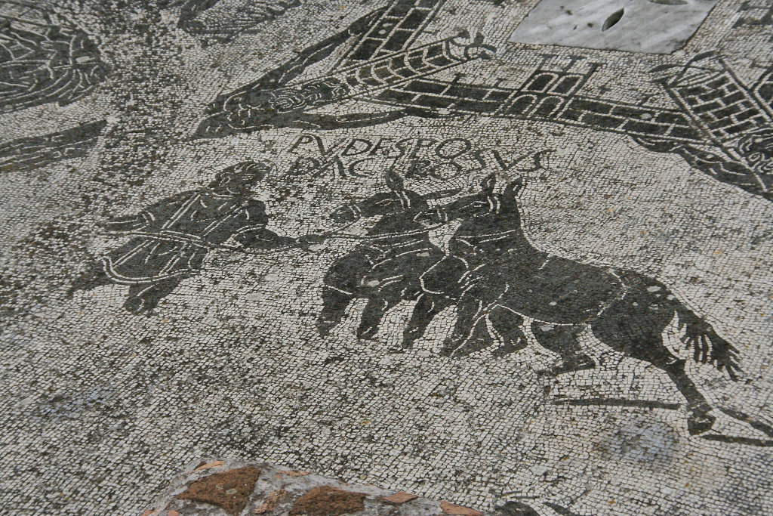
Notes:
Outer and inner walls – Rome and Ostia?
Names of the muleswe think sometimes given.
Pudes ("Modest"), Podagrosus ("Arthritic"),
Potiscus ("Thirsty"?), Barosus ("Silly"). Around the wagons are some marine figures.

Slide 13
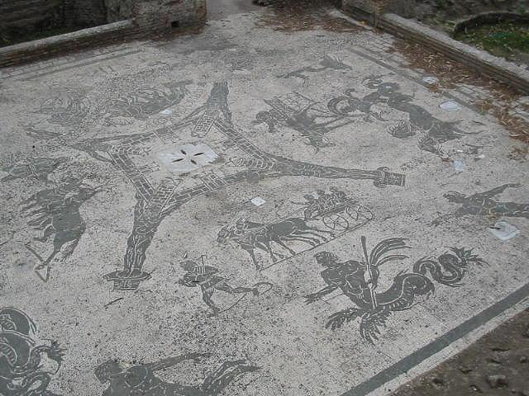
40 lead tokens found in the frigidarium
Spagnoli, E. (2017). ‘Un nucleo di piombi 'monetiformi' da Ostia, Terme dei Cisiarii (II.II.3): problematiche interpretative e quadro di circolazione. Per un contributo di storia economica e di archeologia della produzione tra II e III secolo d.C’ AIIN 63: 179-234.
Notes:
Finds – hair pins etc – so used by a variety of individuals
Rooms H and J are bars.
2nd – 3rd century – built under Hadrian and modified in the third century AD

Slide 14
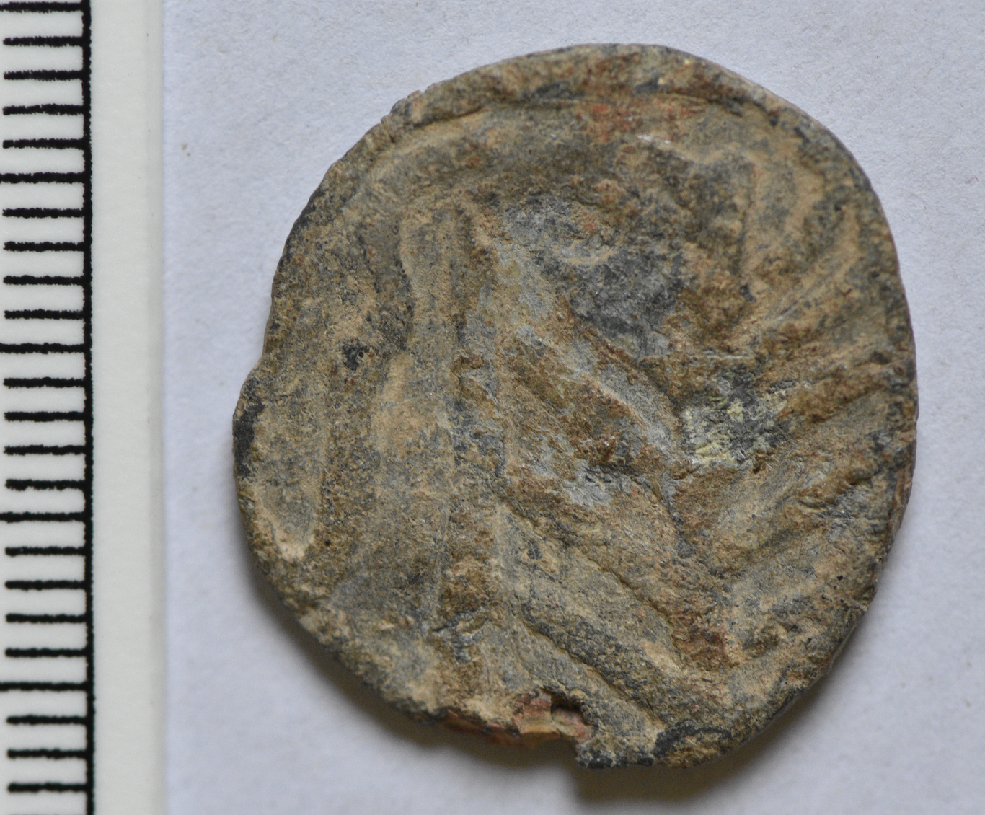
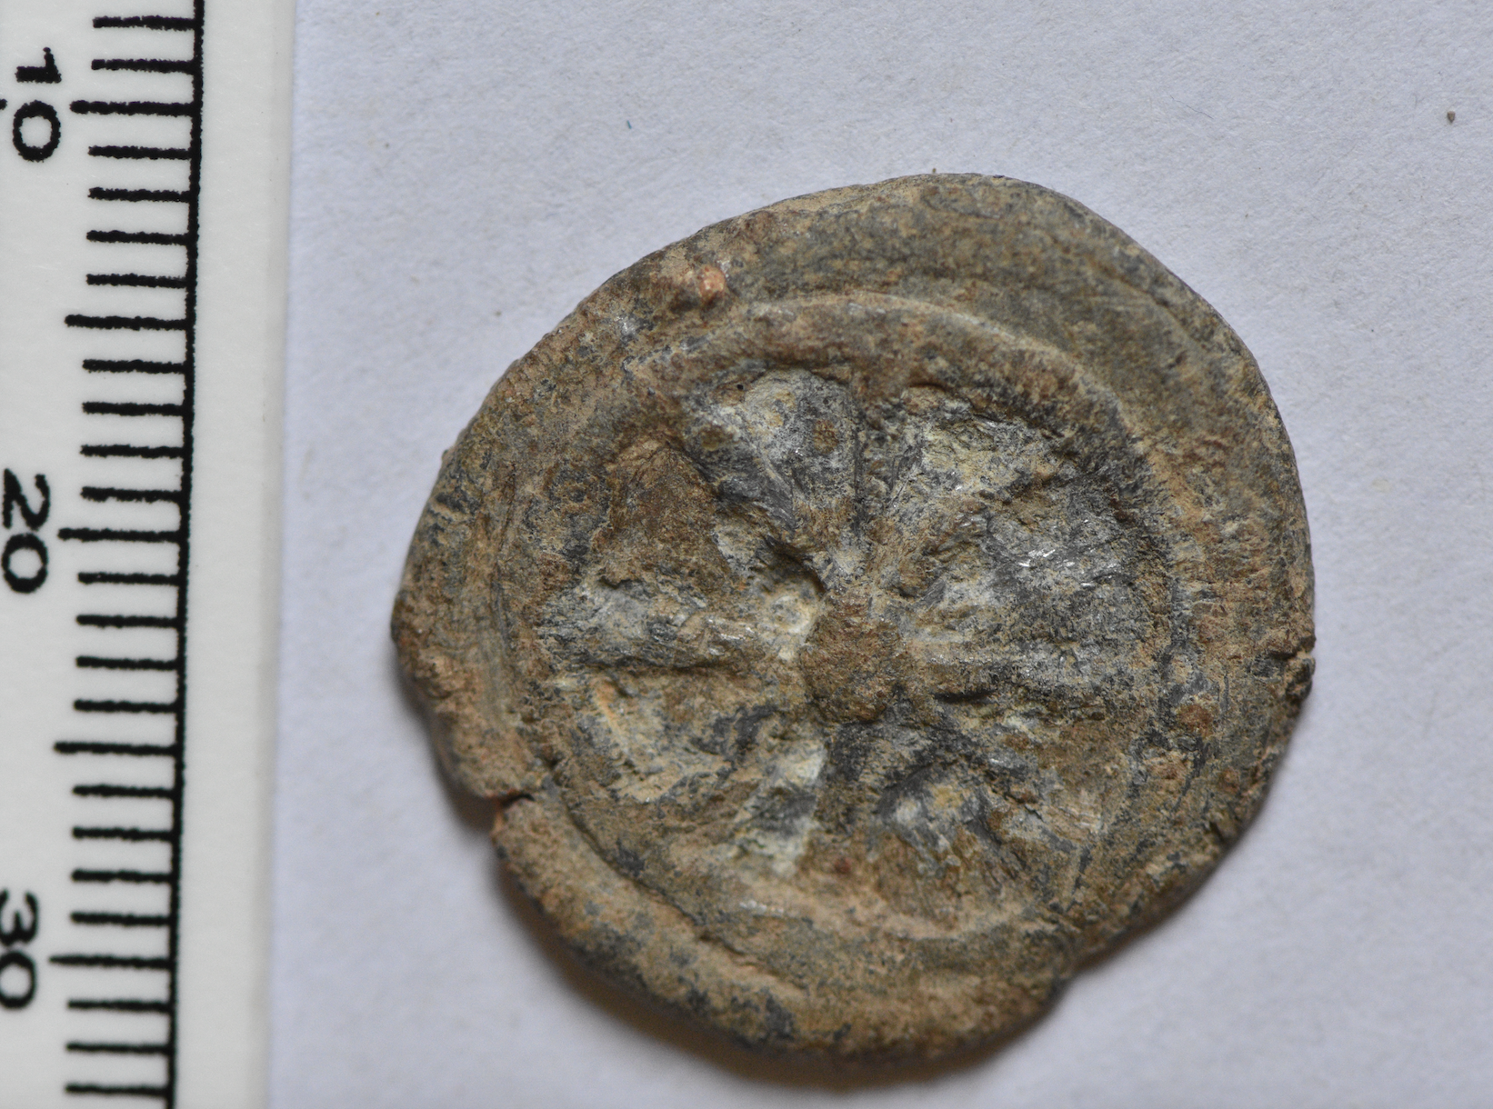
Amphora / Dolium (2 specimens)
EK / I (2 specimens)
EK / II
EC / I
Elephant standing r. / Fortuna standing l.
Fortuna (or Felicitas) seated l. w/ cornucopia / AF[.]
Figure / LCF
Wheel / Whip next to palm branch (3 specimens)
Anchor / HE[.] (7 specimens)
Anchor / palm branch (2 specimens)
Phallus / scales (2 specimens))
CI/SI / Amphora (2 specimens)
SC/V within wreath / blank (2 specimens)
Retrograde F / Retrograde S (4 specimens)
D / C (2 specimens)
Frontal head of calf / illegible
AC/MV / illegible image within wreath (2 specimens)
4 illegible
Notes:
Figure – Fortuna or Mercury

Slide 15
City Life: Games
The opening of the Colosseum (Cassius Dio 66.25.5)
These were the spectacles that were offered, and they continued for a hundred days; but Titus also furnished some things that were of practical use to the people. He would throw down into the theatre from aloft little wooden balls variously inscribed, one designating some article of food, another clothing, another a silver vessel or perhaps a gold one, or again horses, pack-animals, cattle or slaves. Those who seized them were to carry them to the dispensers of the bounty, from whom they would receive the article named.
Notes:
Patrons and clients

Slide 16
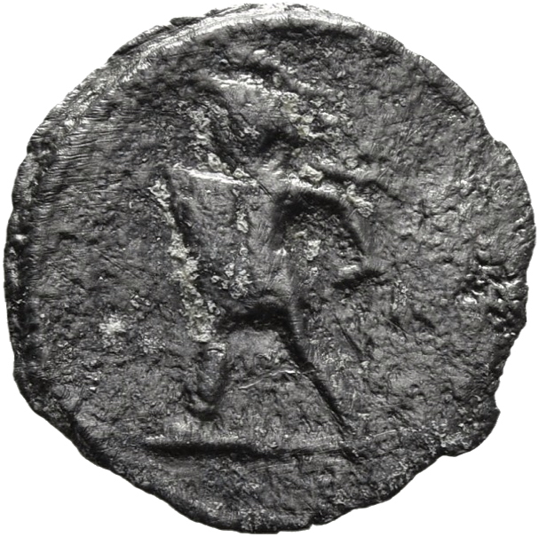
Suetonius, Nero 20.2-3 (claques)
At the same time, he chose young men of the equestrian order, and above five thousand robust young fellows from the common people, on purpose to learn various kinds of applause, called bombi, imbrices, and testae, which the were to practice in his favour, whenever he performed. They were divided into several parties, and were remarkable for their fine heads of hair, and were extremely well dressed, with rings upon their left hands. The leaders of these bands had salaries of forty thousand sesterces allowed them.
See also 25.1, Tacitus Annals 14.15
Notes:
Bombi – buzzing/humming
Imbrices – tile
Testae – pot made from clay

Slide 17
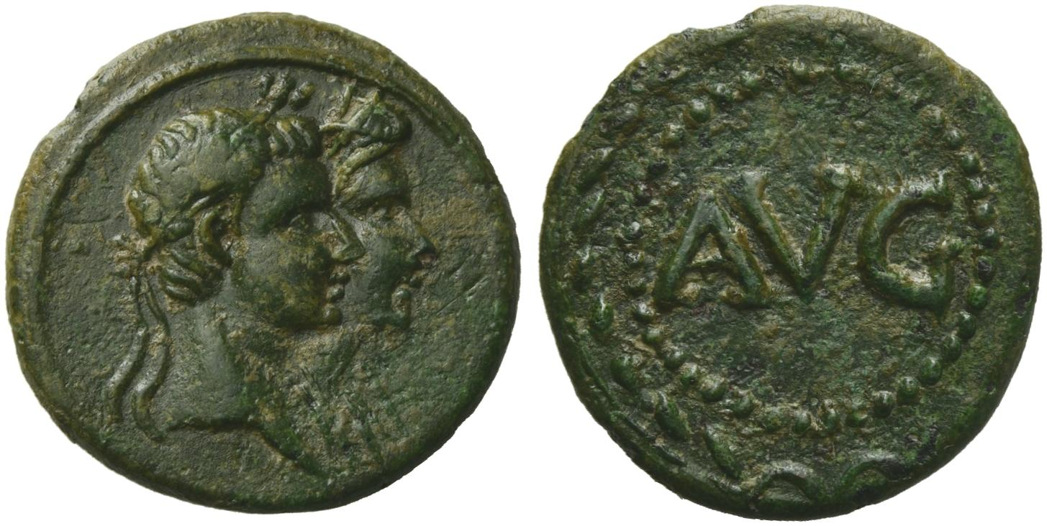
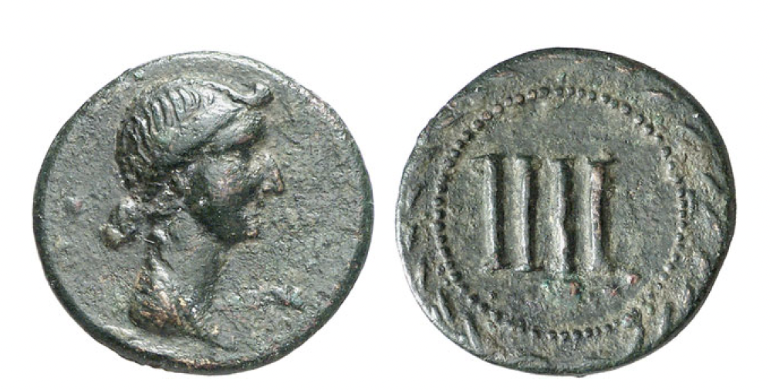
The Imperial Image: Livia
Bronze token, 27 BC – AD 14
Jugate heads of Augustus and Livia right
AVG within dotted border and wreath.
Bronze token, 27 BC – AD 14
Bust of Livia right with nodus and hair drawn together at neck
IIII within dotted border and wreath.

Slide 18
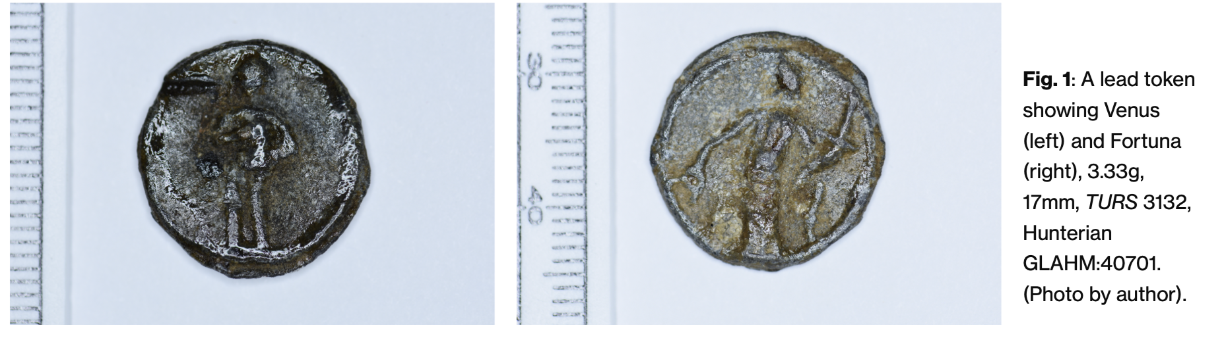
Myth and religion
https://warwick.ac.uk/fac/arts/classics/research/publicengagementimpact/material_musings/2024/

Slide 19
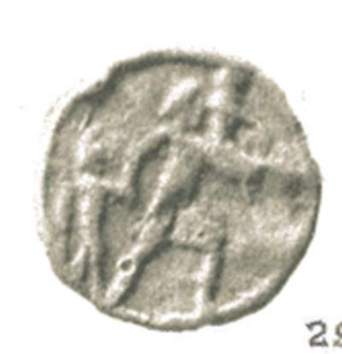
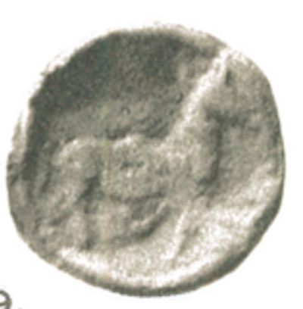
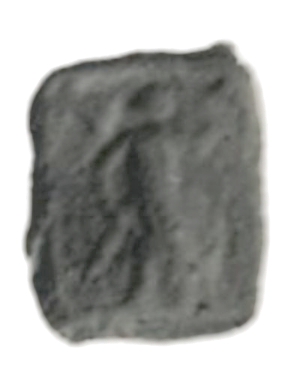
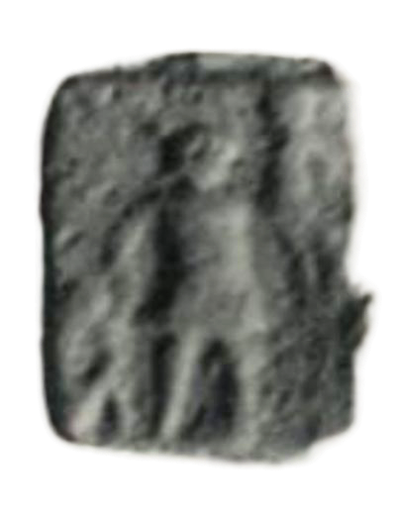
Stick figure Aeneas
Side a: Aeneas advancing right, carrying Anchises and leading Ascanius.
Side b: (Trojan?) horse
Side a: Mars walking right, holding trophy over left shoulder and transverse spear.
Side b: Aeneas advancing right, carrying Anchises and leading Ascanius.

Slide 20
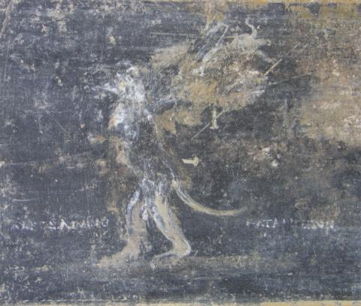
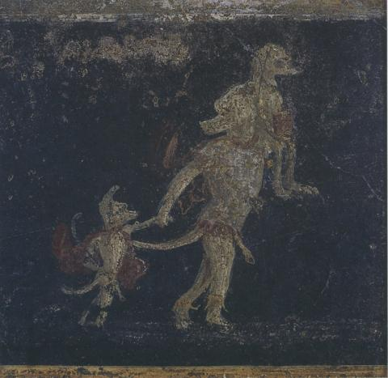
Painted parody showing Aeneas and co. as dog-headed apes.
Pompeii, zone of Masseria di Cuomo
Museo Archeologico Nazionale, Naples, inv. 9889 (Aeneas), inv. 8588 (Romulus).
https://www.judaism-and-rome.org/painted-parody-aeneas-and-romulus-dog-headed-apes
Notes:
Anti-Augustan sentiment on behalf of the home owner?

