Slide 1
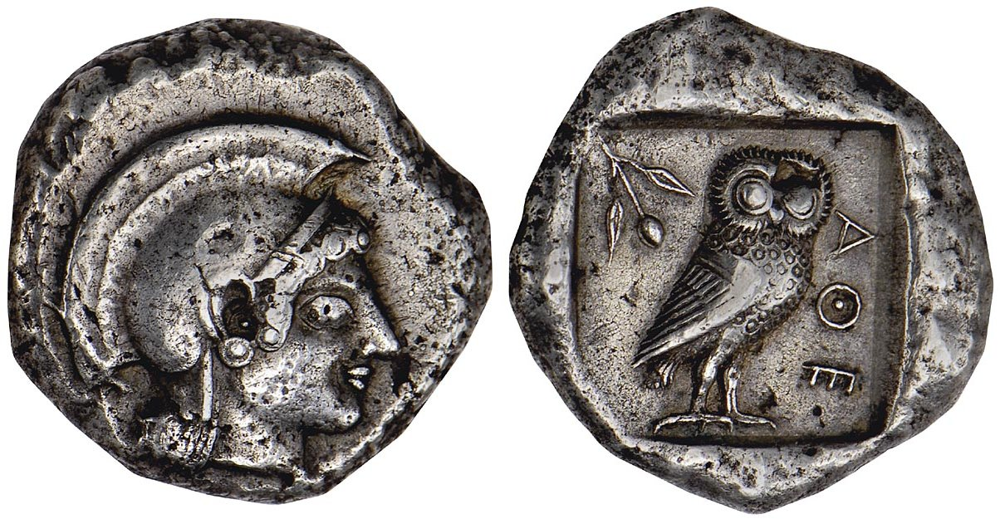
Coins of Early and Classical Athens

Slide 2
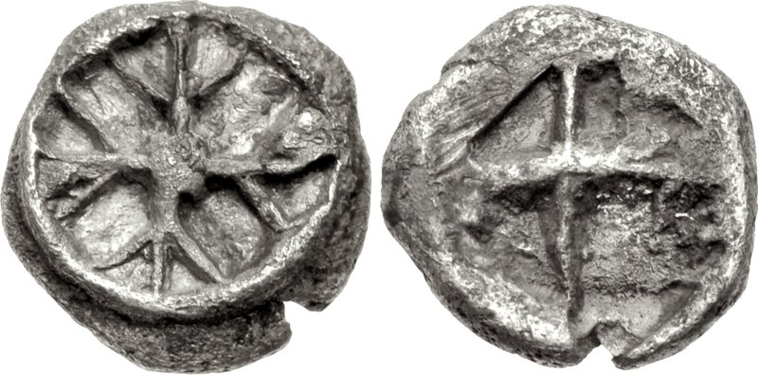
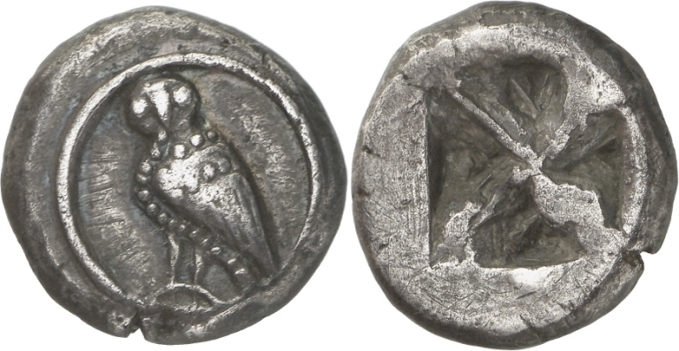
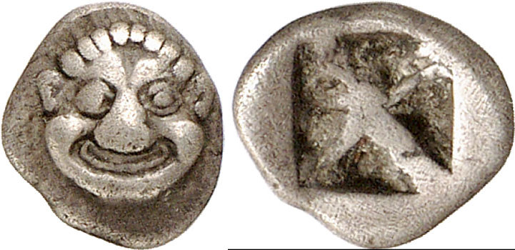
Wappenmünzen
AR hemiobol, 0.3g, 515-510 BC. Wheel / incuse square. SNG München 17.
AR didrachm, 8.29g, c. 545-515 BC. Owl / incuse.
R.J. Hopper, ‘Observations on the Wappenmünzen’, Essays to Robinson p. 32, 71a, pl. 5
AR obol, 0.66g, c. 525 BC. Gorgoneion facing / incuse. Svoronos pl. 1, 66-67
Notes:
Rarely travelled outside Attica and central Greece – local use, so issuing city doesn’t need to be present.
Wappen – heraldic sign.
Metals not attic.
Gorgoneion – reference to Athena – recogniseable outside Athens.

Slide 3
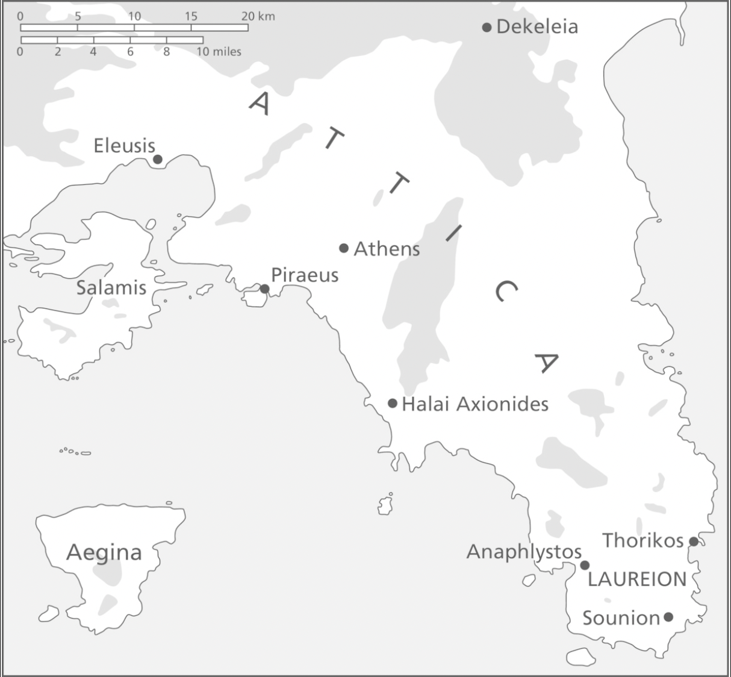
Laureion
c. 520 BC onwards
Heavier tetradrachm introduced
Huge production of coinage throughout 5th century BC
Mining was done by private operators who leased mines from the state and were presumably taxed on the amount of metal uncovered.
These operators used slaves and labourers
Notes:
Why silver?
Mines at Laurion- distinctly ‘Athenian’ deposits (from 483/2 BC)
Kurke – an intentional reaction against the ‘elitist identification with gold’.
Gold associated with the gods, kingship and sovreignty in texts,

Slide 4
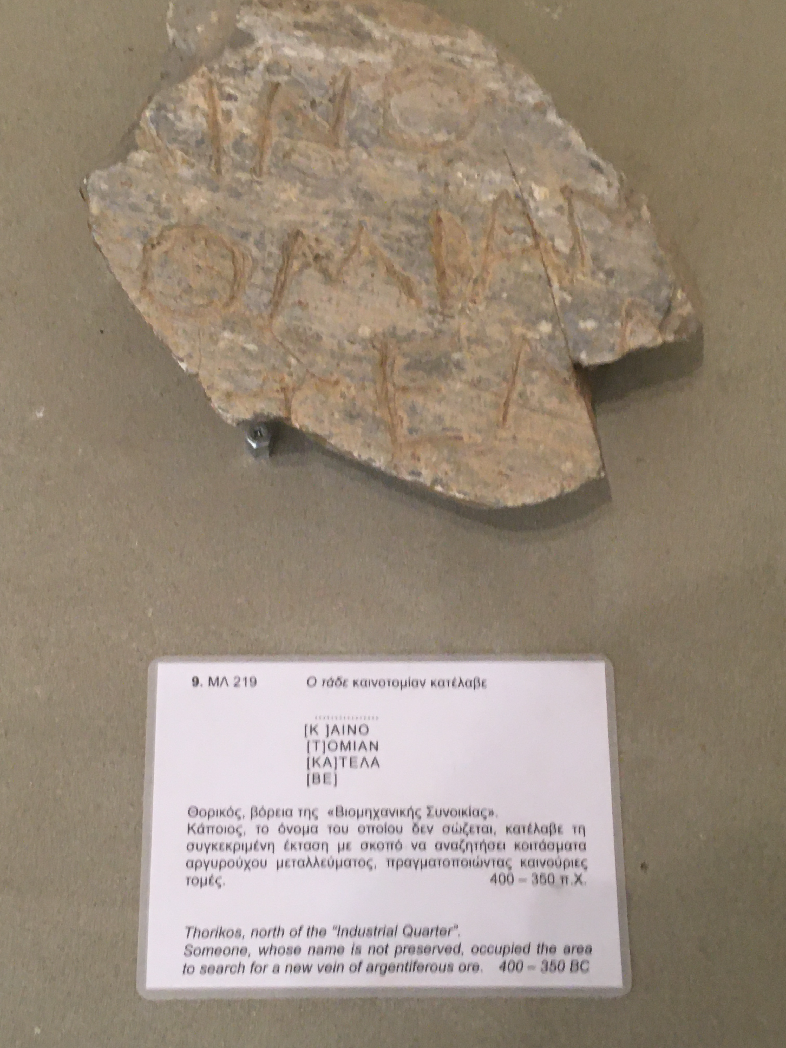

Slide 5
Thorikos
Bedrock of silver, mining from c. 3200 BC
Early 5th century BC: construction of a stone theatre (one of first in ancient world)
Civic features (roads, shrines, houses) juxtaposed with industrial areas (e.g. mines, ore washeries)
https://www.thorikos.be/#home-uk

Slide 6
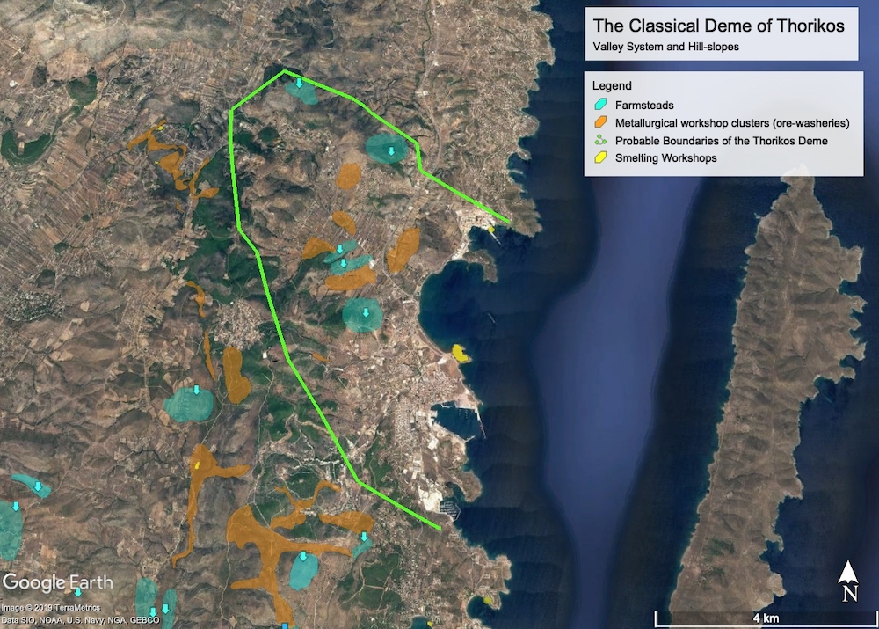
Notes:
Safe harbours

Slide 7
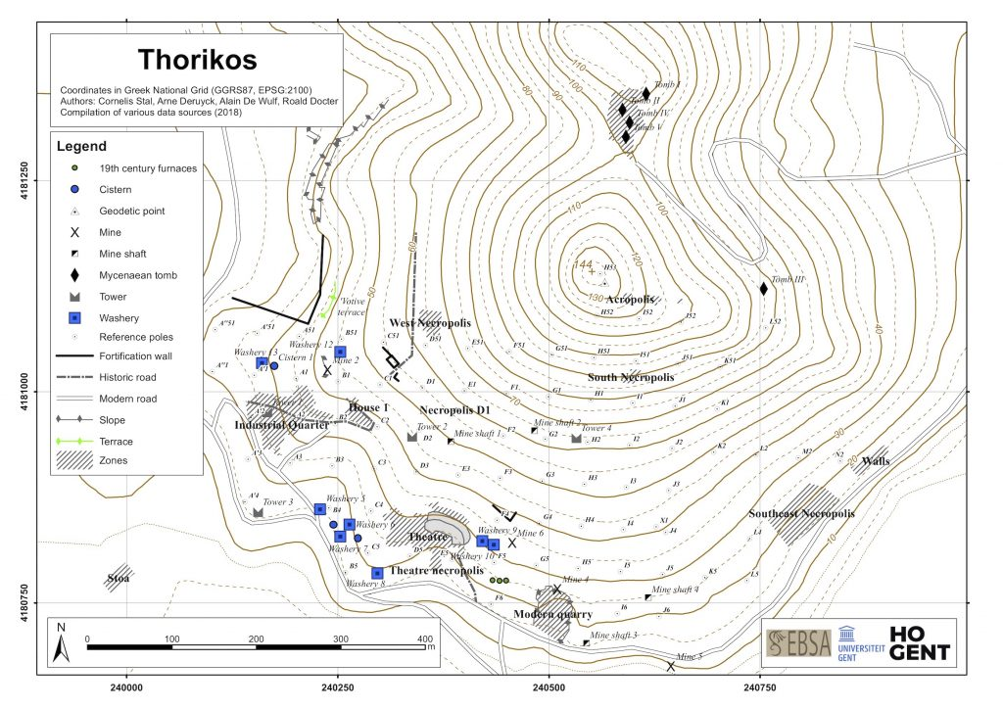

Slide 8
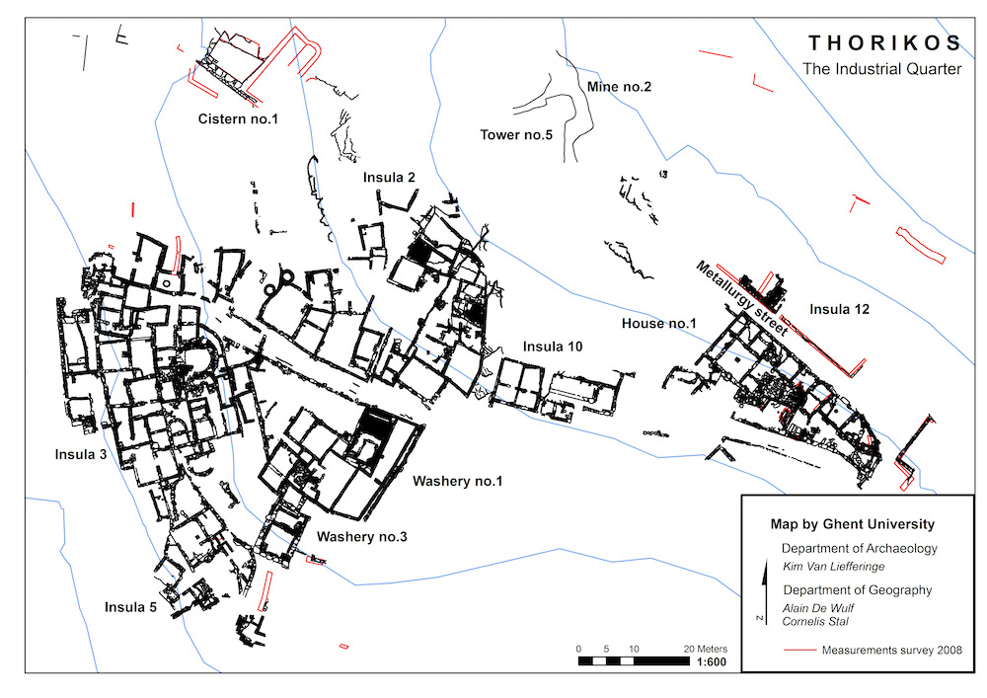
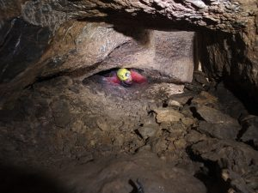
Notes:
Industrial quarter is active 4th century BC
Acropolis mine shown

Slide 9
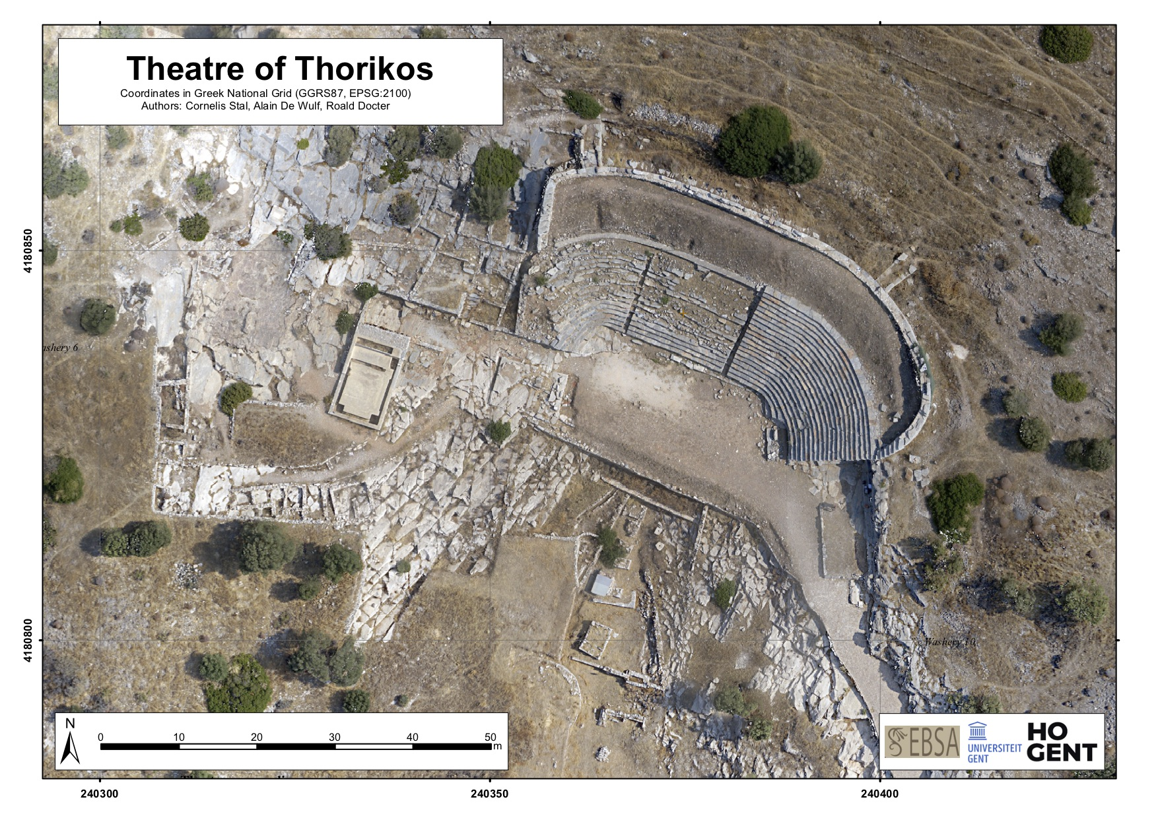
Notes:
Archaic and classical periods
The theatre itself and its adjacent buildings (like a temple for Dionysos, an altar, and a rectangular room with bench to its east) were erected on the surface of an earlier marble- and limestone quarry between two long-lived mines
The western one, Mine no. 3, dates to the 3rd millennium BC and remained active in Classical times; the eastern one, Mine no. 6, seems to have been exploited in Classical times.
Connected with each of these mines are ore processing workshops (ergasteria) with washeries dating to the 4th century BC. The earliest built feature organizing the space of the theatre has been dated to the first half of the 5th century BC.

Slide 10
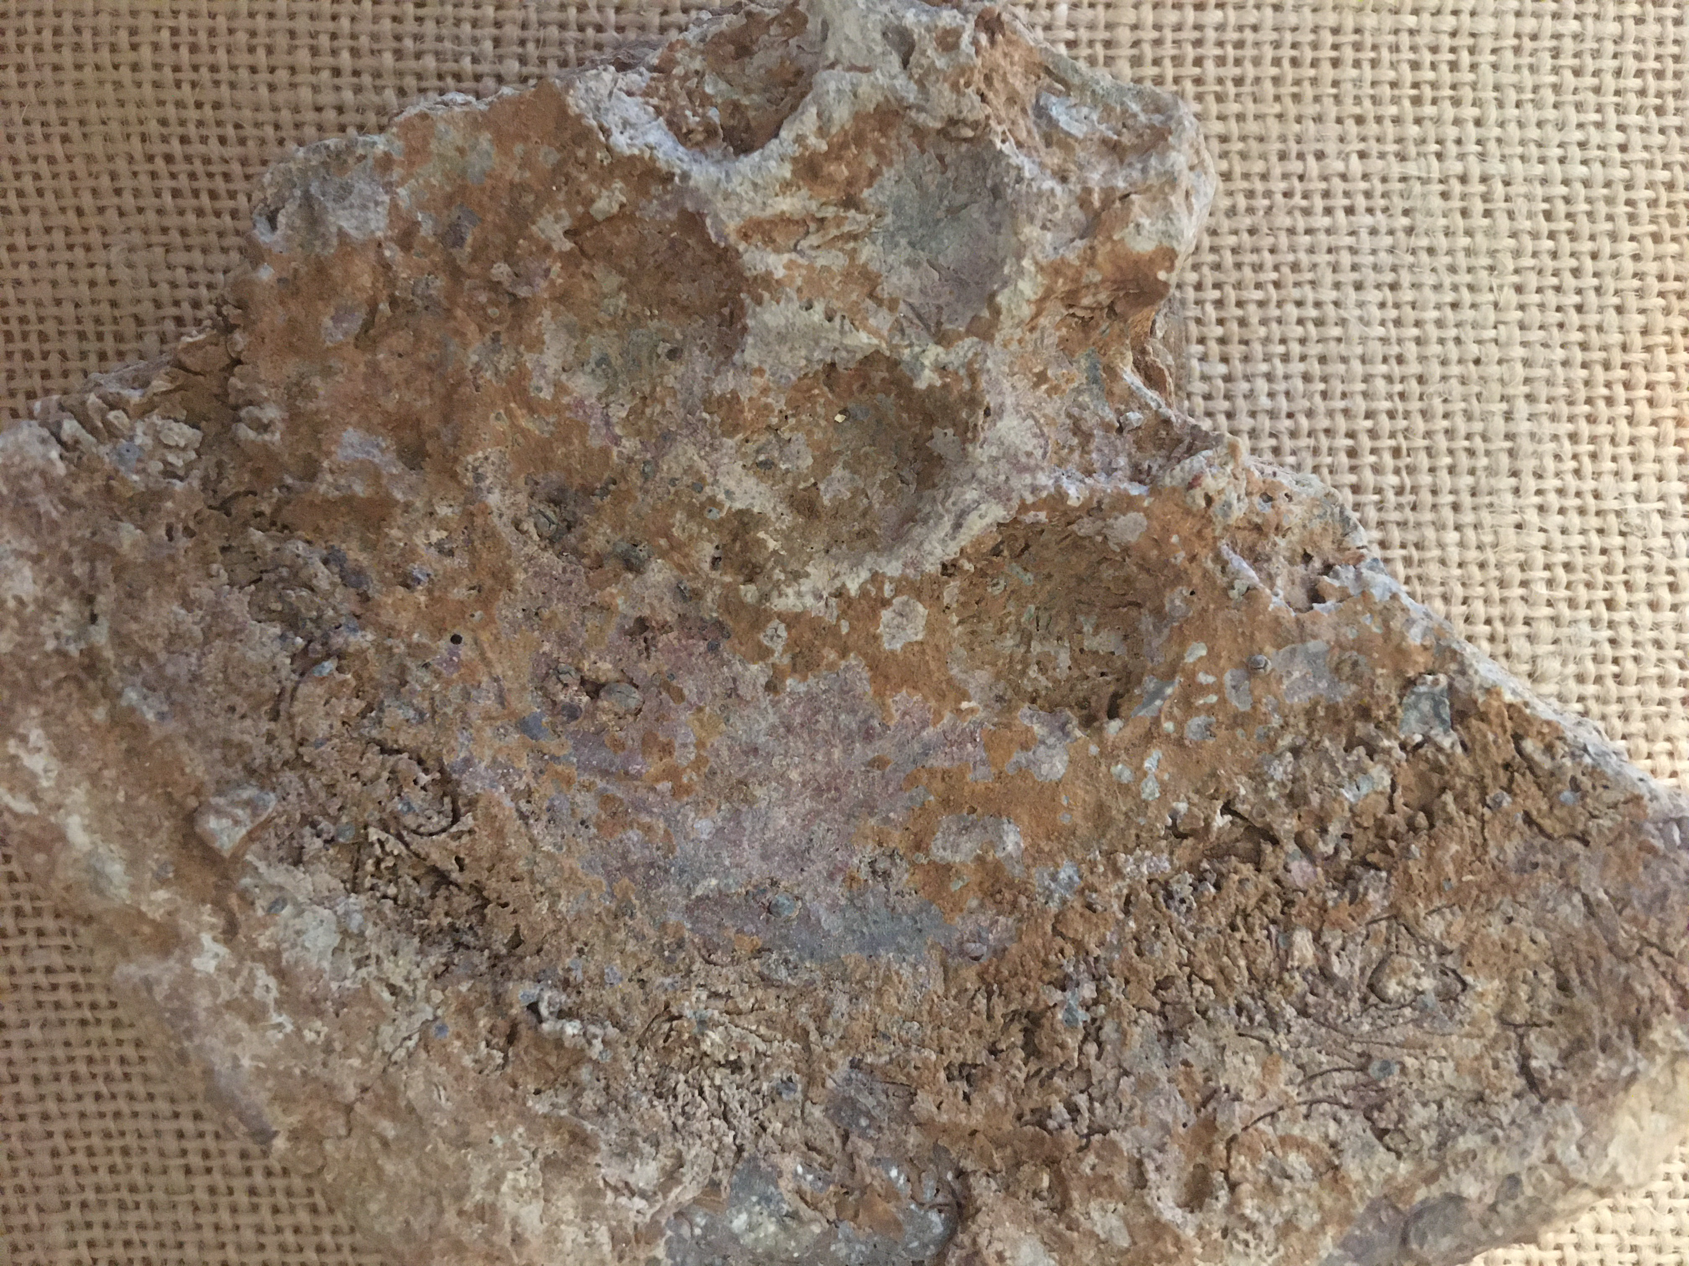
Found in a complex of workshops and houses at Thorikos (classical period)
Mould for casting coin flans

Slide 11
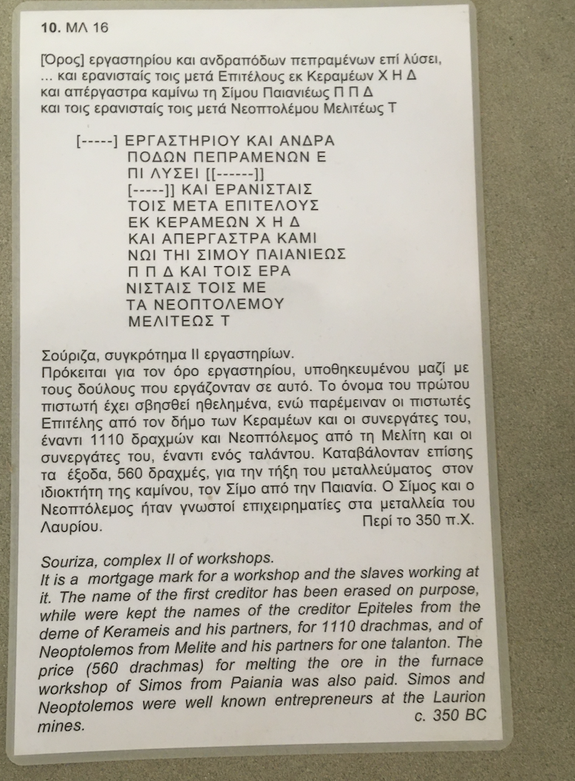
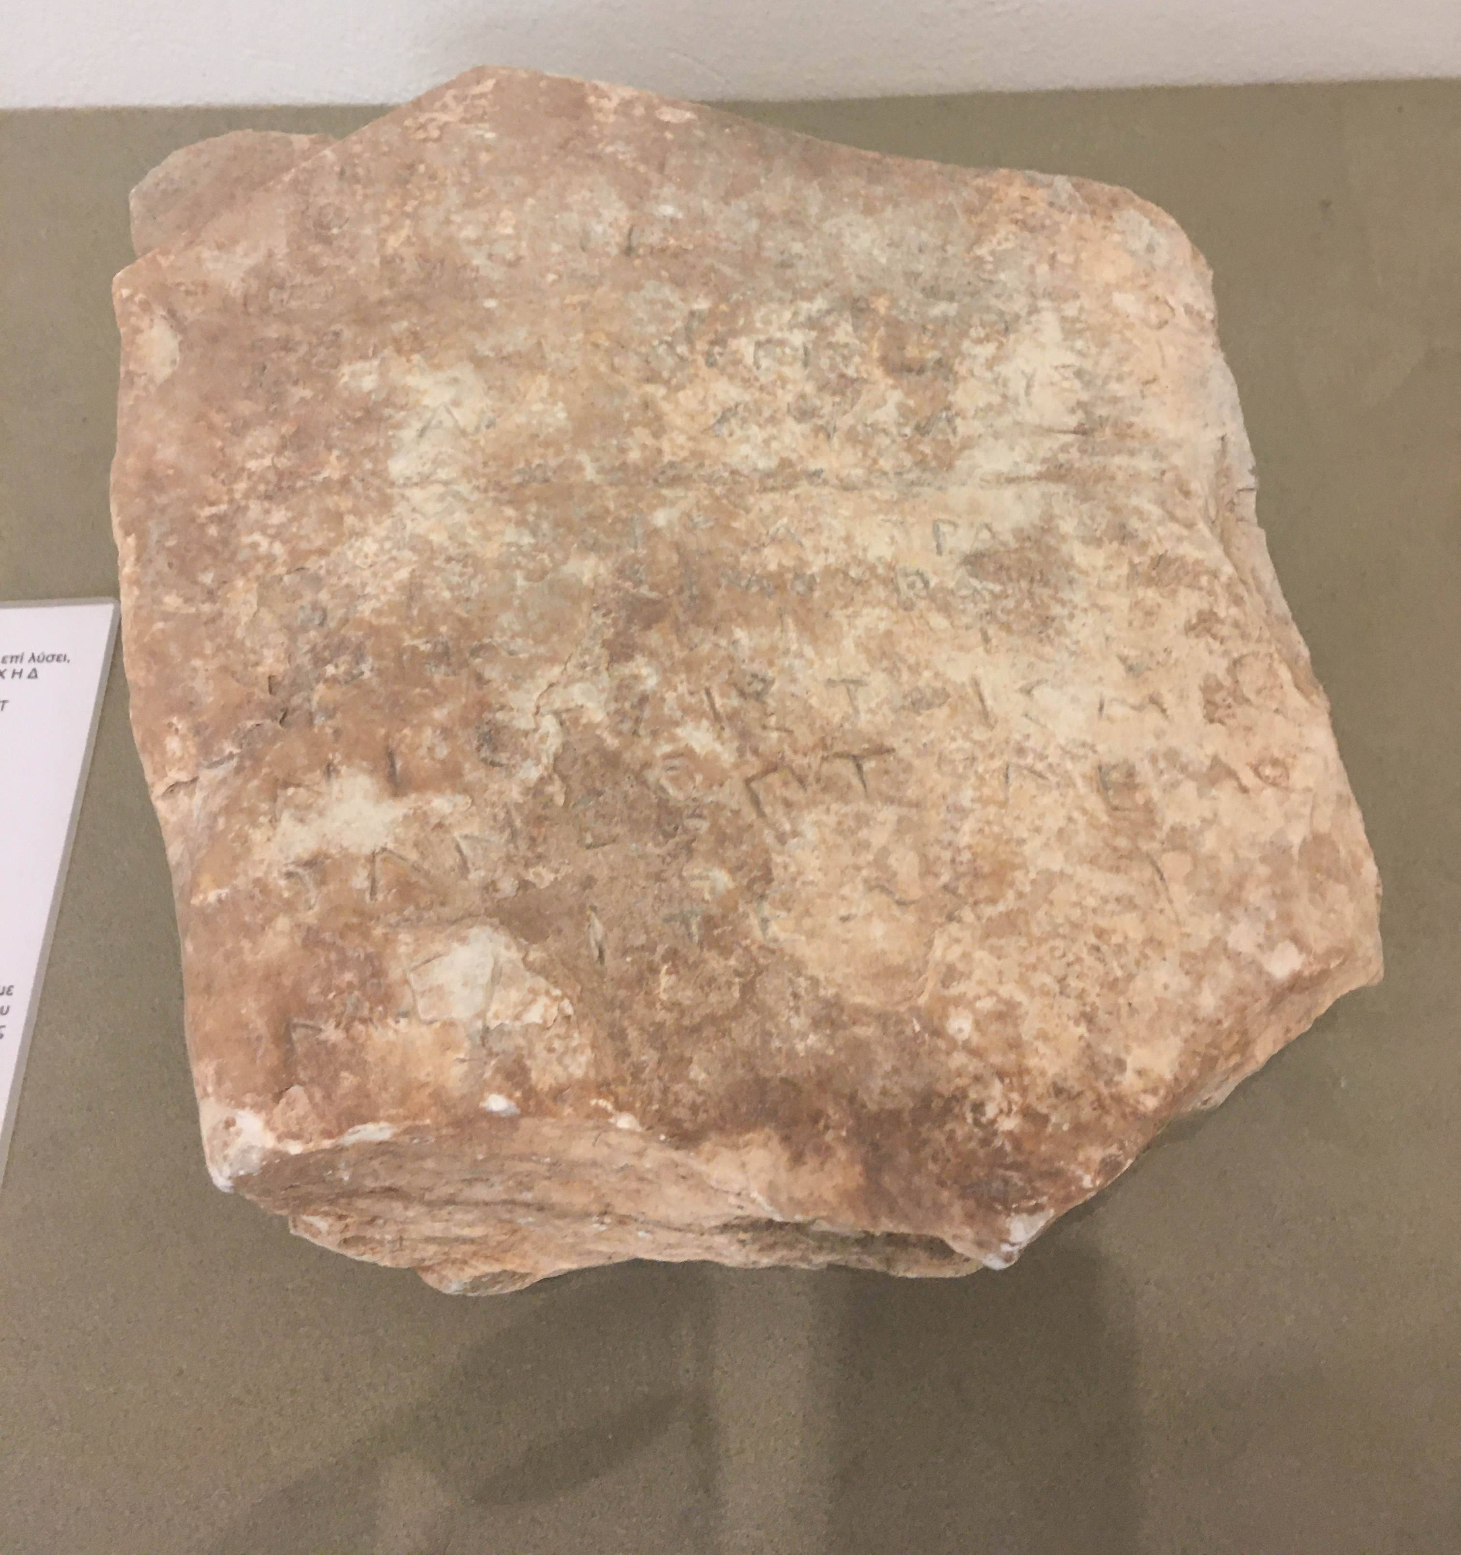
Souriza (ore washing workshops)
Washing the ores increased the silver output from the smelting and saved on wood

Slide 12
Athenian Owls
AR Tetradrachm, c. 17.61g, c.510 BC. Head of Athena / owl standing r., head facing, sprig of olive to l., ATHE to r. Svoronos pl.4.13
Notes:
WHY this change? Democracy? Economic need? (i.e. coins to be recogniseable overseas?)
Don’t know if the change occurred before or after Kleisthenes – i.e. before or after the advent of the democracy, around the same time.
Discovery of the Laurion silver mines c. 520 BC.
Heavier tetradrachm was introduced.
Huge increase in production throughout the 5th century BC.
The
one hundred talents of mining revenues which the Athenians voted in
483/2 to expend on the building of warships gives a comparable glimpse of
the magnitude of silver extraction at that time.6
The mining was in the
hands of private operators who leased their concessions from the state and
who presumably, as in the fourth century, were taxed on the amount of
metal they recovered. If the tax rate was the conventional one that applied
to silver extraction in the fourth century,7 the one hundred talents of
revenue available to the Athenians in 483/2 would represent a total
recovery of 2,400 talents (62,208 metric tons) of silver, an amount that,
when coined, would have produced 3.6 million tetradrachms.
Figuera – reduction in minting of other cities in the region – use of Athenian coinage instead. 280 cities in the Delian league led by Athens. Only 69 struck their own coinage. 50% of the minting members ceased to mint. Kept dropping.
Tribute lists.

Slide 13
The cognitive life of objects…
Extended mind hypothesis
Thinking with and through things
Notes:
Pen and paper. Multiplication tables – even when you do it in your head, you do it a way that mimics the pen and paper.

Slide 14
δοκιμάζω
Dokimasia – examination
          Of citizenship
          Of coinage as legal tender
χαρακτηρίζω – character
to engrave, to stamp, to be characterised by
Notes:
i.e. acutally has value. Not just token
Citizenship granted to slaves who had fought at the battle of Arginousai in 406 BC.

Slide 15
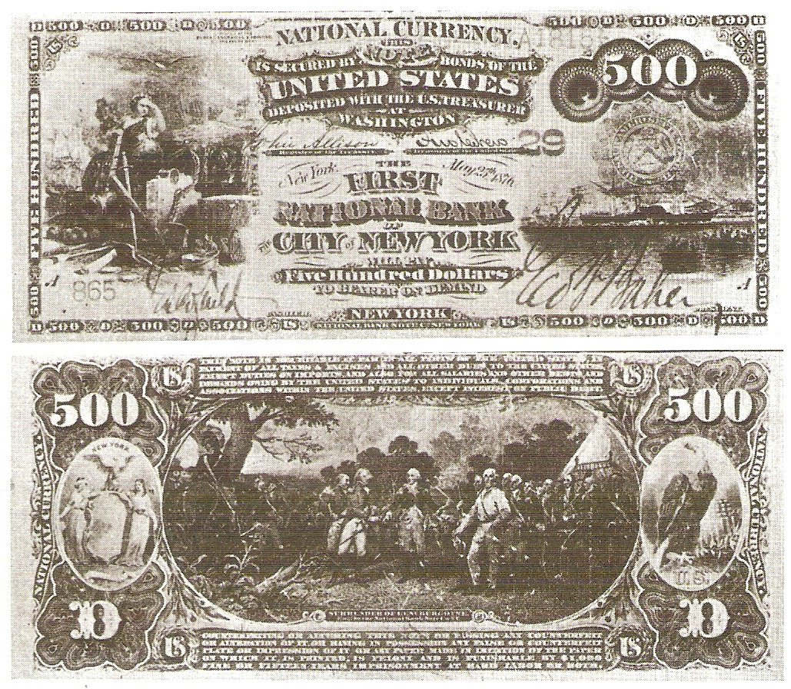
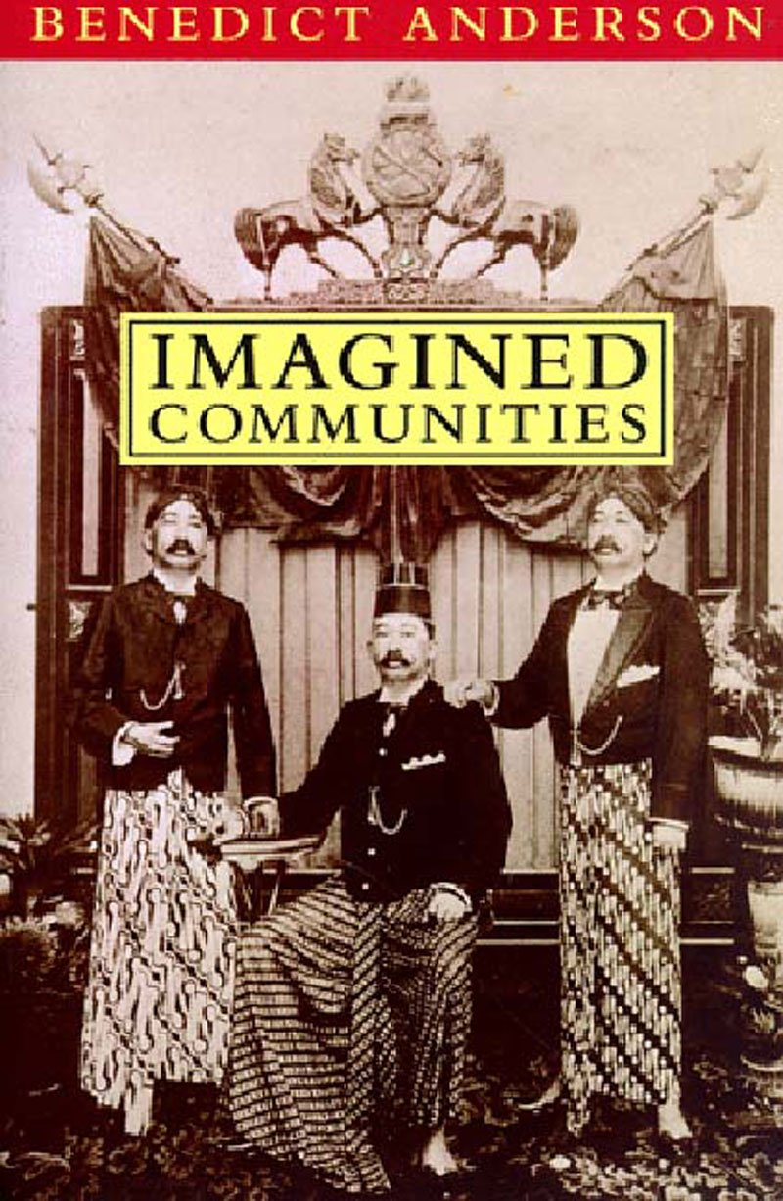
The Athenian ‘Imagined Community’

Slide 16
Kurke, p. 309
Once Athenian silver coinage is established as practice, its ongoing production and circulation not only reflect, but in some measure constitute, the community of citizens. Thus, in what we might call the micro-mechanics of ideology, material practices contribute to the civic imaginary, as pure silver coinage helps constitute the “imaginary community” of citizens who use it. As opposed to token bronze coinage, it asserts that civic order is more than just conventional; as opposed to bronze used at its full value or to debase the silver issue, it constitutes all citizens as the same noble substance. In contrast to gold, it rejects the elitist hierarchy of essence within the citizen body, while it imposes a firm boundary between the human, civic community and the domain of the gods. Finally, of course, its stamp implies that all citizens take shape from and submit to the civic authority that forms them.

Slide 17
Aristotle, Great Ethics I, xxxiii, 12 (1194a) (Melville-Jones 12)
But since the builder’s work is worth more than that of the shoemaker, and it was difficult for the shoemaker and the builder to exchange their work and it was not possible to buy a house with shoes, they settled upon a custom by which all these things might be bought, calling silver coinage nomisma (from nomos, custom), and using it; and by each giving the value of each thing, they created exchange with one another, and thus kept together the political association.

Slide 18
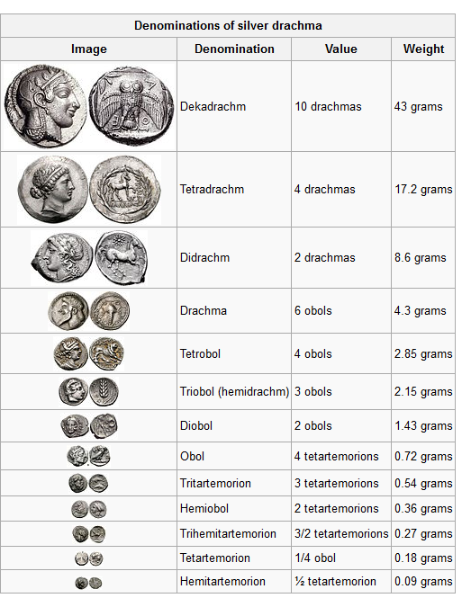

Slide 19
Uses of Money
To pay for building work
Purchase of sacrificial meat to be distributed at state festivals
Payment of citizens for military, political and judicial service
Aristotle, Constitution of Athens, XLI, 3 (Melville-Jones 67)
At first they refused payment for attendance at the Assembly. But because people were not attending the Assembly, and the prytanies were devising many manoeuvres so that the multitude should attend for the carrying out of the voting procedures, first of all Agyrrhius provided an obol, and after him Heracleides of Clazomenae, called Basileus, two obols, and Agyrrhius again three obols.

Slide 20
Aristotle, Constitution of Athens, XLII, 2 (Melville-Jones 69)
The following are paid: first the Demos for meetings of the Assembly one drachma, and nine obols for a sovereign meeting, then the jury courts three obols and the Council five obols. Those who serve as prytanies get an extra obol for food. Then the nine archons get four obols each for food, and have to maintain a herald and a piper; and the archon for Salamis gets a drachma a day. Directors of athletic festivals dine in the Prytaneum during the month Hecatombaeum at the time of the Panathenaic Festival, beginning on the fourth day of the month. Amphictyons for Delos get a drachma a day from Delos. All officials sent to Samos, Scyros, Lemnos or Imbros get money for food.

Slide 21
Money and Empire
Use of Laurium silver to purchase fleet
Money and the army (State-owned trireme navy from c. 515 BC (tyrant Hippias))
Transfer of the Delian treasury to Athens
Tribute from other Greek cities
Athenian standards/coinage decree
Notes:
Easier – rather than booty and food, things could just be bought.
Merecenaries – less to do with citizen body training, rise of professional soldiers who served whoever paid them.

Slide 22
Herodotus, Histories 7.144
Another earlier idea of Themistocles was successful and well-timed, when the Athenians had a great amount of money coming to their public funds from the mines at Laurium, and proposed to distribute ten drachmas a man to each of them. Then Themistocles persuaded the Athenians to stop this distribution and to have two hundred ships built from this money for the war, meaning the one against the Aeginetans.

Slide 23
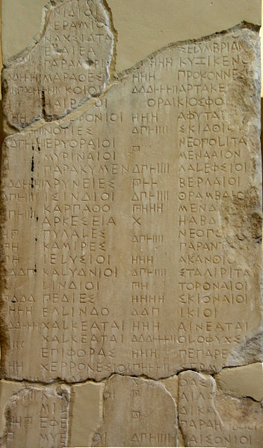
The Delian League (from 478/7 BC)
1/60 reserved for Athena in Athens
From 413 BC a 5% harbour tax
Initially levied in the form of ships or any currency
Transfer of treasury from Delos to Athens: most of the tribute paid in Athenian coin.
Notes:
To fight Persia, led by Athens.
Tribute Quota lists on the Athenian Acropolis

Slide 24
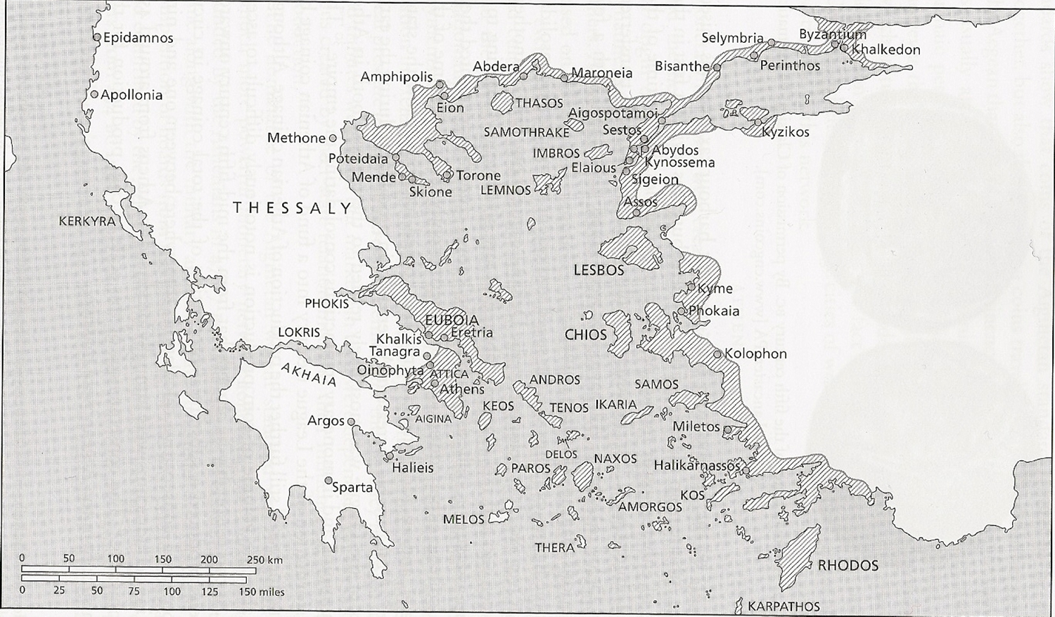
Athenian Empire in the 5th century BC

Slide 25
Athens
Produces tetradrachms
Returns as tribute / tax
via trade (grain) or service in the military (even the fleet?)
Allied States
Notes:
Howgego – 450-400: coins found outside the arche.

Slide 26
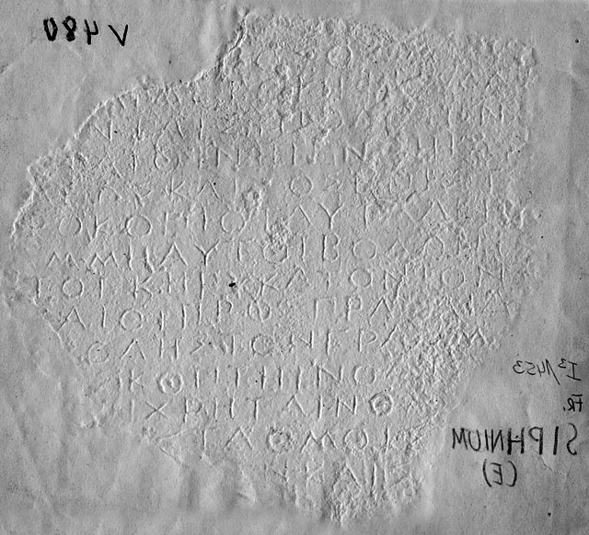
Athenian Standards/Coinage Decree, 445-413 BC
Athenian coins, weights and measures used in Athens and allies of Athens
Exception are those allies who used electrum coinage
Old coinage had to be brought into the mint of Athens and re-coined for a fee.
No evidence that the decree was effective.
Notes:
Siphnos squeeze. Multiple copies, all fragments found within the Athenian arche.
No complete copy survives
Why – make administration and payments easier, get silver, hegemony.
Athenian coinage already popular by this period.
Europe – a ‘common feeling’. Britain didn’t accept this.

Slide 27
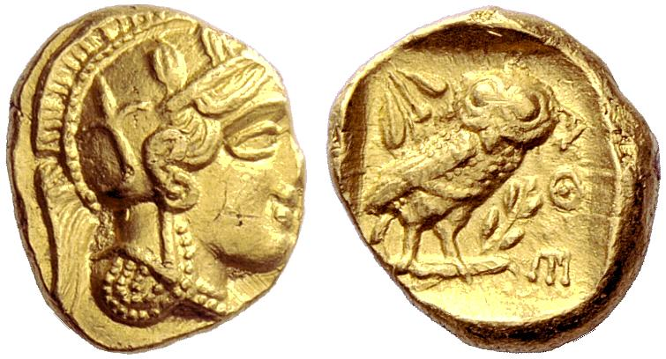
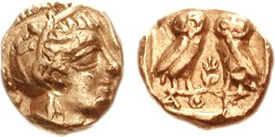
Gold Coinage, 407/6 BC
413 BC: Spartan occupation of the fort of Decelea in Attia, cutting off Athenian access to the silver mines.
14 talents of gold struck from the Nikes on the Acropolis
IG II², 1409, lines 4-6 (Melville-Jones 170). Accounts of the treasurers of Athena, c. 385/4 BC
A wooden casket; a box in which are the dies and the little anvils on which they used to strike the gold coins, sealed with the public seal.
drachm
diobol
… and if everything else were exhausted, they could make use of the gold which was laid around (the statue of) the goddess. He pointed out that the statue had a weight of 40 talents of refined gold on it, which could all be removed. But, he said, if they used it to save themselves, they must put back again at least as much.
Thucydides 2.13.305
Notes:
413 BC – Spartans occupied the fort of Decelea in Attica, cutting of Athenian access to their silver mines. Struck from the 14 talents of gold from the Nikes on the Acropolis.

Slide 28
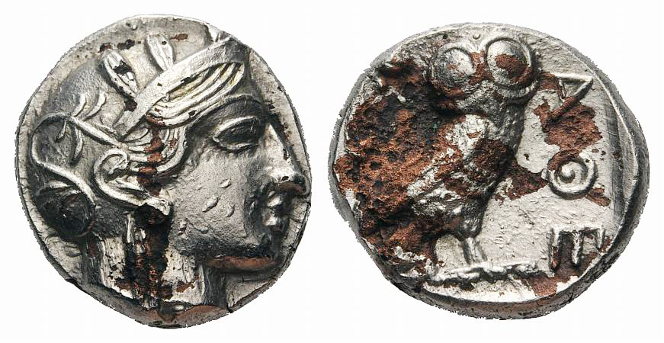
Plated Bronze Coinage, 406/5 BC
Notes:
Why not just strike in bronze. Why plate?? Again perhaps the importance of silver.

Slide 29
Aristophanes, Frogs 718-33 (Chorus)
We have often thought that the same thing has happened to the city, in respect of the good and fine men among its citizens, as happened with the old coinage and the new gold. We do not make use of these coins, not counterfeit but the fairest, as it seems, of all, and the only ones struck well and ringing true among the Greeks and barbarians everywhere, but (we use) these wicked little bronzes, struck yesterday and the day before with the worst possible striking. And of those citizens whom we know to be noble and respectable, just and good and fine, reared in (the traditions of) the wrestling ground, the dance and music, we treat outrageously, and we make use of the bronze ones for every purpose, foreigners, red-heads, villains from evil stock, recent arrivals whom the city in the past would not have used even in the most random way as scapegoats.

Slide 30
Lucan, Nigrinus, prologue. (Melville-Jones 56) (owls to Athens….)
The proverb says ‘owls to Athens’, meaning that it would be stupid for anyone to bring owls there, since they have so many.
Xenophon Poroi 3.2 (trade in Athenian coinage)
Moreover, at most other ports merchants are compelled to ship a return cargo, because the local currency (νομίσμασι) has no circulation in other states; but at Athens they have the opportunity of exchanging their cargo and exporting very many classes of goods that are in demand, or, if they do not want to ship a return cargo of goods, it is sound business to export silver (ἀργύριον); for, wherever they sell it, they are sure to make a profit on the capital invested.

Slide 31
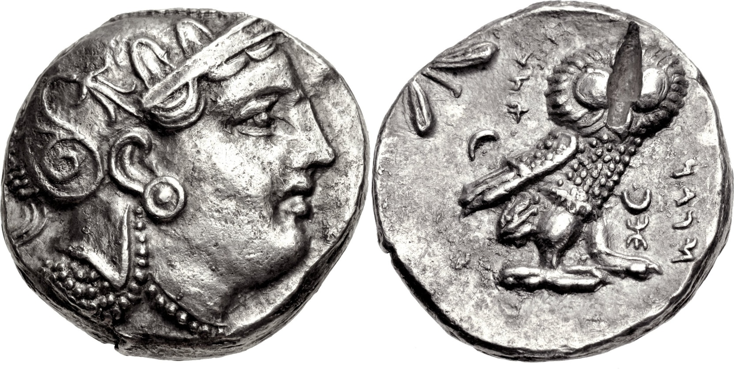
Owls in Persian Egypt
Egypt, Persian administration, Sabakes. AR Tetradrachm, 16.88g, 340-333 BC. Head of Athena/ owl with head facing, olive sprig l., aramaic inscription (?) ‘Sabakes symbol’. Van Alfen type III.
Notes:
After Athens production falls off in 413 BC.

Slide 32
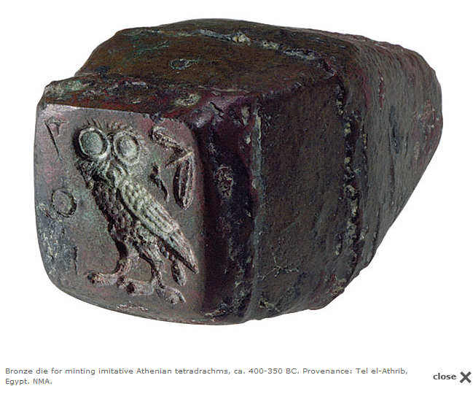
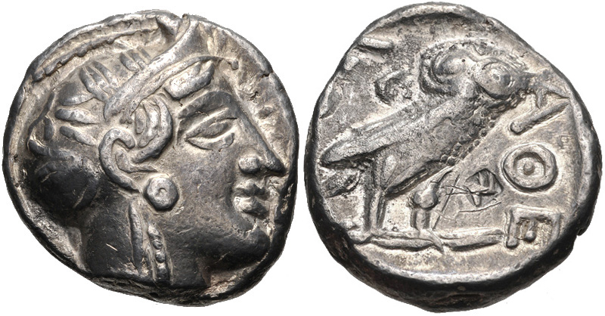
Owls and Imitations...
P.G. van Alfen, "The 'Owls' from the 1989 Syria Hoard with a review of Pre-Macedonian Coinage in Egypt," AJN 14 (2002), pl. 11, 2.
Notes:
Sicily – equipment found for the making of owls.

Slide 33
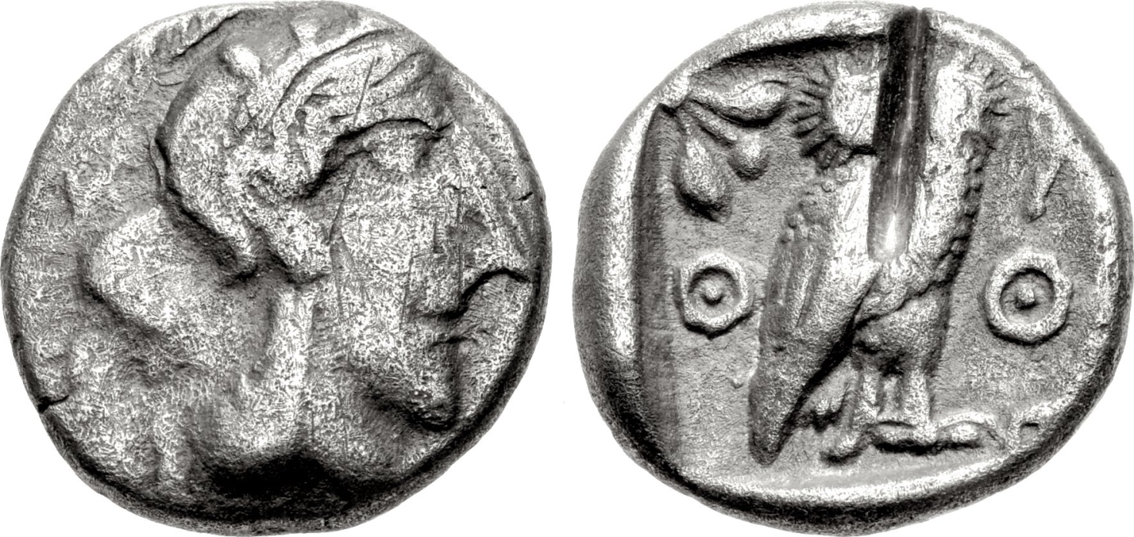
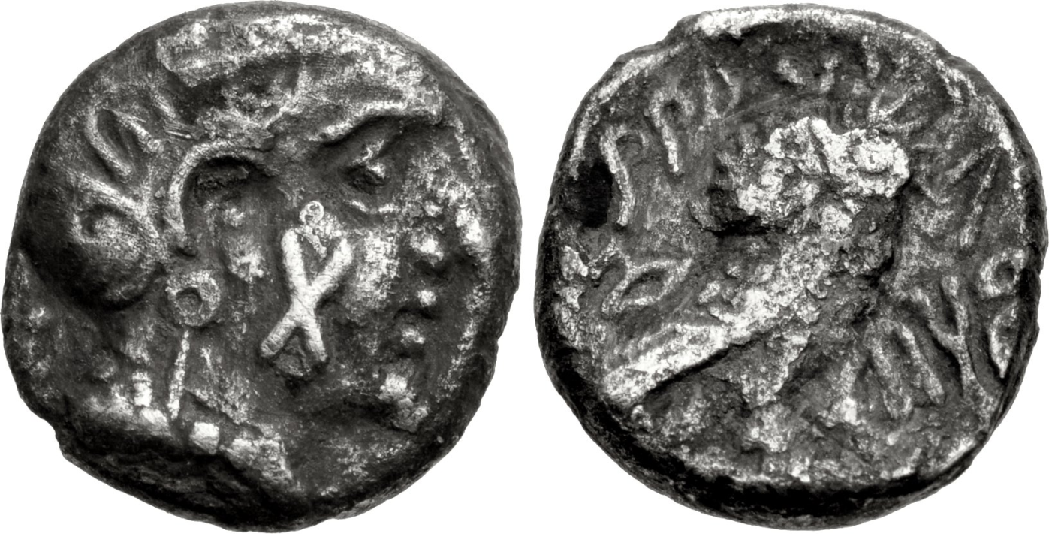
Palestine
Arabia
Notes:
Had a premium over their bullion value in the near east

Slide 34
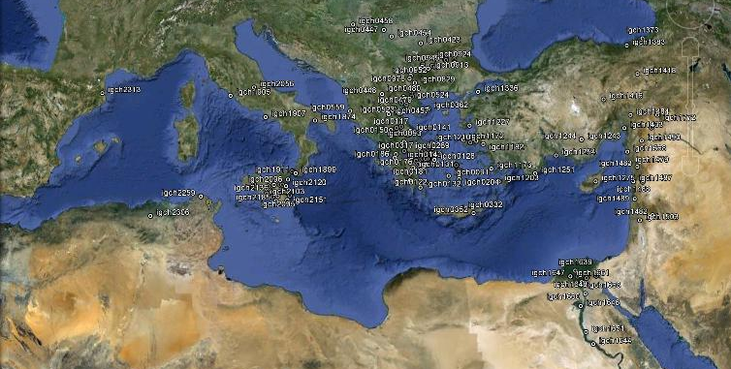
Owls... a commodity?

Slide 35
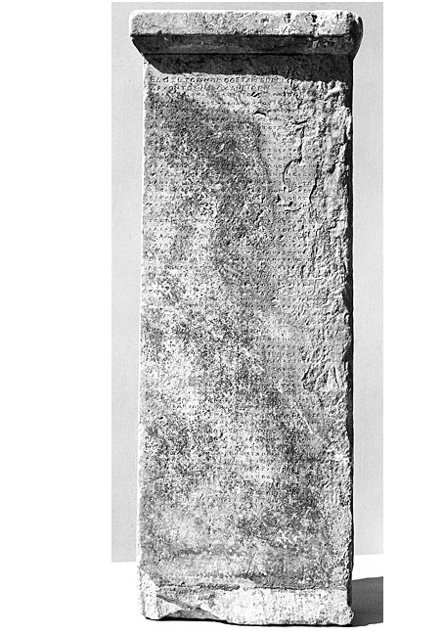
Law of Nicophon, 375/4 BC
Money testers to sit beside the banker’s tables in the agora and the Piraeus
All coins brought forward to be deposited or exchanged to be tested
Bankers had to accept genuine Athenian coins
Foreign silver coins with the Athenian stamp should be approved, but then returned
Plated imitations or counterfeit coins to be destroyed.
Notes:
Display of tribute coinage at the city Dionysia. Money had gone beyond just a statement of Athenian identity.

Slide 36
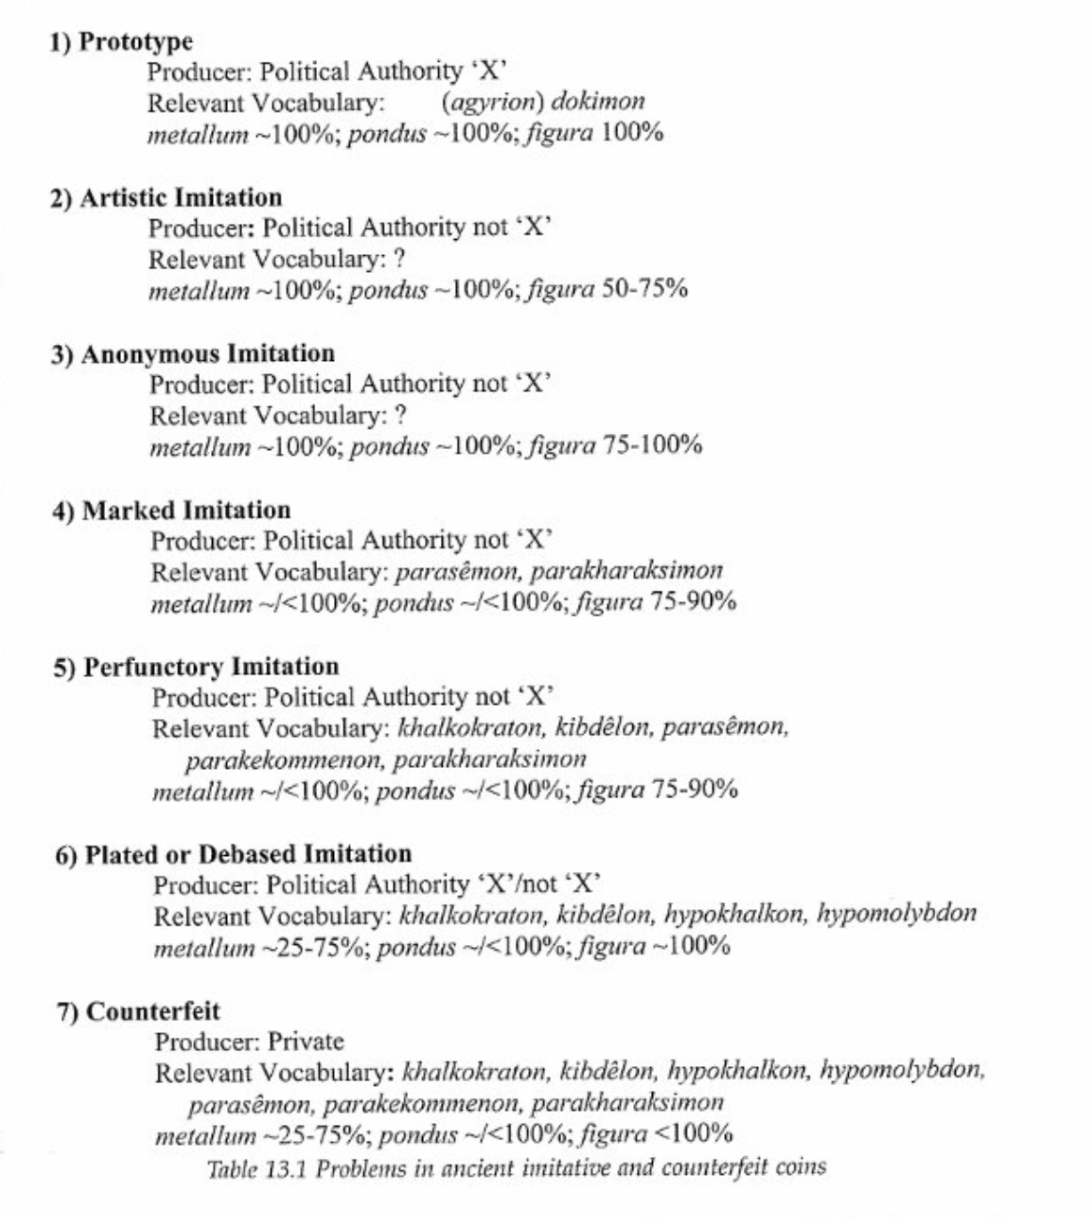
Imitations
P. van Alfen, “Problems in ancient imitative and counterfeit coinage,” in: Z. Archibald, J. Davies, and V. Gabrielsen, eds., Making, moving, and managing: the new world of ancient economies, 323-31 BC. London: Oxbow (2005), pp. 322-354
Notes:
Artisrtic – not always imitated exactly, but key components formed a basis for design
Anonymous imitation – hard to tell or impiossible to tell from prototype, but silver pure, so not about profit in that way. Ew.fg. Buttrey thibnkng many owls in Eurtopean collections were actuallty made in Egypt.
Marked – good silver but something suggests authority other than Athens.

Slide 37
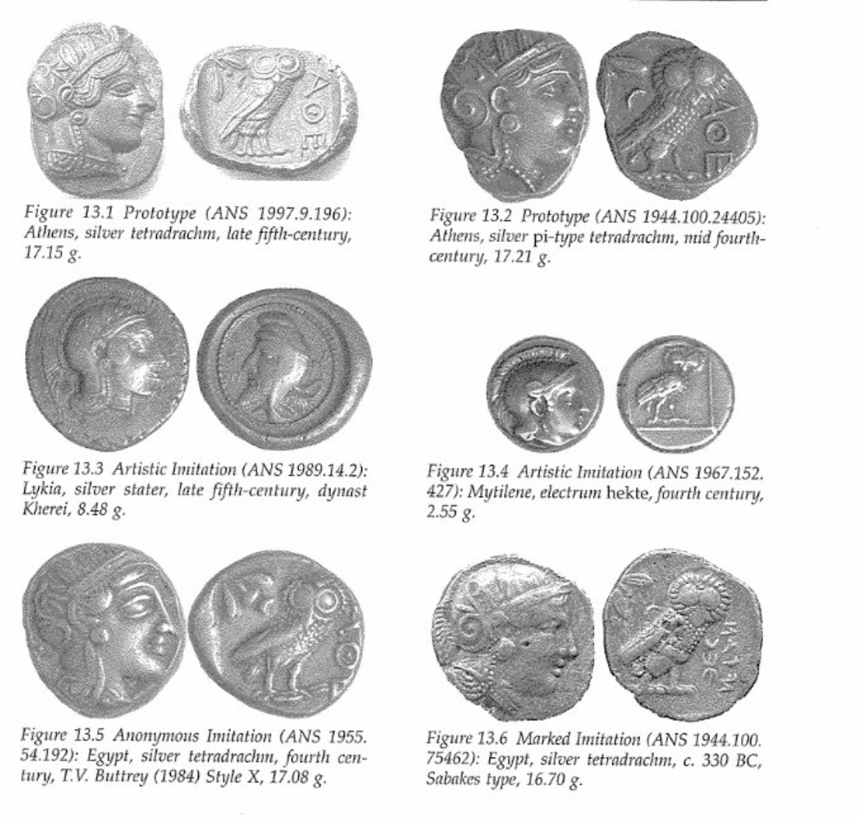
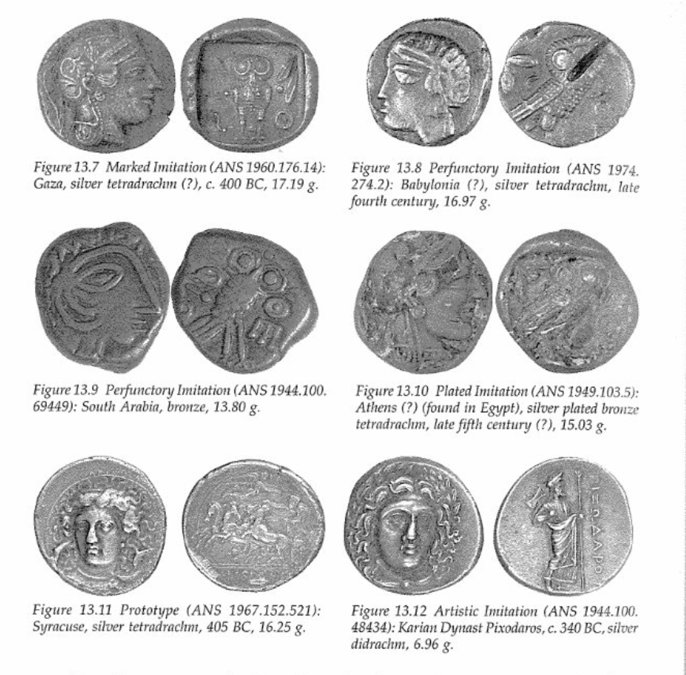

Slide 38
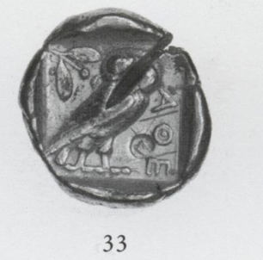
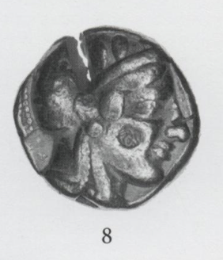
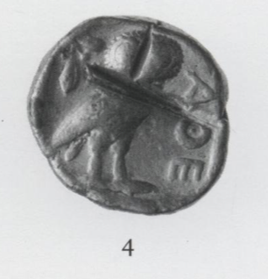
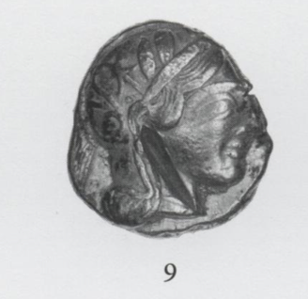
Cuts on Athenian owls
2626 Athenian tetradrachms from a hoard in North Syria, c. 400 BC (total c. 10,000 north of Aleppo)
Imitaiton owls c. 8.5% of the 2626 coins
5th century owls, based on the style = c. 400 BC
82% have intentional surface markings
The Northern Syria 2007 Hoard of Athenian Owls: Behavioral Aspects, by Buxton, American Journal of Numismatics 2009, pp. 1-27
Notes:
Chisel cuts – regular pattewrns of placement.

Slide 39
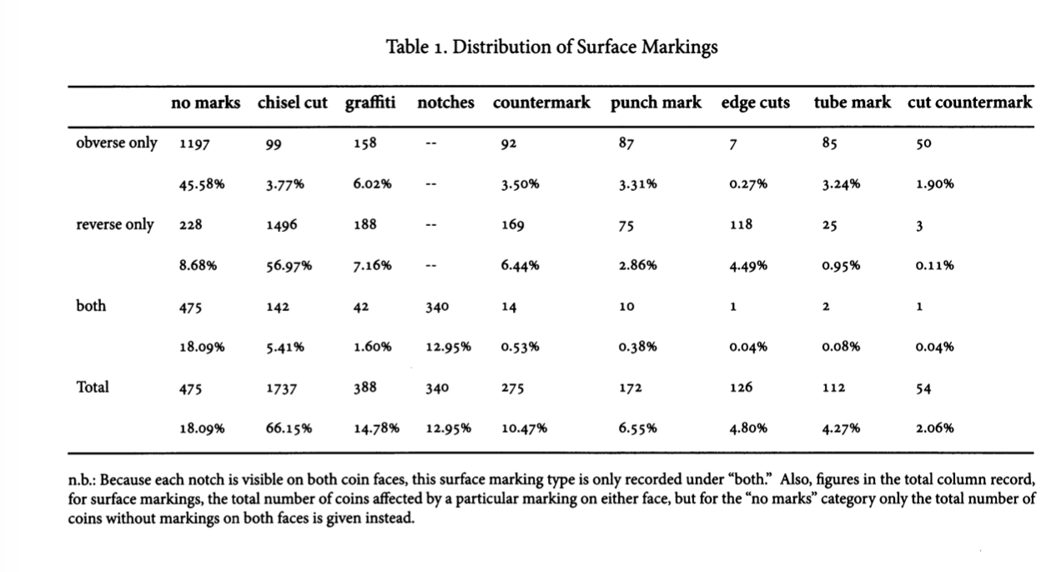
Notes:
Chisel cuts largely if not exclusively how owls handled in the near east.

Slide 40
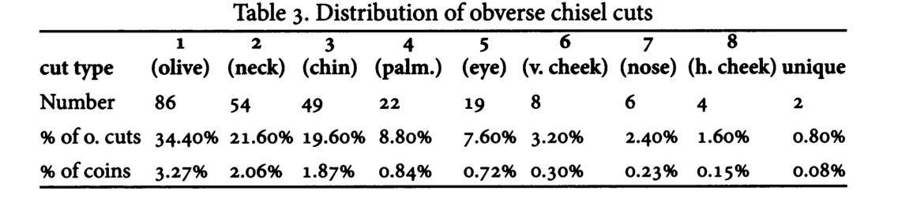
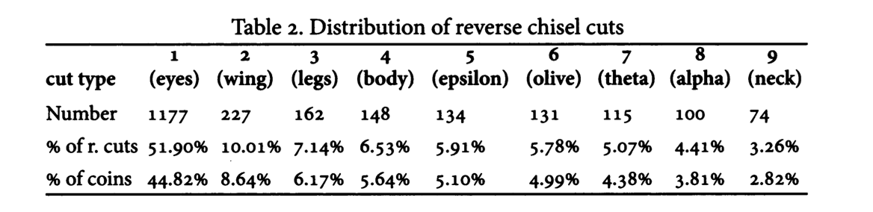
Notes:
IGCH 1259, Cilicia – similar percentage of chisel marks.
Many without chisel cuts though or markings – so a common but not necessary occurrence.
To test metal quality would be moree random – though these ciuts may have done that as well. But a pattern here which suggests beaureacratic control. Sophisticated countermarks that trhe coins have been made subject to and legitimized by a particular authority>
4/5 plated coins in the hoard had chisel cuts, but nonethrless included.
None of the texts suggest testing Athenian coins involved chisel cuts – some disgarded ones in Athens did not have them.
Athenian silver coinage law stipulates that it is only aftewr a coin has been foind wanting that it should receive a chisel cut and be removed from circulation and dedicxated to the mother of the gods – Athenian Agora excavations such plarted owls with chisel cuts found in the area of the Metroon.
Post 375 – cutting an owl in Athens destroyed its value as currency,
Owls marke din the east in this eway thus could not re enter circulation in the Aegeran –hence not really found in Greek areas.

Slide 41
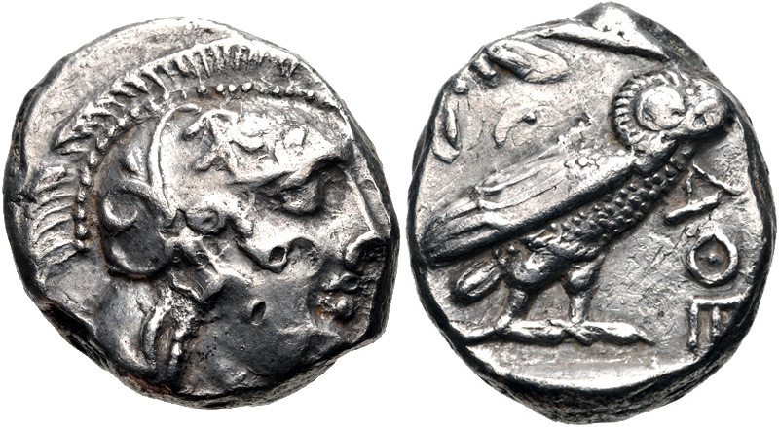
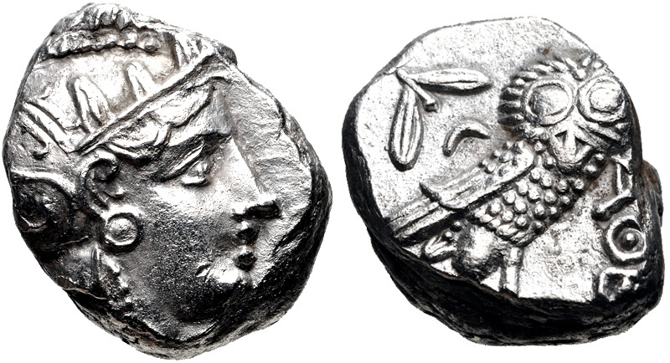
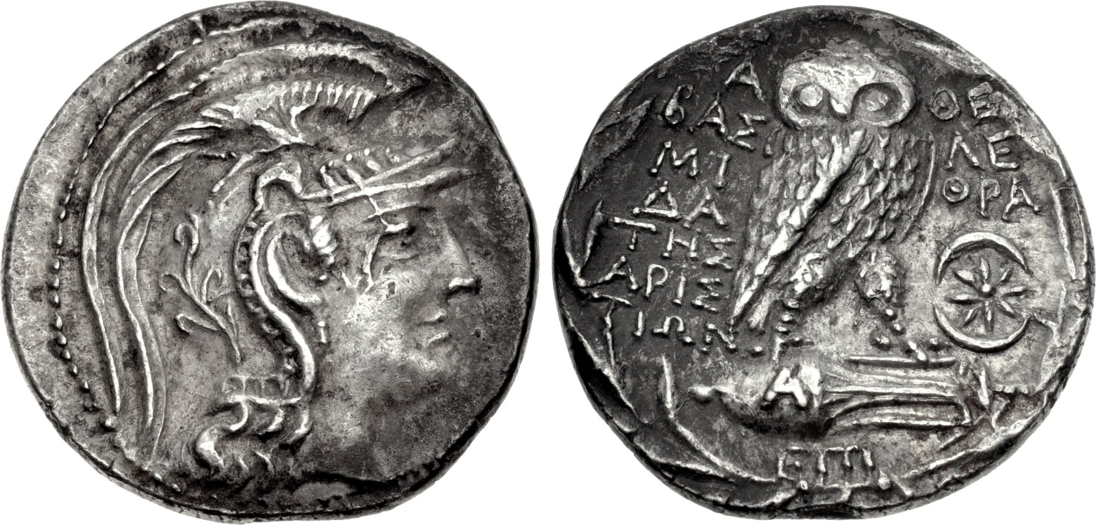
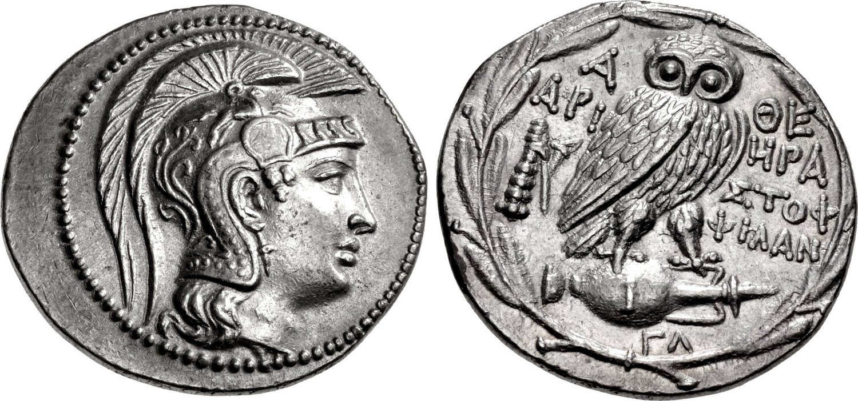
Athenian owls over time…
4th century BC
Stephanephoric / New Style Tetradrachms (165-42 BC)

Slide 42
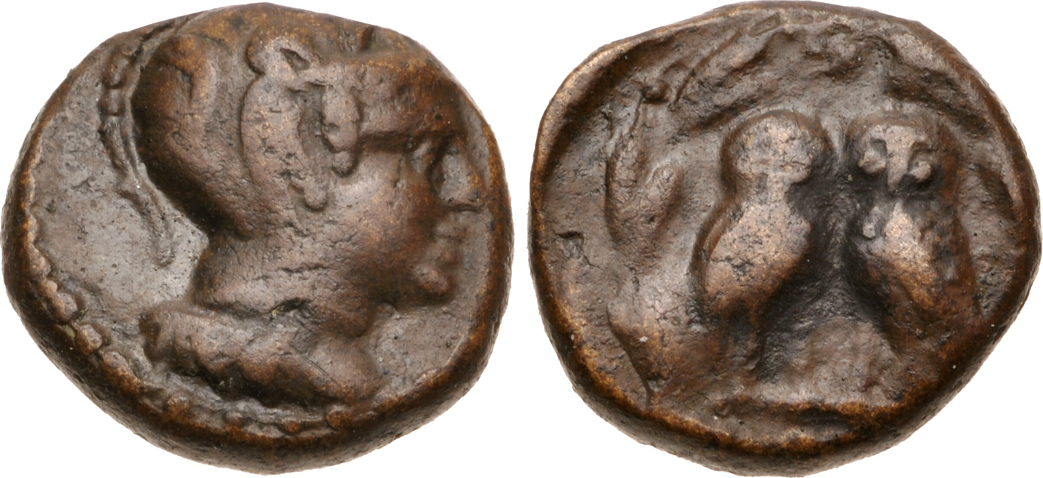
Athenian bronze
Kerameikos cemetary: two bronze coins of Salamis (c. 430s BC).
Dionysios Chalkous (“Dionysios the Bronze Coin”) (Athen. 15.669d). One of the leaders of Athenian colonization in Southern Italy (Thourioi) in 433.
Upon returning to Athens harped on and on about bronze coinage.
First bronze issues of Athens itself just after 340 BC.
Notes:
Salamis a cleuruchy – settled with Athenian citizens, but also natives not incorporayed into Athenian citizen body.

Slide 43
Further Reading
Anderson, B. (2006). Imagined Communities: reflections on the origins and spread of nationalism. London.
Aperghis, G. (2013). Athenian mines, coins and triremes. Historia 62.1, 1-24
Kallet, L., and J. Kroll, (2020). The Athenian Empire. Using Coins as Sources. Cambridge.
Kroll, J. (1981) From Wappenmünzen to Gorgoneia to Owls. American Numismatic Society Museum Notes 26, 1-32
Kurke, L. (1999). Coins, Bodies, Games and Gold. The Politics of Meaning in Archaic Greece. Princeton.
Lewis, D. (2008). The Athenian Coinage Decree. The Athenian Empire, ed. P. Low. Edinburgh.
Melville-Jones, J. (1993). Testimonia Numaria. Greek and Latin Texts concerning Ancient Greek Coinage. London.
Thompson, W.E. (1970). The golden Nikai and the coinage of Athens. Numismatic Chronicle 10: 1-6
Trevett, J. (2001). Coinage and democracy at Athens. Money and its Uses in the Ancient Greek World, ed. A. Meadows & K. Shipton, Oxford, 23-34
Trundle, M. (2010). Coinage and the transformation of Greek warfare. New Perspectives on Greek Warfare, G. Fagan and M. Trundle (eds), Leiden, 227-53

