Slide 1
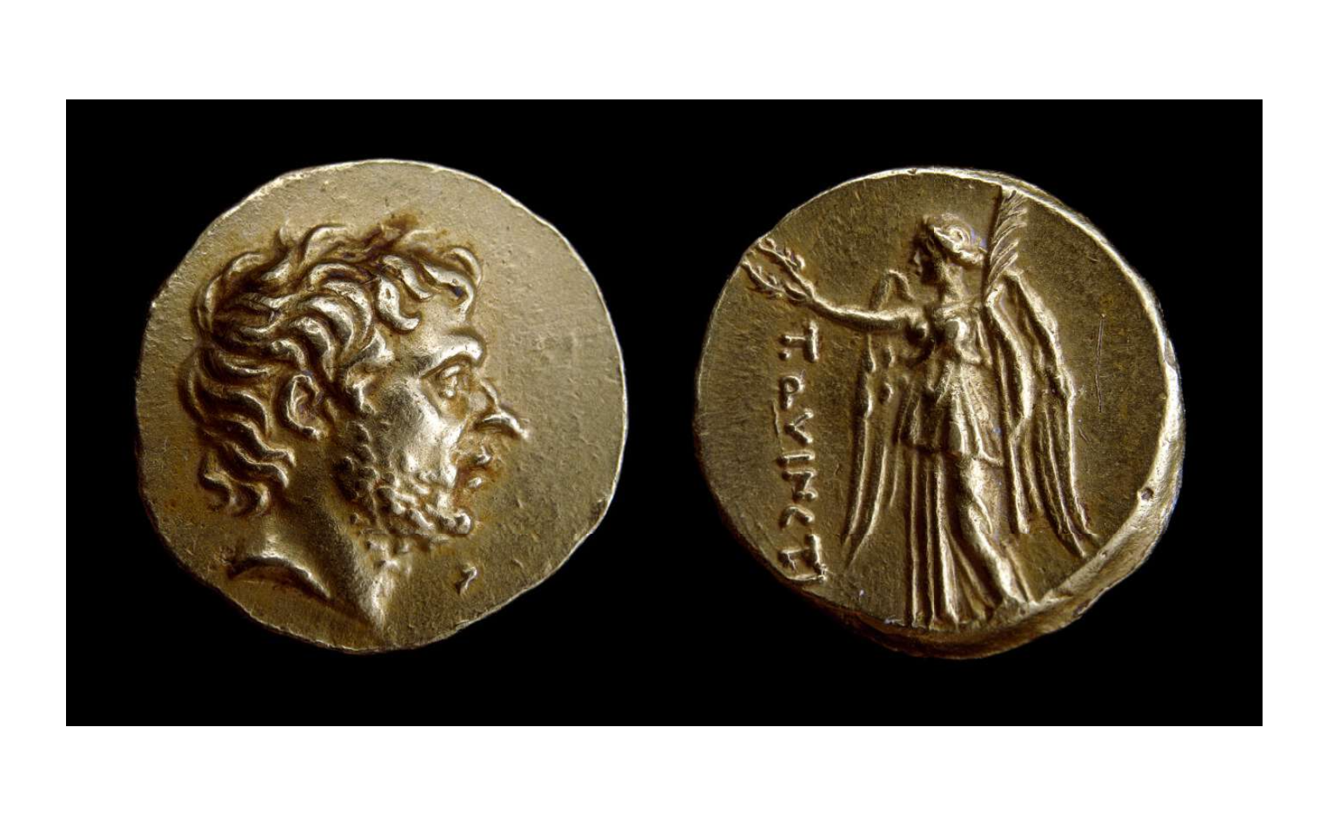
Greek Coinage and Rome

Slide 2
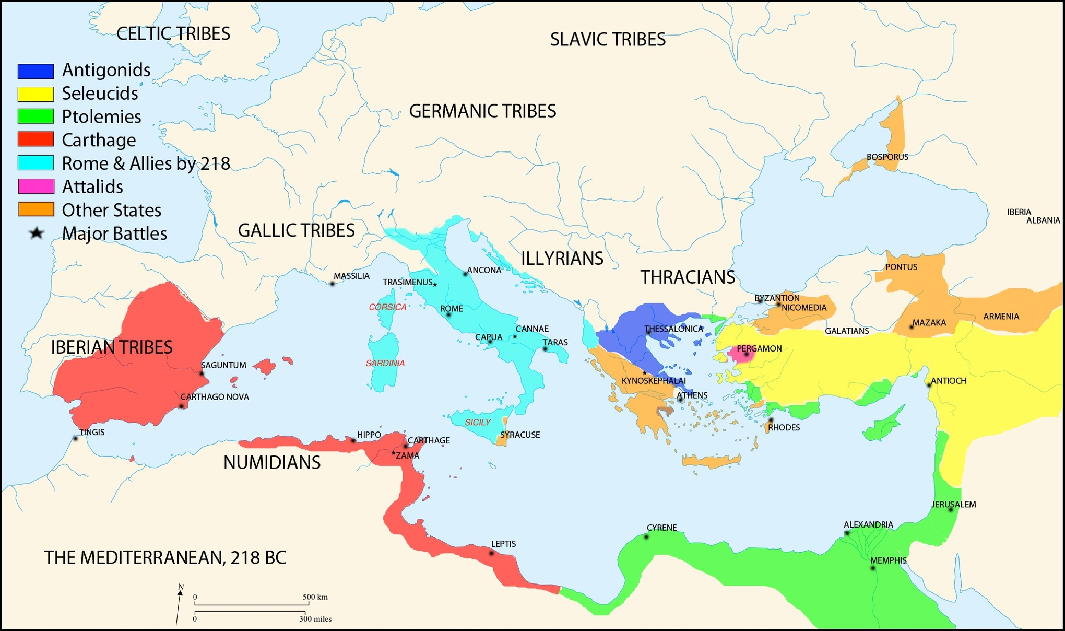
Notes:
As Rome expands, what happens to currency? What might you think happens?

Slide 3
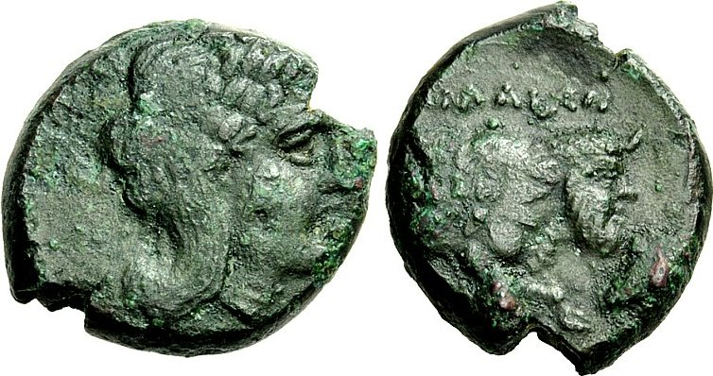
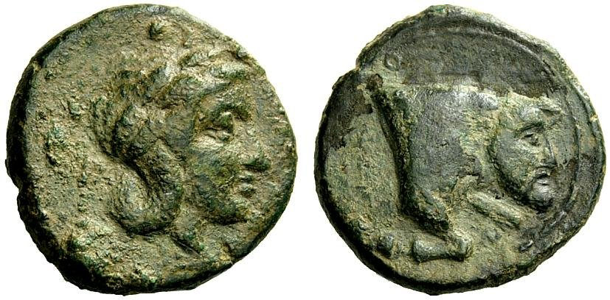
c. 326 BC or after: the first Roman coin
Bronze coin, struck at Neapolis/Naples (?) for (?) Rome, 4.54g, after 326 BC. RRC 1/1
Obv: laureate head of Apollo, r.
Rev: ΡΩΜΑΙΩΝ. Forepart of man-headed bull r.
Bronze coin struck at Neapolis for Neapolis.
Notes:
As part of an alliance with Naples.

Slide 4
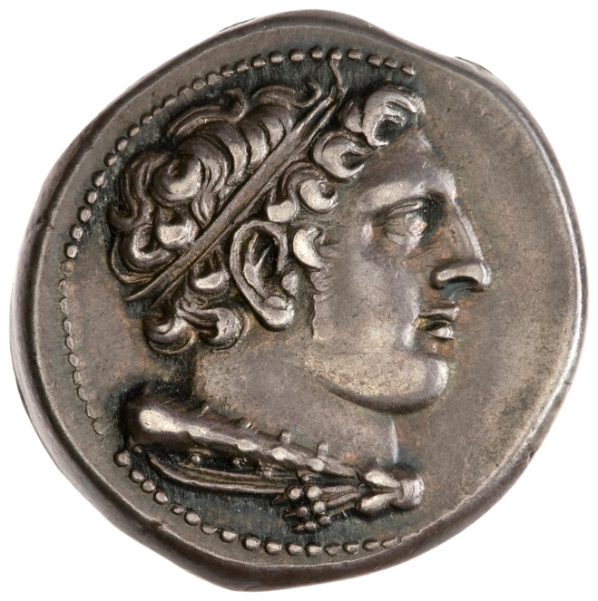
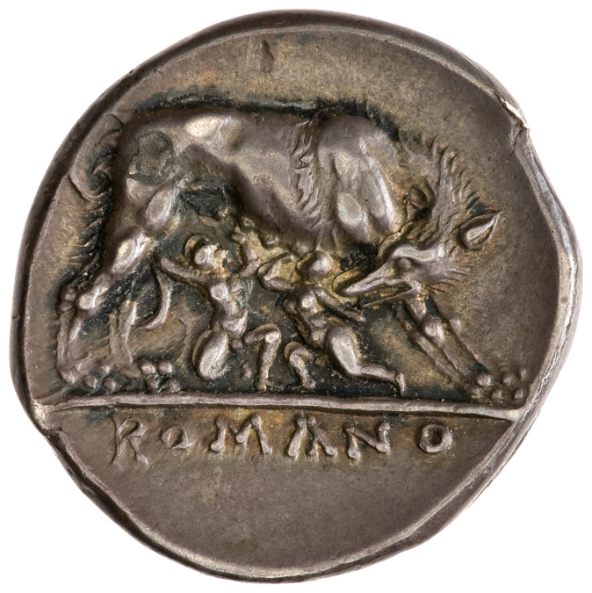
Silver didrachm, 269-266 BC, RRC 20/1.
Obverse: Head of Hercules, right, with hair bound with ribbon; with club and lionskin over shoulder. Border of dots.
Reverse:ROMANO - She-wolf, right; suckling twins; in exergue, inscription.
Notes:
Livy 10.23 – mentions a statue set up by aediles Gnaeus and Quintus Ogulnius set up in 296 at
the Ficus Ruminalis (Livy 10.23). An early Roman silver didrachm, coined around the
time of Q. Ogulnius’ consulship in 269, probably represents this sculpture.2
So fourth cwentury BC.
Initial mentions of the myth mention only Romulus, not Remus. So how/why did it develop? Remus appears last decades 4th century – perhaps to reflect the governing by two consuls

Slide 5
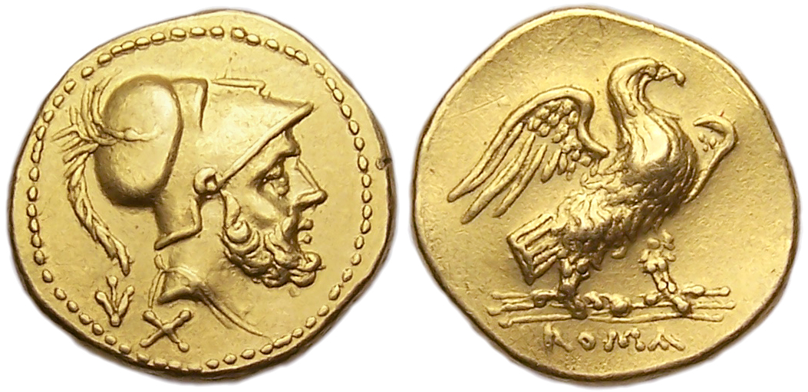
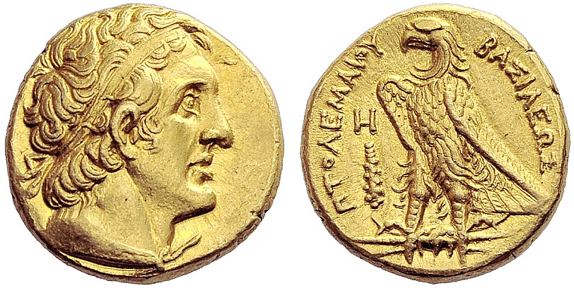
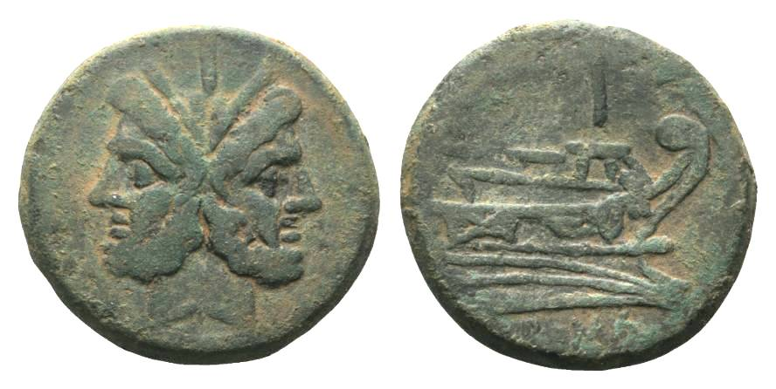
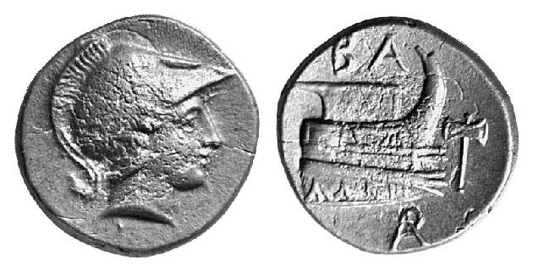
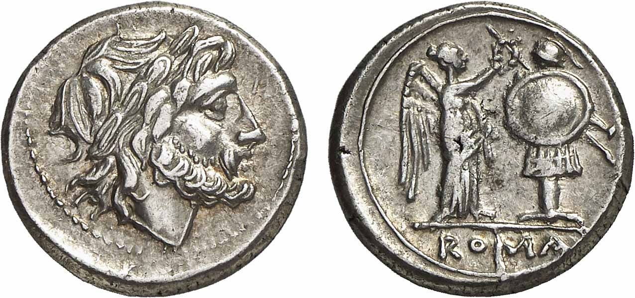
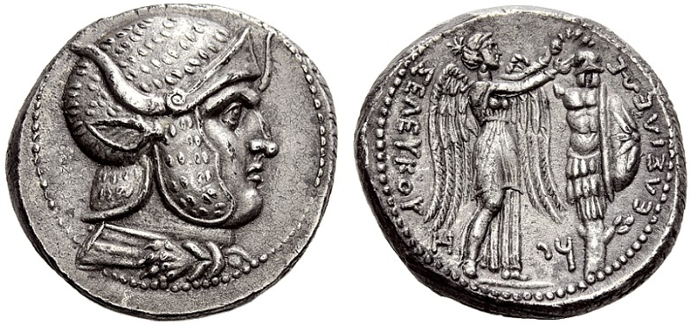
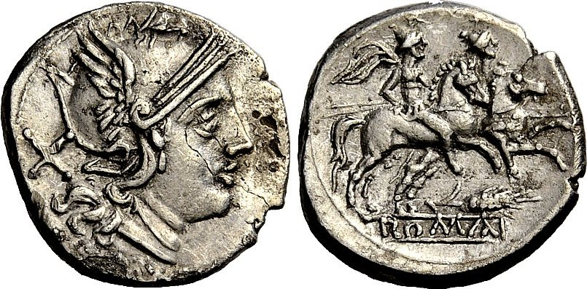
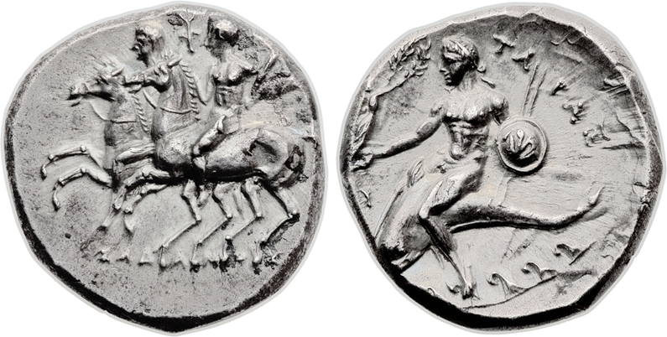
Rome (Denarius System from 211 BC)
Hellenistic World
Ptolemaic
Demetrius Poliorcetes
Seleucid
Tarentum
Notes:
Gold from 211 BC
Prow – Demetrius Poliorcetes. AMNG 17; Newell 163; SNG Cop. 1187
Could have come indirectly, e.g. via Pyrrhus, Syracuse
Antiochos III, Tarsus. Tarentum also strikes Dioscuri types..
https://www.youtube.com/watch?v=CKX0U7arQFw
Makes sense – this is more understandable to those under Roman rule than Roman Latin conceptions!
Disappearance of local Greek coins from circulation/hoards.
Meadows = an indication received Ptolemaic help>? Clear that acknowledgement of Ptolemaic financial assistance by the adoption of the Ptolemaic coin type was a widespread phenomenon in the third century BC: Eagle and thunderbolt would have been a clear motif to Greeks, Italian and Carthaginians. Only the slightly earlier iossues of victoriatii the Romans may h
Kevin’s project – gold is different tio Ptolemaic gold.
Augustan gold different from Hellenistic gold coinage. – New gold supply under Julius Caesar,

Slide 6
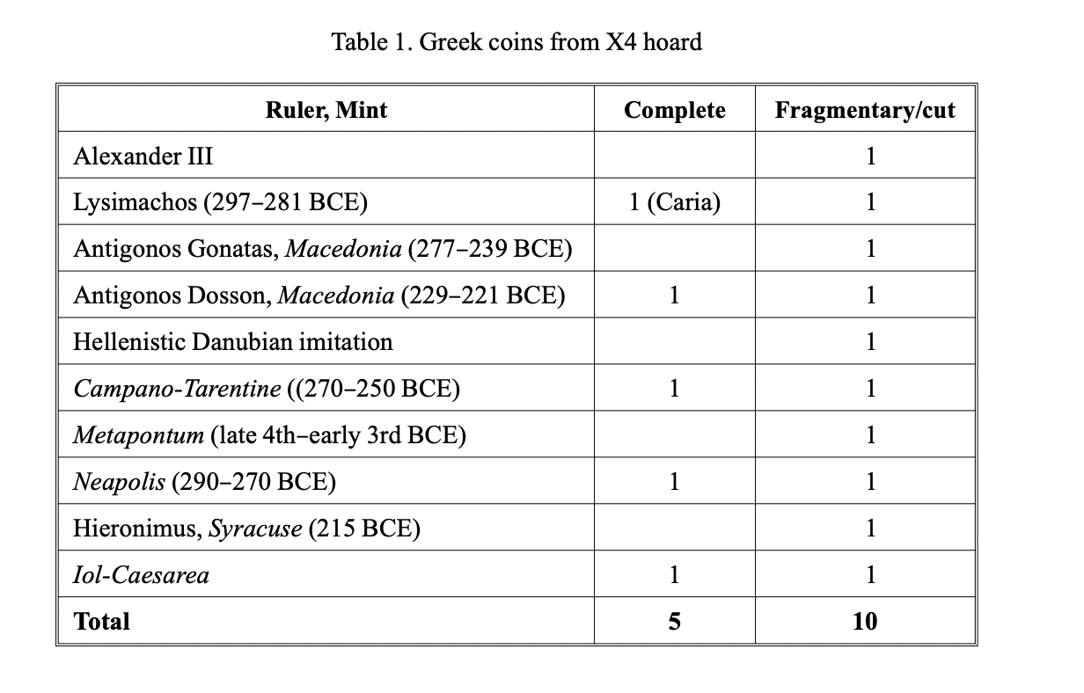
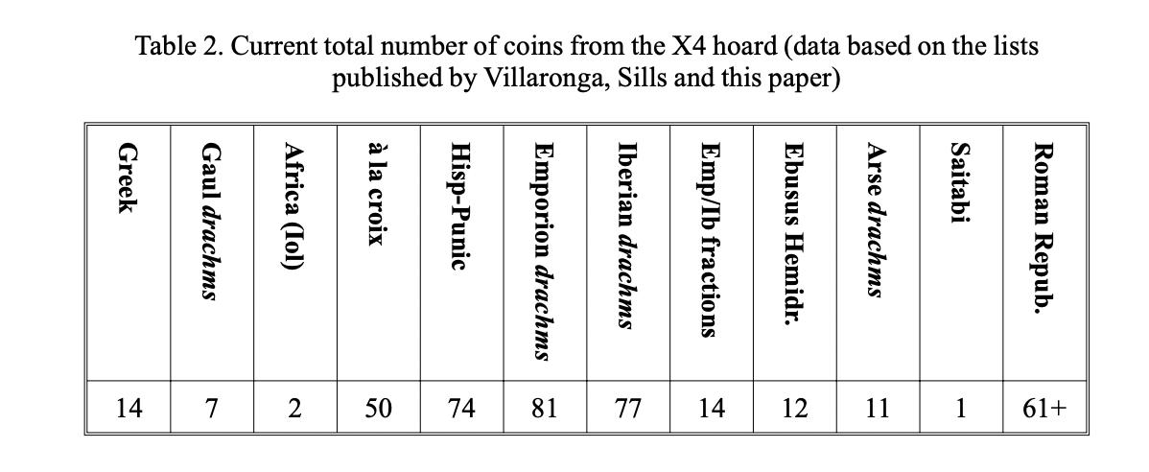
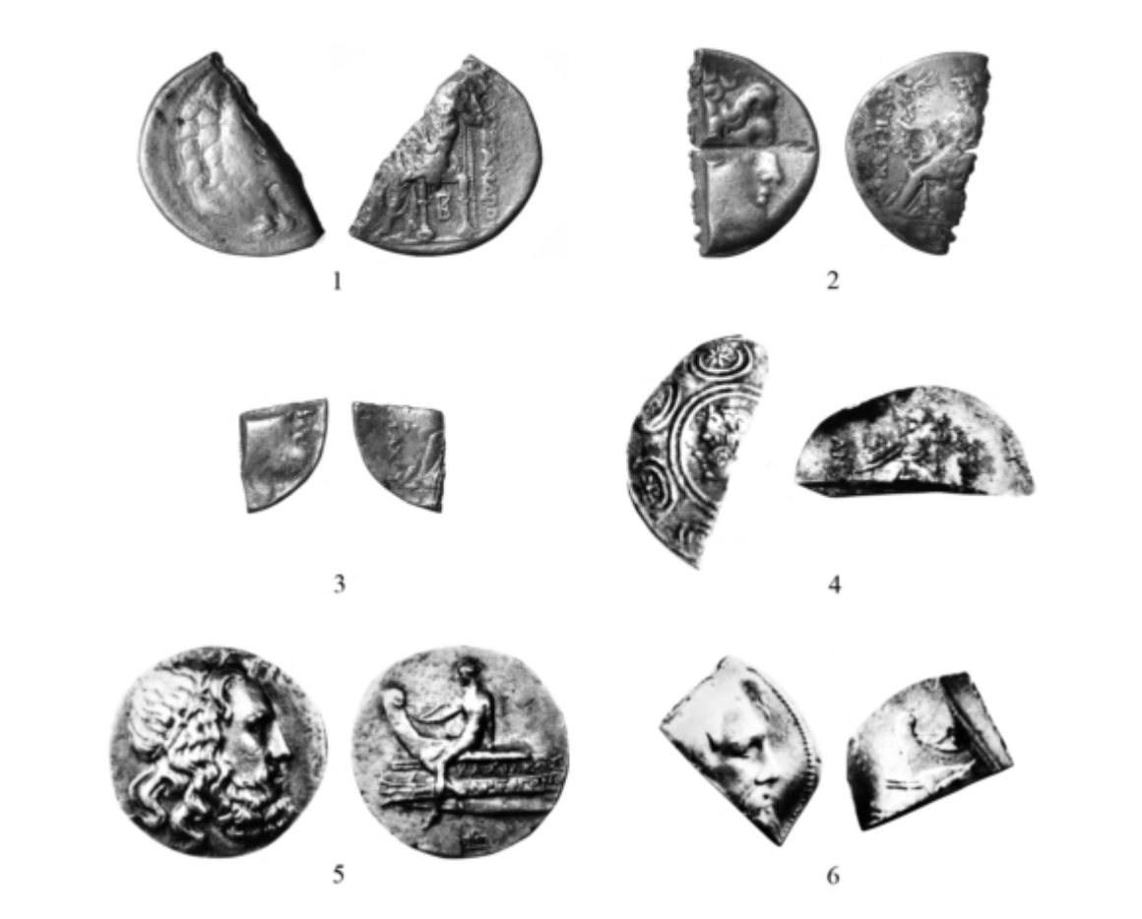
X4 Hoard (Spain) (Second Punic War)
Notes:
Unknown location – came through the markets in lots. Photographed, but some pieces may have been left out (e.g. those of low value).
From contents said to be from the Second Punic War or a few years later.
Hellenistic coins arrive in Spain during the Second Punic War – presumption is it is connected to the funding of the army.
M<ust be modest though – only a small amount.
But actuallty compared to what we see in the east in terms of a Hellenistic monetary zone, very little here in the west. Had ‘Hellenising’ Greek monetart traditions, but not influenced by the cvoinage of Alexander and his successors in the same way we find in the east. Hellenistic West, from a monetary perspective, very different to the east.

Slide 7
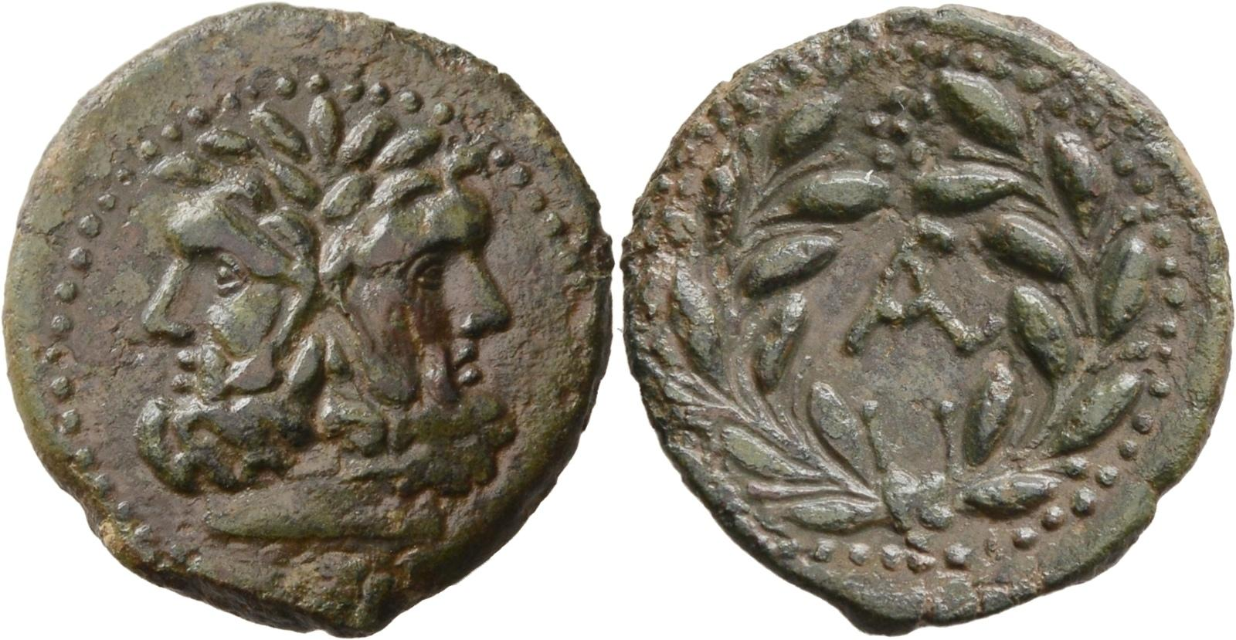
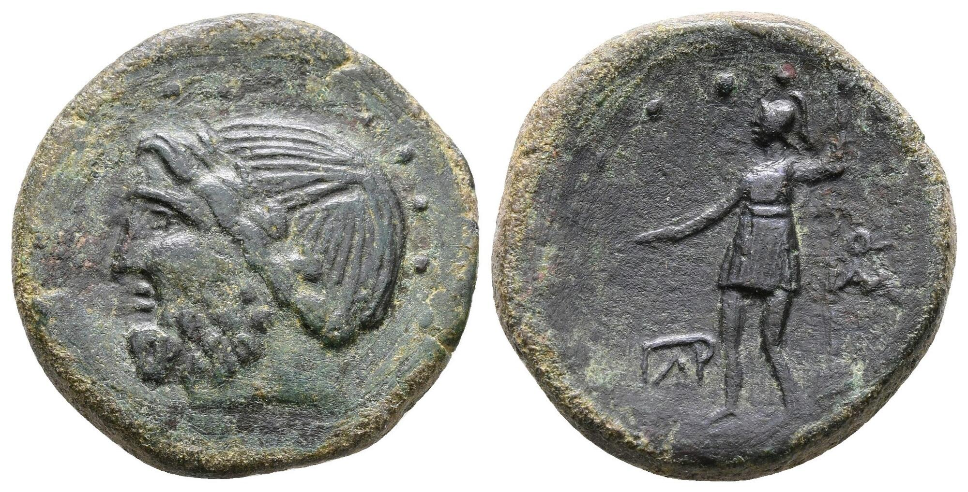
Sicily: Romano-Sicilian coinage, 2nd century BC
Lilybaeum and Panormus
Head of Janus / wreath with name (Roman official)
Jupiter / standing figure of a warrior
Notes:
Denarii was the silver coinage
Locally produced bronze
Also Roman bronze produced for local use

Slide 8
Roman Macedonia
197 BC: Titus Quinctius Flamininus defeated the Macedonian King Philip V at Cynoscephalae.
196 BC: Flamininus at the Isthmian Games, proclaimed the freedom of the Greek states.
168 BC: conclusion of Third Macedonian War, Romans divide Macedon into 4 merides
148 BC: Roman province
Notes:
Philip was forced to surrender, give up all the Greek cities he had conquered, and pay Rome 1,000 talents, but his kingdom was left intact to serve as a buffer state between Greece and Illyria.

Slide 9
RRC 548/1a
AV Stater, 196 BC.
Bearded head of T. Quinctius Flamininus, right / Victory standing left, holding wreath in out-stretched hand right and palm-branch in left hand. T·QVINCTI (downwards). 8.44g.
10 known specimens, 4 of which are in museums.
Notes:
Last gold coins minted in Macedonia presumably those with the name of the Roman general Flamininus. Coins are very rare, but the specimens have few die links between them. Suggests the original issue was quite large and made from a relatively large number of dies, but that it was quickly suppressed for reasons we can only speculate about.
Burnett - p. 99 n. 9 - Flamininus coins - explained if struck by Flamininus and subsequently it was thought inappropriate to represent a Roman general like a Macedonian king.
It is modelled on the traditional gold coinage of Macedonia, initiated by Alexander the Great. From this is borrowed the image of Nike on the reverse.
Supposed that these now very rare coins were mined at .chalcis in Euboea at the time when Flamininus gave the isthmian games to celebrate his victory.
p 60: a plausible context but no means certain. Die study.
These look like a real monetary issue, t be distributed as a souvenir to high officers and friends. (n. 13 Delian inventory in the temple of Artemis in 192 mentions 'Three chrysoi in a wooden case, offering of Quintus the Roman', Melville Jones 258, a line that is repeated in subsequent years. Tempting to see referral to these staters.)
First portrait of a Roman on coinage.
Alfoleldi: p 21: in the hellenistic period the name in geneitive on the coins signifies who was responsible for the issue - T. QUINCTI
Argues this suggests Flamininus struck the coin. The portrait also shows Flamininus - no decoration or diadem, as would be seen on the hellenistic kings.
Why the inspiration drawn from the Alexander gold type? The type was popular on other hellenistic kings as well, esp. for the attic weight standard.
This Alexander gold type was the most common and well known gold coin in Greek.
p 22: if one wanted the coin to immediatelybe accepted in Greece, the Alexander type was the way to go.
p 22: argues clear Flamininus struck the coin, we need only ask in what capacity. One could strike coins as a military impertator.
p 24: but when and from what metal did Flamininus strike the type?
The 200 talents mentioned by Polybius.
p 25: the 200 talents that Flamininus received in late summer or early autumn 197 from Philip after Kyneskephalai.
5 known obverses and reverses – possibly as many as 100,000 pieces originally issued,.

Slide 10
Silver Coinage in Macedonia
Macedonian silver coinage
Athenian silver from c. 150-90 BC. Nearly the complete production of 126/5 BC – 123/2 BC are in North Aegean hoards.
from 80/75BC Roman denarii started to circulate and formed the exclusive currency of the area from after c. 50 BC.
Notes:
De Callatay - p 11: in Touratsoglou's work, 7 hoards of Macedon composed only of Athenian coins, and 6 which contain other currencies as well. Using Morkholm's lower chronology, the nnumerous Athenian issues they contain fit into the period 139-92 BC.
p 17: separate Macedonian circulation phenomenon.
p 18: the massive import of Athenian currency into Macedonia can be dated to 158/7-153/2 according to the high chronology, 126/5-121/0 according to the low chronology. 126-121 attracts attention. A gap of some 20 years exists between the provincialising of Macedonia (and the closing of the mints which is generally linked with this event) and the flood of Athenian tetradrachms which occured to supply the deficiencies of local production.
The emissions which reached northern Greece in a seemingly very abrupt manner continued for some 30 years to provide the bulk of the coinage used in local exchanges. Their longevity in Macedonia is accompanied by their general absence in hoards deposited south of Macedonia. This suggests a rather immobilised circulation, supplying the needs of a local market.
4 years – large coiunage iossued for trade. But de Callatay argues no – why so far north? Myst be a Roman request for money to pay troops.

Slide 11
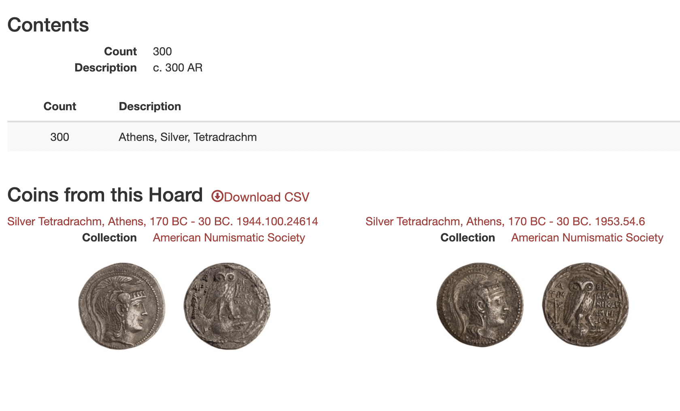
IGCH 478 (Thessalonika, Macedonia)
Hoard Description
Deposit: 130 B.C.
Discovery: 1929
Disposition: London 60; New York 3 (1 ex Berry); private colls.
Description: Tetradrachm: 300

Slide 12
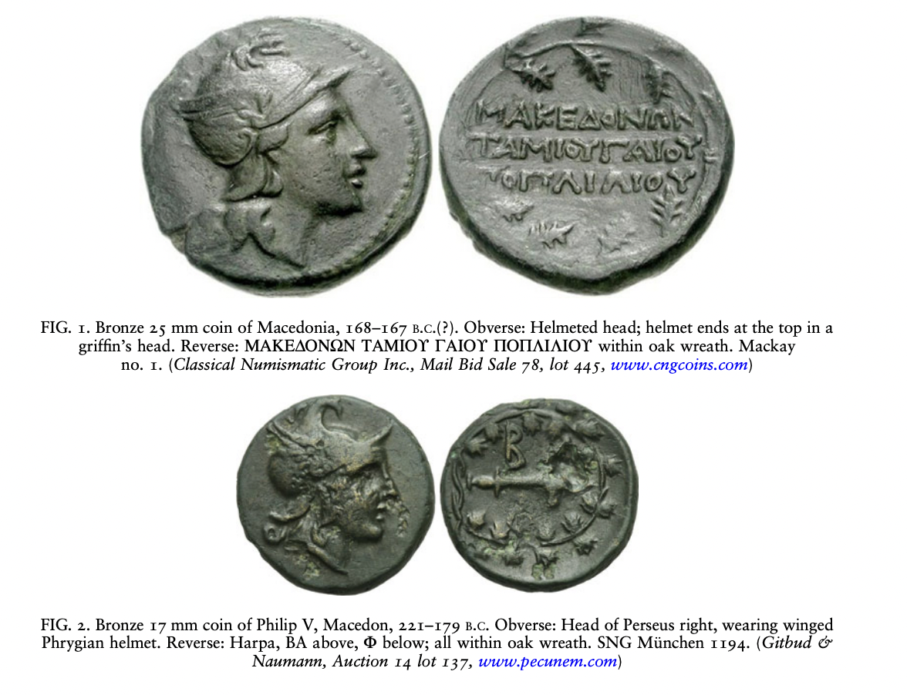
Bronze Coinage
Gaius Publilius, Roman quaestor, 168 BC
Notes:
Ambiguity – is this Roma or Perseus? Roman name clear thjough.
Find similar things in Sicily – Romano-Sicilian issues. Are they Macedonian or Roman? Macedonian-Roman?

Slide 13
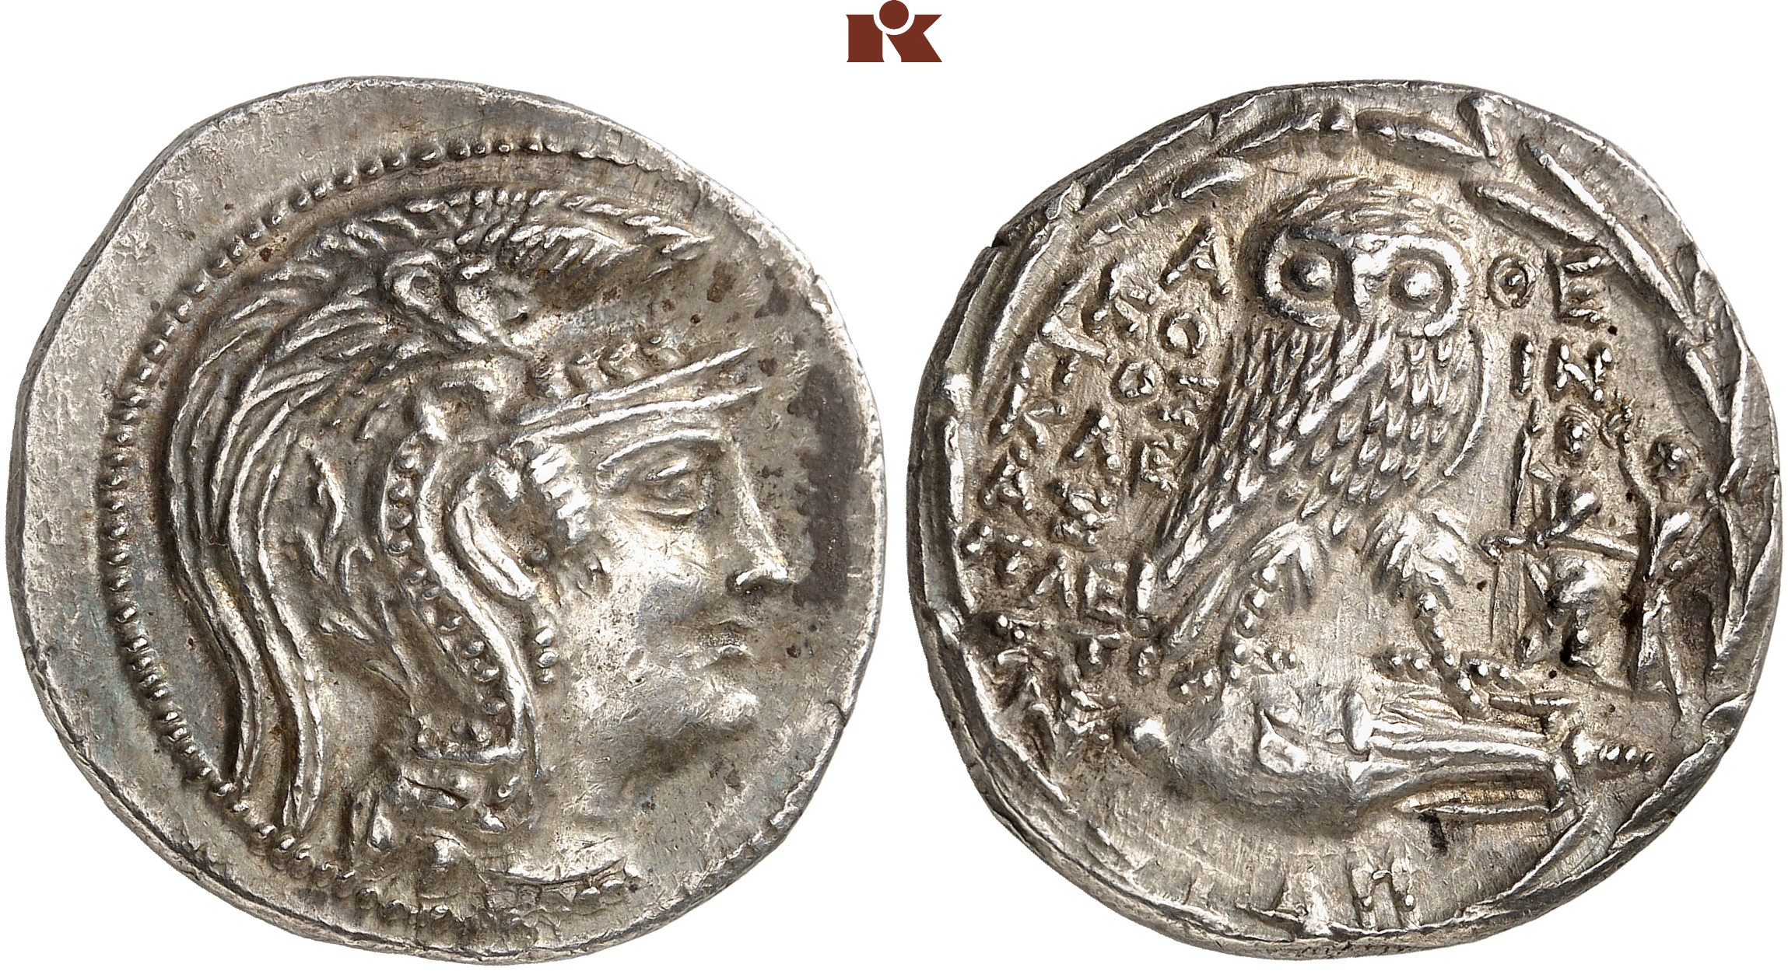
Stephanephoric (”New Style”) Athenian Tetradrachms
89/8 BC, ΚΟΙΝΤΟΣ (Quintus) and ΚΛΕΑΣ. Symbol: seated Roma being crowned by Victory.
Thompson 1127 a/b.
Notes:
Thompson – 467
Struck from mid 160s BC, after a period of very little minting from Athens.
160-140 BC – a veritable explosion of wreath coinages throughout the east.

Slide 14
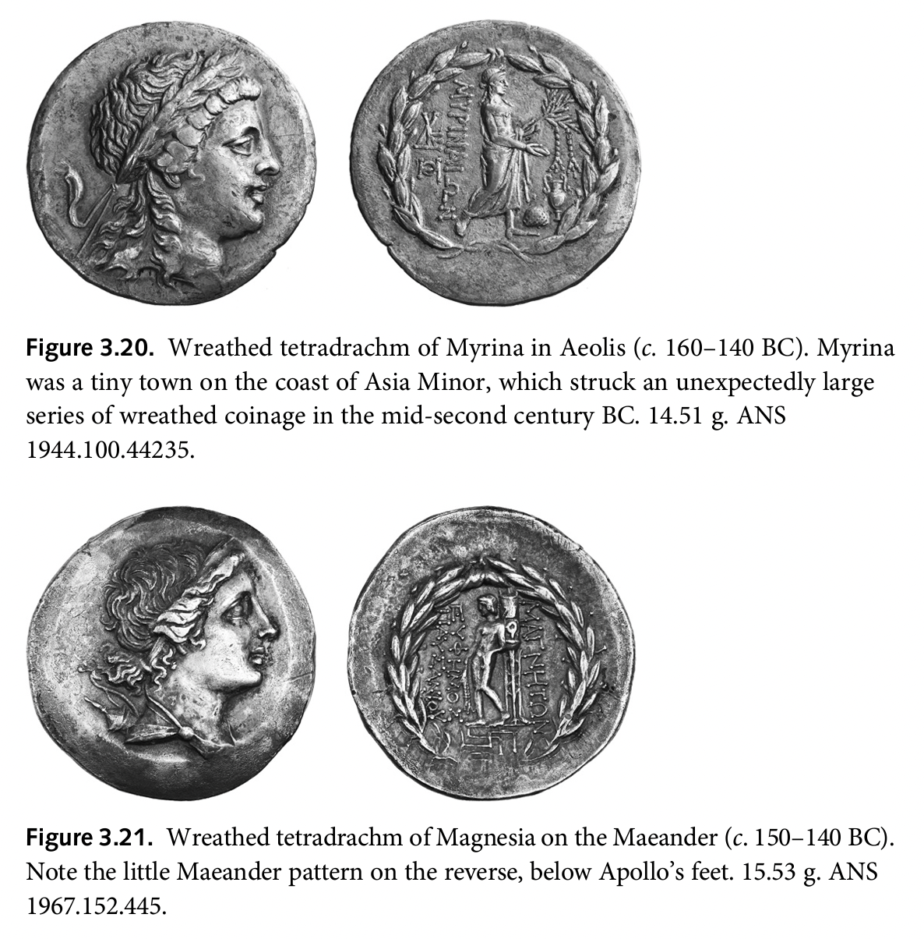
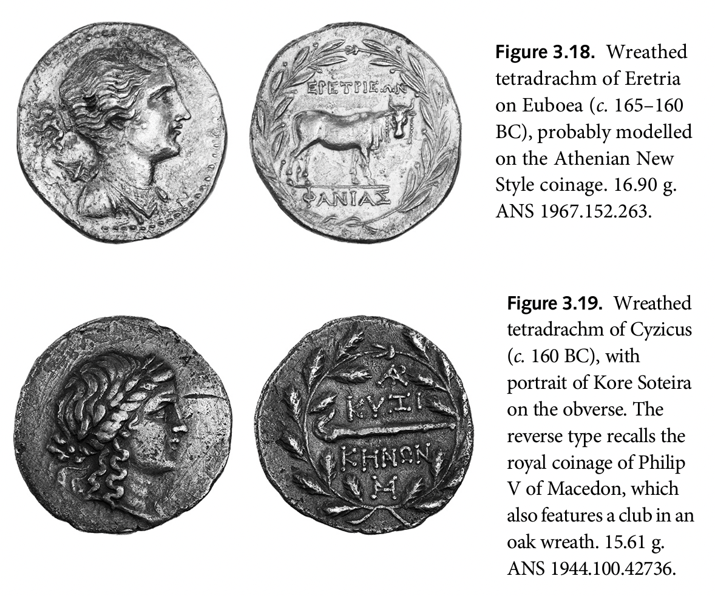

Slide 15
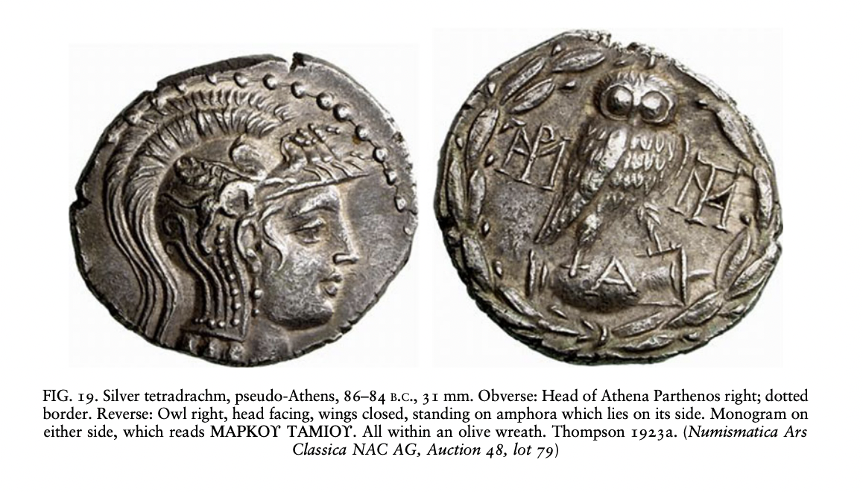
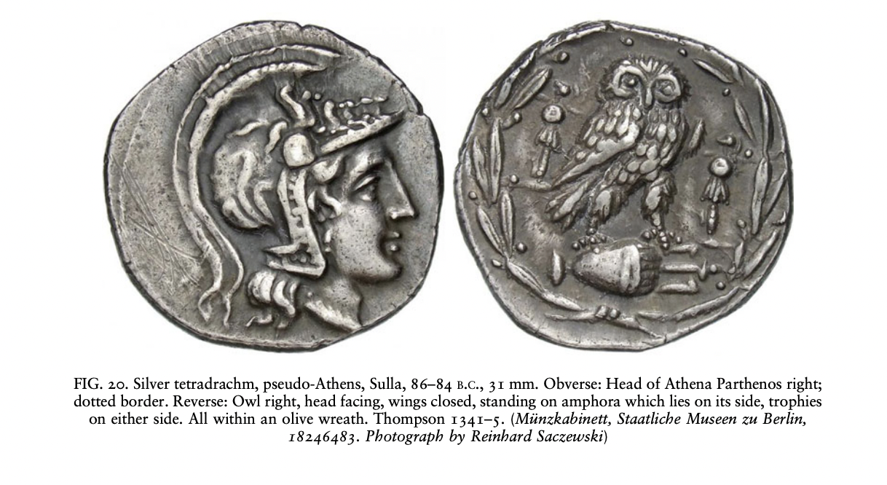
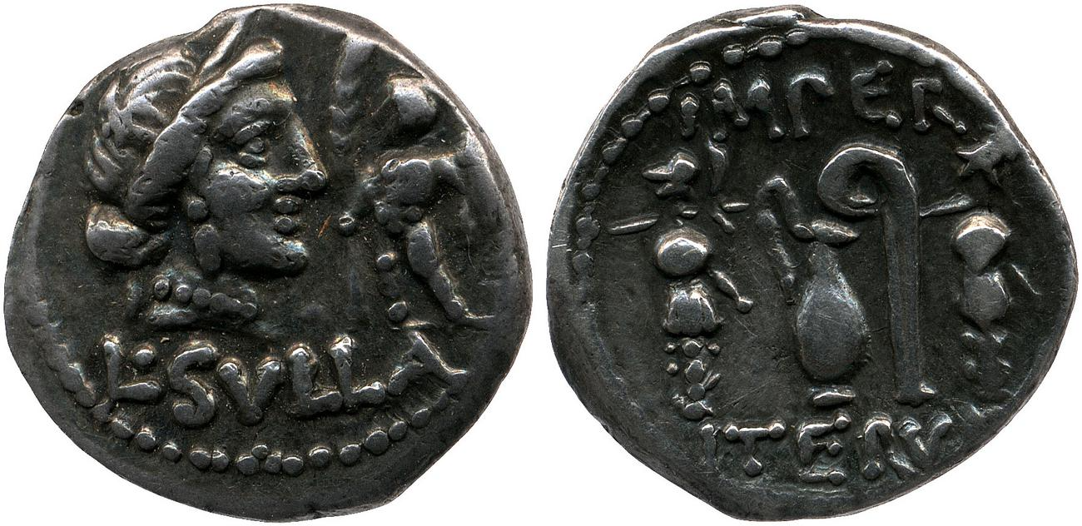
Sulla in Athens
RRC 35/2 (Trophies of Chaironeia)
Notes:
What is different here?
No ethnic – names of Sulla’s commanders – Marcus Luycullus.
Trophies of Chaironea.
After his account of the battle of Chaironeia, Plutarch ( Sulla, 19.5 ) says: "[Sulla] inscribed upon his trophies the names of Ares, Nike and Aphrodite, in the belief that his success in the war was due no less to good fortune than to military skill and strength. This trophy of the battle in the plain stands on the spot where the troops of Archelaos first gave way, by the brook Molos, but there is another planted on the crest of Thourion to commemorate the envelopment of the barbarians there, and it indicates in Greek letters that Homoloïchos and Anaxidamos were the heroes of the exploit."
Two recent discoveries have fully confirmed Plutarch's statement, although the latest discovery was found near Orchomenos, and so the trophy must refer to the battle of Orchomenos. Enough has survived to enable this trophy to be restored; the drawing is taken from M. Magnisali & T. Bilis, in "10th International Symposium on the Conservation of Monuments in the Mediterranean Basin, p. 639 ( Google Books ).
Details of the two trophies have been published by J. Camp, "A Trophy from the Battle of Chaironeia of 86 B. C." ( academia.edu ); and E. Kountouri & N. Petrochilos & S. Zoumbaki, "The Tropaion of Sulla over Mithridates VI Eupator: A first approach" ( academia.edu ).

Slide 16
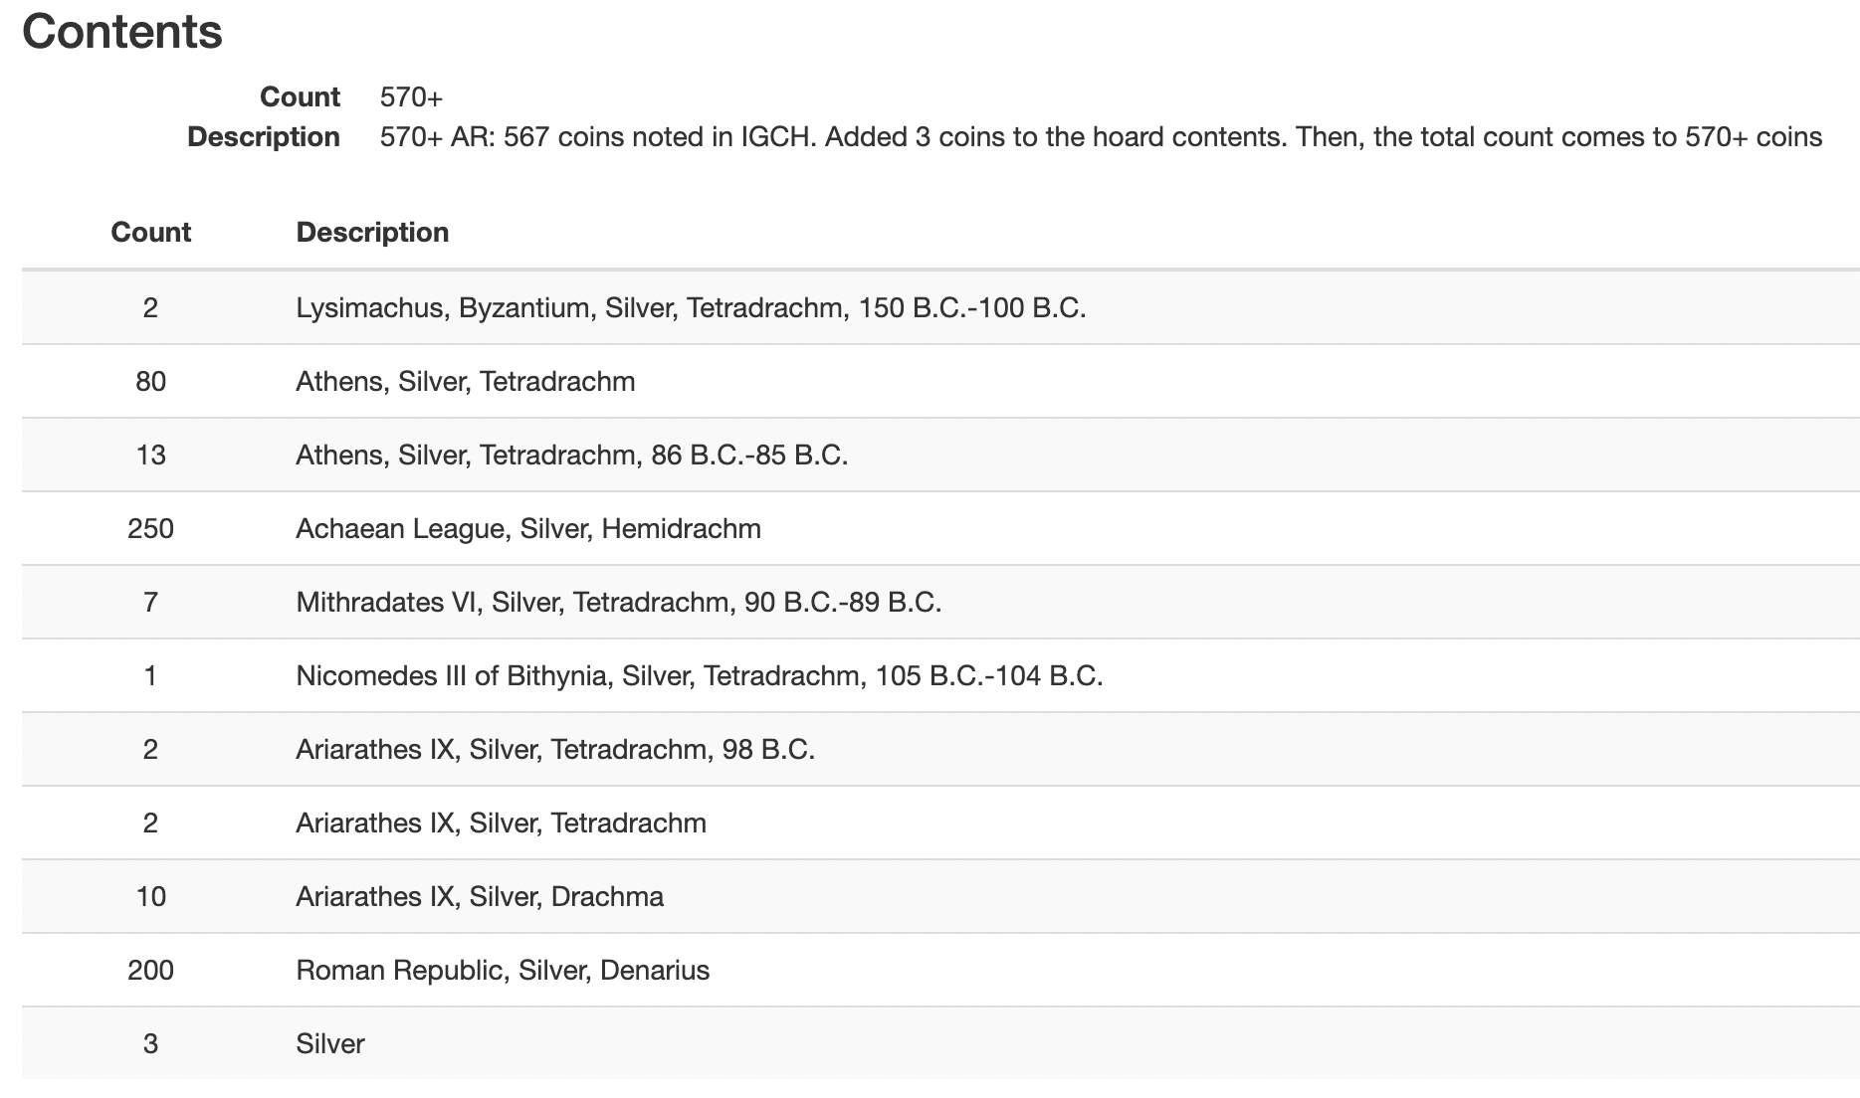
IGCH 2056 (Poggio Picenze, Italy, 80 BC)
Hoard Description
Deposit: 80 B.C.
Discovery: 1954
Disposition: Chieti 324 (incl. Athens 56, Mithradates 3, Ariarathes 10, Achaean League and den., many); New York 28 (Athens); von Aulock 1 (SNG 6300, tetradr. of Ariarathes)
Description: Hemidrachm: 250, Denarius: 200, Tetradrachm: 107, Drachma: 10
Notes:
De Calltay – certainly the pay of one of Sulla;s veterans.

Slide 17
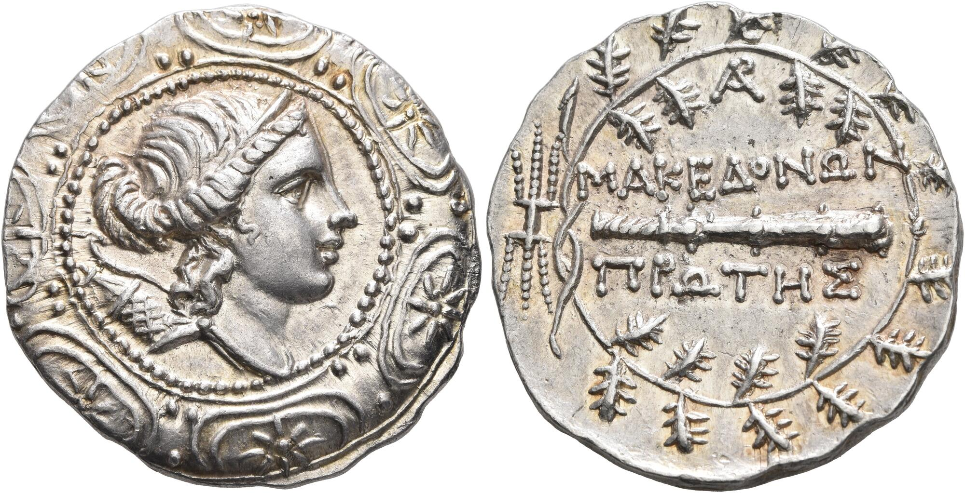
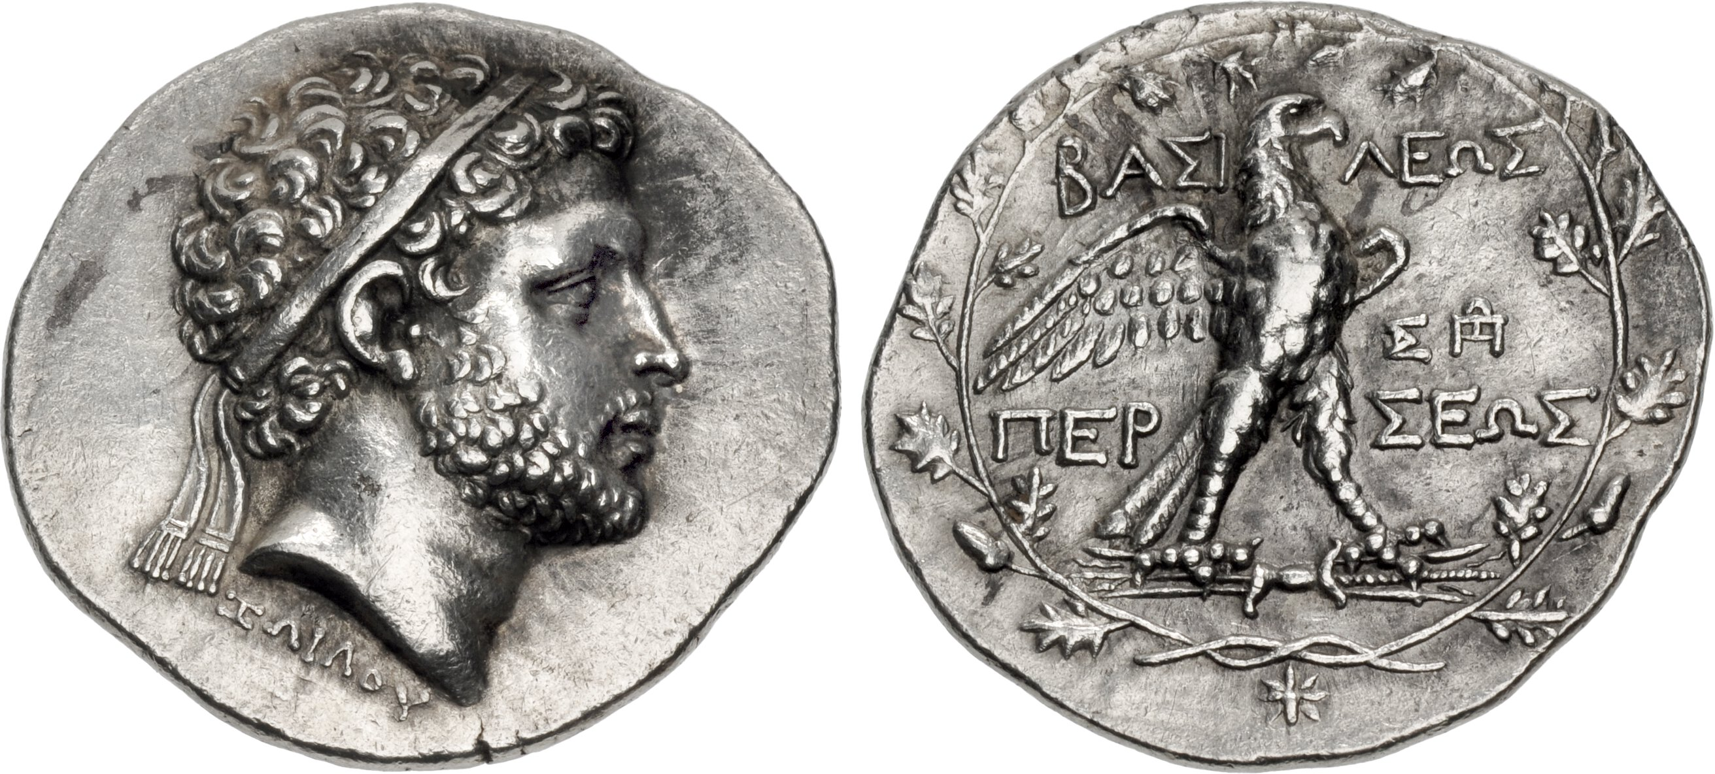
Silver coinage in Macedonia
Roman period, First Meris. Circa 167-149 BC. Tetradrachm (Silver, 34 mm, 16.89 g, 9 h), Amphipolis.
Diademed and draped bust of Artemis to right, bow and quiver over her shoulder; all at the center of a Macedonian shield ornamented with stars within crescents / MAKEΔONΩN / ΠΡΩTHΣ Club to right; above, monogram; around, oak wreath with ties to left; to left of the ties, thunderbolt.
Perseus. 174-170 BC. AR Tetradrachm (32.5mm, 16.51 g, 7h). Attic standard. Amphipolis mint; obverse die signed by Zoilos. Struck circa 174-170 BC. SNG München 1196
Notes:
Crawford – traditional idea that Romans used foreign coinages on campaign, obtained through normal channels. Overall thought there was an absence of intervention.
Diademed head of Perseus
Diademed head right; ZΩIΛOΥ below neck / BAΣI-ΛEΩΣ ΠEP-ΣEΩΣ, eagle, wings spread, standing right on thunderbolt; two monograms to right; all within oak wreath; star below. D
Among the first portrait tetradrachms of the Macedonian King Perseus are a few bearing the legend ZΩIΛOΥ ("of Zoilos") below the neck. The extraordinary quality and relief of the portraits marked with this name have led to speculation that Zoilos was a master die engraver or mint official responsible for production of this type. Clearly, this Zoilos was a figure of some importance, perhaps a "chief finance minister" as some have speculated, since the name is written out in full in nominative form, rather than abbreviated in the form of a monogram, as would be typical for an engraver or magistrate. A monogram with the initials ZΩ occurs on coins of Perseus' father, Philip V, and it is plausible this same magistrate may be the Zoilos named in full here. If so, he may have overreached, as the full name disappears after one brief issue, replaced by a monogram on the reverse for a time before disappearing entirely as the artistic quality and weight of Perseus' coinage declines.

Slide 18
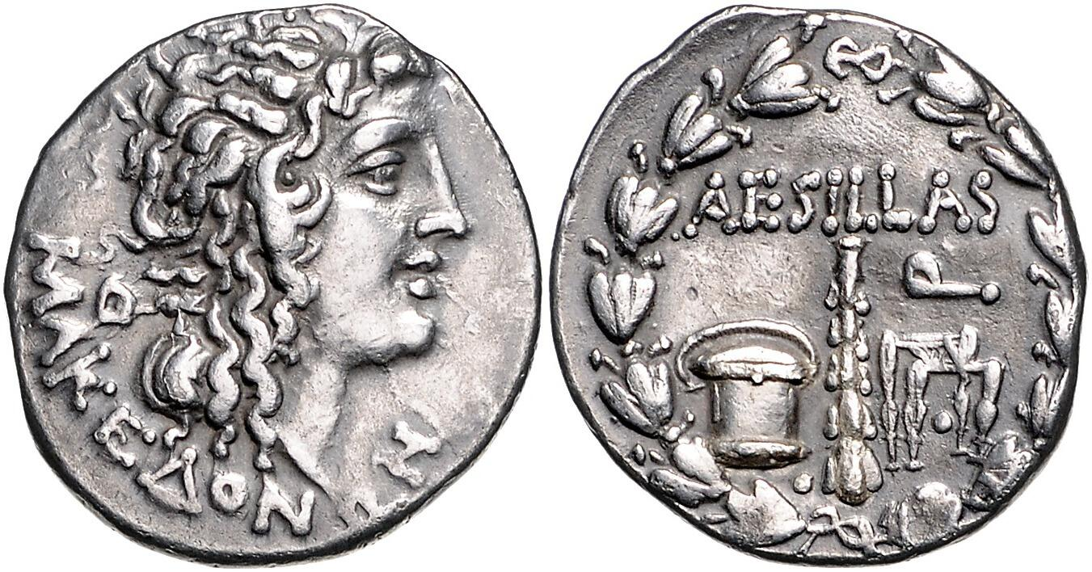
Aesillas Issues
AR tetradrachm, 93-92 BC.
SNG Cop.1330
Notes:
Head of the deified Alexander the Great right; Θ to left / Money chest, club, and chair; all within wreath.
Aesillas as questor
. The conditions of the coins buried, and especially their low grade of wear,
makes it very clear that the coins did not circulate for a long period but were taken
out of circulation shortly after their issue, and some coins (and a higher proportion
than is known for the New Style coinage of Athens) were even holed and thereby
turned into jewellery. This points to a very specific use and function for these coins
p 61: and a deliberate production aiming at a precisely defined political agenda. The coins
with the types of Aesillas were issued to pacify those Thracian tribes during the
Mithradatic wars that were living in the regions neighbouring the Via Egnatia, Rome’s
strategic connecting road from Dyrrachium through Macedonia to the harbours and
ports which were the starting points for the passage into Asia. This historical period
of critical military conflict is the context within which this coinage belongs and is what
it was created for.
The iconography of the coins marks an amazing step away from the traditional
types used in the province earlier. The symbols of a Roman financial officer clearly
show the source of their production and the choice of a portrait of Alexander the
Great even more clearly testifies to a deliberate and quite ingenious decision.
Alexander’s portrait resembles the one on the coins with the type of Lysimachus and
therefore was already familiar especially to the Thracian tribes. In addition Alexander’s
appearance certainly played to Macedonian national pride and in a way enrolled a
national icon into Roman service. But, to stay on the safe side, Aesillas deliberately left
out the royal diadem of Alexander that marks his royal rank on the Lysimachi. The
former king may now be a god but there was certainly no longer any need for a
Macedonian king in a Roman province.

Slide 19
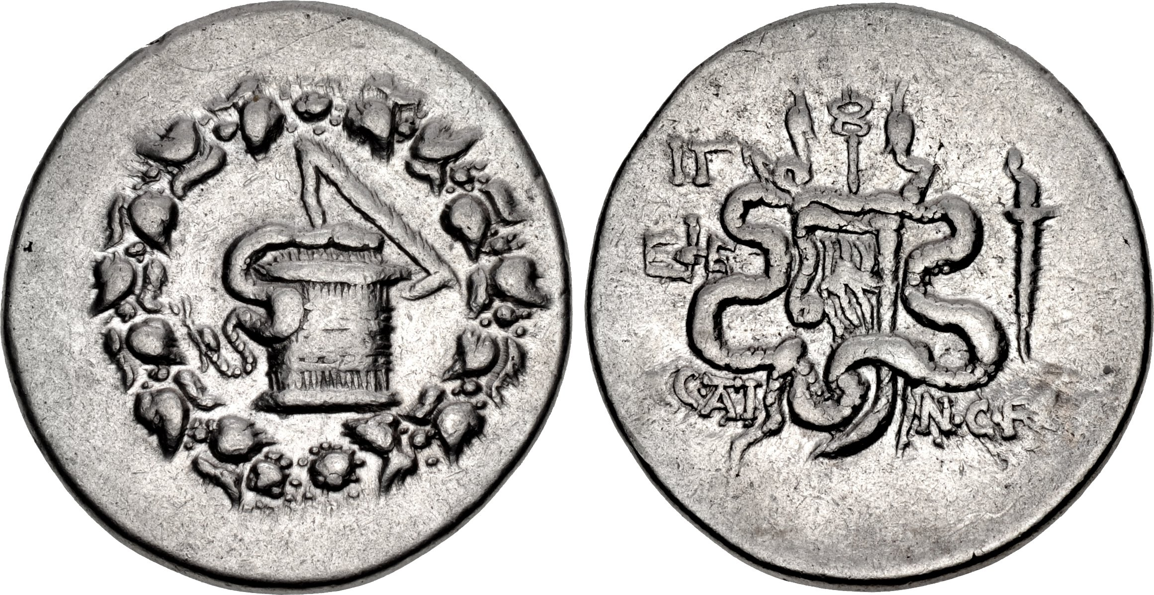
Cistophori in Asia Minor
122/1 BC: C. Atinius C. f. Labeo Macerio (Stumpf 1b)
Notes:
From 59/8 BC – names of Roman proconsuls appear rewgularly. Not before with this exception.
Just one example – Roman names also appear scattered elsewhere in the east 0- de callatay.

Slide 20
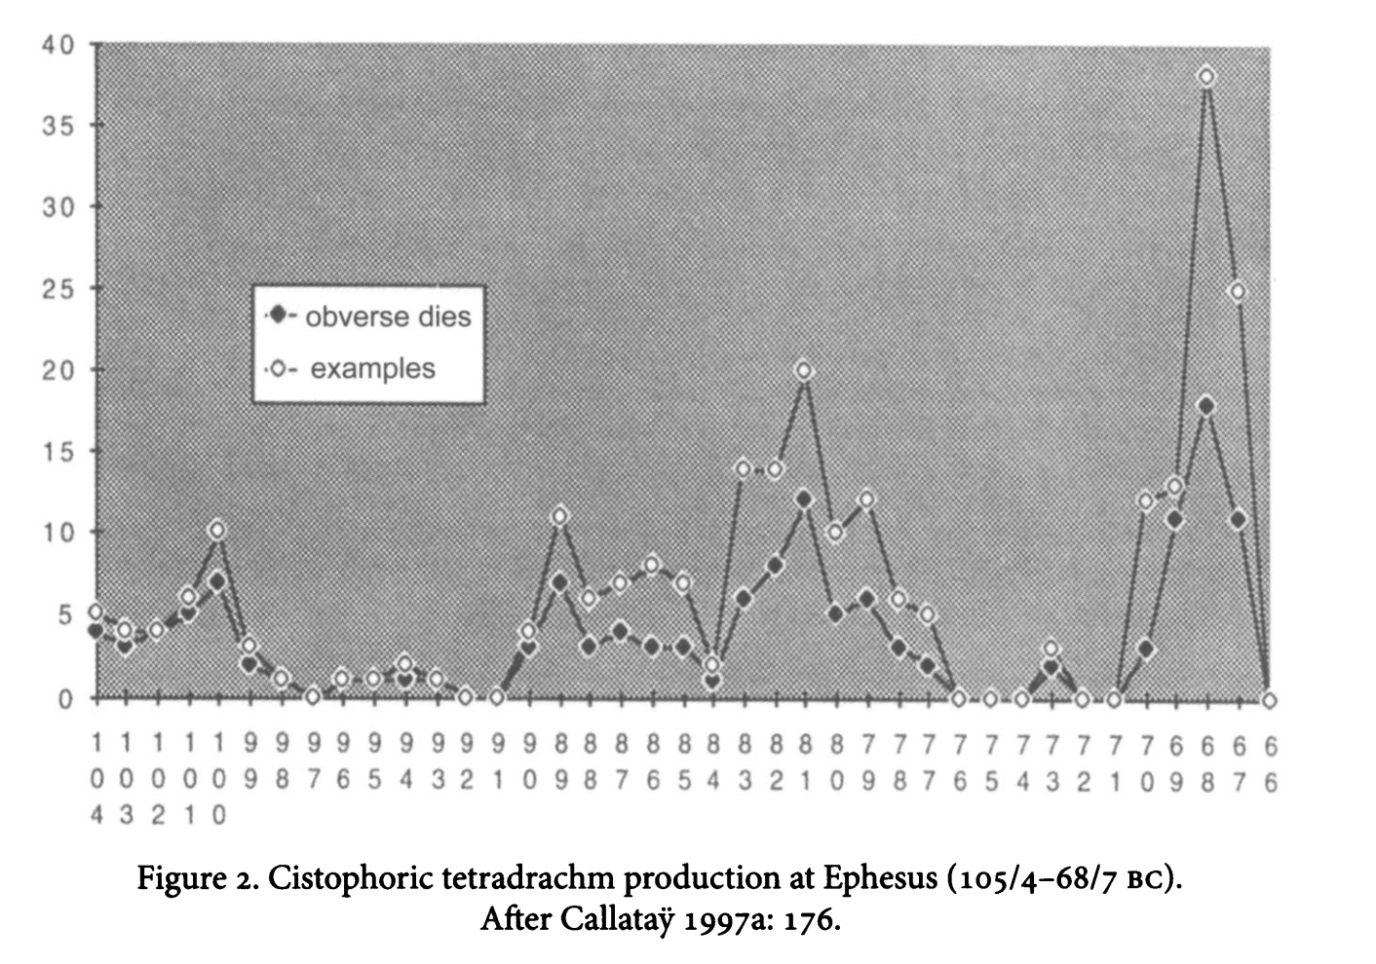
Notes:
Cistophoric tetradrachms dated – so can do this chart. Peak right at the end from 70 BC. These are the years marked by the iconographic innovation connexted to Lucullus.
Another peak in 84 – again probably connected to Lucullus, this time left in Asia by Sulla, who ordered him ti, among other things, restore the finances of the city.

Slide 21
Cistophoric Tetradrachms and Lucullus
Plutarch Lucullus 2.2.
Most of the money used in Peloponnesus during the Mithridatic war was coined by him and was called Lucullean after him. It remained current for a long time, since the wants of the soldiery during the war gave it rapid circulation. Afterwards, at Athens, Sulla found himself master on land, but cut off from supplies by sea, owing to the superior naval force of the enemy. He therefore despatched Lucullus to Egypt and Libya,1 with orders to fetch ships from there.
Inscription from Delphi (FD III 3:281) mentions the ‘flats of Lucullus’. πλάτεων Λευκολλίω̣[ν]
Notes:
Lucullus at Ephesus, victory over Mithridates.
Tjouhjt to perhaps be the Athenian tetradrachms of Sulla (with monograms, those with trophies much much rarer) but de Callatay argues this also a possibility.
Plutarch Lucullus 4.1. 4 1 From thence he joined Sulla at the Chersonesus, where he was about to cross the strait into Asia;​⁴ he rendered his passage safe, and assisted in transporting his troops. After peace had been made, Mithridates sailed away into the Euxine, and Sulla laid a contribution of twenty thousand talents upon Asia. Lucullus was commissioned to collect this money and re-coin it, and the cities of Asia felt it to be no slight assuagement of Sulla's severity when Lucullus showed himself not only honest and just, but even mild in the performance of a task so oppressive and disagreeable.

Slide 22
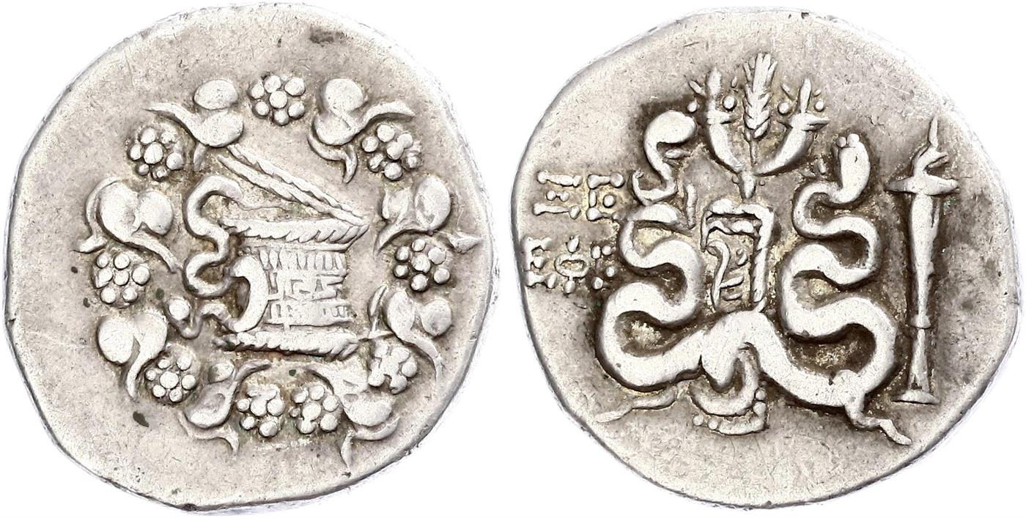
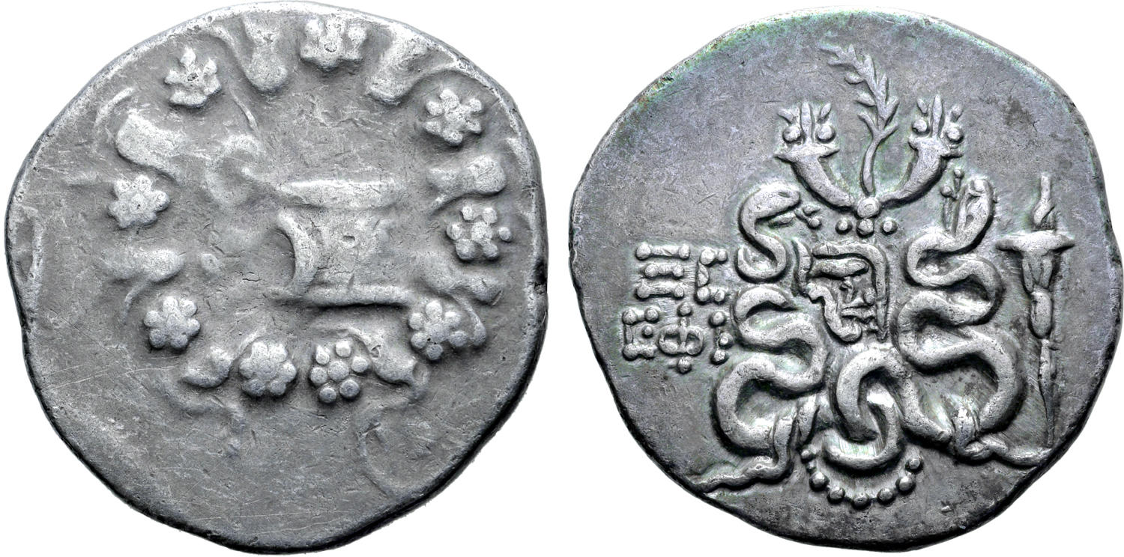
Cistophori 70/69-68/7 BC
Notes:
Instead of one symbol on reverse, several symbols. Thyrsys, palm, grain ear, always between two cornuciopias must be connected with Lucullus who was back from his Pontic expedition and put on games as a result.
Plutarch Lucullus 23.1-2
23 1 Lucullus, after filling Asia full of law and order, and full of peace, did not neglect the things which minister to pleasure and win favour, but during his stay at Ephesus gratified the cities with processions and triumphal festivals and contests of athletes and gladiators. And the cities, in response, celebrated festivals which they called Lucullea, to do honour to the man, and bestowed upon him what is sweeter than honour, their genuine good-will.

Slide 23
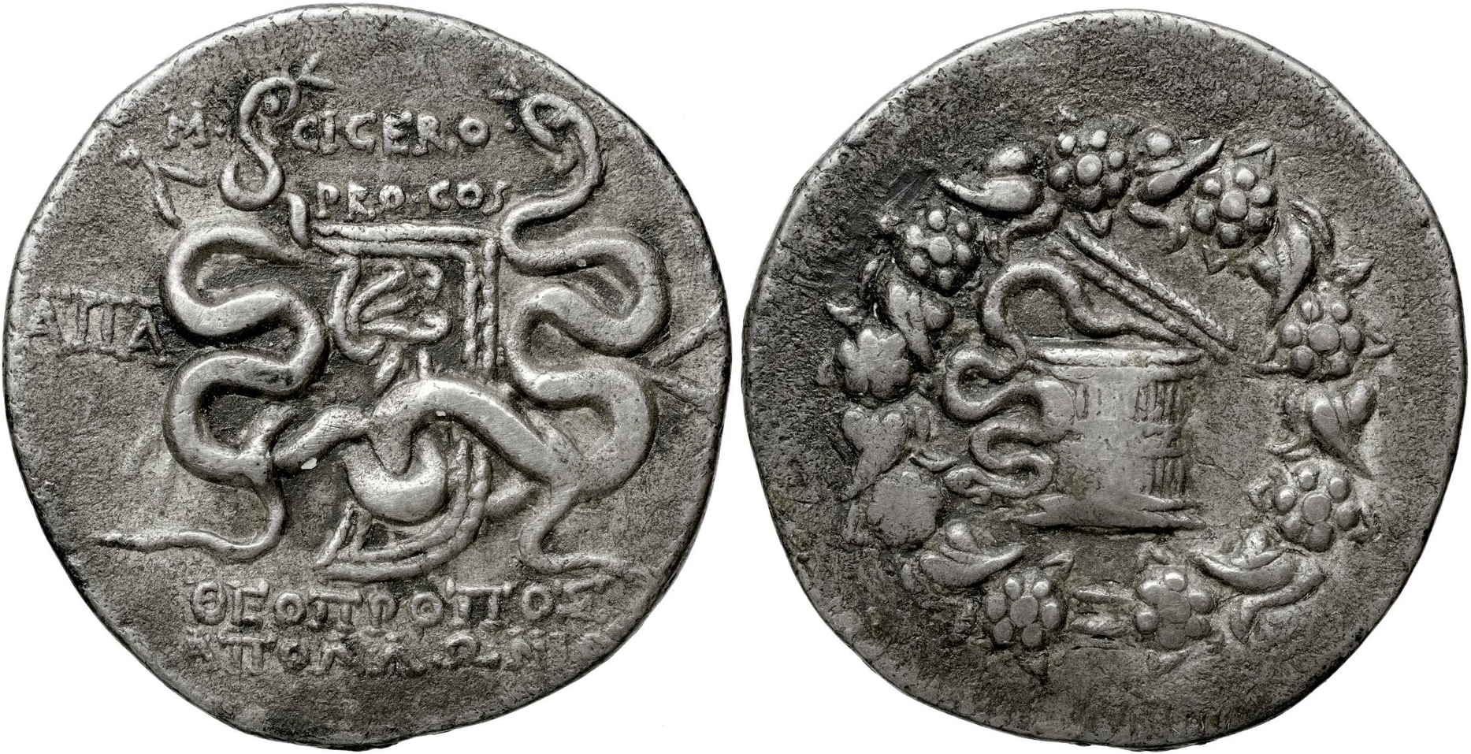
Notes:
M. Tullius Cicero, Apamea Cibotus, AR cistophorus, 51-50 BC, Metcalf 470

Slide 24
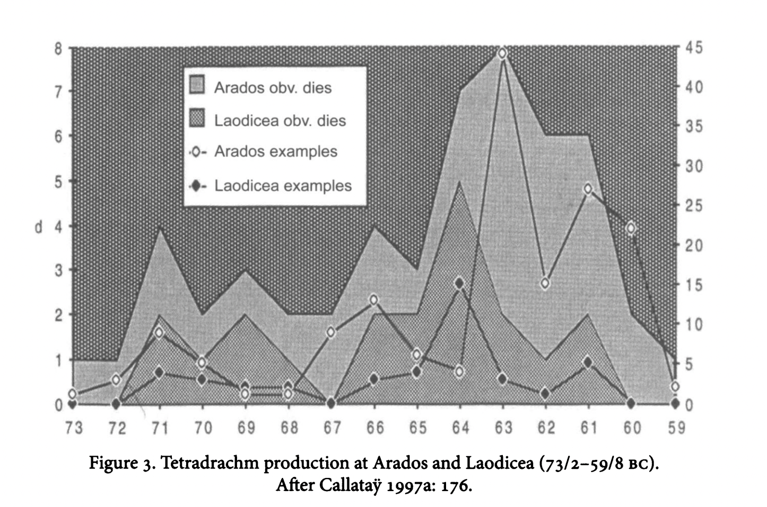
Notes:
Peaks connected to Pompey’s activities in Syria. 65-63 BC.
Syrian mints.
But we can’t know if this was ordered by the Romans or the Romans used these coins. Can just observe the timings here. Don’t know if Romans paid with these coins.

Slide 25
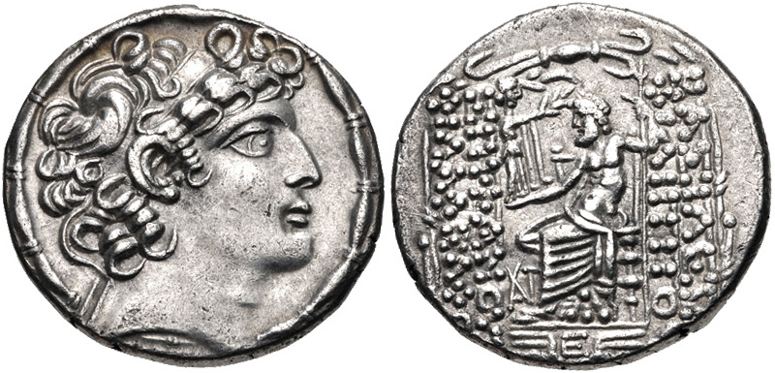
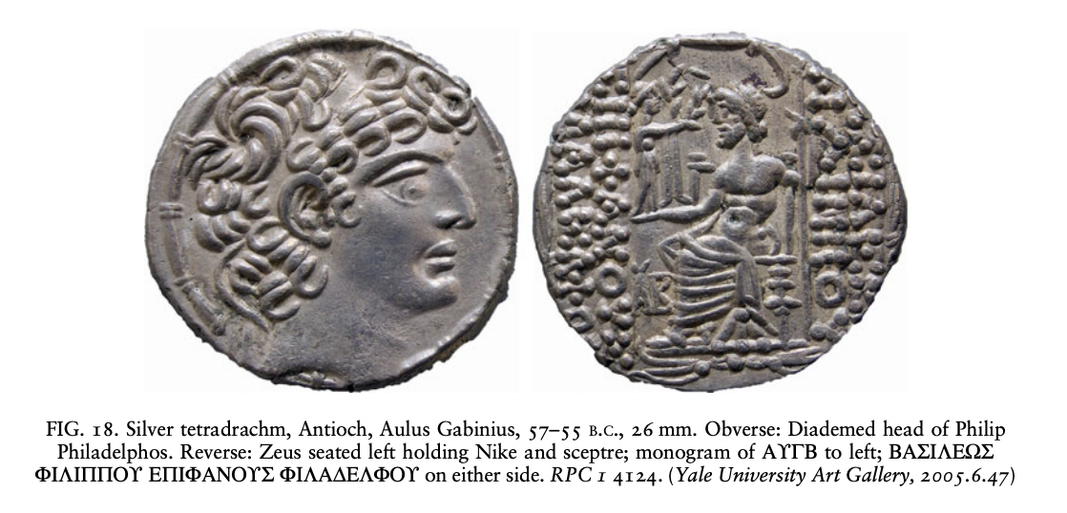
Antioch
Notes:
After became Roman province the Antioch mints continues to strike Philip Philadelphios tetradrachms but with a monogram that refers to Antioch as civic authority. Increase in volume as per other areas that fall under Roman control.
Aulus Gabinius – the governor 57 BC.
Only in 5 BC did the portait change to that of Augustus,
Philadelphios had rtuled the city from 88-83 BC, before it fell to Tigranes (King of Armenia).

Slide 26
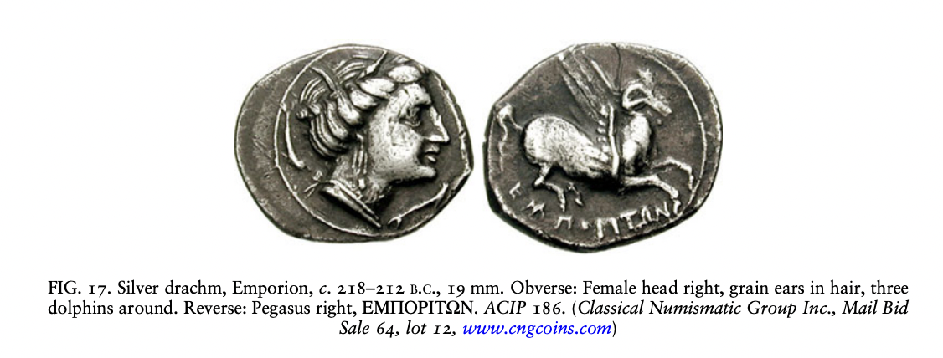
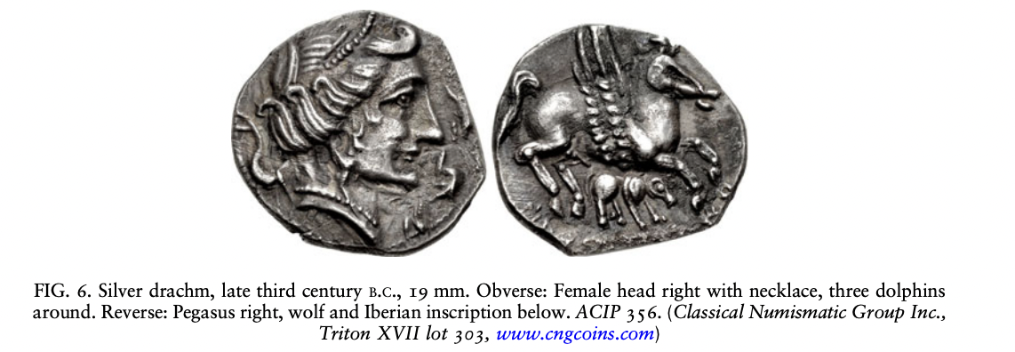
Drachms at Emporion (Iberia)
Notes:
Drachms now struck to finance Roman military campaignas – much larger production.
Stylistic change
Iberian imitations with a wolf and Iberian inscription. Also for Roman campaigns? About this period. But cannot know. Villaronga suggested that the wolf was a totemic animal of Iltirta, and perhaps had religious signicance; alternatively the wolf may have referenced a foundation myth.54 Wolves decorate other items of material culture on the Iberian peninsula, but the arrival of Rome would have given any representation of the wolf in this region further possible associations.

Slide 27
Burnett: Roman Provincial Coinage: Using Coins as sources
The ‘most surprising feature of the coinage in the provinces is (to the modern mind) the almost complete lack of references to the new power, Rome or even dominant personalities like Sulla, Pompey and Caesar’. (p. 79)
normal feature if Roman policy was to allow institutions and systems continue in the areas they conquered.
Punic Wars the exception
No overarching concept of empire imposed or adopted on coinage.

Slide 28
NC 2025 (forthcoming): Smyrna hoard
48 denarii dating from 154-62 BC
3 Athenian New Style drachms
Vicinity of Smyrna, found by a farmer in the 2010s
Coins dispersed in the market
Third Mithridatic War (73-63 BC)
Bodrum hoard / Halicarnassus Peninsula discovered before 1975. 57 Republican denarii, 5 serrated denarii, 36 Asian Cistophori, 1 Phrygian drachm from Kibyra.
Overbeck, B., 1978. ‘Ein Schatzfund der späten Republik von Halikarnassos’, SNR 57,
pp. 164–73.
Notes:
Don’t know if the photos consist of the full hoard
Included serrated denarii
Athenian drachms have similar weight and fineness as Roman Republicam denarii

Slide 29
Roman Republican Coinage
Crawford: Roman Republican Coinage
https://numismatics.org/crro/
- Try and identify the denarius given to you.

Slide 30
Further Reading
R.-Alföldi, M. (1984). "Der Stater des T. Quinctius Flamininus." Numismatische Zeitschrift 98: 19-26.
Bauslaugh, R. A. (2000). Silver Coinage with the Types of Aesillas the Quaestor. New York, American Numismatic Society.
Burnett, A. (1986). "The iconography of Roman coin types in the third century BC." Numismatic Chronicle 146: 67-75.
Burnett, A. (1995). The Unification of the Monetary Systems of the Roman West: Accident or Design? Italy in Europe: Economic Relations 700 BC- AD 50. eds. J. Swaddling, S. Walker and P. Roberts. London: 313-320.
Burnett, A. (2000). The coinage of Roman Macedonia. To nōmisma sto makedonikō chōro : pnaktika b' epiestēmonikēs synantēsēs : Thessalonikē, 15-17 Maioy M. Manoysakas. Thessaloniki, University Studio Press: 89-101.
Dahmen, K. (2010). The numismatic evidence. A Companion to Ancient Macedonia. ed. J. Roisman and I. Worthington. Chichester, Wiley-Blackwell: 41-62.
de Callataÿ, F. (1991-2). "Athenian New Style Tetradrachms in Macedonian Hoards." American Journal of Numismatics 3-4: 11-20.
de Callataÿ, F. (2011). "More than it would seem: the use of coinage by the Romans in Late Hellenistic Asia Minor (133-63 BC) " American Journal of Numismatics 23: 55-86.
Kroll, J. (1997). Coinage as an index of romanization. The Romanization of Athens. eds. M. C. Hoff and S. I. Rotroff. Oxford, Oxbow: 135-150.
Meadows, A. R. (1998). The Mars/eagle and thunderbolt gold and Ptolemaic involvement in the Second Punic War. Coins of Macedonia and Rome: Essays in Honour of Charles Hersh. Eds. A. Burnett, U. Wartenberg and R. Witschonke. London, Spink: 125-134.
Meadows, A. (2001). Money, freedom and empire in the Hellenistic World. Money and Its Uses in the Ancient Greek World. Eds. A. Meadows and K. Shipton. Oxford, Oxford University Press: 53-63.
Prokopov, I. S. (2012). The Silver Coinage of the Macedonian Regions 2nd-1st Century BC. Wetteren, Moneta.
Ripollès, P. P. (2008). "The X4 Hoard (Spain): Unveiling the presence of Greek coinages during the Second Punic War." Israeli Numismatic Journal 3: 51-64.
Ripollès, P. P. (2012). The ancient coinages of the Iberian Peninsula. The Oxford Handbook of Greek and Roman coinage. Ed. W. Metcalf. Oxford, Oxford University Press: 356-371.
Rowan, C. (2016) 'Ambiguity, iconology and entangled objects on coinage of the Republican world', Journal of Roman Studies 106 (2016): 1-37
RRC - Crawford, M. H. (1974). Roman Republican Coinage (2 vols). Cambridge. (Catalogue online at http://numismatics.org/crro/)
Thompson, M. (1961). The New Style Silver Coinage of Athens. New York, The American Numismatic Society.
Touratsoglou, I. (1987). Macedonia. The Coinage of the Roman World in the Late Republic. Eds. A. Burnett and M. Crawford. Oxford, BAR International Series: 53-78.

